Slide 1
Unit II – Pipelining
Linear pipeline processors and Non-linear pipeline processors
Reference :
Chapter-6
Advanced Computer Architecture Parallelism, Scalability – Kai Hwang

Slide 2
How to improve performance?
First step is to apply concept of pipelining to the instruction execution process
Overlap computations
What does this do?
Decrease clock cycle
Decrease effective CPU time compared to original clock cycle

Slide 3
Pipeline Approach to Improve System Performance
Analogous to fluid flow in pipelines and assembly line in factories
Divide process into “stages” and send tasks into a pipeline
Overlap computations of different tasks by operating on them concurrently in different stages

Slide 4
Linear Pipeline Processor
S₁
S₂
S_{k}
• • • •

Slide 5
Linear Pipeline Processor
Linear pipeline processes a sequence of subtasks with linear precedence
Linear pipeline processor is cascade of processing stages which are linearly connected
Data flowing in streams from stage S₁ to the final stage S_{k}
Two types of linear pipelines based on Control of data flow : synchronous or asynchronous Modes

Slide 6

Linear Asynchronous Pipeline

Slide 7
Linear Asynchronous Pipeline
Data flow between adjucent stages
Transfers performed when individual processors are ready
Data flow controlled by Handshaking protocol (Ack) between processors
Mainly used in multiprocessor systems with message-passing
Different amount of delay experienced at different stages

Slide 8
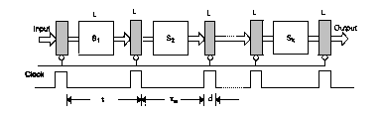
Linear Synchronous Pipeline

Slide 9
Linear Synchronous Pipeline
Clock latches(Master-Slave flip flop) are used to interface between different stages.
Pipeline stages are combinational logic circuits
Approximate equal delay between each stages: Clock period, Speed of pipeline
One task or operation per cycle
K clock cycle for k stage linear stages.
The utilization factors of successive stages :reservation table

Slide 10
Reservation Table for a 3-stage Linear Pipeline
Full pipeline after 3 cycles
S1
X
S2
X
Stages
S3
X
1
2
3
Time (clock cycles)

Slide 11
Clocking and Timing Control
S_{i}
S_{i+1}
τ
τ_{m}
d
Clock cycle of the pipeline : τ
τi : Time delay of circuitry stage Si
d:Time delay of latch
τ = max {τ_{m} } + d
τm :Maximum stage delay
Pipeline frequency : f
f = 1 / τ

Slide 12
Speedup and Efficiency
k-stage pipeline processes n tasks in k + (n-1) clock cycles:
k cycles for the first task and
n-1 cycles for the remaining n-1 tasks
Total time to process n tasks
T_{k} = [ k + (n-1)] τ
For the non-pipelined processor
T₁ = n k τ
Speedup factor
T₁
n k τ
n k
S_{k} =
=
=
k + (n-1)
T_{k}
[ k + (n-1)] τ

Slide 13
Efficiency and Throughput
Efficiency of the k-stages pipeline :
S_{k}
n
E_{k} =
=
k
k + (n-1)
Pipeline throughput (the number of tasks per unit time) :
note equivalence to IPC
n
n f
H_{k} =
[ k + (n-1)] τ
=
k + (n-1)

Slide 14
Pipeline Performance: Example
Task has 4 subtasks with time: t1=60, t2=50, t3=90, and t4=80 ns (nanoseconds)
latch delay = 10
Pipeline cycle time =
For non-pipelined execution, Cycle time =
Speedup for above case is:
Pipeline Time for 1000 tasks
Sequential time
Throughput
90+10 = 100 ns
60+50+90+80 = 280 ns
280/100 = 2.8 !!
= (4+1000-1)*100= 1003*100 ns
= 1000*280ns
= 1000/ (1003 *100)

Slide 15
Non-linear pipelines
Can have non-linear path in pipeline…
How to schedule instructions so they do not conflict for resources
A dynamic pipeline can reconfigured to perform variable function at different stage
Allows feedback , feed forward connection in addition to the streamline connection
Pipeline stages interconnected with loop.

Slide 16
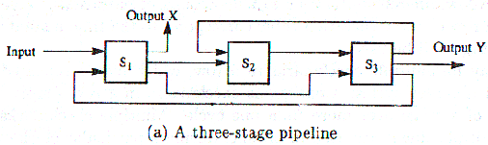
Nonlinear Pipelining
Nonlinear pipeline: Which allows feedback and feed forward connections in addition to streamline connections.
A three stage nonlinear pipeline.

Slide 17
Nonlinear Pipelining
Reservation tables are two-dimensional charts used to show how successive pipeline stages are utilized (or reserved) for a specific function evaluation in successive pipeline cycles.
Evaluation Time: Number of Columns in reservation table
Let X & Y be two functions evaluating in the above pipeline.
1
2
3
4
5
6
7
8
1
2
3
4
5
6
S₁
S₁
S₂
S₂
S₃
S₃
Reservation table for function X
Reservation table for function Y

Slide 18
Nonlinear Pipelining
Latency Analysis
Latency: number of time units (clock cycles) between two initiations of a pipeline is the latency between them.
Latency of k means that two initiations are separated by k clock cycles
Collision: resource conflicts between two initiation in the pipeline.
Forbidden latency: Latency that cause collision.

Slide 19
Evaluate the function X, draw the reservation table for the latency 2 and latency 5, identify the stages of forbidden.
1
2
3
4
5
6
7
8
S₁
S₂
S₃

Slide 20
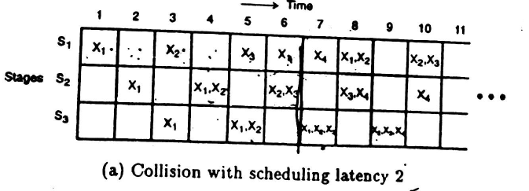
Consider the same pipeline, lets see initiations in the pipeline for function X, with latency=2

Slide 21
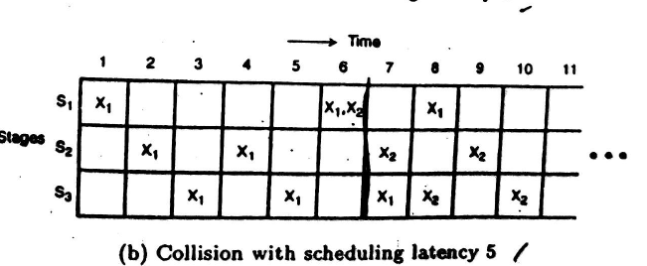
Consider the same pipeline, lets see initiations in the pipeline for function X, with latency=5

Slide 22
Nonlinear Pipelining
Latency Analysis
Forbidden latency: that causes collision.
Permissible latency: that doesn’t.
In the previous example 2 and 5 were forbidden latencies.
With the help of these latencies we will find out the minimal average latency (MAL) that will give maximum efficiency of pipeline without collisions.
The method is called “Collision-free scheduling”.

Slide 23
Nonlinear Pipelining
Latency Analysis
Collision-free Scheduling:
Let us first look at some basic terms:
Latency sequence: a latency sequence is a sequence of permissible latencies between successive tasks initiations.
Latency cycle: is a latency sequence which repeats itself.

Slide 24
Nonlinear Pipelining
Latency Analysis
Constant cycle: which contains a single latency value.
Average Latency: Latency cycle obtained by dividing the sum of all latencies
State diagram: will be used here to specify the permissible state transitions among successive tasks initiations.
Collision vector: (collision array) is a combined set of permissible and forbidden latencies.

Slide 25
Nonlinear Pipelining
Latency Analysis
Formal Methods to find out Permissible & Forbidden Latencies:
To detect a forbidden latency, find out the distance between any two check marks in the same row of the reservation table and the rest are permissible latencies.
1
2
3
4
5
6
7
8
S₁
S₂
S₃

Slide 26
Collision vector: (collision array) is a combined set of permissible and forbidden latencies.
C = ( C_{m} C_{m-1} …… C₂ C₁ )
Where C_{m must always be 1}
Size must be equal to size of the forbidden latency
M : maximum forbidden latency
C_{i} : 0 → permissible
C_{i} : 1 → forbidden

Slide 27
.
Find out permissible and forbidden latencies of the reservation table for function x. Also design the collusion vector and state transition diagram for collision vector.
Q
1
2
3
4
5
6
7
8
S₁
S₂
S₃

Slide 28
F.L_{x} = 2,4,5,7
P.L_{x} = 1,3,6,8
C_{x} = 1011010

Slide 29





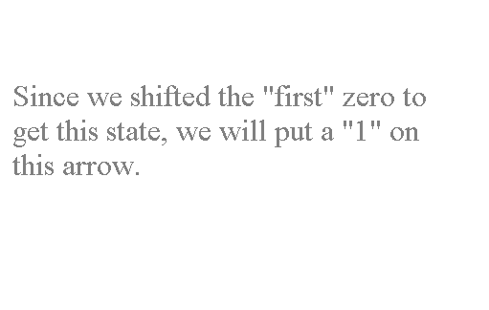



Nonlinear Pipelining
Latency Analysis
First bit (zero bit) to be right shifted
1011010
Starting state
1111111
Current state.

Slide 30








Nonlinear Pipelining
Latency Analysis
1011010
1011011
1111111

Slide 31



Nonlinear Pipelining
Latency Analysis
1011010
1011011
1111111
Now, right shift the sixth bit and see what you get after ORing it with the start state..

Slide 32
Nonlinear Pipelining
Latency Analysis
1011010
1011011
1111111
Since there are no more zeros left in this state to be right, lets move on to the next state.
Now this state is our current state.

Slide 33
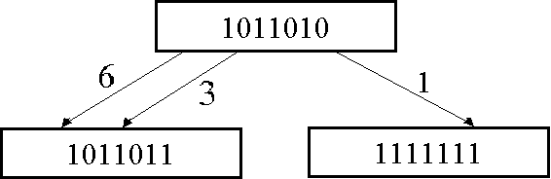

Nonlinear Pipelining
Latency Analysis
So we get,
In this state we don’t have any zeros, so we move on to the next state, as our current state.
Right shifting and ORing of the third and sixth bit gives the same state again.

Slide 34


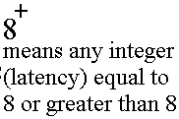
Nonlinear Pipelining
Latency Analysis
1011010
1011011
1111111
One last thing, when the number of shifts is m+1 (m: maximum forbidden latency), all the transitions are redirected back to initial state.
And mark the minimal latencies with *

Slide 35
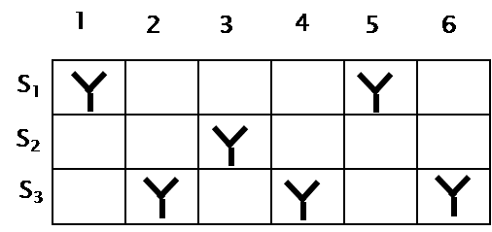
Nonlinear Pipelining
Latency Analysis
Q. Design the collusion vector and state transition diagram for the below case.
F.L_{y} = 4,2 & P.L_{y} = 1,3,5,6.

Slide 36
Cy =1010

Slide 37
Collision Free Scheduling for Y
m….2 1
Collision vector for Y
1 0 1 0
1 : collision
0 : no collision
5+
1 0 1 0
5+
3
5+
1
1 0 1 1
1 1 1 1
3

Slide 38



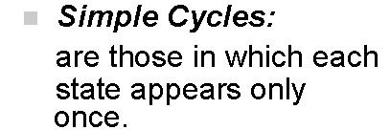

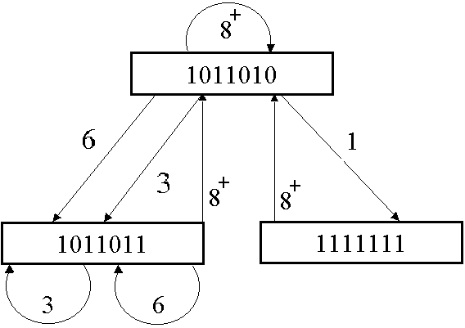


Nonlinear Pipelining
Latency Analysis
The next step is to write the simple latency cycles.
Some of these are called greedy cycles

Slide 39




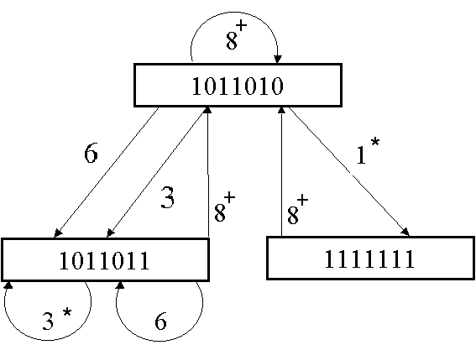
Nonlinear Pipelining
Latency Analysis
Greedy Cycles: are those ones whose edges are all made with minimum latencies from their respective states (ones with *) .

Slide 40
Compute simple cycle and greedy cycle for the below scenario
5+
1 0 1 0
5+
3
5+
1
1 0 1 1
1 1 1 1
3

Slide 41
Greedy cycle (1,5) and (3)
Simple cycle (3),(5),(1,5),(3,5)

Slide 42
Nonlinear Pipelining
Efficiency of Nonlinear Pipelining:
We find the efficiency of nonlinear pipeline using greedy cycle corresponding to MAL.
100% efficiency: when all the stages of pipeline are always busy.
Q. Calculate efficiency for the pipeline function of x with greedy cycle 3.

Slide 43
1
2
3
4
5
6
7
8
S₁
S₂
S₃

Slide 44
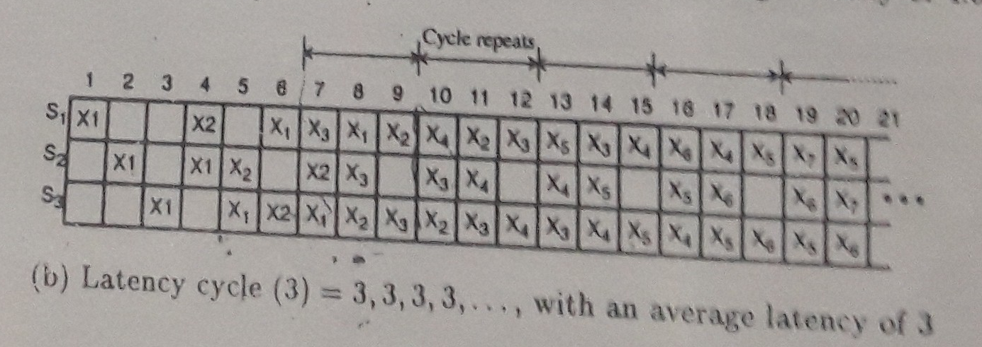

Slide 45

1
2
3
4
5
6
7
8
9
10
11
12
13
14
15
S₁
S₂
S₃
setup time
Mark every 3 x 3 array of squares as a frame.
(since greedy cycle is (3) & we have 3 stages)
Keep on initializing new tasks until consecutive frames begin to match.
The time until there appears no match is called the Setup Time.
Calculating the efficiency: With in a frame we have,
Total stages=9
Stages busy=8 (take from the matched frames)

Slide 46


efficiency: η = x 100
η = x 100
= 88.89%
Q. Calculate efficiency for the same pipeline with greedy cycle (1,8).

Slide 47
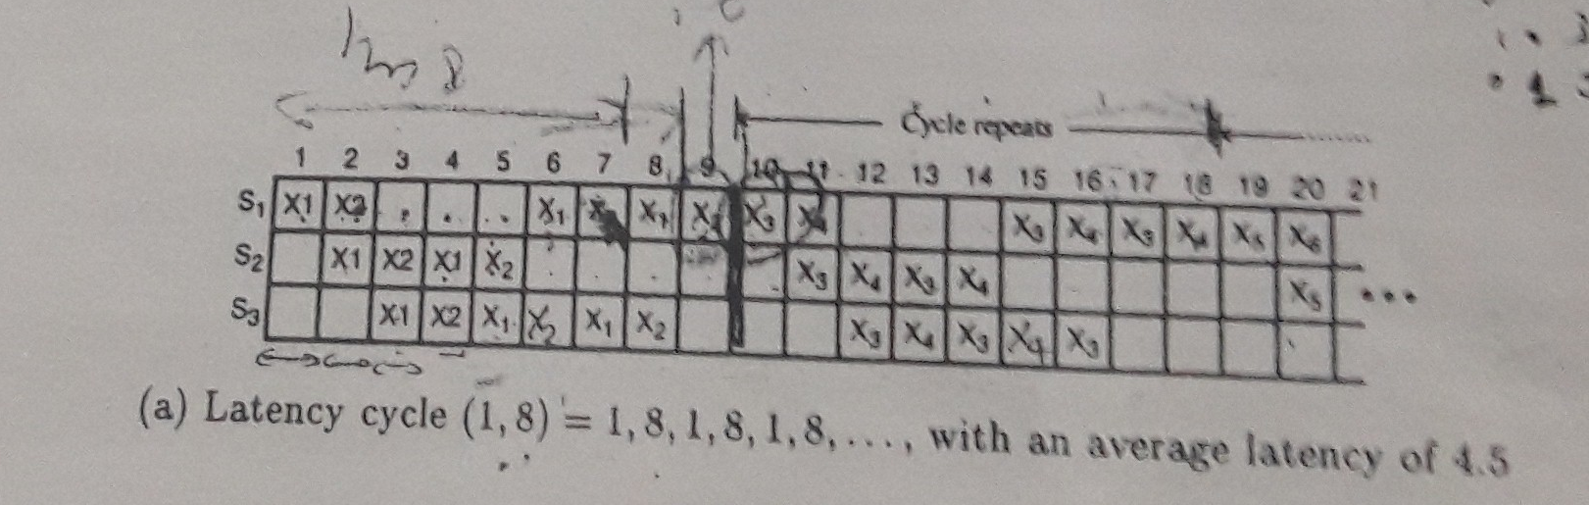

Slide 48
1
2
3
4
5
6
7
8
9
10
11
12
13
14
15
16
17
18
S₁
S₂
S₃
matched
Mark every 9 x 3 array of squares as a frame.
(since greedy cycle is (1,8) & 1+8=9 & we have 3 stages)
Enter the next task with latency 1.
Now enter the next task with latency 8.
Now again enter the next task with latency 1 and then 8 and so on.. Until the frames match.
Calculating the efficiency: With in a frame we have,
Total stages=27
Stages busy=16

Slide 49
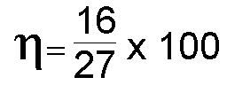
= 59.23%
Which is less than what we got from greedy cycle (3), because (3) is the MAL not (1,8).

Slide 50
END
of
Chapter 4

