Slide 1
INTRODUCTION ,MODELING CONCEPTS,CLASS MODELING

Slide 2
Introduction
Object-oriented modeling and design [OOMD]:
Way of thinking about problems using models
organized around real-world concepts.
The fundamental construct is the object,
which combines both data structure
and behavior.
Analysis, design and implementation phases
of system development can be considered
a process and the process can have different
stages.

Slide 3
An object-oriented notation is used and same notation applies at all stages of the process as
development proceeds.
Use of OOMs: For
Understanding problems
Communicating with application experts, modeling enterprises
Preparing documentation, and
Designing programs and databases.

Slide 4
What is object orientation?
OO is a mindset/approach of organizing software as a collection of discrete objects that incorporate both data structure and behavior.
This contrasts with previous programming approaches in which data structure and behavior are loosely connected .

Slide 5
They are four aspects of OO
Identity
Classification
Inheritance
Polymorphism

Slide 6
Identity
It means the data is quantized into discrete,dintinguisable entities called objects.
E.g. The first paragraph in this chapter, My workstation,White queen in a chess game
Objects can be concrete, such as file system , or conceptual such as scheduling policy in a multiprocessing operating system.
Each object has it own inherent identity. i.e.two objects are distinct even if all their attributes values (such as name, size) are identical.

Slide 7
In the real world an object simply exists,
But in programming language object
Each has a unique handle by which it can be referenced.
Languages implement the handle in various ways,
such as an address, array index, or artificial number.
object references are uniform and independent of
the contents of the objects,
permitting mixed collections of objects to be created,
such as a file system directory that contains both files and subdirectories.

Slide 8
CLASSIFICATION
It means that objects with same data structure(attributes)and behavior (operations) are grouped into a class.
Class: An abstraction that describe properties important to an application and ignores the rest. Any choice of classes is arbitrary & it depends on the application.
E.g. Paragraph, Monitor, Chess Piece
Each class describes a possibly infinite set of individual objects. Each object is said to be an instance of it class.

Slide 9
An object has its own value for each attribute but shares the attributes names and operations with other instances of class.
An object contains an implicit reference to its own class; it "knows what kind of thing it is.“

Slide 10
INHERITANCE
It is the sharing of attributes and operations(feautures) among classes based on a hierarchical relationship.
A super class has general information that subclasses refine and elaborate.
Each subclass incorporate, or inherits, all the features of its super class.

Slide 11
The ability to factor out common features of several classes into a superclass can greatly reduce repetition within designs and programs and is one of the main advantages of OO technology.
E.g. ScrollingWindow and FixedWindow are subclasses of Window. Both subclasses inherit the features of Window, such as a visible region on the screen. ScrollingWindow adds a scroll bar and an offset.

Slide 12
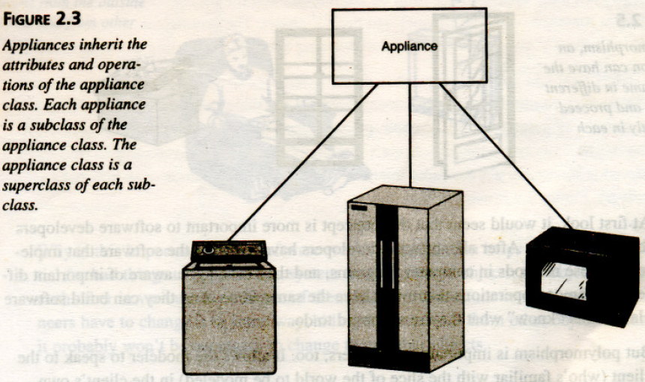

Slide 13
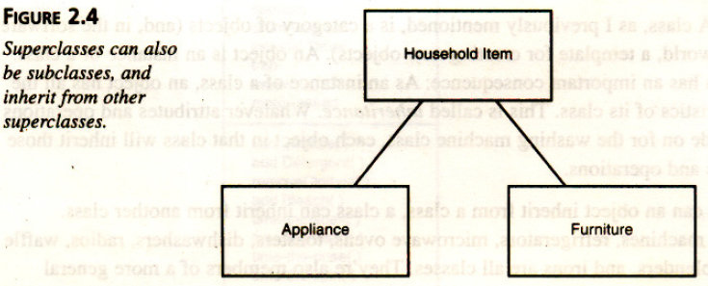

Slide 14
POLYMORPHISM
It means that the same operation may behave differently for different classes.
An operation is a procedure or transformation that an object performs or is subject to. E.g. RightJustify, display, and move
Am implementation of an operation by a specific class is called a method. Because an OO operator is polymorphic, it may have more than one method implementing it, each for a different class of object.

Slide 15
In the real world, an operation is simply an abstraction of analogous behavior across different kinds of objects. Each object "knows how" to perform its own operations.
In an OO programming language, however, the language automatically selects the correct method to implement an operation based on the name of the operation and the class of the object being operated on. The user of an operation need not be aware of how many methods exist to implement a given polymorphic operation. Developers can add new classes without changing existing code, as long as they provide methods for each applicable operation.

Slide 16
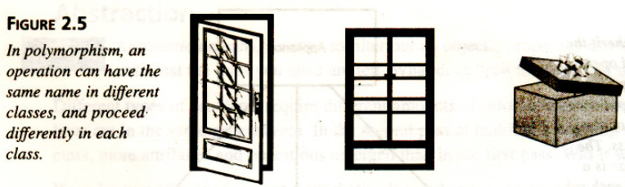

Slide 17
What is OO Development [OOD] ?
Note: The term development refers to software life cycle: analysis, design, and implementation.
OOD refers to the identification and organization of concepts of an application to be developed. It does not refer to the final representation of those concepts in a programming language.

Slide 18
OOD Models Concepts, Not Implementation:
OOD addresses front-end conceptual issues, rather than backend implementation details. Design flaws that surface during implementation are more costly to fix than those that are found earlier. A premature focus on implementation restricts design choices and often leads to an inferior product.

Slide 19
OOD encourages software developers to work and think in terms of the application throughout the software life cycle. Details of data structures and functions can be addressed effectively later, only when the inherent concepts of the application are identified, organized, and understood earlier. OOD is a conceptual process independent of a programming language until the final stages software life cycle.

Slide 20
OOD is fundamentally a way of thinking and not a programming technique.
Advantage: Specifies, developers, and customers can express abstract concepts clearly and communicate those concepts to each other. It can serve as a medium for specification, analysis, documentation, and interfacing, as well as for programming.

Slide 21
OO Methodology [OOMe]:
It is a process for OOD, in which a graphical notation can be used to representing OO concepts.
OOMe consists of
Building a model of an application and
Adding details to the model during design.

Slide 22
Stages of OOMe:
System conception
Analysis
System design
Class design
Implementation

Slide 23
System conception
Software development begins with business analysts or users conceiving an application and formulating tentative requirements.

Slide 24
Analysis
The analysts scrutinizes and rigorously restates the requirements from system conception by constructing models .
The analysts must work with the requester to understand the problem, because problem statements are rarely complete or correct.

Slide 25
The analysis model is a concise ,precise abstraction of what the desired system must do and not how it will be done .
The analysis model should not contain implementation decisions.

Slide 26
System design
The development team derive a high level strategy – the system architecture –for solving the application problem.
They also establish policies that will serve as a default for the subsequent, more detailed portions of design.
The system designer must decide what performance characteristics to optimize , choose a strategy of attacking problem, and make tentative resource allocation .

Slide 27
Class design
The class designer adds details to the analysis model in accordance with the system design strategy.
The class designer elaborates both domain and application objects using the same OO concepts and notation although they exists on different conceptual planes .

Slide 28
The focus of class design is the data structures and algorithms needed to implement each class.
E.g. Class designer now determines data structures and algorithms for each of the operations of the Window class.

Slide 29
Implementation
Implementers translate the classes and relationships developed during class design into particular programming languages, data base, or hard ware.
Programming should be straight forward, because all of the hard decisions should have already been made.

Slide 30
During implementation it is important to follow good software engineering practice so that traceability to the design is apparent so that system remains flexible and extensible .

Slide 31
Other characteristics of OOMe:
Same OO concepts (of identity, classification, polymorphism, and inheritance) apply throughout development (or system development life cycle from analysis through design to implementation). Same classes can be carried from stage to stage without a change of notation, although they gain additional details in the later stages. E.g. Analysis and implementation models of Window are both correct, but they serve different purposes and represent a different level of abstraction.

Slide 32
Comparison with waterfall development process: Waterfall development process suggests each part of the system be developed in tandem during every stage of life-cycle.
In OOMe, developers perform each stage in order, but they need not develop each part of the system in tandem. An iterative process i.e. developing part of the system through several stages and then adding capability – suits OOMe.
E.g. Some classes are not part of analysis but are introduced during design or implementation say data structures such as trees, hash tables, and linked lists are rarely present in the real world and are not visible to users. Designers introduce them to support particular algorithms. Such data structure objects exist within a computer and are not directly observable.

Slide 33
In OOMe, testing is not considered as a distinct step. Testing is important, but it must be part of an overall philosophy of quality control that occurs throughout the life cycle. Developers must check analysis models against reality. They must verify design models against various kinds of errors, in addition to testing implementations for correctness. Confining quality control to a separate step is more expensive and less effective.

Slide 34
OO Themes
Abstraction
Encapsulation
combining data and behavior
Sharing
Object essence
Synergy

Slide 35
Abstraction:
It focuses on essential aspects of an application while ignoring details. This means focusing on what an object is and does, before deciding how to implement it. Use of abstraction preserves the freedom to make decisions as long as possible by avoiding premature commitments to details.
Most modern languages provide data abstraction, but inheritance and polymorphism add power. The ability to abstract is probably the most important skill required for OOD.

Slide 36
What is Abstraction?
Salesperson
Not saying Which salesperson – just a salesperson in general!!!
Product
Customer
Manages Complexity
Notes:
Discuss what makes a good abstraction with the students:
Concise,
Represents a single coherent concept,
etc.

Slide 37
Encapsulation: (information hiding):
It separates the external aspects of an object that are accessible to other objects, from the internal implementation details that are hidden from other objects. Encapsulation prevents portions of a program from becoming so interdependent that a small change has massive ripple effects.
An object's implementation can be changed without affecting the applications that use it. Implementation of an object may need to be changed to improve performance, fix a bug, consolidate code, or support porting. Encapsulation is not unique to OO languages, but the ability to combine data structure and behavior in a single entity makes encapsulation cleaner and more powerful than in prior languages, such as Fortran, Cobol, and C.

Slide 38
What is Encapsulation?
Hide implementation from clients
Clients depend on interface
How does an object encapsulate?
What does it encapsulate?
Improves Resiliency
Notes:
Encapsulation is putting the “databits” and operations that manipulate them in the same place. Encapsulation DISALLOWS direct manipulation of things that have been encapsulated without utilising the supplied interface.
Another example - the accelerator on a car. You put your foot down and car goes faster - this works on most cars, and you don’t worry about the cables, electronics, engine, etc.

Slide 39
Combining data and behavior
The caller of an operation need not consider any implementation tasks.
Operator polymorphism shifts the burden of deciding what implementation to use from the calling code to the class hierarchy.

Slide 40
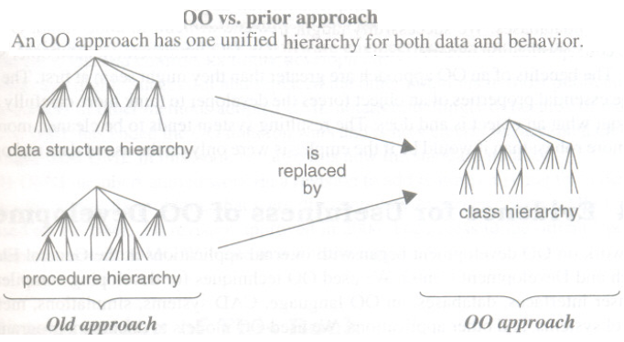
In an OO system, the data structure hierarchy matches the operation inheritance hierarchy:

Slide 41
Sharing
OO techniques promote sharing at different levels. Inheritance of both data structure and behavior lets subclasses share common code. This sharing via inheritance is one of the main advantages of OO languages. More important than the savings in code is the conceptual clarity from recognizing that different operations are all really the same thing. This reduces the number of distinct cases needed to be understood and analyzed.

Slide 42
OOD not only allows sharing information within an application, but also offers the prospect of reusing designs and code on future projects. OOD provides the tools, such as abstraction, encapsulation, and inheritance, to build libraries of reusable components.

Slide 43
CHAPTER 2
MODELING AS DESIGN TECHNIQUE

Slide 44
Modeling:
A model is an abstraction of something for the purpose of understanding it before building it. Because a model omits nonessential details, it is easier to manipulate than the original entity.

Slide 45
To build complex systems, the developer must abstract different views of the system, build models using precise notations, verify that the models satisfy the requirements of the system, and gradually add detail to transform the models into an implementation.
System Designers build many kinds of models for various purposes before constructing things.

Slide 46
E.g. Architectural models to show customers.
Airplane scale models for wind-tunnel tests.
Pencil sketches for composition of oil paintings.
Blueprints of machine parts
Storyboards of advertisements, and outlines of
books.

Slide 47
Models serve several purposes:
Testing a physical entity before building it
Communication with customers
Visualization
Reduction of complexity

Slide 48
Three Models:
Each model describes a system from its own viewpoint. Each model applies during all stages of development and acquires detail as development progresses. A complete description of a system requires models from all three viewpoints. The three models are separate parts of the description of a complete system but are cross-linked.

Slide 49
Three Models:
Class model
State model
Interaction model

Slide 50
Class model:
For the objects in the system and their relationships.
Goal in constructing a class model: To capture those concepts from the real world that are important to an application.

Slide 51
Describes the static structure of the objects in a system and their relationships; Represents the static, structural, "data" aspects of a system. Alternatively they describe the static data structure of objects and their relationships to one another.

Slide 52
Contains class diagrams: A class diagram is a graph whose nodes are classes and whose arcs are relationships among classes. It expresses the class model. Generalization lets classes share structure and behavior, and associations relate the classes. Classes define the attribute values carried by each object and the operations that each object performs or undergoes.

Slide 53
State model:
For the life history of objects;
It represents the temporal, behavioral, "control" aspects of a system.
Describes the aspects of an object that change over time and the sequencing of operations - events that mark changes, states that define the context for events, and the organization of events and states.

Slide 54
Captures control i.e. the aspect of a system that describes the sequences of operations that occur, without regard for what the operations do, what they operate on, or how they are implemented.

Slide 55
Specifies and implements control with state diagrams: A state diagram is a graph whose nodes are states and whose arcs are transitions between states caused by events. State diagrams express the state model. Each state diagram shows the state and event sequences permitted in a system for one class of objects.

Slide 56
State diagrams refer to the other models.
Actions and events in a state diagram become operations on objects in the class model.
References between state diagrams become interactions in the interaction model.

Slide 57
Interaction model:
For the interactions among objects.
Describes how the objects in a system cooperate to achieve broader results; It represents the collaboration of individual objects, the "interaction" aspects of a system i.e. - how individual objects collaborate to achieve the behavior of the system as a whole.

Slide 58
Starts with use cases that are then elaborated with sequence and activity diagrams i.e. Use cases, sequence diagrams, and activity diagrams document the interaction model.

Slide 59
A use case focuses on the functionality of a system-that is, what a system does for users. They document major themes for interaction between the system and outside actors.
A sequence diagram shows the objects that interact and the time sequence of their interactions.
An activity diagram elaborates important processing steps. They show the flow of control among the processing steps of a computation.

Slide 60
The different models are not completely independent i.e. different models have limited and explicit interconnections i.e. each model contains references to entities in other models.
E.g. Class model attaches operations to classes, while the state and interaction models elaborate the operations.

Slide 61
Each of the three models evolves during development. First analysts construct a model of the application without regard for eventual implementation. Then designers add solution constructs to the model. Implementers code both application and solution constructs.
The word model has two dimensions -a view of a system (class model, state model, or interaction model) and a stage of development (analysis, design, or implementation). The meaning is generally clear from context.

Slide 62
Relationship Among the Models:
Each model describes one aspect of the system but contains references to the other models.
The class model describes data structure on which the state and interaction models operate. The operations in the class model correspond to events and actions.

Slide 63
o The state model describes the control structure of objects. It shows decisions that depend on object values and causes actions that change object values and state.
o The interaction model focuses on the exchanges between objects and provides a holistic overview of the operation of a system.

Slide 64
There are occasional ambiguities about which model should contain a piece of information. This is natural, because any abstraction is only a rough cut at reality; something will inevitably straddle the boundaries. Some properties of a system may be poorly represented by the models. This is also normal, because no abstraction is perfect; the goal is to simplify the system description without loading down the model with so many constructs that it becomes a burden and not a help. For those things that the model does not adequately capture, natural language or application-specific notation is still perfectly acceptable.

Slide 65
Evidence for Usefulness of OOD:
OOD work began with internal applications at the General Electric Research and Development Center. OO techniques were used for developing compilers, graphics, user interfaces, databases, an OO language, CAD systems, simulations, meta-models, control systems, and other applications.

Slide 66
OOMs are used to document programs that are ill-structured and difficult to understand. The implementation targets ranged from OO languages to non-OO languages to databases. This approach is successfully taught to others and used it to communicate with application experts.

Slide 67
OO technology is expanded since the mid 1990s beyond General Electric to companies throughout the world. OO technology can no longer be considered a fad or a speculative approach. It is now part of the computer science and software engineering mainstream.

Slide 68
Important forums/ conferences
For disseminating new OO ideas and application results.
The annual OOPSLA (Object-Oriented Programming Systems, Languages, and Applications)
ECOOP (European Conference on Object-Oriented Programming)
TOOLS (Technology of Object-Oriented Languages and Systems)

Slide 69
The conference proceedings describe many applications that have benefited from an OO approach. Articles on OO systems have also appeared in major publications, such as IEEE Computer and Communications of the ACM.

Slide 70
OO Modeling History:
The work at GE R&D led to the development of the Object Modeling Technique (OMT). OMT was a success, but so were several other approaches. The popularity of OO modeling led to a new problem - a plethora of alternative notations. The notations expressed similar ideas but had different symbols, confusing developers and making communication difficult.

Slide 71
As a result, the software community began to focus on consolidating the various notations. In 1994 Jim Rumbaugh joined Rational (now part of IBM) and began working with Grady Booch on unifying the OMT and Booch notations. In 1995, Ivar Jacobson also joined Rational and added Objectory to the unification work.

Slide 72
In 1996the Object Management Group (OMG) issued a request for proposals for a standard OO modeling notation. Several companies responded, and eventually the competing proposals were coalesced into a final proposal. Rational led the final proposal team, with Booch, Rumbaugh, and Jacobson deeply involved. The OMG unanimously accepted the resulting Unified Modeling Language (UML) as a standard in November 1997. The participating companies transferred UML rights to the OMG, which owns the trademark and specification for UML and controls its future development.

Slide 73
The UML was highly successful and replaced the other notations in most publications. The UML has ended the OO notation wars and is now clearly the accepted OO notation. UML is now the standard notation.
In 2001 OMG members started work on a revision to add features missing from the initial specification and to fix problems that were discovered by experience with UML 1. The result is UML 2.0 approved in 2004. For access to the official specification documents, OMG Web site at www.omg.org can be seen.

