Slide 1
ADVANCED CLASS MODELING
UNIT-2

Slide 2
Advanced Object and Class Concepts:
A data type is a description of values. Data types include
Numbers,
Strings, and
Enumerations.

Slide 3
Enumerations:
An enumeration is a data type that has a finite set of values.
E.g. Attributes:
1.accessPermission can be an enumeration with possible values that include read and read-write.
2. Type is an enumeration that includes solid, dashed, and dotted.
3.TwoDimensional.fillType can be an enumeration that includes solid, grey, none, horizontal lines, and vertical lines.

Slide 4
Use of enumerations:
Enumerations often occur and hence they must be carefully noted during modeling. They are important to users.
Enumerations are also significant for an implementation: Possible values may be displayed with a pick list and the data must be restricted to the legitimate values.

Slide 5
Enumeration & Generalization:
Generalization shall not be used to capture the values of an enumerated attribute.
Enumeration is merely a list of values;
Generalization is a means for structuring the description of objects.
Generalization is introduced only when at least one subclass has significant attributes, operations, or associations that do not apply to the super-class.

Slide 6
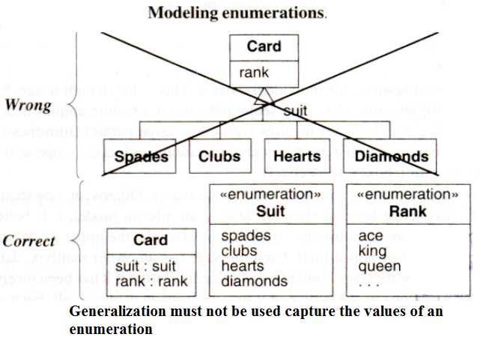
Example:
Generalization for Card should not be used because most games do not differentiate the behavior of spades, clubs, hearts, and diamonds.

Slide 7
Enumeration in UML:
Enumeration is a data type. It can be declared by listing the keyword enumeration in guillemots («») above the enumeration name in the top section of a box. The second section lists the enumeration values.

Slide 8
Multiplicity:
Multiplicity is a constraint on the cardinality of a set. Multiplicity applies not only to associations but also to attributes. It is often helpful to specify multiplicity for an attribute, especially for database applications.

Slide 9
Multiplicity for an attribute :
Specifies the number of possible values for each instantiation of an attribute. The most common specifications are a mandatory single value [1], an optional single value [0..1], and many [*].
Multiplicity specifies whether an attribute is mandatory or optional (in database terminology whether an attribute can be null). Multiplicity also indicates if an attribute is single valued or can be a collection.
If not specified, an attribute is assumed to be a mandatory single value ([1]).

Slide 10
Example:
A person has one name, one or more addresses, zero or more phone numbers, and one birth-date.

Slide 11
Scope:
The scope indicates if a feature applies to an object or a class.
An underline distinguishes features with class scope (static) from those with object scope.
Convention is to list attributes and operations with class scope at the top of the attribute and operation boxes, respectively.

Slide 12
Attributes with class scope:
It is acceptable to use an attribute with class scope to hold the extent of a class (the set of objects for a class)-this is common with OO databases.
Otherwise, attributes with class scope must be avoided because they can lead to an inferior model. It is better to model groups explicitly and assign attributes to them.

Slide 13
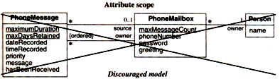
Example:
Figure shows a simple model of phone mail.
Each message has an owner mailbox, date recorded; time recorded, priority, message contents, and a flag indicating if it has been received. A message may have a mailbox as the source or it may be from an external call. Each mailbox has a phone number, password, and recorded greeting. For the PhoneMessage class, one can store the maximum duration for a message and the maximum days a message will be retained. For the PhoneMailbox class, one can store the maximum number of messages that can be stored.

Slide 14
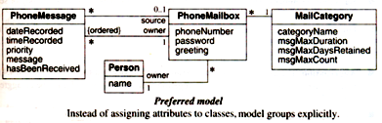
The model shown is inferior, however, because the maximum duration, maximum days retained, and maximum message count have a single value for the entire phone mail system.
In the following figure, these limits can vary for different kinds of users, yielding a more flexible and extensible phone mail system.

Slide 15
Operations with class scope:
In contrast to attributes, it is acceptable to define operations of class scope.
The most common use of class-scoped operations is to create new instances of a class.
Sometimes it is convenient to define class-scoped operations to provide summary data.
The use of class-scoped operations for distributed applications must be carefully dealt with.

Slide 16
Visibility:
Refers to the ability of a method to reference a feature from another class and has the possible values of public, protected, private, and package.
The precise meaning depends on the programming language.
Any method can freely access public features.
Only methods of the containing class and its descendants via inheritance can access protected features. (Protected features also have package accessibility in Java.)
Only methods of the containing class can access private features.
Methods of classes defined in the same package as the target class can access package features.

Slide 17
UML Notation:
UML denotes visibility with a prefix. The character "+" precedes public features. The character "#" precedes protected features. The character "-" precedes private features. And the character “~" precedes package features.
The lack of a prefix reveals no information about visibility.

Slide 18
Issues to be considered when choosing visibility:
Comprehension
Extensibility
Context

Slide 19
Comprehension:
All public features must be understood to understand the capabilities of a class. In contrast, private, protected, and package features can be ignored-they are merely an implementation convenience.

Slide 20
Extensibility:
Many classes can depend on public methods, so it can be highly disruptive to change their signature (number of arguments, types of arguments, type of return value). Since fewer classes depend on private, protected, and package methods, there is more latitude to change them.

Slide 21
Context:
Private, protected, and package methods may rely on preconditions or state information created by other methods in the class. Applied out of context, a private method may calculate incorrect results or cause the object to fail.

Slide 22
Association Ends:
As the name implies, an association end is an end of an association. A binary association has two ends, a ternary association has three ends, and so forth.

Slide 23
Additional properties of association ends: (In unit-1 the properties covered are: Association end name, Multiplicity, Ordering, Bags and sequences, Qualification)
Aggregation
Changeability
Navigability
Visibility

Slide 24
Aggregation:The association end may be an aggregate or constituent part. Only a binary association can be an aggregation; one association end must be an aggregate and the other must be a constituent.
Changeability: It specifies the update status of an association end. The possibilities are changeable (can be updated) and readonly (can only be initialized).

Slide 25
Navigability: Conceptually, an association may be traversed in either direction. However, an implementation may support only one direction. The UML shows navigability with an arrowhead on the association end attached to the target class. Arrowheads may be attached to zero, one, or both ends of an association.
Visibility: Association ends may be public, protected, private, or package.

Slide 26
N-ary Associations:
Whereas binary associations are associations between two classes, n-ary associations are associations among three or more classes.
Most of n-ary associations can be decomposed into binary associations, with possible qualifiers and attributes. Hence they must possibly be avoided.

