Slide 1
INTRODUCTION ,MODELING CONCEPTS,CLASS MODELING

Slide 2
N-ary Associations:
Whereas binary associations are associations between two classes, n-ary associations are associations among three or more classes.
Most of n-ary associations can be decomposed into binary associations, with possible qualifiers and attributes. Hence they must possibly be avoided.

Slide 3
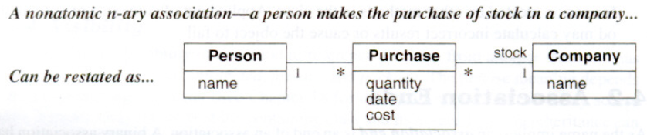
Example:
Figure shows an association that at first glance might seem to be an n-ary but can readily be restated as binary associations.

Slide 4
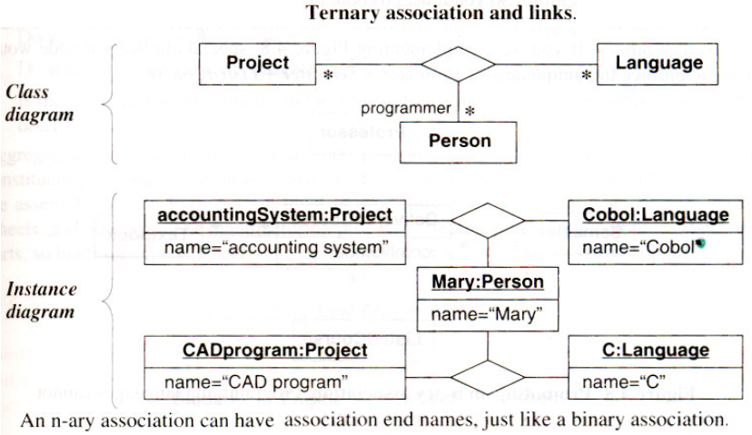
Example: n-ary (ternary) association
Programmers use computer languages on projects. The n-ary association is atomic unit and can not be subdivided into binary associations without losing information. A programmer may know a language and work on a project, but might not use the language on the project.

Slide 5
The UML symbol for n-ary associations:
A diamond with lines connecting to related classes.
If the association has a name, it is written in italics next to the diamond.
An n-ary association can have a name for each end just like a binary association. End names are necessary if a class participates in an n-ary association more than once.
n-ary associations can not be traversed from one end to another as with binary associations, so end names do not represent pseudo attributes of the participating classes.
The OCL does not define notation for traversing n-ary associations.

Slide 6
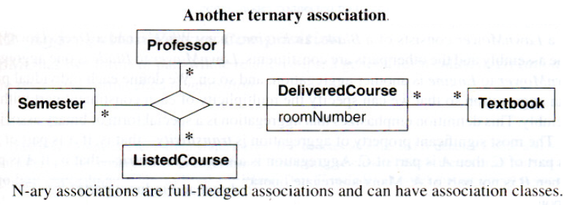
Example: ternary association
A professor teaches a listed course during a semester.
The resulting delivered course has a room number and any number of textbooks.

Slide 7
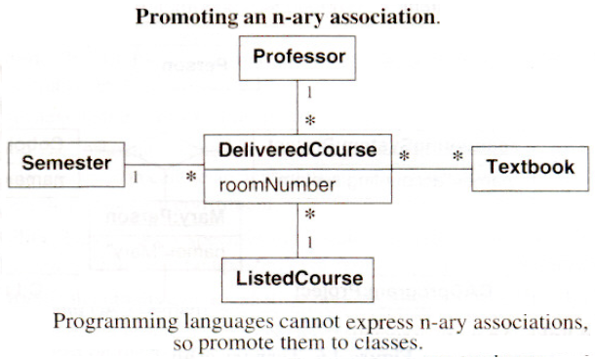
The typical programming language cannot express n-ary associations. Thus during programming, n-ary associations must be promoted to classes as the figure below does for DeliveredClass.

Slide 8
Note:
When an n-ary association is promoted to a class, the meaning of a model is changed. An n-ary association enforces that there is at most one link for each combination-for each combination of Professor, Semester, and ListedCourse in the following non-promoted figure, there is one DeliveredCourse.

Slide 9
In contrast, a promoted class permits any number of links - for each combination of Professor, Semester, and ListedCourse in the following promoted figure, there can be many DeliveredCourses. To implement promoted figure above, special application code would have to enforce the uniqueness of Professor + Semester + ListedCourse.

Slide 10
Aggregation:
Aggregation is a strong form of association in which an aggregate object is made of constituent parts. Constituents are part of the aggregate. The aggregate is semantically an extended object that is treated as a unit in many operations, although physically it is made of several lesser objects.
Aggregation relates an assembly class to one constituent part class.
An assembly with many kinds of constituent parts corresponds to many aggregations.

Slide 11
E.g.
LawnMower consists of a Blade, an Engine, many Wheels, and a Deck. LawnMower is the assembly and the other parts are constituents. LawnMower to Blade is one aggregation, LawnMower to Engine is another aggregation, and so on. Each individual pairing is an aggregation so that multiplicity of each constituent part can be specified within the assembly. This definition emphasizes that aggregation is a special form of binary association.

Slide 12
The most significant property of aggregation is transitivity-i.e. if A is part of Band B is part of C, then A is part of C.
Aggregation is also anti-symmetric-that is, if A is part of B, then B is not part of A.
Many aggregate operations imply transitive closure* and operate on both direct and indirect parts.

Slide 13
Aggregation Versus Association:
Aggregation is a special form of association, not an independent concept. If two objects are tightly bound by a part-whole relationship, it is an aggregation.

Slide 14
If the two objects are usually considered as independent, even though they may often be linked, it is an association
Aggregation is drawn like association, except a small diamond indicates the assembly end.

Slide 15
Aggregation Versus Composition:
The UML has two forms of part-whole relationships:
a general form called aggregation and
a more restrictive form called composition
Composition is a form of aggregation . A constituent part can belong to at most one assembly. Furthermore, once a constituent part has been assigned an assembly, it has a coincident lifetime with the assembly. Deletion of an assembly object triggers deletion of all constituent objects via composition.
The notation for composition is a small solid diamond next to the assembly class (vs. a small hollow diamond for the general form of aggregation).

Slide 16
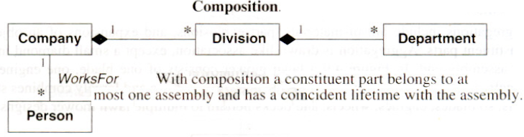
Example:
In the figure, a company consists of divisions, which in turn consist of departments; a company is indirectly a composition of departments. A company is not a composition of its employees, since company and person are independent objects of equal stature.

Slide 17
Propagation of Operations:
Propagation (also called triggering) is the automatic application of an operation to a network of objects when the operation is applied to some starting object .
E.g. Moving an aggregate moves its parts; the move operation propagates to the parts. Propagation of operations to parts is often a good indicator of aggregation.

Slide 18
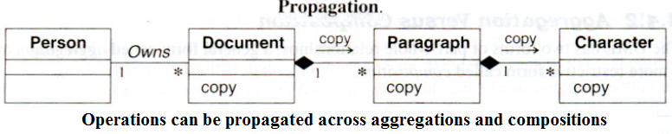
E.g. A person owns multiple documents. Each document consists of paragraphs that, in turn, consist of characters. The copy operation propagates from documents to paragraphs to characters.

Slide 19
Copying a paragraph copies all the characters in it. The operation does not propagate in the reverse direction; a paragraph can be copied without copying the whole document. Similarly, copying a document copies the owner link but does not spawn a copy of the person who is owner.

Slide 20
Most other approaches present an all-or-nothing option:
The concept of propagation of operations provides a concise and powerful way for specifying a continuum of behavior. An operation can be considered as starting at some initial object and flowing from object to object through links according to propagation rules.
Propagation is possible for other operations including save/restore, destroy, print, lock, and display.

Slide 21
Propagation can be shown with a small arrow indicating the direction and operation name next to the affected association. The notation binds propagation behavior to
an association (or aggregation),
direction,
and operation.
Note that this notation is not part of the UML and is a special notation.

Slide 22
Abstract Classes:
An abstract class is a class that has no direct instances but whose descendant classes have direct instances.
A concrete class is a class that is instantiable; that is, it can have direct instances. A concrete class may have abstract subclasses (but they, in turn, must have concrete descendants). Only concrete classes may be leaf classes in an inheritance tree.

Slide 23
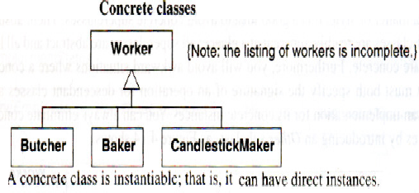
All the occupations shown below are concrete classes.
Butcher;Baker; and CandlestickMaker are concrete classes because they have direct instances. Worker also is a concrete class because some occupations may not be specified.

Slide 24
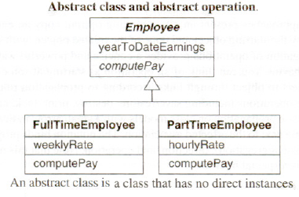
Class Employee below is an example of an abstract class.
All employees must be either full-time or part-time. FullTimeEmployee and PartTimeEmployee are concrete classes because they can be directly instantiated.

Slide 25
UML notation :
Abstract class name is listed in an italic font. Or the keyword {abstract} may be placed below or after the name.
Abstract classes can be used to define methods that can be inherited by subclasses.
Alternatively, an abstract class can define the signature for an operation without supplying a corresponding method. This operation is called an abstract operation. (Recall that an operation specifies the form of a function or procedure; a method is the actual implementation.)

Slide 26
Abstract operation
An abstract operation defines the signature of an operation for which each concrete subclass must provide its own implementation. A concrete class may not contain abstract operations, because objects of the concrete class would have undefined operations.

Slide 27
Figure below shows an abstract operation.
An abstract operation is designated by italics or the keyword {abstract}. ComputePay is an abstract operation of class Employee; its signature but not its implementation is defined. Each subclass must supply a method for this operation.

Slide 28
Note that the abstract nature of a class is always provisional, depending on the point of view. A concrete class can always be refined into subclasses, making it abstract. Conversely, an abstract class may become concrete in an application in which the difference among its subclasses is unimportant.
As a matter of style, it is a good idea to avoid concrete superclasses. Then, abstract and concrete classes are readily apparent at a glance; all superclasses are abstract and all leaf subclasses are concrete.

Slide 29
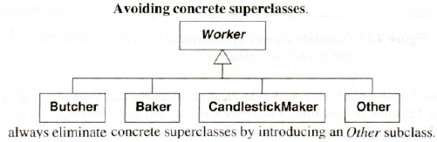
Furthermore, a concrete superclass specifying both the signature of an operation for descendant classes and also provide an implementation for its concrete instances is an awkward situations, which should be avoided. Concrete superclasses can be eliminated by introducing an Other subclass, as below.

Slide 30
Multiple Inheritance:
Multiple inheritance permits a class to have more than one superclass and to inherit features from all parents. Then information from two or more sources can be mixed.
This is a more complicated form of generalization than single inheritance, which restricts the class hierarchy to a tree. The advantage of multiple inheritance is greater power in specifying classes and an increased opportunity for reuse. The disadvantage is a loss of conceptual and implementation simplicity.

Slide 31
The term multiple inheritance is used somewhat imprecisely to mean either
the conceptual relationship between classes or the language mechanism that implements that relationship.
Whenever possible, generalization (the conceptual relationship) and inheritance (the language mechanism) must be distinguished, but the term "multiple inheritance" is more widely used than the term "multiple generalization."

Slide 32
Kinds of Multiple Inheritance:
From sets of disjoint classes:
With overlapping classes:

Slide 33
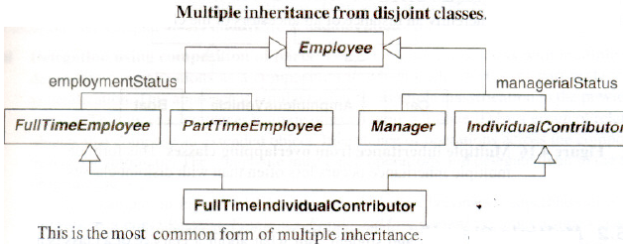
From sets of disjoint classes:
Each subclass inherits from one class in each set.
In Figure, FullTimelndividualContributor is both FullTimeEmployee and IndividualContributor and combines their features. FullTimeEmployee and PartTimeEmployee are disjoint; each employee must belong to exactly one of these. Similarly, Manager and IndividualContributor are also disjoint and each employee must be one or the other. The model does not show it, but we could define three additional combinations: FullTimeManager, PartTimelndividualContributor, and PartTimeManager.

Slide 34
Each generalization should cover a single aspect. Multiple generalizations must be used if a class can be refined on several distinct and independent aspects.
E.g. In previous figure, classEmployee independently specializes on employment status and managerial status. Consequently the model has two separate generalization sets.

Slide 35
A subclass inherits a feature from the same ancestor class found along more than one path only once; it is the same feature. E.g. in the previous figure, FullTimelndividualContributor inherits Employee features along two paths, via employmentStatus and managerialStatus. However, each FullTimelndividualContributor has only a single copy of Employee features.

Slide 36
Conflicts among parallel definitions create ambiguities that implementations must resolve. In practice, such conflicts should be avoided or explicitly resolved in models, even if a particular language provides a priority rule for resolving conflicts.
E.g. Suppose that FullTimeEmployee and IndividualContributor both have an attribute called name. FullTimeEmployee.name could refer to the person's full name while IndividualContributor.name might refer to the person's title. In principle, there is no obvious way to resolve such clashes. The best solution is to try to avoid them by restating the attributes as FullTimeEmployee.personName and IndividuaIContributor.title.

Slide 37
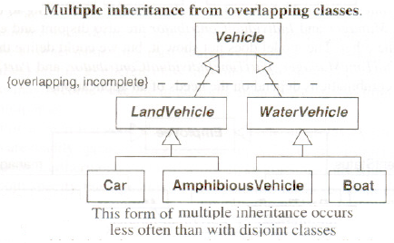
With overlapping classes:
In figure, AmphibiousVehicle is both LandVehicle and WaterVehicle. LandVehicle and WaterVehicle overlap, because some vehicles travel on both land and water. The UML uses a constraint (Section – Constraints) to indicate an overlapping generalization set; the notation is a dotted line cutting across the affected generalizations with keywords in braces. In this example, overlapping means that an individual vehicle may belong to more than one of the subclasses. Incomplete means that all possible subclasses of vehicle have not been explicitly named.

Slide 38
Multiple Classification:
An instance of a class is inherently an instance of all ancestors of the class. E.g. an instructor could be both faculty and student. But what about a Harvard Professor taking classes at MIT? There is no class to describe the combination (it would be artificial to make one). This is an example of multiple classification in which one instance happens to participate in two overlapping classes.

Slide 39
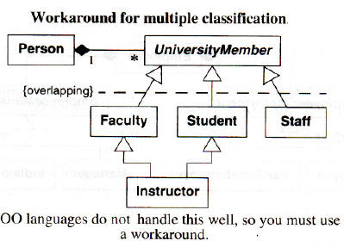
The UML permits multiple classification, but most OO languages handle it poorly.
As figure shows, the best approach using conventional languages is to treat Person as an object composed of multiple UniversityMember objects. This workaround replaces inheritance with delegation (discussed in the next section). This is not totally satisfactory, because there is a loss of identity between the separate roles, but the alternatives involve radical changes in many programming languages [McAllester-86].

Slide 40
Metadata:
Metadata is data that describes other data.
E.g. A class definition is metadata. Models are inherently metadata, since they describe the things being modeled (rather than being the things). Many real-world applications have metadata, such as parts catalogs, blueprints, and dictionaries. Computer-language implementations also use metadata heavily.

Slide 41
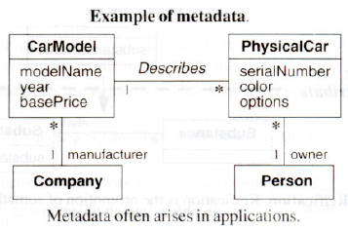

Slide 42
Figure shows an example of metadata and data.
A car model has a model name, year, base price, and a manufacturer. Some examples of car models are a 1969 Ford Mustang and a 1975 Volkswagen Rabbit.
A physical car has a serial number, color, options, and an owner. As an example of physical cars, John Doe may own a blue Ford with serial number 1FABPand a red Volkswagen with serial number 7E81 F.

Slide 43
A car model describes many physical cars and holds common data. A car model is metadata relative to a physical car, which is data.

Slide 44
Reification:
Reification is the promotion of something that is not an object into an object. Reification is a helpful technique for meta applications because it lets shifting the level of abstraction.
On occasion it is useful to promote attributes, methods, constraints and control information into objects so they can be described and manipulated as data.

Slide 45
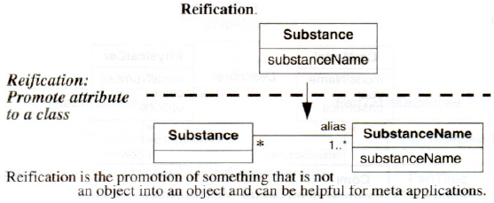

Slide 46
Figure promotes the substanceName attribute to a class to capture the many-to-many relationship between Substance and SubstanceName.
A chemical substance may have multiple aliases. E.g. propylene may be referred to as propylene and C₃H₆. Also, an alias may pertain to multiple chemical substances. Various mixtures of ethylene glycol and automotive additives may have the alias of antifreeze.

Slide 47
Constraints:
A constraint is a boolean condition involving model elements, such as objects, classes, attributes, links, associations, and generalization sets. A constraint restricts the values that elements can assume. Constraints can be expressed with natural language or a formal language such as the Object Constraint Language (OCL) [Warmer-99].

Slide 48
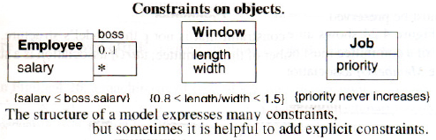

Slide 49
Figure above shows several examples of constraints.
No employee's salary can exceed the salary of the employee's boss (a constraint between two things at the same time).
No window can have an aspect ratio (length/width) of less than 0.8 or greater than 1.5 (a constraint between attributes of a single object).
The priority of a job may not increase (constraint on the same object over time). Simple constraints may be placed in class models

Slide 50
Constraints on Generalization Sets:
Class models capture many constraints through their very structure.
E.g. The semantics of generalization imply certain structural constraints. With single inheritance the subclasses are mutually exclusive. Furthermore, each instance of an abstract superclass corresponds to exactly one subclass instance. Each instance of a concrete superclass corresponds to at most one subclass instance.

Slide 51
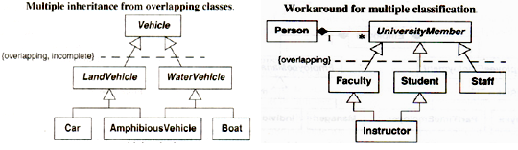

Slide 52
Constraints on Links:
Multiplicity is a constraint on the cardinality of a set. Multiplicity for an association restricts the number of objects related to a given object. Multiplicity for an attribute specifies the number of values that are possible for each instantiation of an attribute

Slide 53
Qualification also constrains an association. A qualifier attribute does not merely describe
the links of an association but is also significant in resolving the "many" objects at an
association end.

Slide 54
An ordinary association presl'mes no particular order on the objects of a "many" end.
The constraint {ordered} indicates that the elements of a "many" association end have an explicit order that must be preserved.

Slide 55
Derived Data:
A derived element is a function of one or more elements, which in turn may be derived.
A derived element is redundant, because the other elements completely determine it. Ultimately, the derivation tree terminates with base elements. Classes, associations, and attributes may be derived.
The notation for a derived element is a slash in front of the element name.

Slide 56
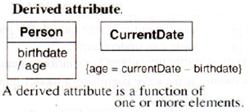
Figure shows a derived attribute. Age can be derived from birthdate and the currentdate.

