Slide 1
State Modeling

Slide 2
A system can better understood by first examining its static structure-that is, the structure of its objects and their relationships to each other at a single moment in time (the class model) and then examining changes to the objects and their relationships over time (the state model).

Slide 3
The state model describes the sequences of operations that occur in response to external stimuli, as opposed to what the operations do, what they operate on, or how they are implemented.

Slide 4
The state model consists of multiple state diagrams, one for each class with temporal behavior that is important to an application. The state diagram is a standard computer science concept (a graphical representation of finite state machines) that relates events and states.
Events represent external stimuli and states represent values of objects.

Slide 5
Events:
An event is an occurrence at a point in time, such as user depresses left button or flight 123 departs from Chicago. Events often correspond to verbs in the past tense (power turned on, alarm set) or to the onset of some condition (paper tray becomes empty, temperature becomes lower than freezing). By definition, an event happens instantaneously with regard to the time scale of an application. Of course, nothing is really instantaneous; an event is simply an occurrence that an application considers atomic and fleeting. The time at which an event occurs is an implicit attribute of the event. Temporal phenomena that occur over an interval of time are properly modeled with a state.

Slide 6
Concurrent Events:
Two events that are causally unrelated are said to be concurrent; they have no effect on each other. E.g. Flight 123 must depart Chicago before it can arrive in San Francisco; the two events are causally related.
Distant events: If the communications delay between two locations exceeds the difference in event times, then the events must be concurrent because they cannot influence each other.
Non-Distant events: Even if the physical locations of two events are not distant, the events are considered concurrent if they do not affect each other. Concurrent events can occur in any order and hence no ordering is established between them during modeling a system.

Slide 7
Related Events:
If one event is logically precede or follow another, they are related. Flight 123 may depart before or after flight 456 departs Rome; the two events are causally unrelated.

Slide 8
Events include:
Error conditions: E.g. Motor jammed, transaction aborted, and timeout are typical error events. There is nothing different about an error event; only the interpretation makes it an "error."
normal occurrences
The term event is often used ambiguously. Sometimes it refers to an instance, at other times to a class. In practice, this ambiguity is usually not a problem and the precise meaning is apparent from the context. If necessary, one can say event occurrence or event type to be precise.

Slide 9
Kinds of events
Signal Event
Change Event
Time Event

Slide 10
Signal Event:
A signal is an explicit one-way transmission of information from one object to another. It is different from a subroutine call that returns a value. An object sending a signal to another object may expect a reply, but the reply is a separate signal under the control of the second object, which may or may not choose to send it.

Slide 11
A signal event is the event of sending or receiving a signal. Usually, event receiving a signal is most significant, because it causes effects in the receiving object.
Difference between signal and signal event: A signal is a message between objects while a signal event is an occurrence in time.

Slide 12
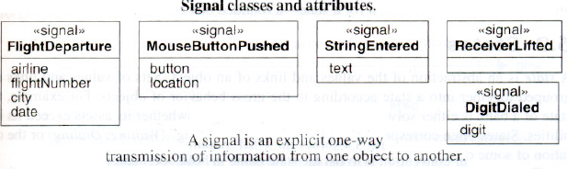
Every signal transmission is a unique occurrence, but they can be grouped into signal classes and give each signal class a name to indicate common structure and behavior.
E.g. UAflight 123 departs from Chicago on January 10, 1991 is an instance of signal class FlightDeparture.
Some signals are simple occurrences, but most signal classes have attributes indicating the values they convey.
Flight Departure has attributes airline, flightNumber, city, and date.
The UML notation is the keyword signal in guillemets (« »)above the signal class name in the top section of a box. The second section lists the signal attributes.

Slide 13
Change Event:
A change event is an event that is caused by the satisfaction of a Boolean expression. The intent of a change event is that the expression is continually tested-whenever the expression changes from false to true, the event happens. Of course, an implementation would not continuously check a change event, but it must check often enough so that it seems continuous from an application perspective.
The UML notation for a change event is the keyword when followed by a parenthesized Boolean expression.

Slide 14
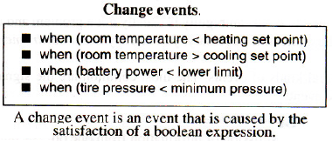
E.g. Figure shows several examples of change events

Slide 15
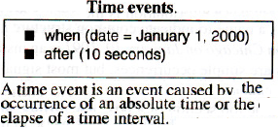
Time Event:
A time event is an event caused by the occurrence of an absolute time or the elapse of a time interval.
UML notation for an absolute time is the keyword when followed by a parenthesized expression involving time. The notation for a time interval is the keyword after followed by a parenthesized expression that evaluates to a time duration.

Slide 16
States:
A state is an abstraction of the values and links of an object. Sets of values and links are grouped together into a state according to the gross behavior of objects.
E.g. The state of a bank is either solvent or insolvent, depending on whether its assets exceed its liabilities.
States often correspond to verbs with a suffix of "ing" (Waiting, Dialing) or the duration of some condition (Powered, BelowFreezing).

Slide 17

UML notation for a state:
a rounded box containing an optional state name. Convention is to list the state name in boldface, center the name near the top of the box, and capitalize the first letter.

Slide 18
In defining states:
Attributes that do not affect the behavior of the object are ignored.
All combinations of values and links with the same response to events are lumped together in a single state.
Of course, every attribute has some effect on behavior or it would be meaningless, but often some attributes do not affect the sequence of control and they can be regarded as simple parameter values within a state.
Recall that the purpose of modeling is to focus on qualities that are relevant to the solution of an application problem and abstract away those that are irrelevant. The three UML models (class, state, and interaction) present different views of a system for which the particular choice of attributes and values are not equally important.

Slide 19
E.g. Except for leading 0s and 1s, the exact digits dialed do not affect the control of the phone line, so all of them can be summarized with state Dialing and track the phone number as a parameter.

Slide 20
Sometimes, all possible values of an attribute are important, but usually only when the number of possible values is small.

Slide 21
The objects in a class have a finite number of possible states - one or possibly some larger number. Each object can only be in one state at a time. Objects may parade through one or more states during their lifetime. At a given moment of time, the various objects for a class can exist in a multitude of states.

Slide 22
A state specifies the response of an object to input events. All events are ignored in a state, except those for which behavior is explicitly prescribed.
The response may include the invocation of behavior or a change of state.
E.g. If a digit is dialed in state Dialtone, the phone line drops the dial tone and enters state Dialing; if the receiver is replaced in state Dialtone, the phone line goes dead and enters state Idle.

Slide 23
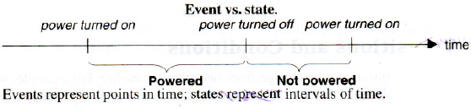
There is certain symmetry between events and states as figure illustrates.
Events represent points in time; states represent intervals of time. A state corresponds to the interval between two events received by an object.

Slide 24
E.g. After the receiver is lifted and before the first digit is dialed, the phone line is in state Dialtone.
The state of an object depends on past events, which in most cases are eventually hidden by subsequent events. E.g. Events that happened before the phone is hung up do not affect future behavior; the Idle state "forgets" events received prior to the receipt of the hang up signal.

Slide 25
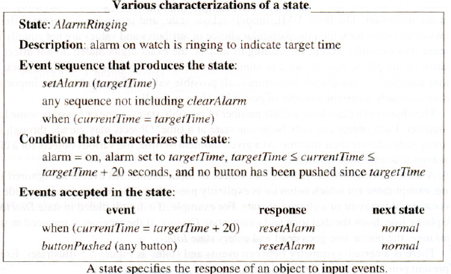
Various ways of characterizing a state:

Slide 26
The state has a suggestive name and a natural-language description of its purpose. The event sequence that leads to the state consists of setting the alarm, doing anything that doesn't clear the alarm, and then having the target time occur. A declarative condition for the state is given in terms of parameters, such as current and target time; the alarm stops ringing after 20 seconds. Finally, a stimulus-response table shows the effect of events i.e. current time and button pushed, including the response that occurs and the next state. The different descriptions of a state may overlap.

Slide 27
Transitions and Conditions:
A transition is an instantaneous change from one state to another.
E.g. When a called phone is answered, the phone line transitions from the Ringing state to the Connected state.
The transition is said to fire upon the change from the source state to the target state.
The origin and target of a transition usually are different states, but may be the same. A transition fires when its event occurs (unless an optional guard condition causes the event to be ignored). The choice of next state depends on both the original state and the event received.

Slide 28
An event may cause multiple objects to transition; from a conceptual point of view such transitions occur concurrently.

Slide 29
Guard condition:
is a Boolean expression that must be true in order for a transition to occur.
E.g. A traffic light at an intersection may change only if a road has cars waiting.
A guarded transition fires when its event occurs, but only if the guard condition is true.
E.g. "when you go out in the morning (event), if the temperature is below freezing (condition), then put on your gloves (next state)."

Slide 30
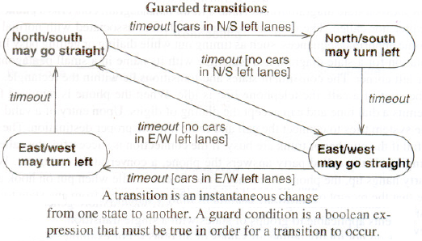
Figure shows guarded transitions for traffic lights at an intersection. One pair of electric eyes checks the north-south left turn lanes; another pair checks the east-west turn lanes.
If no car is in the north-south and/or east-west turn lanes, then the traffic light control logic is smart enough to skip the left turn portion of the cycle.

Slide 31
UML notation for a transition:
is a line from the origin state to the target state. An arrowhead points to the target state. The line may consist of several line segments. An event may label the transition and be followed by an optional guard condition in square brackets. The event name is italicized and the condition is shown in normal font.

Slide 32
State Diagrams:
A state diagram is a graph whose nodes are states and whose directed arcs are transitions between states. A state diagram specifies the state sequences caused by event sequences.
State names must be unique within the scope of a state diagram. All objects in a class execute the state diagram for that class, which models their common behavior.
State diagrams can be implemented by direct interpretation or by converting the semantics into equivalent programming code.

Slide 33
The state model consists of multiple state diagrams, one state diagram for each class with important temporal behavior. The state diagrams must match on their interfaces - events and guard conditions.
The individual state diagrams interact by passing events and through the side effects of guard conditions. Some events and guard conditions appear in a single state diagram; others appear in multiple state diagrams for the purpose of coordination.
This chapter covers only individual state diagrams; Next chapter discusses state models of interacting diagrams.

Slide 34
A class with more than one state has important temporal behavior. Similarly, a class is temporally important if it has a single state with multiple responses to events.
State diagrams with a single state can be represented in a simple non-graphical form - a stimulus-response table listing events and guard conditions and the ensuing behavior.

Slide 35
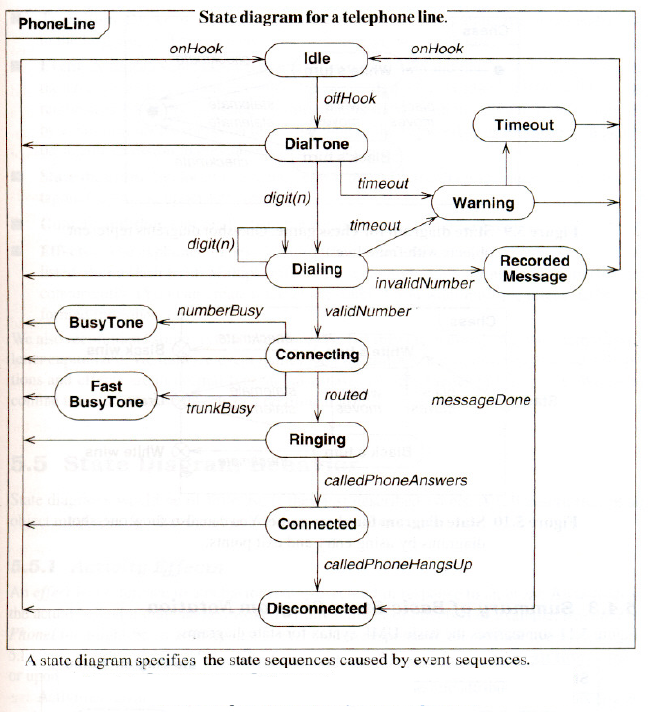
Sample State Diagram for a telephone line:

Slide 36
The diagram concerns a phone line and not the caller nor callee.
The diagram contains sequences associated with normal calls as well as some abnormal sequences, such as timing out while dialing or getting busy lines. The UML notation for a state diagram is a rectangle with its name in a small pentagonal tag in the upper left corner. The constituent states and transitions lie within the rectangle.

Slide 37
At the start of a call, the telephone line is idle. When the phone is removed from the hook, it emits a dial tone and can accept the dialing of digits. Upon entry of a valid number, the phone system tries to connect the call and route it to the proper destination. The connection can fail if the number or trunk is busy. If the connection is successful, the called phone begins ringing. If the called party answers the phone, a conversation can occur. When the called party hangs up, the phone disconnects and reverts to idle when put on hook again.
Note that the receipt of the signal onHook causes a transition from any state to Idle (the bundle of transitions leading to Idle).

Slide 38
One-shot State Diagrams
State diagrams can represent continuous loops or one-shot life cycles. The diagram for the phone line is a continuous loop. In describing ordinary usage of the phone, one does not know or care how the loop is started. (While describing installation of new lines, the initial state would be important.)

Slide 39
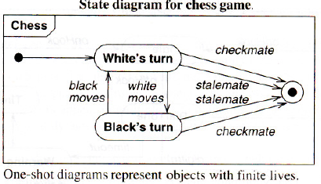
One-shot state diagrams represent objects with finite lives and have initial and final states. The initial state is entered on creation of an object; entry of the final state implies destruction of the object.
Figure shows a simplified life cycle of a chess game with a default initial state (solid circle) and a default final state (bull's eye).

Slide 40
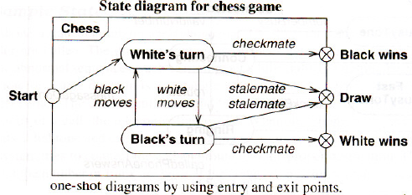
As an alternate notation, initial and final states can be indicated via entry and exit points.
In figure, the start entry point leads to white's first turn, and the chess game eventually ends with one of three possible outcomes. Entry points (hollow circles) and exit points (circles enclosing an "x") appear on the state diagram's perimeter and may be named.

Slide 41
State Diagram Behavior:
State diagrams would be of little use if they just described events. A full description of an object must specify what the object does in response to events.

Slide 42
Activity Effects:
An effect is a reference to a behavior that is executed in response to an event. An activity is the actual behavior that can be invoked by any number of effects. E.g. disconnectPhoneLine might be an activity that is executed in response to an onHook event.

Slide 43
An activity may be performed upon a transition, upon the entry to or exit from a state, or upon some other event within a state. Activities can also represent internal control operations, such as setting attributes or generating other events.

Slide 44
The notation for an activity is a slash (“ / “)and the name (or description) of the activity, following the event that causes it. The keyword do is reserved for indicating an ongoing activity (to be explained) and may not be used as an event name.

Slide 45
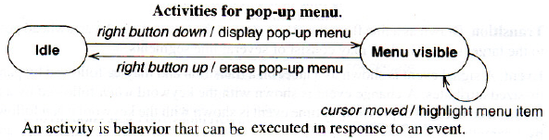
Figure shows the state diagram for a pop-up menu on a workstation. When the right button is depressed, the menu is displayed; when the right button is released, the menu is erased. While the menu is visible, the highlighted menu item is updated whenever the cursor moves.

Slide 46
Do-Activities:
A do-activity is an activity that continues for an extended time. By definition, a do-activity can only occur within a state and cannot be attached to a transition.
E.g. Warning light may flash during the Paperjam state for a copy machine (Figure below).

Slide 47
Do-activities include continuous operations, such as displaying a picture on a television screen, as well as sequential operations that terminate by themselves after an interval of time, such as closing a valve.
The notation "do / ” denotes a do-activity that may be performed for all or part of the duration that an object is in a state.

Slide 48
Entry and Exit Activities:
As an alternative to showing activities on transitions, one can bind activities to entry or to exit from a state. There is no difference in expressive power between the two notations, but frequently all transitions into a state perform the same activity, in which case it is more concise to attach the activity to the state.

Slide 49
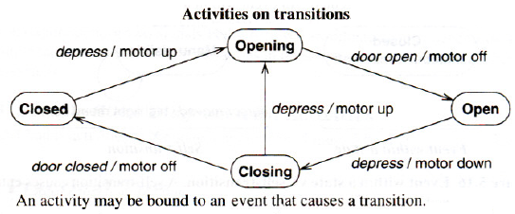
E.g. Figure below shows the control of a garage door opener.
The user generates depress events with a pushbutton to open and close the door. Each event reverses the direction of the door, but for safety the door must open fully before it can be closed. The control generates motor up and motor down activities for the motor. The motor generates door open and door closed events when the motion has been completed. Both transitions entering state Opening cause the door to open.

Slide 50
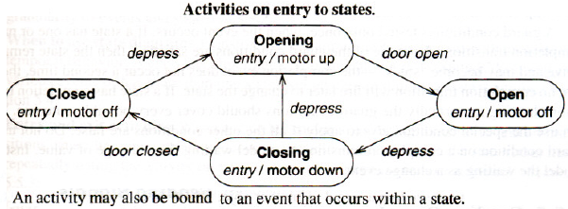
Figure below shows the same model using activities on entry to states.
An entry activity is shown inside the state box following the keyword entry and a "/" character. Whenever the state is entered, by any incoming transition, the entry activity is performed. An entry activity is equivalent to attaching the activity to every incoming transition. If an incoming transition already has an activity, its activity is performed first.

Slide 51
Exit activities are less common than entry activities, but they are occasionally useful. An exit activity is shown inside the state box following the keyword exit and a "/ " character. Whenever the state is exited, by any outgoing transition, the exit activity is performed first.
If a state has multiple activities, they are performed in the following order:
activities on the incoming transition, entry activities, do-activities, exit activities, activities on the outgoing transition.

Slide 52
Events that cause transitions out of the state can interrupt do-activities. If a do activity is interrupted, the exit activity is still performed.
In general, any event can occur within a state and cause an activity to be performed. Entry and exit are only two examples of events that can occur.

