Slide 1
H/W and S/W for VLIW and EPIC
Unit 5
Raju K
Associate Professor
CSE Dept.

Slide 2
Introduction
So far we have considered techniques used to eliminate data and control stalls and achieve an ideal CPI of 1.
To improve performance further we would like to decrease the CPI to less than 1. But this cannot be done if we issue only one instruction every clock cycle.
Multiple issue processors allow us to issue multiple instructions in a clock cycle. There are two variations: superscalar and VLIW (Very Long Instruction Word) processors.
Superscalar processors issue varying numbers of instructions per clock and may be either statically scheduled by compiler or dynamically scheduled using techniques based on scoreboarding or Tomasulo algorithm.
VLIWs issue a fixed number of instructions formatted either as one large instruction or as a fixed instruction packet. VLIW processors are inherently statically scheduled by the compiler.

Slide 3
VLIW: Very Long Instruction Word
Int Op 1
Int Op 2
Mem Op 1
Mem Op 2
FP Op 1
FP Op 2
Two Integer Units,
Single Cycle Latency
Two Load/Store Units,
Three Cycle Latency
Two Floating-Point Units,
Four Cycle Latency
Multiple operations packed into one instruction
Each operation slot is for a fixed function
Constant operation latencies are specified
Architecture requires guarantee of:
Parallelism within an instruction
No data use before data ready

Slide 4
VLIW Compiler Responsibilities
The compiler:
Schedules to maximize parallel execution
Guarantees intra-instruction parallelism
Schedules to avoid data hazards
Typically separates operations with explicit NOPs

Slide 5
Loop Execution
for (i=0; i<N; i++)
B[i] = A[i] + C;
Int1
Int 2
M1
M2
FP+
FPx
loop:
add r1
ld
Compile
loop: ld f1, 0(r1)
add r1, 8
fadd f2, f0, f1
sd f2, 0(r2)
add r2, 8
bne r1, r3, loop
fadd
Schedule
add r2
bne
sd
How many FP ops/cycle?
1 fadd / 8 cycles = 0.125

Slide 6
Loop Unrolling
for (i=0; i<N; i++)
B[i] = A[i] + C;
Unroll inner loop to perform 4 iterations at once
for (i=0; i<N; i+=4)
{
B[i] = A[i] + C;
B[i+1] = A[i+1] + C;
B[i+2] = A[i+2] + C;
B[i+3] = A[i+3] + C;
}
Need to handle values of N that are not multiples of unrolling factor with final cleanup loop

Slide 7
Scheduling Loop Unrolled Code
Unroll 4 ways
loop: ld f1, 0(r1)
ld f2, 8(r1)
ld f3, 16(r1)
ld f4, 24(r1)
add r1, 32
fadd f5, f0, f1
fadd f6, f0, f2
fadd f7, f0, f3
fadd f8, f0, f4
sd f5, 0(r2)
sd f6, 8(r2)
sd f7, 16(r2)
sd f8, 24(r2)
add r2, 32
bne r1, r3, loop
Int1
Int 2
M1
M2
FP+
FPx
loop:
ld f1
ld f2
ld f3
add r1
ld f4
fadd f5
Schedule
fadd f6
fadd f7
fadd f8
sd f5
sd f6
sd f7
add r2
bne
sd f8
How many FLOPS/cycle?
4 fadds / 11 cycles = 0.36

Slide 8
Loop-Level Parallelism
Concepts and techniques
Loop-level parallelism is normally analyzed at the source level while most ILP analysis is done once the instructions have been generated by the compiler.
The analysis of loop-level parallelism focuses on determining whether data accesses in later iterations are data dependent on data values produced in earlier iterations.
Example:
for (i=1; i<=1000; i++)
x[i]=x[i]+s;
Loop-carried data dependence: Dependence exists between different iterations of the loop.
A loop is parallel unless there is a cycle in the dependences. Therefore, a non-cycled loop-carried data dependence can be eliminated by code transformation.

Slide 9
When Safe to Unroll Loop?
Example: Where are data dependencies?
(A,B,C distinct & nonoverlapping)
for (i=0; i<100; i=i+1) { A[i+1] = A[i] + C[i]; /* S1 */ B[i+1] = B[i] + A[i+1]; /* S2 */ }
S2 uses the value, A[i+1], computed by S1 in the same iteration. This is not a loop-carried dependence. ie dependence within the same iteration.
S1 uses a value computed by S1 in an earlier iteration, since iteration i computes A[i+1] which is read in iteration i+1. The same is true of S2 for B[i] and B[i+1]. This is a “loop-carried dependence”: between iterations
For our prior example, each iteration was distinct
LC
Not LC
LC

Slide 10
Another Example
Loop carried dependences?
To overlap iteration execution:
Convert loop-carried data dependence into data dependence.
for (i=1; i<=100; i=i+1) { A[i] = A[i] + B[i]; /* S1 */ B[i+1] = C[i] + D[i]; /* S2 */ }
LC
A[1] = A[1] + B[1];
for (i=1; i<=99; i=i+1) { B[i+1] = C[i] + D[i];
A[i+1] = A[i+1] + B[i+1]; }
B[101] = C[100] + D[100];
Not LC

Slide 11
Another Example
True loop-carried data dependence are usually in the form of a recurrence.
for (I=2; I<=100; I++){
Y[I] = Y[I-1] + Y[I];
}
Even true loop-carried data dependence has parallelism.
for (I=6; I<=100; I++){
Y[I] = Y[I-5] + Y[I];
}
The first, second, …, five iterations are parallel.

Slide 12
Detecting and Eliminating Dependencies
Finding the dependences in a program is an important part of three tasks:
Good scheduling of code
Determining which loops might contain parallelism, and
Eliminating name dependence
Example
for (i=1; i<= 100; i++) {
A[i] = B[i] + C[i];
D[i] = A[i] + E[i];
}
Absence of loop-carried dependence, which implies existence of a large amount of parallelism.

Slide 13
Dependence Detection Problem
GCD test heuristic
Suppose we have stored to an array element with index value a*j+b and loaded from the same array with index value c*k+d, where j and k are the for-loop index variable that runs from m to n. A dependence exists if two conditions hold:
There are two iteration indices, j and k, both within the limits of the for loop.
The loop stores into an array element indexed by a*j+b and later fetches from that same array element when it is indexed by c*k+d. That is, a*j+b=c*k+d.
Note, a,b,c, and d are generally unknown at compile time, making it impossible to tell if a dependence exists.
A simple and sufficient test for the absence of a dependence. If a loop-carried dependence exists, then GCD(c,a) must divide (d-b). That is if GCD(c,a) does not divide (d-b), no dependence is possible
i.e. (d-b) not divisible by GCD(c,a) :- no dependence

Slide 14
Example-1
Using GCD test, determine whether dependences exist in the following loop:
for (i=1; i<=100; i=i+1)
{
X[2*i+3] = X[2*i] * 5.0;
}
a=2 b=3 ; c=2 d=0 ;
Gcd(c,a)= gcd(2,2)= 2
(d-b)=-3
(d-b) is not divisible by GCD(c,a) - Thus, there is no dependence between the statements in this loop.

Slide 15
Example-2
Using GCD test, determine whether dependence exists in the following loop:
for (i=0; i<300; i++)
{ a[301*i+5] = b[i]*c[i];
d[i] = a[301*i]+e; }
Ans:
GCD(c,a)=GCD(301,301)=301
d-b=0-5=-5
(d-b) is not divisible by GCD(c,a)
Hence, the GCD test breaks data dependence between the statements.

Slide 16
Example-3
for (i=0; i<100; i=i+1)
{ x[i+1] = x[i] + y[i]; }
References are to indices x[a*j+b] and x[c*k+d].
i.e x[1*i+1] and x[1*i+0].
a=1 b=1 ; c=1 d=0 ;
Gcd(c,a)= gcd(1,1)= 1
(d-b)=-1
(d-b) is divisible by GCD(c,a)
Thus, there is dependence between the statements in the two iterations of the loop.

Slide 17
Finding dependences in source code
for (i=1; i<=100; i=i+1)
{
Y[i] = X[i] / c; /* S1 */
X[i] = X[i] + c; /* S2 */
Z[i] = Y[i] + c; /* S3 */
Y[i] = c - Y[i]; /* S4 */
}
True dependences S1 to S3, S1 to S4
Antidependence S1 to S2, S3 to S4
Output dependence S1 to S4

Slide 18
Renaming resolves output and anti dependences
for (i=1; i<=100; i=i+1)
{
T1[i] = X[i] / c; /* S1 */
T2[i] = X[i] + c; /* S2 */
Z[i] = T1[i] + c; /* S3 */
Y[i] = c - T1[i]; /* S4 */
}

Slide 19
Situations where Dependence Analysis Fails
When objects are referenced via pointers rather than array indices;
When array indexing is indirect through another array.
When a dependence may exist for some value of the inputs, but does not exist in actuality.
Others.

Slide 20
Eliminating Dependent Computations
Copy propagation
DADDUI R1, R2, #4
DADDUI R1, R1, #4
to
DADDUI R1, R2, #8
Tree height reduction
ADD R1, R2, R3
ADD R4, R1, R6
ADD R8, R4, R7
to
ADD R1, R2, R3
ADD R4, R6, R7
ADD R8, R1, R4

Slide 21
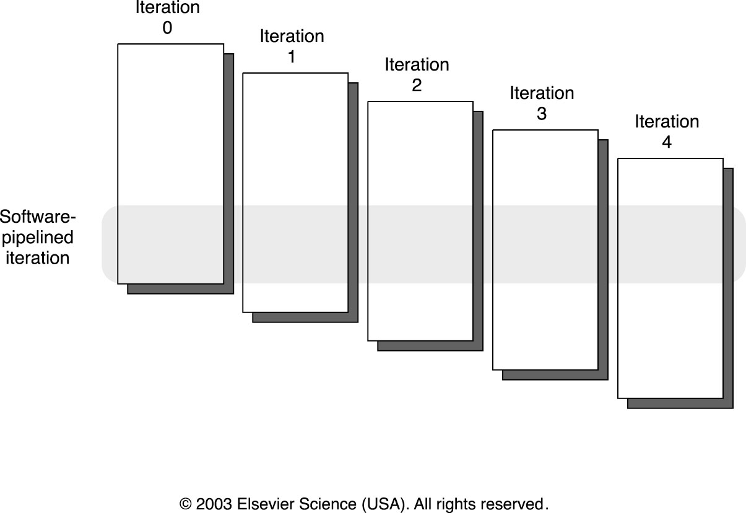
Software Pipelining: Symbolic Loop Unrolling
Software pipelining is a technique for reorganizing loops such that each iteration in the software-pipelined code is made from instructions chosen from different iterations of the original loop.
A software-pipelined loop interleaves instructions from different loop iterations without unrolling the loop.
A software pipeline loop consists of a loop body, start-up code and clean-up code

Slide 22
Software Pipelining Example
After: Software Pipelined
1 SD 0(R1),F4 ; Stores M[i]
2 ADDD F4,F0,F2 ; Adds to M[i-1]
3 LD F0,-16(R1); Loads M[i-2]
4 SUBUI R1,R1,#8
5 BNEZ R1,LOOP
Before: Unrolled 3 times
1 LD F0,0(R1)
2 ADDD F4,F0,F2
3 SD 0(R1),F4
4 LD F6,-8(R1)
5 ADDD F8,F6,F2
6 SD -8(R1),F8
7 LD F10,-16(R1)
8 ADDD F12,F10,F2
9 SD -16(R1),F12
10 SUBUI R1,R1,#24
11 BNEZ R1,LOOP
5 cycles per iteration
Symbolic Loop Unrolling
Maximize result-use distance
Less code space than unrolling
Fill & drain pipe only once per loop vs. once per each unrolled iteration in loop unrolling

Slide 23
Software Pipelining
Unroll 4 ways first
Int1
Int 2
M1
M2
FP+
FPx
loop: ld f1, 0(r1)
ld f2, 8(r1)
ld f3, 16(r1)
ld f4, 24(r1)
add r1, 32
fadd f5, f0, f1
fadd f6, f0, f2
fadd f7, f0, f3
fadd f8, f0, f4
sd f5, 0(r2)
sd f6, 8(r2)
sd f7, 16(r2)
add r2, 32
sd f8, -8(r2)
bne r1, r3, loop
ld f1
ld f2
ld f3
add r1
ld f4
prolog
ld f1
fadd f5
ld f2
fadd f6
ld f3
fadd f7
add r1
ld f4
fadd f8
loop:
ld f1
sd f5
fadd f5
iterate
ld f2
sd f6
fadd f6
add r2
ld f3
sd f7
fadd f7
add r1
bne
ld f4
sd f8
fadd f8
sd f5
fadd f5
sd f6
fadd f6
epilog
add r2
sd f7
fadd f7
bne
sd f8
fadd f8
How many FLOPS/cycle?
sd f5
4 fadds / 4 cycles = 1

Slide 24
Software Pipelining vs. Loop Unrolling
Loop Unrolled
Wind-down overhead
performance
Startup overhead
time
Loop Iteration
Software Pipelined
performance
time
Loop Iteration
Software pipelining pays startup/wind-down costs only once per loop, not once per iteration

Slide 25
Comparison between Software-Pipelining and Loop Unrolling
Advantages
Less code space than conventional unrolling
Loop runs at peak speed during steady state
Overhead only at loop initiation and termination
Complements unrolling
Disadvantages
Hard to overlap long latencies
Unrolling combined with SW pipelining
Requires advanced compiler transformations

Slide 26
What if there are no loops?
Branches limit basic block size in control-flow intensive irregular code
Difficult to find ILP in individual basic blocks
Basic block

Slide 27
Trace Scheduling
Pick string of basic blocks, a trace, that represents most frequent branch path
Use profiling feedback or compiler heuristics to find common branch paths
Schedule whole “trace” at once
Add fixup code to cope with branches jumping out of trace

Slide 28
H/W support - Predication
Conditional move
A predicated instruction packs a conditional and an instruction
Instruction control-dependent on conditional
If conditional is false instruction is converted to no-op, otherwise executed
Convert control dependence to data dependence
/* if (A==0) {S=T;} */
/* simple translation */
BNEZ R1, L /* if (A==0) */
ADDI R2, R3, 0 /* S=T; */
L: . . .
/* predicated instruction */
CMOVZ R2, R3, R1 /* move T to S if R1=0 */

Slide 29
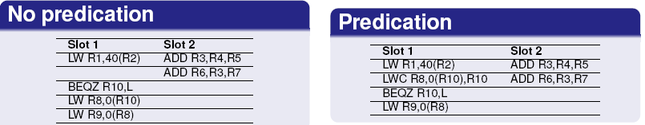
Predication
Generalized predication
Predicates applied to all instructions
Enables predicated execution of large code blocks
Speculatively puts time-critical instructions under predicates

Slide 30
Hardware Support for Compiler Speculation
In moving instructions across a branch the compiler must ensure that exception behavior is not changed and the dynamic data dependence remains the same.
The simplest case is that the compiler is conservative about what instructions it speculatively moves, and the exception behavior is unaffected.
Four methods
The hardware and OS cooperatively ignore exceptions for speculative instructions.
Speculative instructions that never raise exceptions are used, and checks are introduced to determine when an exception should occur.
Poison bits are attached to the result registers written by speculated instructions when the instruction cause exceptions.
The instruction results are buffered until it is certain that the instruction is no longer speculative.

Slide 31
Overview of the Intel IA-64 architecture.
The Intel IA-64 Instruction Set Architecture
The IA-64 is a RISC-style, register-register instruction set, but with many novel features designed to support compiler-based exploitation of ILP.
EPIC approach includes several concepts that extend the earlier VLIW approach. These extensions fall into two main areas:
1. EPIC has greater flexibility in indicating parallelism among instructions and in instruction formats. Rather than relying on a fixed instruction format where all operations in the instruction must be capable of being executed in parallel and where the format is completely rigid, EPIC uses explicit indicators of possible instruction dependence as well as a variety of instruction formats.

Slide 32
Overview of the Intel IA-64 architecture.
2. EPIC has more extensive support for software speculation than the earlier VLIW schemes that had only minimal support.
The IA-64 Register Model
The components of the IA-64 register state are
128 64-bit general-purpose registers, which as we will see shortly are actually 65 bits wide
128 82-bit floating-point registers, which provide two extra exponent bits over the standard 80-bit IEEE format
64 1-bit predicate registers

Slide 33
Overview of the Intel IA-64 architecture.
8 64-bit branch registers, which are used for indirect branches
a variety of registers used for system control, memory mapping, performance counters, and communication with the OS
Instruction Format and Support for Explicit Parallelism
The IA-64 architecture uses two different concepts to achieve the benefits of implicit parallelism and ease of instruction decode. Implicit parallelism is achieved by placing instructions into instruction groups, while the fixed formatting of multiple instructions is achieved through the introduction of a concept called a bundle, which contains three instructions.

Slide 34
Overview of the Intel IA-64 architecture.
An instruction group is a sequence of consecutive instructions with no register data dependences among them. All the instructions in a group could be executed in parallel, if sufficient hardware resources existed and if any dependences through memory were preserved.
An instruction group can be arbitrarily long, but the compiler must explicitly indicate the boundary between one instruction group and another. This boundary is indicated by placing a stop between two instructions that belong to different groups.

Slide 35
Overview of the Intel IA-64 architecture.
Predication and Speculation Support
An instruction is predicated by specifying a predicate register, whose identity is placed in the lower 6 bits of each instruction field. Predicate registers are set using compare or test instructions. A compare instruction specifies one of ten different comparison tests and two predicate registers as destinations.
Speculation support in the IA-64 architecture consists of separate support for control speculation, which deals with deferring exception for speculated instructions, and memory reference speculation, which supports speculation of load instructions

Slide 36
Key features of Intel Itanium processor
The Itanium 2 has clock rate of 1.6GHz.
11 pipelined functional units : two I-units, four M-units(two for loads and two for stores), three B-units, and two F-units.
three-level memory hierarchy all on-chip. The first level uses split instruction and data caches, each 16 KB; The second and third levels are unified caches of 256 KB and of 3 MB to 9 MB, respectively.
Itanium 2 can issue up to six instructions per clock from two bundles. Instructions are allocated to functional units based on the bundle bits.

Slide 37
Key features of Intel Itanium processor
The Itanium 2 processor uses an eight-stage pipeline divided into four major parts:
Front-end (stages IPG and Rotate)—Prefetches up to 32 bytes per clock (two bundles) into a prefetch buffer, which can hold up to eight bundles (24instructions). Branch prediction is done using a multilevel adaptive predictor
Instruction delivery (stages EXP and REN)—Distributes up to six instructions to the 11 functional units. Implements register renaming for both rotation and register stacking.

Slide 38
Key features of Intel Itanium processor
Operand delivery (REG)—Accesses the register file, performs register bypassing, accesses and updates a register scoreboard, and checks predicate dependences.
Execution (EXE, DET, and WRB)—Executes instructions through ALUs and load-store units, detects exceptions and posts NaTs, retires instructions, and performs write back.

Slide 39
End of UNIT 5

