Slide 1
UNIT -5
Hardware and Software for VLIW and EPIC
Ref : Appendix G of the text book

Slide 2
Detecting and Enhancing Loop-Level Parallelism
Loop-level parallelism
  Analyzed at the source or close to it
  Loop-level analysis
  Determine what dependences exist among the operands in a loop across the iterations of that loop
  LCD: Determine whether data accesses in later iterations are dependent on data values produced in earlier iterations
  Finding loop-level parallelism involves recognizing structures such as loops, array references, and induction variable computations

Slide 3
Detecting and Enhancing Loop-Level Parallelism
  Loop-carried dependence
  Data dependent on data values produced in earlier iterations
  Ex: for (i=1000; i>0; i=i-1)
    x[i] = x[i] + s;
    Two dependences:
      Dependence between the definition and use of x[i]
        This dependence within a single iteration (not loop carried)
      Dependence of i (index)
        This dependence is loop-carried (across iteration) but the dependence of index variable is not considered because a compiler can easily handle
    Loop-level parallel → every iteration can be executed in parallel

Slide 4
Example: Assume that A, B, and C are distinct, non-overlapping arrays
for (i=1; i <= 100; i=i+1) {
A[i+1] = A[i] + C[i]; /* S1 */
B[i+1] = B[i] + A[i+1]; /* S2 */
}
S1 uses a value computed by S1 in an earlier iteration (A[i])
  Loop-carried dependence
S2 uses a value computed by S2 in an earlier iteration (B[i])
  Loop-carried dependence
S2 uses a value computed by S1 in the same iteration (A[i+1])
  Not loop-carried

Slide 5
Detecting and Enhancing Loop-Level Parallelism
Ex)
for (i=1; i<=100; i++) {
A[i+1] = A[i] + C[i]; // S1
B[i+1] = B[i] + A[i+1]; // S2
}
  Dependence
A[2] = A[1] + C[1]; // S1 (i=1)
B[2] = B[1] + A[2]; // S2 (i=1)
A[3] = A[2] + C[2]; // S1 (i=2)
B[3] = B[2] + A[3]; // S2 (i=2)
A[4] = A[3] + C[3]; // S1 (i=3)
B[4] = B[3] + A[4]; // S2 (i=3)
  ……
    S1 → S1: loop-carried dependence
    S2 → S2: loop-carried dependence
    S1 → S2: dependence in the same iteration

Slide 6
The loop-carried dependence does not prevent parallelism
for (i=1; i <= 100; i=i+1) {
A[i] = A[i] + B[i]; /* S1 */
B[i+1] = C[i] + D[i]; /* S2 */
}
What are the dependences between s1 and s2? Is this loop parallel? If not show how to make it parallel.

Slide 7
S1 uses a value computed by S2 in an earlier iteration (B[i+1])
  Loop-carried dependence
Dependence is not circular
  Neither statement depends on itself, and although S1 depends on S2, S2 does not depend on S1
A loop is parallel if it can be written without a cycle in the dependences

Slide 8
Loop-Level Parallelism
Ex)
for (i=1; i<=100; i++) {
A[i] = A[i] + B[i]; // S1
B[i+1] = C[i] + D[i]; // S2
}
  Dependence
A[1] = A[1] + B[1]; // S1 (i=1)
B[2] = C[1] + D[1]; // S2 (i=1)
A[2] = A[2] + B[2]; // S1 (i=2)
B[3] = C[2] + D[2]; // S2 (i=2)
A[3] = A[3] + B[3]; // S1 (i=3)
B[4] = C[3] + D[3]; // S2 (i=3)
  ……
    S2 → S1: loop-carried dependence
  Loop-level parallel because of no circular dependence

Slide 9
Detecting and Enhancing Loop-Level Parallelism
Ex)
A[1] = A[1] + B[1]
for (i=1; i<=99; i++) {
B[i+1] = C[i] + D[i]; // S2
A[i+1] = A[i+1] + B[i+1]; // S1
}
B[101] = C[100] +D[100]
  Dependence
A[1] = A[1] + B[1]; // S1
B[2] = C[1] + D[1]; // S2 (i=1)
A[2] = A[2] + B[2]; // S1 (i=1)
B[3] = C[2] + D[2]; // S2 (i=2)
A[3] = A[3] + B[3]; // S1 (i=2)
B[4] = C[3] + D[3]; // S2 (i=3)
……

Slide 10
Circular dependence
Another example)
for (i=1; i<=100; i++) {
A[i] = A[i] + B[i]; // S1
B[i+1] = C[i] + A[i]; // S2
}
  Dependence
A[1] = A[1] + B[1]; // S1 (i=1)
B[2] = C[1] + A[1]; // S2 (i=1)
A[2] = A[2] + B[2]; // S1 (i=2)
B[3] = C[2] + A[2]; // S2 (i=2)
A[3] = A[3] + B[3]; // S1 (i=3)
B[4] = C[3] + A[3]; // S2 (i=3)
  ……
    S2 → S1: loop-carried dependence
    S1 → S2: loop-level dependence
cycle
Circular dependence

Slide 11
Loop carried Dependence
Ex)
A[1] = A[1] + B[1]
for (i=1; i<=99; i++) {
B[i+1] = C[i] + A[i]; // S2
A[i+1] = A[i+1] + B[i+1]; // S1
}
B[101] = C[100] +D[100]
  Dependence
A[1] = A[1] + B[1]; // S1
B[2] = C[1] + A[1]; // S2 (i=1)
A[2] = A[2] + B[2]; // S1 (i=1)
B[3] = C[2] + A[2]; // S2 (i=2)
A[3] = A[3] + B[3]; // S1 (i=2)
B[4] = C[3] + A[3]; // S2 (i=3)
……
Loop-carried
dependence

Slide 12
Loop level Parallel
Another example)
for (i=1; i<=100; i++) {
A[i+1] = C[i] + B[i+1]; // S1
B[i+1] = C[i] + A[i+1]; // S2
}
  Dependence
A[2] = C[1] + B[2]; // S1 (i=1)
B[2] = C[1] + A[2]; // S2 (i=1)
A[3] = C[2] + B[3]; // S1 (i=2)
B[3] = C[2] + A[3]; // S2 (i=2)
A[4] = C[3] + B[4]; // S1 (i=3)
B[4] = C[3] + A[4]; // S2 (i=3)
  ……

Slide 13
Loop-Level Parallelism (LLP) Analysis
Loop-Level Parallelism (LLP) analysis focuses on whether data accesses in later iterations of a loop are data dependent on data values produced in earlier iterations and possibly making loop iterations independent (parallel).
e.g. in for (i=1; i<=1000; i++)
x[i] = x[i] + s;
the computation in each iteration is independent of the previous iterations and the
loop is thus parallel. The use of X[i] twice is within a single iteration.
    Thus loop iterations are parallel (or independent from each other).
Loop-carried Data Dependence: A data dependence between different loop iterations (data produced in an earlier iteration used in a later one).
Not Loop-carried Data Dependence: Data dependence within the same loop iteration.
LLP analysis is important in software optimizations such as loop unrolling since it usually requires loop iterations to be independent (and in vector processing).
LLP analysis is normally done at the source code level or close to it since assembly language and target machine code generation introduces loop-carried name dependence in the registers used in the loop.
  Instruction level parallelism (ILP) analysis, on the other hand, is usually done when instructions are generated by the compiler.
Iteration #
1 2 3 ….. 1000
S1
S1
S1
…
S1
S1
(Body of Loop)
Dependency Graph

Slide 14
LLP Analysis Example 1
Loop-carried Dependence
In the loop:
for (i=1; i<=100; i=i+1) {
A[i+1] = A[i] + C[i]; /* S1 */
B[i+1] = B[i] + A[i+1];} /* S2 */
}
(Where A, B, C are distinct non-overlapping arrays)
  S2 uses the value A[i+1], computed by S1 in the same iteration. This data dependence is within the same iteration (not a loop-carried dependence).
    does not prevent loop iteration parallelism.
  S1 uses a value computed by S1 in the earlier iteration, since iteration i computes A[i+1] read in iteration i+1 (loop-carried dependence, prevents parallelism). The same applies for S2 for B[i] and B[i+1]
    These two data dependencies are loop-carried spanning more than one iteration (two iterations) preventing loop parallelism.
Iteration #
i i+1
Not Loop
Carried
Dependence
(within the
same iteration)
S1
S1
A _{i+1}
A _{i+1}
A _{i+1}
S2
S2
B _{i+1}
Dependency Graph
In this example the loop carried dependencies form two dependency chains
starting from the very first iteration and ending at the last iteration

Slide 15
LLP Analysis Example 2
Dependency Graph
Loop-carried Dependence
Iteration #
i i+1
In the loop:
for (i=1; i<=100; i=i+1) {
A[i] = A[i] + B[i]; /* S1 */
B[i+1] = C[i] + D[i]; /* S2 */
}
  S1 uses the value B[i] computed by S2 in the previous iteration (loop-carried dependence)
  This dependence is not circular:
    S1 depends on S2 but S2 does not depend on S1.
  Can be made parallel by replacing the code with the following:
  A[1] = A[1] + B[1];
  for (i=1; i<=99; i=i+1) {
  B[i+1] = C[i] + D[i];
  A[i+1] = A[i+1] + B[i+1];
  }
  B[101] = C[100] + D[100];
S1
S1
B _{i+1}
S2
S2
Loop Start-up code
Parallel loop iterations
(data parallelism in computation
exposed in loop code)
Loop Completion code

Slide 16
Finding dependences
Good scheduling
Determine which loops contain parallelism
Eliminate name dependences

Slide 17
Detecting and Eliminating Dependencies
Finding the dependences in a program is an important part of three tasks:
  Good scheduling of code
  Determining which loops might contain parallelism, and
  Eliminating name dependence
    Example
      for (i=1; i<= 100; i++) {
      A[i] = B[i] + C[i];
      D[i] = A[i] + E[i];
      }
    Absence of loop-carried dependence, which implies existence of a large amount of parallelism.

Slide 18
Dependence Detection Problem
GCD test heuristic
  Suppose we have stored to an array element with index value a*j+b and loaded from the same array with index value c*k+d, where j and k are the for-loop index variable that runs from m to n. A dependence exists if two conditions hold:
      There are two iteration indices, j and k, both within the limits of the for loop.
      The loop stores into an array element indexed by a*j+b and later fetches from that same array element when it is indexed by c*k+d. That is, a*j+b=c*k+d.
        Note, a,b,c, and d are generally unknown at compile time, making it impossible to tell if a dependence exists.
  GCD test is a simple and sufficient test for the absence of a dependence.
  If a loop-carried dependence exists, then (d-b) / GCD(c,a)
  Else no dependence is possible

Slide 19
In simplest terms, a one-dimensional array index is affine if it can be written in the form a × i + b, where a and b are constants and i is the loop index variable. The index of a multidimensional array is affine if the index in each dimension is affine,.

Slide 20
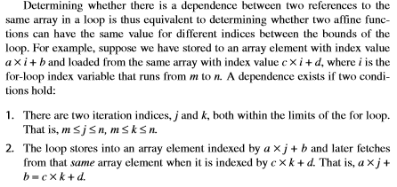

Slide 21
A simple and sufficient test for the absence of a dependence is the greatest common divisor (GCD) test. It is based on the observation that if a loop carried dependency exists between X[a*i + b] and X[c*i + d] (where X is the array;
a, b, c and d are integers, and i is the loop variable), then GCD (c, a) must divide (d – b).
The assumption is that the loop must be normalized – written so that the loop index/variable starts at 1 and gets incremented by 1 in every iteration.
For example, in the following loop, a=2, b=3, c=2, d=0 and GCD(a,c)=2 and (d-b) is -3. Since 2 does not divide -3, no dependence is possible.

Slide 22
Example
Using GCD test, determine whether dependences exist in the following loop:
for (i=1; i<=100; i=i+1)
{
X[2*i+3] = X[2*i] * 5.0;
}

Slide 23
Find Loop carried dependence using GCD test
for (i=0; i<300; i++)
{a[301*i+5] = b[i]*c[i];
d[i] = a[301*i]+e; }
GCD(c,a)=GCD(301,301)=301
d-b=0-5=-5
GCD(c,a) does not divide d-b
The GCD test breaks data dependence between the statements. Thus, there is no dependence between the statements in this loop.

Slide 24
Question:
The following loop has multiple types of dependences. Find all the true dependences, output dependences, and antidependences, and eliminate the output dependences and antidependences by renaming.
Finding dependences in source code
for (i=1; i<=100; i=i+1)
{
  Y[i] = X[i] / c; /* S1 */
  X[i] = X[i] + c; /* S2 */
  Z[i] = Y[i] + c; /* S3 */
  Y[i] = c - Y[i]; /* S4 */
  }

Slide 25
True dependences S1 to S3, S1 to S4
Anti dependence S1 to S2, S3 to S4
Output dependence S1 to S4

Slide 26
Renaming resolves output and anti dependences
for (i=1; i<=100; i=i+1)
{
T1[i] = X[i] / c; /* S1 */
T2[i] = X[i] + c; /* S2 */
Z[i] = T1[i] + c; /* S3 */
Y[i] = c - T1[i]; /* S4 */
}

Slide 27
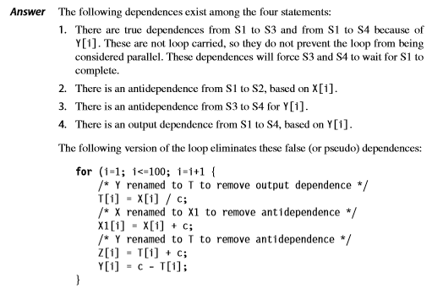

Slide 28
After the loop, the variable X has been renamed X1. In code that follows the loop, the compiler can simply replace the name X by X1. In this case, renaming does not require an actual copy operation but can be done by substituting names or by register allocation. In other cases, however, renaming will require copying.

Slide 29
Situations where Dependence Analysis Fails
  When objects are referenced via pointers rather than array indices;
  When array indexing is indirect through another array.
  When a dependence may exist for some value of the inputs, but does not exist in actuality.
  Others.

Slide 30
ILP Compiler Support:
Loop-Carried Dependence Detection
To detect loop-carried dependence in a loop, the Greatest Common Divisor (GCD) test can be used by the compiler, which is based on the following:
If an array element with index: a x i + b is stored and element: c x i + d of the same array is loaded later where index runs from m to n, a dependence exists if the following two conditions hold:
  There are two iteration indices, j and k , m ≤ j , k ≤ n
  (within iteration limits)
  The loop stores into an array element indexed by:
  a x j + b
  and later loads from the same array the element indexed by:
  c x k + d
  Thus:
  a x j + b = c x k + d
m, n
Produce or write (store) element with this Index
Later read (load) element with this index
j < k
Index of element written (stored)
Index of element read(loaded) later

Slide 31
The Greatest Common Divisor (GCD) Test
If a loop carried dependence exists, then :
GCD(c, a) must divide (d-b)
The GCD test is sufficient to guarantee no loop carried dependence
However there are cases where GCD test succeeds but no
dependence exits because GCD test does not take loop
bounds into account
Example:
for(i=1; i<=100; i=i+1) {
x[2*i+3] = x[2*i] * 5.0;
}
a = 2 b = 3 c = 2 d = 0
GCD(a, c) = 2
d - b = -3
2 does not divide -3 ⇒ No loop carried dependence possible.
Index of element stored:
a x i + b
Index of element loaded:
c x i + d
+ 0

Slide 32
Recurrence (a kind of loop-carried dependence)
  Variable defined based on the value in an earlier iteration
  Example
    for (i=2; i<=100; i=i+1)
    Y[i] = Y[i-1] + Y[i];
  Dependence distance in recurrence
  Example
    for (i=6; i<=100; i=i+1)
    Y[i] = Y[i-5] + Y[i];
    Distance: 5
      More parallelism with larger distance

Slide 33
Recurrence (continued)
  Example
    for (i=6; i<=100; i=i+1)
    Y[i] = Y[i-5] + Y[i];
    Distance: 5
    Y[6] = Y[1] + Y[6]; i=6
    Y[7] = Y[2] + Y[7]; i=7
    Y[8] = Y[3] + Y[8]; i=8
    Y[9] = Y[4] + Y[9]; i=9
    Y[10] = Y[5] + Y[10]; i=10
    Y[11] = Y[6] + Y[11]; i=11
    Y[12] = Y[7] + Y[12]; i=12
    Y[13] = Y[8] + Y[13]; i=13
    Y[14] = Y[9] + Y[14]; i=14
    Y[15] = Y[10] + Y[15]; i=15
    Y[16] = Y[11] + Y[16]; i=16
Parallel execution
possible
Parallel execution
possible

Slide 34
Finding Dependences
Why we do it?
  Good scheduling of code
  Determining which loops might contain parallelism
  Eliminating name dependences
Dependence analysis difficult for arrays & pointers
  Need to compare the index (memory location)

Slide 35
Finding Dependences (conti..)
Issue of analyzing programs with pointers.
Points –to analysis.
The basic approach used in points-to analysis relies on information from
  1. Type information, which restricts what a pointer can point to.
  2. Information derived when an object is allocated or when the address of an object is taken, which can be used to restrict what a pointer can point to.
  3. Information derived from pointer assignment.

Slide 36
Type of Dependence
Example
  for (i=1; i<=100; i=i+1) {
  Y[i] = X[i]/c; // S1
  X[i] = X[i] + c; // S2
  Z[i] = Y[i] + c; // S3
  Y[i] = c – Y[i]; // S4
  }
  True dependences from S1 to S3, S1 to S4
  Anti-dependence from S1 to S2, S3 to S4
  Output dependence from S1 to S4

Slide 37
Eliminates false dependences
for (i=1;i<=100;i=i+1)
{
/* Y renamed to T to remove output dependence */
T[i]=X[i] / c; /* S1 */
/* X renamed to X1 to remove antidependence */
X1[i]=X[i] + c; /* S2 */
/* Y renamed to T to remove antidependence */
Z[i]=T[i] + c; /* S3 */
Y[i]=c – Y[i]; /* S4 */
}

Slide 38
Eliminating Dependent computations
Compilers can reduce the impact of dependent computations so as to achieve more ILP.
Copy propagation
Tree height reduction

Slide 39
Eliminating dependent computations
  Copy propagation
    Eliminates operations that copy values
    DADDUI R1,R2,#4
    DADDUI R1,R1,#4
  Tree height reduction
    Makes tree structure wider but shorter
    ADD R1,R2,R3
    ADD R4,R1,R6
    ADD R8,R4,R7
DADDUI R1,R2,#8
2 execution cycles only
R2 R3
R1 R6
R4 R7
R8
    ADD R1,R2,R3
    ADD R4,R6,R7
    ADD R8,R1,R4
R2 R3 R6 R7
R1 R4
R8

Slide 40
Eliminating Dependent Computations
Copy propagation
    DADDUI R1, R2, #4
    DADDUI R1, R1, #4
  to
  DADDUI R1, R2, #8
Tree height reduction
    ADD R1, R2, R3
    ADD R4, R1, R6
    ADD R8, R4, R7
  To
    ADD R1, R2, R3
    ADD R4, R6, R7
    ADD R8, R1, R4
R8
+
R4
R7
+
R1
R6
+
R2
R3
R8
+
R1
R4
+
+
R2
R3
R6
R7

Slide 41
Recurrences are expressions whose value on one iteration is given by a function that depends on the previous iterations.
When a loop with a recurrence is unrolled, we may be able to algebraically optimize the unrolled loop, so that the recurrence need only be evaluated once per unrolled iteration.
sum = sum + x;

Slide 42
Assume we unroll a loop with this recurrence ﬁve times.
If we let the value of x on these ﬁve iterations be given by x1, x2, x3, x4, and x5, then we can write the value of sum at the end of each unroll as
sum = sum + x1 + x2 + x3 + x4 + x5;
If unoptimized this expression requires ﬁve dependent operations, but it can be rewritten as
sum = ((sum + x1) + (x2 + x3)) + (x4 + x5);
which can be evaluated in only three dependent operations.

Slide 43
Eliminating Dependent Computations
Loop unrolling
Replicate the loop body multiple times and adjust the loop termination code
Take n loop bodies and concatenate them into 1 basic block.
Arithmetic optimization with loop unrolling
Optimization related to recurrence
    Depends on the previous iteration
    sum = sum + x;
    Unroll ➔ sum = sum + x1 + x2 + x3 + x4 + x5;
    However, 5 dependent operations.
    Rewrites
    ➔ sum = ((sum + x1) + (x2 + x3)) + (x4 + x5);
    only 3 dependent operations
    When a loop with a recurrence is unrolled, we may be able to algebraically optimized the unrolled loop, so that the recurrence need only be evaluated once per unrolled iteration..

Slide 44
ILP Compiler Support:
Software Pipelining (Symbolic Loop Unrolling)
  A compiler technique where loops are reorganized:
    Each new iteration is made from instructions selected from a number of independent iterations of the original loop.
  The instructions are selected to separate dependent instructions within the original loop iteration.
  No actual loop-unrolling is performed.
    A software equivalent to the Tomasulo approach?
  Requires:
    Additional start-up code to execute code left out from the first original loop iterations.
    Additional finish code to execute instructions left out from the last original loop iterations.
By one or more
iterations

Slide 45
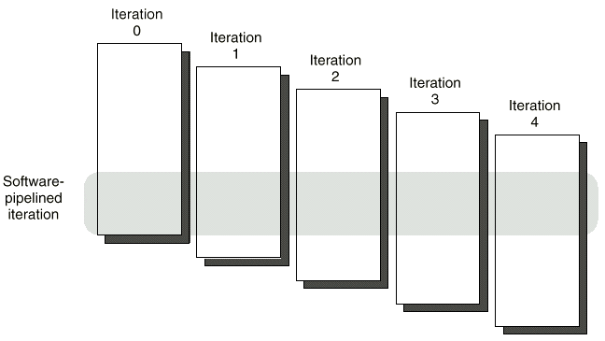
Software Pipelining (Symbolic Loop Unrolling)
New loop iteration body is made from instructions selected
from a number of independent iterations of the original loop.

Slide 46
Show a software-pipelined version of this loop, which increments all the elements of an array whose starting address is in R1 by the contents of F2:
Loop: L.D F0,0(R1)
ADD.D F4,F0,F2
S.D F4,0(R1)
DADDUI R1,R1,#-8
BNE R1,R2,Loop
You may omit the start-up and clean-up code.

Slide 47
Software pipelining symbolically unrolls the loop and then selects instructions from each iteration. Since the unrolling is symbolic,
the loop overhead instructions (the DADDUI and BNE) need not be replicated.
Here’s the body of the unrolled loop without overhead instructions, highlighting the instructions taken from each iteration:

Slide 48
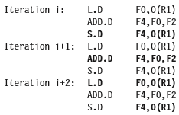

Slide 49

The selected instructions from different iterations are then put together in the loop with the loop control instructions:

Slide 50
Software Pipelining (Symbolic Loop Unrolling) Example
start-up
code
Software Pipeline
Show a software-pipelined version of the code:
finish
code
Loop: L.D F0,0(R1)
ADD.D F4,F0,F2
S.D F4,0(R1)
DADDUI R1,R1,#-8
BNE R1,R2,LOOP
overlapped ops
Time
Loop Unrolled
3 times because chain of dependence of length 3 instructions
exist in body of original loop
Time
i.e. L.D ADD.D S.D
Before: Unrolled 3 times
1 L.D F0,0(R1)
2 ADD.D F4,F0,F2
3 S.D F4,0(R1)
4 L.D F0,-8(R1)
5 ADD.D F4,F0,F2
6 S.D F4,-8(R1)
7 L.D F0,-16(R1)
8 ADD.D F4,F0,F2
9 S.D F4,-16(R1)
10 DADDUI R1,R1,#-24
11 BNE R1,R2,LOOP
After: Software Pipelined Version
L.D F0,0(R1)
ADD.D F4,F0,F2
L.D F0,-8(R1)
1 S.D F4,0(R1) ;Stores M[i]
2 ADD.D F4,F0,F2 ;Adds to M[i-1]
3 L.D F0,-16(R1);Loads M[i-2]
4 DADDUI R1,R1,#-8
5 BNE R1,R2,LOOP
S.D F4, 0(R1)
ADDD F4,F0,F2
S.D F4,-8(R1)
start-up
code
LOOP:
}
}
finish
code
2 fewer loop iterations
No actual loop unrolling is done (do not rename registers)

Slide 51
Software Pipelining
Start-up
Finish-up
Iteration 0 Iteration 1 Iteration 2 Iteration 3
Software pipelined iteration

Slide 52
Example
Iteration i Iteration i+1 Iteration i+2
LD F0, 0(R1)
ADDD F4, F0, F2
SD 0(R1), F4
LD F0, 0(R1)
ADDD F4, F0, F2
SD 0(R1), F4
LD F0, 0(R1)
ADDD F4, F0, F2
SD 0(R1), F4
Loop: LD F0, 0(R1)
ADDD F4, F0, F2
SD 0(R1), F4
SUBI R1, R1, #8
BNEZ R1, Loop
Loop: SD 16(R1), F4
ADDD F4, F0, F2
LD F0, 0(R1)
SUBI R1, R1, #8
BNEZ R1, Loop

Slide 53
Global code scheduing
Global code scheduling aims to compact a code fragment with internal control structure into the shortest possible sequence that preserves the data and control dependences.
The data dependences force a partial order on operations, while the control dependences dictate instructions across which code cannot be easily moved.

Slide 54
Data dependences are overcome by unrolling and, in the case of memory operations, using dependence analysis to determine if two references refer to the same address.
Finding the shortest possible sequence for a piece of code means ﬁnding the shortest sequence for the critical path, which is the longest sequence of dependent instructions.
Control dependences arising from loop branches are reduced by unrolling.

Slide 55
Global code scheduling can reduce the effect of control dependences arising from conditional nonloop branches by moving code.
Since moving code across branches will often affect the frequency of execution of such code, effectively using global code motion requires estimates of the relative frequency of different paths.
Although global code motion cannot guarantee faster code, if the frequency information is accurate, the compiler can determine whether such code movement is likely to lead to faster code.

Slide 56
Trace (global-code)
Scheduling
Find ILP across conditional branches
Two-step process
  Trace selection
    Find a trace (sequence of basic blocks)
    Use loop unrolling to generate long traces
    Use static branch prediction for other conditional branches
  Trace compaction
    Squeeze the trace into a small number of wide instructions
    Preserve data and control dependences

Slide 57
Software pipelining
Interleaves instructions from different iterations of a loop without unrolling
  each iteration is made from instructions from different iterations of the loop
  software counterpart to Tomasulo’s algorithm
  start-up and finish-up code required

Slide 58
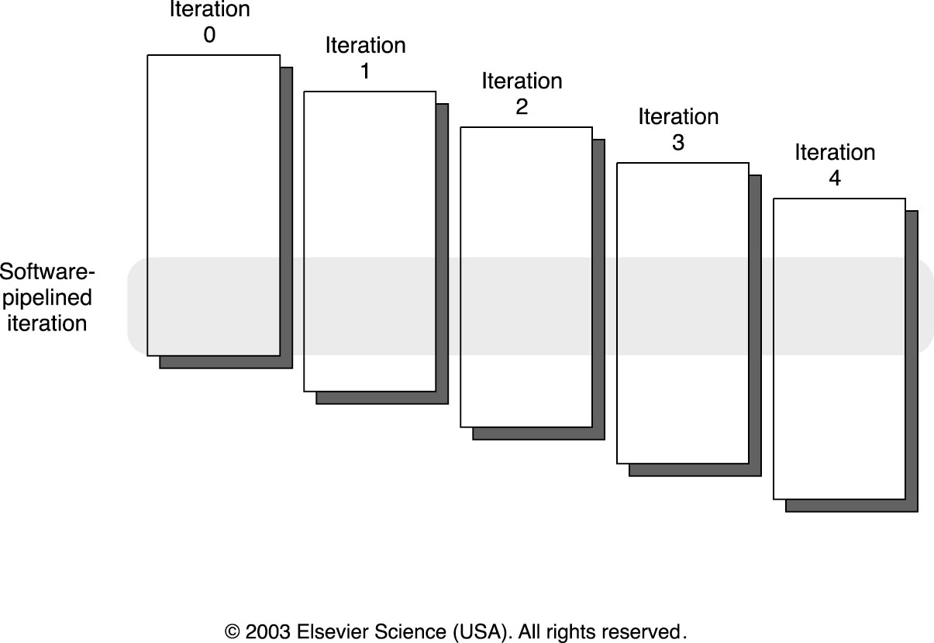

Slide 59
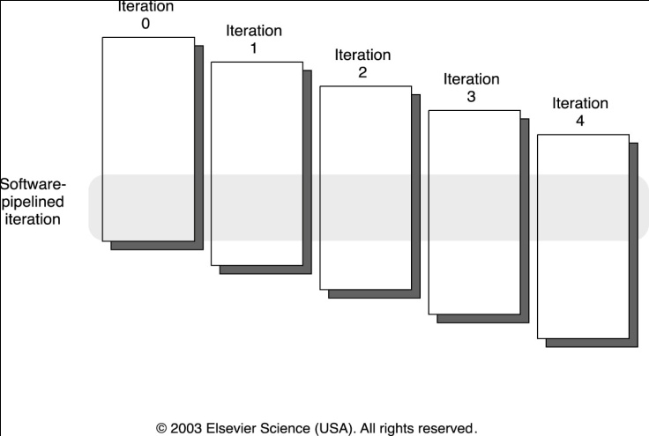
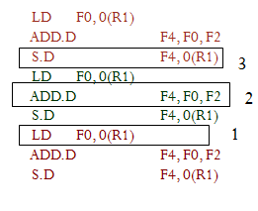
Contd….
Loop: LD F0, 0(R1)
ADD.D F4, F0, F2
S.D F4, 0(R1)
DADDUI R1, R1, # -8
BNE R1,R2, Loop
1 2 3
symbolic unrolling
new loop
Loop: S.D F0, 16(R1) ; store to M[i]
ADD.D F4, F0, F2 ; add to M[i-1]
L.D F4, 0(R1) ; load M[i-2]
DADDUI R1, R1, # -8
BNE R1,R2, Loop

Slide 60
Start-up and Wind-down Code
Iterations in software pipeline loop

Slide 61
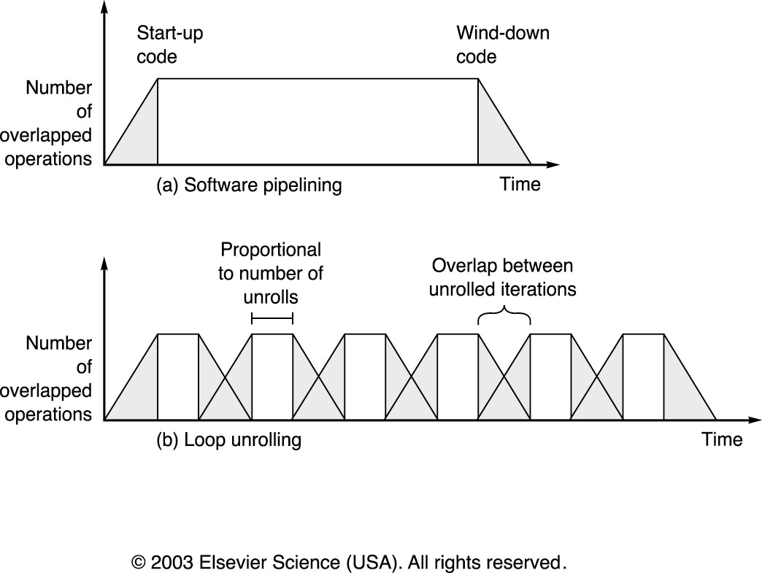
Software Pipelining Benefits
Here the “overhead” includes instructions not optimally overlapped
Here the “overhead” includes branch/counter instructions that are not easy to overlap

Slide 62
The shaded areas are the times when the loop is not running with maximum overlap or parallelism among instructions.
This occurs once at the beginning and once at the end for the software-pipelined loop.
For the unrolled loop it occurs m/n times if the loop has a total of m iterations and is unrolled n times. Each block represents an unroll of n iterations.
Increasing the number of unrollings will reduce the startup and clean-up overhead.
The overhead of one iteration overlaps with the overhead of the next, thereby reducing the impact.
The total area under the polygonal region in each case will be the same, since the total number of operations is just the execution rate multiplied by the time.

Slide 63
Global Code Scheduling
Loop unrolling and software pipelining
  Improve ILP when loop bodies are straight-ling code (no branches)
  Control flow (branches) within loops makes both more complex.
    Will require moving instructions across branches
Global Code Scheduling – moving instructions across branches

Slide 64
Global Code Scheduling
Goal: compact code fragment with internal control structure into shortest possible sequence
  must preserve data and control dependencies
    data dependencies force partial order of instructions
    control dependencies dictate instructions across which code cannot be moved
  Finding shortest possible sequence requires identification of critical path.
  Critical path is the longest sequence of dependent instructions

Slide 65
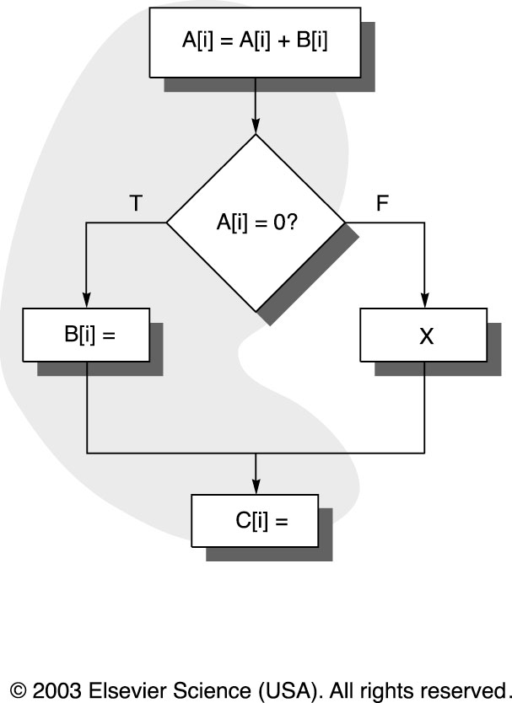
Global Code Motion
Moving code across branches affects frequency of execution of such code
Need to determine relative frequency of different paths

Slide 66
Global Code Motion
Global code motion:
  can we move B[i] or C[i] assignments?
  is it beneficial?
    execution frequencies
    cost of moving (any empty slots?)
    effect on critical path
    which is better move, B[i] or C[i]
    cost of compensation code

Slide 67
Simplifications of Global Code Scheduling
Trace Scheduling
  find the most frequent path (trace selection)
  unroll loop to create trace and then schedule it efficiently (trace compaction)

Slide 68

Trace Scheduling Example
Trace exits and re-entrances are very complex and require much bookkeeping

Slide 69
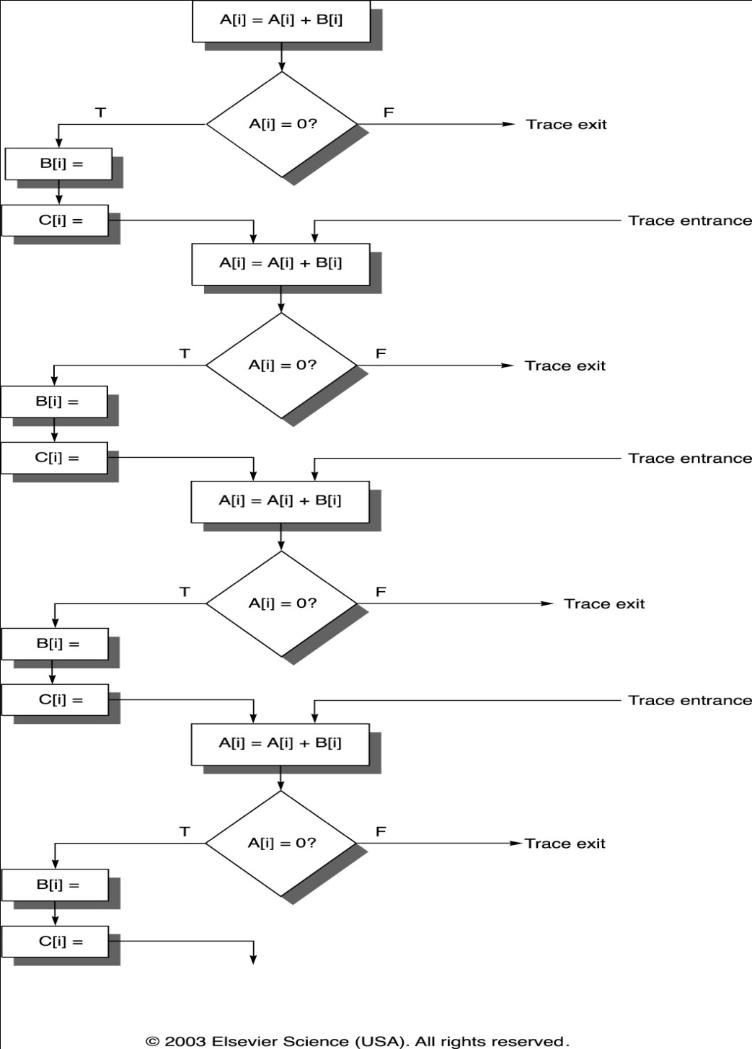

Slide 70
Trace Scheduling
Advantages
  eliminates some hard decisions in global code scheduling
  good for code such as scientific programs with intensive loops and predictable behavior
Disadvantages
  significant overhead in compensation code when trace must be exited

Slide 71
Super blocks
Similar to trace scheduling, but have only ONE entrance point
When trace is exited, a duplicate loop is used for remainder of code (tail duplication)

Slide 72
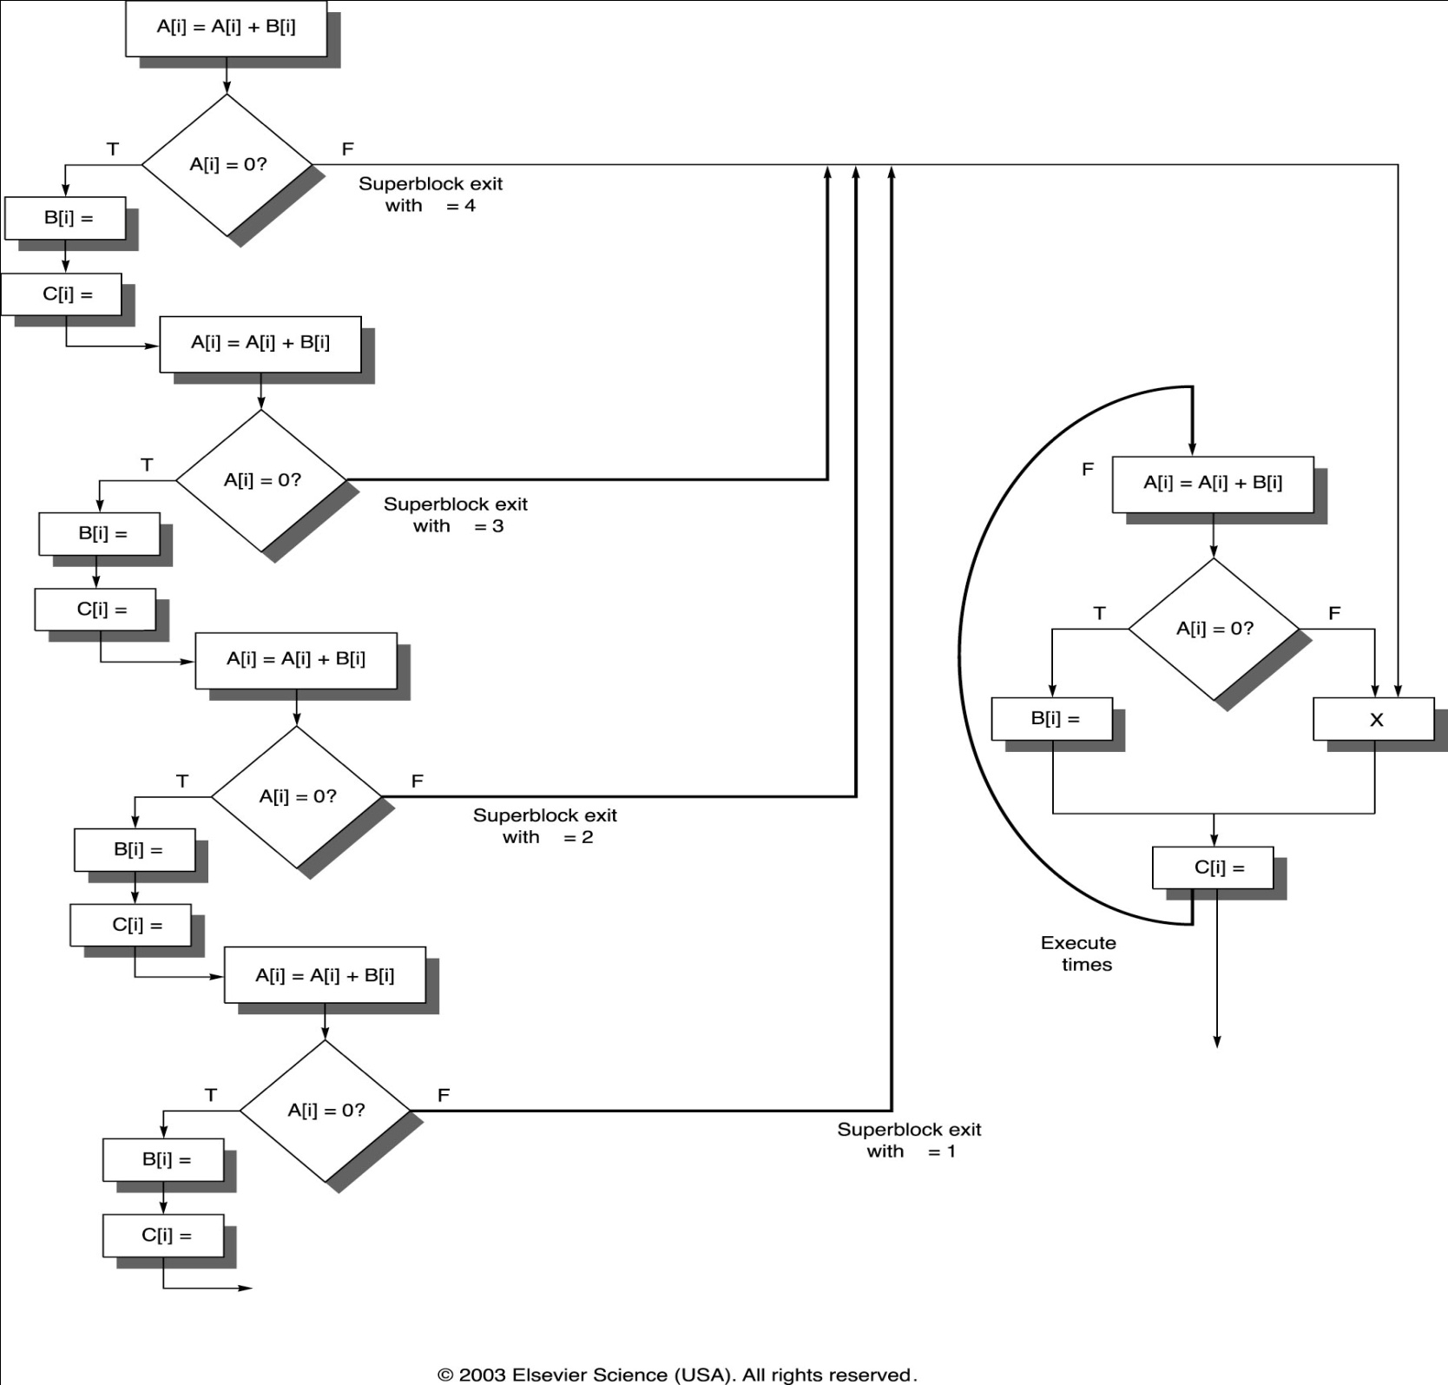

Slide 73
Summary of Compiler Techniques
Try to avoid dependence stalls
Loop unrolling
  Reduce loop overhead
Software pipelining
  Reduce single body dependence stalls
Trace scheduling
  Reduce impact of other branches
Compilers use a mix of three
All techniques depend on prediction accuracy

Slide 74
Comparison between Software-Pipelining and Loop Unrolling
  Advantages
  Less code space than conventional unrolling
  Loop runs at peak speed during steady state
    Overhead only at loop initiation and termination
    Complements unrolling
Disadvantages
  Hard to overlap long latencies
    Unrolling combined with SW pipelining
  Requires advanced compiler transformations

Slide 75
Hardware support for exposing parallelism- Predicated Instructions
Techniques such as loop unrolling, software pipelining, and trace scheduling can be used to increase the amount of parallelism available when the behavior of branches is fairly predictable at compile time.
When the behavior of branches is not well known, compiler techniques alone may not be able to uncover much ILP.
In such cases, the control dependences may severely limit the amount of parallelism that can be exploited.
Similarly, potential dependences between memory reference instructions could prevent code movement that would increase available ILP

Slide 76
conditional or predicated instructions can be used to eliminate branches converting a control dependence into a data dependence and potentially improving performance.
An instruction refers to a condition, which is evaluated as part of the instruction execution.
If the condition is true, the instruction is executed normally;
if the condition is false, the execution continues as if the instruction was a no-op.
The most common example of such an instruction is conditional move, which moves a value from one register to another if the condition is true.
.

Slide 77
H/W support for exposing parallelism- Predicated Instructions
Conditional move
A predicated instruction packs a conditional and an instruction
  Instruction control-dependent on conditional
  If conditional is false instruction is converted to no-op, otherwise executed
Convert control dependence to data dependence
    /* if (A==0) {S=T;} */
    /* simple translation */
    BNEZ R1, L /* if (A==0) */
    ADDI R2, R3, 0 /* S=T; */
    L: . . .
    /* predicated instruction */
    CMOVZ R2, R3, R1 /* move T to S if R1=0 */
R1← A
R2← S
R3←T

Slide 78
Predicated instructions can also be used to speculatively move an instruction that is time-critical, but may cause an exception if moved before a guarding branch.
Predicated instructions are most useful when the predicate can be evaluated early. If the condition evaluation and predicated instructions cannot be separated (because of data dependences in determining the condition), then a conditional instruction may result in a stall for a data hazard.

Slide 79
Hardware Support for Exposing
More Parallelism at Compile-Time
Conditional or Predicated Instructions
  Discussed before in context of branch prediction
  Conditional instruction execution
First instruction slot Second instruction slot
  LW R1,40(R2) ADD R3,R4,R5
  ADD R6,R3,R7
  BEQZ R10,L
  LW R8,0(R10)
  LW R9,0(R8)
Waste slot since 3rd LW dependent on result of 2nd LW

Slide 80
Hardware Support for Exposing
More Parallelism at Compile-Time
Use predicated version load word (LWC)?
  load occurs unless the third operand is 0
First instruction slot Second instruction slot
  LW R1,40(R2) ADD R3,R4,R5
  LWC R8,0(R10),R10 ADD R6,R3,R7
  BEQZ R10,L
  LW R9,0(R8)
If the sequence following the branch were short, the entire block of code might be converted to predicated execution, and the branch eliminated

Slide 81
Hardware Support
Conditional or predicated instructions
  Can be used to eliminate branches
  Control dependence is converted into data dependence
  Useful in hardware as well as software intensive approaches for ILP
Compiler speculation with hardware support
  Support for preserving the exception behavior
  Support for reordering loads and stores

Slide 82
Predicated Instructions
Branch is eliminated
C
F
if (C) {S}
T
S
C : S
Conditional MOVE is the simplest
form of predicated instruction
BNEZ R4, ∗ + 2
MOV R2, R1
CMOVZ R2, R1, R4

Slide 83
Another Example
A = abs (B)
if (B < 0) A = -B; else A = B;
Can be written as
two conditional moves or
one unconditional move and one conditional move

Slide 84
Full predication
Simplest case:
  Only conditional move
  Useful for short sequences only
  For large code blocks, many conditional moves may be required - inefficient
Full predication:
  All instructions can be conditional
  Large code blocks may be converted
  Entire loop body may become free of branches

Slide 85
Multiple branches per clock
Very likely with high issue rate processor
Complex to handle
  control dependence among branches
  difficult to predict, update tables etc.
Reducing branches per clock (if not eliminating) is useful
Remove a branch that is harder to predict increases potential gain

Slide 86
Example: a 2 issue machine
LW R1,40(R2)
BEQZ R10, L
LW R8, 0(R10)
LW R9, 0(R8)
LW R1,40(R2)
LWC R8,0(R10),R10
BEQZ R10, L
LW R9, 0(R8)
ADD R3, R4, R5
ADD R6, R3, R7
ADD R3, R4, R5
ADD R6, R3, R7
One issue slot eliminated
One stall cycle eliminated (dep. between loads)
No improvement if branch condition is false
Entire code (if short) after branch may be moved up

Slide 87
Exceptions and predicated instructions
Predicated instruction must not generate an exception if the predicate is false
  LW R8, 0(R10) may generate protection exception if R10 contains 0
When predicate is true, the exception behavior should be as usual
  LW R8, 0(R10) may still cause a legal and resumable exception (e.g. a page fault) if R10 is not 0

Slide 88
When to annul a pred. instr.?
Early - during issue
  may lead to pipeline stall due to data dependence
Late - just before writing results
  FU resources are consumed - negative impact on performance

Slide 89
Limitations with predicated instructions
Resources wasted when instructions are annulled
  except when the slots taken by these instructions would have been idle anyway
Useful if predicates can be evaluated early
  otherwise stalls for data hazards may result
Usefulness limited when control flow is more complex than simple if-then-else
  e.g. moving an instruction across 2 branches requires 2 predicates - large overheads if this is not supported
Speed penalty - higher cycle count or slower clock

Slide 90
Compiler speculation
Compiler speculation:
  Prediction of a branch from prog structure/ profile data
  Moving an instruction before this branch
Purpose:
  Improve scheduling or issue rate
Compared with predicated instructions:
  Latter may not always remove control dependence
  Here the instruction may be moved even before the condition evaluation

Slide 91
What is required
Find instruction which can be moved
  without effecting data flow
  use register renaming if that helps
Ignore exceptions in speculated instruction
  until you know for sure
Interchange load-store or store-store
  speculate that there are no address conflicts
Hardware support needed for 2nd and 3rd

Slide 92
Example
if (A == 0) A = B; else A = A + 4;
A is at 0(R3) and B is at 0(R2)
LW R1,0(R3)
BNEZ R1,L1
LW R1,0(R2)
J L2
L1: ADDI R1,R1,#4
L2: SW R1,0(R3)
LW R1,0(R3)
LW R14,0(R2)
BEQZ R1,L3
ADDI R14,R1,#4
L3: SW R14,0(R3)
overheads: a) extra registers b) FU usage may get wasted

Slide 93
Preserving exception behavior
Ignore exceptions
  behavior preserved for correct programs only
  may be acceptable only in “fast mode”
Check instructions
  Speculated instruction doesn’t raise exceptions,
  Check instructions see if exception should occur
Poison bits attached to result register
  Done if speculated instruction causes exception
  Cause a fault if non-spec instr reads that register
Use reorder buffer
  results buffered and exceptions delayed until instruction is no longer speculative

Slide 94
Exception types
Program errors
  program needs to be terminated
  results are not well defined
  e.g. memory protection error
Normal events
  program is resumed after handling the event
  e.g. page fault

Slide 95
Speculative instructions and exception types
Normal events
  can be handled for speculative instructions in the same way as normal instructions
  harmless, but resources are consumed
Program errors
  an instruction should not cause program termination until it is found to be no longer speculative

Slide 96
Ignore exceptions
Resumable exceptions - handle normally, as and when exception occurs
Terminating exception - don’t terminate, return undefined value
  speculation correct: wrong program allowed to continue and produce wrong results
  speculation correct: the result will get ignored anyway
Instructions may be marked as speculative or normal
  helpful, but not necessary
  errors in normal instructions can terminate program

Slide 97
Use check instructions
LW R1,0(R3)
BNEZ R1,L1
LW R1,0(R2)
J L2
L1: ADDI R1,R1,#4
L2: SW R1,0(R3)
LW R1,0(R3)
sLW R14,0(R2)
BNEZ R1,L1
SPCH 0(R2)
J L2
L1: ADDI R14,R1,#4
L3: SW R14,0(R3)
Exception behavior preserved exactly
“then” block reappears

Slide 98
Use poison bits
poison bits for registers, speculative bits for instructions
poison bit of destination set if a speculative instruction encounters terminating exception
when an instruction reads a register with poison bit on
  speculative instruction: poison bit of its destination is set
  normal instruction: a fault occurs
stores are never speculative
saving and restoring poison bits on context switch
  special instruction required

Slide 99
Code with poison bit
LW R1,0(R3)
sLW R14,0(R2)
BEQZ R1,L3
ADDI R14,R1,#4
L3: SW R14,0(R3)
sLW instruction sets poison bit of R14 if R2 contains 0

Slide 100
Use reorder buffer
Reorder buffer as in superscalar processor
instructions marked as speculative
remember how many branches (usually not more than 1) it moved across and what branch action compiler assumed
alternative: original location marked by a sentinel - indicates that the results can be committed

Slide 101
Memory reference speculation
Move load up across a store
no problem if absence of address clash can be checked statically
otherwise, mark the instruction as speculative - it saves the address
address examined on subsequent stores - a conflict means speculation failed
a special instruction is kept at the original location of load - can take care of relaod when speculation fails - may require a fix-up sequence as well

Slide 102
Hardware Support for Compiler Speculation
  In moving instructions across a branch the compiler must ensure that exception behavior is not changed and the dynamic data dependence remains the same.
    The simplest case is that the compiler is conservative about what instructions it speculatively moves, and the exception behavior is unaffected.
  Four methods
    The hardware and OS cooperatively ignore exceptions for speculative instructions.
    Speculative instructions that never raise exceptions are used, and checks are introduced to determine when an exception should occur.
    Poison bits are attached to the result registers written by speculated instructions when the instruction cause exceptions.
    The instruction results are buffered until it is certain that the instruction is no longer speculative.

Slide 103
Compiler based speculation - example
if (A==0) A = B; else A = A+4;
  where A is at 0(R3) and B is at 0(R2):
  Assume R14 is unused and available.
    LD R1, 0(R3) ;load A
    BNEZ R1, L1 ;test A
    LD R1,0(R2) ;then clause
    J L2 ;skip else
    L1:DADDI R1,R1,#4 ;else clause
    L2: SD R1,0(R3) ;store A
    Assume the then clause is almost always executed.
    The new code generated by compiler based on speculation
    LD R1, 0(R3) ;load A
    LD R14, 0(R2) ;spec load B
    BEQZ R1, L3 ; then clause
    DADDI R14,R1,#4 ;else clause
    L3: SD R14,0(R3) ;non spec store A

Slide 104
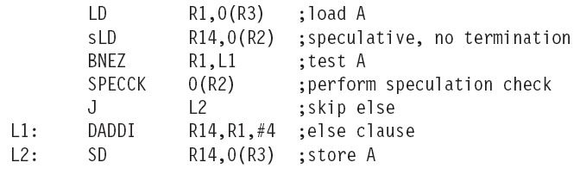
Preserving exception behavior - 1
Use speculative versions of instructions that do not generate terminating exceptions (eg. sLD )
Use instructions to check for such exceptions (eg. SPECCK)

Slide 105
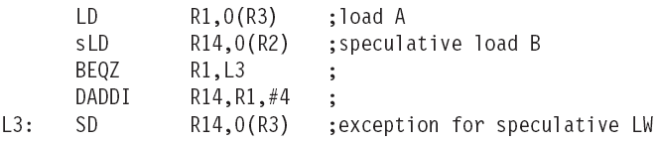
Preserving exception behavior - 2
A poison bit is added to every register
Another bit is added to every speculative instruction
Poison bit of the destination register is set whenever a speculative instruction results in a terminating exception
If a normal instruction (not speculative) attempts to use a register source with its poison bit turned on, the instruction causes a fault.

Slide 106
Superscalar v. VLIW
Smaller code size
Binary compatibility across generations of hardware
Simplified Hardware for decoding, issuing instructions
No Interlock Hardware (compiler checks?)
More registers, but simplified Hardware for Register Ports (multiple independent register files?)

Slide 107
Problems with First Generation VLIW
Increase in code size
  generating enough operations in a straight-line code fragment requires ambitiously unrolling loops
  whenever VLIW instructions are not full, unused functional units translate to wasted bits in instruction encoding
Operated in lock-step; no hazard detection HW
  a stall in any functional unit pipeline caused entire processor to stall, since all functional units must be kept synchronized
  Compiler might prediction function units, but caches hard to predict
Binary code compatibility
  Pure VLIW => different numbers of functional units and unit latencies require different versions of the code

Slide 108
Intel/HP IA-64 “Explicitly Parallel Instruction Computer (EPIC)”
IA-64: instruction set architecture; EPIC is type
  EPIC = 2nd generation VLIW?
Itanium™ is name of first implementation (2001)
  Highly parallel and deeply pipelined hardware at 800Mhz
  6-wide, 10-stage pipeline at 800Mhz on 0.18 µ process
128 64-bit integer registers + 128 82-bit floating point registers
  Not separate register files per functional unit as in old VLIW
Hardware checks dependencies
(interlocks => binary compatibility over time)
Predicated execution (select 1 out of 64 1-bit flags)
=> 40% fewer mispredictions?

Slide 109
IA-64 Registers
The integer registers are configured to help accelerate procedure calls using a register stack
  mechanism similar to that developed in the Berkeley RISC-I processor and used in the SPARC architecture.
  Registers 0-31 are always accessible and addressed as 0-31
  Registers 32-128 are used as a register stack and each procedure is allocated a set of registers (from 0 to 96)
  The new register stack frame is created for a called procedure by renaming the registers in hardware;
  a special register called the current frame pointer (CFM) points to the set of registers to be used by a given procedure
8 64-bit Branch registers used to hold branch destination addresses for indirect branches
64 1-bit predict registers

Slide 110
IA-64 Registers
Both the integer and floating point registers support register rotation for registers 32-128.
Register rotation is designed to ease the task of allocating of registers in software pipelined loops
When combined with predication, possible to avoid the need for unrolling and for separate prologue and epilogue code for a software pipelined loop
  makes the SW-pipelining usable for loops with smaller numbers of iterations, where the overheads would traditionally negate many of the advantages

Slide 111
Intel/HP IA-64 “Explicitly Parallel Instruction Computer (EPIC)”
Instruction group: a sequence of consecutive instructions with no register data dependences
  All the instructions in a group could be executed in parallel, if sufficient hardware resources existed and if any dependences through memory were preserved
  An instruction group can be arbitrarily long, but the compiler must explicitly indicate the boundary between one instruction group and another by placing a stop between 2 instructions that belong to different groups
IA-64 instructions are encoded in bundles, which are 128 bits wide.
  Each bundle consists of a 5-bit template field and 3 instructions, each 41 bits in length
3 Instructions in 128 bit “groups”; field determines if instructions dependent or independent
  Smaller code size than old VLIW, larger than x86/RISC
  Groups can be linked to show independence > 3 instr

Slide 112
5 Types of Execution in Bundle
Execution Instruction Instruction Example
Unit Slot type Description Instructions
I-unit A Integer ALU add, subtract, and, or, cmp
I Non-ALU Int shifts, bit tests, moves
M-unit A Integer ALU add, subtract, and, or, cmp
M Memory access Loads, stores for int/FP regs
F-unit F Floating point Floating point instructions
B-unit B Branches Conditional branches, calls
L+X L+X Extended Extended immediates, stops
5-bit template field within each bundle describes both the presence of any stops associated with the bundle and the execution unit type required by each instruction within the bundle (see Fig 4.12 page 271)

Slide 113
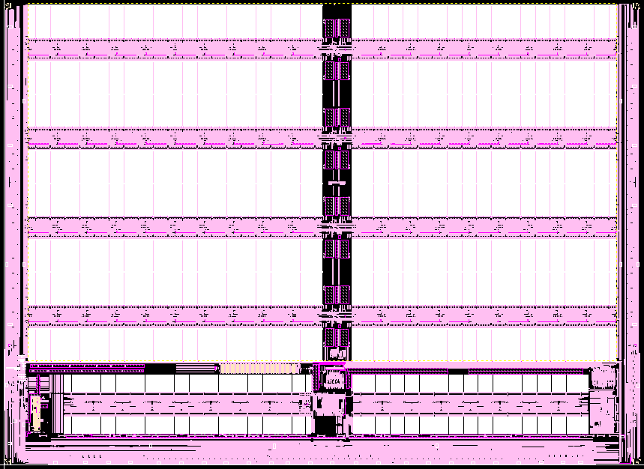
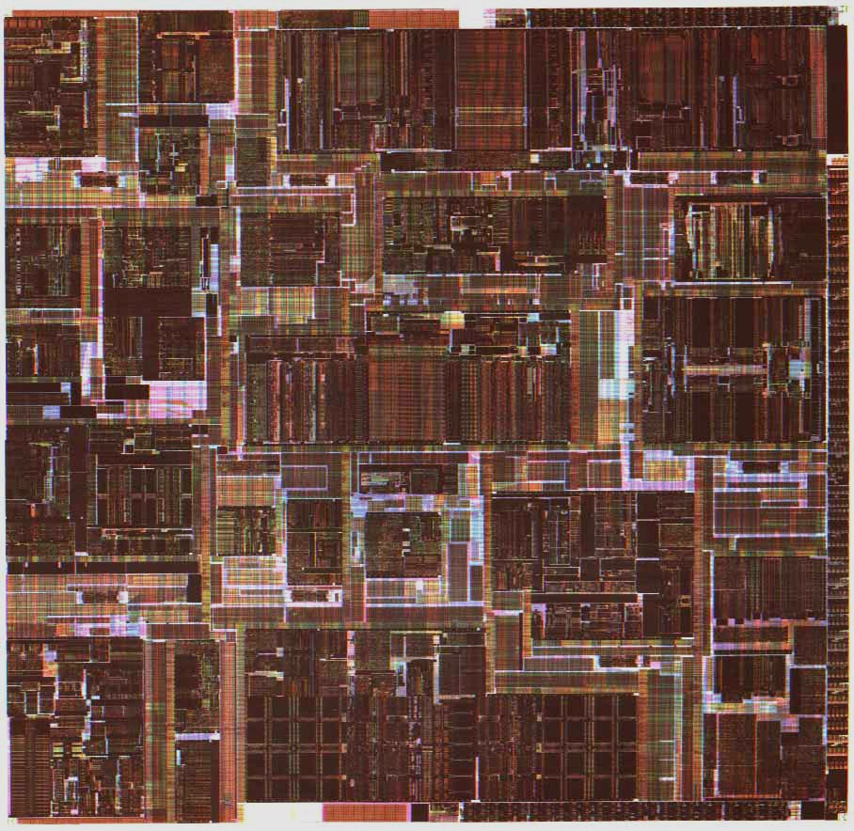
Itanium™ Processor Silicon
(THIS FIGURE IS NOT IN SYLLABUS)
(Copyright: Intel at Hotchips ’00)
IA-32
Control
FPU
IA-64 Control
TLB
Integer Units
Cache
Instr.
Fetch &
Decode
Cache
Bus
Core Processor Die
4 x 1MB L3 cache

Slide 114
Itanium™ Machine Characteristics
(Copyright: Intel at Hotchips ’00)
Frequency
800 MHz
Transistor Count
25.4M CPU; 295M L3
Process
0.18u CMOS, 6 metal layer
Package
Organic Land Grid Array
Machine Width
6 insts/clock (4 ALU/MM, 2 Ld/St, 2 FP, 3 Br)
Registers
14 ported 128 GR & 128 FR; 64 Predicates
Speculation
32 entry ALAT, Exception Deferral
Branch Prediction
Multilevel 4-stage Prediction Hierarchy
FP Compute Bandwidth
3.2 GFlops (DP/EP); 6.4 GFlops (SP)
Memory -> FP Bandwidth
4 DP (8 SP) operands/clock
Virtual Memory Support
64 entry ITLB, 32/96 2-level DTLB, VHPT
L2/L1 Cache
Dual ported 96K Unified & 16KD; 16KI
L2/L1 Latency
6 / 2 clocks
L3 Cache
4MB, 4-way s.a., BW of 12.8 GB/sec;
System Bus
2.1 GB/sec; 4-way Glueless MP
Scalable to large (512+ proc) systems

Slide 115
Itanium™ EPIC Design Maximizes SW-HW Synergy
(Copyright: Intel at Hotchips ’00)
Architecture Features programmed by compiler:
Branch
Hints
Explicit
Parallelism
Register Stack
& Rotation
Data & Control
Speculation
Memory
Hints
Predication
Micro-architecture Features in hardware:
Fetch
Issue
Register
Handling
Control
Parallel Resources
Memory
Subsystem
4 Integer +
4 MMX Units
Instruction
Cache
& Branch
Predictors
128 GR &
128 FR,
Register
Remap
&
Stack
Engine
2 FMACs
(4 for SSE)
Three levels of cache:
L1, L2, L3
Fast, Simple 6-Issue
Bypasses & Dependencies
2 L.D/ST units
32 entry ALAT
Speculation Deferral Management

Slide 116
10 Stage In-Order Core Pipeline
(Copyright: Intel at Hotchips ’00)
Front End
Pre-fetch/Fetch of up to 6 instructions/cycle
Hierarchy of branch predictors
Decoupling buffer
Execution
4 single cycle ALUs, 2 ld/str
Advanced load control
Predicate delivery & branch
Nat/Exception//Retirement
EXPAND
RENAME
WORD-LINE
DECODE
REGISTER READ
IPG
FET
ROT
EXP
REN
WL.D
REG
EXE
DET
WRB
INST POINTER
GENERATION
FETCH
ROTATE
EXECUTE
EXCEPTION
DETECT
WRITE-BACK
Instruction Delivery
Dispersal of up to 6 instructions on 9 ports
Reg. remapping
Reg. stack engine
Operand Delivery
Reg read + Bypasses
Register scoreboard
Predicated dependencies

Slide 117
Itanium processor 10-stage pipeline
Front-end (stages IPG, Fetch, and Rotate): prefetches up to 32 bytes per clock (2 bundles) into a prefetch buffer, which can hold up to 8 bundles (24 instructions)
  Branch prediction is done using a multilevel adaptive predictor like P6 microarchitecture
Instruction delivery (stages EXP and REN): distributes up to 6 instructions to the 9 functional units
  Implements registers renaming for both rotation and register stacking.

Slide 118
Itanium processor 10-stage pipeline
Operand delivery (WLD and REG): accesses register file, performs register bypassing, accesses and updates a register scoreboard, and checks predicate dependences.
  Scoreboard used to detect when individual instructions can proceed, so that a stall of 1 instruction in a bundle need not cause the entire bundle to stall
Execution (EXE, DET, and WRB): executes instructions through ALUs and load/store units, detects exceptions and posts NaTs, retires instructions and performs write-back
  Deferred exception handling for speculative instructions is supported by providing the equivalent of poison bits, called NaTs for Not a Thing, for the GPRs (which makes the GPRs effectively 65 bits wide), and NaT Val (Not a Thing Value) for FPRs (already 82 bits wides)

Slide 119
Comments on Itanium
Remarkably, the Itanium has many of the features more commonly associated with the dynamically-scheduled pipelines
  strong emphasis on branch prediction, register renaming, scoreboarding, a deep pipeline with many stages before execution (to handle instruction alignment, renaming, etc.), and several stages following execution to handle exception detection
Surprising that an approach whose goal is to rely on compiler technology and simpler HW seems to be at least as complex as dynamically scheduled processors!

Slide 120
Peformance of IA-64 Itanium?
Despite the existence of silicon, no significant standard benchmark results are available for the Itanium
Whether this approach will result in significantly higher performance than other recent processors is unclear
The clock rate of Itanium (733 MHz) is competitive but slower than the clock rates of several dynamically-scheduled machines, which are already available, including the Pentium III, Pentium 4 and AMD Athlon

Slide 121
Summary#1: Hardware versus Software Speculation Mechanisms
To speculate extensively, must be able to disambiguate memory references
  Much easier in HW than in SW for code with pointers
HW-based speculation works better when control flow is unpredictable, and when HW-based branch prediction is superior to SW-based branch prediction done at compile time
  Mispredictions mean wasted speculation
HW-based speculation maintains precise exception model even for speculated instructions
HW-based speculation does not require compensation or bookkeeping code

Slide 122
Summary#2: Hardware versus Software Speculation Mechanisms cont’d
Compiler-based approaches may benefit from the ability to see further in the code sequence, resulting in better code scheduling
HW-based speculation with dynamic scheduling does not require different code sequences to achieve good performance for different implementations of an architecture
  may be the most important in the long run?

Slide 123
Summary #3: Software Scheduling
Instruction Level Parallelism (ILP) found either by compiler or hardware.
Loop level parallelism is easiest to see
  SW dependencies/compiler sophistication determine if compiler can unroll loops
  Memory dependencies hardest to determine => Memory disambiguation
  Very sophisticated transformations available
Trace Sceduling to Parallelize If statements
Superscalar and VLIW: CPI < 1 (IPC > 1)
  Dynamic issue vs. Static issue
  More instructions issue at same time => larger hazard penalty
  Limitation is often number of instructions that you can successfully fetch and decode per cycle

Slide 124
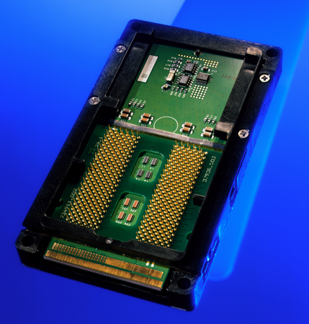
The IA-64 architecture and Itanium processors
Explicitly Parallel Instruction Computing
Notes:
IA-64 and EPIC, Frans Dondorp

Slide 125

Contents
⬥ Introduction to the IA-64 architecture and EPIC
⬥ The Itanium™ processor
⬥ Branch removal
⬥ Predication
⬥ Speculative execution
⬥ Control speculation
⬥ Data speculation
Notes:
IA-64 and EPIC, Frans Dondorp

Slide 126
Introduction to the IA-64 architecture
Joint research by Intel and Hewlett-Packard (1994)
exploitation of the ILP concept
tight coupling of hard- and software
EPIC is introduced as basic concept:
Explicitly Parallel Instruction Computing
This results in a more complex task for the compiler and
Hardware support for communication of meta-information
→ speculation, predication and branch hints
“The future of computing” – Intel web site

Slide 127
IA 64 resources and instructions
Register resources
Support for register stack
and software pipelining
Function call
linkage and return
(64b address space!)
128 GR’s
128 FR’s
128 AR’s
8 BR’s
r0
f0
ar0
b0
AR application register
BR Branch register
FR Floating point register
GR General register
PR Predicate register
r1
f1
ar1
b1
Static
....
....
....
....
b7
....
....
....
r31
f31
....
64 b
f32
....
64 PR’s
r32
....
....
....
....
Stacked /
Rotating
....
Rotating
....
....
p0
...
...
p15
p16
...
...
...
p62
p63
1 b
....
....
f126
r126
f126
f127
r127
f127
Holds result of a conditional expression evaluation
Predication
82 b
64 b
64 + 1 b
Deferred exception
(Not A Thing, NaT)
Control speculation

Slide 128
IA64 resources and instructions
(THIS SLIDE IS ADDITIONAL AND NOT IN SYLLABUS
Instruction encoding
IA-64 “Bundle”
Templates are used to group instructions to exploit parallel execution by keeping execution units buzy.
{.mii
ld8 r1 = 4[r2]
add r3 = r1, r3
shr r7 = r4, r12
}
{.mbb
ld8 r6 = 8[r5]
(p3) br.cond Label1
(p4) br.cond Label2
}
Instruction 2
Instruction 1
Instruction 0
Template
41 b
41 b
41 b
5 b
Instruction format
Predicates are used to allow for conditional execution.
6 bits used to address 64 predicate registers
Op
Reg 1
Reg 2
Reg 3
Predicate
14 b
7 b
7 b
7 b
6 b
The Itanium processor issues 8 ops/clock:
M
I
I
M
B
B
ALU
ALU
ALU
ALU
L/S
L/S
FP S
FP S
FP D
FP D
BR
BR
BR
MMX
MMX
MMX
MMX

Slide 129
Thank You

