Slide 1
HARDWARE AND SOFTWARE FOR VLIW AND EPIC

Slide 2
Introduction
So far we have considered techniques used to eliminate data and control stalls and achieve an ideal CPI of 1.
To improve performance further we would like to decrease the CPI to less than 1. But this cannot be done if we issue only one instruction every clock cycle.
Multiple issue processors allow us to issue multiple instructions in a clock cycles. There are two variations: superscalar and VLIW (Very Long Instruction Word) processors.
Superscalar processors issue varying numbers of instructions per clock and may be either statically scheduled by compiler or dynamically scheduled using techniques based on scoreboarding or Tomasulo algorithm.
VLIWs issue a fixed number of instructions formatted either as one large instruction or as a fixed instruction packet. VLIW processors are inherently statically scheduled by the compiler.

Slide 3
VLIW: Very Long Instruction Word
Int Op 1
Int Op 2
Mem Op 1
Mem Op 2
FP Op 1
FP Op 2
Two Integer Units,
Single Cycle Latency
Two Load/Store Units,
Three Cycle Latency
Two Floating-Point Units,
Four Cycle Latency
Multiple operations packed into one instruction
Each operation slot is for a fixed function
Constant operation latencies are specified
Architecture requires guarantee of:
Parallelism within an instruction
No data use before data ready

Slide 4
VLIW Compiler Responsibilities
The compiler:
Schedules to maximize parallel execution
Guarantees intra-instruction parallelism
Schedules to avoid data hazards
Typically separates operations with explicit NOPs

Slide 5
The advantages of compile time techniques are primarily :
They do not burden runtime execution with any inefficiency
They can take into account a wider range of the program than a runtime approach might be able to incorporate

Slide 6
Detecting and Enhancing Loop-Level Parallelism
Loop-level parallelism is normally analyzed at the source level or close to it,
while most analysis of ILP is done once instructions have been generated by the compiler.
Loop-level analysis involves determining what dependences exist among the operands in a loop across the iterations of that loop.
Data dependences, arise when an operand is written at some point and read at a later point.
Name dependences also exist and may be removed by renaming techniques

Slide 7
Loop-level parallelism
Analyzed at the source or close to it
Loop-level analysis
Determine what dependences exist among the operands in a loop across the iterations of that loop
Loop Carried Dependency: Determine whether data accesses in later iterations are dependent on data values produced in earlier iterations

Slide 8
Loop-carried dependence
Data dependent on data values produced in earlier iterations
Ex: for (i=1000; i>0; i=i-1)
x[i] = x[i] + s;
dependences:
Dependence between the definition and use of x[i]
This dependence within a single iteration (not loop carried)
Loop-level parallel → every iteration can be executed in parallel

Slide 9
Example: Assume that A, B, and C are distinct, non-overlapping arrays
for (i=1; i <= 100; i=i+1) {
A[i+1] = A[i] + C[i]; /* S1 */
B[i+1] = B[i] + A[i+1]; /* S2 */
}
What are the dependences between S1 and S2?

Slide 10
Detecting and Enhancing Loop-Level Parallelism
Ex)
for (i=1; i<=100; i++) {
A[i+1] = A[i] + C[i]; // S1
B[i+1] = B[i] + A[i+1]; // S2
}
Dependence
A[2] = A[1] + C[1]; // S1 (i=1)
B[2] = B[1] + A[2]; // S2 (i=1)
A[3] = A[2] + C[2]; // S1 (i=2)
B[3] = B[2] + A[3]; // S2 (i=2)
A[4] = A[3] + C[3]; // S1 (i=3)
B[4] = B[3] + A[4]; // S2 (i=3)
……
S1 → S1: loop-carried dependence
S2 → S2: loop-carried dependence
S1 → S2: dependence in the same iteration

Slide 11
S1 uses a value computed by S1 in an earlier iteration (A[i])
Loop-carried dependence
S2 uses a value computed by S2 in an earlier iteration (B[i])
Loop-carried dependence
S2 uses a value computed by S1 in the same iteration (A[i+1])
Not loop-carried

Slide 12
Consider a loop like this one:
for (i=1; i<=100; i=i+1) {
A[i] = A[i] + B[i]; /* S1 */
B[i+1] = C[i] + D[i]; /* S2 */
}
What are the dependences between S1 and S2? Is this loop parallel? If not, show how to make it parallel.

Slide 13
Loop-Level Parallelism
Ex)
for (i=1; i<=100; i++) {
A[i] = A[i] + B[i]; // S1
B[i+1] = C[i] + D[i]; // S2
}
Dependence
A[1] = A[1] + B[1]; // S1 (i=1)
B[2] = C[1] + D[1]; // S2 (i=1)
A[2] = A[2] + B[2]; // S1 (i=2)
B[3] = C[2] + D[2]; // S2 (i=2)
A[3] = A[3] + B[3]; // S1 (i=3)
B[4] = C[3] + D[3]; // S2 (i=3)
……
S2 → S1: loop-carried dependence
Loop-level parallel because of no circular dependence

Slide 14
S1 uses a value computed by S2 in an earlier iteration (B[i+1])
Loop-carried dependence
Dependence is not circular
Neither statement depends on itself, and although S1 depends on S2, S2 does not depend on S1
A loop is parallel if it can be written without a cycle in the dependences

Slide 15
Detecting and Enhancing Loop-Level Parallelism
Ex)
A[1] = A[1] + B[1]
for (i=1; i<=99; i++) {
B[i+1] = C[i] + D[i]; // S2
A[i+1] = A[i+1] + B[i+1]; // S1
}
B[101] = C[100] +D[100]
Dependence
A[1] = A[1] + B[1]; // S1
B[2] = C[1] + D[1]; // S2 (i=1)
A[2] = A[2] + B[2]; // S1 (i=1)
B[3] = C[2] + D[2]; // S2 (i=2)
A[3] = A[3] + B[3]; // S1 (i=2)
B[4] = C[3] + D[3]; // S2 (i=3)
……

Slide 16
for (i=1; i<=100; i++) {
A[i] = A[i] + B[i]; // S1
B[i+1] = C[i] + A[i]; // S2
}
Check for dependecy.

Slide 17
Circular dependence
cycle
Another example)
for (i=1; i<=100; i++) {
A[i] = A[i] + B[i]; // S1
B[i+1] = C[i] + A[i]; // S2
}
Dependence
A[1] = A[1] + B[1]; // S1 (i=1)
B[2] = C[1] + A[1]; // S2 (i=1)
A[2] = A[2] + B[2]; // S1 (i=2)
B[3] = C[2] + A[2]; // S2 (i=2)
A[3] = A[3] + B[3]; // S1 (i=3)
B[4] = C[3] + A[3]; // S2 (i=3)
……
S2 → S1: loop-carried dependence
S1 → S2: loop-level dependence
Circular dependence

Slide 18
Recurrence (a kind of loop-carried dependence)
A recurrence is when a variable is defined based on the value of that variable in an earlier iteration
Detecting a recurrence can be important for two reasons:
Some architectures(especially vector computers) have special support for executing recurrences, and
some recurrences can be the source of a reasonable amount of parallelism
for (i=6; i<=100; i=i+1)
Y[i] = Y[i-5] + Y[i];
What kind of dependency exist in this loop?

Slide 19
Recurrence (continued)
Example
for (i=6; i<=100; i=i+1)
Y[i] = Y[i-5] + Y[i];
Distance: 5
Y[6] = Y[1] + Y[6]; i=6
Y[7] = Y[2] + Y[7]; i=7
Y[8] = Y[3] + Y[8]; i=8
Y[9] = Y[4] + Y[9]; i=9
Y[10] = Y[5] + Y[10]; i=10
Y[11] = Y[6] + Y[11]; i=11
Y[12] = Y[7] + Y[12]; i=12
Y[13] = Y[8] + Y[13]; i=13
Y[14] = Y[9] + Y[14]; i=14
Y[15] = Y[10] + Y[15]; i=15
Y[16] = Y[11] + Y[16]; i=16
Parallel execution
possible
Parallel execution
possible

Slide 20
Distance: 5
More parallelism with larger distance

Slide 21
Finding Dependences
Why we do it?
Good scheduling of code
Determining which loops might contain parallelism
Eliminating name dependences
Dependence analysis difficult for arrays & pointers
Need to compare the index (memory location)

Slide 22
Type of Dependence
Example
for (i=1; i<=100; i=i+1) {
Y[i] = X[i]/c; // S1
X[i] = X[i] + c; // S2
Z[i] = Y[i] + c; // S3
Y[i] = c – Y[i]; // S4
}
True dependences from S1 to S3, S1 to S4(RAW)
Anti-dependence from S1 to S2, S3 to S4(WAR)
Output dependence from S1 to S4(WAW)

Slide 23
Eliminates false dependences
for (i=1;i<=100;i=i+1)
{
/* Y renamed to T to remove output dependence */
T[i]=X[i] / c; /* S1 */
/* X renamed to X1 to remove antidependence */
X1[i]=X[i] + c; /* S2 */
/* Y renamed to T to remove antidependence */
Z[i]=T[i] + c; /* S3 */
Y[i]=c – Y[i]; /* S4 */
}

Slide 24
Eliminating Dependent Computations
The key technique is to eliminate or reduce a dependent computation by back substitution, which increases the amount of parallelism which applied both within a basic block and within loops.
Within a basic block, algebraic simplifications of expressions and an optimization called copy propagation.

Slide 25
Copy propagation: eliminates operations that copy value
Example;
ADD R1,R2,#4
ADD R1,R1,#4
Example:
ADD R1,R2,#4
ADD R3,R1,#4
Tree height reduction: increase parallelism
Example:
ADD R1,R2,R3 ADD R1,R2,R3
ADD R4,R1,R6 ADD R4,R6,R7
ADD R8,R4,F7 ADD R8,R1,R4
ADD R1,R2,#8
Assume R1 dead afterwards
ADD R3,R2,#8

Slide 26
Copy propagation
Eliminates operations that copy values
DADDUI R1,R2,#4
DADDUI R1,R1,#4
Tree height reduction
Makes tree structure wider but shorter
ADD R1,R2,R3
ADD R4,R1,R6
ADD R8,R4,R7
DADDUI R1,R2,#8
R2 R3
R1 R6
R4 R7
R8

Slide 27
ADD R1,R2,R3
ADD R4,R6,R7
ADD R8,R1,R4

Slide 28
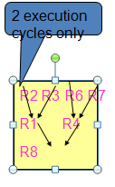

Slide 29
Eliminating Dependent Computations
Loop unrolling
Replicate the loop body multiple times and adjust the loop termination code
Take n loop bodies and concatenate them into 1 basic block.
Arithmetic optimization with loop unrolling
Optimization related to recurrence
Depends on the previous iteration
sum = sum + x;
Unroll ➔ sum = sum + x1 + x2 + x3 + x4 + x5;
However, 5 dependent operations.
Rewrites
➔ sum = ((sum + x1) + (x2 + x3)) + (x4 + x5);
only 3 dependent operations

Slide 30
ILP Compiler Support: Software Pipelining (Symbolic Loop Unrolling)
A compiler technique where loops are reorganized:
Each new iteration is made from instructions selected from a number of independent iterations of the original loop.
The instructions are selected to separate dependent instructions within the original loop iteration.
No actual loop-unrolling is performed.
A software equivalent to the Tomasulo approach?
Requires:
Additional start-up code to execute code left out from the first original loop iterations.
Additional finish code to execute instructions left out from the last original loop iterations.
By one or more
iterations
(In Chapter 4.4)

Slide 31
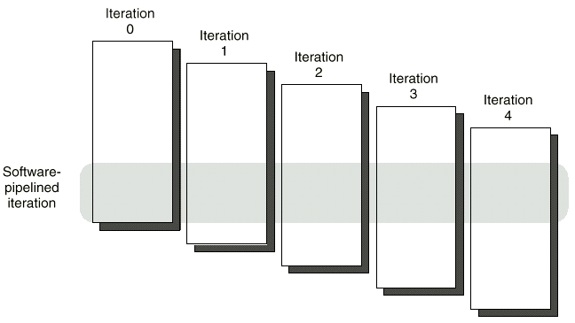
Software Pipelining (Symbolic Loop Unrolling)
New loop iteration body is made from instructions selected
from a number of independent iterations of the original loop.
(In Chapter 4.4)

Slide 32
Show a software-pipelined version of this loop, which increments all the elements of an array whose starting address is in R1 by the contents of F2:
Loop: L.D F0,0(R1)
ADD.D F4,F0,F2
S.D F4,0(R1)
DADDUI R1,R1,#-8
BNE R1,R2,Loop
You may omit the start-up and clean-up code.

Slide 33
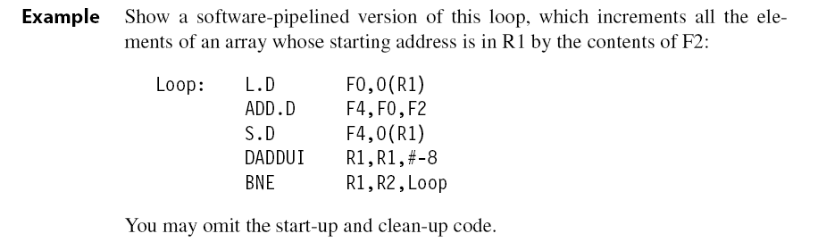

Slide 34
Software Pipelining
Start-up
Finish-up
Iteration 0 Iteration 1 Iteration 2 Iteration 3
Software pipelined iteration

Slide 35
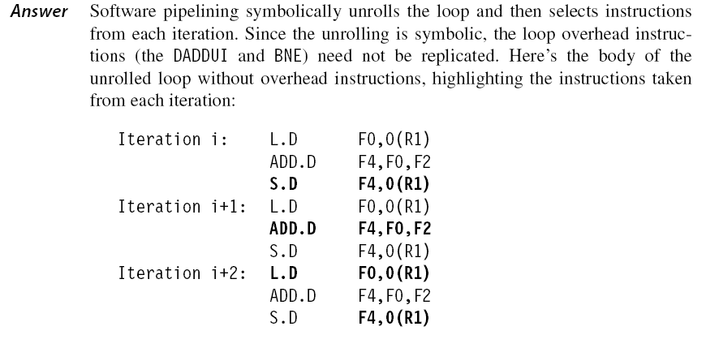

Slide 36

The selected instructions from different iterations are then put together in the loop with the loop control instructions:

Slide 37
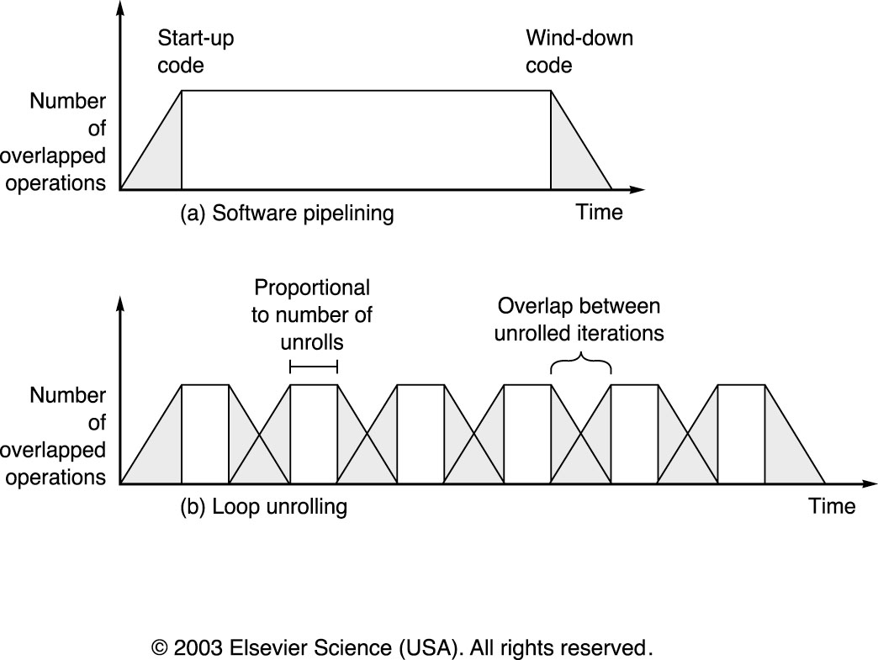
Software Pipelining Benefits

Slide 38
The shaded areas are the times when the loop is not running with maximum overlap or parallelism among instructions.
This occurs once at the beginning and end for software-pipelined loop.
For the unrolled loop it occurs m/n times if the loop has a total of m iterations and is unrolled n times.
Increasing the number of unrollings will reduce the startup and clean-up overhead.

Slide 39
Comparison between Software-Pipelining and Loop Unrolling
Advantages
Less code space than conventional unrolling
Loop runs at peak speed during steady state
Overhead only at loop initiation and termination
Complements unrolling
Disadvantages
Hard to overlap long latencies
Unrolling combined with SW pipelining
Requires advanced compiler transformations

Slide 40
Global Code Scheduling
Loop unrolling and software pipelining
Improve ILP when loop bodies are straight-ling code (no branches)
Control flow (branches) within loops makes both more complex.
Will require moving instructions across branches
Global Code Scheduling – moving instructions across branches

Slide 41
Global code scheduling aims to compact a code fragment that preserves the data and control dependences.
Finding the shortest possible sequence for a piece of code means ﬁnding the shortest sequence for the critical path, which is the longest sequence of dependent instructions.
Global code scheduling can reduce the effect of control dependences arising from conditional non loop branches by moving code.

Slide 42
Goal: compact code fragment with internal control structure into shortest possible sequence
must preserve data and control dependencies
data dependencies force partial order of instructions
control dependencies dictate instructions across which code cannot be moved
Critical path is the longest sequence of dependent instructions

Slide 43
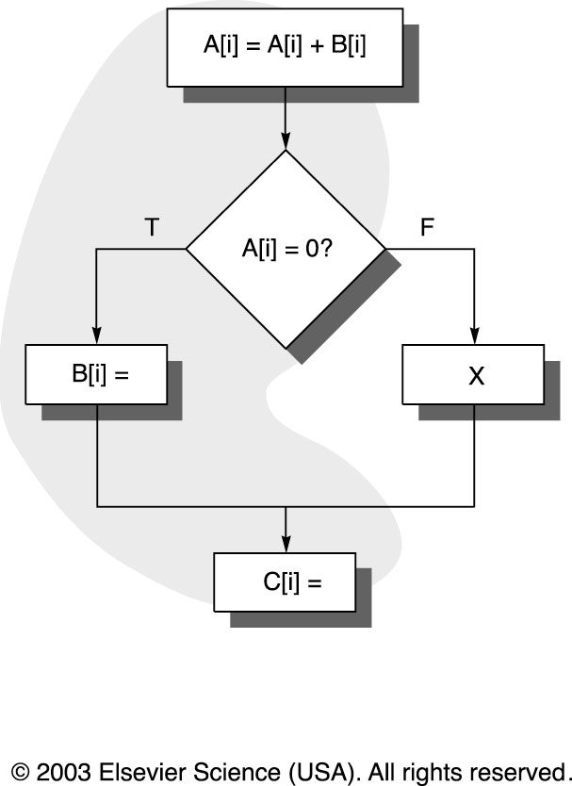
Global Code Motion
Moving code across branches affects frequency of execution of such code
Need to determine relative frequency of different paths

Slide 44
Trace scheduling
Used when Processors with large number of issues per clock
Predicated or conditional branch unsupported
Unrolling is not sufficient
Significant difference in frequency between different paths
Steps
Trace selection
Trace compaction

Slide 45
Trace Scheduling
Find the most frequent path (trace selection)
unroll loop to create trace and then schedule it efficiently (trace compaction)

Slide 46
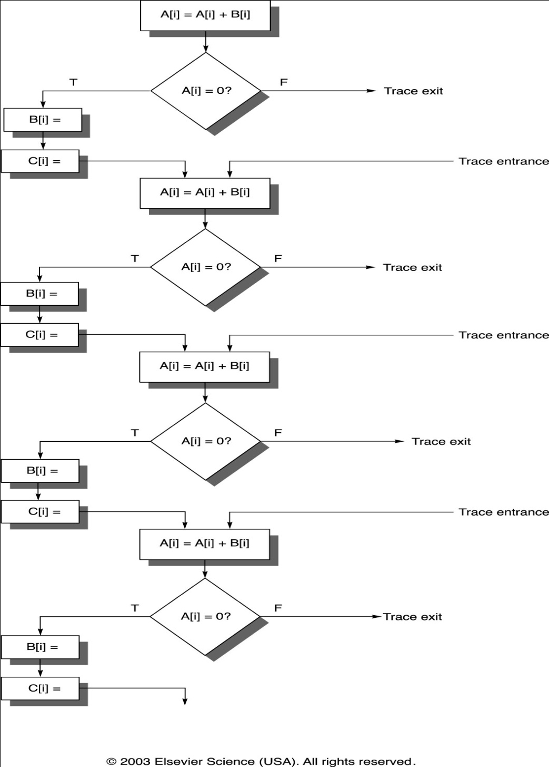

Slide 47

Trace Scheduling Example
Trace exits and re-entrances are very complex and require much bookkeeping

Slide 48
Trace Scheduling
Advantages
Eliminates some hard decisions in global code scheduling
good for code such as scientific programs with intensive loops and predictable behavior
Disadvantages
significant overhead in compensation code when trace must be exited

Slide 49
Super blocks
Similar to trace scheduling, but have only ONE entrance point
Tail duplication
– Create a separate block that corres ponds to the portion of the trace after the entry as exit point
• Superblock approach vs. trace-based approach
– Reduce the complexity of book keeping and scheduling, but may enlarge code size
– Both may be most appropriate when other techniques fail

Slide 50
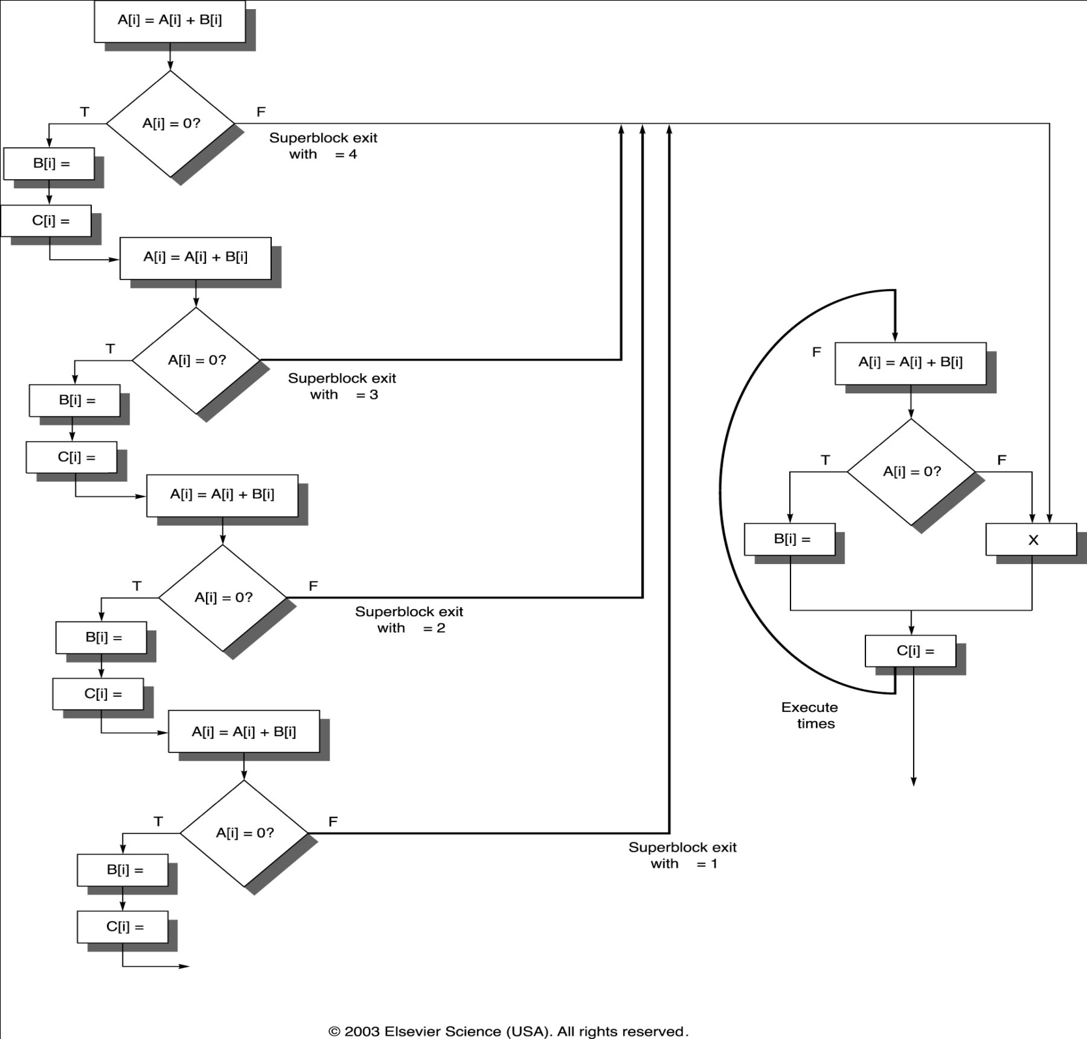

Slide 51
Summary of Compiler Techniques
Try to avoid dependence stalls
Loop unrolling
Reduce loop overhead
Software pipelining
Reduce single body dependence stalls
Trace scheduling
Reduce impact of other branches
Compilers use a mix of three
All techniques depend on prediction accuracy

Slide 52
H/W support for exposing parallelism- Predicated Instructions
Loop unrolling, software pipelining, and trace scheduling work well – But only when branches are predicted at compile time
In other situations branch instructions can severely limit parallelism!!!!
To overcome these problems, an architect can extend the instruction set to include conditional or predicated instructions.
Such instructions can be used to eliminate branches, converting a control dependence into a data dependence and potentially improving performance.
Instructions refer to a condition that is evaluated at the time of execution
If the condition is true, the instruction is executed normally else, it behaves like a no-op.

Slide 53
Conditional move
Convert control dependence to data dependence
/* if (A==0) {S=T;} */
/* simple translation */
BNEZ R1, L /* if (A==0) */
ADDU R2, R3,0 /* S=T; */
L: . . .
/* predicated instruction */
CMOVZ R2, R3, R1 /* move T to S if R1=0 */
Example 2:
if (B<0) {A=-B;} else {A=B;}
A = abs (B),
R1← A
R2← S
R3←T

Slide 54
What does this do?
Converting a control dependence to a data dependence
Eliminates simple branches and improves the pipeline’s performance
When is this inefficient and why?
When branches guard large blocks of code. Because this will introduce many conditional moves.

Slide 55
Hardware Support for Compiler Speculation
Branches that can be accurately predicted at compile time either from the program structure or by using a profile
Compiler may want to speculate either to improve the scheduling or to increase the issue rate.
To speculate ambitiously requires three capabilities:
1. The ability of the compiler to find instructions that, with the possible use of register renaming, can be speculatively moved and not affect the program data flow
2. The ability to ignore exceptions in speculated instructions, until we know that such exceptions should really occur
3. The ability to speculatively interchange loads and stores, or stores and stores, which may have address conflicts

Slide 56
Hardware Support for Preserving Exception Behavior
The results of a mis-predicted speculated sequence should not used in the
final computation
Such an instruction should not cause an exception
Four methods have been investigated
1)Hardware and OS cooperatively ignore exceptions for speculated instructions.
2) Speculated instructions should never raise exceptions. Introduce checks to
determine when an exception should occur
3) Poison bits are attached to the result registers written by such instructions that cause exceptions.
4) A mechanism to indicate that an instruction is speculative. So that the hardware can buffer the instruction result until it is certain that the instruction is no longer speculative

Slide 57
Hardware Support for Memory Reference Speculation
Memory dependence prediction is a technique employed by high-performance out-of-order execution microprocessors that execute memory access operations (loads and stores) out of program order,
Later in the pipeline, memory disambiguation techniques are used to determine if the loads and stores were correctly executed and, if not, to recover
Speculation succeeds when the load is independent of the store, that is, when the two instructions access different memory locations.
Speculation fails when the load is dependent upon the store, that is, when the two accesses overlap in memory

Slide 58
Speculation failure can be handled in two ways.
If only the load instruction was speculated, then it suffices to redo the load at the point of the check instruction
If additional instructions that depended on the load were also speculated, then a fix-up sequence that re executes all the speculated instructions starting with the load is needed.

Slide 59
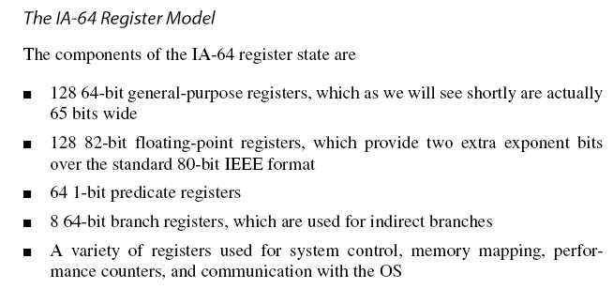
The Intel IA-64 Architecture and Itanium Processor
The IA-64 is a RISC-style, register-register instruction set, but with many novel features designed to support compiler-based exploitation of ILP

Slide 60
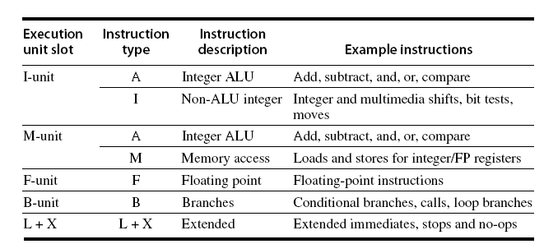

Slide 61
The Itanium 2 Processor
The Itanium 2 processor is the second implementation of the IA-64 architecture.
The first version, Itanium 1, became available in 2001 with an 800 MHz clock.
The Itanium 2, first delivered in 2003, had a maximum clock rate in 2005 of 1.6 GHz.
The Itanium 2 is about four times faster than the Itanium 1.
This performance improvement comes from a,
doubling of the clock rate,
a more aggressive memory hierarchy,
Additional functional units that improve instruction throughput

Slide 62
There are 11 functional units in the Itanium 2 processor:
two I-units,
four M-units(two for loads and two for stores),
three B-units, and two F-units.
All the functional units are pipelined.
Itanium 2 can issue up to six instructions per clock

Slide 63
