Slide 1
UNIT 3 Memory Hierarchy Design

Slide 2
Outline
Introduction- Review of concepts
Six Basic Cache Optimizations
Ten Advanced Cache Optimizations
Memory Technology and Optimizations

Slide 3
Introduction
The necessity of memory-hierarchy in a computer system design is enabled by the following two factors:
Locality of reference: The nature of program behavior
Large gap in speed between CPU and mass storage devices such as DRAM.
Level of memory hierarchy
High level <--- --> Low level
CPU-Register, Cache, Main-memory, Disk
The levels of the hierarchy subset one another: all data in one level is also found in the level below.

Slide 4
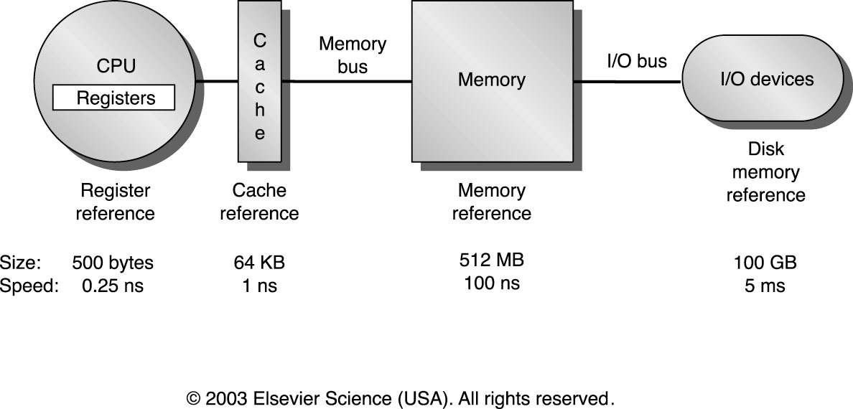
Memory Hierarchy

Slide 5
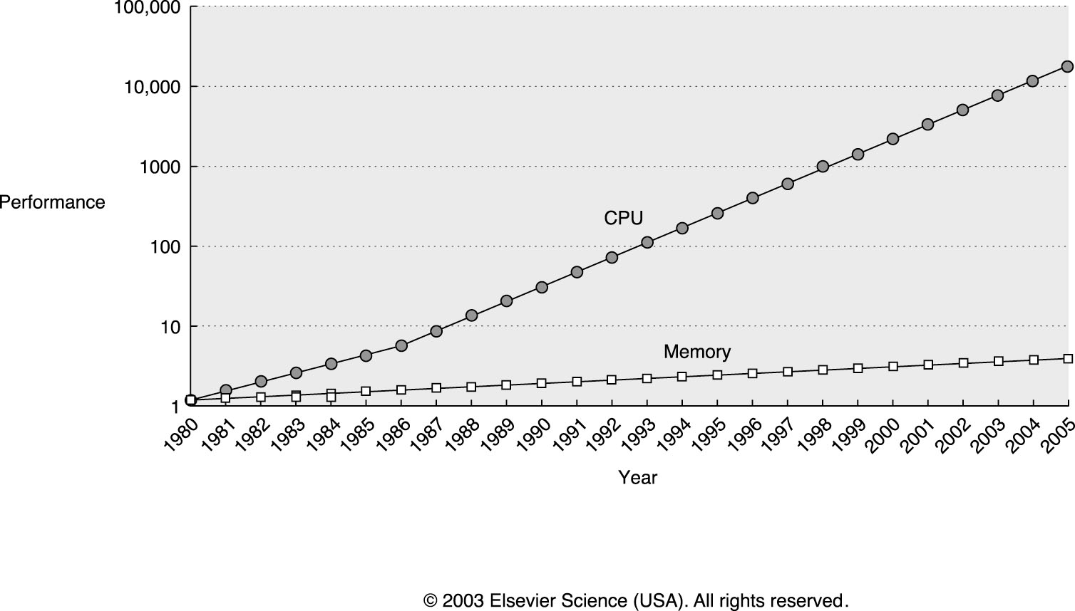
Speed Gap between CPU and DRAM

Slide 6
ABCs of Caches
Recalling some terms
Cache: The name given to the first level of the memory hierarchy encountered once the address leaves the CPU.
Miss rate: The fraction of accesses not in the cache.
Miss penalty: The additional time to service the miss.
Block: The minimum unit of information that can be present in the cache.

Slide 7
Cache Performance
Formula for performance evaluation
CPU execution time = (CPU clock cycles + Memory stall cycles) * Clock cycle time
Memory stall cycles = IC * Memory reference per instruction *miss rate *miss penalty
Measure of memory-hierarchy performance
Average memory access time = Hit time + Miss rate * Miss penalty

Slide 8
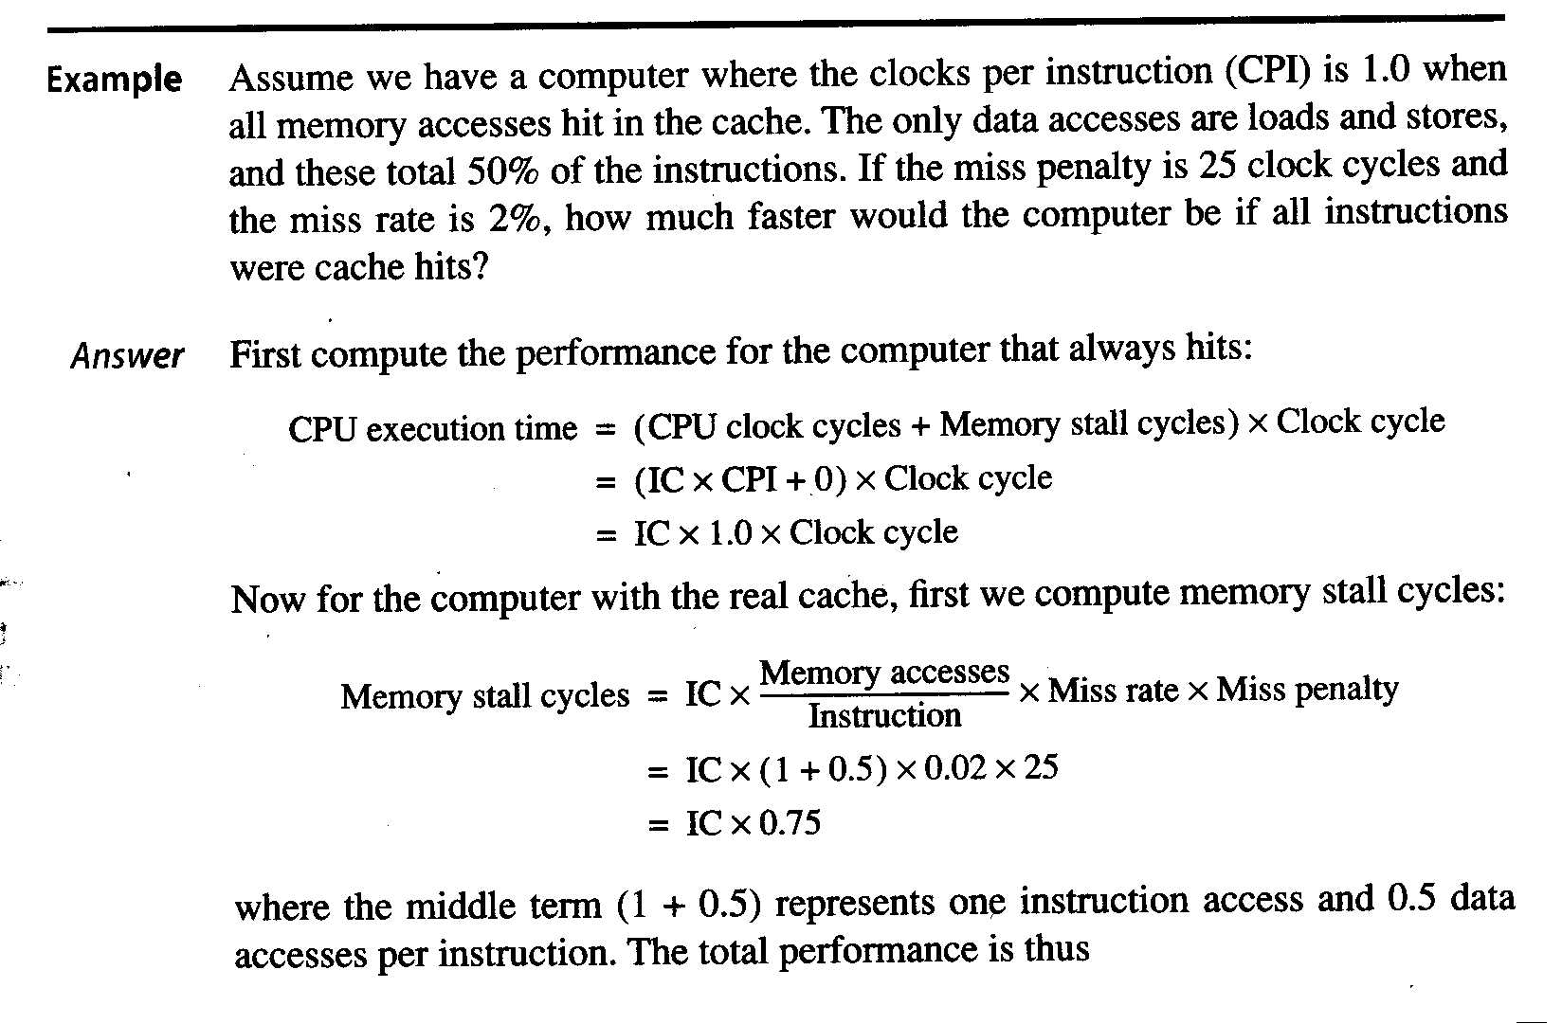

Slide 9
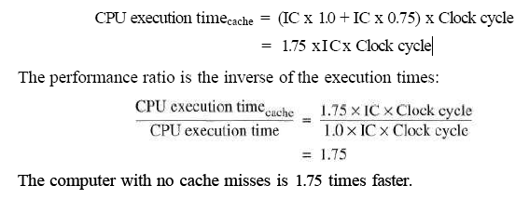

Slide 10
Block Placement (1)
Q1: Where can a block be placed in a cache?
Direct mapped: Each block has only one place it can appear in the cache. The mapping is usually
(Block address) MOD (Number of blocks in cache)
Fully associative: A block can be placed anywhere in the cache.
Set associative: A block can be placed in a restricted set of places in the cache. A set is a group of blocks in the cache. A block is first mapped onto a set, and then the block can be placed anywhere within that set. The set is usually obtained by
(block address) MOD (Number of sets in a cache)
If there are n blocks in a set, the cache is called n-way set associative.

Slide 11
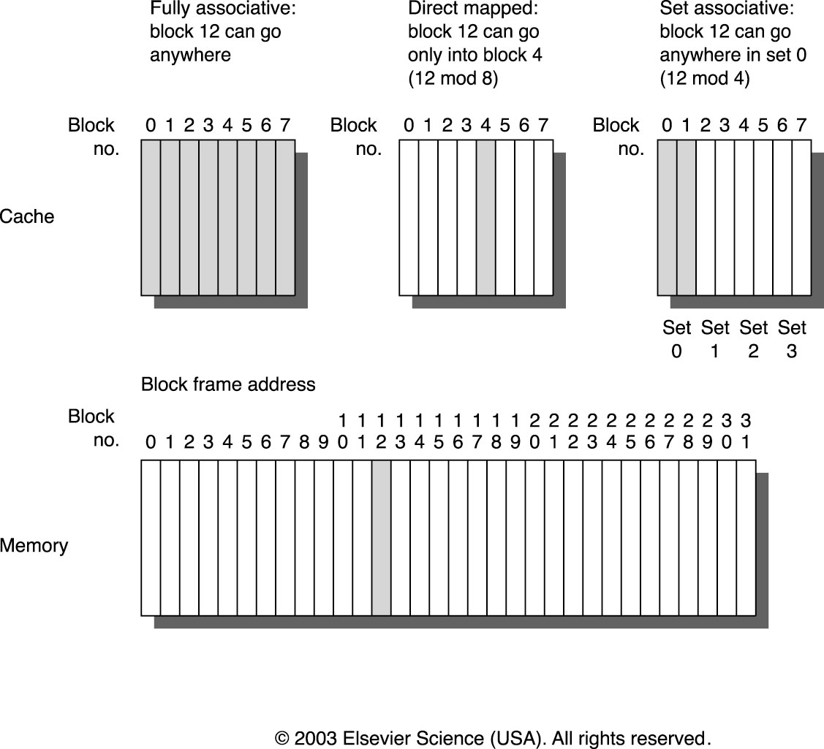
Block Placement (2)

Slide 12
Block Replacement
Q3: Which block should be replaced on a cache miss?
For direct mapped cache, the answer is obvious.
For set associative or fully associative cache, the following two strategies can be used:
Random:- to spread allocation automatically, candidate blocks are randomly selected.
Least-recently used (LRU):- to reduce the chance of throwing out information that will be needed soon, accesses to blocks are recorded. LRU relies on a corollary of locality
First in, first out (FIFO):- Because LRU can be complicated to calculate, this approximate LRU by determining the oldest block rather than the LRU.

Slide 13
Write Strategy
Q4: What happens on a write?
Traffic patterns
“Writes” take about 7% of the overall memory traffic and take about 28% of the data cache traffic.
“Read” can be done faster than “write”
In reading, the block data can be read at the same time that the tag is read and compared.
-If the read is hit then requested data passed to the processor
-If the read is a miss then there is no benefit and also no harm except the power consumption.
In writing, modifying a block cannot begin until the tag is checked to see if the address is a hit.
Since tag checking cannot be done in parallel, write normally takes longer than reads

Slide 14
Write Policies
Write policies
Write through (or store through)
Write to both the block in the cache and the block in the lower-level memory.
Write back
Write only to the block in the cache. A dirty bit, attached to each block in the cache, is set when the block is modified. When a block is being replaced and the dirty bit is set, the block is copied back to main memory. Clean bocks are not copied back to MM. This can reduce bus traffic.

Slide 15
A write-through cache uses no-write allocate.
Here, subsequent writes have no advantage, since they still need to be written directly to the backing store, read after write is hit
write-back cache uses write allocate,
hoping for subsequent writes (or even reads) to the same location, which is now cached.

Slide 16
Example
Assume a fully associative write-back cache with many cache entries that starts empty. Below is a sequence of five memory operations (the address is in square brackets):
Write Mem[100];
WriteMem[100];
Read Mem[200];
WriteMem[200];
WriteMem[100].
What are the number of hits and misses when using no-write allocate versus write allocate?

Slide 17
Answer
For no-write allocate, the address 100 is not in the cache, and there is no allocation on write, so the first two writes will result in misses. Address 200 is also not in the cache, so the read is also a miss. The subsequent write to address 200 is a hit. The last write to 100 is still a miss. The result for no-write allocate is four misses and one hit.
For write allocate, the first accesses to 100 and 200 are misses, and the rest are hits since 100 and 200 are both found in the cache. Thus, the result for write allocate is two misses and three hits.

Slide 18
Answer
No allocate: (1 hit , 4 misses)
Write Mem[100] miss
WriteMem[100] miss
Read Mem[200] miss
WriteMem[200] hit
WriteMem[100] miss
Allocate: (3 hits , 2 misses)
Write Mem[100] miss
WriteMem[100] hit
Read Mem[200] miss
WriteMem[200] hit
WriteMem[100] hit

Slide 19
Miss Categories
Compulsory miss
The first access to a block is not in the cache.
Capacity miss
Occur because of blocks being discarded and later retrieved if the cache cannot contain all the blocks needed during execution of a program.
Conflict miss
Occur because a block can be discarded and later retrieved if too many blocks map to its set for direct mapped or set associative caches.

Slide 20
Improving Cache Performance Six Basic Cache Optimizations
Average memory access time = Hit time + Miss rate x Miss penalty
Reduce the miss rate
larger block size
larger cache size
and higher associativity
Reduce the miss penalty
multilevel caches
giving reads priority over writes
Reduce the hit time
avoiding address translation when indexing the cache

Slide 21
First:Larger block size to reduce miss rate:
- To reduce miss rate through spatial locality.
- Increase block size.
- Larger block size reduce compulsory misses.
- But they increase the miss penalty.

Slide 22
Second :Bigger caches to reduce miss rate:
capacity misses can be reduced by increasing the cache capacity.
- Increases larger hit time for larger cache memory and higher cost and power
Notes:
Increases conflict miss and even capacity miss if cache is small.

Slide 23
Second: Larger Caches to reduce miss rate
Drawbacks
Longer hit time
Higher cost, power
This technique has been especially popular in Off chip caches.

Slide 24
Third: Higher Associativity
Increase in associativity reduces conflict misses.
Greater associativity can come at the cost of increased hit time

Slide 25
Fourth: Multilevel caches to reduce penalty:
- Introduces additional level cache
- Between original cache and memory.
- L1- original cache
L2- added cache.
L1 cache: - small enough
- speed matches with clock cycle time.
L2 cache: - large enough
- capture many access that would go to main memory.
Average access time can be redefined as
Hit timeL1+ Miss rate L1 X ( Hit time L2 + Miss rate L2 X Miss penalty L2)

Slide 26
Fifth: Give Priority to Read Miss over Writes to reduce miss penalty
write buffer is a good place to implement this optimization.
- write buffer creates hazards: read after write hazard.

Slide 27
Sixth. Avoiding address translation during indexing of the cache to reduce hit time:
Caches must cope with the translation of a virtual address from the processor to a physical address to access memory.
- common optimization is to use the page offset.
- part that is identical in both virtual and physical addresses- to index the cache.

Slide 28
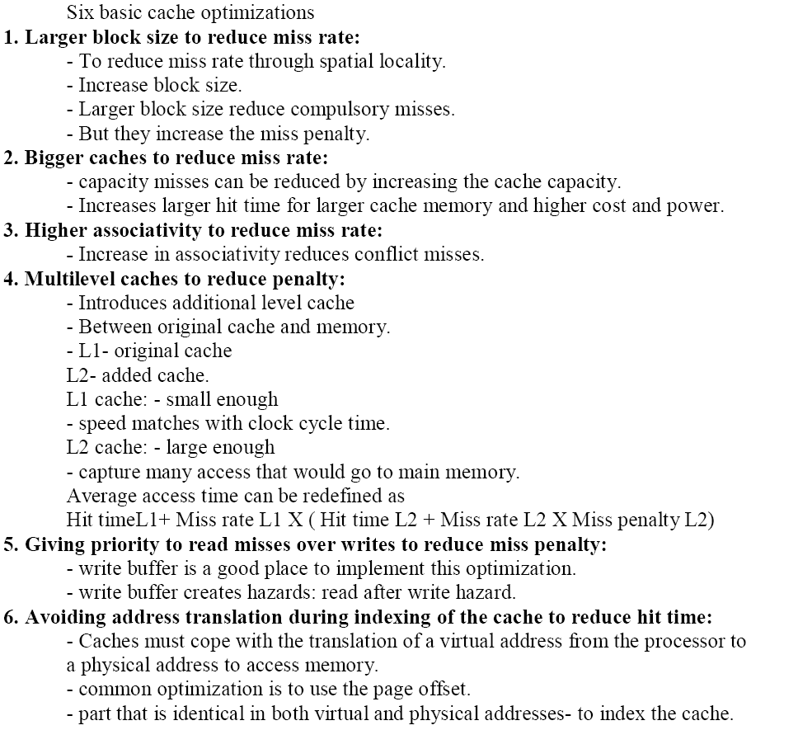

Slide 29
Eleven Advanced cache optimizations
Categories :
Reducing the hit time: small and simple caches, way prediction, and trace caches
Increasing cache bandwidth: pipelined caches, multibanked caches, and nonblocking caches
Reducing the miss penalty: critical word first and merging write buffers
Reducing the miss rate: compiler optimizations
Reducing the miss penalty or miss rate via parallelism: hardware prefetching and compiler prefetching

Slide 30
1st: Hit Time Reduction Technique: Small and Simple Caches
Smaller hardware is faster => small cache helps the hit time
Keep the cache small enough to fit on the same chip as the processor (avoid the time penalty of going off-chip)
Keep the cache simple
Use Direct Mapped cache: it overlaps the tag check with the transmission of data

Slide 31
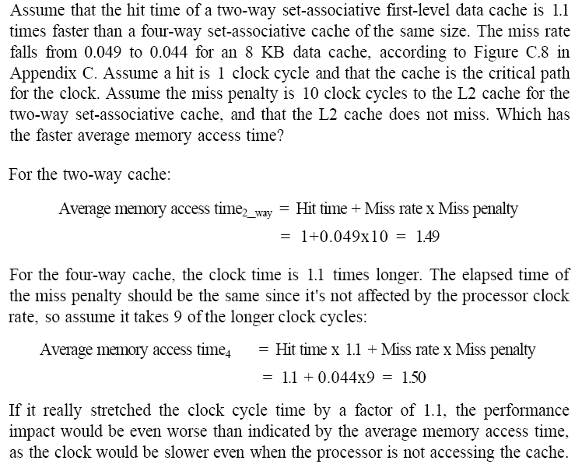
Example : Compare AMAT of 2-way and 4-way

Slide 32
2nd: Hit Time Reduction Technique: Way Prediction
How to combine fast hit time of Direct Mapped and have the lower conflict misses of 2-way SA cache?
Way Prediction:
block predictor bits are added each block of the cache
These bits select which of the blocks to try on the next cache access.
Mux is set early to select the desired block
Only a single tag comparison is performed in parallel with reading the cache data
If tag match succeeds (hit) predicted block returned in one cycle
If tag match fails (miss) rest of the blocks checked in second cycle
Two hit times: fast hit (way predicted), slow hit (way mispredicted)
Prediction accuracy is 85%
Used in Pentium 4

Slide 33
3rd: Hit Time Reduction Technique: Trace Caches
Higher ILP needs enough instructions every cycle.
Solution – Trace caches:
Contains dynamic trace of executed intructions
Branch prediction is now implemented (built in) by the cache
Real target address must be validated with trace cache addresses
Better utilization of long blocks in instr. trace cache
Conventional caches may be entered in the middle and exited before the end by branches.
So, poor space utilization
drawback:
instructions may appear multiple times in multiple dynamic traces due to different branch outcomes
Pentium 4 uses decoded micro operations in trace cache (saves decode time)

Slide 34
Trace Cache
Key Idea: Pack multiple non-contiguous basic blocks into one contiguous trace cache line
BR
BR
BR
BR
BR
BR
Single fetch brings in multiple basic blocks
Trace cache indexed by start address and next n branch predictions

Slide 35
4th: Pipelined Cache Access to Increase Cache Bandwidth
Pipeline cache access to maintain bandwidth (but higher latency)
Instruction-cache pipeline stages:
Pentium: 1 stage
Pentium Pro through Pentium III: 2 stages
Pentium 4: 4 stages
Greater penalty on mispredicted branches
More clock cycles between issue of load and use of data

Slide 36
5th : Nonblocking Caches to Increase Cache Bandwidth
Pipelined computers that allow out-of-order completion the processor need not stall on a data cache miss.
Processor could continue fetching instructions from the instruction cache while waiting for the data cache to return the missing data
Thus nonblocking cache allows data cache to continue to supply cache hits during a miss
Known as “hit under miss” optimization
Lowers miss penalty
cache may further lower the effective miss penalty if it can overlap multiple misses
Known as "hit under multiple miss"
Requires suitable multi-bank, pipelined memory system
Hard to measure miss penalty due to overlap of hits and misses

Slide 37
6th: Multibanked Caches to Increase Cache Bandwidth
divide cache into independent banks that can support simultaneous accesses
banking works best when the accesses naturally spread themselves across the banks
mapping of addresses to banks:
spread the addresses of the block sequentially across the banks
called as sequential interleaving

Slide 38
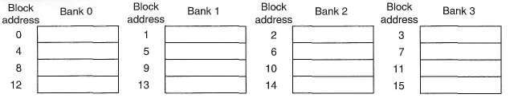
Example : Four-way interleaved cache banks using block addressing
Assuming 64 bytes per blocks.
assume cache has four banks,
bank 0 has all blocks whose address modulo 4 is 0;
bank 1 has all blocks whose address modulo 4 is 1; and so on.
each of these addresses would be multiplied by 64 to get byte addressing
0-63
64-127
128-191
192-255
256-319

Slide 39
7th : Critical Word First and Early Restart to Reduce Miss Penalty
Cache block size tends to increase to exploit spatial locality
Any given reference needs only one word from a multi-word Block
CWF fetches requested word first and sends it to processor
Processor continues execution while rest of the block is fetched

Slide 40
7th : Critical Word First and Early Restart to Reduce Miss Penalty
Early restart
Fetches words in the order stored in the block
As soon as critical word arrives, sends to processor and processor restarts

Slide 41
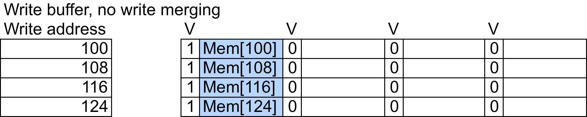
8th : Merging Write Buffer to Reduce Miss Penalty
Processor blocks on write if write buffer is full
Processor checks write address with address in write buffer
Processor merges writes to same address if address is present in write buffer
Assume write buffer with 4 entries, with 4 words of 64-bit each

Slide 42
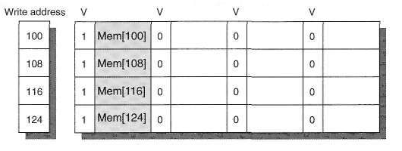
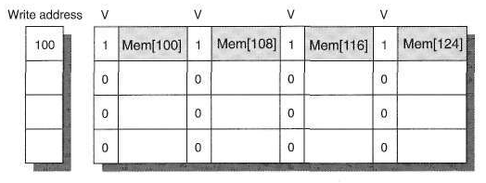
Example for write merging
4 Writes to same cache block in different cycles, without write merging
Addr 108
116
124
4 Writes to same cache block in different cycles, with write merging

Slide 43
Example…
Without write merging, all 4 buffer entries are used
If writes are merged only one buffer entry is used
Multiword writes are faster than writes one word at a time
Write misses can be served faster
Reduces stalls due to write buffer being full

Slide 44
Victim cache
Tiny cache holds evicted cache blocks
On a subsequent cache miss, check the victim cache for the desired data before going to lower level memory
Reduces the impact of conflict miss
Used in AMD Opteron

Slide 45
9th : Compiler Optimizations to Reduce Miss Rate
Code transformations to improve:
Spatial locality, through higher utilization of fetched cache blocks
Temporal locality, through reduction of the reuse distance of cache blocks
Examples: loop interchange, loop fusion, blocking …
Data layout and data structure transformations to improve:
Spatial locality, through higher utilization of fetched cache blocks
Examples: array merging, structure/object class member reordering in memory, block array layouts

Slide 46
Reordering procedures to reduce instruction miss rate
Assume that cache has 2 sets of 2way set associativity
Proc1 through proc3 map to set 0 – hence conflicts
Reorder procedures in MM such that they occupy contiguous blocks
block0
proc1
proc1
Proc1, 2, 3
Set 0 blck0
block0
block1
proc1
Set 0 blck0
block1
proc2
Set 0 blck1
block2
proc2
proc3
Set 0 blck1
block2
proc3
Set 1 blck0
block3
proc2
Set 1 blck0
Set 1 blck1
block3
block4
proc3
Set 1 blck1
block4
Before reordering
After reordering

Slide 47
Array merging
Data structure reorganization for spatial locality
/* Before */
int val[SIZE];
int key[SIZE];
Assume code accessing val[i], key[i], for every i
Accesses to val and key may conflict in direct-mapped caches
Solution, merge arrays, accesses to val[i], key[i] do not conflict in the cache, spatial locality exploited
/* After */
struct merge {
int val;
int key;
}
struct merge merged_array[SIZE];

Slide 48
Loop interchange
Code transformation for spatial locality
/* Before */
for (j = 0; j < 500; j++)
for (i = 0; i < 100; i++)
x[i][j] = 2 * x[i][j];
Arrays in C stored in row-major order
Innermost loop over column of x
Long strides lead to poor spatial locality
assume that size of cache block = size of 1 row (ie 100 words)
At each iteration of inner loop accesses go to different blocks
Hence more cache misses
/* After */
for (i = 0; i < 100; i = i+1)
for (j = 0; j < 500; j = j+1)
x[i][j] = 2 * x[i][j];
Here, once a block is brought in there wont be any cache miss for all iteration of the inner loop

Slide 49
Data blocking
A Code transformation for temporal locality
Reduce reuse distance for same data
Organize code so that data is accessed in blocks
Best performance if block accessed many times and few
accesses to data outside block
Example: Matrix multiplication without blocking
/* Before */
for (i = 0; i < N; i = i+1)
for (j = 0; j < N; j = j+1)
{r = 0;
for (k = 0; k < N; k = k + 1)
r = r + y[i][k]*z[k][j];
x[i][j] = r;
};

Slide 50
Prefetching of instructions and data to reduce miss penalty or miss rate
Processor requests data in advance
Processor speculates that requested data will be accessed in the future
Need a guess for what data will be needed in the future
Guess is easy in linear memory access pattern
Fixed stride between data accesses
Strided prefetching
Need prefetch triggers, e.g. two consecutive misses

Slide 51
Prefetching -Performance implications
Prefetched data may displace other useful data from cache
Prefetched data may come too early and be evicted before used
Prefetched data may come too late and not be there when needed
Prefetched data may be useless, i.e. not accessed at all
Prefetched data wastes memory bandwidth, if useless

Slide 52
10th : Hardware Prefetching of Instructions and Data
A processor fetches two (consecutive) blocks on a miss.
The requested block is placed in the instruction (data) cache when it returns.
The prefetched block is placed into instruction (data) stream buffer.
When the requested block can be found and read from the stream buffer, the next prefetch request is issued.
With four instruction (data) stream buffers, the hit rate improves to 50% (43%).

Slide 53
11th : Software Prefetching Data
Compiler inserts prefetching instructions to request data before the processor needs it
2 types
Register prefetch : Load data into register (HP PA-RISC loads)
Cache Prefetch: load into cache (MIPS IV, PowerPC, SPARC v. 9)
Issuing Prefetch Instructions takes time
cost of prefetch issues should be < savings in reduced misses

Slide 54
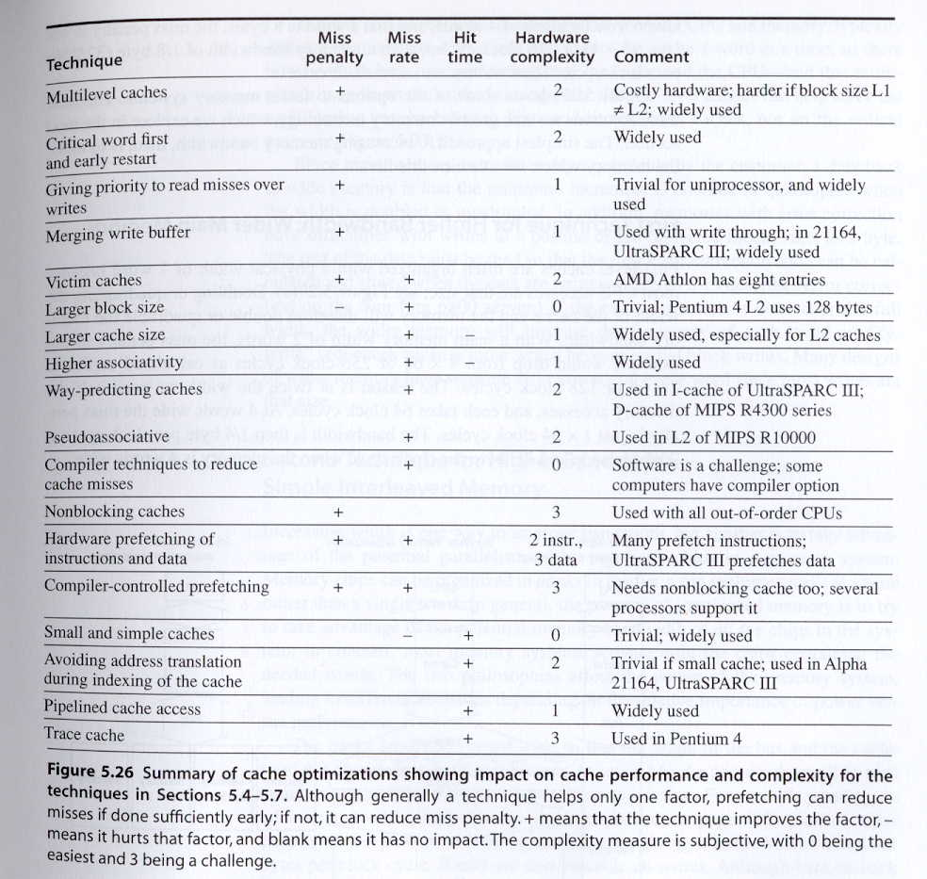
Summary of Cache Optimizations
Fig. 5.26

Slide 55
Memory Technology and Optimizations

Slide 56
Main Memory
SRAM for cache
DRAM for main memory

Slide 57
SRAM
Static Random Access Memory
Six transistors per bit to prevent the information from being disturbed when read
Don’t need to refresh, so access time is very close to cycle time

Slide 58
DRAM
Dynamic Random Access Memory
Single transistor per bit
Reading destroys the information
Refresh periodically
cycle time > access time

Slide 59
DRAM
Dynamic Random Access Memory
Single transistor per bit
Reading destroys the information
Refresh periodically
cycle time > access time
DRAMs are commonly sold on small boards called DIMM (dual inline memory modules), typically containing 4 ~ 16 DRAMs

Slide 60
As DRAMs grew in capacity, the cost of a package with all the necessary address lines was an issue. 2. The solution was to multiplex the address lines, thereby cutting the number of address pins in half.
• One-half of the address is sent first, called the row access strobe (RAS).
• The other half of the address, sent during the column access strobe (CAS), follows it.
These names come from the internal chip organization, since the memory is organized as a rectangular matrix addressed by rows and columns.

Slide 61
To pack more bits per chip, DRAMs use only a single transistor to store a bit.
Reading that bit destroys the information, so it must be restored. This is one reason the DRAM cycle time is much longer than the access time.
To prevent loss of information when a bit is not read or written, the bit must be “refreshed” periodically, all the bits in a row can be refreshed simultaneously just by reading that row.
Hence, every DRAM in the memory system must access every row within a certain time window, such as 8 ms.
Memory controllers include hardware to refresh the DRAMs periodically.
This requirement means that the memory system is occasionally unavailable because it is sending a signal telling every chip to refresh.
The time for a refresh is typically a full memory access (RAS and CAS) for each row of the DRAM. Since the memory matrix in a DRAM is conceptually square, the number of steps in a refresh is usually the square root of the DRAM capacity

Slide 62
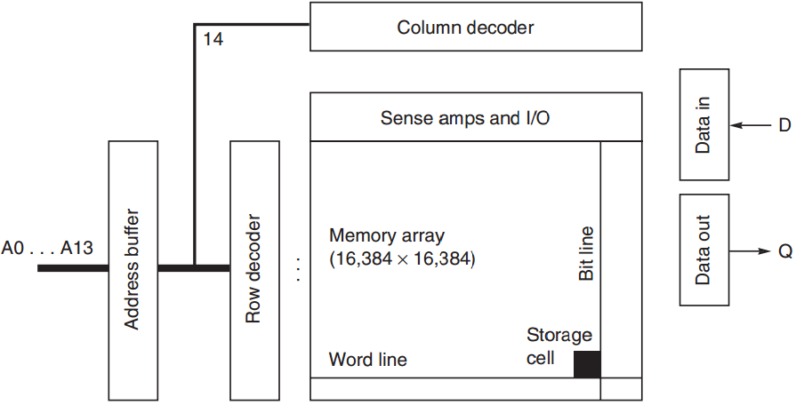
DRAM Organization

Slide 63
DRAM Improvement
Timing signals
allow repeated accesses to the row buffer w/o another row access time;
Leverage spatial locality
each array will buffer 1024 to 4096 bits for each access;

Slide 64
DRAM Improvement
Clock signal
added to the DRAM interface,
so that repeated transfers will not involve overhead to synchronize with memory controller;
SDRAM: synchronous DRAM

Slide 65
DRAM Improvement
Wider DRAM
to overcome the problem of getting a wide stream of bits from memory without having to make the memory system too large as memory system density increased;
widening the cache and memory widens memory bandwidth;
e.g., 4-bit transfer mode up to 16-bit buses

Slide 66
DRAM Improvement
DDR: double data rate
to increase bandwidth,
transfer data on both the rising edge and falling edge of the DRAM clock signal,
thereby doubling the peak data rate;

Slide 67
DRAM Improvement
Multiple Banks
break a single SDRAM into 2 to 8 blocks;
they can operate independently;
Provide some of the advantages of interleaving
Help with power management

Slide 68
DRAM Improvement
Reducing power consumption in SDRAMs
dynamic power: used in a read or write
static/standby power
Depend on the operating voltage
Power down mode: entered by telling the DRAM to ignore the clock
disables the SDRAM except for internal automatic refresh;

Slide 69
DRAM Improvement
1. A DRAM access is divided into row access and column access. DRAMs must buffer a row of bits inside the DRAM for the column access,
2. Although presented logically as a single monolithic array of memory bits, the internal organization of DRAM actually consists of many memory modules. For a variety of manufacturing reasons, these modules are usually 1–4M bits.
3. To improve bandwidth, there has been a variety of evolutionary innovations over time.

Slide 70
4.The first was timing signals that allow repeated accesses to the row buffer without another row access time, typically called fast page mode. Conventional DRAMs had an asynchronous interface to the memory controller, and hence every transfer involved overhead to synchronize with the controller.
•5. The second major change was to add a clock signal to the DRAM interface, so that the repeated transfers would not bear that overhead. Synchronous DRAM (SDRAM) is the name of this optimization. SDRAMs typically also had a programmable register to hold the number of bytes requested, and hence can send many bytes over several cycles per request.
• 6.The third major DRAM innovation to increase bandwidth is to transfer data on both the rising edge and falling edge of the DRAM clock signal, thereby doubling the peak data rate. This optimization is called double data rate (DDR).

Slide 71
Thank you
END
of
UNIT IV

