Slide 1
DISCRIMINANT
ADAPTIVE
NEAREST NEIGHBOR CLASSIFICATION
PRESENTED BY
Scott Connor
smconnor@uvm.edu
DATA MINING – Xindong Wu (Course Instructor)
UNIVERSITY OF VERMONT
1

Slide 2
SLIDES BASED ON
k nearest neighbor classification
Presented by
Vipin Kumar
University of Minnesota
kumar@cs.umn.edu
Based on discussion in "Intro to Data Mining"
by Tan, Steinbach, Kumar
2
ICDM: Top Ten Data Mining Algorithms k nearest neighbor classification December 2006

Slide 3
OUTLINE
Nearest Neighbor Overview
k Nearest Neighbor
Discriminant Adaptive Nearest Neighbor
Other variants of Nearest Neighbor
Related Studies
Conclusion
References
?
3

Slide 4
WHY NEAREST NEIGHBOR?
Used to classify objects based on closest training examples in the feature space
  Feature space: raw data transformed into sample vectors of fixed length using feature extraction (Training Data)
Top 10 Data Mining Algorithm
  ICDM paper – December 2007
Among the simplest of all Data Mining Algorithms
  Classification Method
Implementation of lazy learner
  All computation deferred until classification
?
4

Slide 5
NEAREST NEIGHBOR CLASSIFICATION
Nearest Neighbor Overview
k Nearest Neighbor
Discriminant Adaptive Nearest Neighbor
Other variants of Nearest Neighbor
Related Studies
Conclusion
References
?
5

Slide 6
k NEAREST NEIGHBOR
Requires 3 things:
  Feature Space(Training Data)
  Distance metric
    to compute distance between records
  The value of k
    the number of nearest neighbors to retrieve from which to get majority class
To classify an unknown record:
  Compute distance to other training records
  Identify k nearest neighbors
  Use class labels of nearest neighbors to determine the class label of unknown record
?
6
ICDM: Top Ten Data Mining Algorithms k nearest neighbor classification December 2006

Slide 7
k NEAREST NEIGHBOR
Common Distance Metrics:
  Euclidean distance(continuos distribution)
  d(p,q) = √∑(p_{i} – q_{i})²
  Hamming distance (overlap metric)
  Discrete Metric(boolean metric)
Determine the class from k nearest neighbor list
  Take the majority vote of class labels among the k-nearest neighbors
  Weighted factor
  w =1/d(generalized linear interpolation) or 1/d²
bat (distance = 1) toned (distance = 3)
cat roses
if x = y then d(x,y) = 0. Otherwise, d(x,y) = 1
7
ICDM: Top Ten Data Mining Algorithms k nearest neighbor classification December 2006

Slide 8
k NEAREST NEIGHBOR
k = 1:
Belongs to square class
k = 3:
Belongs to triangle class
?
k = 7:
Belongs to square class
Choosing the value of k:
  If k is too small, sensitive to noise points
  If k is too large, neighborhood may include points from other classes
  Choose an odd value for k, to eliminate ties
8
ICDM: Top Ten Data Mining Algorithms k nearest neighbor classification December 2006

Slide 9
k NEAREST NEIGHBOR
Accuracy of all NN based classification, prediction, or recommendations depends solely on a data model, no matter what specific NN algorithm is used.
Scaling issues
  Attributes may have to be scaled to prevent distance measures from being dominated by one of the attributes.
  Examples
    Height of a person may vary from 4’ to 6’
    Weight of a person may vary from 100lbs to 300lbs
    Income of a person may vary from $10k to $500k
Nearest Neighbor classifiers are lazy learners
  No pre-constructed models for classification
9
ICDM: Top Ten Data Mining Algorithms k nearest neighbor classification December 2006

Slide 10
k NEAREST NEIGHBOR ADVANTAGES
Simple technique that is easily implemented
Building model is inexpensive
Extremely flexible classification scheme
  does not involve preprocessing
Well suited for
  Multi-modal classes (classes of multiple forms)
  Records with multiple class labels
Asymptotic Error rate at most twice Bayes rate
  Cover & Hart paper (1967)
Can sometimes be the best method
  Michihiro Kuramochi and George Karypis, Gene Classification using Expression Profiles: A Feasibility Study, International Journal on Artificial Intelligence Tools. Vol. 14, No. 4, pp. 641-660, 2005
  K nearest neighbor outperformed SVM for protein function prediction using expression profiles
10
ICDM: Top Ten Data Mining Algorithms k nearest neighbor classification December 2006

Slide 11
k NEAREST NEIGHBOR DISADVANTAGES
Classifying unknown records are relatively expensive
  Requires distance computation of k-nearest neighbors
  Computationally intensive, especially when the size of the training set grows
Accuracy can be severely degraded by the presence of noisy or irrelevant features
NN classification expects class conditional probability to be locally constant
  bias of high dimensions
11
ICDM: Top Ten Data Mining Algorithms k nearest neighbor classification December 2006

Slide 12
NEAREST NEIGHBOR CLASSIFICATION
Nearest Neighbor Overview
k Nearest Neighbor
Discriminant Adaptive Nearest Neighbor
Other variants of Nearest Neighbor
Related Studies
Conclusion
References
?
12

Slide 13
DISCRIMINANT ADAPTIVE NEAREST NEIGHBOR CLASSIFICATION
Trevor Hastie
Stanford University
Robert Tibshirani
University of Toronto
KDD-95 Proceedings
13

Slide 14
DISCRIMINANT ADAPTIVE NEAREST NEIGHBOR CLASSIFICATION (DANN)
Discriminant – Characteristic used for distinguishing between classes
Adaptive – Capability of being able to adapt or adjust
Nearest Neighbor – classification based on a locality metric selected by the majority of adjacent neighbor’s class
14

Slide 15
DISCRIMINANT ADAPTIVE NEAREST NEIGHBOR CLASSIFICATION (DANN)
NN expects the class conditional probabilities to be locally constant.
NN suffers from bias in high dimensions.
DANN uses local linear discriminant analysis to estimate an effective metric for computing neighborhoods.
DANN posterior probabilities tend to be more homogeneous in the modified neighborhoods.
Goals:
  Determine local decision boundaries from centroid information and shrink orthogonal to boundaries
  Propose method for global dimension reduction
15

Slide 16
DISCRIMINANT ADAPTIVE NEAREST NEIGHBOR CLASSIFICATION (DANN)
?
?
Class 1
Class 2
Using k -NN, we misclassify by crossing the boundary between classes.
Standard linear discriminants extend infinitely in any direction. This is dangerous to local classification.
16

Slide 17
DISCRIMINANT ADAPTIVE NEAREST NEIGHBOR CLASSIFICATION (DANN)
?
Class 1
Class 2
DANN utilizes a small tuning parameter to shrink neighborhoods.
17

Slide 18
DISCRIMINANT ADAPTIVE NEAREST NEIGHBOR CLASSIFICATION (DANN)
?
The process of tuning can be done iteratively allowing shrinking in all axis
18

Slide 19
DISCRIMINANT ADAPTIVE NEAREST NEIGHBOR CLASSIFICATION (DANN)
The DANN procedure has a number of adjustable tuning parameters:
  K_{M} – The number of nearest neighbors in the neighborhood N for estimation of the metric.
  K – The number of neighbors in the final nearest neighbor rule.
  ε – the “softening” parameter in the metric.
Linear Discriminant Analysis (LDA)
  Linear combination of features which characterizes or separates two or more classes
19

Slide 20
DISCRIMINANT ADAPTIVE NEAREST NEIGHBOR CLASSIFICATION (DANN)
Algorithm:
Initialize the metric ∑ = I, the identity matrix.
Spread out a nearest neighborhood of K_{M} points around the test point x_{o}, in the metric ∑.
Calculate the weighted within and between sum of squares matrices W and B using the points in the neighborhood (partition of TSS (T = W+B)).
Define a new metric ∑ = W^{-1/2}[W^{-1/2}BW^{-1/2} + εI]W^{-1/2}
Iterate steps 1, 2, and 3.
At completion, use the metric ∑ for k-nearest neighbor classification at the test point x_{o.}
20

Slide 21

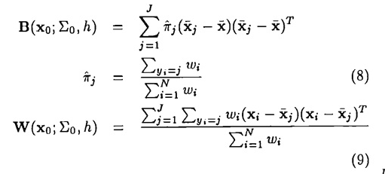
DANN Metric Functions
DANN weight function
DANN Sum of squares “between” and “within”
21

Slide 22

DANN Iterative Mapping
DANN Metric
DANN SSP construction
DANN Metric Iterative Mapping
22

Slide 23
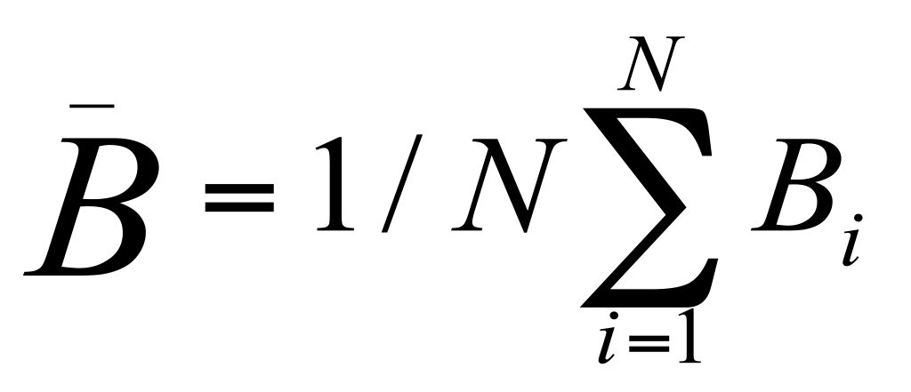
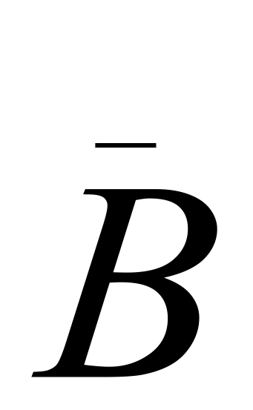
Global Dimension Reduction
For the local neighborhood N(i) of x_{i}, the local class centroids are contained in a subspace useful for classification.
At each training point x_{i}, the between-centroids sum of square matrix B_{i} is computed, and then these matrices are averaged over all training points:
The eigenvectors e1, e2, …e_{p} of the matrix span the optimal subspaces for global subspace reduction.
23

Slide 24
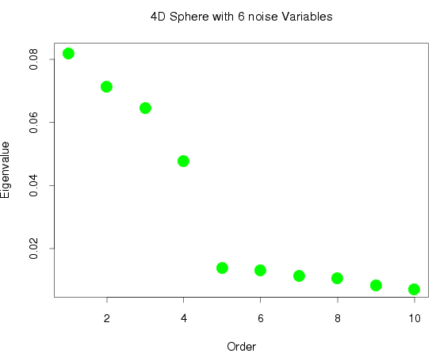
Global Dimension Reduction
Eigenvalues of for a two class, 4 dimensional sphere model with 6 noise dimensions
Decision boundary is a 4 dimensional sphere.
24

Slide 25
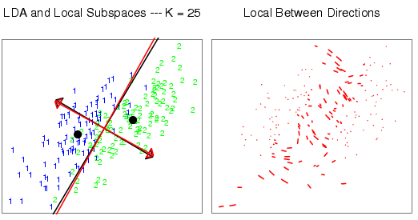
Global Dimension Reduction
Two dimensional Gaussian data with two classes (substantial within class covariance).
Estimates subspace for global dimension reduction.
25

Slide 26
EXPERIMENTAL DATA
DANN classifier used on several different problems and compared against other classifiers.
Classifiers
  LDA – linear discriminant analysis
  Reduced – LDA (restricted known subspace)
  5-NN – 5 nearest neighbors
  DANN – Discriminant adaptive nearest neighbor – One iteration
  Iter-DANN – five iterations
  Sub-DANN – with automatic subspace reduction
26

Slide 27
EXPERIMENTAL DATA
Problems
  2 Dimensional Gaussian with 14 noise
  Unstructured with 8 noise
  4 Dimensional spheres with 6 noise
  10 Dimensional Spheres
27

Slide 28
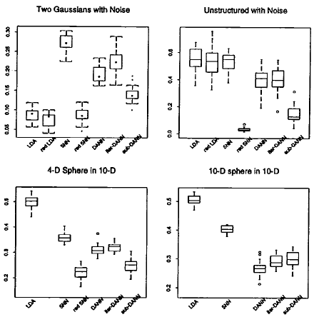
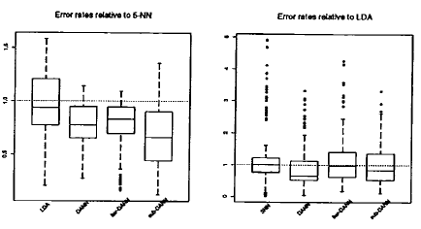
EXPERIMENTAL DATA
Relative error rates across
the 8 simulated problems
Boxplots of error rates over 20 simulations
28

Slide 29
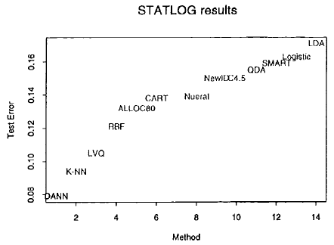
EXPERIMENTAL DATA
Misclassification results of a variety of classification
procedures on the satellite image test data
DANN can offer substantial improvements over other classification methods in some problems.
29

Slide 30
NEAREST NEIGHBOR CLASSIFICATION
Nearest Neighbor Overview
k Nearest Neighbor
Discriminant Adaptive Nearest Neighbor
Other variants of Nearest Neighbor
Related Studies
Conclusion
References
?
30

Slide 31
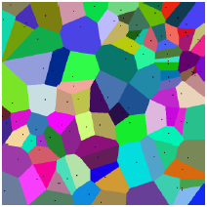
OTHER VARIANTS OF NEAREST NEIGHBOR
Linear Scan
  Compare object with every object in database.
    No preprocessing
    Exact Solution
    Works in any data model
Voronoi Diagram
  A diagram that maps every point into a polygon of points for which a point is the nearest neighbor.
31

Slide 32
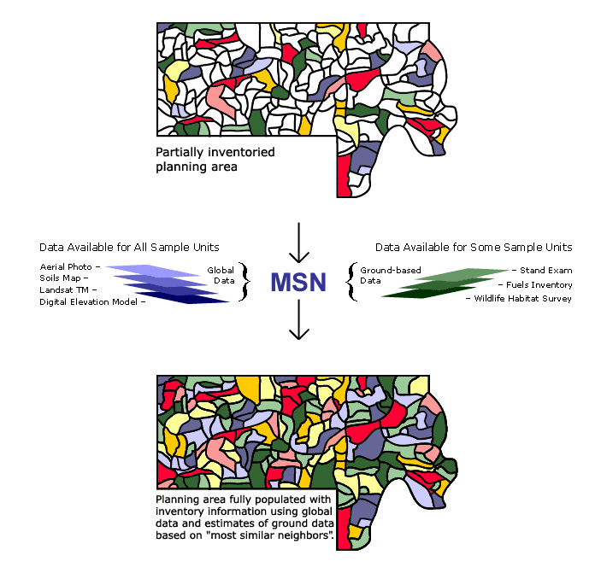
OTHER VARIANTS OF NEAREST NEIGHBOR
K-Most Similar Neighbor (k-MSN)
  Used to impute attributes measured on some sample units to sample units where they are not measured.
  A fast k-NN classifier
32

Slide 33
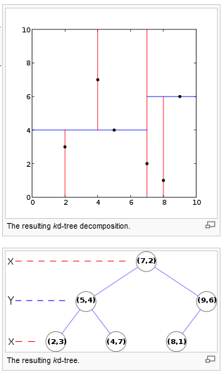
OTHER VARIANTS OF NEAREST NEIGHBOR
Kd-trees
  Build a K d-tree for every internal node.
  Go down to the leaf corresponding to the query object and compute the distance.
  Recursively check whether the distance to the next branch is larger than that to current candidate neighbor.
33

Slide 34
NEAREST NEIGHBOR CLASSIFICATION
Nearest Neighbor Overview
k Nearest Neighbor
Discriminant Adaptive Nearest Neighbor
Other variants of Nearest Neighbor
Related Studies
Conclusion
Test Questions
References
?
34

Slide 35
FOREST CLASSIFICATION
USDA Forest Service
Nationwide forest inventories
Field plot inventories have not been able to produce precise county and local estimates for useful operational maps
Traditional satellite based forest classifications are not detailed enough to produce interpolation and extrapolation of forest data.
Uses k-NN and MSN
35
Remote Sensing Lab University of Minnesota http://rsl.gis.umn

Slide 36
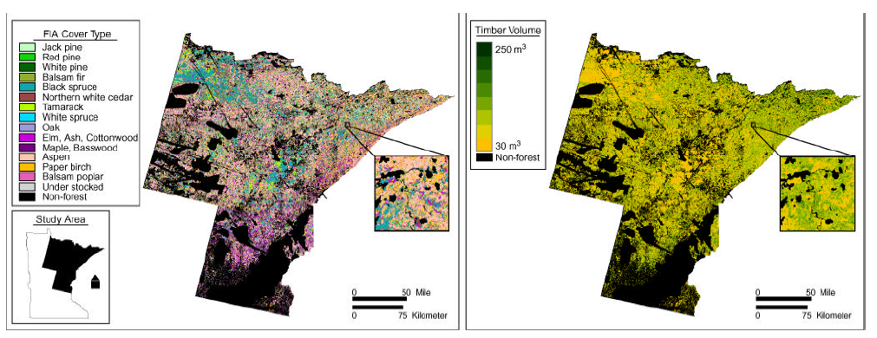
FOREST CLASSIFICATION
Tree Cover Type
Remote Sensing Lab
  http://rsl.gis.umn.edu
36
Remote Sensing Lab University of Minnesota http://rsl.gis.umn

Slide 37
TEXT CATEGORIZATION
Department of Computer Science and Engineering, Army HPC Research Center
  Text categorization is the task of deciding whether a document belongs to a set of pre-specified classes of documents.
  K-NN is very effective and capable of identifying neighbors of a particular document. Drawback is that it uses all features in computing distances.
  Weight adjusted k-NN is used to improve the classification objective function. A small subset of the vocabulary may be useful in categorizing documents.
  Each feature has an associated weight. A higher weight implies that this feature is more important in the classification task.
37

Slide 38
NEAREST NEIGHBOR CLASSIFICATION
Nearest Neighbor Overview
k Nearest Neighbor
Discriminant Adaptive Nearest Neighbor
Other variants of Nearest Neighbor
Related Studies
Conclusion
References
?
38

Slide 39
QUESTION 1:
Compare and contrast k-Means and k-Nearest Neighbors. Be sure to address the types of these algorithms, the way neighborhoods are calculated and the number of calculations involved.
K-Means | K-Nearest Neighbors
Clustering algorithm | Classification Algorithm
Uses distance from data points to k-centroids to cluster data into k-groups. | Calculates k nearest data points from data point X. Uses these points to determine which class X belongs to
Centroids are not necessarily data points. | “Centroid” is the point X to be classified.
Updates centroid on each pass by calculations over all data in a class. | Data point to be classified remains the same.
Must iterate over data until center point doesn’t move. | Only requires k distance calculations.
39

Slide 40
QUESTION 2:
What are some major disadvantages of k-Nearest Neighbor Classification?
Classifying unknown records is relatively expensive:
Lazy learner; must compute distance over k neighbors
Large data sets → expensive calculation
Accuracy of regions declines for higher dimensional data sets
Accuracy is severely degraded by noisy or irrelevant functions
40

Slide 41
QUESTION 3:
Identify a set of data over 2 classes (squares and triangles) for which DANN will give a better result than kNN. Explain why this is the case.
?
?
or
In these data sets, a spherical region would incorrectly classify the object O (a square) because it is not able to adapt to the correct shape of the data. DANN will be more successful because it is able to intelligently shape the neighborhood to fit the correct class.
41

Slide 42
NEAREST NEIGHBOR CLASSIFICATION
Nearest Neighbor Overview
k Nearest Neighbor
Discriminant Adaptive Nearest Neighbor
Other variants of Nearest Neighbor
Related Studies
Conclusion
References
?
42

Slide 43
KUMAR – NEAREST NEIGHBOR REFERENCES
Hastie, T. and Tibshirani, R. 1996. Discriminant Adaptive Nearest Neighbor Classification. IEEE Trans. Pattern Anal. Mach. Intell. 18, 6 (Jun. 1996), 607-616.
DOI= http://dx.doi.org/10.1109/34.506411
D. Wettschereck, D. Aha, and T. Mohri. A review and empirical evaluation of featureweighting methods for a class of lazy learning algorithms. Artificial Intelligence Review, 11:273–314, 1997.
B. V. Dasarathy. Nearest neighbor (NN) norms: NN pattern classification techniques. IEEE Computer Society Press, 1991.
Godfried T. Toussaint: Open Problems in Geometric Methods for Instance-Based Learning. JCDCG 2002: 273-283.
Godfried T. Toussaint, "Proximity graphs for nearest neighbor decision rules: recent progress," Interface-2002, 34th Symposium on Computing and Statistics (theme: Geoscience and Remote Sensing), Ritz-Carlton Hotel, Montreal, Canada, April 17-20, 2002
Paul Horton and Kenta Nakai. Better prediction of protein cellular localization sites with the k nearest neighbors classifier. In Proceeding of the Fifth International Conference on Intelligent Systems for Molecular Biology, pages 147--152, Menlo Park, 1997. AAAI Press.
J.M. Keller, M.R. Gray, and jr. J.A. Givens. A fuzzy k-nearest neighbor. algorithm. IEEE Trans. on Syst., Man & Cyb., 15(4):580–585, 1985
Seidl, T. and Kriegel, H. 1998. Optimal multi-step k-nearest neighbor search. In Proceedings of the 1998 ACM SIGMOD international Conference on Management of Data (Seattle, Washington, United States, June 01 - 04, 1998). A. Tiwary and M. Franklin, Eds. SIGMOD '98. ACM Press, New York, NY, 154-165. DOI= http://doi.acm.org/10.1145/276304.276319
Song, Z. and Roussopoulos, N. 2001. K-Nearest Neighbor Search for Moving Query Point. In Proceedings of the 7th international Symposium on Advances in Spatial and Temporal Databases (July 12 - 15, 2001). C. S. Jensen, M. Schneider, B. Seeger, and V. J. Tsotras, Eds. Lecture Notes In Computer Science, vol. 2121. Springer-Verlag, London, 79-96.
N. Roussopoulos, S. Kelley, and F. Vincent. Nearest neighbor queries. In Proc. of the ACM SIGMOD Intl. Conf. on Management of Data, pages 71--79, 1995.
Hart, P. (1968). The condensed nearest neighbor rule. IEEE Trans. on Inform. Th., 14, 515--516.
Gates, G. W. (1972). The Reduced Nearest Neighbor Rule. IEEE Transactions on Information Theory 18: 431-433.
D.T. Lee, "On k-nearest neighbor Voronoi diagrams in the plane," IEEE Trans. on Computers, Vol. C-31, 1982, pp. 478 - 487.
Franco-Lopez, H., Ek, A.R., Bauer, M.E., 2001. Estimation and mapping of forest stand density, volume, and cover type using the k-nearest neighbors method. Rem. Sens. Environ. 77, 251–274.
Bezdek, J. C., Chuah, S. K., and Leep, D. 1986. Generalized k-nearest neighbor rules. Fuzzy Sets Syst. 18, 3 (Apr. 1986), 237-256. DOI= http://dx.doi.org/10.1016/0165-0114(86)90004-7
Cost, S., Salzberg, S.: A weighted nearest neighbor algorithm for learning with symbolic features. Machine Learning 10 (1993) 57–78. (PEBLS: Parallel Examplar-Based Learning System)
43

Slide 44
GENERAL REFERENCES
Kumar, Vipin. K Nearest Neighbor Classification. University of Minnesota. December 2006.
Hastie, T. and Tibshirani, R. 1996. Discriminant Adaptive Nearest Neighbor Classification. IEEE Trans. Pattern Anal. Mach. Intell. 18, 6 (Jun. 1996), 607-616.
DOI= http://dx.doi.org/10.1109/34.506411
Wu et. al. Top 10 Algorithms in Data Mining. Knowledge Information Systems. 2008.
Han, Karypis, Kumar. Text Categorization Using Weight Adjusted k-Nearest Neighbor Classification. Department of Computer Science and Engineering. Army HPC Research Center. University of Minnesota.
Tan, Steinbach, and Kumar. Introduction to Data Mining.
Han, Jiawei and Kamber, Micheline. Data Mining: Concepts and Techniques.
Wikipedia
Lifshits, Yury. Algorithms for Nearest Neighbor. Steklov Insitute of Mathematics at St. Petersburg. April 2007
Cherni, Sofiya. Nearest Neighbor Method. South Dakota School of Mines and Technology.
Thomas D’Silva. Discriminant Adaptive Nearest Neighbor Classification & Distance metric learning, with application to clustering with side-information.
44

