Slide 1
SOFTWARE ARCHITECTURE
UNIT I : QUALITY
Software Architecture
QUALITY

Slide 2
Objectives
What are Different Quality Attributes?
What is Availability?
What is Modifiability?
What is Performance?
Software Architecture
QUALITY

Slide 3
Functionality And Architecture
Functionality & quality attributes are orthogonal
Some architectural choices will lead to higher performance; some will lead in the other direction
Software Architecture
QUALITY

Slide 4
Functionality And Architecture contd
What is functionality?
It is the ability of the system to do the work for which it was intended
Functionality may be achieved through the use of any of a no. of possible structures.
Software Architecture
QUALITY

Slide 5
Functionality And Architecture contd..
Functionality is largely independent of structure
Software architecture constrains its allocation to structure when other quality attributes are important
For example, systems are frequently divided so that several people can cooperatively build them
The interest of functionality is how it interacts with, & constrains those other qualities.
Software Architecture
QUALITY

Slide 6
Architecture And Quality Attributes
Achieving quality attributes must be considered throughout design, implementation, & deployment
No quality attribute is entirely dependent on design, nor is it entirely dependent on implementation or deployment.
Software Architecture
QUALITY

Slide 7
For example:
  Usability involves both architectural & non-architectural aspects. The non-architectural aspects include making the user interface clear & easy to use;
  should you provide a radio button or a check box?
  What typeface is most clear? Etc.
  Modifiability is determined by how functionality is divided & by coding techniques within a module
  Performance involves both architectural & non-architectural dependencies
Software Architecture
QUALITY

Slide 8
Architecture And Quality Attributes contd..
The message of this section is twofold:
  Architecture is critical to the realization of many qualities of interest in a system, & these qualities should be designed in & can be evaluated at the architectural level
  Architecture, by itself, is unable to achieve qualities, it provides the foundation for achieving quality, but this foundation will be to no avail if attention is not paid to the details
Within complex systems, quality attributes can never be achieved in isolation
The achievement of any one will have an effect, sometimes positive ?& sometimes negative, on the achievement of others
Software Architecture
QUALITY

Slide 9
System Quality Attributes
Here we focus on availability, modifiability, performance, security, testability, & usability
From an architect’s perspective, there are 3 problems:
  The definitions provided for an attribute are not operational. It is meaningless to say that a system will be modifiable
  A focus of discussion is often on which quality a particular aspect belongs to.
Software Architecture
QUALITY

Slide 10
System Quality Attributes contd..
  Each attribute community has developed its own vocabulary. The performance community has “events” arriving at a system, the security community has “attacks” arriving at the system, the availability community has “failures” of a system & the usability community has “user input”.
Software Architecture
QUALITY

Slide 11
System Quality Attributes contd..
A solution to the first two of these problems (non-operational definitions & overlapping attribute concerns) is to use quality attribute scenarios as a means of characterizing quality attributes
A solution to the third problem is to provide a brief discussion of each attribute –concentrating on its underlying concerns-to illustrate the concepts that are fundamental to that attribute community
Software Architecture
QUALITY

Slide 12
Quality Attribute Scenarios
A quality attribute scenario is a quality-attribute-specific requirement. It consists of 6 parts:
  Source of stimulus- this is some entity (a human, a computer etc.) that generated the stimulus
  Stimulus- the stimulus is the condition that needs to be considered when it arrives at a system
  Environment- the stimulus occurs within certain conditions. The system may be in overload condition or may be running when the stimulus occurs, or some other condition may be true
Software Architecture
QUALITY

Slide 13
Quality Attribute Scenarios contd
  Artifact- some artifact is stimulated. This may be the whole system or some pieces of it
  Response- the response is the activity undertaken after the arrival of the stimulus
  Response measure- when the response occurs, it should be measurable in some fashion so that the requirement can be tested
Software Architecture
QUALITY

Slide 14
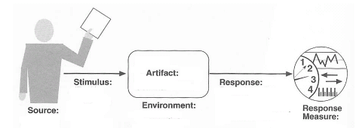
Quality Attribute Parts
Software Architecture
QUALITY

Slide 15
Availability Scenario
A general scenario for the quality attribute of availability has 6 parts.
From this we can derive concrete system specific scenarios
Not every system-specific scenario has 6 parts.
The parts that are necessary are the result of the application of the scenario & the types of testing that will be preformed to determine whether the scenario has been achieved
Software Architecture
QUALITY

Slide 16
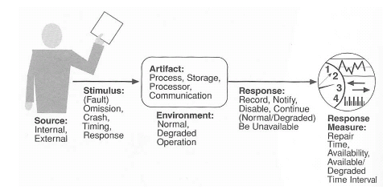
Availability General Scenario
Software Architecture
QUALITY

Slide 17
Availability Scenario contd..
An example availability scenario, derived from the general scenario (shown in the previous diagram) by instantiating each of the parts, is “An unanticipated external message is received by a process during normal operation. The process informs the operator of the receipt of the message & continues to operate with no downtime”
Software Architecture
QUALITY

Slide 18
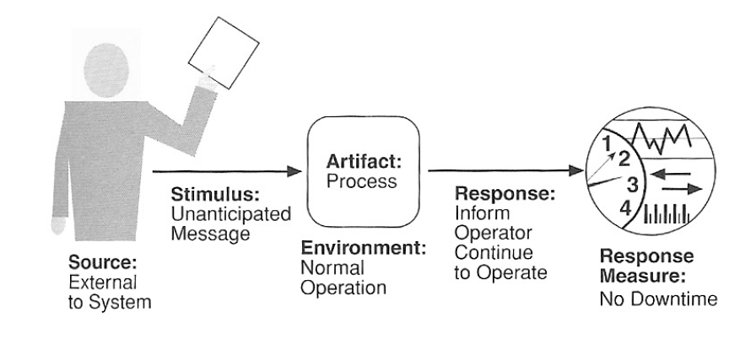
Example Availability Scenario
Software Architecture
QUALITY

Slide 19
Availability contd..
The distinction between faults & failures allows discussion of automatic repair strategies i.e., if code containing a fault is executed but the system is able to recover from the fault without it being observable, there is no failure.
The availability of the system is the probability that it will be operational when it is needed. It is typically defined as:
  = mean time to failure
  mean time to failure + mean time to repair
Scheduled downtimes are not usually considered when calculating availability, since the system is “not needed” by definition
Software Architecture
QUALITY

Slide 20
Availability
Availability is concerned with system failure & its associated consequences
Among the areas of concern are how system failure is detected, how frequently system failure may occur, what happens when a failure occurs, how long a system is allowed to be out of operation, etc.
A fault may become a failure if not corrected or masked i.e., a failure is observable by the system’s user & a fault is not.
Once a system fails, an important related concept becomes the time it takes to repair it.
Since a failure is observable by users, the time to repair is the time until the failure is no longer observable
Software Architecture
QUALITY

Slide 21
Availability general scenarios
Source of stimulus: we differentiate b/w internal & external indications of faults & failures since the desired system response may be different. In our ex, the unexpected message comes from outside the system
Stimulus: a fault of one of the following classes occurs:
  omission- a component fails to respond to an input
  crash- the component repeatedly suffers omission faults
  timing- a component responds but the response is early or late
  response- a component responds with an incorrect value
  In our ex, the stimulus is that an unanticipated message
  arrives
Artifact: this specifies the resource that is req. to be highly available, such as a processor, process or storage
Software Architecture
QUALITY

Slide 22
Availability general scenarios
Environment: the state of the system when fault or failure occurs may also affect the desired system response.
In our ex, the system is operating normally
Response: there are a no. of possible reactions to a system failure. These include logging the failure, notifying selected users & systems etc.
In our example, the system should notify the operator of the unexpected message & continue to operate normally
Response measure: the response measure can specify an availability percentage, or it can specify a time to repair, times during which the system must be available etc.
In our ex, there is no downtime as a result of the unexpected message
Software Architecture
QUALITY

Slide 23
Availability general scenarios
Source | Internal to the system; external to the system
Stimulus | Fault: omission, crash, timing, response
Artifact | System’s processors, persistent storage, processes
Environment | Normal operation; degraded mode (fewer features, a fall back solution)
Response | Notify appropriate parties; disable sources that cause faults; be unavailable for a prespecified interval; continue normal operation or in degraded mode
Response measure | Time interval when the sys. must be available; availability time; time interval in which system can be in degraded mode; repair time
Software Architecture
QUALITY

Slide 24
Modifiability scenario
A sample modifiability scenario is “A developer wishes to change the user interface to make a screen’s background color blue.
This change will be made to the code at design time.
It will take less than 3 hours to make & test the change & no side effect changes will occur in the behavior”
Software Architecture
QUALITY

Slide 25
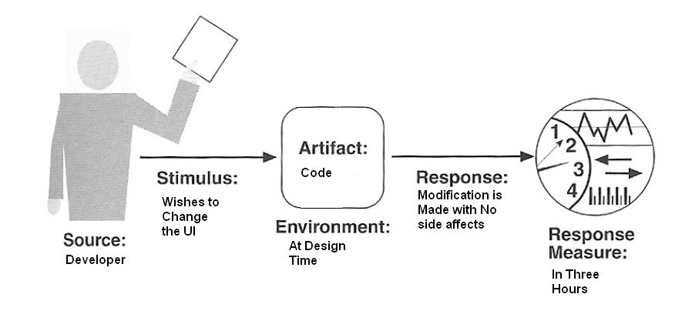
Modifiability scenario
Software Architecture
QUALITY

Slide 26
Modifiability scenario contd..
A collection of concrete scenarios can be used as the quality attribute req. of the system
When eliciting req., we typically organize our discussion of general scenarios by quality attributes; if the same scenario is generated by 2 different attributes, one can be eliminated
For each attribute we present a table that gives possible system-independent values for each of the 6 parts.
A general scenario is generated by selecting one value for each element; a concrete scenario is generated by choosing one or more entries from each column of the table & then making the result readable
Software Architecture
QUALITY

Slide 27
Quality attribute scenarios in practice
General scenarios provide framework for generating a large no. of generic, system-independent, quality-attribute-specific scenarios
To make general scenarios useful for a particular system, they must be made system specific, which means translating them into concrete terms
For ex:
  A general scenario is “ A request arrives for a change in functionality & the change must be made at a particular time within the development process within a specified period”
  A system specific version may be “A request arrives to add support for a new browser to a web-based system, & change must be made within 2 weeks
Software Architecture
QUALITY

Slide 28
Modifiability
Modifiability is about the cost of change. It brings up 2 concerns:
  What can change (the artifact)? A change can occur to any aspect of a system, most commonly the function that the system , computes, the platform the system exists on, the environment etc. some portions of the system, such as the user interface or platform, are sufficiently distinguished and are subjected to change that we consider them separately the category of platform changes is also called portability.
Software Architecture
QUALITY

Slide 29
Modifiability contd.
  When is the change made & who makes it (the environment)? Most commonly in the past, a change was made to source code. Now, the question of when a change is made is intertwined with the question of who makes it.
  Changes can be made to the implementation during compile, during build, during configuration setup or during execution. Change can also be made by a developer, an end user, or system administrator.
Once a change has been specified, the new
implementation must be designed, implemented, tested, &
deployed. All of these actions take time & money, both of
which can be measured
Software Architecture
QUALITY

Slide 30
Modifiability general scenarios
“ A developer wishes to change the user interface. This change will be made to the code at design time, it will take less than 3 hrs to make & test the change, and no-side-effect changes will occur in the behavior”
  Source of stimulus-this portion specifies who makes changes. In our example, the modification is to be made by the developer
  Stimulus-this portion specifies the changes to be made. A change can be the addition of a function, the modification of an existing function, or deleting a function. In our example, the stimulus is a request to make a modification, which can be to the function, quality, or capacity.
  Artifact-this portion specifies what is to be changed. In our example, the modification is to the user interface
Software Architecture
QUALITY

Slide 31
Modifiability general scenarios contd..
  Environment-this portion specifies when the change can be made: design time, compile time, build time, initiation time or runtime. In our example, the modification is to occur at design time
  Response-whoever makes the change must understand how to make it, and then make it, test it & deploy it
  Response measure-time and cost are the most desirable measures. Time is not always possible to predict, however, and so less measures are frequently used such as extent of the change. In our example, the time to perform the modification should be less than 3 hours.
Software Architecture
QUALITY

Slide 32
Modifiability general scenario generation
Source | End user, developer, system administrator
Stimulus | Wishes to add/delete/modify/vary functionality, quality attribute, capacity
Artifact | System user interface, platform, environment; system that interoperates with target system
Environment | At runtime, compile time, build time, design time
Response | Locates places in architecture to be modified; makes modification without affecting other functionality; tests modification; deploys modification
Response measure | Cost in terms of number of elements affected, effort, money; extent to which this affects other functions or quality attributes
Software Architecture
QUALITY

Slide 33
Performance
Performance is about timing. Events occur, and the system must respond to them.
Basically, performance is concerned with how long it takes the system to respond when an event occurs
One thing that makes performance complicated is the number of event sources & arrival patterns
Events can arrive from user requests, from other systems, or from within the system
For example:
  A web-based financial service system gets events from its users. For this system, the response might be the number of transactions that can be processed in a minute
Software Architecture
QUALITY

Slide 34
Performance contd..
A performance scenario begins with a request for some service arriving at the system. Satisfying the request requires resources to be consumed
An arrival pattern for events may be characterized as either periodic or stochastic
Periodic event arrival is most often seen in real-time systems
Stochastic arrival means that events arrive according to some probabilistic distribution
Events may also arrive sporadically, i.e., according to a pattern not captured by either periodic or stochastic characterizations
The response of the system to a stimulus can be characterized by latency, deadlines in processing, throughput of the system, the jitter of the response, etc.
Software Architecture
QUALITY

Slide 35
Performance general scenarios
“ Users initiate 1000 transactions per minute stochastically under normal operations, & these transactions are processed with an average latency of 2 seconds”
  Source of stimulus-the stimuli arrive either from external or internal sources. In our example, the source of stimulus is a collection of users.
  Stimulus-the stimuli are the event arrivals. In our example, the stimulus is the stochastic initiation of 1000 transactions per minute
  Artifact-the artifact is always the system’s services, as it is in our example.
Software Architecture
QUALITY

Slide 36
Performance general scenarios contd..
  Environment-the system can be in various operational modes, such as normal, emergency, or overload. In our example, the system is in normal mode
  Response-the system must process the arriving events. In our example, the transactions are processed.
  Response measure-the response measures are the time it takes to process the arriving events, the jitter, the throughput, or a characterization of the events that cannot be processed. in our example, the transactions should be processed with an average latency of 2 seconds.
Software Architecture
QUALITY

Slide 37
Performance general scenario generation
Source | One of a no. of independent sources, possibly from within the system
Stimulus | Periodic events arrive; sporadic events arrive; stochastic events arrive
Artifact | System
Environment | Normal mode; overload mode
Response | Processes stimuli; changes level of service
Response measure | Latency, deadline, throughput, jitter, miss rate, data loss
Software Architecture
QUALITY

Slide 38
Security
Security is a measure of the system’s ability to resist unauthorized usage while still providing its services to legitimate users
An attempt to breach security is called an attack
Attack may be an unauthorized attempt to access data or services, or to modify data, or it may be intended to deny services to legitimate users
Security can be characterized as a system providing nonrepudiation, confidentiality, integrity, assurance, availability & auditing.
Software Architecture
QUALITY

Slide 39
Security contd..
Nonrepudiation-its the property that a transaction cannot be denied by any of the parties to it
Confidentiality-it’s the property that the data or services are protected from unauthorized access
Integrity-it’s the property that the data or services are being delivered as intended
Assurance-it’s the property that the parties to a transaction are who they purport to be
Availability-it’s the property that the system will be available for legitimate use
Auditing-it’s the property that the system tracks activities within it at levels sufficient to reconstruct them
Software Architecture
QUALITY

Slide 40
Security general scenarios
“ A correctly identified individual tries to modify system data from an external site; system maintains an audit trail & the correct data is restored within one day”
  Source of stimulus-the source of the attack may be either a human or another system. In our example, source is a correctly identified individual
  Stimulus-the stimulus is an attack or an attempt to break the security. In our example, the stimulus is an attempt to modify data
  Artifact-the target of the attack can be either the services of the system or the data within it. In our example, the target is data within the system
Software Architecture
QUALITY

Slide 41
Security general scenarios contd..
  Environment-the attack can come when the system is either online or offline, either connected to or disconnected from a n/w, either behind a firewall or open to the network
  Response-system must authorize legitimate users & reject unauthorized users. In our example, an audit trail is maintained
  Response measure-measures of a system’s response include the difficulty of mounting various attacks & the difficulty of recovering from & surviving attacks. In our example, the audit trail helps restore the correct data within a day
Software Architecture
QUALITY

Slide 42
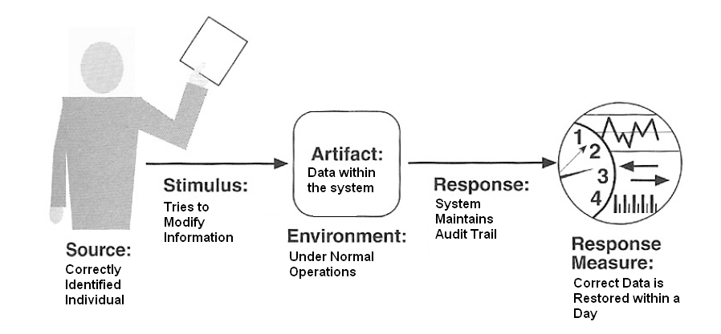
Security general scenarios contd..
Software Architecture
QUALITY

Slide 43
Testability
Software testability refers to the ease with which software can be made to demonstrate its faults thro’ testing
Testability refers to the probability, assuming that the software has at least one fault, that it will fail on its next test execution
For a system to be properly testable, it must be possible to control each component’s internal state & input and then to observe its outputs.
This is done thro’ use of test harness
Testing is done by various developers, testers or users & is the last step of various parts of the software life cycle
Software Architecture
QUALITY

Slide 44
Testability general scenarios
“ A unit tester performs a unit test on a completed system component tat provides an interface for controlling its behavior & observing its output; 85% path coverage is done within 3 hrs”
  Source of stimulus-testing is performed by unit testers, integration testers, system testers or the client. In our example, the testing is performed by a tester
  Stimulus-the stimulus for the testing is that a milestone in the development process is met
  Artifact-a design, piece of code, or the whole system is the artifact being tested. In our example, a unit code is being tested
Software Architecture
QUALITY

Slide 45
Testability general scenarios contd..
  Environment-the test can happen at design time, development time, or at deployment time. In our example, test occurs during development
  Response-desired response is that the system can be controlled to perform the desired tests & the response to each test can be observed. In our example, the unit can be controlled & its responses captured
  Response measure-its the % of statements that have been executed in some test, length of the longest test chain etc,. In our example, measurement is the % coverage of executable statements
Software Architecture
QUALITY

Slide 46
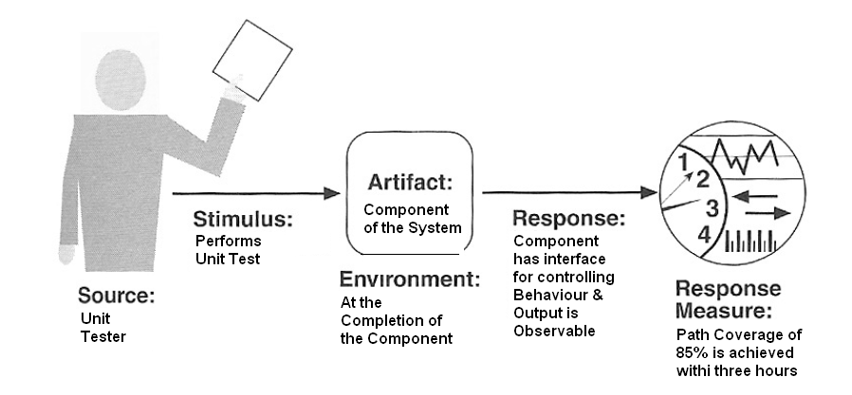
Testability general scenarios contd..
Software Architecture
QUALITY

Slide 47
Usability
Usability is concerned with how easy it is for the user to accomplish a desired task & the kind of user support the system provides
It can be broken down as:
  Learning system features
  Using a system efficiently
  Minimizing the impact of errors
  Adapting the system to user needs
  Increasing confidence & satisfaction
Software Architecture
QUALITY

Slide 48
Usability general scenarios
“ A user, wanting to minimize the impact of an error, wishes to control a system operation at runtime; cancellation takes place in less than 1 sec.”
  Source of stimulus-the end user is always the source of stimulus
  Stimulus-the stimulus is that the end user wishes to use a system efficiently, learn to use the system, minimize impact of errors etc,. In our example, user wishes to cancel an operation
  Artifact-the artifact is always the system
  Environment-the user actions with which usability is concerned always occur at runtime or at system configuration time.
  In our example, the cancellation occurs at runtime
Software Architecture
QUALITY

Slide 49
Usability general scenarios contd..
  Response-the system should either provide the user with features needed or anticipate the user’s needs. In our example, the cancellation occurs as the user wishes & the system is restored to its prior state
  Response measure-it is measured by task time, number of errors, no. of problems solves, user satisfaction etc,. In our example, the cancellation should occur in less than 1 second
Software Architecture
QUALITY

Slide 50
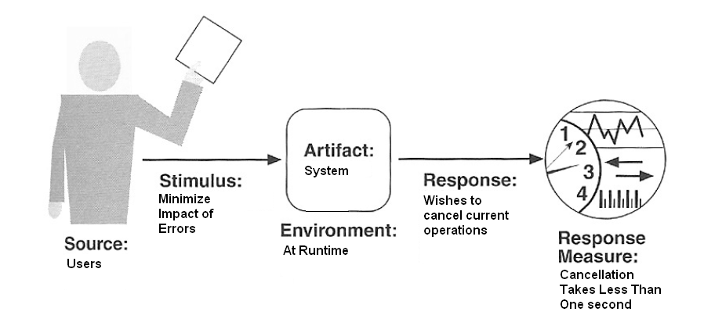
Usability general scenarios contd..
Software Architecture
QUALITY

Slide 51
Communicating Concepts Using General Scenarios
Quality Attribute | Stimulus
Availability | Unexpected event, nonoccurrence of expected event
Modifiability | Request to add/delete/change/vary functionality, platform, quality attribute, or capacity
Performance | Periodic, stochastic, or sporadic
Security | Tries to display, modify, change/delete information, access, or reduce availability to system services
Testability | Completion of phase of system development
Usability | Wants to learn system features, use a system efficiently, minimize the impact of errors, adapt the system, feel comfortable
Software Architecture
QUALITY

Slide 52
Business Qualities
Time to Market :
Cost & Benefit
Projected lifetime of the system
Targeted Market
Rollout schedule
Integration with legacy systems
Software Architecture
QUALITY

Slide 53
Architecture Qualities
Conceptual Integrity : is the underlying theme or vision that unifies the design of the system at all levels.
Correctness & Completeness : are essential for the architecture to allow for all of the system’s requirements and runtime resource constraints to be met.
Buildability : allows the system to be completed by the available team in a timely manner and to be open to certain changes as development progresses.
Software Architecture
QUALITY

Slide 54
UNIT -2
Achieving Qualities
Software Architecture
QUALITY

Slide 55
Introducing Tactics
A tactic is a design decision that influences a quality attribute
We call a collection of tactics an architectural strategy
Tactics can refine other tactics
Stimulus
Tactics to control Response
Response
Software Architecture
QUALITY

Slide 56
Availability Tactics
Fault Detection
  Ping/echo
  Heartbeat
  Exceptions
Fault Recovery
  Voting – space shuttle
  Active redundancy (hot restart)
  Passive redundancy (warm restart)
  Spare
  Shadow operation
  State synchronization
  Checkpoint/rollback
Fault Prevention
  Removal from service
  Transactions
  Process monitor

Slide 57
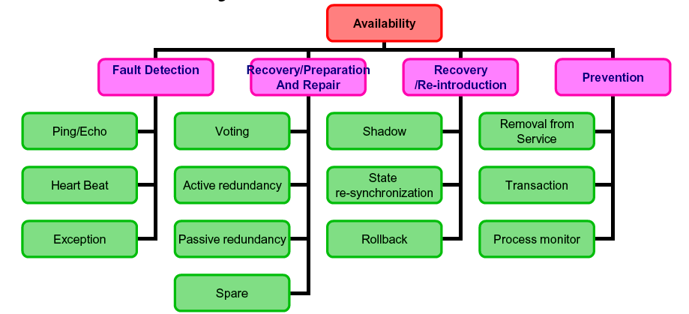
Availability Tactics
Tactics to control availability
Fault
Fault masked or repair mode
Software Architecture
QUALITY

Slide 58
Fault detection
Ping/Echo
  Components issue a ping & experts echo in a predefined time
  Used by client to ensure that the server object & communication path are within the expected performance bounds
  Follows hierarchy
  Eg: Ping command in DOS
Heart beat (dead man timer)
  One component emits a heartbeat message periodically & another component listens for it. If there’s no heartbeat, its assumed that the component failed
  Heart beat can carry data
  Eg: ATM sending the last transaction to the server
Software Architecture
QUALITY

Slide 59
Fault detection contd.
Exceptions
  One method to recognize the fault is to encounter an exception, which is raised when one of the fault classes is recognized
  Typically executed in the same process that can introduce the exception
  Eg: Try & catch
Ping/Echo & Heart beat can work on distinct processes
Software Architecture
QUALITY

Slide 60
Fault Recovery
Voting
  Detects deviant behavior from a single process
  Only process faults are detected not algorithm fault
  Extreme version-redundant component developed by different teams
  Simple version-preferred component & trusted component
  Diversity has no downtime as voting continues
  Used only in Mission critical applications
  Diversity is expensive to develop & maintain
  Eg: control of services of aircraft
Software Architecture
QUALITY

Slide 61
Fault Recovery contd.
Active redundancy ( hot restart)
  All redundant components respond to events in parallel & the first response is taken into account
  Down time is usually in milliseconds, so used in areas where response time must be quick
  Synchronization process ensures that all redundant components are in sync
  All message from all components are sent to all the components continuously till acknowledgement is received
  Eg: distributed database management system
Software Architecture
QUALITY

Slide 62
Fault Recovery contd….
Passive redundancy (warm restart/dual/triple redundancy)
  If the primary component does not respond then standby components take control
  In terms of failure, component should ensure that backup sufficiently fresh
  Primary system is responsible for sharing the data & backup system is responsible for synchronization
  Some systems force switching between them on daily, weekly basis
  Down time is limited to seconds
  Eg: communication channels
Software Architecture
QUALITY

Slide 63
Fault Recovery contd………
Spare
  A standby platform is configured & made available
  The system should be re-booted & then configured to the required state
  Logging all the state changes to a persistence devise helps to bring the backup system in the same state
  Takes minutes to resume
  Ex: standby client work station
Software Architecture
QUALITY

Slide 64
Recovery re-introduction
Tactics for repair relying on component re-introduction
Shadow operation
  Re-run the previous operation in controlled & monitored environment
State re-synchronization (active/passive redundancy)
  Upgrade depends on sustainable down time, size of update & no. of messages req. for upgrade
  Single message upgrade preferable
  Incremental upgrades
Checkpoint/rollback
  Records consistent state
  When fails in an unusual manner, the system rolls back to the last consistent state
Software Architecture
QUALITY

Slide 65
Fault Prevention
Removal from service
  Remove the component from operation to undergo some activities
  If this removal is automatic, architecture should support it
  If its manual, the system should support it
  Ex: rebooting a component to prevent memory leaks
Transactions
  Bundle of several sequential steps so that undone can be done at once
  Prevents data loss even if a step of the process fails
  Prevents collisions among several simultaneous threads
Software Architecture
QUALITY

Slide 66
Fault Prevention contd.
Process monitor
  Once fault in a process is detected, a monitoring process can delete the nonperforming process & create a new instance of it, initialize to some appropriate state as in the spare tactics
Software Architecture
QUALITY

Slide 67
Modifiability tactics
We organize the tactics for modifiability in sets according to their goals,
One set has, as its goal, reducing the number of modules that are directly affected by a change. We call this set “localize modifications”.
A second set has as its goal, limiting modifications to the localized modules. We use this set of tactics to “prevent the ripple effect”
A third set of tactics has as its goal, controlling deployment time & cost. We call this set “defer binding time”
Tactics to control modifiability
Change arrives
Change made, tested, & deployed within time & budget
Software Architecture
QUALITY

Slide 68
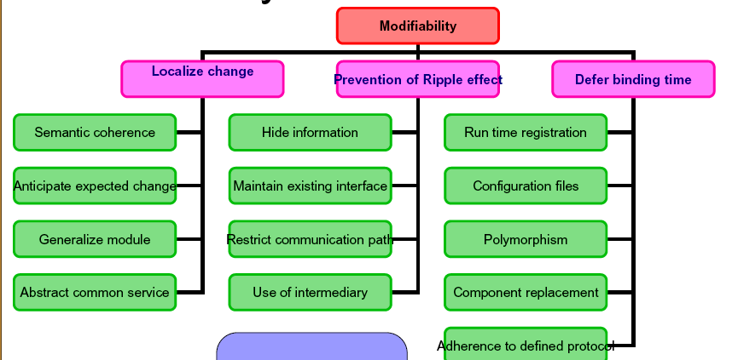
Modifiability tactics
Software Architecture
QUALITY

Slide 69
Localize modifications
Goal is to reduce the number of modules that gets affected directly
Maintain semantic coherence
  Works with the relationship & responsibilities of modules
  Ensure all the modules work with less reliance on other modules
  Abstract common service
  Ex: middleware software, services
Software Architecture
QUALITY

Slide 70
Localize modifications contd.
Anticipate expected change
  Considering the set of envisioned changes
  Goes in conjunction with semantic coherence
  Hard to follow in real life as all changes cannot be envisioned
Generalize the module
  Allows computing broader range of functions using inputs
  So changes are made to input not to the module
Limit possible options
  Limit modification within the product line
  Restrict modification from a variation point (like version)
Software Architecture
QUALITY

Slide 71
Prevent ripple effects
If module A is changed to accomplish particular modification then module B is changed only coz of change in module A. B has to be modified coz it depends, in some sense, on A
8 types:
  Syntax of-
      Data: for B to compile correctly, the type of the data that is produced by A & consumed by B must be consistent wit the type of data assumed by B
      Service: for B to compile & execute correctly, the signature of services provided by A & invoked by B must be consistent with the assumption of B
Software Architecture
QUALITY

Slide 72
Prevent ripple effects contd..
  2) Semantic of-
      Data: for B to execute correctly, the semantics of the data produced by A & consumed by B must be consistent with the assumptions of B
      Service: for B to execute correctly, the semantics of the service produced by A & used by B must be consistent with the assumptions of B
  3) Sequence of-
      Data: for B to execute correctly, it must receive data produced by A in a fixed sequence ex: a data packet’s header must precede its body
      Control: for B to execute correctly, A must have executed previously within certain timing constraints ex: A must have executed no longer than 5ms before B executes
Software Architecture
QUALITY

Slide 73
Prevent ripple effects contd..
  4) Identity of an interface of A: A may have multiple interfaces. For B to compile & execute correctly, the identity of the interface must be consistent with the assumptions of B
  5) Location of A (runtime): for B to execute correctly, the runtime location of A must be consistent with the assumptions of B
  6) Quality of service/data provided by A: for B to execute correctly, some property involving the quality of the data or service provided by A must be consistent with the assumption of B. ex: data provided by a particular sensor must have a certain accuracy in order for the algo. of B to work correctly
Software Architecture
QUALITY

Slide 74
Prevent ripple effects contd..
  7) Existence of A: for B to execute correctly, A must exist
  8) Resource behavior of A: for B to execute correctly, the resource behavior of A must be consistent with B’s assumptions
Software Architecture
QUALITY

Slide 75
Prevent ripple effects-Tactics
Hide information
  Decompose responsibilities for an entity & decide which one should be private & which one should go public
  The goal is to isolate change
  It depends strongly on “anticipate expected changes
Maintain existing interface
  Adding interfaces
    Allow existing interface to be unchanged & create a new interface
  Adding adapter
    Add an adapter that wraps A & provides the signature of the original A
  Providing stubs
    If A has to be deleted provide a stub with A so that deletion does not affect B
Software Architecture
QUALITY

Slide 76
Prevent ripple effects-Tactics contd.
Restrict communication path
  Reduce the no. of modules that consumes data produced by component & vice versa
  Data production & consumption causes ripple effect
Use an intermediary
  Intermediary cannot handle semantic changes
  Intermediaries are:
    Data (syntax): use repositories that convert the syntax produced by A into that assumed by B
    Service: bridge, mediator etc. provides intermediaries that convert the syntax of a service from one form to another. They are used to prevent changes in A from propagating to B
Software Architecture
QUALITY

Slide 77
Prevent ripple effects-Tactics contd.
    Identity of an interface of A: introduce broker who has identity of A which communicates b/w A & B without changing the identity of A
    Location of A (runtime): the location of A can be changed with out affecting B by registering A in a named server & B accessing the same using named server
    Resource behavior of A: having a resource manager to be responsible for the resource behavior
    Existence of A: the factory pattern has the ability to create instance as needed, thus the dependence of B on the existence of A is satisfied by actions of the factory
Software Architecture
QUALITY

Slide 78
Defer binding time
Runtime registration support: support Plug & Play at the run time
Configuration files: are intended to set parameters at startup
Polymorphism: allows late binding of the method calls
Component replacement: allows load time binding
Adherence to defined protocols: allows runtime binding of independent processes
Software Architecture
QUALITY

Slide 79
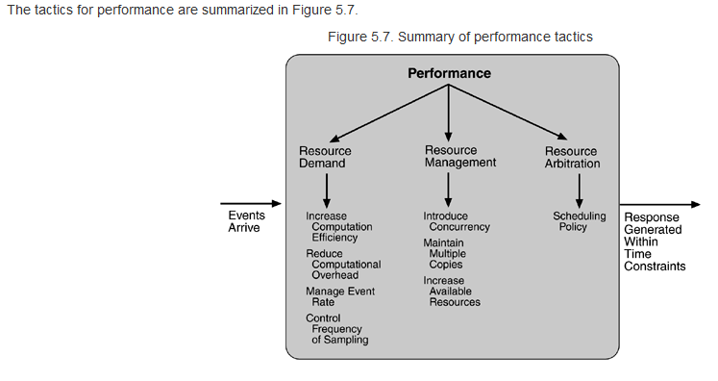
Performance Tactics
Software Architecture
QUALITY

Slide 80
Performance Tactics
The goal is to generate a response to an arriving event within some time constraint.
  Event: single or stream; message, expiration of a time interval, detection of a state change, etc.
Performance tactics control the time within which a response is generated.
Latency is the time between the arrival of an event & the generation of a response.

Slide 81
Response Time
Two basic contributors:
  resource consumption
    CPU, data stores, network communication bandwidth, memory, buffers, etc.
  blocked time
    contention for resources
    availability of resources
    dependency on other computation

Slide 82
Resource Demand
Event streams are the source of resource demand.
Two characteristics:
  time between events in a stream
  how much of a resource is consumed by each request
Tactic: reduce resources required to process an event stream
  increase computational efficiency
  reduce computational overhead

Slide 83
Resource Demand, con’t
Tactic: reduce the number of events processed
  manage event rate
  control frequency of sampling
Tactic: control use of resources
  bound execution times
  bound queue lengths

Slide 84
Resource Management
If the demand for resources isn’t controllable, they might be managed by these tactics:
  introduce concurrency
  maintain multiple copies of either data or computations
  increase available resources

Slide 85
Resource Arbitration
When there is contention for a resource, the resource must be scheduled:
  processors, buffers, networks are all scheduled
A scheduling policy has two parts:
  a priority assignment
  dispatching

Slide 86
Common Scheduling Policies
First-in/First-out all requests are equal
Fixed-priority scheduling are prioritized based on:
  semantic importance - statically assigned based on domain characteristics (mainframes)
  deadline monotonic - statically assigned with higher priority to streams with shorter deadlines (real-time)
  rate monotonic - statically assigned with higher priority to streams with shorter periods (real-time)

Slide 87
Scheduling Policies, con’t
Dynamic priority scheduling
  round robin
  earliest deadline first
Static scheduling - cyclic executive schedule with pre-emption points & sequence determined offline

