Slide 1
Android - SQLite Database
SQLite is a opensource SQL database that stores data to a text file on a device. Android comes in with built in SQLite database implementation.
SQLite supports all the relational database features.
The main package is android.database.sqlite that contains the classes to manage your own databases.
For managing all the operations related to the database , an helper class has been given and is called SQLiteOpenHelper. It automatically manages the creation and update of the database.

Slide 2
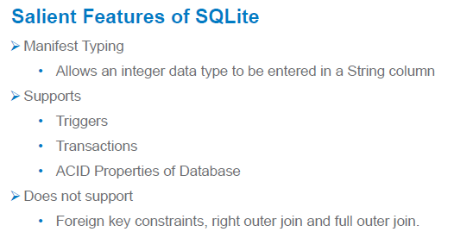

Slide 3
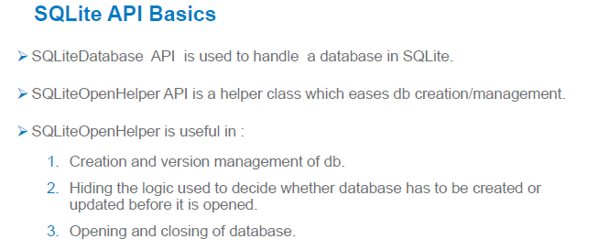

Slide 4
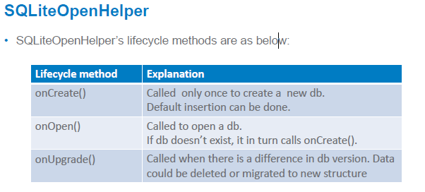

Slide 5
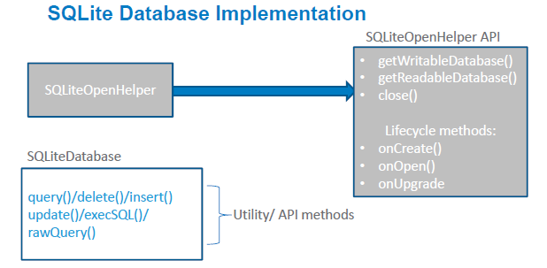

Slide 6
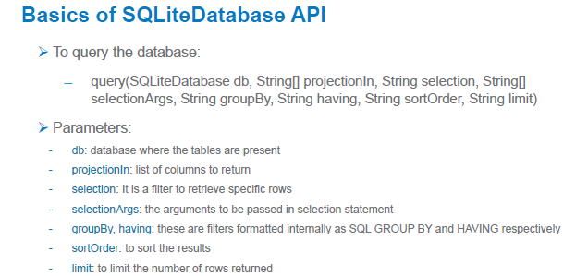

Slide 7
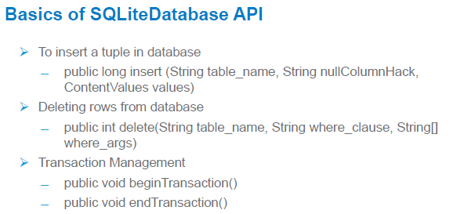

Slide 8
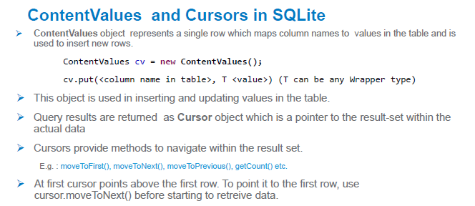

Slide 9
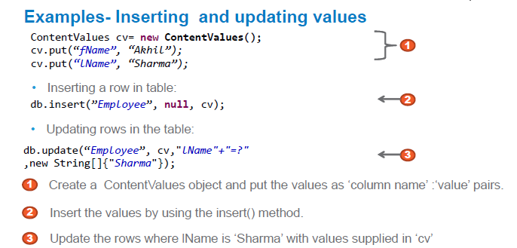

Slide 10
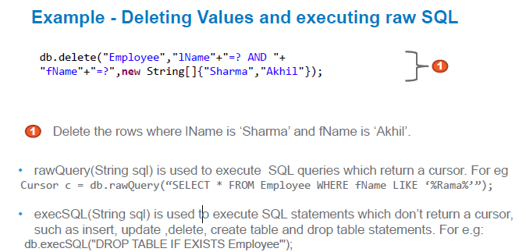

Slide 11
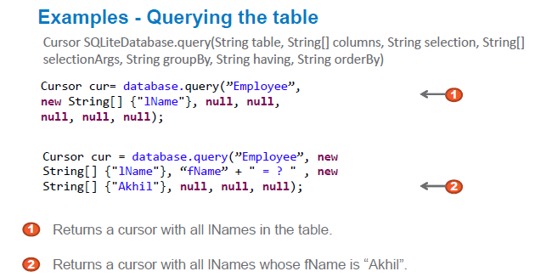

Slide 12
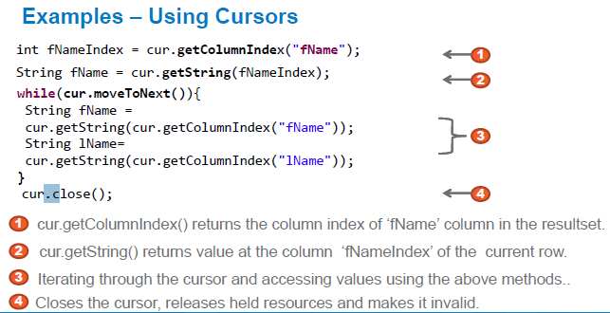

Slide 13
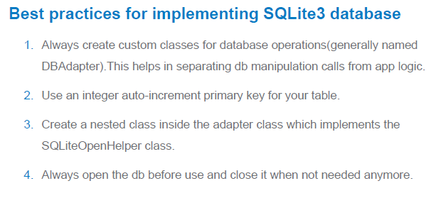
Thanks To:
Slides By Infosys , “5-day workshop on application development on Android OS” , @NMAMIT,Nitte

