Slide 1

Enterprise Resource Planning Systems
ERP
Notes:
1

Slide 2
Problems with Non-ERP Systems
In-house design limits connectivity outside the company
Tendency toward separate IS’s within firm
  lack of integration limits communication within the company
Strategic decision-making not supported
Long-term maintenance costs high
Limits ability to engage in process reengineering

Slide 3
Traditional IS Model:
Closed Database Architecture
Similar in concept to flat-file approach
  data remains the property of the application
  fragmentation limits communications
Existence of numerous distinct and independent databases
  redundancy and anomaly problems
Paper-based
  requires multiple entry of data
  status of information unknown at key points

Slide 4
Business Enterprise
Products
Materials
Order Entry
System
Manufacturing
and
Distribution
System
Procurement
System
Customer
Supplier
Orders
Purchases
Customer
Sales
Account Rec
Production
Scheduling
Shipping
Vendor
Accts Pay
Inventory
Customer Database
Manufacturing Database
Procurement Database
Traditional Information System with Closed Database Architecture

Slide 5
What is ERP?
Those activities supported by multi-module application software that help a company manage the important parts of its business in an integrated fashion.
Key features include:
  Smooth and seamless flow of information across organizational boundaries
  Standardized environment with shared database independent of applications and integrated applications

Slide 6
ERP System
Business Enterprise
Data Warehouse
Legacy
Systems
ERP System
On-Line Analytical Processing
(OLAP)
Bolt-On Applications
(Industry Specific Functions)
Customers
Suppliers
Core Functions [On-Line Transaction Processing (OLTP)]
Sales
&
Distribution
Business
Planning
Shop Floor
Control
Logistics
Operational Database
Customers, Production,
Vendor, Inventory, etc.

Slide 7
Two Main ERP Applications
Core applications
a.k.a. Online Transaction Processing (OLTP)
transaction processing systems
support the day-to-day operational activities of the business
support mission-critical tasks through simple queries of operational databases
include Sales and Distribution, Business Planning, Production Planning, Shop Floor Control, and Logistics modules

Slide 8
Two Main ERP Applications
Business analysis applications
a.k.a. Online Analytical Processing (OLAP)
decision support tool for management-critical tasks through analytical investigation of complex data associations
supplies management with “real-time” information and permits timely decisions to improve performance and achieve competitive advantage
includes decision support, modeling, information retrieval, ad-hoc reporting/analysis, and what-if analysis

Slide 9
OLAP
Supports management-critical tasks through analytical investigation of complex data associations captured in data warehouses:
  Consolidation is the aggregation or roll-up of data.
  Drill-down allows the user to see data in selective increasing levels of detail.
  Slicing and Dicing enables the user to examine data from different viewpoints often performed along a time axis to depict trends and patterns.

Slide 10
ERP System Configurations:
Client-Server Network Topology
Two-tier
  common server handles both application and database duties
  used especially in LANs

Slide 11
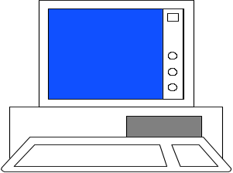

First Tier
User Presentation Layer
Application and Database Layer
Server
Second Tier
Server
Applications
Database
Two-Tier Client Server

Slide 12
ERP System Configurations:
Client-Server Network Topology
Three-tier
  client links to the application server which then initiates a second connection to the database server
  used especially in WANs

Slide 13
User Presentation Layer
First Tier
Applications
Second Tier
Application
Server
Application Layer
Database
Database
Server
Database Layer
Third Tier
Three-Tier Client Server

Slide 14
User Presentation Layer
First Tier
OLTP
Applications
OLTP
Server
OLAP
Server
OLAP
Applications
Second Tier
Application Layer
Operations
Database
Operations
Database
Server
Data
Warehouse
Third Tier
Data
Warehouse
Server
Database Layer
ERP with OLTP and OLAP Client Server using Data Warehouse

Slide 15
ERP System Configurations:
Databases and Bolt-Ons
Database Configuration
  selection of database tables in the thousands
  setting the switches in the system
Bolt-on Software
  third-party vendors provide specialized functionality software
  Supply-Chain Management (SCM) links vendors, carriers, third-party logistics companies, and information systems providers

Slide 16
What is a Data Warehouse?
A relational or multi-dimensional database that may consume hundreds of gigabytes or even terabytes of disk storage
  The data is normally extracted periodically from operational database or from a public information service.
A database constructed for quick searching, retrieval, ad-hoc queries, and ease of use
An ERP system could exist without having a data warehouse. The trend, however, is that organizations that are serious about competitive advantage deploy both. The recommended data architecture for an ERP implementation includes separate operational and data warehouse databases

Slide 17
Data Warehouse Process
The five essential stages of the data warehousing process are:
    Modeling data for the data warehouse
    Extracting data from operational databases
    Cleansing extracted data
    Transforming data into the warehouse model
    Loading the data into the data warehouse database

Slide 18
Data Warehouse Process:
Stage 1
Modeling data for the data warehouse
  Because of the vast size of a data warehouse, the warehouse database consists of de-normalized data.
    Relational theory does not apply to a data warehousing system.
    Wherever possible normalized tables pertaining to selected events may be consolidated into de-normalized tables.

Slide 19
Data Warehouse Process:
Stage 2
Extracting data from operational databases
  The process of collecting data from operational databases, flat-files, archives, and external data sources.
  Snapshots vs. Stabilized Data:
    a key feature of a data warehouse is that the data contained in it are in a non-volatile (stable) state.

Slide 20
Data Warehouse Process:
Stage 3
Cleansing extracted data
  Involves filtering out or repairing invalid data prior to being stored in the warehouse
    Operational data are “dirty” for many reasons: clerical, data entry, computer program errors, misspelled names, and blank fields.
  Also involves transforming data into standard business terms with standard data values

Slide 21
Data Warehouse Process:
Stage 4
Transforming data into the warehouse model
  To improve efficiency, data is transformed into summary views before they are loaded.
  Unlike operational views, which are virtual in nature with underlying base tables, data warehouse views are physical tables.
    OLAP, however, permits the user to construct virtual views from detail data when one does not already exist.

Slide 22
Data Warehouse Process:
Stage 5
Loading the data into the data warehouse database
  Data warehouses must be created and maintained separately from the operational databases.
    Internal Efficiency
    Integration of Legacy Systems
    Consolidation of Global Data

Slide 23
Data Warehouse System
Legacy Systems
Order
Entry
System
VSAM Files
Hierarchical DB
Network DB
Purchases
System
The Data Warehouse
Previous
Years
ERP
System
Previous Quarters
Sales Data Summarized Annually
Previous Weeks
Sales Data Summarized Quarterly
Data Cleansing
Process
Operations
Database
Archived over Time
Current (this weeks) Detailed Sales Data

Slide 24
Risks Associated with ERP Implementation
Pace of Implementation
  Big Bang--switch operations from legacy systems to ERP in a single event
  Phased-In--independent ERP units installed over time, assimilated and integrated
Opposition to Changes to the Businesses Culture
  User reluctance and inertia
  Need of (upper) management support

Slide 25
Risks Associated with ERP Implementation
Choosing the Wrong ERP
  Goodness of Fit: no ERP system is best for all industries
  Scalability: system’s ability to grow
Choosing the Wrong Consultant
  Common to use a third-party (the Big Five)
  Be thorough in interviewing potential consultants
  Establish explicit expectations

Slide 26
Risks Associated with ERP Implementation
High Cost and Cost Overruns
  Common areas with high costs:
    Training
    Testing and Integration
    Database Conversion
Disruptions to Operations
  ERP is reengineering--expect major changes in how business is done

Slide 27
Implications for Internal Control and Auditing
Transaction Authorization
  Controls are needed to validate transactions before they are accepted by other modules.
  ERPs are more dependent on programmed controls than on human intervention.
Segregation of Duties
  Manual processes that normally require segregation of duties are often eliminated.
  User role: predefined user roles limit a user’s access to certain functions and data.

Slide 28
Implications for Internal Control and Auditing
Supervision
  Supervisors need to acquire a technical and operational understanding of the new system.
  Employee-empowered philosophy should not eliminate supervision.
Accounting Records
  Corrupted data may be passed from external sources and from legacy systems.
  Loss of paper audit trail

Slide 29
Implications for Internal Control and Auditing
Access Controls
  Critical concern with confidentiality of information
  Who should have access to what?
Access to Data Warehouse
  Data warehouses often involve sharing information with suppliers and customers.

Slide 30
Implications for Internal Control and Auditing
Contingency Planning
  How to keep business going in case of disaster
  Key role of servers requires backup plans: redundant servers or shared servers
Independent Verification
  Traditional verifications are meaningless
  Need to shift from transaction level to overall performance level

Slide 31
Implications for Internal Control and Auditing
ERP projects may be concurrent with BPR, CRM, Data Warehousing, SCM
All of these increase risk of successful implementation
ERP systems impact organizational structure and internal controls
New control policies must precede migration to an ERP system

Slide 32
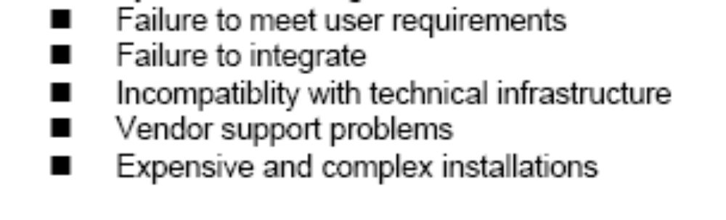
Implications for Internal Control and Auditing
Gartner Group noted following concerns regarding implementing ERP:

Slide 33
Audits of ERPs
Audit could provide assurance covering the areas of …
process integrity
application security
infrastructure integrity
implementation integrity

Slide 34
ERP Products
SAP: largest ERP vendor
  modules can be integrated or used alone
  new features include SCM, B2B, e-commerce, XML
J.D. Edwards
  flexibility: users can change features; less of a pre-set structure than SAP’s
  modularity: accept modules (bolt-ons) from other vendors

Slide 35
ERP Products
Oracle
  tailored to e-business focus
  Internet based vs. client-server based applications
PeopleSoft
  open, modular architecture allows rapid integration with existing systems
Baan
  use of “best-of-class” applications

Slide 36
this concludes the ERP slide presentation

