Slide 1
Keyword Search on External Memory Data Graphs
Bhavana Dalvi* Meghana Kshirsagar#
S. Sudarshan
Indian Institute of Technology, Bombay
*: Current affiliation: Google Inc.
#: Current affiliation: Yahoo Labs.

Slide 2
Keyword Search on Graph Data
Motivation: querying of data from (possibly) multiple data sources
  E.g. Organizational, government, scientific, medical
  Often no schema or partially defined schema
Graph data model
  Lowest common denominator model, across relational, HTML, XML, RDF, …
  Much recent work on extracting and integrating data into a graph model
Keyword search is a natural way to query such data graphs, esp. in the absence of schema
  This is the focus of this paper

Slide 3
Keyword Search on
Graph-Structured Data
BANKS: Keyword search…
Focused Crawling …
paper
writes
Sudarshan
Soumen C.
Byron Dom
author
E.g. query: “soumen byron”
Key differences from IR/Web Search:
  Normalization (implicit/explicit) splits related data across multiple nodes
  To answer a keyword query we need to find a (closely) connected set of entities that together match all given keywords

Slide 4
Query/Answer Models on Graph Data
paper
Query : set of keywords
Answer: rooted directed tree connecting keyword nodes (e.g. BANKS)
Answer relevance based on
  node prestige
  1/(tree edge weight)
Several closely related ranking models
Focused Crawling
writes
writes
author
author
Soumen C.
Byron Dom
query: “soumen byron”

Slide 5
Keyword Search on Graphs
Goal: efficiently find top k answers to keyword query
Several algorithms proposed earlier
  Backward expanding search
  Bidirectional search
  DPBF, BLINKS, Spark, …
All above algorithms assume graph fits in memory

Slide 6
External Memory Graph Search
Problem: what if graph size > memory?
Motivation: Web crawl graphs, social networks, Wikipedia, data generated by IE from Web
Algorithm Alternatives:
  Alternative 1: Virtual Memory
    −ve: thrashing (experimental results later)
  Alternative 2: SQL
    −ve: For relational data only
    −ve: not good for top-K answer generation
  Our proposal: use in-memory graph summary
    to focus search on relevant parts of the graph
    avoid IO for rest of graph

Slide 7
Related Work
Keyword querying on graphs using precomputed info
  Idea: Avoid search at query time, use only inverted list merge
  Drawbacks include high space overhead (ObjectRank, EKSO)
External memory graph traversal
  Several algorithms (Nodine, Buchsbaum, etc) that give worst case guarantees, but require excessive replication
Shortest path computation in external memory graphs
  Several algorithms (Shekhar, Chang etc)
  But all depend on properties specific to road networks (large diameter, near planarity etc)
Hierarchical clustering
  For visualization (Lieserson, Buchsbaum etc.)
  For web graph computations (Raghavan and Garcia-M.)
    2-level graph clustering

Slide 8
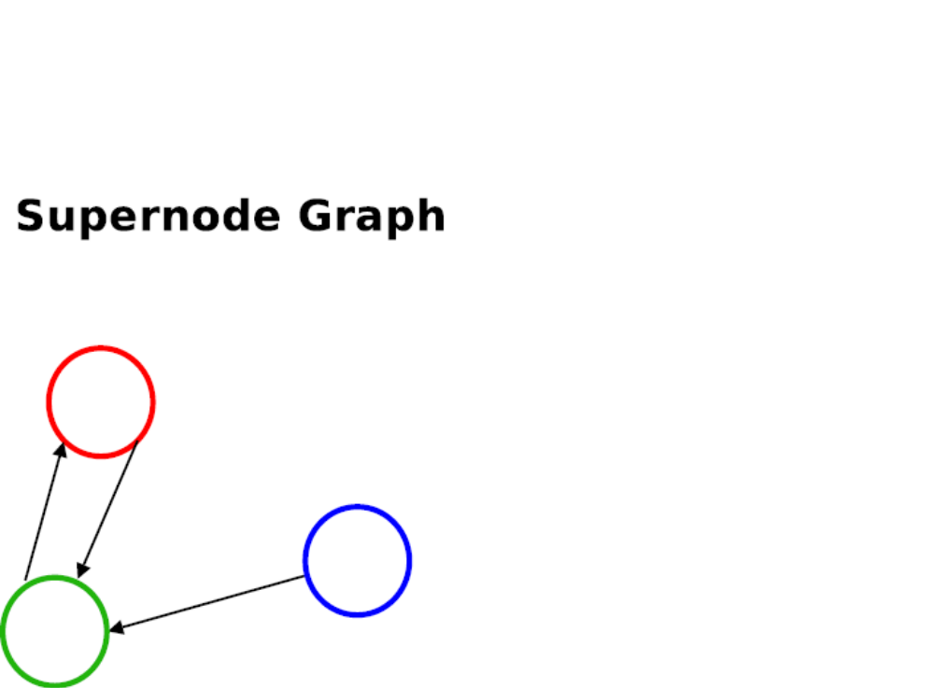
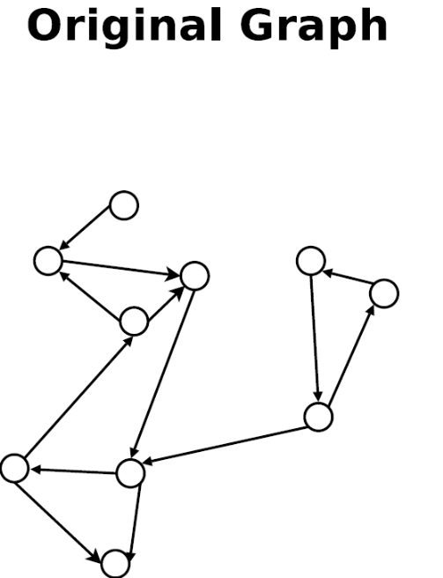
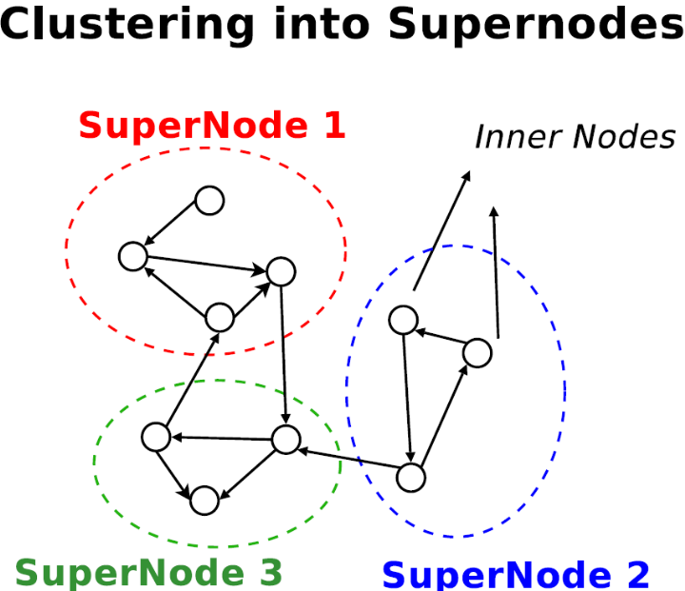
Supernode Graph
Inner node
Edge weights: wt(S1 → S2): min{wt(i → j): i ∈ S1, j ∈ S2}

Slide 9
Strawman: 2-Phase Search
First-Attempt Algorithm:
  Phase 1 : Search on supernode graph to get top-k results (containing supernodes)
    Using any search algorithm
  Expand all supernodes from supernode results
  Phase 2 : Search on this expanded component of graph to get final top-k results
Doesn’t quite work:
  Top-k on expanded component may not be top-k on full graph
  Experiments show poor recall

Slide 10
Multi-Granular Graph Representation
Original supernode graph is in-memory
Some supernodes are expanded
  i.e. their contents are fetched into cache
Multi-granular graph: a logical graph view containing
  inner nodes from expanded supernodes
  unexpanded supernodes
  edges between these nodes
Search runs on resultant multi-granular graph
  Multi-granular graph evolves as execution proceeds, and supernodes get expanded

Slide 11
Multi-Granular Graph
S4
Supernode
(unexpanded)
S1
Key:
Inner Node
S2
Expanded
Supernode
I - I edge
S3
S - I edge
S - S edge
Edge-weights:Supernode ←→ Innernode
    wt(S → j): min{wt(i → j): i ∈ S}
    wt(j → S): symmetric to above

Slide 12
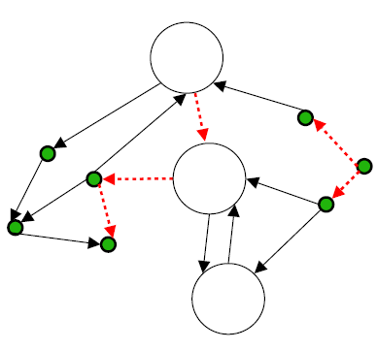
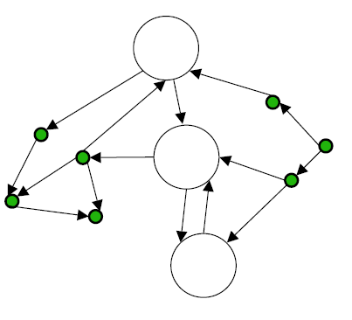
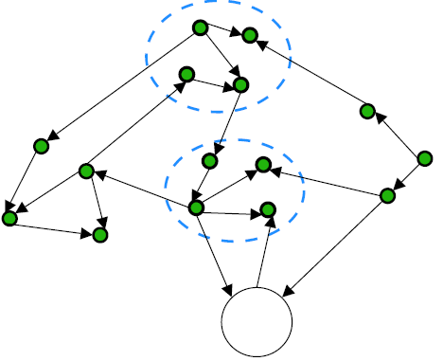
Iterative Expansion Search
Explore (generate top-k answers on current MG graph,
using any in-memory search method)
top-k answers pure?
Yes
No
Expand supernodes
in top answers
Output
Edges in top-k answers

Slide 13
Iterative Expansion (Cont.)
Any in-memory search algorithm can be used
Iteration will terminate
What if too many nodes are expanded?
  Eviction of expanded nodes from MG graph
    Can lead to non-convergence
  Evict expanded nodes from cache, but retain in logical MG graph, re-fetch as required
    Can cause thrashing (thrashing control possible)
Performance Evaluation (details later)
  Significantly reduces IO compared to search using virtual memory
  BUT: High CPU cost due to multiple iterations, with each iteration starting search from scratch

Slide 14
Incremental Search
  Motivation
    Repeated restarts of search in iterative search
  Basic Idea
    Search on multi-granular graph
    Expand supernode(s) in top answer
    Unlike Iterative Search
      Update the state of the search algorithm when a supernode is expanded, and
      Continue search instead of restarting
  State update depends on search algorithm
    We present state update for backward expanding search (BANKS, ICDE02/VLDB05)

Slide 15
Backward Expanding Search
Query: soumen byron
paper
Focused Crawling
writes
authors
Soumen C.
Byron Dom
SPI Tree
SPI Tree

Slide 16
Backward Expanding Search
Based on Dijkstra’s single-source shortest path algorithm
  One instance of Dijkstra’s algorithm per keyword
  Explored nodes: nodes for which shortest path already found
  Fringe nodes: unexplored nodes adjacent to explored nodes
  Shortest-Path Iterator Tree (SPI-Tree):
    Tree containing explored and fringe nodes.
    Edge u → v if (current) shortest path from u to keyword passes through v
More details in paper

Slide 17
Incremental Backward Search
Backward search run on multi-granular graph
repeat
  Find next best answer on current multi-granular graph
  If answer has supernodes
    expand supernode(s)
    Update the state of backward search, i.e. all SPI trees, to reflect state change of multi-granular graph due to expansion
  until top-k answers on current multi-granular graph are “pure” answers

Slide 18
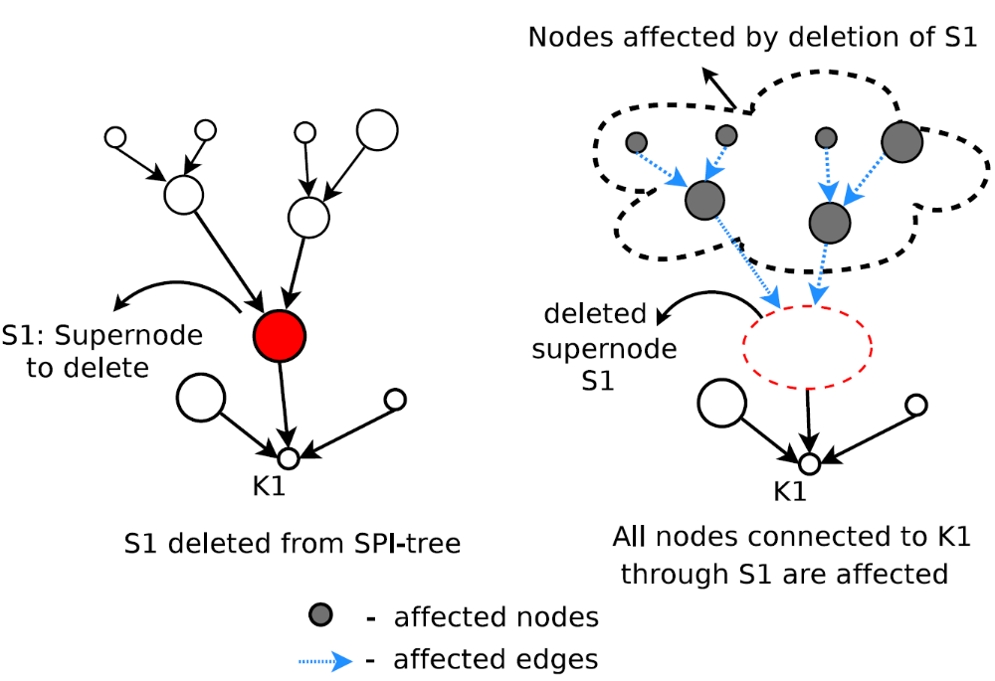
State Update on Supernode Expansion
Nodes affected by deletion
S1
Result containing supernodes
Supernode S1 to be expanded
SPI tree containing S1

Slide 19
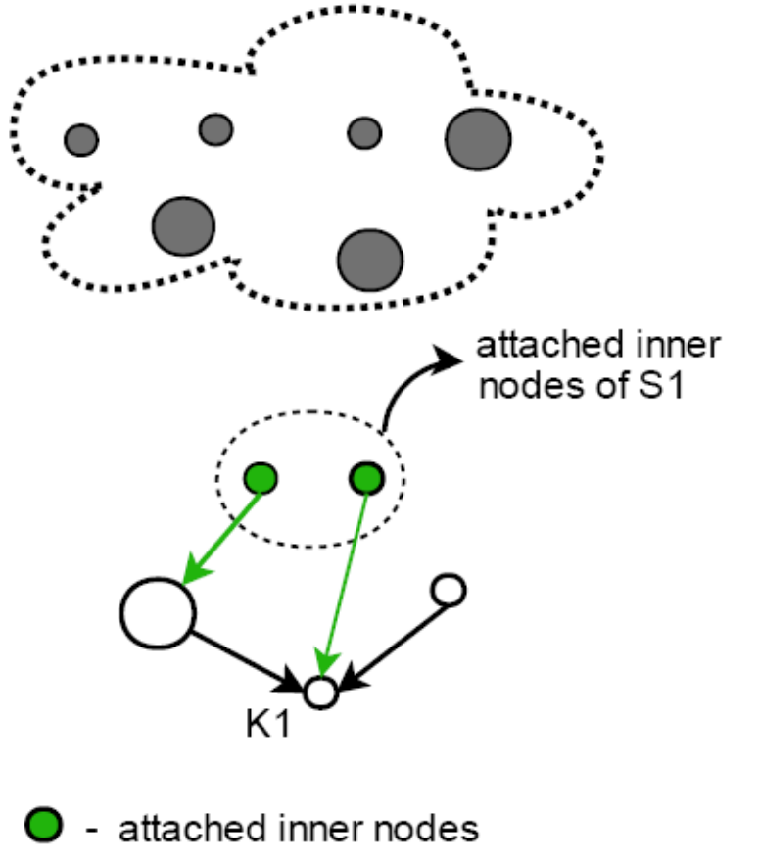
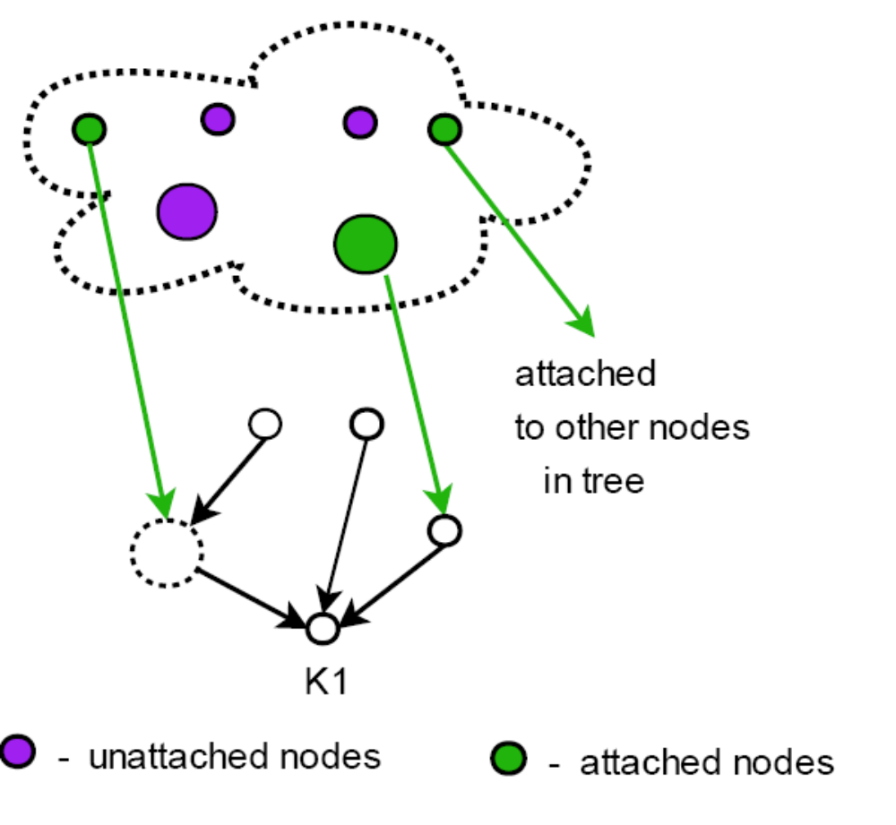
Nodes Get Attached
Affected nodes get detached
Inner-nodes get attached (as fringe nodes) to adjacent explored nodes
based on shortest path to K1
3. Affected nodes get attached
(as fringe nodes) to adjacent
explored nodes based on
shortest path to K1

Slide 20
Effect of Supernode Expansion
Differences from Dijkstra's shortest-path algorithm:
  For Explored nodes:
    Path-costs of explored nodes may increase
    Explored nodes may become fringe nodes
  For Fringe nodes:
    Incremental Expansion: Path-costs may increase or decrease
Invariant
  SPI trees reflect shortest paths for explored nodes in current multi-granular graph
Theorem: Incremental backward expanding search generates correct top-k answers

Slide 21
Heuristics
Thrashing Control :
  Stop supernode expansion on cache full
  Use only parts of the graph already expanded for further search
Intra-supernode edge weight
  details in paper
Heuristics can affect recall
  Recall at or close to 100% for relevant answers, with heuristics, in our experiments (see paper for details)

Slide 22
Experimental Setup
Clustering algorithm to create supernodes
  Orthogonal to our work
  Experiments use Edge prioritized BFS (details in paper)‏
  Ongoing work: develop better clustering techniques
All experiments done on cold cache
  echo 3 > /proc/sys/vm/drop caches
Dataset | Original Graph Size | Supernode Graph Size | Edges | Superedges
DBLP | 99MB | 17MB | 8.5M | 1.4M
IMDB | 94MB | 33MB | 8M | 2.8M
Default Cache size (Incr/Iter) | 1024 (7MB)
Default Cache Size (VM, DBLP) | 3510 (24MB)
Default Cache Size (VM, IMDB) | 5851 (40MB)

Slide 23
Algorithms Compared
Iterative
Incremental
Virtual Memory (VM) Search
  Use same clustering as for supernode graph
  Fetch cluster into cache whenever a node is accessed
    evicting LRU cluster if required
  Search code unaware of clustering/caching
    gets “Virtual Memory” view
Sparse
  SQL-based approach from Hristidis et al. [VLDB03]
  Not applicable to graphs without schema
    used for comparison, on graphs derived from relational schema

Slide 24
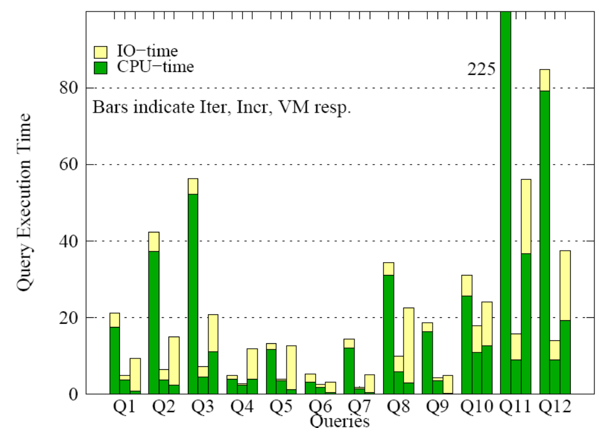
Query Execution Time (top 10 results)
Bars: Iterative, Incremental and VM resp.
Query Execution Time (Seconds)
Notes:
What do bars indicate
Split between IO and CPU time differs for Iter, Incr and VM. For Iter, more nodes are expanded in each iteration, to reduce the number of iterations, hence there is more IO than for Incr. VM shows more IO especially when thrashing. We also tried VM with thrashing control, but recall was very poor, so we don’t show results

Slide 25
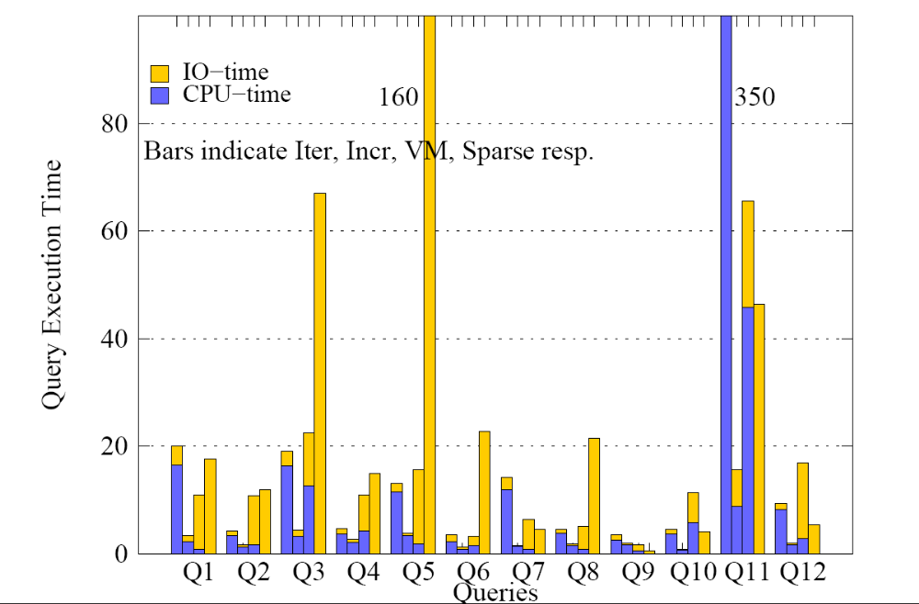
Query Execution Time (Last Relevant Result)
Iterative, Incremental, VM and Sparse resp.
Query Execution Time (Seconds)

Slide 26
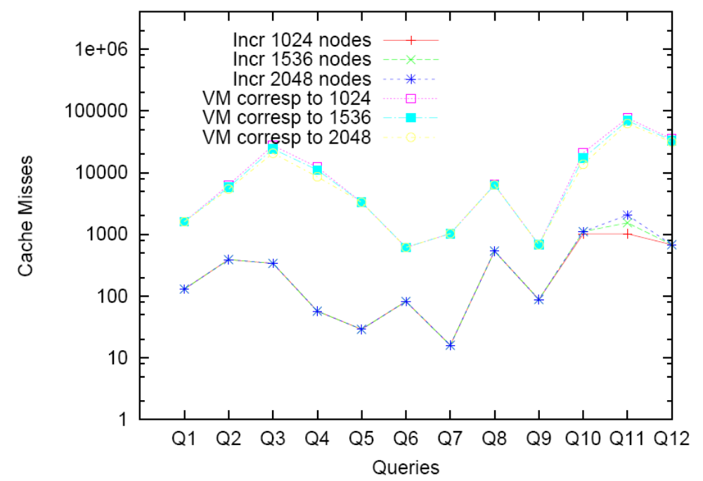
Cache Misses for Different Cache Sizes
All VM
All Incr.
Note: Graphs in paper used wrong cache sizes for VM queries on IMDB (Q8,Q9, Q10 and Q12). Graph above shows corrected results, but there are no significant differences.

Slide 27
Conclusions
Graph summarization coupled with a multi-granular graph representation shows promise for external memory graph search
Ongoing/Future work
  Applications in distributed memory graph search
  Improved clustering techniques
  Extending Incremental to bidirectional search and other graph search algorithms
  Testing on really large graphs

Slide 28
The End
  Queries?

Slide 29
Minor Correction to Paper
Cache size (Incr/Iter) | 1024 (7MB) | 1536 (10.5MB) | 2048 (14MB)
Cache Size (VM, DBLP) | 3510 (24MB) | 4023 (27.5MB) | 4535 (31MB)
Cache Size (VM, IMDB) | 5851 (40MB) | 6363 (43.5MB) | 6875 (47MB)
For IMDB queries Q8-Q10,Q12, for the case of VMSearch, cache sizes
from DBLP were inadvertently used earlier instead of the cache sizes
shown above. Queries were rerun on the correct cache size,
but there were no changes in the relative performance of
Incremental versus VMSearch, on cache misses as well time taken.

