Slide 1
Twitter Mining Searching for tweets & Analysing the 140 character

Slide 2

INTRODUCTION
What is twitter?
An online social networking service that enables users to send and read short 140-character messages called “tweets”.
Over 300 million monthly active users (as of 2015).
Creating over 500 million tweets per day.
Tweets also contain links to pictures, videos, or other websites as well as hashtags—words that begin with # and are turned into links to make it easier to find certain terms.

Slide 3
Searching for tweets
Problem:
You want to search Twitter for tweets using specific keywords and query constraints.
Solution:
Use the Search API to perform a custom query.

Slide 4
Searching for tweets
Twitter’s Search API returns results in batches, and we can configure the number of results per batch to a maximum value using the count keyword parameter.
Generally the count is taken as 200. It is possible that more than 200 results (or the maximum value that you specify for count) may be available for any given query.
In Twitter’s API, we also have cursor to navigate to the next batch of results.

Slide 5
Searching for tweets
Cursors are a new enhancement to Twitter’s API and provide a more robust scheme than the pagination paradigm.
The essence of the cursor paradigm is that it is able to better accommodate the dynamic and real-time nature of the Twitter platform.
It could be the case that while you are navigating a batch of query results, relevant information becomes available that you would want to have included in your current results while you are navigating them, rather than needing to dispatch a new query.

Slide 6
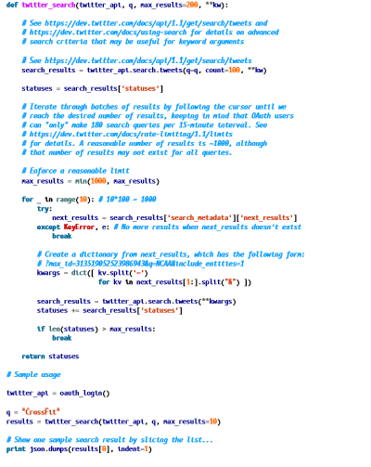

Slide 7
Analysing the 140 character
Tweets Analysis
Extracting Tweets Text Cleaning
Frequent Words and Word Cloud Word Associations
Topic Modelling Sentiment Analysis
7 / 40

Slide 8
Techniques and Tools
e Techniques
⁾ Text mining
⁾ Topic modelling
⁾ Sentiment analysis
⁾ Social network analysis
e Tools
⁾ Twitter API
⁾ R and its packages:
⁾ twitter
⁾ tm
⁾ topicmodels
⁾ sentiment140
⁾ igraph
8 / 40

Slide 9
Process
e Extract tweets and followers from the Twitter website with R and the twitteR package
e With the tm package, clean text by removing punctuations, numbers, hyperlinks and stop words, followed by stemming and stem completion
e Build a term-document matrix
e Analyse topics with the topicmodels package
e Analyse sentiment with the sentiment140 package
e Analyse following/followed and retweeting relationships with the igraph package
9 / 40

Slide 10
Retrieve Tweets
## Option 1: retrieve tweets from Twitter
library(twitteR) library(ROAuth)
## Twitter authentication
setup_twitter_oauth(consumer_key, consumer_secret, access_token, access_secret)
## 3200 is the maximum to retrieve
tweets<-userTimeline("RDataMining",n=3200)
## Option 2: download @RDataMining tweets from RDataMining.com
url<-"http://www.rdatamining.com/data/RDataMining-Tweets-20160212.rds" download.file(url,destfile="./data/RDataMining-Tweets-20160212.rds") ## load tweets into R
tweets<-readRDS("./data/RDataMining-Tweets-20160212.rds")
10 / 40

Slide 11
(n.tweet<-length(tweets))
## [1] 448
# convert tweets to a data frame
tweets.df<-twListToDF(tweets)
# tweet #190
tweets.df[190,c("id","created","screenName","replyToSN", "favoriteCount","retweetCount","longitude","latitude","text")]
## id created screenName re... ## 190 362866933894352898 2013-08-01 09:26:33 RDataMining ...
##
## 190 ##
favoriteCount retweetCount longitude latitude
9 9 NA NA
...
## 190 The R Reference Card for Data Mining now provides lin...
# print tweet #190 and make text fit for slide width
writeLines(strwrap(tweets.df$text[190],60))
## The R Reference Card for Data Mining now provides links to ## packages on CRAN. Packages for MapReduce and Hadoop added. ## http://t.co/RrFypol8kw
11 / 40

Slide 12
Text Cleaning
library(tm)
# build a corpus, and specify the source to be character vectors
myCorpus<-Corpus(VectorSource(tweets.df$text))
# convert to lower case
myCorpus<-tm_map(myCorpus,content_transformer(tolower))
# remove URLs
removeURL<-function(x)gsub("http[^[:space:]]*","", x) myCorpus<-tm_map(myCorpus,content_transformer(removeURL)) # remove anything other than English letters or space
removeNumPunct<-function(x)gsub("[^[:alpha:][:space:]]*","", x) myCorpus<-tm_map(myCorpus,content_transformer(removeNumPunct)) # remove stopwords
myStopwords<-c(setdiff(stopwords( 'english'),c("r","big")), "use","see","used","via","amp")
myCorpus<-tm_map(myCorpus, removeWords, myStopwords)
# remove extra whitespace
myCorpus<-tm_map(myCorpus, stripWhitespace)
# keep a copy for stem completion later
myCorpusCopy<-myCorpus
12 / 40

Slide 13
Stemming and Stem Completion ¹
myCorpus<-tm_map(myCorpus, stemDocument) # stem words
writeLines(strwrap(myCorpus[[190]]$content,60))
## r refer card data mine now provid link packag cran packag ## mapreduc hadoop ad
stemCompletion2<-function(x,dictionary) { x<-unlist(strsplit(as.character(x)," ")) x<-x[x!=""]
x<-stemCompletion(x,dictionary=dictionary) x<-paste(x,sep="",collapse=" ") PlainTextDocument(stripWhitespace(x))
}
myCorpus<-lapply(myCorpus, stemCompletion2,dictionary=myCorpusCopy) myCorpus<-Corpus(VectorSource(myCorpus)) writeLines(strwrap(myCorpus[[190]]$content,60))
## r reference card data miner now provided link package cran ## package mapreduce hadoop add
13 / 40

Slide 14
Build Term Document Matrix
tdm<-TermDocumentMatrix(myCorpus, control=list(wordLengths=c(1,Inf))) tdm ## <<TermDocumentMatrix (terms: 1073, documents: 448)>> ## Non-/sparse entries: 3594/477110 ## Sparsity : 99 ## Maximal term length: 23 ## Weighting : term frequency (tf) idx<-which(dimnames(tdm)$Terms inc("r","data","mining")) as.matrix(tdm[idx,21:30]) ## Docs ## Terms 21 22 23 24 25 26 27 28 29 30
## | data | 0 | 1 | 0 | 0 | 1 | 0 | 0 | 0 | 0 | 1
## | mining | 0 | 0 | 0 | 0 | 1 | 0 | 0 | 0 | 0 | 1
## | r | 1 | 1 | 1 | 1 | 0 | 1 | 0 | 1 | 1 | 1
14 / 40

Slide 15
Top Frequent Terms
# inspect frequent words
(freq.terms<-findFreqTerms(tdm,lowfreq=20))
## [1] "analysing"
## [5] "canberra"
## [9] "group"
"analytics" "course"
"australia" "data"
"big" "example" "mining" "r" "slide"
"university"
"introduction" "learn"
## [13] "network"
## [17] "rdatamining"
## [21] "talk"
"package" "research" "text"
"position" "science" "tutorial"
term.freq<-rowSums(as.matrix(tdm)) term.freq<-subset(term.freq, term.freq>=20)
df<-data.frame(term=names(term.freq),freq= term.freq)
15 / 40

Slide 16
library(ggplot2) ggplot(df,aes(x=term,y=freq))+geom_bar(stat="identity")+
xlab("Terms")+ylab("Count")+coord_flip()+ theme(axis.text=element_text(size=7))
university tutorial
text talk slide science
research rdatamining
r position package network mining learn introduction
group example
data course canberra
big australia analytics analysing
Terms
0
50
100
Count
150
200
15 / 40

Slide 17
Wordcloud
m<-as.matrix(tdm)
# calculate the frequency of words and sort it by frequency
word.freq<-sort(rowSums(m),decreasing= T)
# colors
pal<-brewer.pal(9,"BuGn")[-(1:4)]
# plot word cloud
library(wordcloud)
wordcloud(words=names(word.freq),freq= word.freq,min.freq=3, random.order= F,colors= pal)
17 / 40

Slide 18
^{updated} result please
competition _{interacting}
_{friday} facebook
developed
_{natural} version nov retrieval
performance nice map
canada kdd_{coursera}
titled
project decision
pls
extract
toolintern
graphical
website _{credittricks}
recent
vs card
edited
reference
link
document ^{cran}
melbournekdnuggets^{area webinar}
list function format
^{thursday detection august} conferencebusiness advanced
source handling ^{postdoctoral}
computationaldetailed ^{francisco}
published _{parallel}
position analysing _{slide}twitter
introduction ^{process distributed}
regression week
v
pmaustralia lecture
guidance
page_{us} start
quick
_{book} create
_{excel} looking
skills apache
^{add} modeling
fitexample
workshop
_{go}contain
tuesday
forest ^{notes} seminartext
mining
june
rstudio
center
dynamic
improve fast postdoc tutorial th
linkedin public
paper make
sparkapril _{canberra}
data
datasetsentiment
mode
search sigkdd
join
submission littlesnowfall
ieee machine
group
keynote
science
learn
application
march
system series
^{sept}associate ^{visit}load
_{prof nd}visualisationsfeb
senior _{fellow}
california
sydney free
packagerresearch
cfp engine easier ^{lab}
graph course^{dr}
due _{big}
open
youtube
state available
_{pdf} analytics
provided
plot
together
octchina _{present} talkjan
top
technique_{various}
industrial
language
now
chapter _{comment}
case
network
time
_{will stanford} participation
run san web hadoop
social university
job
outlieramazon track
algorithm analyst mid
rdatamining
scientist
googlemassive
americaclassification online
ausdm
vacancies share
task
member ^{call} statistical ^{iapa} useful
video
_{follow} download
18 / 40
dmapps
find
mapreduce program ^{code}
_{can}file^{new}ranked ^{neoj}
deadline _{may software}
_{user} cluster _{large} acm check
tweet
sas high
event thanks get ^{poll}
risk
_{world} media
healthcare step
close
predicting
knowledge
rule
informal cloud iselect
^{official} short access
database
forecasting australian
simple experience ^{technological} give
topic
australasian
random extended
build _{today}
_{aug} datacamp
sna seattle^{mexico}
spatial
studies_{sunday}
support singapore
answers
wwwrdataminingcom initial
tree survey
summit southern
management

Slide 19
Associations
# which words are associated with 'r'?
findAssocs(tdm,"r",0.2)
## r
## code 0.27
## example 0.21
## series 0.21
## markdown 0.20
## user 0.20
# which words are associated with 'data'?
findAssocs(tdm,"data",0.2)
##
## mining ## big
data 0.48
0.44
19 / 40
## analytics 0.31
## science ## poll
0.29
0.24

Slide 20
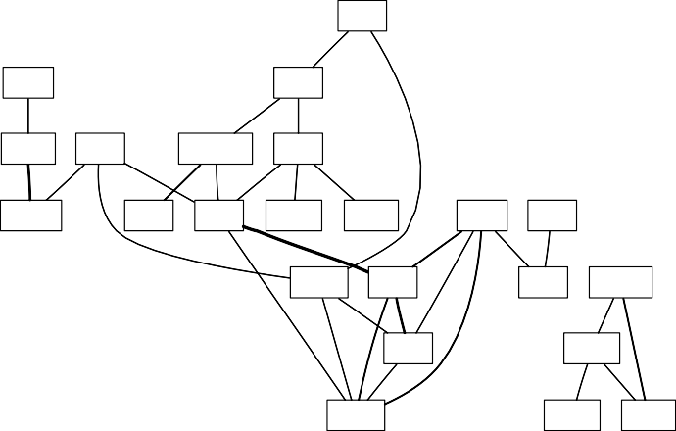
Network of Terms
library(graph) library(Rgraphviz)
plot(tdm,term= freq.terms,corThreshold=0.1,weighting= T)
talk
tutorial
slide
network
text
rdatamining
r
analysing
group
mining
example package
science
learn
canberra
data
course
university
20 / 40
big
research
analytics
australia position
introduction

Slide 21
Topic Modelling
dtm<-as.DocumentTermMatrix(tdm) library(topicmodels)
lda<-LDA(dtm,k=8) term<-terms(lda,7)
# find 8 topics
# first 7 terms of every topic
(term<-apply(term,MARGIN=2, paste,collapse=", "))
## ## ## ## ## ## ## ## ## ## ##
Topic 1 "data, mining, big, r, analysing, scientist, group"
Topic 2 "r, mining, data, analysing, university, slide, network"
Topic 3 "r, data, book, package, mining, cluster, tutorial"
Topic 4 "data, r, big, mining, rstudio, tutorial, slide"
Topic 5
“data, mining, research, slide, free, course, position”
Topic 6
## "data, group, package, r, computational, canberra, machine"
## ## ## ##
Topic 7 "mining, slide, r, analytics, example, talk, will"
Topic 8 "r, data, mining, example, pdf, series, available"
20 / 40

Slide 22
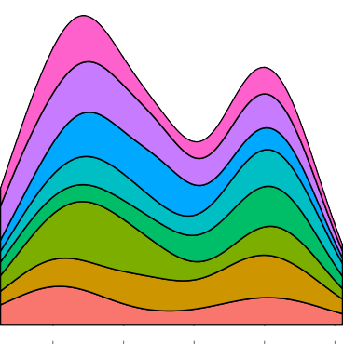
Topic Modelling
topics<-topics(lda) # 1st topic identified for every document (tweet) topics<-data.frame(date=as.IDate(tweets.df$created),topic=topics) qplot(date, ..count..,data=topics,geom="density",
fill=term[topic],position="stack")
0.3
term[topic]
0.2
data, group, package, r, computational, canberra, machine data, mining, big, r, analysing, scientist, group
data, mining, research, slide, free, course, position data, r, big, mining, rstudio, tutorial, slide
mining, slide, r, analytics, example, talk, will
r, data, book, package, mining, cluster, tutorial r, data, mining, example, pdf, series, available
r, mining, data, analysing, university, slide, network
count
0.1
22 / 40
0.0
2012
2013 2014 2015
date
2016

Slide 23
Sentiment Analysis
# install package sentiment140
require(devtools) install_github("sentiment140","okugami79")
# sentiment analysis
library(sentiment)
sentiments<-sentiment(tweets.df$text) table(sentiments$polarity)
##
## neutral positive ## 428 20
# sentiment plot
sentiments$score<-0 sentiments$score[sentiments$polarity=="positive"]<-1 sentiments$score[sentiments$polarity=="negative"]<--1 sentiments$date<-as.IDate(tweets.df$created)
result<-aggregate(score~date,data= sentiments, sum) plot(result,type="l")
23 / 40

Slide 24
THANK YOU

