Slide 1
SOFTWARE TESTING AND AUTOMATION

Slide 2
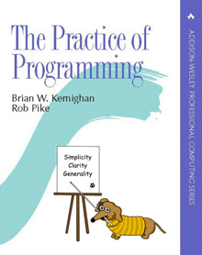
Style
Objective: Appreciate the importance of good programming style and to develop good programming style themselves.
  “Well-written programs are better than badly-written ones – they have fewer errors and are easier to debug and to modify – so it is important to think about style from the beginning.”

Slide 3
Themes
Code should be clear and simple
  Straightforward logic
  Natural expression
  Conventional (idiomatic) language use
  Meaningful names
  Neat formatting
  Helpful comments
  Avoid clever tricks and unusual constructs
Consistency is important because others will find it easier to read your code if you stick to the same style.

Slide 4
Chapter 1: Styles
  Names
  Expressions and statements
  Consistency and idioms
  Function macros
  Comments

Slide 5
Choose good names
if( country==SING || country==BRNI
|| country==POL )
{
/*
* If the country is Singapore, Brunei
* or Poland then the current time is
* the answer time rather that the off
* hook time. Reset answer time and set
* day of week.
*/
…

Slide 6
Keep comments in synch
Code is often updated, while comments are neglected:
if( country==SING || country==BRNI
|| country==POL || country==ITALY )
{
/*
* If the country is Singapore, Brunei or Poland
* then the current time is the answer time
* rather that the off hook time.
* Reset answer time and set day of week.
*/
…

Slide 7
Names
A variable or function name labels an object and conveys information about its purpose.
Informative, concise, pronounceable, memorable.

Slide 8
Names
Use descriptive names for global and short names for locals
  The smaller the scope, the shorter the name
Namespaces
  Use them to avoid clashes, and contrived-sounding names
Follow consistent naming conventions
  You'll develop your own style.
  But learn (and use!) the standards for each project

Slide 9
Names (cont.)
Use active names for functions
  Make it clear what the function does
  Make the return value easy to infer
Be accurate
  And comment units!

Slide 10
Use Meaningful Names
  (there is no const in C)
#define ONE 1
#define TEN 10
#define TWENTY 20
#define INPUT_MODE 1
#define INPUT_BUFSIZE 10
#define OUTPUT_BUFSIZE 20
…

Slide 11
Use Descriptive Names for Globals, short names for locals
int nPending = 0;
// current length of input queue
for( theElementIndex = 0;
theElementIndex < numberOfElements;
theElementIndex++ )
elementArray[theElementIndex] = theElementIndex;
for( i = 0; i < nelems; i++ )
elem[i] = i;

Slide 12
Conventions
Use intermixed caps OR underscores:
    numPending, num_pending
  Names that begin or end with p for pointers
    p_head, tail_p
  Initial capital letter for Globals
  and all capitals for CONSTANTS.
Be Consistent!

Slide 13
Use namespaces
Don't be silly
class UserQueue {
int noOfItemsInQ, frontOfTheQueue,
queueCapacity;
public: int noOfUsersInQueue() { … }
}
queue.queueCapacity
class UserQueue {
int nItems, front, capacity;
public int nUsers() { … }
}
queue.capacity++; n = queue.nUsers();

Slide 14
Use Active Names for Functions
now = date.getTime();
putchar(‘\n’);
Functions that return a boolean should be named so that the return value is unambiguous.
if( checkoctal( c )) …
if( isoctal( c )) …

Slide 15
Be Accurate
#define isoctal( c) ((c) >= ‘0’ && (c) <= ‘8’)
#define isoctal( c) ((c) >= ‘0’ && (c) <= ‘7’)
public boolean inTable( Object obj ) {
int j = this.getIndex( obj );
return( j == nTable );
}
return( j < nTable );

Slide 16
Expressions and Statements
Use indentation to show structure
Use the natural form of an expression
Parenthesize to resolve ambiguity
Break up complex expressions
Be careful with side effects

Slide 17
Indent to Show Structure
for( n++;n<100;field[n++]='\0' );
*i = '\0'; return( '\n' );
for( n++; n < 100; field[n++] = '\0' )
; // cleaner – show intention
*i = '\0';
return ('\n');
// Better still – use idioms
for( n++; n < 100; n++)
field[n] = '\0';
*i = '\0';
return '\n';

Slide 18
Use the Natural Form for Expressions
if (!(block_id < actblks)
|| !(block_id >= unblocks))
if(( block_id >= actblks )
|| ( block_id < unblocks ))
Remember DeMorgan's Laws
if( !( r=='n' || r=='N' ))
if( r!='n' && r!='N' )

Slide 19
Parenthesize to Resolve Ambiguity
Even if it's well-defined in the language
if( x & ( MASK==BITS )) // incorrect
if( x&MASK == BITS ) // correct, but ugly
if(( x&MASK ) == BITS) // better
leap_year = y%4 == 0 && y%100 != 0
|| y%400 == 0;
leap_year = ( y%400==0 ) ||
(( y%4==0) && ( y%100!=0 ));

Slide 20
Break up Complex Expressions
*x += (*xp=(2*k < (n-m) ? c[k+1] : d[k--]));
if( 2*k < n-m )
*xp = c[k+1];
else
*xp = d[k--];
*x += *xp;

Slide 21
Be Clear
subkey = subkey >> (bitoff – ((bitoff >> 3) << 3));
subkey = subkey >> (bitoff & 0x7);
subkey >>= bitoff & 0x7;
max = (a > b) ? a : b;
printf( "The list has %d item%s\n",
n, ( n==1 ? "" : "s" ));

Slide 22
Be Clear
child=( !LC&&!RC )? 0 : (!LC?RC:LC);
if( LC==0 && RC==0 ) // Okay
child = 0;
else if( LC==0 )
child = RC;
else
child = LC;
if( LC==0 ) // Even better
child = RC
else
child = LC

Slide 23
Be Careful with Side Effects
Assignment associates right->left, but the order in which the arguments are evaluated is not defined
str[i++] = str[i++] = ' ';
str[i++] = ' ';
str[i++] = ' ';
array[i++] = i;
array[i] = i;
i++;

Slide 24
Side-effects (cont.)
Arguments to a function are evaluated before the function is called. yr is not read first
scanf(“%d %d”, &yr, &profit[yr]);
scanf(“%d”,&yr);
scanf(“%d”, &profit[yr]);

Slide 25
Consistency and Idioms
Use a consistent naming convention
Use a consistent indentation and brace style
Use idioms for consistency
Use else-if for multi-way decisions

Slide 26
Use a Consistent Indentation and Brace Style
if (month == FEB) {
if (year%4 == 0)
if (day > 29)
legal = FALSE;
else
if (day > 28)
legal = FALSE;
}
// correct, but we can
// do better…
if (month == FEB) {
if (year%4 == 0) {
if (day > 29)
legal = FALSE;
} else {
if (day > 28)
legal = FALSE;
}
}

Slide 27
Use a Consistent Indentation and Brace Style
if (month == FEB) {
int nday;
nday = 28;
if (year%4 == 0)
nday = 29;
if (day > nday)
legal = FALSE;
}
The code is still wrong. Why?
  Output is correct, but style is wrong

Slide 28
Use Idioms for Consistency
i = 0;
while (i <= n-1)
array[i++] = 1.0;
for (i = 0; i < n; )
array[i++] = 1.0;
for (i = n; --i >= 0; )
array[i] = 1.0;
for (i = 0; i < n; i++)
array[i] = 1.0;

Slide 29
Use Idioms for Consistency
for (p = list; p != NULL; p = p->next)
…
for (;;)
…
while (1)
…

Slide 30
Use Idioms for Consistency
for (
ap = arr;
ap < arr + 128;
*ap++ = 0;
)
{
;
}
for (ap = arr; ap < arr+128; ap++)
*ap = 0;

Slide 31
Use Idioms for Consistency
while ((c = getchar()) != EOF)
putchar(c);
? do {
? c = getchar();
? putchar(c);
? } while (c != EOF);
Only use do-while loop when the loop body must be executed at least once.

Slide 32
Use Idioms for Consistency
One advantage of the consistent use of idioms is that it draws attention to non-standard loops, a frequent sign of trouble.
? int i, *iArray, nmemb;
?
? iArray = malloc(nmemb * sizeof(int));
? for (i = 0; i <= nmemb; i++)
? iArray[i] = i;

Slide 33
Use else-ifs for Multi-Way Decisions
? if (argc == 3)
? if ((fin = fopen(argv[1], “r”)) != NULL)
? if ((fout = fopen(argv[2], “w”)) != NULL) {
? while ((c = getc(fin)) != EOF)
? putc(c, fout);
? fclose(fin); fclose(fout);
? } else
? printf(“Can’t open output file %s\n”, argv[2]);
? else
? printf(“Can’t open input file %s\n”, argv[1]);
? else
? printf(“Usage: cp inputfile outputfile\n”);

Slide 34
Better:
if( argc != 3 )
printf( "Usage: cp inputfile outputfile\n" );
else if( ( fin=fopen( argv[1], "r" )) == NULL )
printf( "Can’t open input file %s\n", argv[1] );
else if( ( fout=fopen( argv[2], "w" )) != NULL )
printf( "Can’t open output file %s\n", argv[2] );
else {
while( (c=getc( fin )) != EOF )
putc( c, fout );
fclose( fin ); fclose( fout );
}

Slide 35
Use else-ifs for Multi-Way Decisions
? switch (c) {
? case ‘-’:
? sign = -1;
? /* fall through */
? case ‘+’:
? c = getchar();
? break;
? case ‘.’:
? break;
? default:
? if (!isdigit(c))
? return 0;
? break;
? }
? switch (c) {
? case ‘-’: sign = -1;
? case ‘+’: c = getchar();
? case ‘.’: break;
? default: if (!isdigit(c))
? return 0;
? }
/* ok without comment */
case ‘0’:
case ‘1’:
case ‘2’:
…
break;

Slide 36
Use else-ifs for Multi-Way Decisions
? if (c == ‘-’) {
? sign = -1;
? c = getchar();
? } else if (c == ‘+’) {
? c = getchar();
? } else if (c != ‘.’ && !isdigit(c)) {
? return 0;
? }

Slide 37
Function Macros
Avoid function macros
Parenthesize the macro body and arguments

Slide 38
Avoid Function Macros
Macros have been used to avoid the overhead of function calls – this is no longer necessary
  In C++, inline functions renders macros unnecessary
? #define isupper(c) ((c) >= ‘A” && (c) <= ‘Z’)
? …
? while (isupper(c = getchar()))
while ((c = getchar()) != EOF && isupper(c))
…
? #define ROUND_TO_INT(x) ((int) ((x)+(((x)>0)?0.5:-0.5)))
? size = ROUND_TO_INT(sqrt(dx*dx + dy*dy));

Slide 39
Parenthesize the Macro Body and Argument
If you insist on using function macros, be careful.
? #define square(x) (x) * (x)
? 1/square(x) ⇒ 1/(x) * (x)
#define square(x) ((x) * (x))

Slide 40
Magic Numbers
Give meaningful names to magic numbers
Define numbers as constants, not macros
Use character constants, not integers
Use the language to calculate the size of an object

Slide 41
Give Names to Magic Numbers
? fac = lim/20; /* set scale factor */
? if (fac < 1)
? fac = 1;
? /* generate histogram */
? for (i=0,col = 0; i<27; i++,j++) {
? col += 3;
? k = 21 – (let[i]/fac);
? star = (let[i] == 0) ? ‘ ‘ : ’*’;
? for (j=k;j<22;j++)
? draw(j,col,star);
? }
? draw(23,2,’ ‘); /* label x axis */
? for (i=‘A’;i<=‘Z’;i++)
? printf(“%c “,i);

Slide 42
Give Names to Magic Numbers
enum {
MINROW = 1, /* top edge */
MINCOL = 1, /* left edge */
MAXROW = 24, /* bottom edge (<=) */
MAXCOL = 80, /* right edge (<=) */
LABELROW = 1, /* position of labels */
NLET = 26, /* size of alphabet */
HEIGHT = MAXROW – 4, /* height of bars */
WIDTH = (MAXCOL-1)/NLET /* width of bars */
};

Slide 43
Give Names to Magic Numbers
fac = (lim + HEIGHT-1) / HEIGHT; /* set scale factor */
if (fac < 1)
fac = 1;
for (i=0,i<NET;i++) { /* generate histogram */
if (let[i] == 0)
continue;
for (j = HEIGHT – let[i]/fac; j < HEIGHT;j++)
draw(j+1 + LABELROW, (i+1)*WIDTH, ‘*’);
}
draw(MAXROW-1,MINCOL+1, ‘ ‘); /* label x axis */
for (i=‘A’;i<= ‘Z’;i++)
printf(“%c “,i);

Slide 44
Define Numbers as Constants, not Macros
const int MAXROW = 24, MAXCOL = 80;
static final int MAXROW = 24, MAXCOL = 80

Slide 45
Use Character Constants, not Integers
? (c >= 65 && c <= 90)
? …
? (c >= ‘A’ && c <= ‘Z’)
? …
if (isupper(c)) // C or C++
// Java
if (Character.isUpperCase(c))
? str = 0;
? name[i] = 0;
? x = 0;
str = NULL;
name[i] = ‘\0’;
x = 0.0;

Slide 46
Use the Language to Calculate the Size of an Object
char buf[1024];
fgets(buf,sizeof(buf),stdin);
// Java
char buf[] = new char[1024];
for (int i=0;i<buf.length;i++)
…
#define NELEMS(array) (sizeof(array) / sizeof(array[0]))
double dbuf[100];
for (i = 0; i < NELEMS(dbuf); i++)

Slide 47
1.6 Comments
Don’t belabor the obvious
Comment functions and global data
Don’t comment bad code, rewrite it
Don’t contradict the code
Clarify don’t confuse

Slide 48
Don’t Belabor the Obvious
? /*
? * default
? */
? default:
? break;
? /* return SUCCESS */
? return SUCCESS;
? zerocount++; /* Increment zero entry counter */
? /* Initialize “total” to “number_received” */
? node->total = node->number_received;

Slide 49
Don’t Belabor the Obvious
? while ((c = getchar()) != EOF && isspace(c))
? ; /* skip white space */
? if (c == EOF) /* end of file */
? type = endoffile;
? else if (c == ‘(’) /* left paren */
? type = leftparen;
? else if (c == ‘)’) /* right paren */
? type = rightparen;
? else if (c == ‘;’) /* semicolon */
? type = semicolon;
? else if (is_op(c)) /* operator */
? type = operator;
? else if (isdigit(c)) /* number */

Slide 50
Comment Functions and Global Data
struct State { /* prefix + suffix list */
char *pref[NPREF]; /* prefix words */
Suffix *suf; /* list of suffixes */
State *next; /* next in hash table */
}
// random: return an integer in the range [0..r-1].
int random(int r)
{
return (int) (Math.floor(Math.random()*r));
}

Slide 51
Don’t Comment Bad Code, Rewrite it
? /* If “result” is 0 a match was found so
? return true (non-zero). Otherwise,
? “result” is non-zero so return
? false (zero). */
? #ifdef DEBUG
? printf(“*** isword returns !result = %d\n”, !result);
? fflush(stdout);
? #endif
? return(!result);

Slide 52
Don’t Comment Bad Code, Rewrite it
#ifdef DEBUG
printf(“*** isword returns matchfound = %d\n”,matchfound);
fflush(stdout);
#endif
return matchfound;

Slide 53
Don’t Contradict the Code
Most comments agree with the code when they are written, but as bugs are fixed and the program evolves, the comments are often left in their original form, resulting in disagreement with the code.
? time(&now);
? strcpy(date, ctime(&now));
? /* get rid of trailing newline character copied from ctime */
? i = 0;
? while (date[i] >= ‘ ‘) i++;
? date[i] = 0;

Slide 54
Don’t Contradict the Code
? time(&now);
? strcpy(date, ctime(&now));
? /* get rid of trailing newline character copied from ctime */
? for (i=0; date[i] != ‘\n’; i++)
? ;
? date[i] = ‘\0’;
time(&now);
strcpy(date, ctime(&now));
/* ctime() puts newline at end of string; delete it */
date[strlen(date)-1] = ‘\0’;

Slide 55
Clarify, don’t Confuse
? int strcmp(char *s1, char *s2)
? /* string comparison routine returns –1 if s1 is */
? /* above s2 in ascending order list, 0 if equal */
? /* 1 if s1 below s2 */
? {
? while (*s1 == *s2) {
? if (*s1==‘\0’) return(0);
? s1++; s2++;
? }
? if (*s1 > *s2) return(1);
? return(-1);
? }
/* strcmp: return < 0 if s1 < s2, > 0 if s1 > s2, 0 if equal */
/* ANSI C, section 4.11.4.2 */

Slide 56
Summary
“good style should be a matter of habit”

Slide 57
Interfaces

Slide 58
Topics
CSV - Comma separated values
CSV - Prototype library
Interface principles
Resource management
User interfaces

Slide 59
Themes
Interfaces: what services and access are provided?
  The interface is in effect a contract between the supplier and the customer. The desire is to provide services that are uniform and convenient, with enough functionality to be easy to use but not so much as to become unwieldy.

Slide 60
Information Hiding: What information is visible and what is private?
  An interface must provide straight forward access to the components while hiding the details of the implementation so they can be changed without affecting users.

Slide 61
Resource Management: who is responsible for managing memory and other resources?
  Here, the main problems are allocating and freeing storage, and managing shared copies of information.

Slide 62
Error handling: who detects errors, who reports them, and how? When an error is detected, what recovery is attempted?

Slide 63

Comma-separated values
Comma-separated values, or CSV, is the term for a natural and widely used representation
for tabular data.
Each row of a table is a line of text; the fields on each line are separated by commas.
The table at the end of the previous chapter might begin this way in CSV format:

Slide 64
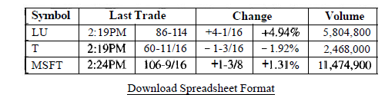
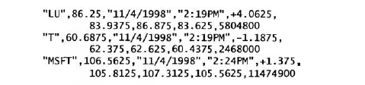
Retrieving numbers by interacting with a web browser is effective but time consuming.

Slide 65
A Prototype Library
the construction of a library for CSV by building one to throw away, a prototype.
Our starting point is a function csvgetl i ne that reads one line of CSV data from a
file into a buffer, splits it into fields in an array, removes quotes. and returns the number
of fields.

Slide 66
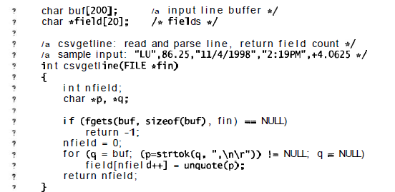

Slide 67
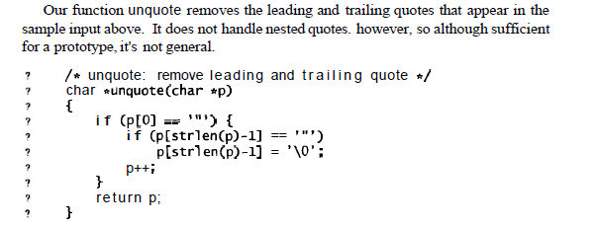

Slide 68
The comment at the top of the function includes an example of the input format that the program accepts; such comments are helpful for programs that parse messy input.
The CSV format is too complicated to be parsed easily by scanf so we use the C standard library function strtok.
Each call of strtok(p, s) returns a pointer to the first token within p consisting of characters not in s;
strtok terminates the token by overwriting the following character of the original string with a null byte.
On the first all, strtok's first argument is the string to scan; subsequent calls use NULL to indicate that scanning should resume where it left off in the previous call.
strtok stores a variable in a secret place between calls, only one sequence of calls may be active at one time

Slide 69
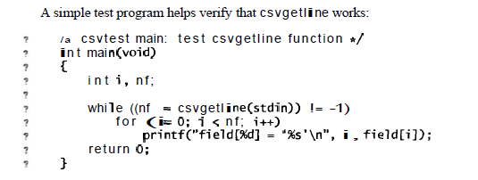

Slide 70
Comma Separated Values (CSV)
A natural and widely used format for tabular data
  Each row is a line of text
  The fields on each line are separated by commas
  Text format used by many spreadsheets
Example
  “Good Student”,CS265,”Advanced Programming Tools and Techniques”,A
  “Bad Student”,CS265,”Advanced Programming Tools and Techniques”,D

Slide 71
Prototype Library
“plan to throw one away; you will, anyhow” – Frederick Brooks
“It is not usually until you’ve built and used a version of the program that you understand the issues well enough to get the design right.”
First version
  ignore many of the difficulties
  complete enough to be useful and to gain some familiarity with the problem

Slide 72
Prototype
char buf[200]; /* input line buffer */
char *field[20]; /* fields */
/* csvgetline: read and parse line, return field count */
/* sample input: "LU",86.25,"11/4/1998","2:19PM",+4.0625 */
int csvgetline(FILE *fin)
{
int nfield;
char *p, *q;
if (fgets(buf, sizeof(buf), fin) == NULL)
return -1;
nfield = 0;
for (q = buf; (p=strtok(q, ",\n\r")) != NULL; q = NULL)
field[nfield++] = unquote(p);
return nfield;
}

Slide 73
Prototype
/* unquote: remove leading and trailing quote */
char *unquote(char *p)
{
if (p[0] == '"') {
if (p[strlen(p)-1] == '"')
p[strlen(p)-1] = '\0';
p++;
}
return p;
}
/* csvtest main: test csvgetline function */
int main(void)
{
int i, nf;
while ((nf = csvgetline(stdin)) != -1)
for (i = 0; i < nf; i++)
printf("field[%d] = `%s'\n", i, field[i]);
return 0;
}

Slide 74
Decisions Made in Prototype
Doesn’t handle long input lines or lots of fields
Lines terminated by newlines
Fields are separated by commas and surrounding quotes removed – no embedded quotes
Input line not preserved – overwritten when creating fields
No data saved from one input line to the next
Access to fields through global variable (does not prevent access beyond last field)

Slide 75
Decisions Made in Prototype
Global variables make code unsuitable to multi-threaded environment or interleaved calls
Caller must open and close files
Input and splitting are inextricably linked
The return value is the number of fields (each line must be split to compute this value)
Each decision is interwoven into the code. There is no way to change any of these properties without changing the code

Slide 76
Interface Principles
What is interface?
Interface is a detailed boundary between code that provides a service and code that uses it.
An interface defines what some body of code does for its users, how the functions and perhaps data members can be used by the rest of the program.

Slide 77
Interface (continue)
Interface provides three functions that only operations can be performed(CSV):
  Read a line
  Get a field
  Return the number of fields
  Must be well suited for its task to prosper (simple, general. regular, predictable, robust)
  Must adapt gracefully as its users and its implementation change.

Slide 78
Principles
Hide implementation details
Choose a small orthogonal set of primitives
Don't reach behind the user's back.
Do the same thing the same way everywhere

Slide 79
Hide implementation details
The implementation behind the interface should be hidden so it can be changed without affecting or breaking anything of the program.
Organizing principle: information hiding, encapsulation, abstraction, modularization, and the like all refer to related ideas.
An interface should hide details of the implementation that are irrelevant to the client (user) of the interface.
Details that are invisible can be changed without affecting the client. (extend the interface, more efficient, replace implementation)

Slide 80
Hide implementation details (continue)
Most programming languages provide almost same examples. Some are not perfectly well-designed:
For example: The C standard I/O library
The implementation of file I/O is hidden behind a data type FILE*. whose properties one might be able to see (because they are often spelled out in <stdi o. h>) but should not exploit.
opaque type: The header file does not include the actual structure declaration, just the name of the structure.
Avoid global variables: is better to pass references to all data through function arguments.

Slide 81
Hide implementation details (continue)
Classes in C++ and Java are better mechanisms for hiding information---they are central to the proper use of those languages.

Slide 82
Choose a small orthogonal set of primitives
An interface should provide as much functionality as necessary but no more, and the functions should not overlap excessively
in their capabilities.
A large interface is harder to build and maintain.
It also makes users harder to learn.
Narrow interface are preferred.

Slide 83
Choose a small orthogonal set of primitives ( continue)
Example:
C standard I/O library provides several ways to write a single character to an output stream:
char c;
putc(c, fp);
fputc(c, fp);
fprintf(fp, "%c", c);
fwrite(&c, sizeof (char), 1, fp) ;
If the stream is stdout, there are several more possibilities. These are convenient, but not all are necessary.

Slide 84
Choose a small orthogonal set of primitives ( continue)
Narrow interfaces are to be preferred to wide ones: “ Do one thing, and do it well.”-- Don't add to an interface just because it's possible to do so, and don't fix the interface when it's the implementation that's broken.

Slide 85
Don't reach behind the user's back(Do not be secret)
A library function should not write secret files and variables or change global data, and it should be circumspect about modifying data in its caller.
Example: Strtok function: strtok writes null characters into middle of input string. However the function writes NULL bytes into the middle of its input string.
The use of one interface should not demand another one just for the convenience of the interface designer or implementer. Instead, make the interface self-contained, or failing that, be explicit about what external services are required. Otherwise, you place a maintenance burden on the client.
Example: Managing huge lists of header files in C and C++ source.

Slide 86
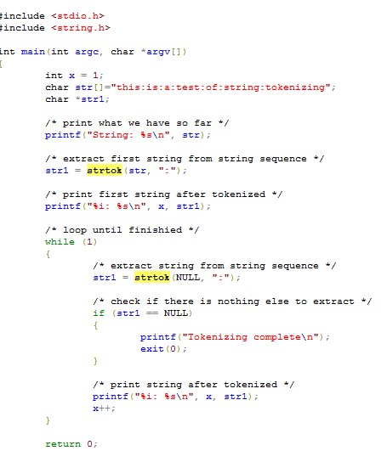

Slide 87
Do the same thing the same way everywhere ( be consistency)
Consistency and regularity are important.
The basic s t r . . . functions: easy to use without documentation -data flows from right to left, the same direction as in an assignment statement, and return the resulting string.
C Standard I/O library: hard to predict the order of arguments to functions.—Orders and sizes of elements varies.

Slide 88
be consistency (continue)
External consistency:
Example:
Mem function borrow style from str function.
f read and fwri t e would based on read and write function.

Slide 89
Summary of four principles
easier to follow, but still stand:
Example:
hard to hide implementation details in C
Comments in header files, names with special forms (such as --i ob), and so on are ways of encouraging good behavior when it can't be enforced.

Slide 90
there is a limit to how well we can do in designing an interface. Even the best interfaces of today may eventually become the problems of tomorrow, but good design can push tomorrow off a while longer.

