Slide 1
Message Passing Interface
COS 597C
Hanjun Kim

Slide 2


Serial Computing
1k pieces puzzle
Takes 10 hours

Slide 3

Parallelism on Shared Memory
Orange and green share the puzzle on the same table
Takes 6 hours
(not 5 due to communication & contention)

Slide 4







The more, the better??
Lack of seats (Resource limit)
More contention among people

Slide 5

Parallelism on Distributed Systems
Scalable seats (Scalable Resource)
Less contention from private memory spaces

Slide 6
How to share the puzzle?
DSM (Distributed Shared Memory)
Message Passing

Slide 7
DSM (Distributed Shared Memory)
Provides shared memory physically or virtually
Pros - Easy to use
Cons - Limited Scalability, High coherence overhead

Slide 8
Message Passing
Pros – Scalable, Flexible
Cons – Someone says it’s more difficult than DSM

Slide 9
MPI (Message Passing Interface)
A standard message passing specification for the vendors to implement
Context: distributed memory parallel computers
  Each processor has its own memory and cannot access the memory of other processors
  Any data to be shared must be explicitly transmitted from one to another
Most message passing programs use the single program multiple data (SPMD) model
  Each processor executes the same set of instructions
  Parallelization is achieved by letting each processor operation a different piece of data
  MIMD (Multiple Instructions Multiple Data)
Notes:
In practice, MPI is a set of functions (C) and subroutines (Fortran) used for exchanging data between processes

Slide 10
SPMD example
main(int argc, char **argv){
if(process is assigned Master role){
/* Assign work and coordinate workers and collect results */
MasterRoutine(/*arguments*/);
} else { /* it is worker process */
/* interact with master and other workers. Do the work and send results to the master*/
WorkerRoutine(/*arguments*/);
}
}

Slide 11
Why MPI?
Small
  Many programs can be written with only 6 basic functions
Large
  MPI’s extensive functionality from many functions
Scalable
  Point-to-point communication
Flexible
  Don’t need to rewrite parallel programs across platforms

Slide 12
What we need to know…
How many people are working?
What is my role?
How to send and receive data?

Slide 13
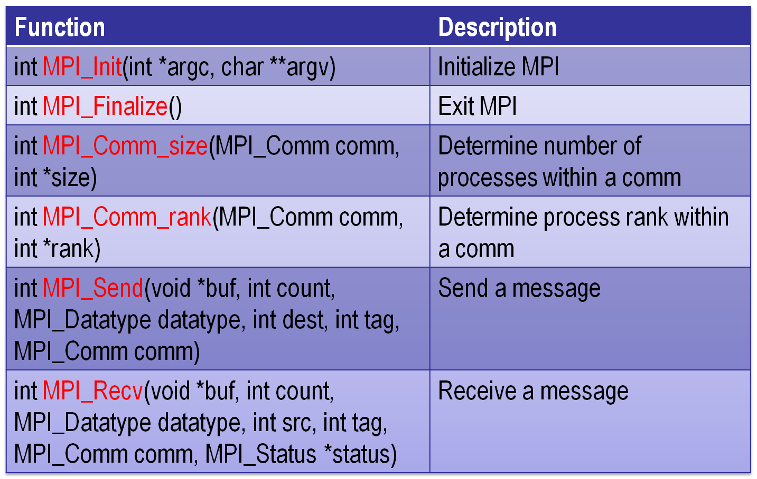
Basic functions

Slide 14
Communicator
An identifier associated with a group of processes
  Each process has a unique rank within a specific communicator from 0 to (nprocesses-1)
  Always required when initiating a communication by calling an MPI function
Default: MPI_COMM_WORLD
  Contains all processes
Several communicators can co-exist
  A process can belong to different communicators at the same time

Slide 15
Hello World
#include "mpi.h”
int main( int argc, char *argv[] ) {
int nproc, rank;
MPI_Init (&argc,&argv); /* Initialize MPI */
MPI_Comm_size(MPI_COMM_WORLD,&nproc); /* Get Comm Size*/
MPI_Comm_rank(MPI_COMM_WORLD,&rank); /* Get rank */
printf(“Hello World from process %d\n”, rank);
MPI_Finalize(); /* Finalize */
return 0;
}

Slide 16
How to compile…
Need to tell the compiler where to find the MPI include files and how to link to the MPI libraries.
Fortunately, most MPI implementations come with scripts that take care of these issues:
  mpicc mpi_code.c –o a.out
Two widely used (and free) MPI implementations
  MPICH (http://www-unix.mcs.anl.gov/mpi/mpich)
  OPENMPI (http://www.openmpi.org)

Slide 17
Blocking Message Passing
The call waits until the data transfer is done
  The sending process waits until all data are transferred to the system buffer
  The receiving process waits until all data are transferred from the system buffer to the receive buffer
  Buffers can be freely reused

Slide 18
Blocking Message Send
MPI_Send (void *buf, int count, MPI_Datatype dtype, int dest, int tag, MPI_Comm comm);
buf | Specifies the starting address of the buffer.
count | Indicates the number of buffer elements
dtype | Denotes the datatype of the buffer elements
dest | Specifies the rank of the destination process in the group associated with the communicator comm
tag | Denotes the message label
comm | Designates the communication context that identifies a group of processes

Slide 19
Blocking Message Send
Standard (MPI_Send) | The sending process returns when the system can buffer the message or when the message is received and the buffer is ready for reuse.
Buffered (MPI_Bsend) | The sending process returns when the message is buffered in an application-supplied buffer.
Synchronous (MPI_Ssend) | The sending process returns only if a matching receive is posted and the receiving process has started to receive the message.
Ready (MPI_Rsend) | The message is sent as soon as possible.

Slide 20
Blocking Message Receive
MPI_Recv (void *buf, int count, MPI_Datatype dtype, int source, int tag, MPI_Comm comm, MPI_Status *status);
buf | Specifies the starting address of the buffer.
count | Indicates the number of buffer elements
dtype | Denotes the datatype of the buffer elements
source | Specifies the rank of the source process in the group associated with the communicator comm
tag | Denotes the message label
comm | Designates the communication context that identifies a group of processes
status | Returns information about the received message
Notes:
. Status information is useful when wildcards are used or the received message is smaller than expected. Status may also contain error codes.

Slide 21
Example (from http://mpi.deino.net/mpi_functions/index.htm)
…
if (rank == 0) {
for (i=0; i<10; i++) buffer[i] = i;
MPI_Send(buffer, 10, MPI_INT, 1, 123, MPI_COMM_WORLD);
} else if (rank == 1) {
for (i=0; i<10; i++) buffer[i] = -1;
MPI_Recv(buffer, 10, MPI_INT, 0, 123, MPI_COMM_WORLD, &status);
for (i=0; i<10; i++)
if (buffer[i] != i)
printf("Error: buffer[%d] = %d but is expected to be %d\n", i, buffer[i], i);
}
…

Slide 22
Non-blocking Message Passing
Returns immediately after the data transferred is initiated
Allows to overlap computation with communication
Need to be careful though
  When send and receive buffers are updated before the transfer is over, the result will be wrong

Slide 23
Non-blocking Message Passing
MPI_Isend (void *buf, int count, MPI_Datatype dtype, int dest, int tag, MPI_Comm comm, MPI_Request *req);
MPI_Recv (void *buf, int count, MPI_Datatype dtype, int source, int tag, MPI_Comm comm, MPI_Request *req);
MPI_Wait(MPI_Request *req, MPI_Status *status);
req | Specifies the request used by a completion routine when called by the application to complete the send operation.
Blocking | MPI_Send | MPI_Bsend | MPI_Ssend | MPI_Rsend | MPI_Recv
Non-blocking | MPI_Isend | MPI_Ibsend | MPI_Issend | MPI_Irsend | MPI_Irecv

Slide 24
Non-blocking Message Passing
…
right = (rank + 1) % nproc;
left = rank - 1;
if (left < 0) left = nproc – 1;
MPI_Irecv(buffer, 10, MPI_INT, left, 123, MPI_COMM_WORLD, &request);
MPI_Isend(buffer2, 10, MPI_INT, right, 123, MPI_COMM_WORLD, &request2);
MPI_Wait(&request, &status);
MPI_Wait(&request2, &status);
…

Slide 25
How to execute MPI codes?
The implementation supplies scripts to launch the MPI parallel calculation
  mpirun –np #proc a.out
  mpiexec –n #proc a.out
A copy of the same program runs on each processor core within its own process (private address space)
Communication
  through the network interconnect
  through the shared memory on SMP machines

Slide 26
PBS: Portable Batch System
A cluster is shared with others
  Need to use a job submission system
PBS will allocate the job to some other computer, log in as the user, and execute it
  The script must contain cd's or absolute references to access files
Useful Commands
  qsub : submits a job
  qstat : monitors status
  qdel : deletes a job from a queue

Slide 27
PBS script
PBS | Description
#PBS -N jobname | Assign a name to job
#PBS -M email_address | Specify email address
#PBS -m b | Send email at job start
#PBS -m e | Send email at job end
#PBS -m a | Send email at job abort
#PBS -o out_file | Redirect stdout to specified file
#PBS -e errfile | Redirect stderr to specified file
#PBS -q queue_name | Specify queue to be used
#PBS -l select=chunk specification | Specify MPI resource requirements
#PBS -l walltime=runtime | Set wallclock time limit

Slide 28
PBS script example
#!/bin/bash
# request 4 nodes, each node runs 2 processes for 2 hours
#PBS –l nodes=4:ppn=2,walltime=02:00:00
# specify job queue
#PBS –q dque
# declare a name for this job
#PBS –N job_name
# specify your email address
#PBS –M usename@domain
# mail is sent to you when the job starts and when it terminates or aborts
#PBS –m bea
cd $WORK_DIR
mpirun –np 8 a.out

Slide 29
Collective communications
A single call handles the communication between all the processes in a communicator
There are 3 types of collective communications
  Data movement (e.g. MPI_Bcast)
  Reduction (e.g. MPI_Reduce)
  Synchronization (e.g. MPI_Barrier)

Slide 30
Broadcast
int MPI_Bcast(void *buffer, int count, MPI_Datatype datatype, int root, MPI_Comm comm);
  One process (root) sends data to all the other processes in the same communicator
  Must be called by all the processes with the same arguments
P1
A | B | C | D
P1
A | B | C | D
P2
P2
A | B | C | D
MPI_Bcast
P3
P3
A | B | C | D
P4
P4
A | B | C | D

Slide 31
Gather
int MPI_Gather(void *sendbuf, int sendcnt, MPI_Datatype sendtype, void *recvbuf, int recvcnt, MPI_Datatype recvtype, int root, MPI_Comm comm)
  One process (root) collects data to all the other processes in the same communicator
  Must be called by all the processes with the same arguments
P1
A
P1
A | B | C | D
P2
B
P2
MPI_Gather
P3
C
P3
P4
D
P4

Slide 32
Gather to All
int MPI_Allgather(void *sendbuf, int sendcnt, MPI_Datatype sendtype, void *recvbuf, int recvcnt, MPI_Datatype recvtype, MPI_Comm comm)
  All the processes collects data to all the other processes in the same communicator
  Must be called by all the processes with the same arguments
P1
A
P1
A | B | C | D
P2
B
P2
A | B | C | D
MPI_Allgather
P3
C
P3
A | B | C | D
P4
D
P4
A | B | C | D

Slide 33
Reduction
int MPI_Reduce(void *sendbuf, void *recvbuf, int count, MPI_Datatype datatype, MPI_Op op, int root, MPI_Comm comm)
  One process (root) collects data to all the other processes in the same communicator, and performs an operation on the data
  MPI_SUM, MPI_MIN, MPI_MAX, MPI_PROD, logical AND, OR, XOR, and a few more
  MPI_Op_create(): User defined operator
P1
A | … | … | …
P1
A+B+C+D
P2
B | … | … | …
P2
MPI_Reduce
P3
C | … | … | …
P3
P4
D | … | … | …
P4

Slide 34
Reduction to All
int MPI_Allreduce(void *sendbuf, void *recvbuf, int count, MPI_Datatype datatype, MPI_Op op, MPI_Comm comm)
  All the processes collect data to all the other processes in the same communicator, and perform an operation on the data
  MPI_SUM, MPI_MIN, MPI_MAX, MPI_PROD, logical AND, OR, XOR, and a few more
  MPI_Op_create(): User defined operator
P1
A | … | … | …
P1
A+B+C+D
P2
B | … | … | …
P2
A+B+C+D
MPI_Reduce
P3
C | … | … | …
P3
A+B+C+D
P4
D | … | … | …
P4
A+B+C+D

Slide 35
Synchronization
int MPI_Barrier(MPI_Comm comm)
  #include "mpi.h"
  #include <stdio.h>
  int main(int argc, char *argv[]) {
  int rank, nprocs;
  MPI_Init(&argc,&argv);
  MPI_Comm_size(MPI_COMM_WORLD,&nprocs);
  MPI_Comm_rank(MPI_COMM_WORLD,&rank);
  MPI_Barrier(MPI_COMM_WORLD);
  printf("Hello, world. I am %d of %d\n", rank, nprocs);
  MPI_Finalize();
  return 0;
  }

Slide 36
For more functions…
http://www.mpi-forum.org
http://www.llnl.gov/computing/tutorials/mpi/
http://www.nersc.gov/nusers/help/tutorials/mpi/intro/
http://www-unix.mcs.anl.gov/mpi/tutorial/gropp/talk.html
http://www-unix.mcs.anl.gov/mpi/tutorial/
MPICH (http://www-unix.mcs.anl.gov/mpi/mpich/)
Open MPI (http://www.open-mpi.org/)
MPI descriptions and examples are referred from
  http://mpi.deino.net/mpi_functions/index.htm
  Stéphane Ethier (PPPL)’s PICSciE/PICASso Mini-Course Slides

Slide 37
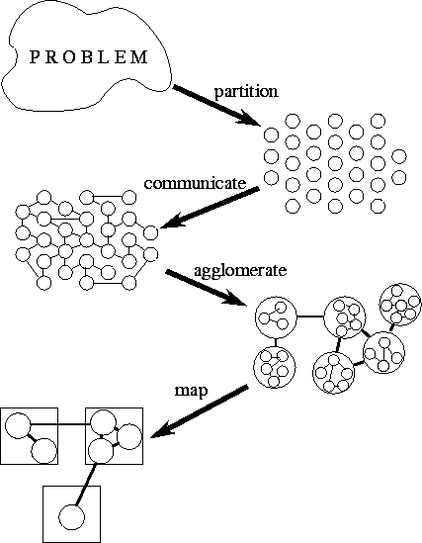
PARALLEL ALGORITHMS
Stages for designing parallel algorithms
Partitioning
Communication
Agglomeration
Mapping

