Slide 1
Multi-core Programming
Programming with OpenMP

Slide 2
Parallel Programming Models
Shared memory model
Message passing model

Slide 3
Shared memory model
All the threads can access Shared Memory Data.
Private Memory Data can only be accessed by the thread that owns it.
data reside in a single, shared address space
Communication is done implicitly through shared reads and writes of variables

Slide 4
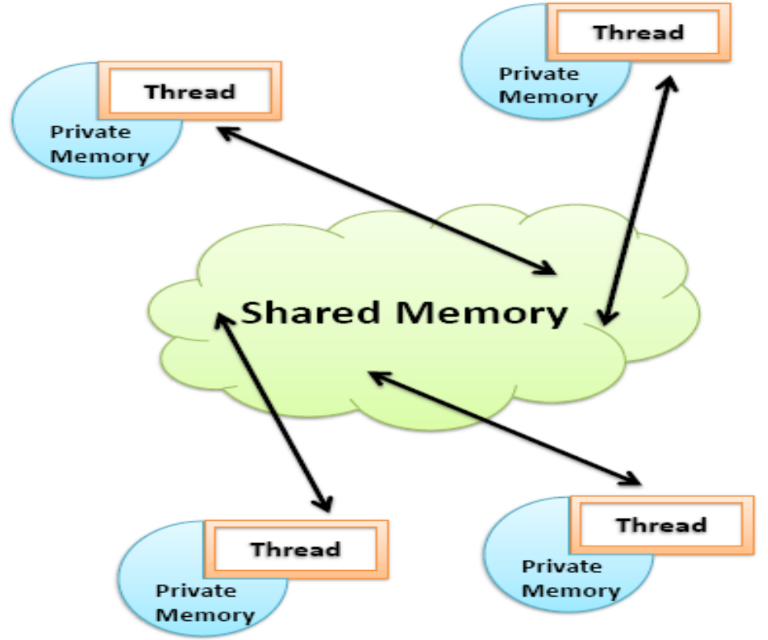
Shared memory model

Slide 5
Shared memory model
When a program starts to run, it consists of just one thread. The master thread then uses directives which initialize executing the Parallel Section. When all the threads finish executing their instructions, the results are synchronized and the program can continue through the completion.
Useful for multicore processors
Framework -OpenMP

Slide 6
Message passing model
  Allows data to be passed between processes.
  Send specifies buffer to be transmitted and receiving process
  Recv specifies sending process and storage to receive into
  Matching send and receive cause data transfer from one process to another

Slide 7
Message passing model
  Set of functions for cooperation of parallel processes
  For portable parallel programming
  For parallel computers, clusters and heterogeneous networks
  Framework - MPI
Match
Receive
Y
,
P
,
t
Send
X, Q, t
Addr
ess
Y
Addr
ess
X
Local pr
ocess
Local pr
ocess
addr
ess space
addr
ess space
Pr
ocess
P
Pr
ocess
Q

Slide 8
OpenMP Programming

Slide 9
Topics
What is OpenMP?
Parallel Regions
Worksharing Construct
Data Scoping to Protect Data
Explicit Synchronization
Scheduling Clauses
Other Helpful Constructs and Clauses

Slide 10
What Is OpenMP*?
Open Multi-Processing
Compiler directives for multithreaded programming
Easy to create threaded Fortran and C/C++ codes
Supports data parallelism model
Incremental parallelism
  Combines serial and parallel code in single source
Programming with OpenMP*
Notes:
Multi-core Programming: Programming with OpenMP Speaker’s Notes
Purpose of the Slide
Describe of the features and advantages of OpenMP.
Details
Incremental parallelism is when you can modify only a portion of the code to test for better performance in parallel, then move on to another position in the code to test. Explicit threading models require a change to all parts of the code affected by the threading.
Serial code can be “retrieved” by not compiling with the OpenMP options turned on. Assuming that there were no drastic changes required to get the code into a state that could be parallelized.

Slide 11
OpenMP* Architecture
Fork-join model
Work-sharing constructs
Data environment constructs
Synchronization constructs
Extensive Application Program Interface (API) for finer control
Programming with OpenMP*
Notes:
Multi-core Programming: Programming with OpenMP Speaker’s Notes
Purpose of the Slide
Describe several points about how OpenMP is structured.
Details
The first bullet point is the execution model of thread in OpenMP parallel regions. Last four bullet points are categories for the pragmas and directives.

Slide 12
Programming Model
Fork-join parallelism:
  Master thread spawns a team of threads as needed
  Parallelism is added incrementally: the sequential program evolves into a parallel program
Master Thread
Parallel Regions
Programming with OpenMP*
Notes:
Multi-core Programming: Programming with OpenMP Speaker’s Notes
Purpose of the Slide
Give a more detailed definition and example of fork-join parallelism within OpenMP.
Details
Applications starts execution in serial with Master Thread. At each parallel region encountered, threads are forked off, execute concurrently, and then join together at the end of the region.
Background
There is an API call to change the number of threads that will execute within a parallel region. This will be covered briefly later, if asked. How to choose the number of treads for a parallel region is covered in 3 slides.

Slide 13
OpenMP* Pragma Syntax
Most constructs in OpenMP* are compiler directives or pragmas.
    For C and C++, the pragmas take the form:
    #pragma omp construct [clause [clause]…]
Programming with OpenMP*
Notes:
Multi-core Programming: Programming with OpenMP Speaker’s Notes
Purpose of the Slide
Show the format of OpenMP pragmas and optional clauses.
Background
For Fortran, you can also use other sentinel’s (!$OMP), but these must exactly line up on columns 1-5. Column 6 must be blank or contain a + indicating that this line is a continuation from the previous line.
C$OMP
*$OMP
!$OMP

Slide 14
Parallel Regions
#pragma omp parallel
Defines parallel region over structured block of code
Threads are created as ‘parallel’ pragma is crossed
Threads block at end of region
Data is shared among threads unless specified otherwise
Thread
Thread
Thread
1
2
3
C/C++ :
  #pragma omp parallel
  {
  block
  }
Programming with OpenMP*
Notes:
Multi-core Programming: Programming with OpenMP Speaker’s Notes
Purpose of the Slide
Demonstrate use and execution of the “parallel” pragma that defines a parallel region.
Details
Pragma will operate over a single statement or block of statements enclosed within curly braces.
Variables accessed within the parallel region are all shared by default. (Methods to specify otherwise are covered later.)

Slide 15
How Many Threads?
Set environment variable for number of threads
  set OMP_NUM_THREADS=4
There is no standard default for this variable
  Many systems:
    # of threads = # of processors
    Intel® compilers use this default
Programming with OpenMP*
Notes:
Multi-core Programming: Programming with OpenMP Speaker’s Notes
Purpose of the Slide
Provide details on how to specify the number of threads that will be used during the execution of an OpenMP application.
Details
The order in which the system will try to determine the number threads is
1. default
2. environment variable
3. API call
Each successive method (if present) will override the previous.

Slide 16
Loop-Level Parallelism
  Concepts and techniques
    Loop-level parallelism is normally analyzed at the source level while most ILP analysis is done once the instructions have been generated by the compiler.
    The analysis of loop-level parallelism focuses on determining whether data accesses in later iterations are data dependent on data values produced in earlier iterations.
    Example:
    for (i=1; i<=1000; i++)
    x[i]=x[i]+s;
    Loop-carried data dependence: Dependence exists between different iterations of the loop.
    A loop is parallel unless there is a cycle in the dependences. Therefore, a non-cycled loop-carried data dependence can be eliminated by code transformation.

Slide 17
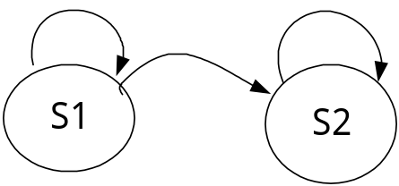
When Safe to parallelize a Loop?
Example: Where are data dependencies?
(A,B,C distinct & nonoverlapping)
for (i=0; i<100; i=i+1) {
A[i+1] = A[i] + C[i]; /* S1 */
B[i+1] = B[i] + A[i+1]; /* S2 */
}
S2 uses the value, A[i+1], computed by S1 in the same iteration. This is not a loop-carried dependence. ie dependence within the same iteration.
S1 uses a value computed by S1 in an earlier iteration, since iteration i computes A[i+1] which is read in iteration i+1. The same is true of S2 for B[i] and B[i+1]. This is a “loop-carried dependence”: between iterations
For our prior example, each iteration was distinct
LC
Not LC
LC

Slide 18
Parallelize Loop - Work-sharing Construct
#pragma omp parallel
#pragma omp for
for (i=0; i<N; i++){
Do_Work(i);
}
Splits loop iterations into threads
Must be in the parallel region
Must precede the loop
Programming with OpenMP*
Notes:
Multi-core Programming: Programming with OpenMP Speaker’s Notes
Purpose of the Slide
Introduce and describe the work-sharing loop coinstruct.

Slide 19
Work-sharing Construct
#pragma omp parallel
#pragma omp for
for(i = 0; i < 12; i++)
c[i] = a[i] + b[i]
#pragma omp parallel
#pragma omp for
i = 0
i = 1
i = 2
i = 3
i = 4
i = 5
i = 6
i = 7
i = 8
i = 9
i = 10
i = 11
Threads are assigned an independent set of iterations
Threads must wait at the end of work-sharing construct
Implicit barrier
Programming with OpenMP*
Notes:
Multi-core Programming: Programming with OpenMP Speaker’s Notes
Purpose of the Slide
Demonstrate use and execution of the “for” work-sharing pragma.
Details
Diagram shows a static division of iterations based on the number of threads.
Note implicit barrier at end of construct.
Questions to Ask Students
Q: Why is there a barrier at the end of the work-sharing construct?
A: Code following the for-loop may rely on the results of the computations within the for-loop. In serial code, the for-loop completes before proceeding on to the next computation. Thus, to remain serially consistent, the barrier at the end of the construct is enforced.

Slide 20
Combining pragmas
These two code segments are equivalent
#pragma omp parallel
{
#pragma omp for
for (i=0; i< MAX; i++) { res[i] = huge();
}
}
#pragma omp parallel for
for (i=0; i< MAX; i++) {
res[i] = huge();
}
Programming with OpenMP*
Notes:
Multi-core Programming: Programming with OpenMP Speaker’s Notes
Purpose of the Slide
Demonstrate that some pragmas can be combined.
Details
If there is parallel work to be done by threads before and/or after the for-loop, the program will need to use the separate version.

Slide 21
Data Environment
OpenMP uses a shared-memory programming model
    Most variables are shared by default.
    Global variables are shared among threads
      C/C++: File scope variables, static
Programming with OpenMP*
Notes:
Multi-core Programming: Programming with OpenMP Speaker’s Notes
Purpose of the Slide
Reiterate and provide more detail about shared variables in OpenMP.

Slide 22
Data Environment
But, not everything is shared...
  Stack variables in functions called from parallel regions are PRIVATE
  Automatic variables within a statement block are PRIVATE
  Loop index variables are private (with exceptions)
    C/C+: The first loop index variable in nested loops following a #pragma omp for
Programming with OpenMP*
Notes:
Multi-core Programming: Programming with OpenMP Speaker’s Notes
Purpose of the Slide
Give details on exceptions to the shared variable default.
Background
In Fortran, ALL nested loop index variables are private.

Slide 23
Data Scope Attributes
The default status can be modified with
  default (shared | none)
Scoping attribute clauses
  shared(varname,…)
  private(varname,…)
Programming with OpenMP*
Notes:
Multi-core Programming: Programming with OpenMP Speaker’s Notes
Purpose of the Slide
Give details on the data scoping clauses.
Details
All data clauses apply to parallel regions and work-sharing constructs except “shared,” which only applies to parallel regions.

Slide 24
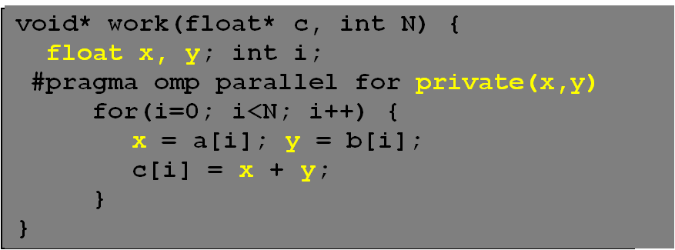
The Private Clause
Reproduces the variable for each thread
    Variables are un-initialized; C++ object is default constructed
    Any value external to the parallel region is undefined
Programming with OpenMP*
Notes:
Multi-core Programming: Programming with OpenMP Speaker’s Notes
Purpose of the Slide
Give an example of how to use the private clause.
Details
For-loop iteration variable is PRIVATE by default.
Emphasize that private variables are uninitialized when entering the region. Thus, the assignment to x and y is done before reading the values.
The private variables are destroyed at the end of the construct to which they are scoped.
Background
The shared copy of the private variables are undefined at the end of the construct (region). Thus, the value of x and y before the function returns is undefined and should not be relied upon.

Slide 25
Example: Dot Product
float dot_prod(float* a, float* b, int N)
{
float sum = 0.0;
#pragma omp parallel for shared(sum)
for(int i=0; i<N; i++) {
sum += a[i] * b[i];
}
return sum;
}
What is Wrong?
Programming with OpenMP*
Notes:
Multi-core Programming: Programming with OpenMP Speaker’s Notes
Purpose of the Slide
Example code that has a problem with a data race on the shared variable.
Details
Standard dot product algorithm. Multiply corresponding elements from 1-D vectors and add all the products to a single value.
The “shared” clause is superfluous since this is the default. It is used here to emphasize the problem.
We can’t make sum a private because we need to have the value after the parallel region.
Questions to Ask Students
Q: What is wrong with this code?
A: The shared variable “sum” is being read and updated by multiple threads and the answer is likely to be incorrect because of this data race.
Transition Quote
“Okay, so how do we fix this problem?”

Slide 26
Protect Shared Data
Must protect access to shared, modifiable data
float dot_prod(float* a, float* b, int N)
{
float sum = 0.0;
#pragma omp parallel for shared(sum)
for(int i=0; i<N; i++) {
#pragma omp critical
sum += a[i] * b[i];
}
return sum;
}
Programming with OpenMP*
Notes:
Multi-core Programming: Programming with OpenMP Speaker’s Notes
Purpose of the Slide
Demonstrate and illustrate one method of enforcing mutual exclusion in OpenMP.
Details
The “critical” pragma allows only one thread at a time to execute the update of sum.

Slide 27
OpenMP* Critical Construct
#pragma omp critical [(lock_name)]
Defines a critical region on a structured block
float R1, R2;
#pragma omp parallel
{ float A, B;
#pragma omp for
for(int i=0; i<niters; i++){
B = big_job(i);
#pragma omp critical
consum (B, &R1);
A = bigger_job(i);
#pragma omp critical
consum (A, &R2);
}
}
Threads wait their turn –at a time, only one calls consum() thereby protecting R1 and R2 from race conditions.
Naming the critical constructs is optional, but may increase performance.
(R1_lock)
(R2_lock)
Programming with OpenMP*
Notes:
Multi-core Programming: Programming with OpenMP Speaker’s Notes
Purpose of the Slide
Show format of critical pragma and give an example on why naming critical regions would be useful.
Details
Build points reveal that the critical constructs can be named. Without names, each construct has the same name and only one thread will be allowed to execute within each different named region. Thus, in the example, since R1 and R2 are unrelated and will never be aliased, naming the constructs allows one thread to be in each at the same time.

Slide 28
OpenMP* Reduction Clause
reduction (op : list)
The variables in “list” must be shared in the enclosing parallel region
Inside parallel or work-sharing construct:
    A PRIVATE copy of each list variable is created and initialized depending on the “op”
    These copies are updated locally by threads
    At end of construct, local copies are combined through “op” into a single value and combined with the value in the original SHARED variable
Programming with OpenMP*
Notes:
Multi-core Programming: Programming with OpenMP Speaker’s Notes
Purpose of the Slide
Describe format and usage of the reduction clause.
Details
The operation must be an associative operation. Different operations are defined for C and Fortran, depending on what intrinsics are available in the language.
The private copies of the list variables will be initialized with a value that depends on the operation. (Initial values are shown in two slides.)

Slide 29
Reduction Example
#pragma omp parallel for reduction(+:sum)
for(i=0; i<N; i++) {
sum += a[i] * b[i];
}
Local copy of sum for each thread
All local copies of sum added together and stored in “global” variable
Programming with OpenMP*
Notes:
Multi-core Programming: Programming with OpenMP Speaker’s Notes
Purpose of the Slide
Rewrite the dot product function with the reduction clause.

Slide 30
C/C++ Reduction Operations
A range of associative and commutative operators can be used with reduction
Initial values are the ones that make sense
Operator | Initial Value
+ | 0
* | 1
- | 0
Operator | Initial Value
^ | 0
& | ~0
| | 0
&& | 1
|| | 0
Programming with OpenMP*
Notes:
Multi-core Programming: Programming with OpenMP Speaker’s Notes
Purpose of the Slide
Provide a list of the legal operators for C/C++ and their associated initial values.
Background
It is assumed that the operation performed with the scope of a reduction clause will be the same as the operator in the clause. Thus, the partial results of a subtraction reduction will be added together (having been subtracted from the initial zero value).
There is no check to ensure that the computation within the reduction matches the reduction operator.

Slide 31
Numerical Integration Example
static long num_steps=100000; double step, pi;
void main()
{ int i;
double x, sum = 0.0;
step = 1.0/(double) num_steps;
#pragma omp parallel for reduction(+:sum)
{
for (i=0; i< num_steps; i++)
{
x = (i+0.5)*step;
sum = sum + 4.0/(1.0 + x*x);
}
}
pi = step * sum;
printf(“Pi = %f\n”,pi);
}
1
4.0
∫
4.0
4.0
dx = π
f(x) =
(1+x²)
(1+x²)
0
2.0
0.0
X
1.0
Programming with OpenMP*
Notes:
Multi-core Programming: Programming with OpenMP Speaker’s Notes
Purpose of the Slide
Present information and code to compute pi by numerical integration.
Details
Point out all the salient features of the source code.
Questions to Ask Students
Q: Where is the bulk of the work found in the code?
A: The for-loop.
Q: Where should we focus attention if we were to thread this code?
A: The for-loop.
Transition Quote
“Okay, let’s thread that code!”

Slide 32
Assigning Iterations
The schedule clause affects how loop iterations are mapped onto threads
  schedule(static [,chunk])
    Blocks of iterations of size “chunk” to threads
    Round robin distribution
  schedule(dynamic[,chunk])
    Threads grab “chunk” iterations
    When done with iterations, thread requests next set
  schedule(guided[,chunk])
    Dynamic schedule starting with large block
    Size of the blocks shrink; no smaller than “chunk”
Programming with OpenMP*
Notes:
Multi-core Programming: Programming with OpenMP Speaker’s Notes
Purpose of the Slide
Present the three main scheduling clauses for work-sharing loop construct.
Details
Default chunk size for static is to divide the set of iterations into one chunk per thread.
Default chunk size for dynamic is 1.
Default chunk size for guided is 1.
Background
There is also the runtime schedule. This takes a schedule and chunk from the string assigned to the environment variable OMP_SCHEDULE. Rather than rebuild the application each time a new schedule is desired, the runtime schedule can be specified at run-time and performance tested. Thus, the best schedule can be found empirically and then coded into the application source.

Slide 33
Assigning Iterations
The partitioning of a loop is based on the formula - Π_{k}= β_{k}/2N
  β₀ initial number of iterations
  Π_{k} size of kth chunk
  S chunk size
  N number of threads

Slide 34
If a loop has 800 iterations, chunk size is 80 and number of threads are 2, how the loop scheduling is performed if schedule type is guided.
Given – loop with β0= 800 , N=2, and S=80
The loop partition={π0=200, π1=150, π2=113, π3=85, π4=80, π5=80, π6=80, π7=12}
When π4 is smaller than 80, it gets clipped to 80.

Slide 35
Which Schedule to Use
Schedule Clause | When To Use
STATIC | Predictable and similar work per iteration
DYNAMIC | Unpredictable, highly variable work per iteration
GUIDED | Special case of dynamic to reduce scheduling overhead
Programming with OpenMP*
Notes:
Multi-core Programming: Programming with OpenMP Speaker’s Notes
Purpose of the Slide
Describe situations where each of the preceding schedule clauses would be most useful.

Slide 36
Schedule Clause Example
#pragma omp parallel for schedule (static, 8)
for( int i = start; i <= end; i += 2 )
{
if ( TestForPrime(i) ) gPrimesFound++;
}
Iterations are divided into chunks of 8 iterations each.
    If start = 3, then first chunk is i={3,5,7,9,11,13,15,17}
Programming with OpenMP*
Notes:
Multi-core Programming: Programming with OpenMP Speaker’s Notes
Purpose of the Slide
Show example of the use of a schedule clause.
Details
C example uses STATIC scheduling. Set of iterations is divided up into chunks of size 8 and distributed to threads in round robin fashion.

Slide 37
Parallel Sections
Independent sections of code can execute concurrently
#pragma omp parallel sections
{
#pragma omp section
phase1();
#pragma omp section
phase2();
#pragma omp section
phase3();
}
Serial
Parallel
Programming with OpenMP*
Notes:
Multi-core Programming: Programming with OpenMP Speaker’s Notes
Purpose of the Slide
Present and show example of OpenMP sections for task parallelism.
Details
Note that the outer pragma is plural.
No need to block code within curly braces. The task is composed of all lines of code between the “section” pragmas. Thus, if the third “section” pragma were erased, there would be two tasks defined: A. phase1, and B) phase2 followed by phase3.
There is an implicit barrier at the end of the “sections” pragma.
Questions to Ask Students
Q: What if there are more/less threads than tasks? How are tasks assigned to threads?
A: Scheduling of tasks to threads is implementation dependent. Sections are distributed among the threads in the parallel team. Each section is executed only once and each thread may execute zero or more sections. It’s not possible to determine whether or not a section will be executed before another. Therefore, the output of one section should not serve as the input to another. Instead, the section that generates output should be moved before the sections construct.

Slide 38
Single Construct
Denotes block of code to be executed by only one thread
    Thread chosen is implementation dependent
Implicit barrier at end
#pragma omp parallel
{
DoManyThings();
#pragma omp single
{
ExchangeBoundaries();
} // threads wait here for single
DoManyMoreThings();
}
Programming with OpenMP*
Notes:
Multi-core Programming: Programming with OpenMP Speaker’s Notes
Purpose of the Slide
Describe the OpenMP single construct.
Details
Used when only one thread should execute a portion of code. This could be used when two parallel regions have very little serial code in between. Combine the two regions into a single region (less overhead for fork-join) and add the “single” construct for the serial portion.

Slide 39
Master Construct
Denotes block of code to be executed only by the master thread
No implicit barrier at end
#pragma omp parallel
{
DoManyThings();
#pragma omp master
{ // if not master skip to next stmt
ExchangeBoundaries();
}
DoManyMoreThings();
}
Programming with OpenMP*
Notes:
Multi-core Programming: Programming with OpenMP Speaker’s Notes
Purpose of the Slide
Describe the OpenMP master construct.
Details
Similar to “single” but the master thread is chosen. No barrier at end of construct.

Slide 40
Implicit Barriers
Several OpenMP* constructs have implicit barriers
    parallel
    for
    single
Unnecessary barriers hurt performance
    Waiting threads accomplish no work!
Suppress implicit barriers, when safe, with the nowait clause
Programming with OpenMP*
Notes:
Multi-core Programming: Programming with OpenMP Speaker’s Notes
Purpose of the Slide
Provide introduction and rationale for use of nowait clause on constructs with implicit barrier.

Slide 41
Nowait Clause
#pragma omp for nowait
for(...)
{...};
#pragma single nowait
{ [...] }
Use when threads would wait between independent computations
#pragma omp for schedule(dynamic,1) nowait
for(int i=0; i<n; i++)
a[i] = bigFunc1(i);
#pragma omp for schedule(dynamic,1)
for(int j=0; j<m; j++)
b[j] = bigFunc2(j);
Programming with OpenMP*
Notes:
Multi-core Programming: Programming with OpenMP Speaker’s Notes
Purpose of the Slide
Give examples of syntax and usage for nowait clause.
Details
Schedule in each loop is (dynamic, 1) and computations in each loop are independent of each other (one loop updates a[], other loop updates b[]). Without nowait clause, threads would pause until all work is done in first loop; with nowait clause, when work is exhausted from first loop, threads can begin executing work in second loop. (It is possible that the second loop can complete all work before the work in the first loop is done.)

Slide 42
Barrier Construct
Explicit barrier synchronization
Each thread waits until all threads arrive
#pragma omp parallel shared (A, B, C)
{
DoSomeWork(A,B);
printf(“Processed A into B\n”);
#pragma omp barrier
DoSomeWork(B,C);
printf(“Processed B into C\n”);
}
Programming with OpenMP*
Notes:
Multi-core Programming: Programming with OpenMP Speaker’s Notes
Purpose of the Slide
Describe the OpenMP barrier construct.
Details
Example code likely uses A to update B in first call, and B to update C in second call. Thus, to ensure correct execution, all processing from first call must be completed before starting second call.

Slide 43
Atomic Construct
Special case of a critical section
Applies only to simple update of memory location
#pragma omp parallel for shared(x, y, index, n)
for (i = 0; i < n; i++) {
#pragma omp atomic
x[index[i]] += work1(i);
y[i] += work2(i);
}
Programming with OpenMP*
Notes:
Multi-core Programming: Programming with OpenMP Speaker’s Notes
Purpose of the Slide
Describe the OpenMP atomic construct.
Details
Only a small set of instruction can be used within the atomic pragma.
Since index[i] can be the same for different i values, the update to x must be protected. In this case, the update to an element of x[] is atomic. The other computations (call to work1() and the computation of the value in index[i]) will not be done atomically.
Use of a critical section would serialize updates to x. Atomic protects individual elements of x array, so that if multiple, concurrent instances of index[i] are different, updates can still be done in parallel.
Background
The operations allowed within atomic are:
x <binop>= <expr>
x++
++x
x—
--x
where x is “an lvalue expression of scalar type.”
Questions to Ask Students
(Include any specific questions (and answers) that the instructor could/should ask to enhance understanding.)
<Remove these lines and start typing here; retain the sub-heading.>
Transition Quote
(Suggested dialog that can be used by the instructor to segue into the next slide.)
<Remove these lines and start typing here; retain the sub-heading.>
Atomic Construct
Since index[i] can be the same for different I values, the update to x must be protected. Use of a critical section would serialize updates to x. Atomic protects individual elements of x array, so that if multiple, concurrent instances of index[i] are different, updates can still be done in parallel.

Slide 44
Use of a critical section would serialize updates to x.
Atomic protects individual elements of x array, so that if multiple, concurrent instances of index[i] are different, updates can still be done in parallel.
The operations allowed within atomic are:
  x <binop>= <expr>
  x++
  ++x
  X--
  --x

Slide 45
OpenMP* API
Get the thread number within a team
  int omp_get_thread_num(void);
Get the number of threads in a team
  int omp_get_num_threads(void);
Usually not needed for OpenMP codes
    Can lead to code not being serially consistent
    Does have specific uses (debugging)
    Must include a header file
    #include <omp.h>
Programming with OpenMP*
Notes:
Multi-core Programming: Programming with OpenMP Speaker’s Notes
Purpose of the Slide
Give a brief overview of the OpenMP API functions available, specifically the two listed in the slide.
Details
Emphasize that API calls are usually not needed. Assignment of loop iterations and other computations to threads is already built into OpenMP.
Background
It has been seen that MPI programmers that use OpenMP use the API routines more often than others. This is likely due to the need in MPI to know the rank of the process and compute the work to be done based on that rank within the set of all processes.

Slide 46

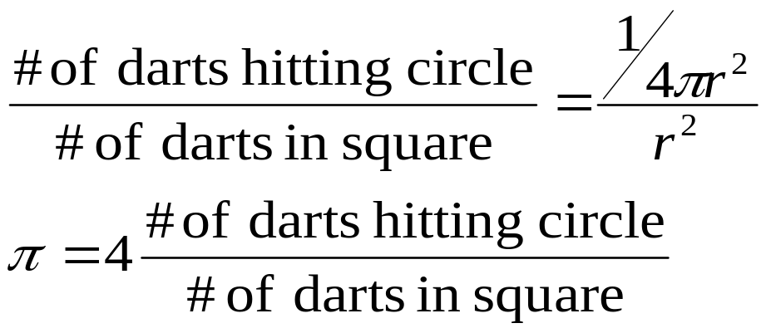
Monte Carlo Pi
loop 1 to MAX
  x.coor=(random#)
  y.coor=(random#)
  dist=sqrt(x^2 + y^2)
  if (dist <= 1)
  hits=hits+1
pi = 4 * hits/MAX
r
Programming with OpenMP*
Notes:
Multi-core Programming: Programming with OpenMP Speaker’s Notes
Purpose of the Slide
Introduce the method of using Monte Carlo techniques for computing pi.

Slide 47
Making Monte Carlo’s Parallel
  hits = 0
  call SEED48(1)
  DO I = 1, max
  x = DRAND48()
  y = DRAND48()
  IF (SQRT(x*x + y*y) .LT. 1) THEN
  hits = hits+1
  ENDIF
  END DO
  pi = REAL(hits)/REAL(max) * 4.0
What is the challenge here?
Programming with OpenMP*
Notes:
Multi-core Programming: Programming with OpenMP Speaker’s Notes
Purpose of the Slide
Promote discussion of what might be a problem if the serial code were to be threaded.
Details
The problem is that the library routines for random number generation may not be thread safe. The Random Number generator maintains a static variable (the Seed). The only way to make this parallel is to do it in a critical section for each call of the DRAND(), which is a lot of overhead.

Slide 48
Programming with OpenMP
What’s Been Covered
OpenMP* is:
    A simple approach to parallel programming for shared memory machines
We explored basic OpenMP coding on how to:
    Make code regions parallel (omp parallel)
    Split up work (omp for)
    Categorize variables (omp private….)
    Synchronize (omp critical…)
We reinforced fundamental OpenMP concepts through several labs
Programming with OpenMP*
Notes:
Multi-core Programming: Programming with OpenMP Speaker’s Notes
Purpose of the Slide
Summary of the module.

Slide 49
Advanced Concepts

Slide 50
More OpenMP*
Data environment constructs
    FIRSTPRIVATE
    LASTPRIVATE
    THREADPRIVATE
Programming with OpenMP*
Notes:
Multi-core Programming: Basic Concepts Speaker’s Notes
Purpose of the Slide
(This is mandatory.)
<Remove these lines and start typing here; retain the sub-heading.>
Details
(Explain points not obvious on slide, or describe build steps; suggested strategies for approaching the material would be included here, too.)
<Remove these lines and start typing here; retain the sub-heading.>
Background
(Include any support material, stories, anecdotes, or references that might be helpful to the instructor.)
<Remove these lines and start typing here; retain the sub-heading.>
Questions to Ask Students
(Include any specific questions (and answers) that the instructor could/should ask to enhance understanding.)
<Remove these lines and start typing here; retain the sub-heading.>
Transition Quote
(Suggested dialog that can be used by the instructor to segue into the next slide.)
<Remove these lines and start typing here; retain the sub-heading.>

Slide 51
Firstprivate Clause
Semantically similar to a private variable.
Each thread’s copy of firstprivate variable is initialized with the value of the original variable.
incr=0;
#pragma omp parallel for firstprivate(incr)
for (I=0;I<=MAX;I++) {
if ((I%2)==0) incr++;
A(I)=incr;
}
Programming with OpenMP*
Notes:
Multi-core Programming: Basic Concepts Speaker’s Notes
Purpose of the Slide
(This is mandatory.)
<Remove these lines and start typing here; retain the sub-heading.>
Details
(Explain points not obvious on slide, or describe build steps; suggested strategies for approaching the material would be included here, too.)
<Remove these lines and start typing here; retain the sub-heading.>
Background
(Include any support material, stories, anecdotes, or references that might be helpful to the instructor.)
<Remove these lines and start typing here; retain the sub-heading.>
Questions to Ask Students
(Include any specific questions (and answers) that the instructor could/should ask to enhance understanding.)
<Remove these lines and start typing here; retain the sub-heading.>
Transition Quote
(Suggested dialog that can be used by the instructor to segue into the next slide.)
<Remove these lines and start typing here; retain the sub-heading.>

Slide 52
Lastprivate Clause
The value of the master thread’s copy of a lastprivate variable will be assigned with the value produced by sequentially last iteration of the associated for loop
void sq2(int n,
double *lastterm)
{
double x; int i;
#pragma omp parallel
#pragma omp for lastprivate(x)
for (i = 0; i < n; i++)
{
x = a[i]*a[i] + b[i]*b[i];
b[i] = sqrt(x);
}
lastterm = x;
}
Programming with OpenMP*
Notes:
Multi-core Programming: Basic Concepts Speaker’s Notes
Purpose of the Slide
(This is mandatory.)
<Remove these lines and start typing here; retain the sub-heading.>
Details
(Explain points not obvious on slide, or describe build steps; suggested strategies for approaching the material would be included here, too.)
<Remove these lines and start typing here; retain the sub-heading.>
Background
(Include any support material, stories, anecdotes, or references that might be helpful to the instructor.)
<Remove these lines and start typing here; retain the sub-heading.>
Questions to Ask Students
(Include any specific questions (and answers) that the instructor could/should ask to enhance understanding.)
<Remove these lines and start typing here; retain the sub-heading.>
Transition Quote
(Suggested dialog that can be used by the instructor to segue into the next slide.)
<Remove these lines and start typing here; retain the sub-heading.>

Slide 53
Lastprivate -example
void main()
{
int lp=0,i,tid;
printf("In the parallel region\n");
#pragma omp parallel for firstprivate(lp),
lastprivate(lp) private(tid)
for(i=0;i<10;i++)
{
tid=omp_get_thread_num();
lp = lp+i;
printf("Thread %d i=%d lp=%d\n",tid,i,lp);
}
printf("\nAfter the parallel region lp=%d \n",lp);
}

Slide 54
Lastprivate -example
In the parallel region
Thread 0 i=0 lp=0
Thread 1 i=5 lp=5
Thread 0 i=1 lp=1
Thread 0 i=2 lp=3
Thread 0 i=3 lp=6
Thread 1 i=6 lp=11
Thread 1 i=7 lp=18
Thread 1 i=8 lp=26
Thread 1 i=9 lp=35
Thread 0 i=4 lp=10
After the parallel region lp=35

Slide 55
Threadprivate Clause
Makes global file-scope variables private to each thread but global within the thread
Use copyin to initialize from master thread
struct Astruct A;
#pragma omp threadprivate(A)
…
#pragma omp parallel copyin(A)
do_something_to(&A);
…
#pragma omp parallel
do_something_else_to(&A);
Private copies of “A” persist between regions
Programming with OpenMP*
Notes:
Multi-core Programming: Basic Concepts Speaker’s Notes
Purpose of the Slide
(This is mandatory.)
<Remove these lines and start typing here; retain the sub-heading.>
Details
(Explain points not obvious on slide, or describe build steps; suggested strategies for approaching the material would be included here, too.)
<Remove these lines and start typing here; retain the sub-heading.>
Background
(Include any support material, stories, anecdotes, or references that might be helpful to the instructor.)
<Remove these lines and start typing here; retain the sub-heading.>
Questions to Ask Students
(Include any specific questions (and answers) that the instructor could/should ask to enhance understanding.)
<Remove these lines and start typing here; retain the sub-heading.>
Transition Quote
(Suggested dialog that can be used by the instructor to segue into the next slide.)
<Remove these lines and start typing here; retain the sub-heading.>

Slide 56
Threadprivate Clause
Reference to a threadprivate variable outside a parallel region or inside a master region will result in reference to master thread's copy of that variable
The data in the thread’s copy of a threadprivate variable is carried on from one parallel region to another only if the dynamic adjustment of number of threads is disabled and the number of threads remains the same in all parallel regions.
Programming with OpenMP*
Notes:
Multi-core Programming: Basic Concepts Speaker’s Notes
Purpose of the Slide
(This is mandatory.)
<Remove these lines and start typing here; retain the sub-heading.>
Details
(Explain points not obvious on slide, or describe build steps; suggested strategies for approaching the material would be included here, too.)
<Remove these lines and start typing here; retain the sub-heading.>
Background
(Include any support material, stories, anecdotes, or references that might be helpful to the instructor.)
<Remove these lines and start typing here; retain the sub-heading.>
Questions to Ask Students
(Include any specific questions (and answers) that the instructor could/should ask to enhance understanding.)
<Remove these lines and start typing here; retain the sub-heading.>
Transition Quote
(Suggested dialog that can be used by the instructor to segue into the next slide.)
<Remove these lines and start typing here; retain the sub-heading.>

Slide 58
Threadprivate -example
int tp1,p;
float tp2;
#pragma omp threadprivate(tp1, tp2)
int main ()
{
int tid;
omp_set_dynamic(0); // To enable threadprivate variables
tp1=5;
printf("----------------------------------------\n");
printf("Parallel Region-1\n");
#pragma omp parallel private(tid,p) copyin(tp1)
{
tid = omp_get_thread_num();
tp1+=tid;
tp2+=tid;
p=tp1+tp2;
printf("Thread %d: tp1=%d, tp2=%0.1f,
p=%d\n",tid,tp1,tp2,p);
}

Slide 59
Threadprivate -example
printf("----------------------------------------\n");
printf("Serial Region \n");
tid = omp_get_thread_num();
printf("Thread %d: tp1=%d, tp2=%0.1f,
p=%d\n",tid,tp1,tp2,p);
printf("----------------------------------------\n");
printf("Parallel Region-2\n");
#pragma omp parallel private(tid)
{
tid = omp_get_thread_num();
printf("Thread %d: tp1=%d, tp2=%0.1f\n",tid,tp1,tp2);
}
printf("----------------------------------------\n");
return 0;
}

Slide 60
Threadprivate -example
----------------------------------------
Parallel Region-1
Thread 0: tp1=5, tp2=0.0, p=5
Thread 1: tp1=6, tp2=1.0, p=7
----------------------------------------
Serial Region
Thread 0: tp1=5, tp2=0.0, p=0
----------------------------------------
Parallel Region-2
Thread 1: tp1=6, tp2=1.0
Thread 0: tp1=5, tp2=0.0
----------------------------------------

Slide 61
Performance Issues
Idle threads do no useful work
Divide work among threads as evenly as possible
    Threads should finish parallel tasks at same time
Synchronization may be necessary
    Minimize time waiting for protected resources
Programming with OpenMP*
Notes:
Multi-core Programming: Basic Concepts Speaker’s Notes
Purpose of the Slide
(This is mandatory.)
<Remove these lines and start typing here; retain the sub-heading.>
Details
(Explain points not obvious on slide, or describe build steps; suggested strategies for approaching the material would be included here, too.)
<Remove these lines and start typing here; retain the sub-heading.>
Background
(Include any support material, stories, anecdotes, or references that might be helpful to the instructor.)
<Remove these lines and start typing here; retain the sub-heading.>
Questions to Ask Students
(Include any specific questions (and answers) that the instructor could/should ask to enhance understanding.)
<Remove these lines and start typing here; retain the sub-heading.>
Transition Quote
(Suggested dialog that can be used by the instructor to segue into the next slide.)
<Remove these lines and start typing here; retain the sub-heading.>

Slide 62
Load Imbalance
Unequal work loads lead to idle threads and wasted time.
#pragma omp parallel
{
#pragma omp for
for( ; ; ){
}
}
Busy
Idle
time
time
Programming with OpenMP*
Notes:
Multi-core Programming: Basic Concepts Speaker’s Notes
Purpose of the Slide
(This is mandatory.)
<Remove these lines and start typing here; retain the sub-heading.>
Details
(Explain points not obvious on slide, or describe build steps; suggested strategies for approaching the material would be included here, too.)
<Remove these lines and start typing here; retain the sub-heading.>
Background
(Include any support material, stories, anecdotes, or references that might be helpful to the instructor.)
<Remove these lines and start typing here; retain the sub-heading.>
Questions to Ask Students
(Include any specific questions (and answers) that the instructor could/should ask to enhance understanding.)
<Remove these lines and start typing here; retain the sub-heading.>
Transition Quote
(Suggested dialog that can be used by the instructor to segue into the next slide.)
<Remove these lines and start typing here; retain the sub-heading.>
Load Imbalance
Relieve load imbalance
Static even scheduling
Equal size iteration chunks
Based on runtime loop limits
Totally parallel scheduling
OpenMP* default
Dynamic and guided scheduling
The threads do some work then get the next chunk.
There is some cost in scheduling algorithm.

Slide 63
Synchronization
Lost time waiting for locks
#pragma omp parallel
{
#pragma omp critical
{
...
}
...
}
Busy
Idle
In Critical
time
Programming with OpenMP*
Notes:
Multi-core Programming: Basic Concepts Speaker’s Notes
Purpose of the Slide
(This is mandatory.)
<Remove these lines and start typing here; retain the sub-heading.>
Details
(Explain points not obvious on slide, or describe build steps; suggested strategies for approaching the material would be included here, too.)
<Remove these lines and start typing here; retain the sub-heading.>
Background
(Include any support material, stories, anecdotes, or references that might be helpful to the instructor.)
<Remove these lines and start typing here; retain the sub-heading.>
Questions to Ask Students
(Include any specific questions (and answers) that the instructor could/should ask to enhance understanding.)
<Remove these lines and start typing here; retain the sub-heading.>
Transition Quote
(Suggested dialog that can be used by the instructor to segue into the next slide.)
<Remove these lines and start typing here; retain the sub-heading.>
Synchronization
Methods for tuning synchronization:
Reduce lock contention
Different named critical sections
Introduce domain-specific locks
Merge parallel loops and remove barriers
Merge small critical sections
Move critical sections outside loops

Slide 64
Performance Tuning
Profilers use sampling to provide performance data.
Traditional profilers are of limited use for tuning OpenMP*:
    Measure CPU time, not wall clock time
    Do not report contention for synchronization objects
    Cannot report load imbalance
    Are unaware of OpenMP constructs
Programmers need profilers specifically designed for OpenMP.
Programming with OpenMP*
Notes:
Multi-core Programming: Basic Concepts Speaker’s Notes
Purpose of the Slide
(This is mandatory.)
<Remove these lines and start typing here; retain the sub-heading.>
Details
(Explain points not obvious on slide, or describe build steps; suggested strategies for approaching the material would be included here, too.)
<Remove these lines and start typing here; retain the sub-heading.>
Background
(Include any support material, stories, anecdotes, or references that might be helpful to the instructor.)
<Remove these lines and start typing here; retain the sub-heading.>
Questions to Ask Students
(Include any specific questions (and answers) that the instructor could/should ask to enhance understanding.)
<Remove these lines and start typing here; retain the sub-heading.>
Transition Quote
(Suggested dialog that can be used by the instructor to segue into the next slide.)
<Remove these lines and start typing here; retain the sub-heading.>
Performance Tuning
Mention time inside synch constructs, and so on.

Slide 65
Static Scheduling: Doing It By Hand
Must know:
    Number of threads (Nthrds)
    Each thread ID number (id)
Compute start and end iterations:
#pragma omp parallel
{
int i, istart, iend;
istart = id * N / Nthrds;
iend = (id+1) * N / Nthrds;
for(i=istart;i<iend;i++){ c[i] = a[i] + b[i];}
}
Programming with OpenMP*
Notes:
Multi-core Programming: Basic Concepts Speaker’s Notes
Purpose of the Slide
(This is mandatory.)
<Remove these lines and start typing here; retain the sub-heading.>
Details
(Explain points not obvious on slide, or describe build steps; suggested strategies for approaching the material would be included here, too.)
<Remove these lines and start typing here; retain the sub-heading.>
Background
(Include any support material, stories, anecdotes, or references that might be helpful to the instructor.)
<Remove these lines and start typing here; retain the sub-heading.>
Questions to Ask Students
(Include any specific questions (and answers) that the instructor could/should ask to enhance understanding.)
<Remove these lines and start typing here; retain the sub-heading.>
Transition Quote
(Suggested dialog that can be used by the instructor to segue into the next slide.)
<Remove these lines and start typing here; retain the sub-heading.>

