Slide 1
Unit II
Introduction to Threading
Slides by
RAJU K

Slide 2
Concurrency vs. Parallelism
CPU
CPU1
CPU2
Multiple tasks are executed in an interleaved order
Multiple tasks are executed simultaneously

Slide 3
Process Concept
Process - a program in execution
process execution proceeds in a sequential fashion
A process contains
program counter, stack and data section

Slide 4
Process States
New - The process is being created.
Running - Instructions are being executed.
Waiting - Waiting for some event to occur.
Ready - Waiting to be assigned to a processor.
Terminated - Process has finished execution.

Slide 5
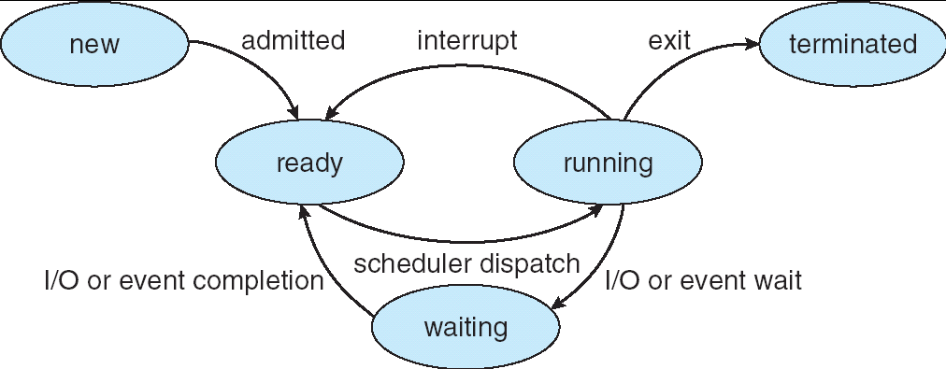
Lifecycle of a Thread (or Process)
As a process/thread executes, it changes state:
new: The thread is being created
ready: The thread is waiting to run
running: Instructions are being executed
waiting: Thread waiting for some event to occur
terminated: The thread has finished execution
“Active” processes are represented by their PCBs
PCBs organized into queues based on their state

Slide 6
Process Control Block
Contains information associated with each process
Process State - e.g. new, ready, running etc.
Program Counter - address of next instruction to be executed
CPU registers - general purpose registers, stack pointer etc.
CPU scheduling information - process priority, pointer
Memory Management information - base/limit information
Accounting information - time limits, process number
I/O Status information - list of I/O devices allocated

Slide 7
Processes and Threads
Stack
Modern operating systems load programs as processes
Resource holder
Execution
A process starts executing at its entry point as a thread
Threads can create other threads within the process
Each thread gets its own stack
All threads within a process share code & data segments
thread
main()
Stack
Stack
thread
thread
…
Code segment
Data segment
Notes:
Purpose of the Slide
Defines the relationship of processes and threads.
Details
A key point: threads share code and data (this will come up later in race conditions).

Slide 8
What are threads ?
A thread is a piece of code that is treated by the OS scheduler as a single unit.
A system that supports multithreading can run multiple threads concurrently.
Concurrency is achieved by round-robin scheduling. The CPU cycles through threads, running each thread for a specified time slice.
Notes:
It must be emphasized here that concurrency does not mean parallelism

Slide 9
What are threads ? (Cont.)
Do not mix threads with processes
A single process can contain multiple threads.
Different processes have different address spaces (do not share memory) while different threads belonging to the same process share the same address space of the process.
Therefore, processes can only communicate using special inter-process communication functions while threads in the same process can simply communicate using shared variables.
Process 1
Process 2
Process 3

Slide 10
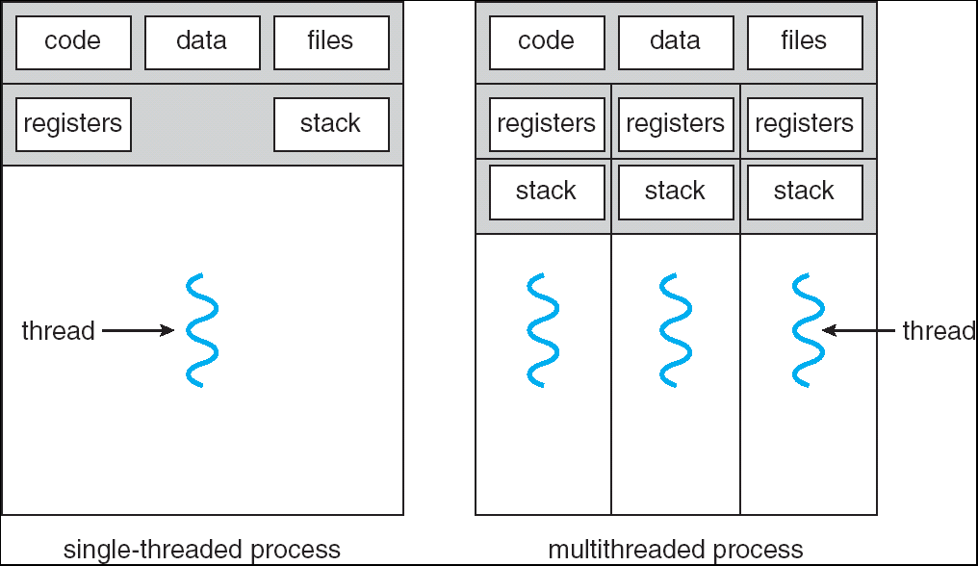
Single vs. Multithreaded Processes
Process: everything we’ve seen up to now
Thread: like a process, only shares memory, global variables, files, PID
with other threads within the same process

Slide 11
Should you use threads or processes?
Why use threads instead of processes?
Faster context switch (why?)
Easier to share data
Uses less memory and resources
Thread creation faster than process creation (30x faster in Solaris)
Less things to set-up
Why use processes instead of threads?
Different code
Running on different machines
Different owners
Little communication
Sharing memory can lead to obscure bugs

Slide 12
Multithreaded Server: For Serving Multiple Clients Concurrently
Client 1 Process
Server Process
Server
Threads
Internet
Client 2 Process

Slide 13
Editing and Printing documents in background.
Printing Thread
Editing Thread
Slide by : Rajkumar Buyya, School of Computer Science and Software Engineering, Monash Technology
Melbourne, Australia

Slide 14
Why Multithreading ?
By running a long blocking function in a separate thread, the program does not halt until the function finishes (asynchronous programming).
Multithreading allows I/O functions to be overlapped with computation functions.
In a multiprocessor system, multiple threads can be executed simultaneously by assigning a thread to each processor.
Take advantage of multiple processors available for a computation.
IPC through shared memory is more efficient

Slide 15
Potential Problems with Threads
Conflicting access to shared memory
one thread begins an operation on shared memory, is suspended, and leaves that memory region incompletely transformed
a second thread is activated and accesses the shared memory in the corrupted state, causing errors in its operation and potentially errors in the operation of the suspended thread when it resumes
Race Conditions occur when:
correct operation depends on the order of completion of two or more independent activities
the order of completion is not deterministic
Starvation
a high priority thread dominates CPU resources, preventing lower priority threads from running often enough or at all.

Slide 16
Problems with Threads (continued)
Deadlock
two or more tasks each own resources needed by the other preventing either one from running so neither ever completes and never releases its resource

Slide 17
Threading Models
Threads can be provided at
user level
or
kernel level

Slide 18
User-level threads by Silberschtz& Galvin
Kernel knows nothing about threads
Implemented in a library by users without touching the kernel
User library handles
Thread creation
Thread deletion
Thread scheduling

Slide 19
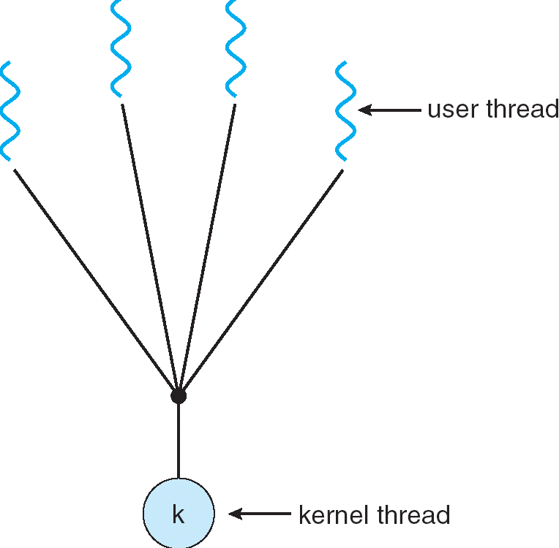
Mapping of user threads to kernel-level scheduled entity Many-to-One Model

Slide 20
Many-to-One
All application-level threads mapped to single kernel-level scheduled entity
Kernel has no knowledge of the application threads
process as whole gets one time slice irrespective of whether process has one thread or 1000 threads within
The library scheduler decides which thread gets the priority
Examples:
Solaris Green Threads
GNU Portable Threads
Advantages
Faster creation and scheduling
can be implemented even on simple kernels which do not support threading
Any disadvantages?
All block when one blocks
All run on 1 CPU ; hence it cannot benefit from the multi-processor computers

Slide 21
User-level threads (cont’d)
Three primary thread libraries:
POSIX Pthreads
Win32 threads
Java threads

Slide 22
Kernel-level threads
Kernel knows about threads
Kernel handles thread creation, deletion, scheduling
Most modern OSes support kernel-level threads
Windows XP/2000
Solaris
Linux
Tru64 UNIX
Mac OS X

Slide 23
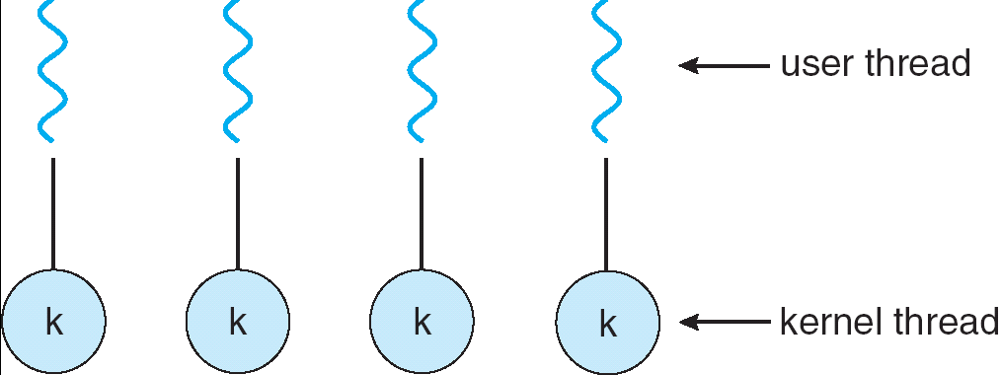
Mapping- One-to-one

Slide 24
One-to-One
Threads created by the user are in 1-1 correspondence with schedulable entities in the kernel
Advantages
Kernel can schedule another thread if current one does blocking I/O
Kernel can schedule multiple threads on different CPUs on SMP multiprocessor
Any disadvantages?
Slower to schedule, create, delete than user-level
Many operating systems limit number of threads

Slide 25
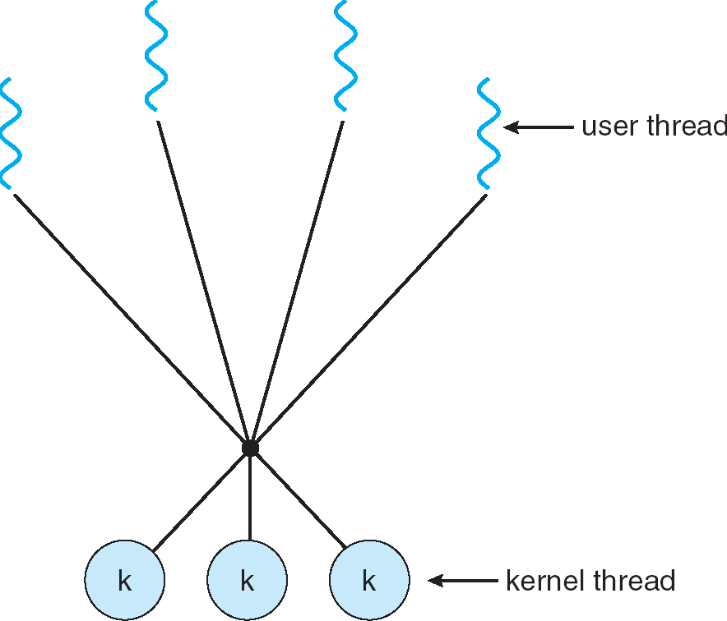
Hybrid Threading- Many-to-Many Model

Slide 26
Many-to-Many Model
Allows many user level threads to be mapped to smaller or equal number of schedulable kernel entities
Allows the flexibility of choosing the number of kernel threads allocated to a process
The threading library is responsible for scheduling user threads on the available schedulable entities
“Best of both worlds”
complex to implement
Solaris prior to version 9, Microsoft Windows 7

Slide 27
Synchronization
A program may need multiple threads to share some data.
If access is not controlled to be sequential, then shared data may become corrupted.
One thread accesses the data, begins to modify the data, and then is put to sleep because its time slice has expired. The problem arises when the data is in an incomplete state of modification.
Another thread awakes and accesses the data, that is only partially modified. The result is very likely to be corrupt data.
The process of making access serial is called serialization or synchronization.

Slide 28
Critical Section
A section of code that contains shared data
This shared data has dependency among multiple threads
Only one thread is allowed to access to acrical section at any instance
Synchronization primitives are used to keep critical sections safe

Slide 29
Critical section in source code
<Critical section Entry, keeps other threads in waiting status>
………..
Critical Section
………
<Critical section Exit, allow other threads to enter critical section>

Slide 30
Synchronization primitives
Synchronization is typically performed by
Semaphores
Locks
Condition variables

Slide 31
Semaphores
Semaphore is a variable that has an integer value
➔May be initialized to a nonnegative number
➔Wait operation decrements the semaphore value
➔Signal operation increments semaphore value
Wait and signal operations cannot be interrupted
If a process is waiting for a signal, it is suspended until that signal is sent
Queue is used to hold processes waiting on the semaphore

Slide 32
Semaphore Operations
Semaphore S is a variable
initially contains a non-negative integer value
User cannot read or write value directly after initialization
Only 3 operations allowed: init, wait and signal
Wait or Test
P() for “test” in Dutch (proberen)
Waits until value of S > 0, then decrements S value
Signal or Increment
V() for “increment” in Dutch (verhogen)
Increments value of semaphore

Slide 33
Implementation
Semaphore operations are now defined as
P(S): S--;
if (S < 0) {
add this thread to a waiting list; block this thread;
}
V(S): S++;
if (S<= 0) {
remove a thread from the waiting list and wakeup it;
}
Value of semaphore can be negative and represents the number of processes waiting on it

Slide 34
Synchronization using Semaphores
semaphore s
s=1
begin thread T
<non-critical section>
P(s)
<critical section>
V(s)
end Thread T
Example with semaphore S:
<non-critical section>
wait(S);
balance += amount;
signal(S);

Slide 35
Semaphore - Initial Values
What happens if sem is initialized to 2?
Scenario: Three threads call wait(S)
Two threads can proceed
One thread will be blocked (current S = -1)
Observations
Initial S value is positive → Number of threads that can be in critical section at same time
Current S value is negative → Number of waiters on queue currently

Slide 36
Semaphore - Initial Values
What happens if S is initialized to 0?
No one will be able enter the C/S, the system is deadlock
What happens if S is initialized to 1?
it will work like a lock
lock(L);
balance += amount;
unlock(L);

Slide 37
Binary Semaphores
Binary semaphore is sufficient for mutex
Binary semaphore has boolean value (not integer)
bsem_wait(): Waits until value is 1, then sets to 0
bsem_signal(): Sets value to 1, waking one waiting process
General semaphore is also called counting semaphore

Slide 38
Semaphore Solution Producer/Consumer Problem
Simplest case:
shared buffer between producer and consumer
Requirements
Consumer must wait for producer to fill buffer
Producer must wait for consumer to empty buffer (if filled)
Requires 2 semaphores
empty: Initialize to 1
full: Initialize to 0
What happens if:
empty is initialized to 0: produce can never start filling the buffer
full is initialized to 1: consumer will consume a garbage buffer (the buffer that hasn’t been filled)
Producer
While (1) {
wait(empty); Fill(buffer);
signal(full);
}
Consumer
While (1) {
wait(full);
Use(buffer);
signal(empty);
}

Slide 39
Locks
Similar to semaphore initialized to 1
Only a single thread accesses critical section
ie only one thread acquires a lock
A thread has to acquire a lock before using a shared resource
Otherwise it waits until the lock becomes available
After accessing the shared data the thread releases the lock for other threads to use
Atomic operations performed on lock
acquire() : similar to P()
release() : similar to V()

Slide 40
Example
public class BankAccount { Lock aLock = new Lock; int balance = 0;
...
public void deposit(int amount) { aLock.acquire(); balance = balance + amount; aLock.release(); }
public void withdrawal(int amount) { aLock.acquire(); balance = balance - amount; aLock.release(); }

Slide 41
Locks/Semaphores: Not Convenient
Problems:
Must initialize semaphore properly
Last time: semaphore can be set to 0, 1, or N
Misordering of locks/semaphores can be a problem
func1() { wait(a); wait(b); …. /* do job */ signal(b); signal(a); }
func2() { wait(b); wait(a); …. /* do job */ signal(a); signal(b); }
Deadlock!
Users can inadvertently misuse locks and semaphores
Ex: forget to call signal(a) after wait(a)
Solution:
Build another higher-level software primitive: Monitors

Slide 42
Motivation for Monitors and Condition Variables
Definition: Monitor: a lock and zero or more condition variables for managing concurrent access to shared data
Use of Monitors is a programming paradigm
Some languages like Java provide monitors in the language
The lock provides mutual exclusion to shared data:
Always acquire before accessing shared data structure
Always release after finishing with shared data
Lock initially free

Slide 43
Simple Monitor Example
Here is an (infinite) synchronized queue
Lock lock; Queue queue;
AddToQueue(item) { lock.Acquire(); // Lock shared data queue.enqueue(item); // Add item lock.Release(); // Release Lock }
RemoveFromQueue() { lock.Acquire(); // Lock shared data item = queue.dequeue();// Get next item or null lock.Release(); // Release Lock return(item); // Might return null }

Slide 44
Condition Variables
How do we change the RemoveFromQueue() routine to wait until something is on the queue?
Could do this by keeping a count of the number of things on the queue (with semaphores), but error prone
Condition Variable: a queue of threads waiting for something inside a critical section
Key idea: allow sleeping inside critical section by atomically releasing lock at time we go to sleep
Contrast to semaphores: Can’t wait inside critical section
Operations:
Wait(&lock): Atomically release lock and go to sleep. Re-acquire lock later, before returning.
Signal(): Wake up one waiter, if any
Broadcast(): Wake up all waiters

Slide 45
Complete Monitor Example (with condition variable)
Here is an (infinite) synchronized queue
Lock lock; Condition dataready; Queue queue;
AddToQueue(item) { lock.Acquire(); // Get Lock queue.enqueue(item); // Add item dataready.signal(); // Signal any waiters lock.Release(); // Release Lock }
RemoveFromQueue() { lock.Acquire(); // Get Lock while (queue.isEmpty()) { dataready.wait(&lock); // If nothing, sleep } item = queue.dequeue(); // Get next item lock.Release(); // Release Lock return(item); }

Slide 46
Readers/Writers Problem
W
R
R
R
Motivation: Consider a shared database
Two classes of users:
Readers – never modify database
Writers – read and modify database
Is using a single lock on the whole database sufficient?
Like to have many readers at the same time
Only one writer at a time

Slide 47
Basic Readers/Writers Solution
Correctness Constraints:
Readers can access database when no writers
Writers can access database when no readers or writers
Only one thread manipulates state variables at a time
Basic structure of a solution:
Reader() - Wait until no writers - Access data base - Check out – wake up a waiting writer
Writer() - Wait until no active readers or writers - Access database - Check out – wake up waiting readers or writer
State variables (Protected by a lock called “lock”):
int AR: Number of active readers; initially = 0
int WR: Number of waiting readers; initially = 0
int AW: Number of active writers; initially = 0
int WW: Number of waiting writers; initially = 0
Condition okToRead = NIL
Conditioin okToWrite = NIL

Slide 48
Code for a Reader
Reader() { // First check self into system lock.Acquire();
while ((AW + WW) > 0) { // Is it safe to read? WR++; // No. Writers exist okToRead.wait(&lock); // Sleep on cond var WR--; // No longer waiting }
AR++; // Now we are active! lock.release();
// Perform actual read-only access AccessDatabase(ReadOnly);
// Now, check out of system lock.Acquire(); AR--; // No longer active if (AR == 0 && WW > 0) // No other active readers okToWrite.signal(); // Wake up one writer lock.Release(); }
Why Release the Lock here?

Slide 49
Code for a Writer
Writer() { // First check self into system lock.Acquire();
while ((AW + AR) > 0) { // Is it safe to write? WW++; // No. Active users exist okToWrite.wait(&lock); // Sleep on cond var WW--; // No longer waiting }
AW++; // Now we are active! lock.release();
// Perform actual read/write access AccessDatabase(ReadWrite);
// Now, check out of system lock.Acquire(); AW--; // No longer active if (WW > 0){ // Give priority to writers okToWrite.signal(); // Wake up one writer } else if (WR > 0) { // Otherwise, wake reader okToRead.broadcast(); // Wake all readers } lock.Release(); }
Why Give priority to writers?
Why broadcast() here instead of signal()?

Slide 50
Message Passing Interface
Message : is a special method of communication to transfer information from one process/thread to another
3 types
Intra-process
Inter-process
Process-process

Slide 51
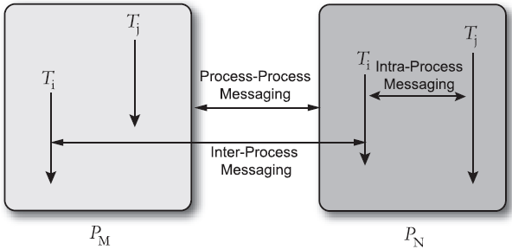
Message passing models

Slide 52
Message passing models
Intra-process
two threads that communicate with messages and reside in the same process
Inter-process
two threads that communicate with messages and reside in the different processes
Process-process
two processes that communicate with each other rather than depending on thread

Slide 53
Message passing models
Classification based on memory models :
Synchronous message passing model
Used in shared memory model
After sending the message sender does nothing and waits for the reply to come
Asynchronous message passing model
Used in distributed memory model
Sender doesn’t wait for the reply to arrive and continues the operation

Slide 54
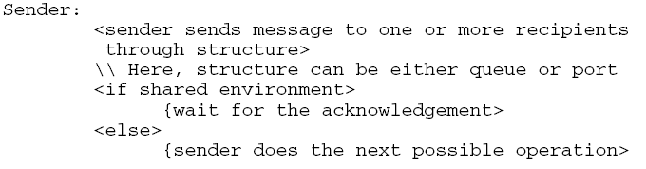
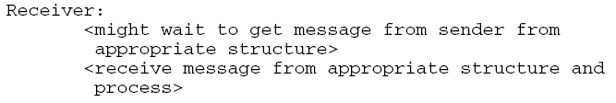
The generic form of communication

Slide 55
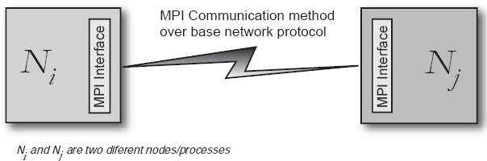
Message passing interface
MPI - is an interface used to perform message passing
As there is acknowledgement after receiving messages synchronization remains explicit
Avoids deadlocks and race conditions

Slide 56
Message size vs h/w used
Small messages are transferred between registers
Larger messages require caches
Still larger messages require main memory
Largest messages require DMA

Slide 57
End of introductory part Next – Threading APIs

