Slide 1
UNIT IV
Multithreaded Program Debugging

Slide 2
Benchmark
The benchmark is the program or process used to:
Objectively evaluate the performance of an application.
Provide repeatable application behavior for use with performance analysis tools.

Slide 3
Benchmark
The benchmark is run before and after optimizations are made to detect changes in performance.
It is the function of the benchmark to detect performance improvements and regressions so that it is easy to avoid changes that make the application run slower

Slide 4
Benchmark
Benchmarks can be either off-the-shelf programs or new programs written specifically to test your application.
Many industry standard benchmark programs exist, such as
TPC-C, 3D WinBench, and SPEC CPU2000

Slide 5
Benchmark
Using industry standard benchmarks has an added benefit:
You can compare the performance of the same set of applications on various platforms for marketing purposes
Drawbacks of industry standard benchmarks:
can be a little too general, too difficult to install, or time consuming
Hence, for some cases the custom-built situation-specific benchmarks are a better choice.

Slide 6
The Attributes of the Benchmark
1) Repeatable (Required)
2) Representative (Required)
3) Easy to run (Required)
4) Verifiable (Required)
5) Measure Elapsed time (optional)
5) Complete coverage (situation dependent)
6) Precision (situation dependent)

Slide 7
Repeatable
A benchmark that produces different results each time it is run is not very useful.
Shutting down all other applications like virus checkers, email programs, and fax drivers helps to produce more consistent results
But transient issues such as the cache state, temporary files, operating system background tasks still could cause the application to run differently on successive runs.
A better choice might be to use the best performance number of a few runs as opposed to the average or poorest performance number.

Slide 8
Representative
The benchmark needs to cause the execution of a typical code path in the application, so that common situations are analyzed and therefore optimized.
Analyzing error conditions, degenerate cases, or atypical cases generates misleading performance numbers, subsequent analysis, and worthless optimization attempts.

Slide 9
Easy to Run
Easy to run means
easy to install,
easy to operate,
runs in a short period of time,
and produces simple to interpret results.

Slide 10
Verifiable
It must be possible to verify the accuracy of what the benchmark is testing and the results it produces.
If the benchmark is defective, we may spend time optimizing a portion of the application which in reality doesn’t need any optimization.

Slide 11
Measure Elapsed Time
Some benchmark metrics are:
elapsed time
The amount of memory used,
the milliseconds per frame,
the vertices per second,
the maximum number of users that can be supported by a system.
Any number that represents your application’s software performance is valid.

Slide 12
Complete Coverage
A benchmark should only exercise the typical code paths or, more importantly, the code paths that should be optimized.
It is a waste of time to use or create a benchmark that tests error conditions or other non-performance sensitive code.
For applications like drivers, the whole application is performance sensitive, in which case, complete coverage would be desired.

Slide 13
Precision
Optimizations are only kept when they result in satisfactory performance improvement
So benchmarks only need be accurate enough to detect satisfactory performance gains.
Usually, detecting a percent or two of improvement is sufficient and desirable

Slide 14
Example 1: Compression Benchmark
Create a benchmark for the HUFF.EXE program - which uses the technique of Huffman Encoding to compress a file.
Determine what should be measured
Elapsed time
Or amount of compression
Choose files of different lengths and compression difficulty.
To record the benchmark results, use the table shown below:

Slide 15
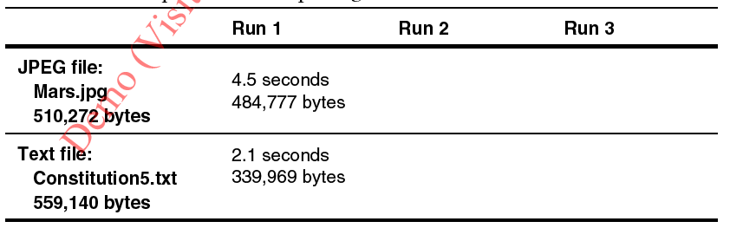
Sample Table for Reporting Benchmark Numbers for HUFF.EXE
After running the tests multiple times in a row, the timings are very similar meaning that the results contain very few transient issues

Slide 16
Example 2: Sorting Benchmark
Given two sorting algorithms, to determine which of these two sorting methods is superior, you need to construct a benchmark.
Use clock ticks to measure the elapsed time
Invoke instruction rdtsc before and after calling the sorting algorithm, and compute the difference of the returned values.

Slide 17
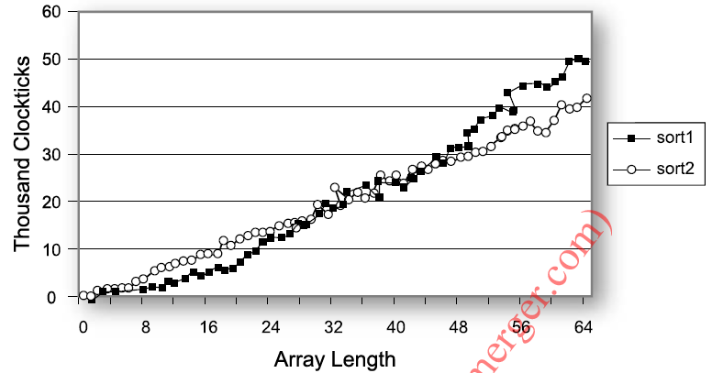
Clock ticks for sorting smaller arrays
sort1 performs similar to sort2 for array lengths in the range 0 to 64.

Slide 18
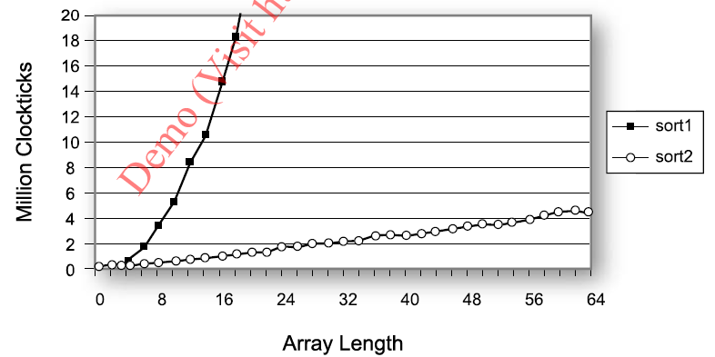
Clock ticks for sorting larger arrays
the execution time of sort2 grows less rapidly in relation to the input data size.
Hence we can say sort2 has better performance.

Slide 19
VTune™ Performance Analyzer
A full-featured software profiler that can analyze the whole system, an application, or a driver using both sampling and instrumentation.

Slide 20
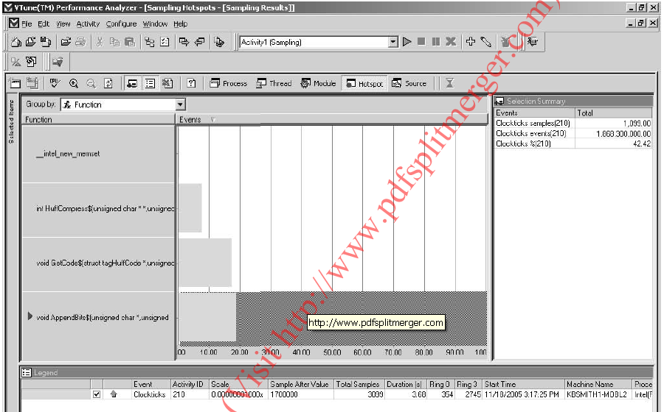
VTune™ Performance Analyzer Sampling on Clockticks for HUFF.EXE
AppendBits, consumes the most time because it has the longest bar,
And the GetCode and HuffCompress functions are the second and third highest consumers

Slide 21
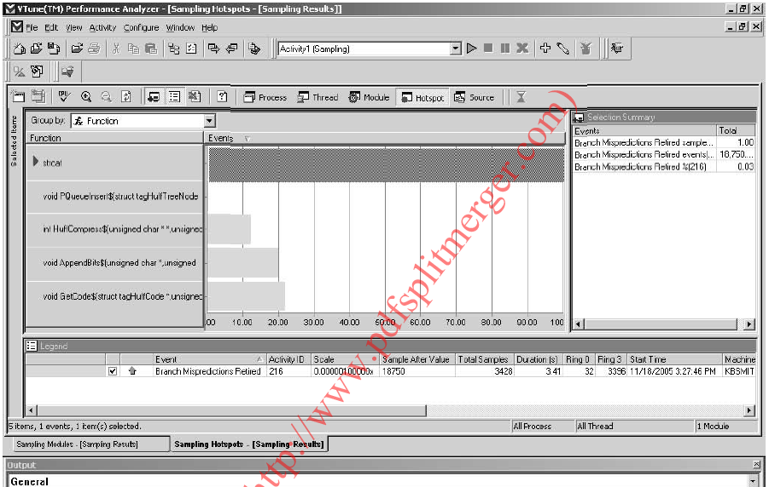
VTune™ Analyzer Sampling Branch Mispredictions Retired for HUFF.EXE
GetCode, has the most mis-predicted branches.
But it is not the most time consuming function

Slide 22
Call graph profiling
Shows function hierarchy
Uses instrumentation to profile an application
Critical path – path of functions that consumes more time
Critical path is displayed in bold arrow in the profile

Slide 23
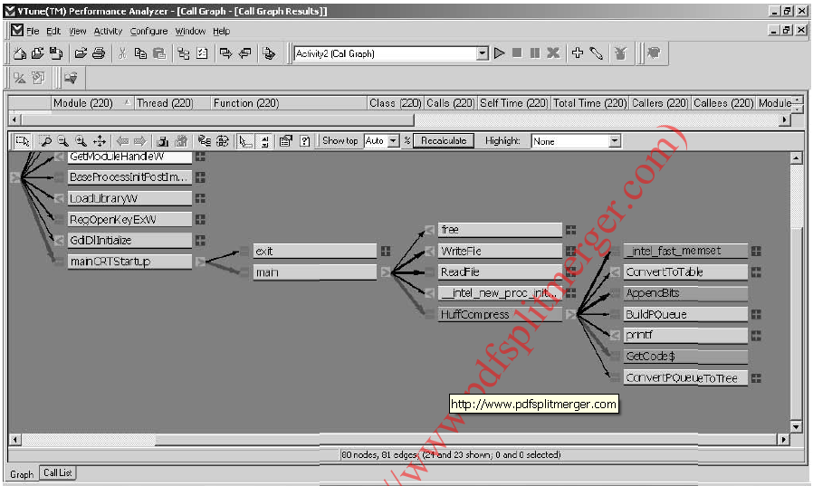
Call Graph Profiling for HUFF.EXE
The bold arrow drawn from the function main through HuffCompress and finally to GetCode indicates the critical path or the path of functions that consume the most time.

Slide 24
Intel Compiler Codecov Profiler
Codecov – Code coverage tool
Included with Intel C++ compiler
Gives execution count of the lines in the source code
Codecov is an instrumenting profiler
Instrumentation code is inserted by the cmpiler
How to use-
Compile the pgm using -Qprof_genx option
Run the pgm
Files are created that contains count for each line
From the counts (next slide) you can see exactly how many times the functions GetCode and AppendBits were called

Slide 25
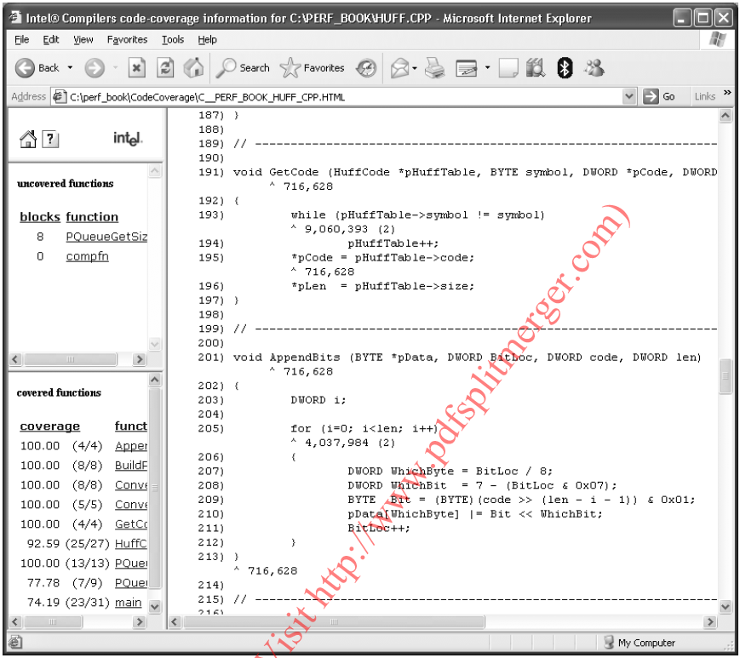
Output of Codecov tool for Huffman encoding example

Slide 26
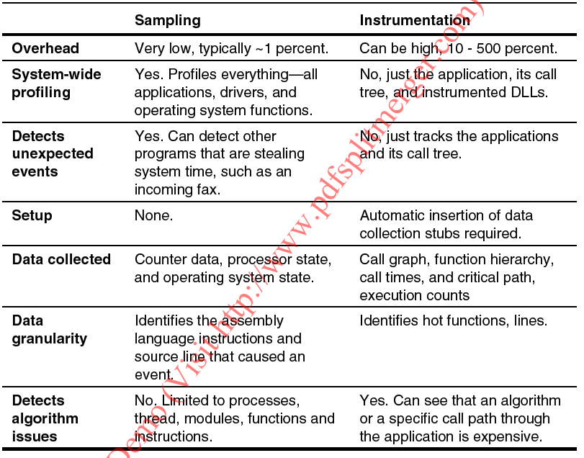
Sampling Versus Instrumentation

Slide 27
The Hotspot
A hotspot is defined as an area of intense activity
Software does not execute uniformly
Some parts of an application take little or no time to execute while other parts seem to take forever

Slide 28
Reasons for inconsistent execution
Infrequent execution:
Cold spots - portions of an application executed once or never
Ex: initialization code and error handling
Take very little time
not worth optimizing
Slow execution:
Computationally demanding portions of an application
Consume more time
Treated as hotspots only if they consume a significant portion of time compared to the rest of the application

Slide 29
Reasons for inconsistent execution
Frequent execution:
many parts of an application are executed frequently
Eg. Redrawing the screen in a game
Treated as hotspots if executed frequently and also consume a significant amount of time relative to the rest of the application

Slide 30
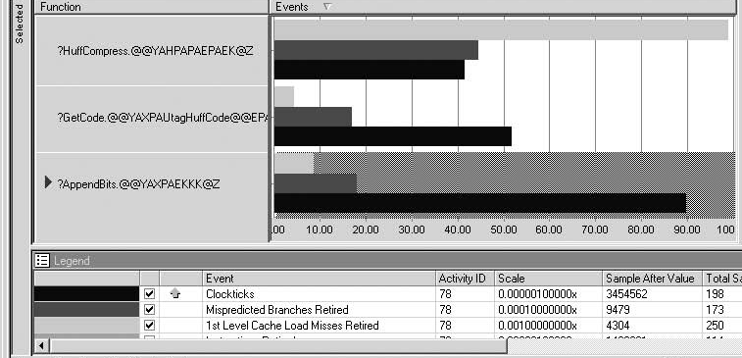
Cache Misses, Mis-predicted Branches, and Time-based Hotspots
HuffCompress consumes the least amount of time
But contains the most mis-predicted branches
And has by far the most L1 cache misses
Hence it can be decided to optimize memory accesses or branching

Slide 31
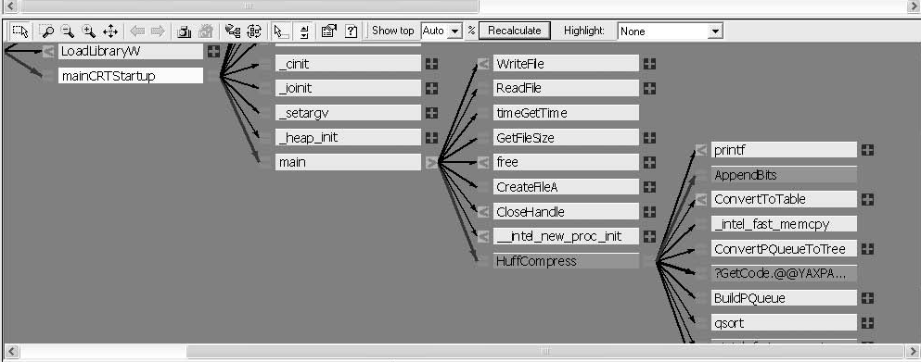
Finding Hotspots Using Call Graph
Function HuffCompress and its children are the hotspot
Hence , need to improve HuffCompress algorithm instead of those smaller blocks of code within the other individual functions.

Slide 32
Performance issues in Algorithms
Speed of s/w depends on choosing an appropriate algorithm
Factors affecting the perofmance
Computational complexity
memory usage
data dependencies
instructions used to implement the algorithm

Slide 33
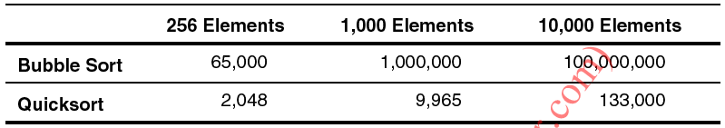
Computational Complexity
Computational complexity of
bubble sort : O(n2)
Quick sort : O(n log n)
Approximate Number of Operations Performed by Sorting Algorithms
For large no. of elements Quick sort algorithm uses more than 1000 times fewer operations than Bubble sort
Even if bubble sort algorithm is optimized, due to its computational complexity it cant be faster than Quick sort

Slide 34
Choice of Instructions
Choice of instructions has big impact on performance
Instructions like integer addition are executed quickly
Instructions like integer division are executed slowly
Instruction latency is the number of clocks required to complete one instruction after the instruction’s operands are ready
Instruction throughput is the number of clocks that the processor is required to wait before starting the execution of an identical instruction
Latency on Pentium 4
integer addition is 1 cycle
integer multiplication is 9 cycle
integer divide is 40 cycle
For integer multiplication throughput is 4 clocks on P4

Slide 35
Impact of latency in algorithms
The latency and throughput must be considered while selecting an algorithm
On a P4 processor, latency of add=1 and divide=40
If for eg. one algorithm uses ten additions while a second algorithm uses only one divide, the addition version will be faster

Slide 36
Impact of latency in GCD algorithm
2 variants of Euclid’s algorithm for computation of GCD are
Repetitive subtraction
Modulo division

Slide 37
Repetitive subtraction algorithm written in C
int find_gcf(int a, int b)
{
/* assumes both a and b are greater than 0 */
while (1) {
if (a > b) a = a - b;
else if (a < b) b = b - a;
else /* they are equal */ return a;
}
}

Slide 38
Assembly code generated by Intel compiler
_find_gcf$::
$B2$2:
cmp eax, edx
jle $B2$4
sub eax, edx
jmp $B2$2
$B2$4:
jge $B2$6
sub edx, eax
jmp $B2$2
$B2$6:
ret
For the case of a=48, b=40 the no. of instructions executed are:
5 compares
14 branches
5 subtracts
Total of 24 instructions

Slide 39
Modulo division algorithm written in C
int find_gcf(int a, int b)
{
/* assumes both a and b are
greater than 0 */
while (1) {
a = a % b;
if (a == 0) return b;
if (a == 1) return 1;
b = b % a;
if (b == 0) return a;
I f (b == 1) return 1;
}
}
For a=48, b=40, the assembly code generated for this algorithm executes :
2 divides
3 compares
3 branches
4 moves
2 cdq
Total of 14 instructions

Slide 40
Comparison of the Two Different Versions of Euclid's Algorithm
Modulo division takes less no. of clocks compared to Repetitive subtraction
But on P4 processor, the repetitive subtract algorithm is faster for a=48, b=40 inputs
Modulo division takes about 68 clocks
Subtraction takes only 1 clock

Slide 41
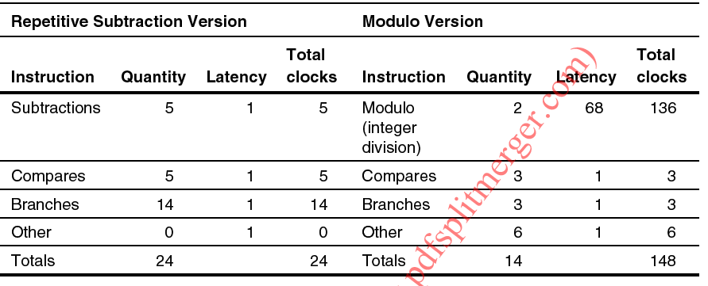
Comparison of the Two Different Versions of Euclid's Algorithm

Slide 42
A combined algorithm
Depending on the numbers chosen for a and b, the run-time results can vary widely
For a=1000, b=1; the GCd is 1
The repetitive subtraction algorithm takes 999 iterations of the loop
Takes a total of roughly 5,000 cycles
The modulo algorithm completes in a single iteration of the loop
Takes only about 74 cycles

Slide 43
Combined algorithm
int find_gcf(int a, int b)
{
/* assumes both a and b are greater than 0 */
while (1) {
if (a > (b * 4)) {
a = a % b;
if (a == 0) return b;
if (a == 1) return 1;
}
else if (a >= b) {
a = a - b;
if (a == 0) return b;
if (a == 1) return 1;
}
if (b > (a * 4)) {
b = b % a;
if (b == 0) return a;
if (b == 1) return 1;
}
else if (b >= a) {
b = b - a;
if (b == 0) return a;
if (b == 1) return 1;
}
}
}

Slide 44
Combined algorithm
The combined algorithm uses repetitive version for fewer no. of iterations
If computation is going to take more iterations then the modulo version is used

Slide 45
Data Dependencies and Instruction Parallelism
The P4 processor is capable of executing six instructions per clock cycle
but due to data dependencies the number of instructions executed/cycle is usually less

Slide 46
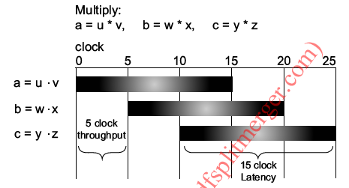
Gantt chart showing how three multiplies without dependency execute
No data dependencies among 3 instructions
Each instruction execution is separated by instruction throughput ie 5 cycles
3 multiplies take a total of 25 clock cycles

Slide 47
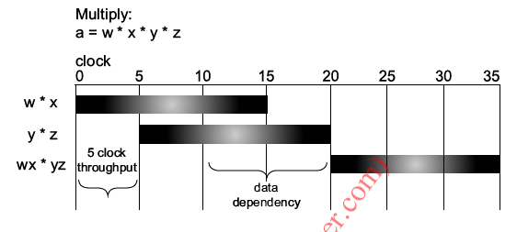
Gantt chart showing how three multiplies with dependency execute
data dependency exist among 3 multiplies
At 10th clock a new multiplication cant be started due to data dependency
Result of w*x can be multiplied to result of y*z only after y*z completes at 20th clock cycle
Hence the 3 multiplies take a total of 35 clock cycles

Slide 48
Data dependency and loop unrolling
Improve the following loop :
a = 0;
for (x=0; x<1000; x++)
a += buffer[x];
Observations
Loop carried dependency exists on variable a
So, rewrite the loop so that more arithmetic can occur on each clock
Hence more instruction level parallelism

Slide 49
The unrolled loop
for (x=0; x<1000; x+=4)
{
a += buffer[x];
b += buffer[x+1];
c += buffer[x+2];
d += buffer[x+3];
}
a = a + b + c + d;
More instructions per iteration
Total no. of iterations are reduced by a factor of 4
All these factors makes the loop run faster

Slide 50
Memory Requirements of algorithms
Algorithms that use smaller amounts of memory are usually faster
Some sorting algorithms sort data in place while others sort using additional memory
For example, selection sort algorithm sorts in-place while merge sort uses additional memory
Any benefit that an algorithm gains by using extra memory might be lost due to the latency of the memory accesses involved

Slide 51
Parallel Algorithms
In a uniprocessor system multiple instructions are run in parallel
aka fine grained parallelism or instruction level parallelism
In multicore systems portions of programs are run in parallel
Aka coarse grained parallelism
Processors produced these days contain multiple cores
Hence it is better to design algorithms with coarse grain parallelism

Slide 52
Four Phases of parallel algorithm design
Partitioning
Decompose the computation into smaller tasks
The tasks must allow parallel execution
Synchronization
Coordinate task execution and choose appropriate data-sharing scheme
Agglomeration
Evaluate the task and synchronization schemes with respect to performance requirements and costs.
If necessary, combine the tasks into larger tasks to improve performance or to reduce threading costs
Scheduling
Assign each task to a core or processor
Assign in such a way that core/processor utilization is maximized and synchronization costs are minimized

Slide 53
Generality of Algorithms
General algorithms solve general problems
In reality problems differ slightly
So, use custom tailored algorithms
These are efficient for a specific problem
Eg. Checking for empty string – options are
Call strlen() - complexity is O(n)
Check if first element is ‘\0’ – complexity is O(1)
Algorithms design should focus on making common cases faster

Slide 54
Branching
Two basic types
Conditional
If taken, jump to a designated instruction
Else goto the fall through ( ie sequentially next instruction)
Unconditional
Always jump to a new location (target instruction)
Based on the branch target address; 2 types
Direct jumps
Target address may be known before jump instr. is executed
Indirect jumps
Target may not be known until jump instr. is executed
Call instr. is a form of Unconditional jump

Slide 55
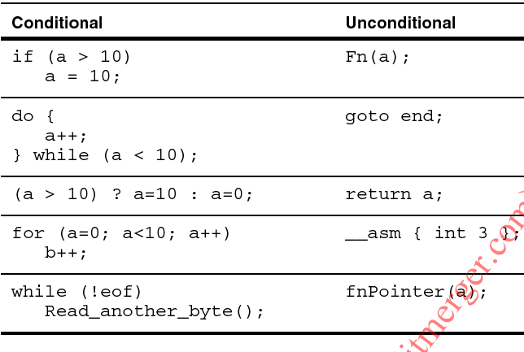
Examples of the Two Types of Branches

Slide 56
Branch predictors
In a pipelined execution of instructions, branch predictors help in determining the next instruction to be executed after a branch even before the branch is instr. is executed
Accuracy of prediction affects processor performance
Pentium 4 and Pentium M use a branch target buffer (BTB) and branch history to predict the outcome of a branch

Slide 57
A predictable branch
A branch is more predictable if its behavior follows a particular pattern (ie non random)
An Example -
// simple branch pattern that will be correctly
// predicted by the Pentium 4 & Pentium M processors
for (a=0; a<100; a++)
{
if ((a & 1) == 0)
do_even();
else
do_odd();
}
50 percent of the time the do_even function will be called (taken)
and the other 50 percent of the time the do_odd function will be called (not taken)
The branch pattern is predictable

Slide 58
An unpredictable branch
A branch is unpredictable if its behavior doesn’t follows any particular pattern (ie random)
// random branch pattern that is difficult to predict
for (a=0; a<100; a++)
{
side = flip_coin();
if (side == HEADS)
NumHeads++;
else
NumTails++;
}
outcome of coin flip is very random
hence the branch doesn’t follow a regular pattern
Therefore the branch is very much unpredictable

Slide 59
Optimizing branches
Mis-predicted branch degrades performance
Therefore avoid unpredictable branches in performance critical code
But some mispredictions are unavoidable
For example in the odd/even example the last comparison to exit the loop is mispredicted
But one misprediction in hundred does not need any improvement
Frequently mispredicted branches are worth improving

Slide 60
How to Identify critical mispredicted branches?
Critical mispredicted branches are are those branches that consume significant amount of program time and are frequently mispredicted
These branches are worth optimising
Identify critical mispredicted branches nd change the code to optimize the branch prediction

Slide 61
The three steps to find critical mispredicted branches
For the sample code MISPRED.C, find the critical mispredicted braches using Vtune performance analizer
Step 1 : Find the mispredicted branches
The event Mispredicted Branches Retired increments when a branch is mis-predicted
Use Vtune performance analyzer to sample on this event
The next slide shows the sampling result

Slide 62
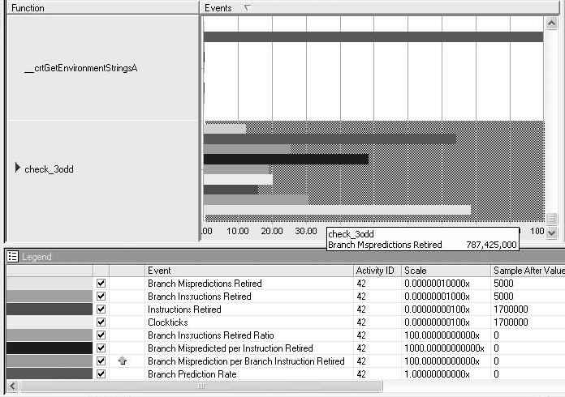
Mis-predicted Branches during MISPRED.EXE Execution
All the mis-predicted branches occur in the function check_3odd.

Slide 63
The three steps…
Step 2 :Find the Time-Consuming Hotspots
mis-predicted branches does not necessarily mean the area consumes enough time
So it is important to see if the function check_3odd is also an execution time hotspot
ie, check whether check_3odd consumes more execution time
use the VTune analyzer and sample on Clockticks
the result of sampling is shown in next slide

Slide 64
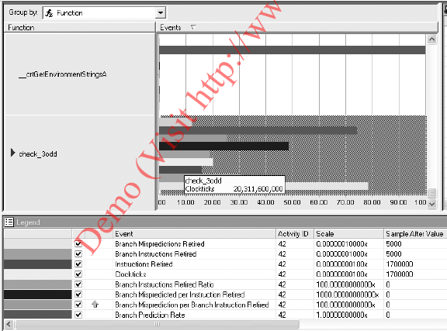
Time-based Hotspots in MISPRED.EXE
check_3odd consumes almost all of the time in this program

Slide 65
The three steps…
Step 3: Determine the Percentage of Mis-predicted Branches
determine the ratio of branches retired to branches mis-predicted
A branch with few mispredictions may appear as a hotspot if it is executed many times
Hence optimiztion efforts cannot be based on misprediction count
Above ratio gives the number of mispredictions of a branch relative to the no. of times it is executed
Optimization is necessary for those branches having poor ratio
1 misprediction out of 1,000 times - not worth optimizing
1 out of 2 is definitely worth optimizing
A ratio of about 1 in 20 is roughly the crossover point

Slide 66
Contd…
The event counter Branches Retired counts every branch
The event Mispredicted Branches Retired counts the mispredicted brances
Determine the ratio using the above counts and decision is made about whether or not to proceed with branch optimizations.

Slide 67
Types of Branches from optimization point of view
Conditional branches executed for the first time
These branches are based on those which have not been executed previously or at least recently
In C : if, do/while, and for generate conditional branches
In assembly, jumps like jz and jne are conditional branches
Difficult to predict first time
Hence the best method of handling is to make all these branches be not-taken
Performance is not much affected by improving the first pass of these branches
better results are obtained from improving the long-term predictability of these branches

Slide 68
Types..
Conditional branches that have been executed more than once
These conditional branches have been executed before or at least recently, and the results of the previous branches are still in the processor’s internal branch target buffer
These branches are predicted based upon the saved branch history.
Remove frequently mispredicted branches (only if it is consuming a significant amount of time) to reduce its randomness
To check for mis-predicted conditional branches with Vtune Performance analyzer, use Mispredicted Conditional Branch Instructions Executed event for the Pentium M processor

Slide 69
Types..
Call and Return
For every call, the return address is pushed on the processor’s internal return-stack buffer
The return-stack buffer is limited in size and has 16 elements
On stack overflow, the oldest element of stack is overwritten
On execution of Return statement, the top of the return-stack buffer is popped and used as the predicted address

Slide 70
Types..
Cases of Call/return prediction failures:
Function does not contain a matching return instruction for each call instruction
You can optimize return branches by avoiding calls without matching returns
return-stack buffer overflow
If depth of the call-chains in the hot spot goes above 16, function inlining can be used
On the Pentium M processor the VTune analyzer event Mispredicted Return Branch Instructions Executed should be used to check for the call-return mispredictions

Slide 71
Types..
Indirect calls and jumps (function pointers and jump tables)
Indirect branches can be difficult to predict because the code could have an infinite number of branch targets
Optimize indirect calls and jumps by reducing the randomness of the target address
Testing the most likely case using a conditional branch then using a jump table sometimes helps

Slide 72
Types..
In C/C++, this test commonly is accomplished by placing an if statement before a switch statement that tests for the most common case ( as shown below)
if (common case)
{ …… }
else
{ switch ()
case ….
….
}
On Pentium M processor use the the VTune analyzer event Mispredicted Indirect Branch Instructions Executed

Slide 73
Types..
Unconditional direct branches/ jumps :
These branches always jump and they are always predicted correctly
these branches need little optimization

Slide 74
Making Branches More Predictable
In MISPRED.EXE the function check_3odd has a very poor branch prediction rate
it is due to the following code
if (t1 == 0 && t2 == 0 && t3 == 0)
Each condition is evaluated using a separate branch instruction
each of the branches associated with checking for t1==0, t2==0, and t3==0 is not very predictable.
Hence use only one branch, rather than 3 to implement the total condition, as shown
if ((t1 | t2 | t3) == 0)
With this the branch prediction rate is improved from 74.5 to 92 percent

Slide 75
Removing Branches with CMOV
From the MISPRED.EXE example
// In C
if ((t1 | t2 | t3) == 0) {
t4 = 1;
}
// In assembly, t1 - edi, t2 - ebx, t3 - ebp, t4 - eax
or edi, ebx
or edi, ebp
jne L1
mov eax, 1
L1:
The instructions still have the possibility of a branch mis-prediction.

Slide 76
CMOV
This type of branch can be removed using the CMOV instruction that was introduced on the Pentium Pro processor
Use CMOV as follows:
mov ecx, 1
or edi, ebx
or edi, ebp
cmove eax, ecx
Copy ecx to eax if the result of previous operation is zero
Drawback - CMOV instruction cant have an immediate value as the source operand

Slide 77
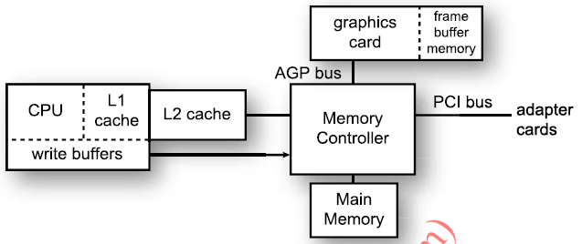
Cache organization
Pentium M and Pentium 4 processors have two level caches – L1 and L2
L3 cache – typically used on servers

Slide 78
Contd..
On P-4 processors L1 cache is used only for data and trace cache is used for instructions
On P-M processors – L1 is used for data and a separate L1 cache is used for instructions
Both P-M and P-4 processors L2 and L3 cache contain both data & instuctions- these caches are called as unified caches
L1 is smaller but faster than L2

Slide 79
Contd..
Caches are based on the principles of spatial and temporal locality
Spatial locality
Memory accesses are usually localized
If once an application accesses byte x, its next access is very likely going to be byte x+1 and so on
So, on a cache miss an application retrieves more than a single byte from main memory
Hoping that other bytes will be used in the next access

Slide 80
Contd..
Temporal locality
A memory location that has just been accessed is accessed again in the near future
Applications tend to access the same memory locations repeatedly
Caches replace data which has been least recently used (LRU) with the new data

Slide 81
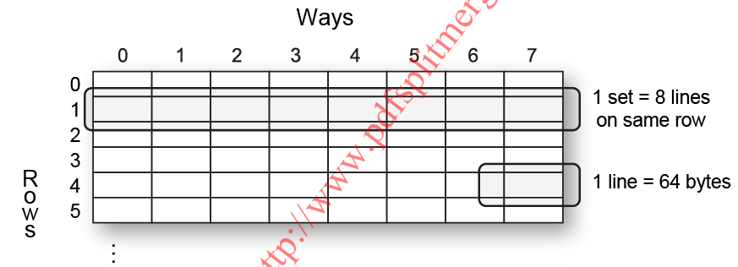
Cache details
Almost all memory accesses made by an application pass through L1 cache
So L1 cache is the basis of memory analysis

Slide 82
Contd..
Cache line – a chunk of 64 bytes
There can be a total of 256 or 512 lines
Set – a group of 8 lines
Way – a column of 32 lines
A set can accommodate only a particular range of addresses
So, the processor tests only eight lines (set) to determine a cache hit (not all the lines)

Slide 83
Cache details- Data Prefetching
Hardware Prefetch
Pentium 4 and Pentium M processors both support hardware assisted data prefetching
The hardware is able to detect cache misses in the highest level cache and trigger prefetch
Software Prefetch
s/w prefetching instructions are supported in Intel processors starting with the Pentium III
More overhead compared to h/w prefetch
s/w prefetch instructions are most effective when
the code has more streams of data than the h/w prefetchers can handle
the strides are larger than about 1 kilobyte,
the processor can do enough computation on the current data to allow the memory accesses that are caused by the software prefetch instructions to go in parallel with the computations.

Slide 84
Cache details
Non-temporal Writes :
In some cases caching the writes can harm performance and functionality
Uncacheable data is written to memory immediately bypassing the cache
every piece of data has to be written with its own memory bus transaction
Degrades performance

Slide 85
Cache details
Uncacheable write-combining memory:
higher performance
a contiguous series of memory writes are saved to an internal buffer
The content of buffer is written to memory in one large transaction

Slide 86
Cache details
Cache Loads -Three things cause cache loads
Compulsory Loads
occurs when data is referenced for the first time
The number of compulsory loads can be reduced but not avoided totally
Making application to access less memory is the only way to reduce compulsory loads
Capacity Loads
Occurs due to the lack of cache storage space
A cache line is replaced due to low cache capacity
Same line is later reloaded on another access to that line
This load would have been avoided if cache had more lines
To reduce capacity loads algorithms are made to operate on smaller chunks that do fit in the cache

Slide 87
Cache details
Conflict Loads
Cache conflicts occur when more than one memory block maps onto the same cache line
If an application accesses nine or more pieces of data which are in different cache lines, then all the data pieces cannot be fitted in a that row – this results in conflict loads
Conflict loads can be reduced by changing the memory alignment.

Slide 88
Cache details
Store Forwarding
A load must wait for the store to complete if load uses the stored data
if load data overlaps store data in memory, load has to wait until store retires.
But value from the store can be forwarded to load
So load can continue without waiting for the store to complete

Slide 89
Cache details
Cache Efficiency
measure of how much memory is loaded into the cache versus how much memory is used
cache always loads whole cache lines, even if only one byte is used
time is wasted loading the unused values
Poorly organized data structures can result in low cache efficiencies
organize data structures so that elements that are used together are located next to each other, placing them on the same cache line.

Slide 90
The techniques used to improve memory performance
Fix any store forwarding issues that are found.
use same data types for store and load
Use less memory to reduce compulsory cache misses
Select a different algorithm that uses less memory
select a computationally and memory efficient algorithm
don’t select an algorithm based solely on its use of memory

Slide 91
Contd..
Increase cache efficiency
place data items used at the same time next to each other in memory
Adjust data structures and memory buffers accordingly
Read memory sooner with prefetch
Arrange the data structure accesses so that hardware prefetch naturally prefetches the data
If the data cannot be arranged to allow h/w prefetch, the s/w prefetch instructions can be used

Slide 92
Contd..
Write memory faster with non-temporal instructions
The non-temporal instructions write data without using the cache, saving one cache read and one cache write
But when using the non-temporal instructions make sure that the data is not loaded in the near future by another function

Slide 93
Contd..
Avoid conflicts
Avoid reading or writing nine or more buffers at the same time with the same 2-kilobyte alignment
Avoid capacity issues
This problem usually occurs in two-pass algorithms where both passes use same, large data set
Both pass cause cache miss even though the same data is used
Instead try operating on smaller cache sized data sets
run the first function on a cache-sized subset of data, run the second function on the same cache-sized subset of data

Slide 94
Contd..
Add more work
The processor can execute non-dependent instructions while waiting for memory to be fetched.

Slide 95
End of Unit IV

