Slide 1
UNIT V
Compiler Optimizations and Parallel Algorithms

Slide 2
Compilers for High performance Computing
Intel Corporation has been supporting multithreading capabilities in its compilers.
Intel compilers have support for OpenMP within the Windows and Linux environments.
To get the Intel compiler to recognize the OpenMP constructs, compile with the following switch:
Windows: /Qopenmp
Linux: -openmp

Slide 3
Compilers for High performance Computing
The auto-parallelization feature automatically translates serial source code into equivalent multi-threaded code.
The resulting binary behaves as if the user inserted OpenMP pragmas around various loops within their code.
The switch to do this is as follows:
Windows: /Qparallel
Linux: -parallel

Slide 4
Compilers for High performance Computing
The following switch guides the compiler heuristics for loops:
Windows: /Qpar_threshold[:n]
Linux: -par_threshold[n]
where the condition 0 <= n <= 100 holds and represents the threshold for the auto-parallelization of loops.
If n=0 the loop get auto parallelized always regardless of computation work volume.
If n=100, then loops get auto-parallelized when performance gains are predicted based on the compiler analysis data.
For example, n=50 directs the compiler to parallelize only if there is a 50 percent probability of the code speeding up if executed in parallel.

Slide 5
Code optimization techniques:
1. Eliminating common sub-expressions
Optimization compilers are able to perform quite well by removing common sub-expressions
eg. X = A * LOG(Y) + (LOG(Y) ** 2)
Introduce an explicit temporary variable t:
t = LOG(Y)
X = A * t + (t ** 2)

Slide 6
Code optimization techniques:
2. Strength reduction:
Replacement of an operator with a less costly one.
Example:
temp = 5;
for i=1 to 10 do for i=1 to 10 do
… …
x = i * 5 x = temp
… …
temp = temp + 5
end end

Slide 7
Code optimization techniques:
3. Copy propagation :
f := g are called copy statements or copies
Use of g for f, whenever possible after copy statement
Example:
x[i] = a; x[i] = a;
sum = x[i] + a; sum = a + a;
May not appear to be code improvement, but opens up scope for other optimizations.

Slide 8
Loops
Advantages
Loops are the most common sources of hotspots
Loops reduce the number of stored instructions
When the same instruction is executed for a second time, re-fetching and re-decoding time is saved
Disadvantages
Loops add conditional branches which are typically mis-predicted when exiting the loop
Extra instructions are added to maintain the loop

Slide 9
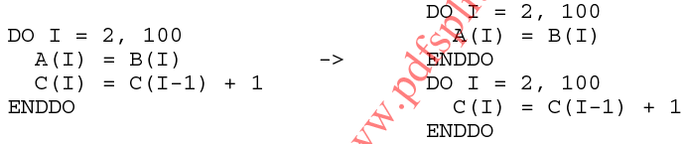
Loop optimizations
Loop distribution (fission) :divides loop control over different statements in the loop body
This transformation is valid if no loop-carried data dependences exist
Improves locality of reference as less amount of data is referenced
Improves hardware prefetching
reduces store buffer pressure

Slide 10
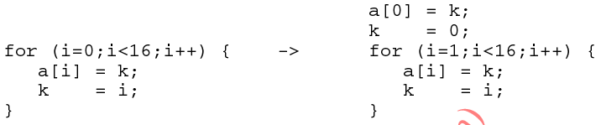
Contd..
Loop Peeling : moves one or more iterations into separate code outside the loop
In the peeled loop right hand side occurrence of k can be replaced by expression i-1
After Peeling
Before Peeling

Slide 11
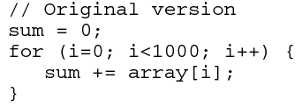
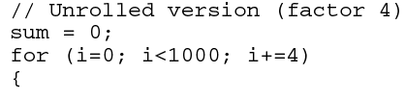
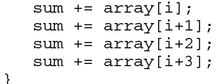
Contd..
Loop Unrolling and Re-rolling : is the combination of two or more loop iterations together with a corresponding reduction of the trip count

Slide 12
Contd..
The unrolled version of the loop has increased code size
Hence reduces the no of branches and loop maintaining instructions
Loop re-rolling : sometimes compilers undo hand optimized loop unrolling in order to
improve the accuracy of program analysis
to chose different unrolling factors that better match the target processor

Slide 13
Contd..
When unrolling is helpful?
Low trip counts, small loop bodies
don’t unroll. Replace loop bodies with a non-loop version of the code
Low trip counts, large loop bodies
Unroll the loop
High trip counts, small loop bodies
Unroll the loop
High trip counts, large loop bodies
Unroll the loop
In options 2,3, and 4 the objective of unrolling is to provide a good blend of instructions with fewer data dependencies.

Slide 14
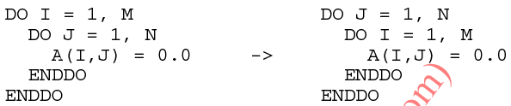
Contd..
Loop Interchanging : This transformation switches the positions of one loop that is tightly nested within another loop
Changes the non-unit stride memory reference into a unit stride memory reference
ie elements that are adjacent in memory are accessed by subsequent iterations of the innermost loop (ref next slide)

Slide 15
Contd..
Fortran stores arrays in column-major Order
Memory representation
and its indices
matrix
1
4
7
2
5
8
3
6
9
1,1
2,1
3,1
1,2
2,2
3,2
1,3
2,3
3,3
2 3
5 6
7 8 9

Slide 16

Contd..
Loop Invariant Computations :
Calculations that do not change between loop iterations are called loop invariant computations
Compilers move such computations outside the loop to increase performance
val /3 in the following loop does not change inside the loop so it can be moved outside the loop

Slide 17
Temporal and spatial locality-matrix multiplication example.

Slide 18
Spatial locality of reference
Most programs exhibit locality of reference
There are two types of LOR
Temporal -same items are referred very close in time
Spatial - nearby locations are referred frequently
Programmers do not have control over memory
Programmers can take advantage of cache

Slide 19

Example : Matrix Multiplication -Normal method
for i:= 1 to n do
for j:= 1 to n do
for k:= 1 to n do
c[ i,j] = c[i,j] + a[i,k] * b[k,j]
end for
end for
end for

Slide 20
Improve Spatial Locality
Use cache to improve performance
Matrices are stored row major order
Fetch A[i,k] shows good spatial locality
But Fetch B[k,j] is slow –every time B[k][j] is accessed a different row must be loaded. And B[k][j] is the only element accessed from that row
Re-order loops to improve spatial locality

Slide 21

Improve Spatial Locality -new method
for i:= 1 to n do
for k:= 1 to n do
for j:= 1 to n do
c[ i,j] = c[i,j] + a[i,k] * b[k,j]
end for
end for
end for

Slide 22
Improve Spatial Locality - An Example
C
A
B
- 0,0 | - 0,1 | - 0,2
1,0 | 1,1 | 1,2
- 2,0 | - 2,1 | - 2,2
1 0,0 | 2 0,1 | 3 0,2
4 1,0 | 5 1,1 | 6 1,2
7 2,0 | 8 2,1 | 9 2,2
9 0,0 | 8 0,1 | 7 0,2
6 1,0 | 5 1,1 | 4 1,2
3 2,0 | 2 2,1 | 1 2,2
84
69
54
€
x
=
i=1 | J=0 | J=1 | J=2
K=0 | C[1,0]+=A[1,0]*B[0,0] 4*9 | C[1,1]+=A[1,0]*B[0,1] 4*8 | C[1,2]+=A[1,0]*B[0,2] 4*7
K=1 | C[1,0]+=A[1,1]*B[1,0] 36+5*6 | C[1,1]+=A[1,1]*B[1,1] 32+5*5 | C[1,2]+=A[1,1]*B[1,2] 28+5*4
K=2 | C[1,0]+=A[1,2]*B[2,0] 66+6*3 | C[1,1]+=A[1,2]*B[2,1] 57+6*2 | C[1,2]+=A[1,2]*B[2,2] 48+6*1
€

Slide 23
Temporal locality of reference
Previous program has no temporal locality for large matrices
Entire matrix B is fetched for each i
If row of B or C are large it does not benefit from temporal locality
To improve Temporal Locality use sub-matrix multiplication

Slide 24
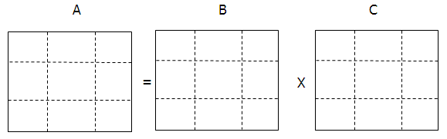
Temporal locality of reference
for it := 1 to n by s do
for kt := 1 to n by s do
for jt := 1 to n by s do
for i = it to min(it+s-1, n) do
for k = kt to min(kt+s-1, n) do
for j = jt to min(jt+s-1, n) do
c[ i,j] = c[i,j] + a[i,k] * b[k,j]
end for
end for
end for
end for
end for
end for

Slide 25
Temporal locality of reference
A_{0,0}
A_{0,1}
B_{0,0}
B_{0,1}
x
A_{1,0}
A_{1,1}
B_{1,0}
B_{1,1}
=
C_{0,0}
C_{0,1}
C_{1,0}
C_{1,1}

Slide 26
Temporal locality of reference
A_{0,0}
A_{0,1}
B_{0,0}
B_{1,0}
C_{0,0} = A_{0,0} x B_{0,0} + A_{0,1} x B_{1,0}
C_{0,0}

Slide 27
Temporal locality of reference
A_{0,0}
A_{0,1}
B_{0,1}
B_{1,1}
C_{0,1} = A_{0,0} x B_{0,1} + A_{0,1} x B_{1,1}
C_{0,1}

Slide 28
Temporal locality of reference
B_{0,0}
A_{1,0}
A_{1,1}
B_{1,0}
C_{1,0} = A_{1,0} x B_{0,0} + A_{1,1} x B_{1,0}
C_{1,0}

Slide 29
Temporal locality of reference
B_{0,1}
A_{1,0}
A_{1,1}
B_{1,1}
C_{1,1} = A_{1,0} x B_{0,1} + A_{1,1} x B_{1,1}
C_{1,1}

Slide 30
Parallel algorithms

Slide 31
The Sieve of Eratosthenes
For example, to find all the primes less than or equal to 30
First list the numbers from 2 to 30.
2 3 4 5 6 7 8 9 10 11 12 13 14 15 16 17 18 19 20 21 22 23 24 25 26 27 28 29 30
The first number 2 is prime, so keep it (we will color it green) and cross out its multiples (we will make them 0).
2 3 0 5 0 7 0 9 0 11 0 13 0 15 0 17 0 19 0 21 0 23 0 25 0 27 0 29 0

Slide 32
The Sieve of Eratosthenes
The first number left (still black) is 3, so it is the first prime. Keep it and cross out all of its multiples.
We know that all multiples less than 9 (i.e. 6) will already have been crossed out, so we can start crossing out at3²=9.
Before- 2 3 0 5 0 7 0 9 0 11 0 13 0 15 0 17 0 19 0 21 0 23 0 25 0 27 0 29 0
After- 2 3 0 5 0 7 0 0 0 11 0 13 0 0 0 17 0 19 0 0 0 23 0 25 0 0 0 29 0

Slide 33
The Sieve of Eratosthenes
Now the first number left (still black) is 5, the second prime. So keep it also and cross out all of its multiples (all multiples less than 5²=25 have already been crossed out, and in fact 25 is the only multiple not yet crossed out).
Before-
2 3 0 5 0 7 0 0 0 11 0 13 0 0 0 17 0 19 0 0 0 23 0
25 0 0 0 29 0
After-
2 3 0 5 0 7 0 0 0 11 0 13 0 0 0 17 0 19 0 0 0 23 0
0 0 0 0 29 0

Slide 34
The Sieve of Eratosthenes
The next number left, 7, is larger than the square root of 30, so there are no multiples of 7.
Therefore all of the numbers left are primes:
2 3 0 5 0 7 0 0 0 11 0 13 0 0 0 17 0 19 0 0 0 23 0
0 0 0 0 29 0
{2, 3, 5, 7, 11, 13, 17, 19, 23, 29}

Slide 35
i=0;
#pragma omp parallel for
{
for(j=0; j<n; j++)
{
if(in[j]!=0)
out[i++]=in[j];
} //endfor
}//endpragma
return 0;
}
//The Sieve of Eratosthenes- program to generate list of prime numbers from 2 to n
int main()
{
int n,p,j,i,in[100],out[50];
printf(“enter value for n\n”);
scanf(“%d”,&n);
#pragma omp parallel for
{ for(i=0; i<n; i++)
in[i]=i;
} //endpragma
for(i=2; i<sqrt(n); i++)
{
if(in[i]!=0)
{
j=i*i;
while(j<=n)
{
in[j]=0;
j=j+i;
} //endwhile
} //endif
} //endfor

Slide 36
Matrix Multiplication using MPI - 1
/* send matrix data to the worker tasks */
averow = NRA/numworkers;
extra = NRA%numworkers;
offset = 0;
mtype = FROM_MASTER;
for (dest=1; dest<=numworkers; dest++) {
rows = (dest <= extra) ? averow+1 : averow; // If # rows not divisible absolutely by # workers
printf("sending %d rows to task %d\n",rows,dest); // some workers get an additional row
MPI_Send(&offset, 1, MPI_INT, dest, mtype, MPI_COMM_WORLD); // Starting row being sent
MPI_Send(&rows, 1, MPI_INT, dest, mtype, MPI_COMM_WORLD); // # rows sent
count = rows*NCA; // Gives total # elements being sent
MPI_Send(&a[offset][0], count, MPI_DOUBLE, dest, mtype, MPI_COMM_WORLD);
count = NRB*NCB; // # elements in B
MPI_Send(&b, count, MPI_DOUBLE, dest, mtype, MPI_COMM_WORLD);
offset = offset + rows; // Increment offset for the next worker
}

Slide 37
Matrix Multiplication-2
/* wait for results from all worker tasks */
mtype = FROM_WORKER;
for (i=1; i<=numworkers; i++) // Get results from each worker
{
source = i;
MPI_Recv(&offset, 1, MPI_INT, source, mtype, MPI_COMM_WORLD, &status);
MPI_Recv(&rows, 1, MPI_INT, source, mtype, MPI_COMM_WORLD, &status);
count = rows*NCB; // #elements in the result from the worker
MPI_Recv(&c[offset][0], count, MPI_DOUBLE, source, mtype, MPI_COMM_WORLD, &status);
}
/* print results */
} /* end of master section */

Slide 38
Matrix Multiplication-3
if (taskid > MASTER)
{ // Implies a worker node
mtype = FROM_MASTER;
source = MASTER;
printf ("Master =%d, mtype=%d\n", source, mtype);
// Receive the offset and number of rows
MPI_Recv(&offset, 1, MPI_INT, source, mtype, MPI_COMM_WORLD, &status);
printf ("offset =%d\n", offset);
MPI_Recv(&rows, 1, MPI_INT, source, mtype, MPI_COMM_WORLD, &status);
printf ("row =%d\n", rows);
count = rows*NCA; // # elements to receive for matrix A
MPI_Recv(&a, count, MPI_DOUBLE, source, mtype, MPI_COMM_WORLD, &status);
printf ("a[0][0] =%e\n", a[0][0]);
count = NRB*NCB; // # elements to receive for matrix B
MPI_Recv(&b, count, MPI_DOUBLE, source, mtype, MPI_COMM_WORLD, &status);

Slide 39
Matrix Multiplication-4
for (k=0; k<NCB; k++)
for (i=0; i<rows; i++) {
c[i][k] = 0.0; // Do the matrix multiplication from the # rows you are assigned to
for (j=0; j<NCA; j++)
c[i][k] = c[i][k] + a[i][j] * b[j][k];
}
mtype = FROM_WORKER;
printf ("after computing \n");
MPI_Send(&offset, 1, MPI_INT, MASTER, mtype, MPI_COMM_WORLD);
MPI_Send(&rows, 1, MPI_INT, MASTER, mtype, MPI_COMM_WORLD);
MPI_Send(&c, rows*NCB, MPI_DOUBLE, MASTER, mtype, MPI_COMM_WORLD); // Sending the actual result
printf ("after send \n");
} /* end of worker */

Slide 40
Floyd’s Algorithm

Slide 41
Floyd's Algorithm
1. D ← W // initialize D array to W [ ] 2. P ← 0 // initialize P array to [0] 3. for k ← 1 to n // Computing D’ from D 4. do for i ← 1 to n 5. do for j ← 1 to n 6. if (D[ i, j ] > D[ i, k ] + D[ k, j ] ) 7. then D’[ i, j ] ← D[ i, k ] + D[ k, j ] 8. P[ i, j ] ← k; 9. else D’[ i, j ] ← D[ i, j ] 10. Move D’ to D.

Slide 42
The pointer array P
Used to enable finding a shortest path
Initially the array contains 0
Each time that a shorter path from i to j is found the k that provided the minimum is saved (highest index node on the path from i to j)
To print the intermediate nodes on the shortest path a recursive procedure that print the shortest paths from i and k, and from k to j can be used

Slide 43
Example
1
2
3
1
0
4
5
W = D⁰ =
1
2
2
0
∞
5
3
∞
-3
0
4
2
3
1
2
3
2
-3
1
0
0
0
P =
2
0
0
0
3
0
0
0

Slide 44
k = 1 Vertex 1 can be intermediate node
1
1
2
3
5
D⁰ =
1
0
4
5
4
2
3
2
2
0
∞
2
-3
3
∞
-3
0
1
2
3
1
0
4
5
D¹[2,3] = min( D⁰[2,3], D⁰[2,1]+D⁰[1,3] )
= min (∝, 7)
= 7
D¹[3,2] = min( D⁰[3,2], D⁰[3,1]+D⁰[1,2] )
= min (-3,∝)
= -3
D¹ =
2
2
0
7
3
∞
-3
0
1
2
3
1
0
0
0
P =
2
0
0
1
3
0
0
0

Slide 45
k = 2 Vertices 1, 2 can be intermediate
1
2
3
1
5
D¹ =
1
0
4
5
4
2
3
2
2
0
7
2
-3
3
∞
-3
0
1
2
3
1
0
4
5
D²[1,3] = min( D¹[1,3], D¹[1,2]+D¹[2,3] )
= min (5, 4+7)
= 5
D²[3,1] = min( D¹[3,1], D¹[3,2]+D¹[2,1] )
= min (∝, -3+2)
= -1
D² =
2
2
0
7
3
-1
-3
0
1
2
3
1
0
0
0
P =
2
0
0
1
3
2
0
0

Slide 46
k = 3 Vertices 1, 2, 3 can be intermediate
1
1
2
3
5
D² =
1
0
4
5
3
4
2
2
2
0
7
2
-3
3
-1
-3
0
1
2
3
1
0
2
5
D³ =
D³[1,2] = min(D²[1,2], D²[1,3]+D²[3,2] )
= min (4, 5+(-3))
= 2
D³[2,1] = min(D²[2,1], D²[2,3]+D²[3,1] )
= min (2, 7+ (-1))
= 2
2
2
0
7
3
-1
-3
0
1
2
3
1
0
3
0
P =
2
0
0
1
3
2
0
0

Slide 47
Execution of the algorithm for a 3x3 matrix
 | J=1 | J=2 | J=3
K=1 i=1 | A[1,1] = a[1,1] +a[1,1] | A[1,2 ] = a[ 1,1 ] +a[1 ,2 ] | A[ 1,3 ] = a[ 1,1 ] +a[1 ,3 ]
K=1 i=2 | A[ 2,1 ]= a[ 2,1 ]+a[1 ,1 ] | A[ 2,1 ]= a[ 2,1 ]+A[1,2 ] | A[ 2,1 ]= a[ 2,1 ]+a[1 ,3 ]
K=1 i=3 | A[3,1 ] = A[3,1 ]+a[1,1] | A[ 3,2 ]= A[3,1 ] +A[1,2 ] | A[ 3,3]= A[3,1 ] +a[1 ,3 ]
K=2 i=1 | A[ 1,1] = a[1 ,2]+A[ 2,1] | a[1 , 2] = a[1 , 2] +A[ 2,2] | A[ 1,3 ]= a[1 , 2] +A[ 2,3]
K=2 i=2 | A[ 2,1] = A[ 2,2]+A[ 2,1] | A[ 2,2] = A[ 2,2] +A[ 2,2] | A[ 2,3] = A[ 2,2] + A[ 2,3]
K=2 i=3 | A[3,1]= A[3,2 ]+A[ 2,1] | A[3,2 ] = A[3,2 ] +A[ 2,2] | A[3,3]= A[3,2 ] + A[ 2,3]
K=3 i=1 | A[1,1 ]= a[1,3 ]+A[ 3,1] | A[ 1,2]= a[1,3 ] +A[ 3,2] | A[1,3]= a[1,3 ] +A[3,3 ]
K=3 i=2 | A[ 2,1]= A[ 2,3]+A[ 3,1] | A[ 2,2]= A[ 2,3] +A[ 3,2] | A[ 2,3] = A[ 2,3] +A[3,3 ]
K=3 i=3 | A[ 3,1] = A[3,3 ]+A[ 3,1] | A[ 3,2] = A[3,3 ] +A[ 3,2] | A[3,3 ] = A[3,3 ] +A[3,3 ]

Slide 48
Observations
The entries of the a-matrix are updated n rounds
a[i, j] is compared with all n possibilities, that is, against a[i, k] + a[k, j], for 0 ≤ k ≤ n − 1
n³ of comparisons in total

Slide 49
Design of a parallel algorithm
Partitioning — each a[i, j] is a primitive task
Communication — during the k’th iteration, updating a[i, j] needs values of a[i, k] and a[k, j]
broadcast a[k, j] to a[0, j], a[1, j], . . . , a[n − 1, j]
broadcast a[i, k] to a[i, 0], a[i, 1], . . . , a[i, n − 1]
Involves huge amount of communication

Slide 50
Agglomeration and mapping
We assign one MPI process with a number of consecutive rows of a matrix
row-wise block data division is very convenient as -
2D arrays in C are row-major
easy to send/receive an entire row of a

Slide 51
Communication
Recall that in the k’th iteration:
a[i, j] ← min(a[i, j], a[i, k] + a[k, j])
Since entries of a are divided into rowwise blocks, so a[i,k] is also in the memory of the MPI process that owns a[i, j]
However, a[k, j] is probably in another MPI process’s memory
Communication is therefore needed!
Before the k’th iteration, the MPI process that owns the k’th row of the a matrix should broadcast this row to everyone else

Slide 52
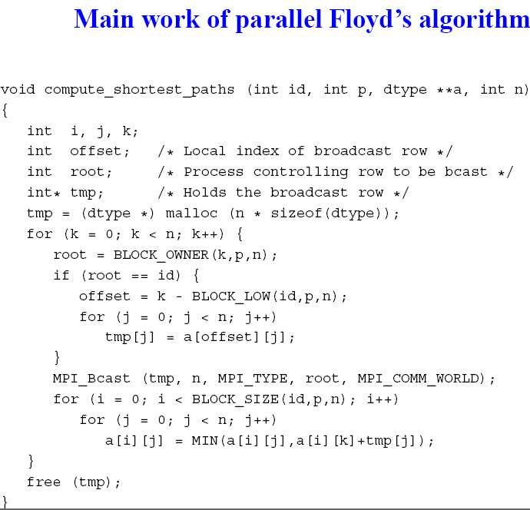

Slide 53
Parallel Quick Sort algorithm
For Parallel Quick Sort algorithm refer the Unit5_ notes.doc uploaded to moodle.

Slide 54
Thank you

Slide 55
The communication involved for each a[i, j]
 | J=1 | J=2 | J=3
K=1 i=1 | A[1,1] = a[1,1] +a[1,1] | A[1,2 ] = a[ 1,1 ] +a[1 ,2 ] | A[ 1,3 ] = a[ 1,1 ] +a[1 ,3 ]
K=1 i=2 | A[ 2,1 ]= a[ 2,1 ]+a[1 ,1 ] | A[ 2,1 ]= a[ 2,1 ]+A[1,2 ] | A[ 2,1 ]= a[ 2,1 ]+a[1 ,3 ]
K=1 i=3 | A[3,1 ] = A[3,1 ]+a[1,1] | A[ 3,2 ]= A[3,1 ] +A[1,2 ] | A[ 3,3]= A[3,1 ] +a[1 ,3 ]
K=2 i=1 | A[ 1,1] = a[1 ,2]+A[ 2,1] | a[1 , 2] = a[1 , 2] +A[ 2,2] | A[ 1,3 ]= a[1 , 2] +A[ 2,3]
K=2 i=2 | A[ 2,1] = A[ 2,2]+A[ 2,1] | A[ 2,2] = A[ 2,2] +A[ 2,2] | A[ 2,3] = A[ 2,2] + A[ 2,3]
K=2 i=3 | A[3,1]= A[3,2 ]+A[ 2,1] | A[3,2 ] = A[3,2 ] +A[ 2,2] | A[3,3]= A[3,2 ] + A[ 2,3]
K=3 i=1 | A[1,1 ]= a[1,3 ]+A[ 3,1] | A[ 1,2]= a[1,3 ] +A[ 3,2] | A[1,3]= a[1,3 ] +A[3,3 ]
K=3 i=2 | A[ 2,1]= A[ 2,3]+A[ 3,1] | A[ 2,2]= A[ 2,3] +A[ 3,2] | A[ 2,3] = A[ 2,3] +A[3,3 ]
K=3 i=3 | A[ 3,1] = A[3,3 ]+A[ 3,1] | A[ 3,2] = A[3,3 ] +A[ 3,2] | A[3,3 ] = A[3,3 ] +A[3,3 ]

Slide 56
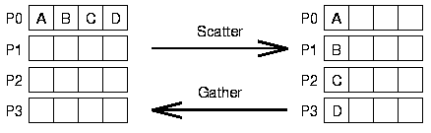
Scatter and Gather
MPI_Scatter: Source (array) on the sending processor is spread to all processors
MPI_Gather: Opposite of scatter; array locations at the receiver correspond to the rank of the senders

