Slide 1
The Process

Slide 2
Mechanism of Process Creation
Process is a program under execution.
There are 3 distinct phases in the creation of a process and uses 3 important system calls or functions- fork, exec and wait.

Slide 3
Fork A process in UNIX is created with the fork system call, which creates a copy of the process that invokes it.
The process image is practically identical to that of the calling process, except for a few parameters like the PID.

Slide 4
Fork()
Creat a new process
Copy of parents virtual memory
Parent return value is child’s PID
Child return value is 0
Notes:
The reason the child's process ID is returned to the parent is that a process can have more than one child, and there is no function that allows a process to obtain the process IDs of its children.
The reason fork returns 0 to the child is that a process can have only a single parent, and the child can always call getppid to obtain the process ID of its parent. (Process ID 0 is reserved for use by the kernel, so it's not possible for 0 to be the process ID of a child.)

Slide 5
EXEC : Forking creates a process but it is not enough to run a new program. To do that, the forked child needs to overwrite its own image with the code and data of the new program. This mechanism is called exec, and the child process is said to exec a new program.
No new process is created here, the PID and PPID of the exec’d process remain unchanged.
Overwrite with new program

Slide 6
Wait The parent then executes the wait system call to wait for the child process to complete. It picks up the exit status of the child and then continues with its other functions.

Slide 7
Eg: When you run a command(say cat) from the shell, the shell first forks another shell process. The newly forked shell then overlays itself with the executable image of cat, which then starts to run.
The parent(the shell) waits for cat to terminate and then picks up the exit status of the child.

Slide 8
Unix Kernel support for Process
Unix process consists minimally of a text segment, a data segment and a stack segment.
Test segment contains the program text of a process in machine –executable instruction code format.
Data segment contains static and global variables and their corresponding data.
Stack segment contains a run time stack. It provides storage for function arguments, automatic variables, and return addresses of all active functions for a process at any time.

Slide 9
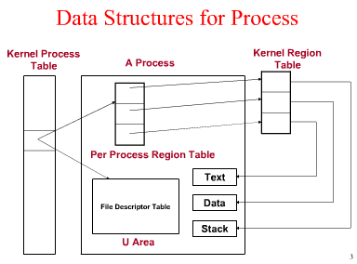

Slide 10
Process table entry
Contains general fields of processes that must be always be accessible to the kernel.
Keeps track of all active processes. Some processes belong to the kernel(system processes).
Each entry in the Process table contains pointers to the text, data and stack segments and the U-area of a process.

Slide 11
U area
further characteristics of the process only need to be accessible to the running process itself.
Extension of a Process Table entry and contains process specific data such as File descriptor table, current root and working directory, inode numbers and a set of system –imposed process resource limits etc.

Slide 12
Per Process Region Table (Pregion)
Each pregion entry points to the kernel region table
Starting virtual (absolute) address of the region
Permission field:
read-only, read-write, read-execute
- Kernel region table
Kernel region table contains the pointer to the page table which keeps the physical memory address

Slide 13
All processes in a UNIX system, except the very first process(process 0) which is created by the system boot code, are created via the fork system calls.
As shown in fig, when a process is created by fork, it contains duplicated copies of text, data and stack segments of it.
Also it has a file descriptor table that contains references to the same opened files as its parent.

Slide 14
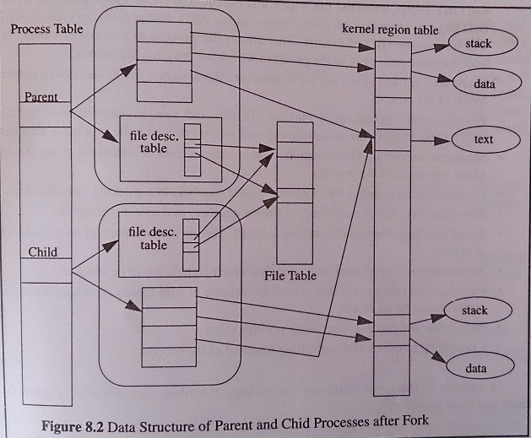

Slide 15
Furthermore, the process is assigned the following attributes which are either inherited from its parent or set by the kernel:
• Real user ID, real group ID, effective user ID, effective group ID
• Supplementary group IDs
• Process group ID
• Session ID
• Controlling terminal
• The set-user-ID and set-group-ID flags
• Current working directory
• Root directory
• File mode creation mask
• Signal mask and dispositions
• The close-on-exec flag for any open file descriptors
• Environment
• Attached shared memory segments
• Memory mappings
• Resource limits

Slide 16
The following attributes are different between the parent and child processes:
• The return value from fork
• The process IDs are different
• The two processes have different parent process IDs: the parent process ID of the child is the parent; the parent process ID of the parent doesn't change
• The child's tms_utime, tms_stime, tms_cutime, and tms_cstime values are set to 0
• File locks set by the parent are not inherited by the child
• Pending alarms are cleared for the child
• The set of pending signals for the child is set to the empty set
Notes:
The elements of this structure are defined as follows:
tms_utime The CPU time charged for the execution of user instructions.
tms_stime The CPU time charged for execution by the system on behalf of the process.
tms_cutime The sum of the tms_utimes and tms_cutimes of the child processes.
tms_cstime The sum of the tms_stimes and tms_cstimes of the child processes.

Slide 17
The Environment of a Unix Process
main Function –Program starts execution with a function called main.
Prototype
int main(int argc,char *argv[]);
argc is the number of command-line arguments and argv is an array of pointers to the arguments.

Slide 18
Process Termination
There are 5 ways for a process to terminate:
1. Normal termination:
(a) return from main
(b) calling exit
(c) calling _exit
Abnormal termination
(a) calling abort
(b) terminated by a signal.

Slide 19
_exit and exit Functions:
_exit returns to the kernel immediately and exit performs certain cleanup processing and then returns to the kernel.
Prototype:
#include <stdio.h>
void exit(int status);
#include<unistd.h>
void _exit(int status);

Slide 20
atexit Function
with ANSI C a process can register up to 32 functions that are automatically called by exit.
These are called exit handlers and are registered by calling the atexit function.
Prototype:
#include<stdio.h>
int atexit(void (*func)(void));
Return : zero if ok, nonzero on error.

Slide 21
This declaration says that we pass the address of a function as the argument to atexit.
When this function is called, it is not passed any arguments and is not expected to return a value.
The exit function calls these functions in reverse order of their registration.
Each function is called as many times as it was registered.

Slide 22
• PROCESS MANAGEMENT
User process
_exit
user
functions
exit
exit handler
return
call
call
return
_exit
main
function
exit
exit function
exit handler
return
call
exit
C startup
routine
standard I/O
cleanup
_exit
exec
kernel

Slide 23
Command-Line Arguments
When a program is executed, the process that does the exec can pass command-line arguments to the new program.
Environment List:
Like the argument list, each program is also passed an environment list which is an array of character pointers, with each pointer containing the address of a null-terminated C string. The address of the array of pointers is contained in the global variable environ.
extern char **environ;

Slide 24
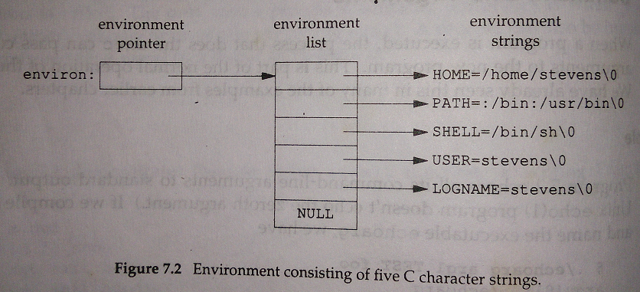
By convention the environment consists of name=value strings.

Slide 25
We call environ the environment pointer, the array of pointers the environment list, and the strings they point to the environment strings
.

Slide 26
Memory Layout of a C Program
•Text segment:
the machine instructions that the CPU executes. Usually, the text segment is sharable so that only a single copy needs to be in memory for frequently executed programs, such as text editors, the C compiler, the shells, and so on. Also, the text segment is often read-only, to prevent a program from accidentally modifying its instructions.
•Initialized data segment:
usually called simply the data segment, containing variables that are specifically initialized in the program. For example, the C declaration
int maxcount = 99;
appearing outside any function causes this variable to be stored in the initialized data segment with its initial value.

Slide 27
.Uninitialized data segment:
often called the "bss“ segment, named after an ancient assembler operator that stood for "block started by symbol." Data in this segment is initialized by the kernel to arithmetic 0 or null pointers before the program starts executing. The C declaration
long sum[1000];
appearing outside any function causes this variable to be stored in the uninitialized data segment.

Slide 28
•Stack:
where automatic variables are stored, along with information that is saved each time a function is called. Each time a function is called, the address of where to return to and certain information about the caller's environment, such as some of the machine registers, are saved on the stack.
The newly called function then allocates room on the stack for its automatic and temporary variables. This is how recursive functions in C can work. Each time a recursive function calls itself, a new stack frame is used, so one set of variables doesn't interfere with the variables from another instance of the function.
•Heap:
where dynamic memory allocation usually takes place. Historically, the heap has been located between the uninitialized data and the stack.

Slide 29
Figure shows the typical arrangement of these segments. This is a logical picture of how a program looks; there is no requirement that a given implementation arrange its memory in this fashion. The stack grows from higher-numbered addresses to lower-numbered addresses on this particular architecture. The unused virtual address space between the top of the heap and the top of the stack is large.
Notes:
$size /usr/bin/cc /bin/sh

Slide 30
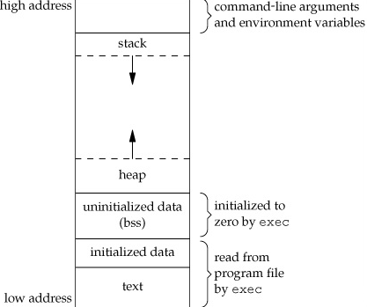
Typical memory arrangement Fig 2

Slide 31
Memory Allocation
ISO C specifies three functions for memory allocation:
1.malloc
which allocates a specified number of bytes of memory. The initial value of the memory is indeterminate.
2.calloc
which allocates space for a specified number of objects of a specified size. The space is initialized to all 0 bits.
3.realloc
which increases or decreases the size of a previously allocated area. When the size increases, it may involve moving the previously allocated area somewhere else, to provide the additional room at the end. Also, when the size increases, the initial value of the space between the old contents and the end of the new area is indeterminate.

Slide 32
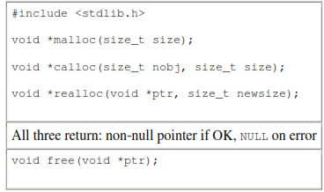
The pointer returned by the three allocation functions is guaranteed to be suitably aligned so that it can be used for any data object.

Slide 33
For example, if the most restrictive alignment requirement on a particular system requires that doubles must start at memory locations that are multiples of 8, then all pointers returned by these three functions would be so aligned.
Because the three alloc functions return a generic void * pointer, if we #include <stdlib.h> (to obtain the function prototypes), we do not explicitly have to cast the pointer returned by these functions when we assign it to a pointer of a different type.
The function free causes the space pointed to by ptr to be deallocated. This freed space is usually put into a pool of available memory and can be allocated in a later call to one of the three alloc functions.

Slide 34
The realloc function lets us increase or decrease the size of a previously allocated area.
For example, if we allocate room for 512 elements in an array that we fill in at runtime but find that we need room for more than 512 elements, we can call realloc. If there is room beyond the end of the existing region for the requested space, then realloc doesn't have to move anything; it simply allocates the additional area at the end and returns the same pointer that we passed it.
But if there isn't room at the end of the existing region, realloc allocates another area that is large enough, copies the existing 512-element array to the new area, frees the old area, and returns the pointer to the new area.
Note that the final argument to realloc is the new size of the region, not the difference between the old and new sizes. As a special case, if ptr is a null pointer,realloc behaves like malloc and allocates a region of the specified newsize.

Slide 35
alloca Function
The function alloca has the same calling sequence as malloc; however, instead of allocating memory from the heap, the memory is allocated from the stack frame of the current function.
The advantage is that we don't have to free the space; it goes away automatically when the function returns. The alloca function increases the size of the stack frame.
The disadvantage is that some systems can't support alloca, if it's impossible to increase the size of the stack frame after the function has been called.

Slide 36
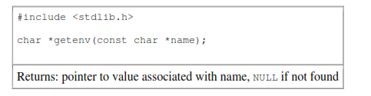
Environment Variables
getenv() function returns a pointer to the value of a name=value string.
We should always use getenv to fetch a specific value from the environment, instead of accessing environ directly.

Slide 37
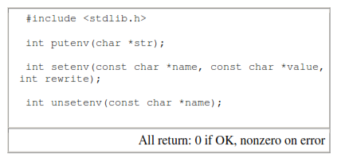
clearenv() is not part of the Single UNIX Specification. It is used to remove all entries from the environment list.
The prototypes for the other environ functions are listed below:

Slide 38
The operation of these three functions is as follows.
• The putenv function takes a string of the form name=value and places it in the environment list. If name already exists, its old definition is first removed.
• The setenv function sets name to value. If name already exists in the environment, then
(a) if rewrite is nonzero, the existing definition for name is first removed;
(b) if rewrite is 0, an existing definition for name is not removed, name is not set to the new value, and no error occurs.
• The unsetenv function removes any definition of name. It is not an error if such a definition does not exist.

Slide 39
Whereas setenv must allocate memory to create the name=value string from its arguments, putenv is free to place the string passed to it directly into the environment.
The environment list—the array of pointers to the actual name=value strings—and the environment strings are typically stored at the top of a process's memory space, above the stack.
Deleting a string is simple; we simply find the pointer in the environment list and move all subsequent pointers down one.
But adding a string or modifying an existing string is more difficult. The space at the top of the stack cannot be expanded, because it is often at the top of the address space of the process and so can't expand upward; it can't be expanded downward, because all the stack frames below it can't be moved.

Slide 40
1. If we're modifying an existing name:
a. If the size of the new value is less than or equal to the size of the existing value, we can just copy the new string over the old string.
b. If the size of the new value is larger than the old one, however, we must malloc to obtain room for the new string, copy the new string to this area, and then replace the old pointer in the environment list for name with the pointer to this allocated area.
2. If we're adding a new name, it's more complicated. First, we have to call malloc to allocate room for the name=value string and copy the string to this area.
a. Then, if it's the first time we've added a new name, we have to call malloc to obtain room for a new list of pointers. We copy the old environment list to this new area and store a pointer to the name=value string at the end of this list of pointers. We also store a null pointer at the end of this list, of course.

Slide 41
Finally, we set environ to point to this new list of pointers. Note from Figure 2 that if the original environment list was contained above the top of the stack, as is common, then we have moved this list of pointers to the heap. But most of the pointers in this list still point to name=value strings above the top of the stack.
b. If this isn't the first time we've added new strings to the environment list, then we know that we've already allocated room for the list on the heap, so we just call realloc to allocate room for one more pointer. The pointer to the new name=value string is stored at the end of the list (on top of the previous null pointer), followed by a null pointer.

Slide 42
setjmp and longjmp Functions
In C, we can't goto a label that's in another function. Instead, we must use the setjmp and longjmp functions to perform this type of branching.
These two functions are useful for handling error conditions that occur in a deeply nested function call.

Slide 43
Consider the skeleton in Figure. It consists of a main loop that reads lines from standard input and calls the function do_line to process each line.
This function then calls get_token to fetch the next token from the input line. The first token of a line is assumed to be a command of some form, and a switch statement selects each command.
For the single command shown, the function cmd_add is called.

Slide 44
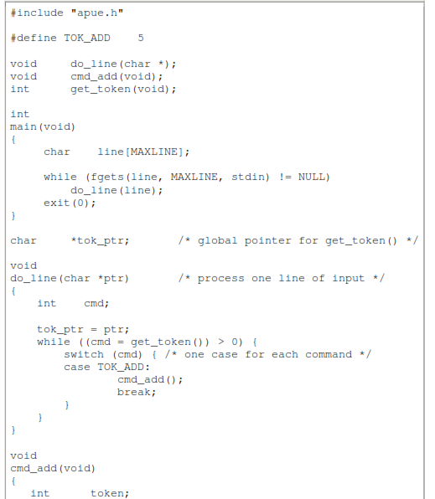
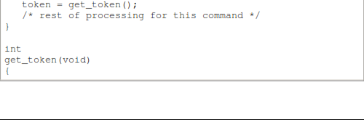

Slide 45
The skeleton in Figure is typical for programs that read commands, determine the command type, and then call functions to process each command.
Figure shows what the stack could look like after cmd_add has been called.
Storage for the automatic variables is within the stack frame for each function. The array line is in the stack frame for main, the integer cmd is in the stack frame for do_line, and the integer token is in the stack frame for cmd_add.

Slide 46
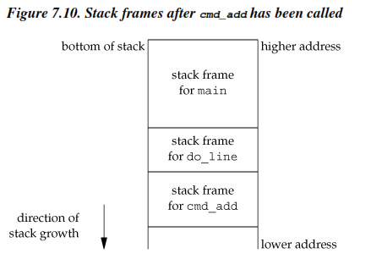

Slide 47
The coding problem that's often encountered with programs like the one shown in Figure is how to handle nonfatal errors.
For example, if the cmd_add function encounters an error—say, an invalid number—it might want to print an error, ignore the rest of the input line, and return to the main function to read the next input line.
But when we're deeply nested numerous levels down from the main function, this is difficult to do in C. (In this example, in the cmd_add function, we're only two levels down from main, but it's not uncommon to be five or more levels down from where we want to return to.) It becomes messy if we have to code each function with a special return value that tells it to return one level.

Slide 48
The solution to this problem is to use a nonlocal goto: the setjmp and longjmp functions. The adjective nonlocal is because we're not doing a normal C goto statement within a function; instead, we're branching back through the call frames to a function that is in the call path of the current function.

Slide 49
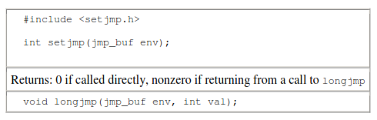

Slide 50
We call setjmp from the location that we want to return to, which in this example is in the main function. In this case, setjmp returns 0 because we called it directly.
In the call to setjmp, the argument env is of the special type jmp_buf. This data type is some form of array that is capable of holding all the information required to restore the status of the stack to the state when we call longjmp. Normally, the env variable is a global variable, since we'll need to reference it from another function.

Slide 51
When we encounter an error—say, in the cmd_add function—we call longjmp with two arguments. The first is the same env that we used in a call to setjmp, and the second, val, is a nonzero value that becomes the return value from setjmp. The reason for the second argument is to allow us to have more than one longjmp for each setjmp.

Slide 52
For example, we could longjmp from cmd_add with a val of 1 and also call longjmp from get_token with a val of 2.
In the main function, the return value from setjmp is either 1 or 2, and we can test this value, if we want, and determine whether the longjmp was from cmd_add or get_token.

Slide 53
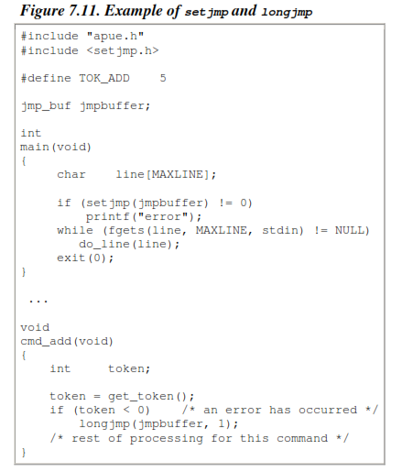

Slide 54
When main is executed, we call setjmp, which records whatever information it needs to in the variable jmpbuffer and returns 0.
We then call do_line, which calls cmd_add, and assume that an error of some form is detected. Before the call to longjmp in cmd_add, the stack looks like that in Fig 1.
But longjmp causes the stack to be "unwound" back to the main function, throwing away the stack frames for cmd_add and do_line. Calling longjmp causes the setjmp in main to return, but this time it returns with a value of 1(the second argument for longjmp).

Slide 55
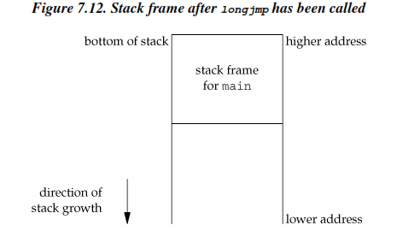

Slide 56
Automatic, Register, and Volatile Variables
We've seen what the stack looks like after calling longjmp. The next question is, "what are the states of the automatic variables and register variables in the main function?"
When main is returned to by the longjmp, do these variables have values corresponding to when the setjmp was previously called (i.e., are their values rolled back), or are their values left alone so that their values are whatever they were when do_line was called (which caused cmd_add to be called, which caused longjmp to be called)? Unfortunately, the answer is "it depends."

Slide 57
Potential Problem with Automatic Variables
Most implementations do not try to roll back these automatic variables and register variables, but the standards say only that their values are indeterminate.
If you have an automatic variable that you don't want rolled back, define it with the volatile attribute. Variables that are declared global or static are left alone when longjmp is executed.
Having looked at the way stack frames are usually handled, it is worth looking at a potential error in dealing with automatic variables.
The basic rule is that an automatic variable can never be referenced after the function that declared it returns.
Figure 6 shows a function called open_data that opens a standard I/O stream and sets the buffering for the stream.

Slide 58
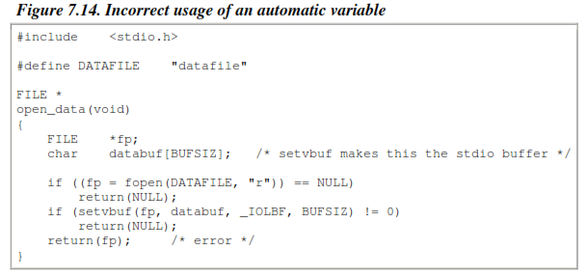

Slide 59
The problem is that when open_data returns, the space it used on the stack will be used by the stack frame for the next function that is called. But the standard I/O library will still be using that portion of memory for its stream buffer. Chaos is sure to result.
To correct this problem, the array databuf needs to be allocated from global memory, either statically (static or extern) or dynamically (one of the alloc functions).

Slide 60
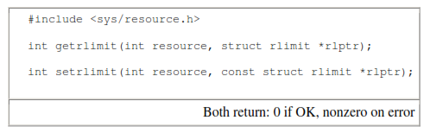
getrlimit and setrlimit Functions
Every process has a set of resource limits, some of which can be queried and changed by the getrlimit and setrlimit functions.

Slide 61
These two functions are defined as XSI extensions in the Single UNIX Specification.
The resource limits for a process are normally established by process 0 when the system is initialized and then inherited by each successive process.
Each implementation has its own way of tuning the various limits.
Each call to these two functions specifies a single resource and a pointer to the following structure:
struct rlimit {
rlim_t rlim_cur; /* soft limit: current limit */
rlim_t rlim_max; /* hard limit: maximum value for rlim_cur */
};
Notes:
Process ID 0 is usually the scheduler process and is often known as the swapper. No program on disk corresponds to this process, which is part of the kernel and is known as a system process.
Process ID 1 is usually the init process and is invoked by the kernel at the end of the bootstrap procedure. init becomes the parent process of any orphaned child process.
Process ID 2 is the pagedaemon.This process is responsible for supporting the paging of the virtual memory system.

Slide 62
Three rules govern the changing of the resource limits.
1. A process can change its soft limit to a value less than or equal to its hard limit.
2. A process can lower its hard limit to a value greater than or equal to its soft limit. This lowering of the hard limit is irreversible for normal users.
3. Only a superuser process can raise a hard limit.
An infinite limit is specified by the constant RLIM_INFINITY.

Slide 63
RLIMIT_AS
The maximum size in bytes of a process's total available memory. This affects the sbrk function and the mmap function(memory management system calls).
RLIMIT_CORE
The maximum size in bytes of a core file. A limit of 0 prevents the creation of a core file.
RLIMIT_CPU
The maximum amount of CPU time in seconds. When the soft limit is exceeded, the SIGXCPU signal is sent to the process.
RLIMIT_DATA
The maximum size in bytes of the data segment: the sum of the initialized data, uninitialized data, and heap.
Notes:
core file is the file created when a program terminates unexpectedly due to a bug or a violation of the OS or hardware protection mechanism.

Slide 64
RLIMIT_LOCKS
The maximum number of file locks a process can hold.
RLIMIT_MEMLOCK
The maximum amount of memory in bytes that a process can lock into memory using mlock(2).
RLIMIT_NOFILE
The maximum number of open files per process. Changing this limit affects the value returned by the sysconf function for its _SC_OPEN_MAX argument .
RLIMIT_NPROC
The maximum number of child processes per real user ID. Changing this limit affects the value returned for _SC_CHILD_MAX by the sysconf function.

Slide 65
RLIMIT_FSIZE
The maximum size in bytes of a file that may be created. When the soft limit is exceeded, the process is sent the SIGXFSZ signal.
RLIMIT_RSS
Maximum resident set size (RSS) in bytes. If available physical memory is low, the kernel takes memory from processes that exceed their RSS.
RLIMIT_SBSIZE
The maximum size in bytes of socket buffers that a user can consume at any given time.
RLIMIT_STACK
The maximum size in bytes of the stack.
RLIMIT_VMEM
This is a synonym for RLIMIT_AS. The maximum size of the process’s virtual memory(address space) in bytes.
Notes:
RLIMIT_RSS :The maximum amount of physical memory that this process should get.

Slide 66
The resource limits affect the calling process and are inherited by any of its children. This means that the setting of resource limits needs to be built into the shells to affect all our future processes. Indeed, the Bourne shell, the GNU Bourne-again shell, and the Korn shell have the built-in ulimit command, and the C shell has the built-in limit command. (The umask and chdir functions also have to be handled as shell built-ins.)

Slide 67
References
Terrence Chan: UNIX System Programming Using C++, Prentice Hall India,1999.
W.Richard Stevens: Advanced Programming in the UNIX Environment,Addison –Wesley/PHI
Sumitaba Das, UNIX-Concepts and Applications, 4th Edition, Tata McGraw Hill, 2006. (Chapter 9).

