Slide 1
Makefile

Slide 2
Make: Keep a set of programs current
– C programs depend on a number of files (system header files, user header files, C source files, object files, executable files, etc.)
– When a change occurs to a file that others depend on, you MUST recompile all dependent files.
– The “make” program allows you to specify dependency relationships to automate this process
– Make looks at dependency lines in the specified file
Rule Syntax:
target: dependency-list
[TAB] commands_list

Slide 3
- If any of the files in the dependency list have been modified since the target file’s last modification date, then the specified commands_list are invoked.
– Defaults to first rule unless specified explicitly on the command line

Slide 4
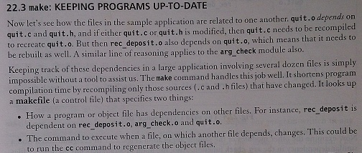

Slide 5
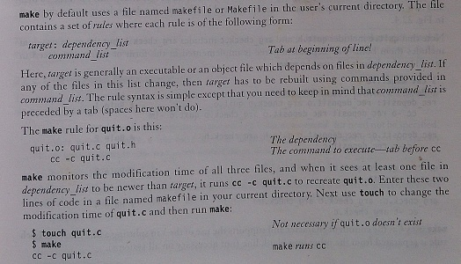

Slide 6
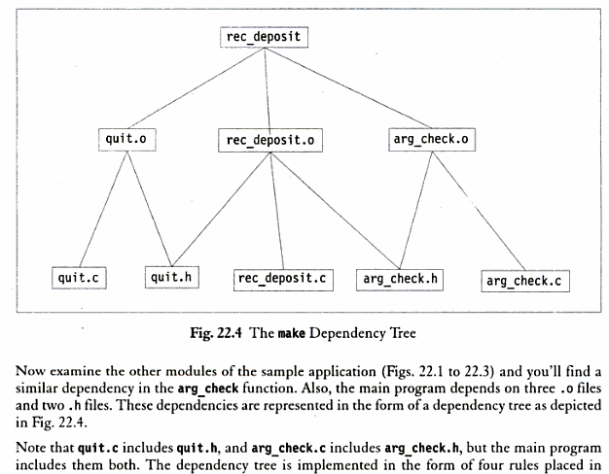

Slide 7
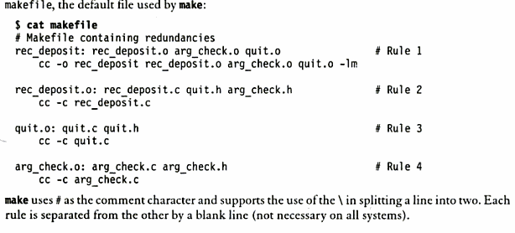

Slide 8
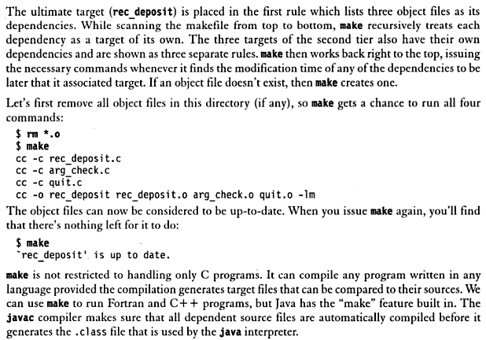

Slide 9
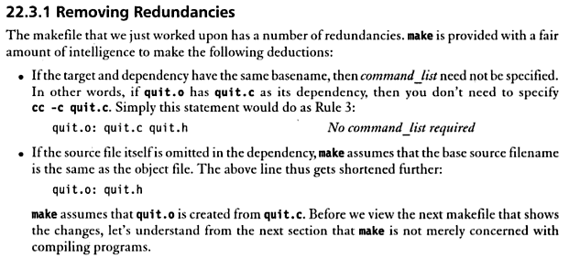

Slide 10
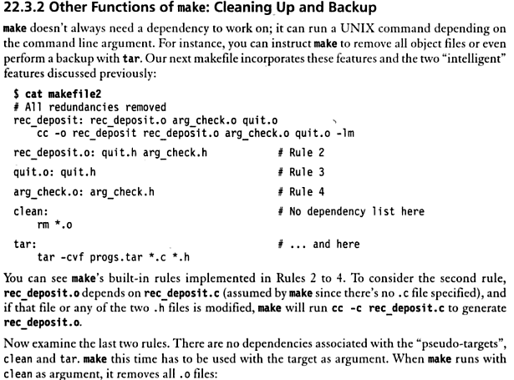

Slide 11
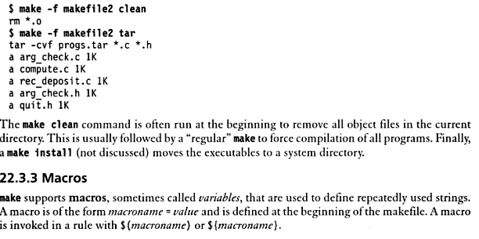

Slide 12
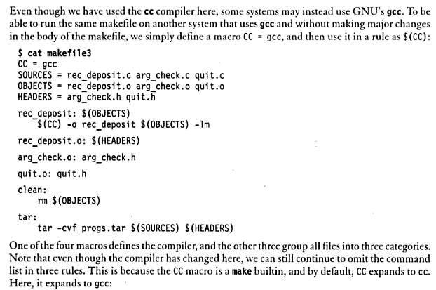

Slide 13
