Slide 1
InterProcess Communication

Slide 2
Introduction
IPC:
Techniques for processes to communicate with each other.
E.g.: Pipes, FIFOs, message queues, semaphores, shared memory and sockets.

Slide 3
Pipes
Pipes are the oldest form of UNIX System IPC and are provided by all UNIX systems. Pipes have two limitations.
1. Historically, they have been half duplex (i.e., data flows in only one direction). Some systems now provide full-duplex pipes.
2. Pipes can be used only between processes that have a common ancestor. Normally, a pipe is created by a process, that process calls fork, and the pipe is used between the parent and the child.

Slide 4
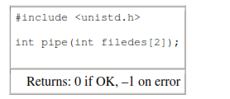
A pipe is created by calling the pipe function.
Two file descriptors are returned through the filedes argument: filedes[0] is open for reading, and filedes[1] is open for writing. The output of filedes[1] is the input for filedes[0].

Slide 5
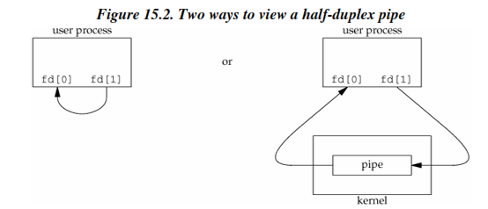
Two ways to picture a half-duplex pipe are shown in Figure 15.2.
The left half of the figure shows the two ends of the pipe connected in a single process.
The right half of the figure emphasizes that the data in the pipe flows through the kernel.

Slide 6
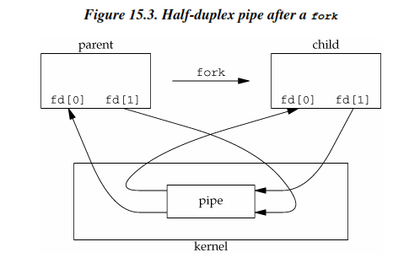
Normally, the process that calls pipe then calls fork, creating an IPC channel from the parent to the child or vice versa. Figure 15.3 shows this scenario.

Slide 7
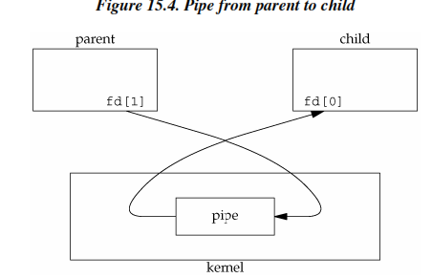
What happens after the fork depends on which direction of data flow we want. For a pipe from the parent to the child, the parent closes the read end of the pipe (fd[0]), and the child closes the write end (fd[1]). Figure 15.4shows the resulting arrangement of descriptors.

Slide 8
For a pipe from the child to the parent, the parent closes fd[1], and the child closes fd[0].
When one end of a pipe is closed, the following two rules apply.
1. If we read from a pipe whose write end has been closed, read returns 0 to indicate an end of file after all the data has been read
2. If we write to a pipe whose read end has been closed, the signal SIGPIPE is generated. If we either ignore the signal or catch it and return from the signal handler, write returns –1 with errno set to EPIPE.

Slide 9
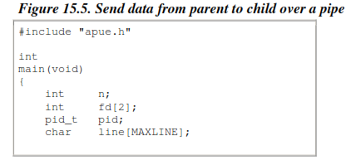
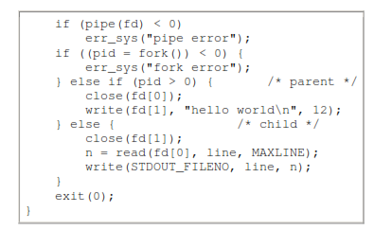

Slide 10
popen and pclose Functions
Since a common operation is to create a pipe to another process, to either read its output or send it input, the standard I/O library has historically provided the popen and pclose functions.
These two functions handle all the work that we've been doing ourselves: creating a pipe, forking a child, closing the unused ends of the pipe, executing a shell to run the command, and waiting for the command to terminate.

Slide 11
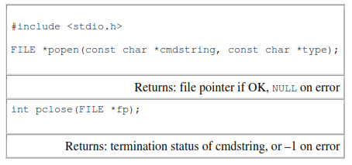

Slide 12
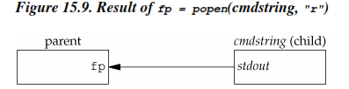
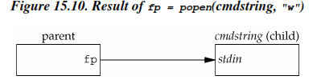
The function popen does a fork and exec to execute the cmdstring, and returns a standard I/O file pointer. If type is "r", the file pointer is connected to the standard output of cmdstring (Figure 15.9).
If type is "w", the file pointer is connected to the standard input of cmdstring, as shown in Figure 15.10.

Slide 13
FIFOs
FIFOs are sometimes called named pipes.
Pipes can be used only between related processes when a common ancestor has created the pipe.
With FIFOs, however, unrelated processes can exchange data.

Slide 14
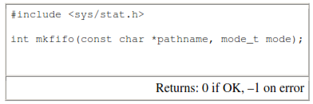
Creating a FIFO is similar to creating a file. Indeed, the pathname for a FIFO exists in the file system.

Slide 15
The specification of the mode argument for the mkfifo function is the same as for the open.
Once we have used mkfifo to create a FIFO, we open it using open. Indeed, the normal file I/O functions (close, read, write, unlink, etc.) all work with FIFOs.
Applications can create FIFOs with the mknod function. Because POSIX.1 originally didn't include mknod, the mkfifo function was invented specifically for POSIX.1.

Slide 16
When we open a FIFO, the nonblocking flag (O_NONBLOCK) affects what happens.
• In the normal case (O_NONBLOCK not specified), an open for read-only blocks until some other process opens the FIFO for writing.
Similarly, an open for write-only blocks until some other process opens the FIFO for reading.
• If O_NONBLOCK is specified, an open for read-only returns immediately. But an open for write-only returns –1 with errno set to ENXIO if no process has the FIFO open for reading.

Slide 17
As with a pipe, if we write to a FIFO that has no process open for reading, the signal SIGPIPE is generated.
When the last writer for a FIFO closes the FIFO, an end of file is generated for the reader of the FIFO.
It is common to have multiple writers for a given FIFO. This means that we have to worry about atomic writes if we don't want the writes from multiple processes to be interleaved.
As with pipes, the constant PIPE_BUF specifies the maximum amount of data that can be written atomically to a FIFO.

Slide 18
There are two uses for FIFOs.
1. FIFOs are used by shell commands to pass data from one shell pipeline to another without creating intermediate temporary files.
2. FIFOs are used as rendezvous points in client–server applications to pass data between the clients and the servers.

Slide 19
With a FIFO and the UNIX program tee(1), we can accomplish this procedure without using a temporary file(The tee program copies its standard input to both its standard output and to the file named on its command line.)
mkfifo fifo1
prog3 < fifo1 &
prog1 < infile | tee fifo1 | prog2
We create the FIFO and then start prog3 in the background, reading from the FIFO. We then start prog1 and use tee to send its input to both the FIFO and prog2.

Slide 20
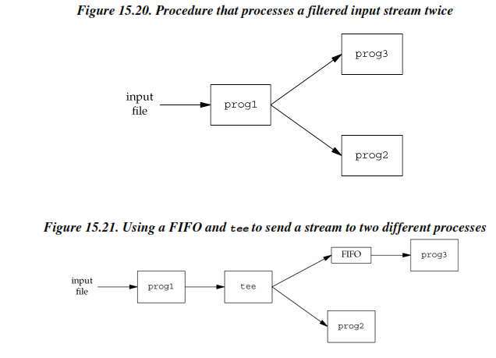

Slide 21
Another use for FIFOs is to send data between a client and a server. If we have a server that is contacted by numerous clients, each client can write its request to a well-known FIFO that the server creates. (By "well-known" we mean that the pathname of the FIFO is known to all the clients that need to contact the server.)
Figure 15.22 shows this arrangement. Since there are multiple writers for the FIFO, the requests sent by the clients to the server need to be less than PIPE_BUF bytes in size.This prevents any interleaving of the client writes.

Slide 22
The problem in using FIFOs for this type of client–server communication is how to send replies back from the server to each client. A single FIFO can't be used, as the clients would never know when to read their response versus responses for other clients.
One solution is for each client to send its process ID with the request. The server then creates a unique FIFO for each client, using a pathname based on the client's process ID.
For example, the server can create a FIFO with the name /tmp/serv1.XXXXX, where XXXXX is replaced with the client's process ID. Figure 15.23 shows this arrangement.

Slide 23
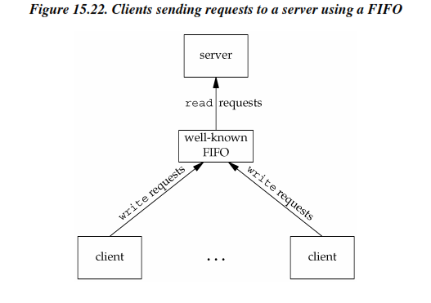

Slide 24
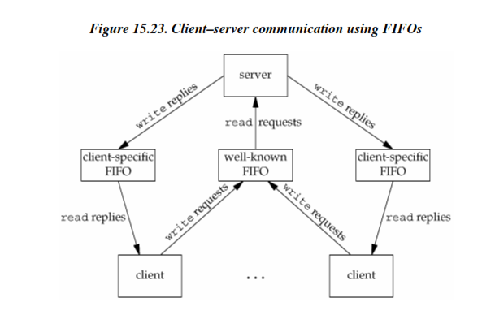

Slide 25
Message Queues
A message queue is a linked list of messages stored within the kernel and identified by a message queue identifier. We'll call the message queue just a queue and its identifier a queue ID.
A new queue is created or an existing queue opened by msgget. New messages are added to the end of a queue by msgsnd. Every message has a positive long integer type field, a non-negative length, and the actual data bytes (corresponding to the length), all of which are specified to msgsnd when the message is added to a queue.
Messages are fetched from a queue by msgrcv. We don't have to fetch the messages in a first-in, first-out order.
Instead, we can fetch messages based on their type field.

Slide 26
Each queue has the following msqid_ds structure associated with it:
struct msqid_ds {
struct ipc_perm msg_perm;
msgqnum_t msg_qnum; /* # of messages on queue */
msglen_t msg_qbytes; /* max # of bytes on queue */
pid_t msg_lspid; /* pid of last msgsnd() */
pid_t msg_lrpid; /* pid of last msgrcv() */
time_t msg_stime; /* last-msgsnd() time */
time_t msg_rtime; /* last-msgrcv() time */
time_t msg_ctime; /* last-change time */
.
.
.
};

Slide 27
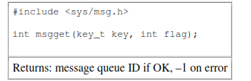
The first function normally called is msgget to either open an existing queue or create a new queue.

Slide 28
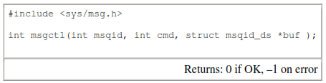
The msgctl function performs various operations on a queue. This function and the related functions for semaphores and shared memory (semctl and shmctl) are the ioctl-like functions.

Slide 29
The cmd argument specifies the command to be performed on the queue specified by msqid.
IPC_STAT
Fetch the msqid_ds structure for this queue, storing it in the structure pointed to by buf.
IPC_SET
Copy the following fields from the structure pointed to by buf to the msqid_ds structure associated with this queue: msg_perm.uid, msg_perm.gid, msg_perm.mode, and msg_qbytes. This command can be executed only by a process whose effective user ID equals msg_perm.cuid or msg_perm.uid or by a process with superuser privileges. Only the superuser can increase the value of msg_qbytes.
IPC_RMID
Remove the message queue from the system and any data still on the queue. This removal is immediate. Any other process still using the message queue will get an error of EIDRM on its next attempted operation on the queue. This command can be executed only by a process whose effective user ID equals msg_perm.cuid or msg_perm.uid or by a process with superuser privileges.

Slide 30
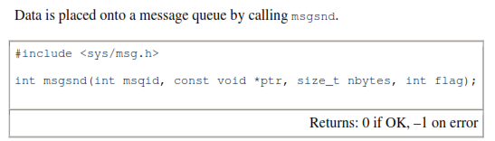

Slide 31
The ptr argument points to a long integer that contains the positive integer message type, and it is immediately followed by the message data. (There is no message data if nbytes is 0.) If the largest message we send is 512 bytes, we can define the following structure:
struct mymesg {
long mtype; /* positive message type */
char mtext[512]; /* message data, of length nbytes */
};

Slide 32
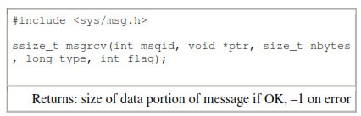
Messages are retrieved from a queue by msgrcv.

Slide 33
The type argument lets us specify which message we want.
type ==0
The first message on the queue is returned.
type > 0
The first message on the queue whose message type equals type is returned.
type < 0
The first message on the queue whose message type is the lowest value less than or equal to the absolute value of type is returned.

Slide 34
Semaphores
A semaphore isn't a form of IPC similar to the others that we've described (pipes, FIFOs, and message queues).A semaphore is a counter used to provide access to a shared data object for multiple processes.
To obtain a shared resource, a process needs to do the following:
1. Test the semaphore that controls the resource.
2. If the value of the semaphore is positive, the process can use the resource. In this case, the process decrements the semaphore value by 1, indicating that it has used one unit of the resource.
3. Otherwise, if the value of the semaphore is 0, the process goes to sleep until the semaphore value is greater than 0. When the process wakes up, it returns to step 1.

Slide 35
When a process is done with a shared resource that is controlled by a semaphore, the semaphore value is incremented by 1.
If any other processes are asleep, waiting for the semaphore, they are awakened.
To implement semaphores correctly, the test of a semaphore's value and the decrementing of this value must be an atomic operation.
For this reason, semaphores are normally implemented inside the kernel.
A common form of semaphore is called a binary semaphore. It controls a single resource, and its value is initialized to 1.
In general, however, a semaphore can be initialized to any positive value, with the value indicating how many units of the shared resource are available for sharing.

Slide 36
1. A semaphore is not simply a single non-negative value. Instead, we have to define a semaphore as a set of one or more semaphore values. When we create a semaphore, we specify the number of values in the set.
2. The creation of a semaphore (semget) is independent of its initialization (semctl). This is a fatal flaw, since we cannot atomically create a new semaphore set and initialize all the values in the set.
3. Since all forms of XSI IPC remain in existence even when no process is using them, we have to worry about a program that terminates without releasing the semaphores it has been allocated. The undo feature that we describe later is supposed to handle this.

Slide 37
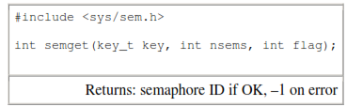
The first function to call is semget to obtain a semaphore ID.

Slide 38
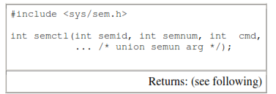
The semctl function is the catchall for various semaphore operations.

Slide 39
Shared Memory
Shared memory allows two or more processes to share a given region of memory. This is the fastest form of IPC, because the data does not need to be copied between the client and the server. The only trick in using shared memory is synchronizing access to a given region among multiple processes.
If the server is placing data into a shared memory region, the client shouldn't try to access the data until the server is done.
Often, semaphores are used to synchronize shared memory access. (record locking can also be used.)

Slide 40
The kernel maintains a structure with at least the following members for each shared memory segment:
struct shmid_ds {
struct ipc_perm shm_perm;
size_t shm_segsz; /* size of segment in bytes */
pid_t shm_lpid; /* pid of last shmop() */
pid_t shm_cpid; /* pid of creator */
shmatt_t shm_nattch; /* number of current attaches */
time_t shm_atime; /* last-attach time */
time_t shm_dtime; /* last-detach time */
time_t shm_ctime; /* last-change time */
.
.
.
};

Slide 41
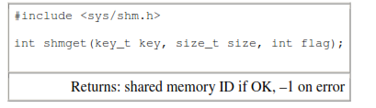
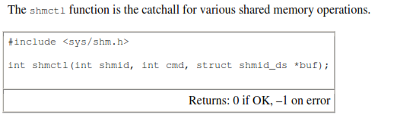
The first function called is usually shmget, to obtain a shared memory identifier.

Slide 42
The cmd argument specifies one of the following five commands to be performed, on the segment specified by shmid.
IPC_STAT
Fetch the shmid_ds structure for this segment, storing it in the structure pointed to by buf.
IPC_SET
Set the following three fields from the structure pointed to by buf in the shmid_ds structure associated with this shared memory segment: shm_perm.uid, shm_perm.gid, and shm_perm.mode.
This command can be executed only by a process whose effective user ID equals shm_perm.cuid or shm_perm.uid or by a process with superuser privileges.
IPC_RMID
Remove the shared memory segment set from the system

Slide 43
IPC_STAT
Fetch the shmid_ds structure for this segment, storing it in the structure pointed to by buf. This command can be executed only by a process whose effective user ID equals shm_perm.cuid or shm_perm.uid or by a process with superuser privileges.
SHM_LOCK
Lock the shared memory segment in memory. This command can be executed only by the superuser.
SHM_UNLOCK
Unlock the shared memory segment. This command can be executed only by the superuser.

Slide 44
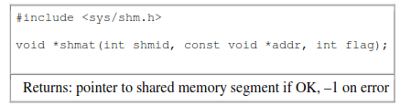
Once a shared memory segment has been created, a process attaches it to its address space by calling shmat.

Slide 45
The address in the calling process at which the segment is attached depends on the addr argument and whether the SHM_RND bit is specified in flag.
• If addr is 0, the segment is attached at the first available address selected by the kernel
• If addr is nonzero and SHM_RND is not specified, the segment is attached at the address given by addr.
• If addr is nonzero and SHM_RND is specified, the segment is attached at the address given by (addr - (addrmodulus SHMLBA)).
The SHM_RND command stands for "round." SHMLBA stands for "low boundary address multiple" and is always a power of 2. What the arithmetic does is round the address down to the next multiple of SHMLBA.

Slide 46
Where a kernel places shared memory segments that are attached with an address of 0 is highly system dependent.
Figure 15.31 shows a program that prints some information on where one particular system places various types of data.
Running this program on an Intel-based Linux system gives us the following output:
$ ./a.out
array[] from 804a080 to 8053cc0
stack around bffff9e4
malloced from 8053cc8 to 806c368
shared memory attached from 40162000 to 4017a6a0

Slide 47
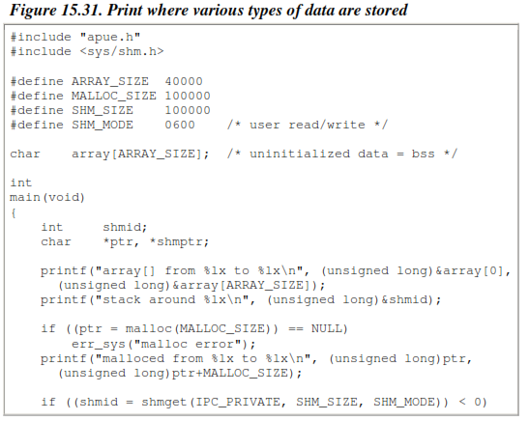

Slide 48
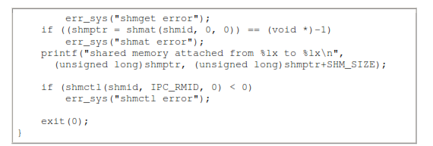

Slide 49
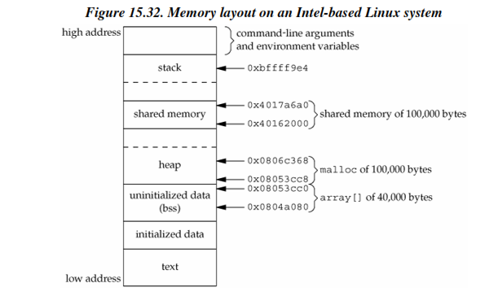

Slide 50
Thank you….

