Slide 1

Chapter 3
Data and Signals
Copyright © The McGraw-Hill Companies, Inc. Permission required for reproduction or display.

Slide 2

Note
To be transmitted, data must be transformed to electromagnetic signals.

Slide 3
3-1 ANALOG AND DIGITAL
Data can be analog or digital. The term analog data refers to information that is continuous;
Example : Analog clock
digital data refers to information that has discrete states. Analog data take on continuous values. Digital data take on discrete values.
Example : Digital clock.
Topics discussed in this section:
Analog and Digital Data
Analog and Digital Signals
Periodic and Nonperiodic Signals

Slide 4
Note
Data can be analog or digital.
Analog data are continuous and take continuous values.
Digital data have discrete states and take discrete values.

Slide 5
Analog and Digital signals
Analog Signals : An analog signal has infinitely many levels of intensity over a period of time. As the wave moves from value A to B it passes and includes an infinite number of values along its path.
Digital Signals : It has a limited number of defined values.

Slide 6
Note
Signals can be analog or digital.
Analog signals can have an infinite number of values in a range; digital signals can have only a limited
number of values.

Slide 7

Figure 3.1 Comparison of analog and digital signals

Slide 8
Note
In data communications, we commonly use periodic analog signals and nonperiodic digital signals.

Slide 9

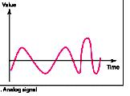
Periodic and Non – Periodic Signals
Both analog and digital signals can take one of the two forms : periodic or non-periodic
Periodic Signals Completes a pattern within a measurable time frame , called a period, and repeats that pattern over subsequent identical period.
Completion of one full pattern is called a cycle.
A non-periodic signal changes without exhibiting a pattern.
_{Periodic signal}
_{Non - Periodic signal}

Slide 10
3-2 PERIODIC ANALOG SIGNALS
Periodic analog signals can be classified as simple or composite. A simple periodic analog signal, a sine wave, cannot be decomposed into simpler signals. A composite
periodic analog signal is composed of multiple sine waves.
Topics discussed in this section:
Sine Wave
Wavelength
Time and Frequency Domain
Composite Signals
Bandwidth

Slide 11
Figure 3.2 A sine wave

Slide 12
Sine Wave
Peak Amplitude : It is the absolute value of its highest intensity.
Period (T) and Frequency (f) :
  Period refers to the amount of time, in seconds, a signal needs to complete one cycle.
  Frequency is the number of periods in 1 secs.
  Frequency and period are the inverse of each other.
  T = 1/f or T = 1/f

Slide 13

Figure 3.3 Two signals with the same phase and frequency,
but different amplitudes

Slide 14
Example 3.1
The power in your house can be represented by a sine wave with a peak amplitude of 155 to 170 V. However, it is common knowledge that the voltage of the power in U.S. homes is 110 to 120 V. This discrepancy is due to the fact that these are root mean square (rms) values. The signal is squared and then the average amplitude is calculated. The peak value is equal to 2^{½} × rms value.

Slide 15
Example 3.2
The voltage of a battery is a constant; this constant value can be considered a sine wave, as we will see later. For example, the peak value of an AA battery is normally
1.5 V.

Slide 16

Note
Frequency and period are the inverse of each other.

Slide 17

Figure 3.4 Two signals with the same amplitude and phase,
but different frequencies

Slide 18

Table 3.1 Units of period and frequency

Slide 19

Example 3.3
The power we use at home has a frequency of 60 Hz. The period of this sine wave can be determined as follows:

Slide 20
Example 3.4
Express a period of 100 ms in microseconds.
Solution
From Table 3.1 we find the equivalents of 1 ms (1 ms is 10⁻³ s) and 1 s (1 s is 10⁶ μs). We make the following substitutions:.

Slide 21

Example 3.5
The period of a signal is 100 ms. What is its frequency in kilohertz?
Solution
First we change 100 ms to seconds, and then we calculate the frequency from the period (1 Hz = 10⁻³ kHz).

Slide 22
Note
Frequency is the rate of change with respect to time.
Change in a short span of time
means high frequency.
Change over a long span of
time means low frequency.

Slide 23
Note
If a signal does not change at all, its frequency is zero.
If a signal changes instantaneously, its frequency is infinite.

Slide 24
_{Phase}
Note
Phase describes the position of the waveform relative to time 0.
Phase is measured in degree or radian

Slide 25

Figure 3.5 Three sine waves with the same amplitude and frequency,
but different phases

Slide 26

Example 3.6
A sine wave is offset 1/6 cycle with respect to time 0. What is its phase in degrees and radians?
Solution
We know that 1 complete cycle is 360°. Therefore, 1/6 cycle is

Slide 27

_{Wave length}
Wave length is the distance a simple signal can travel in one period.
Wave length (λ) = propagation speed( c ) X Period (T) = c/f
Figure 3.6 Wavelength and period

Slide 28

The time-domain and frequency-domain plots
Figure 3.7 The time-domain and frequency-domain plots of a sine wave

Slide 29
Note
A complete sine wave in the time domain can be represented by one single spike in the frequency domain.

Slide 30
Example 3.7
The frequency domain is more compact and useful when we are dealing with more than one sine wave. For example, Figure 3.8 shows three sine waves, each with different amplitude and frequency. All can be represented by three spikes in the frequency domain.

Slide 31

Figure 3.8 The time domain and frequency domain of three sine waves

Slide 32
Note
A single-frequency sine wave is not useful in data communications;
we need to send a composite signal, a signal made of many simple sine waves.

Slide 33
Note
According to Fourier analysis, any composite signal is a combination of
simple sine waves with different frequencies, amplitudes, and phases.
Fourier analysis is discussed in Appendix C.

Slide 34
Note
If the composite signal is periodic, the decomposition gives a series of signals with discrete frequencies;
if the composite signal is nonperiodic, the decomposition gives a combination of sine waves with continuous frequencies.

Slide 35
Example 3.8
Figure 3.9 shows a periodic composite signal with frequency f. This type of signal is not typical of those found in data communications. We can consider it to be three alarm systems, each with a different frequency. The analysis of this signal can give us a good understanding of how to decompose signals.

Slide 36
Composite Signals
A Composite signal is actually a combination of simple sine wave with different frequencies , amplitude and phases.
It can be a periodic or non – periodic .
A periodic composite signal can be decomposed into a series of simple sine waves with discrete frequencies.
A non-periodic composite signal can be decomposed into a combination of an infinite number of simple sine waves with continuous frequencies.

Slide 37

A Composite Signal with frequency f
Figure 3.9 A composite periodic signal

Slide 38
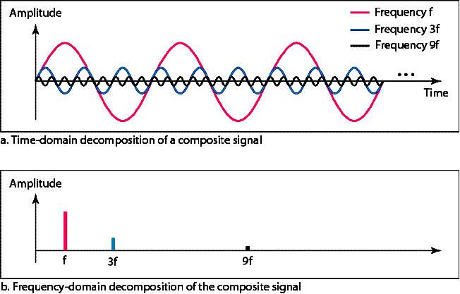
Figure 3.10 Decomposition of a composite periodic signal in the time and
frequency domains
_{Frequency}

Slide 39
Example 3.9
Figure 3.11 shows a non-periodic composite signal. It can be the signal created by a microphone or a telephone set when a word or two is pronounced. In this case, the composite signal cannot be periodic, because that implies that we are repeating the same word or words with exactly the same tone.

Slide 40

Figure 3.11 The time and frequency domains of a nonperiodic signal

Slide 41
_{Bandwidth}
Note
The bandwidth of a composite signal is the difference between the
highest and the lowest frequencies contained in that signal.

Slide 42

Figure 3.12 The bandwidth of periodic and nonperiodic composite signals

Slide 43

Example 3.10
If a periodic signal is decomposed into five sine waves with frequencies of 100, 300, 500, 700, and 900 Hz, what is its bandwidth? Draw the spectrum, assuming all components have a maximum amplitude of 10 V.
Solution
Let f_{h} be the highest frequency, f_{l} the lowest frequency, and B the bandwidth. Then
The spectrum has only five spikes, at 100, 300, 500, 700, and 900 Hz (see Figure 3.13).

Slide 44

Figure 3.13 The bandwidth for Example 3.10

Slide 45
Example 3.11
A periodic signal has a bandwidth of 20 Hz. The highest frequency is 60 Hz. What is the lowest frequency? Draw the spectrum if the signal contains all frequencies of the same amplitude.
Solution
Let f_{h} be the highest frequency, f_{l} the lowest frequency, and B the bandwidth. Then
The spectrum contains all integer frequencies. We show this by a series of spikes (see Figure 3.14).

Slide 46

Figure 3.14 The bandwidth for Example 3.11

Slide 47
Example 3.12
A nonperiodic composite signal has a bandwidth of 200 kHz, with a middle frequency of 140 kHz and peak amplitude of 20 V. The two extreme frequencies have an amplitude of 0. Draw the frequency domain of the signal.
Solution
The lowest frequency must be at 40 kHz and the highest at 240 kHz. Figure 3.15 shows the frequency domain and the bandwidth.

Slide 48

Figure 3.15 The bandwidth for Example 3.12

Slide 49
Example 3.13
An example of a nonperiodic composite signal is the signal propagated by an AM radio station. In the United States, each AM radio station is assigned a 10-kHz bandwidth. The total bandwidth dedicated to AM radio ranges from 530 to 1700 kHz. We will show the rationale behind this 10-kHz bandwidth in Chapter 5.

Slide 50
Example 3.14
Another example of a nonperiodic composite signal is the signal propagated by an FM radio station. In the United States, each FM radio station is assigned a 200-kHz bandwidth. The total bandwidth dedicated to FM radio ranges from 88 to 108 MHz. We will show the rationale behind this 200-kHz bandwidth in Chapter 5.

Slide 51
Example 3.15
Another example of a nonperiodic composite signal is the signal received by an old-fashioned analog black-and-white TV. A TV screen is made up of pixels. If we assume a resolution of 525 × 700, we have 367,500 pixels per screen. If we scan the screen 30 times per second, this is 367,500 × 30 = 11,025,000 pixels per second. The worst-case scenario is alternating black and white pixels. We can send 2 pixels per cycle. Therefore, we need 11,025,000 / 2 = 5,512,500 cycles per second, or Hz. The bandwidth needed is 5.5125 MHz.

Slide 52
3-3 DIGITAL SIGNALS
In addition to being represented by an analog signal, information can also be represented by a digital signal. For example, a 1 can be encoded as a positive voltage and a 0 as zero voltage. A digital signal can have more than two levels. In this case, we can send more than 1 bit for each level.
Bit Rate: No. of bits sent per second.
Bit Length : The Distance one bit occupies on the transminssion media
Digital Signal as a Composite Analog Signal
Application Layer

Slide 53

Figure 3.16 Two digital signals: one with two signal levels and the other
with four signal levels

Slide 54
Note
Appendix C reviews information about exponential and logarithmic functions.
Appendix C reviews information about exponential and logarithmic functions.

Slide 55
Example 3.16
A digital signal has eight levels. How many bits are needed per level? We calculate the number of bits from the formula
Each signal level is represented by 3 bits.

Slide 56
Example 3.17
A digital signal has nine levels. How many bits are needed per level? We calculate the number of bits by using the formula. Each signal level is represented by 3.17 bits. However, this answer is not realistic. The number of bits sent per level needs to be an integer as well as a power of 2. For this example, 4 bits can represent one level.

Slide 57
Example 3.18
Assume we need to download text documents at the rate of 100 pages per minute. What is the required bit rate of the channel?
Solution
A page is an average of 24 lines with 80 characters in each line. If we assume that one character requires 8 bits, the bit rate is

Slide 58
Example 3.19
A digitized voice channel, as we will see in Chapter 4, is made by digitizing a 4-kHz bandwidth analog voice signal. We need to sample the signal at twice the highest frequency (two samples per hertz). We assume that each sample requires 8 bits. What is the required bit rate?
Solution
The bit rate can be calculated as

Slide 59
Example 3.20
What is the bit rate for high-definition TV (HDTV)?
Solution
HDTV uses digital signals to broadcast high quality video signals. The HDTV screen is normally a ratio of 16 : 9. There are 1920 by 1080 pixels per screen, and the screen is renewed 30 times per second. Twenty-four bits represents one color pixel.
The TV stations reduce this rate to 20 to 40 Mbps through compression.

Slide 60
Digital Signal as Composite Analog Signal
Based Fourier Analysis , a digital signal is a composite analog signal.
A vertical line in the time domain means a frequency of infinity, A horizontal line in the time domain means a frequency of 0.
All frequencies in between (0 to infinity) are part of the domain.
This concept can be used to decompose and transmit a digital signal

Slide 61

Figure 3.17 The time and frequency domains of periodic and nonperiodic
digital signals

Slide 62
Note
A digital signal is a composite analog signal with an infinite bandwidth.

Slide 63

Transmission of Digital Signals.
Base Band Transmission : Sending a digital signal over a channel without changing the digital signal into an analog signal.
We require a low pass channel . A base band channel or low pass channel is a channel that can transfer frequencies that are equal to or very near zero. Examples are serial cables and local area networks (LANs)

Slide 64

Figure 3.19 Bandwidths of two low-pass channels

Slide 65

Case 1 : Using low channel with wide band width
Baseband transmission using a dedicated medium

Slide 66
Note
Baseband transmission of a digital signal that preserves the shape of the digital signal is possible only if we have a low-pass channel with an infinite or very wide bandwidth.

Slide 67
Example 3.21
An example of a dedicated channel where the entire bandwidth of the medium is used as one single channel is a LAN. Almost every wired LAN today uses a dedicated channel for two stations communicating with each other. In a bus topology LAN with multipoint connections, only two stations can communicate with each other at each moment in time (timesharing); the other stations need to refrain from sending data. In a star topology LAN, the entire channel between each station and the hub is used for communication between these two entities. We study LANs in Chapter 14.

Slide 68

Case 1 : Using low channel with wide narrow width (Rough appxomation)

Slide 69

_{Better Approximation}
Simulating a digital signal with first three harmonics

Slide 70
Note
In baseband transmission, the required bandwidth is proportional to the bit rate;
if we need to send bits faster, we need more bandwidth.
In baseband transmission, the required bandwidth is proportional to the bit rate;
if we need to send bits faster, we need more bandwidth.

Slide 71

Table 3.2 Bandwidth requirements

Slide 72
Example 3.22
What is the required bandwidth of a low-pass channel if we need to send 1 Mbps by using baseband transmission?
Solution
The answer depends on the accuracy desired.
a. The minimum bandwidth, is B = bit rate /2, or 500 kHz.
b. A better solution is to use the first and the third
harmonics with B = 3 × 500 kHz = 1.5 MHz.
c. Still a better solution is to use the first, third, and fifth
harmonics with B = 5 × 500 kHz = 2.5 MHz.

Slide 73
Example 3.22
We have a low-pass channel with bandwidth 100 kHz. What is the maximum bit rate of this
channel?
Solution
The maximum bit rate can be achieved if we use the first harmonic. The bit rate is 2 times the available bandwidth, or 200 kbps.

Slide 74

Broad band transmission: Changing the digital signal into an analog signal for transmission. Requires band pass channel.

Slide 75

Figure 3.24 Modulation of a digital signal for transmission on a bandpass
channel

Slide 76
Note
If the available channel is a bandpass channel, we cannot send the digital signal directly to the channel;
we need to convert the digital signal to an analog signal before transmission.

Slide 77
Example 3.24
An example of broadband transmission using modulation is the sending of computer data through a telephone subscriber line, the line connecting a resident to the central telephone office. These lines are designed to carry voice with a limited bandwidth. The channel is considered a bandpass channel. We convert the digital signal from the computer to an analog signal, and send the analog signal. We can install two converters to change the digital signal to analog and vice versa at the receiving end. The converter, in this case, is called a modem which we discuss in detail in Chapter 5.

Slide 78
Example 3.25
A second example is the digital cellular telephone. For better reception, digital cellular phones convert the analog voice signal to a digital signal (see Chapter 16). Although the bandwidth allocated to a company providing digital cellular phone service is very wide, we still cannot send the digital signal without conversion. The reason is that we only have a bandpass channel available between caller and callee. We need to convert the digitized voice to a composite analog signal before sending.

Slide 79
3-4 TRANSMISSION IMPAIRMENT
Signals travel through transmission media, which are not perfect. The imperfection causes signal impairment. This means that the signal at the beginning of the medium is not the same as the signal at the end of the medium. What is sent is not what is received. Three causes of impairment are attenuation, distortion, and noise.
Topics discussed in this section:
Attenuation
Distortion
Noise

Slide 80

Figure 3.25 Causes of impairment

Slide 81

Attenuation: means loss of energy because of resistance of the wires. To compensate for this loss amplifiers are used
To find lost or gained strength we use the unit of decibel.
dB = 10 log10 (P2 / P1 ) where P1 & P2 are powers of the signal at point 1 & 2

Slide 82

Example 3.26
Suppose a signal travels through a transmission medium and its power is reduced to one-half. This means that P₂ is (1/2)P₁. In this case, the attenuation (loss of power) can be calculated as
A loss of 3 dB (–3 dB) is equivalent to losing one-half the power.

Slide 83


Example 3.27
A signal travels through an amplifier, and its power is increased 10 times. This means that P₂ = 10P₁ . In this case, the amplification (gain of power) can be calculated as

Slide 84

Example 3.28
One reason that engineers use the decibel to measure the changes in the strength of a signal is that decibel numbers can be added (or subtracted) when we are measuring several points (cascading) instead of just two. In Figure 3.27 a signal travels from point 1 to point 4. In this case, the decibel value can be calculated as

Slide 85

Figure 3.27 Decibels for Example 3.28

Slide 86

Example 3.29
Sometimes the decibel is used to measure signal power in milliwatts. In this case, it is referred to as dB_{m} and is calculated as dB_{m} = 10 log10 P_{m} , where P_{m} is the power in milliwatts. Calculate the power of a signal with dB_{m} = −30.
Solution
We can calculate the power in the signal as

Slide 87

Example 3.30
The loss in a cable is usually defined in decibels per kilometer (dB/km). If the signal at the beginning of a cable with −0.3 dB/km has a power of 2 mW, what is the power of the signal at 5 km?
Solution
The loss in the cable in decibels is 5 × (−0.3) = −1.5 dB. We can calculate the power as

Slide 88

Distortion : Signal changes shape or form . It means signal components at the receiver side will have different phases from what they had at the sender.

Slide 89

Noise : Thermal , induced , cross talk, and impulse noise
Signal to Noise ratio (SNR) : Defined as
SNR = Avg signal power / Avg noise power
It is also described in decibels as
_{SNRdB = 10 log 10 SNR}

Slide 90

Example 3.31
The power of a signal is 10 mW and the power of the noise is 1 μW; what are the values of SNR and SNR_{dB} ?
Solution
The values of SNR and SNR_{dB} can be calculated as follows:

Slide 91

Example 3.32
The values of SNR and SNR_{dB} for a noiseless channel are
We can never achieve this ratio in real life; it is an ideal.

Slide 92

Figure 3.30 Two cases of SNR: a high SNR and a low SNR

Slide 93
3-5 DATA RATE LIMITS
A very important consideration in data communications is how fast we can send data, in bits per second, over a channel. Data rate depends on three factors:
1. The bandwidth available
2. The level of the signals we use
3. The quality of the channel (the level of noise)
4. Two theatrical formulas :
    By Nyquist for a noiseless channel
    By Shannon for a noisy channel

Slide 94
Nyquist bit rate for noiseless channel.
Bit rate = 2 X bandwidth X log₂ L
Where L -> no. of signal levels
Shannon capacity :
Capacity = band width X log₂ (1 + SNR)

Slide 95
Note
Increasing the levels of a signal may reduce the reliability of the system.

Slide 96
Example 3.33
Does the Nyquist theorem bit rate agree with the intuitive bit rate described in baseband transmission?
Solution
They match when we have only two levels. We said, in baseband transmission, the bit rate is 2 times the bandwidth if we use only the first harmonic in the worst case. However, the Nyquist formula is more general than what we derived intuitively; it can be applied to baseband transmission and modulation. Also, it can be applied when we have two or more levels of signals.

Slide 97
Example 3.34
Consider a noiseless channel with a bandwidth of 3000 Hz transmitting a signal with two signal levels. The maximum bit rate can be calculated as

Slide 98
Example 3.35
Consider the same noiseless channel transmitting a signal with four signal levels (for each level, we send 2 bits). The maximum bit rate can be calculated as

Slide 99

Example 3.36
We need to send 265 kbps over a noiseless channel with a bandwidth of 20 kHz. How many signal levels do we need?
Solution
We can use the Nyquist formula as shown:
Since this result is not a power of 2, we need to either increase the number of levels or reduce the bit rate. If we have 128 levels, the bit rate is 280 kbps. If we have 64 levels, the bit rate is 240 kbps.

Slide 100
Example 3.37
Consider an extremely noisy channel in which the value of the signal-to-noise ratio is almost zero. In other words, the noise is so strong that the signal is faint. For this channel the capacity C is calculated as
This means that the capacity of this channel is zero regardless of the bandwidth. In other words, we cannot receive any data through this channel.

Slide 101
Example 3.38
We can calculate the theoretical highest bit rate of a regular telephone line. A telephone line normally has a bandwidth of 3000. The signal-to-noise ratio is usually 3162. For this channel the capacity is calculated as
This means that the highest bit rate for a telephone line is 34.860 kbps. If we want to send data faster than this, we can either increase the bandwidth of the line or improve the signal-to-noise ratio.

Slide 102
Example 3.39
The signal-to-noise ratio is often given in decibels. Assume that SNR_{dB} = 36 and the channel bandwidth is 2 MHz. The theoretical channel capacity can be calculated as

Slide 103


Example 3.40
For practical purposes, when the SNR is very high, we can assume that SNR + 1 is almost the same as SNR. In these cases, the theoretical channel capacity can be simplified to
For example, we can calculate the theoretical capacity of the previous example as

Slide 104
Example 3.41
We have a channel with a 1-MHz bandwidth. The SNR for this channel is 63. What are the appropriate bit rate and signal level?
Solution
First, we use the Shannon formula to find the upper limit.

Slide 105
Example 3.41 (continued)
The Shannon formula gives us 6 Mbps, the upper limit. For better performance we choose something lower, 4 Mbps, for example. Then we use the Nyquist formula to find the number of signal levels.

Slide 106
Note
The Shannon capacity gives us the upper limit; the Nyquist formula tells us how many signal levels we need.

Slide 107
3-6 PERFORMANCE
One important issue in networking is the performance of the network—how good is it? We discuss quality of service, an overall measurement of network performance, in greater detail in Chapter 24. In this section, we introduce terms that we need for future chapters.
Topics discussed in this section:
Bandwidth
Throughput
Latency (Delay)
Bandwidth-Delay Product

Slide 108
_{Bandwidth}
In networking, we use the term bandwidth in two contexts.
❏ The first, bandwidth in hertz, refers to
the range of frequencies in a
composite signal or the range of
frequencies that a channel can pass.
❏ The second, bandwidth in bits per
second, refers to the speed of bit
transmission in a channel or link.
Relationship : Bandwith (in Hz) α Bandwidth (in bps)

Slide 109
Example 3.42
The bandwidth of a subscriber line is 4 kHz for voice or data. The bandwidth of this line for data transmission
can be up to 56,000 bps using a sophisticated modem to change the digital signal to analog.

Slide 110
Example 3.43
If the telephone company improves the quality of the line and increases the bandwidth to 8 kHz, we can send 112,000 bps by using the same technology as mentioned in Example 3.42.

Slide 111
Throughput : It is a measure how fast we can actually send data through a network.
  Bandwidth and Throughput are not same.
  Bandwidth is a potential measure of a link ; Throughput is the actual measure of how fast we can send data.
Latency (Delay) : It defines how long it takes for an entire message to completely arrive at the destination from the time the first bit is sent out from the source
  Latency = Propagation time + Transmission time + queuing time + Processing delay.
  where
  The Propagation time = (Distance / Propagation speed)
  ( It measures the time required for a bit to travel from the source to the destination.)
Transmission Time : ( Message size / Bandwidth)
( It measures the time first bit leaving the sender and last bit arriving at the receiver.)
Queuing Time : Time needed for each intermediate or end device to hold the message before it can be processed.
Processing delay : Time required for processing the message.

Slide 112

Example 3.44
A network with bandwidth of 10 Mbps can pass only an average of 12,000 frames per minute with each frame carrying an average of 10,000 bits. What is the throughput of this network?
Solution
We can calculate the throughput as
The throughput is almost one-fifth of the bandwidth in this case.

Slide 113

Example 3.45
What is the propagation time if the distance between the two points is 12,000 km? Assume the propagation speed to be 2.4 × 108 m/s in cable.
Solution
We can calculate the propagation time as
The example shows that a bit can go over the Atlantic Ocean in only 50 ms if there is a direct cable between the source and the destination.

Slide 114
Example 3.46
What are the propagation time and the transmission time for a 2.5-kbyte message (an e-mail) if the bandwidth of the network is 1 Gbps? Assume that the distance between the sender and the receiver is 12,000 km and that light travels at 2.4 × 108 m/s.
Solution
We can calculate the propagation and transmission time as shown on the next slide:

Slide 115

Example 3.46 (continued)
Note that in this case, because the message is short and the bandwidth is high, the dominant factor is the propagation time, not the transmission time. The transmission time can be ignored.

Slide 116
Example 3.47
What are the propagation time and the transmission time for a 5-Mbyte message (an image) if the bandwidth of the network is 1 Mbps? Assume that the distance between the sender and the receiver is 12,000 km and that light travels at 2.4 × 10⁸ m/s.
Solution
We can calculate the propagation and transmission times as shown on the next slide.

Slide 117

Example 3.47 (continued)
Note that in this case, because the message is very long and the bandwidth is not very high, the dominant factor is the transmission time, not the propagation time. The propagation time can be ignored.

Slide 118

_{Bandwidth – Delay Product}
Figure 3.31 Filling the link with bits for case 1

Slide 119
Example 3.48
We can think about the link between two points as a pipe. The cross section of the pipe represents the bandwidth, and the length of the pipe represents the delay. We can say the volume of the pipe defines the bandwidth-delay product, as shown in Figure 3.33.

Slide 120

Filling the link with bits in case 2

Slide 121
Note
The bandwidth-delay product defines the number of bits that can fill the link.

Slide 122

Figure 3.33 Concept of bandwidth-delay product
_{Jitter}

Slide 123
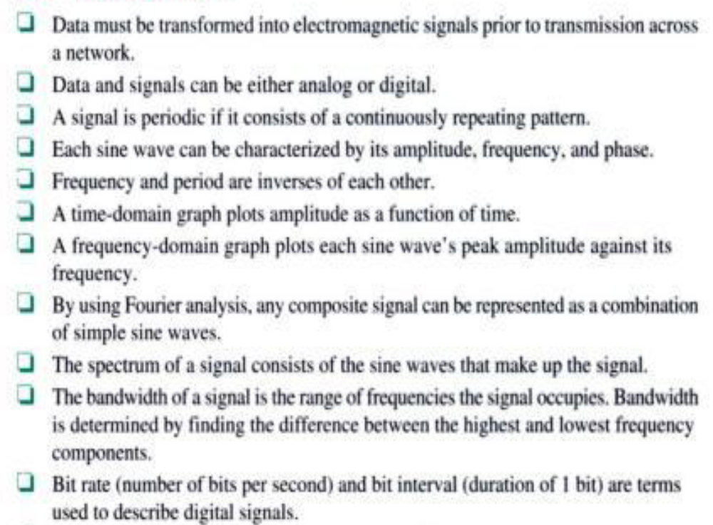
Summary

Slide 124
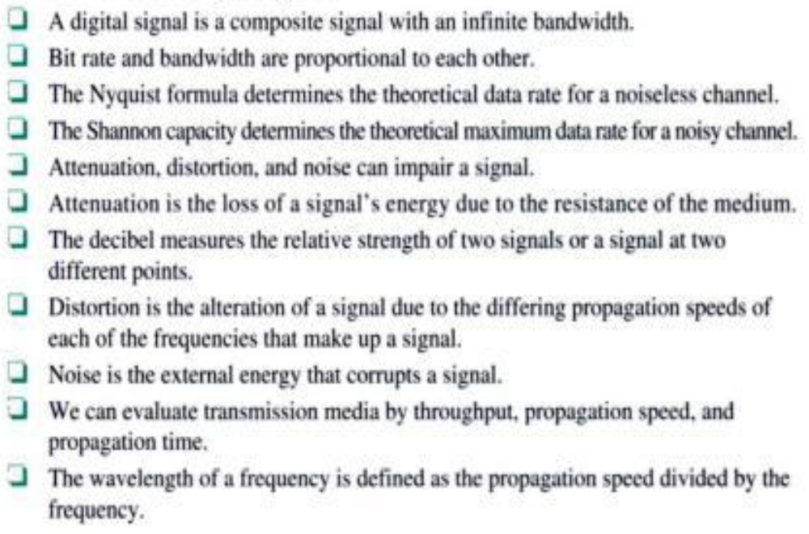
Summary

Slide 125

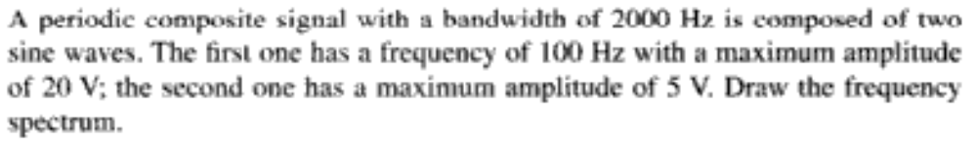

Chapter 3 Assignment
₁
₂
₃
₄
₅

Slide 126
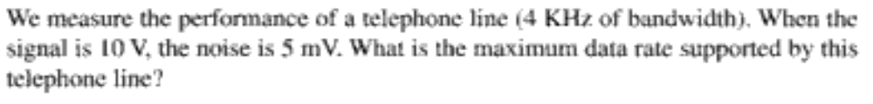
₆
₇

