Slide 1

Chapter 4
Digital Transmission
Copyright © The McGraw-Hill Companies, Inc. Permission required for reproduction or display.

Slide 2
4-1 DIGITAL-TO-DIGITAL CONVERSION
In this section, we see how we can represent digital data by using digital signals. The conversion involves three techniques: line coding, block coding, and scrambling. Line coding is always needed; block coding and scrambling may or may not be needed.
Topics discussed in this section:
Line Coding
Line Coding Schemes
Block Coding
Scrambling

Slide 3

_{Line Coding}
Figure 4.1 Line coding and decoding

Slide 4
Characteristics of Line Coding
Signal Elements vs Data Elements
  Data elements are what need to send and signal elements are what we can send.
  signal elements are careers for data elements
  We define a ratio which is the no. of data elements carried by each signal.

Slide 5

Figure 4.2 Signal element versus data element

Slide 6
Characteristics of Line Coding
2. Data rate v/s Signal Rate :
  Data rate : No. of data elements sent in 1 sec. Also called bit rate.
  Signal rate is the no . of signal elements sent in 1 sec. Also called pulse rate , modulation rate or baud rate.
  Goal is to increase data rate.
  Relationship between Data rate and Signal Rate.
    S = c X N X 1/ r baud
      N→ data rate
      r-> previously defined factor
      C→ case factor.
      S→ signal rate.

Slide 7

Example 4.1
A signal is carrying data in which one data element is encoded as one signal element ( r = 1). If the bit rate is 100 kbps, what is the average value of the baud rate if c is between 0 and 1?
Solution
We assume that the average value of c is 1/2 . The baud rate is then

Slide 8
Characteristics of Line Coding
3.Bandwidth :
  The actual band width of digital signal is infinite , the effective band width is finite.
  Bandwidth is proportional to signal rate.
  Therefore we can define minimum band width
    Bmin = c X N X 1/r;
    Therefore Nmax = 1/C X B X r

Slide 9

Note
Although the actual bandwidth of a digital signal is infinite, the effective bandwidth is finite.

Slide 10

Example 4.2
The maximum data rate of a channel (see Chapter 3) is N_{max} = 2 × B × log₂ L (defined by the Nyquist formula). Does this agree with the previous formula for N_{max}?
Solution
A signal with L levels actually can carry log₂L bits per level. If each level corresponds to one signal element and we assume the average case (c = 1/2), then we have

Slide 11
Characteristics of Line Coding
4.Baseline wandering : Running average of received signal.
5. DC components : When the voltage level in a digital signal is constant for while , the spectrum creates very low frequencies. These frequencies around zero , called DC components.
6. Self – Synchronization : A Self – Synchronizing digital signal includes timing information in the data being sent.
This timing information can be used to reset the receiver clock.
7. Built in error detection : Error encoding
8. Immunity to Noise and Interface :
9. Complexity :

Slide 12
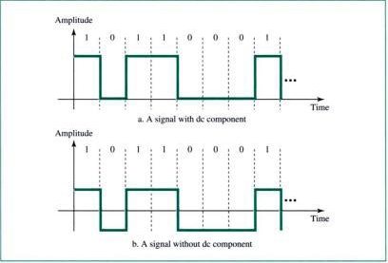
dc components

Slide 13

Figure 4.3 Effect of lack of synchronization

Slide 14
Example 4.3
In a digital transmission, the receiver clock is 0.1 percent faster than the sender clock. How many extra bits per second does the receiver receive if the data rate is
1 kbps? How many if the data rate is 1 Mbps?
Solution
At 1 kbps, the receiver receives 1001 bps instead of 1000 bps.
At 1 Mbps, the receiver receives 1,001,000 bps instead of 1,000,000 bps.

Slide 15

_{Line coding schemes}
Figure 4.4 Line coding schemes

Slide 16

_{Unipolar scheme}
Signals are on one side of the time axis
_{1. NRZ (Non – Return Zero)}
Figure 4.5 Unipolar NRZ scheme

Slide 17

_{Polar schemes}
Signals are on both side of the time axis
Figure 4.6 Polar NRZ-L and NRZ-I schemes

Slide 18
Note
In NRZ-L the level of the voltage determines the value of the bit.
In NRZ-I the inversion
or the lack of inversion
determines the value of the bit.

Slide 19
Note
NRZ-L and NRZ-I both have an average signal rate of N/2 Bd.

Slide 20
Note
NRZ-L and NRZ-I both have a DC component problem.

Slide 21
Example 4.4
A system is using NRZ-I to transfer 10-Mbps data. What are the average signal rate and minimum bandwidth?
Solution
The average signal rate is S = N/2 = 500 kbaud. The minimum bandwidth for this average baud rate is B_{min} = S = 500 kHz.

Slide 22

_{Polar RZ scheme}
Figure 4.7 Polar RZ scheme

Slide 23

Figure 4.8 Polar biphase: Manchester and differential Manchester schemes

Slide 24
Note
In Manchester and differential Manchester encoding, the transition
at the middle of the bit is used for synchronization.

Slide 25
Note
The minimum bandwidth of Manchester and differential Manchester is 2 times that of NRZ.

Slide 26
Note
In bipolar encoding, we use three levels: positive, zero, and negative.

Slide 27

Figure 4.9 Bipolar schemes: AMI and pseudoternary

Slide 28
Note
In mBnL schemes, a pattern of m data elements is encoded as a pattern of n signal elements in which 2^{m} ≤ L^{n}.

Slide 29
Multilevel schemes
Also called as mBnL Schemes , where
  m= No. of data elements
  n= No. of Signal elements
  L = No. of Signal levels
  B means binary data
  For L = 2 , we use B
  For L = 3 , we use T
  For L = 4 , we use Q
There are 3 schemes
  2B1Q scheme
  8B6T scheme
  4D-PAM5 scheme

Slide 30
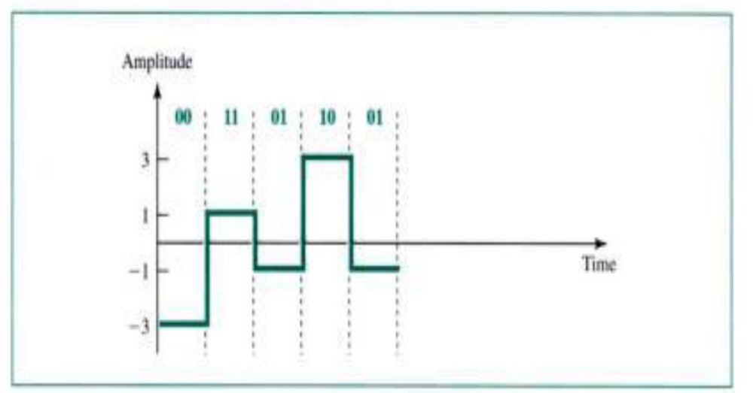
2B1Q scheme

Slide 31

_{8B6T scheme}
Figure 4.11 Multilevel: 8B6T scheme

Slide 32

4D-PAM5 scheme(4 dimensional five pulse amplitude modulation).(8B4Q)

Slide 33
Multitransition: MLT-3 scheme
If next bit is 0 there is no transition
If next bit is 1 and current level is not 0 , the next level is 0
If next bit is 1 and current level is 0 , the next level is opposite of the last non zero level.

Slide 34

Figure 4.13 Multitransition: MLT-3 scheme

Slide 35


Table 4.1 Summary of line coding schemes

Slide 36
Note
Block coding is normally referred to as mB/nB coding;
it replaces each m-bit group with an
n-bit group.

Slide 37

Block coding concept

Slide 38

_{4B/5B sheme}
Figure 4.15 Using block coding 4B/5B with NRZ-I line coding scheme

Slide 39


Table 4.2 4B/5B mapping codes

Slide 40

Figure 4.16 Substitution in 4B/5B block coding

Slide 41
Example 4.5
We need to send data at a 1-Mbps rate. What is the minimum required bandwidth, using a combination of 4B/5B and NRZ-I or Manchester coding?
Solution
First 4B/5B block coding increases the bit rate to 1.25 Mbps. The minimum bandwidth using NRZ-I is N/2 or 625 kHz. The Manchester scheme needs a minimum bandwidth of 1 MHz. The first choice needs a lower bandwidth, but has a DC component problem; the second choice needs a higher bandwidth, but does not have a DC component problem.

Slide 42

8B/10B block encoding

Slide 43

_{Scrambling}
Figure 4.18 AMI used with scrambling

Slide 44

B8ZS – Bipolar with 8 bit Substitution
Figure 4.19 Two cases of B8ZS scrambling technique

Slide 45
Note
B8ZS substitutes eight consecutive zeros with 000VB0VB.

Slide 46
HDB3(High density bipolar 3 zero) scrambling technique
HDB3 substitutes four consecutive zeros with 000V or B00V depending on the number of non zero pulses after the last substitution.
  if the number of non – zero pulses after the last substitution is odd , the substitution pattern will be 000V, which makes no. of non zero pulses even.
  If the number of non zero pulses after the last substitution is even , the substitution pattern will be B00V, which makes the total no. of non – zero pulses even

Slide 47

HDB3(High density bipolar 3 zero) scrambling technique
Figure 4.20 Different situations in HDB3 scrambling technique

Slide 48
Note
HDB3 substitutes four consecutive zeros with 000V or B00V depending
on the number of nonzero pulses after the last substitution.

Slide 49
4-2 ANALOG-TO-DIGITAL CONVERSION
We have seen in Chapter 3 that a digital signal is superior to an analog signal. The tendency today is to change an analog signal to digital data. In this section we describe two techniques,
1. pulse code modulation.
2. delta modulation.

Slide 50

_{PCM (Pulse Code Modulation)}
Figure 4.21 Components of PCM encoder

Slide 51
1.Sampling :
  Sampling is the reduction of a continuous signal to a discrete signal.
  Analog signal is sampled every Ts s, where Ts is sample interval or period.
  The inverse of sampling interval is called the sampling rate or sampling frequency
  (fs = 1/Ts).
  There are 3 sampling methods:
    Ideal (Pulses from analog signal is sampled)
    Natural (A high speed switch is turned on for the small period of time)
    Flat top (also called sample and hold)

Slide 52

Figure 4.22 Three different sampling methods for PCM

Slide 53
Note
According to the Nyquist theorem, the sampling rate must be
at least 2 times the highest frequency contained in the signal.

Slide 54

Figure 4.23 Nyquist sampling rate for low-pass and bandpass signals

Slide 55
Example 4.6
For an intuitive example of the Nyquist theorem, let us sample a simple sine wave at three sampling rates: f_{s} = 4f (2 times the Nyquist rate), f_{s} = 2f (Nyquist rate), and
f_{s} = f (one-half the Nyquist rate). Figure 4.24 shows the sampling and the subsequent recovery of the signal.
It can be seen that sampling at the Nyquist rate can create a good approximation of the original sine wave (part a). Oversampling in part b can also create the same approximation, but it is redundant and unnecessary. Sampling below the Nyquist rate (part c) does not produce a signal that looks like the original sine wave.

Slide 56

Figure 4.24 Recovery of a sampled sine wave for different sampling rates

Slide 57
Example 4.7
Consider the revolution of a hand of a clock. The second hand of a clock has a period of 60 s. According to the Nyquist theorem, we need to sample the hand every 30 s (T_{s} = T or f_{s} = 2f ). In Figure 4.25a, the sample points, in order, are 12, 6, 12, 6, 12, and 6. The receiver of the samples cannot tell if the clock is moving forward or backward. In part b, we sample at double the Nyquist rate (every 15 s). The sample points are 12, 3, 6, 9, and 12. The clock is moving forward. In part c, we sample below the Nyquist rate (T_{s} = T or f_{s} = f ). The sample points are 12, 9, 6, 3, and 12. Although the clock is moving forward, the receiver thinks that the clock is moving backward.

Slide 58

Figure 4.25 Sampling of a clock with only one hand

Slide 59
Example 4.8
An example related to Example 4.7 is the seemingly backward rotation of the wheels of a forward-moving car in a movie. This can be explained by under-sampling. A movie is filmed at 24 frames per second. If a wheel is rotating more than 12 times per second, the under-sampling creates the impression of a backward rotation.

Slide 60
Example 4.9
Telephone companies digitize voice by assuming a maximum frequency of 4000 Hz. The sampling rate therefore is 8000 samples per second.

Slide 61
Example 4.10
A complex low-pass signal has a bandwidth of 200 kHz. What is the minimum sampling rate for this signal?
Solution
The bandwidth of a low-pass signal is between 0 and f, where f is the maximum frequency in the signal. Therefore, we can sample this signal at 2 times the highest frequency (200 kHz). The sampling rate is therefore 400,000 samples per second.

Slide 62
Example 4.11
A complex bandpass signal has a bandwidth of 200 kHz. What is the minimum sampling rate for this signal?
Solution
We cannot find the minimum sampling rate in this case because we do not know where the bandwidth starts or ends. We do not know the maximum frequency in the signal.

Slide 63
Quantization:
  The result of a sampling process is a series of pulses with amplitude between maximum and minimum amplitude of the signal.
  These values cannot be used in encoding process.
  We need to quantize these values to get for encoding process.

Slide 64
Quantization Process.
We assume that original analog signal has amplitude between Vmin and Vmax.
We divide the range into L zones , each of height Δ .
      Δ = (Vmax – Vmin ) / L
We assign quantizes values of 0 to L-1 to the mid point of each zone.
We approximate the values of the amplitude to the quantized values.

Slide 65
Let us assume that we have a signal sampled signal and the sample amplitude are between -20 and +20. we decide to have 8 levels. The sample amplitudes are as follows.
-6.1, 7.5, 16.2 , 19.7, 11.0, -5.5, -11.3, -9.4, -6.0

Slide 66

Figure 4.26 Quantization and encoding of a sampled signal

Slide 67
Example 4.12
What is the SNR_{dB} in the example of Figure 4.26?
Solution
We can use the formula to find the quantization. We have eight levels and 3 bits per sample, so
SNR_{dB} = 6.02(3) + 1.76 = 19.82 dB
Increasing the number of levels increases the SNR.

Slide 68
Example 4.13
A telephone subscriber line must have an SNR_{dB} above 40. What is the minimum number of bits per sample?
Solution
We can calculate the number of bits as
Telephone companies usually assign 7 or 8 bits per sample.

Slide 69
Encoding :
  After each sample is quantized the no. of bits per sample is decided , each sample can be changed to an n_{b} – bit code word.
  Bit rate = sampling rate X number of bits per sample = f_{s X} n_{b}

Slide 70

Example 4.14
We want to digitize the human voice. What is the bit rate, assuming 8 bits per sample?
Solution
The human voice normally contains frequencies from 0 to 4000 Hz. So the sampling rate and bit rate are calculated as follows:

Slide 71

_{Recovery of original Signal}
Figure 4.27 Components of a PCM decoder

Slide 72
Example 4.15
We have a low-pass analog signal of 4 kHz. If we send the analog signal, we need a channel with a minimum bandwidth of 4 kHz. If we digitize the signal and send 8 bits per sample, we need a channel with a minimum bandwidth of 8 × 4 kHz = 32 kHz.

Slide 73

Delta modulation
This process records a small +ve or -ve changes , called delta.
If delta is +ve , the process records 1.
If delta is -ve , the process records 0.
Figure 4.28 The process of delta modulation

Slide 74

_{Modulator}
Figure 4.29 Delta modulation components

Slide 75

_{demodulator}
Figure 4.30 Delta demodulation components

Slide 76
4-3 TRANSMISSION MODES
The transmission of binary data across a link can be accomplished in either parallel or serial mode. In parallel mode, multiple bits are sent with each clock tick. In serial mode, 1 bit is sent with each clock tick. While there is only one way to send parallel data, there are three subclasses of serial transmission: asynchronous, synchronous, and isochronous.
Topics discussed in this section:
Parallel Transmission
Serial Transmission

Slide 77

Figure 4.31 Data transmission and modes

Slide 78

Parallel transmission
Multiple bits are sent with each clock tick
n wires are used to send n bits at one time
Figure 4.32 Parallel transmission

Slide 79

_{Serial transmission}
One bit is sent with each clock tick.
Only one wire (link) is used to send all the bits.
Figure 4.33 Serial transmission Serial transmission

Slide 80
Serial transmission
1.Asynchronous transmission
The timing of the signal is not important.
Information is received and translated by agreed upon patterns.
A start bit , usually a 0 , is added to the beginning of the byte to mark the start of the data.
Stop bits , usually 1s , are added to the end of the byte to mark the end of the data.

Slide 81
Note
In asynchronous transmission, we send 1 start bit (0) at the beginning and 1 or more stop bits (1s) at the end of each byte. There may be a gap between
each byte.

Slide 82
Note
Asynchronous here means “asynchronous at the byte level,”
but the bits are still synchronized;
their durations are the same.

Slide 83

Figure 4.34 Asynchronous transmission

Slide 84
Synchronous transmission
Bit stream is combined into longer frames.
Each byte is transmitted without a gap between it and the next one.
Receiver will separate the bytes.
There are uneven gaps between frames
Faster and used in high speed application.

Slide 85
Synchronous transmission
_{Frame1}
_{Frame2}
_{Frame3}
_{Multiple Bytes}
_{Multiple Bytes}
_{Multiple Bytes}
_{Sender}
_{Receiver}

Slide 86
Isochronous transmission
Used to send real time video and audio.
No gaps between frames.
In this transmission the data arrives at a fixed rate.

Slide 87

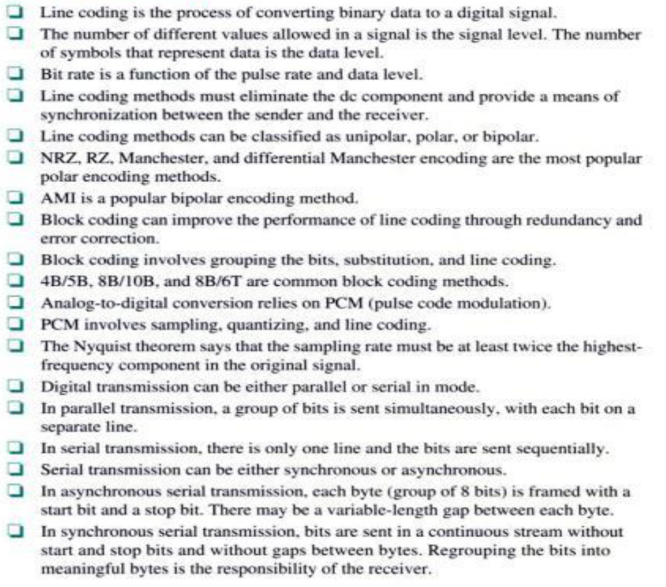

Slide 88
_{Chapter 4 - Assignment}
1 . a) A data stream has three 0s followed by two 1s followed by two 0s and another three 1s. Encode this stream using
    _{Manchester}
    _{Differential Manchester}
    _{MLT-3}
  Encode 1010000100000000 using B8ZS and HDB3 schemes
2. Encode 00101101100101101110 using 4B/5B scheme.

