Slide 1
Computer Graphics 5:
Line Drawing Algorithms

Slide 2
Contents
Graphics hardware
The problem of scan conversion
Considerations
Line equations
Scan converting algorithms
  A very simple solution
  The DDA algorithm
Conclusion

Slide 3
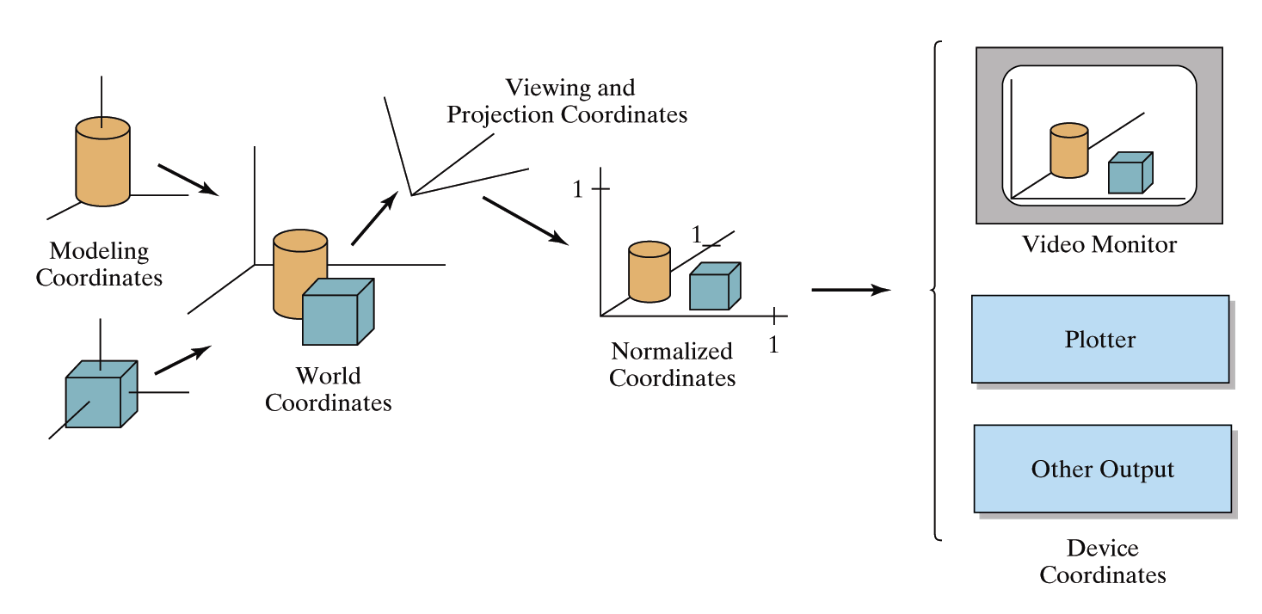

Graphics Hardware
It’s worth taking a little look at how graphics hardware works before we go any further
How do things end up on the screen?
Images taken from Hearn & Baker, “Computer Graphics with OpenGL” (2004)

Slide 4
Architecture Of A Graphics System
Display Processor Memory
Frame Buffer
Video Controller
Monitor
Monitor
CPU
Display Processor
System Memory
System Bus

Slide 5
Output Devices
There are a range of output devices currently available:
  Printers/plotters
  Cathode ray tube displays
  Plasma displays
  LCD displays
  3 dimensional viewers
  Virtual/augmented reality headsets
We will look briefly at some of the more common display devices

Slide 6
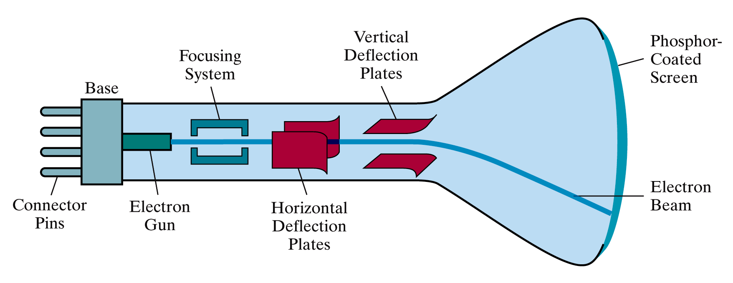
Basic Cathode Ray Tube (CRT)
Fire an electron beam at a phosphor coated screen
Images taken from Hearn & Baker, “Computer Graphics with OpenGL” (2004)

Slide 7
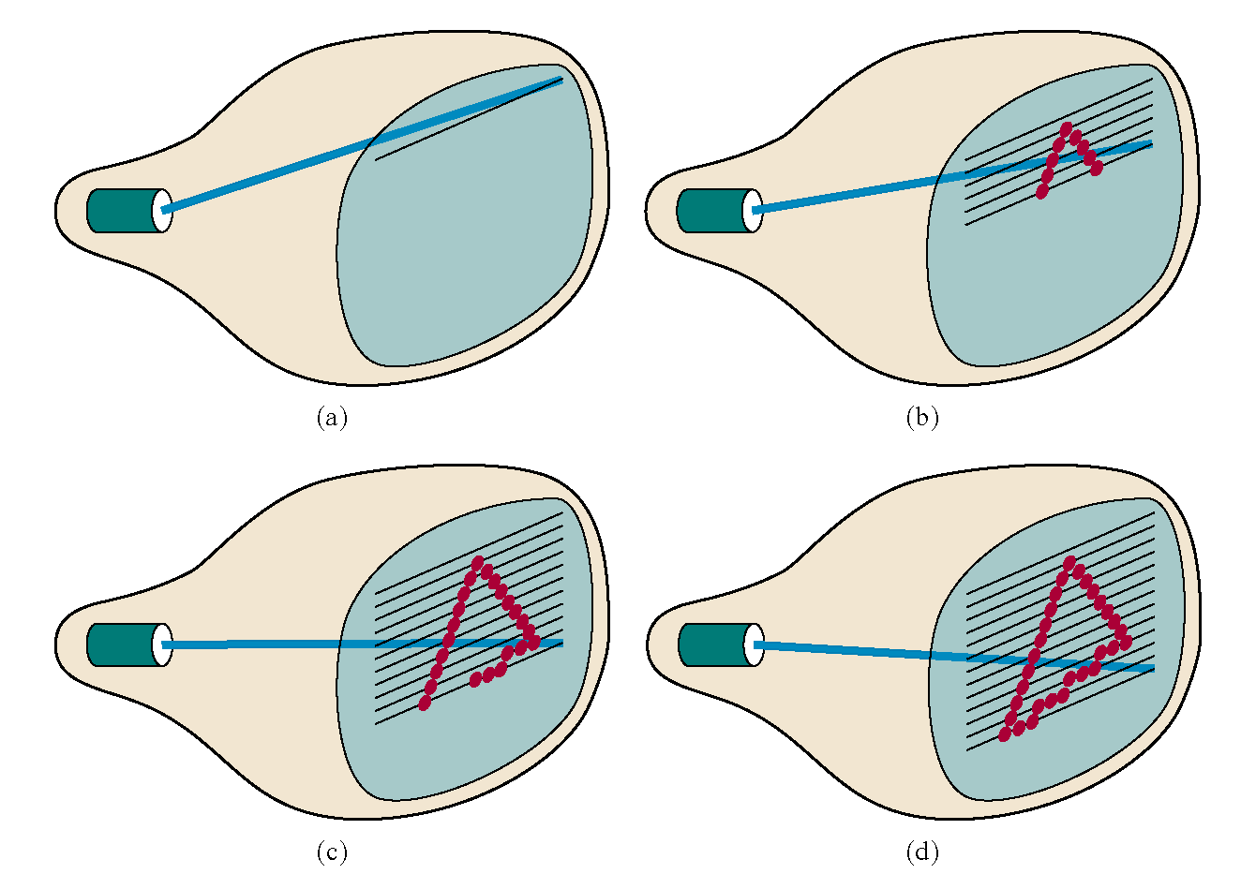
Raster Scan Systems
Draw one line at a time
Images taken from Hearn & Baker, “Computer Graphics with OpenGL” (2004)

Slide 8
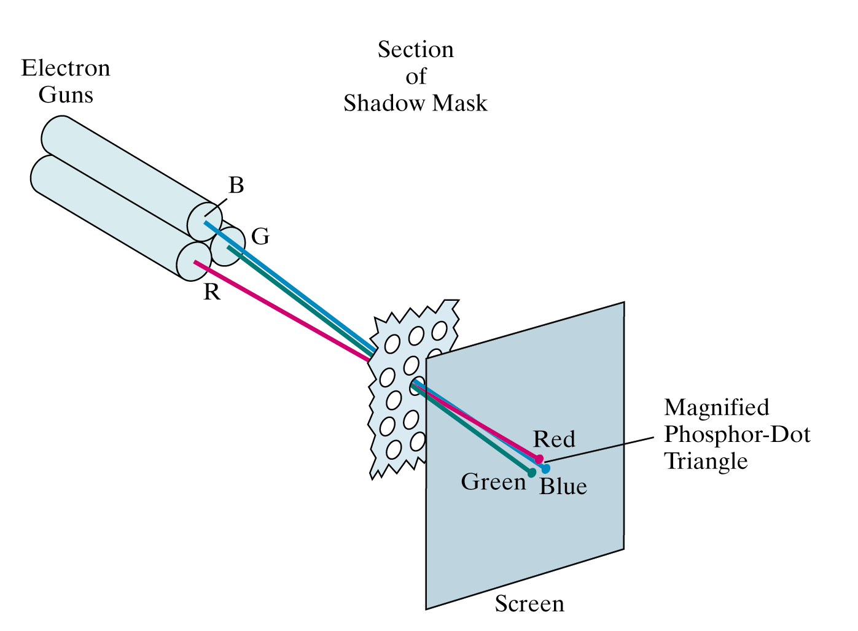
Colour CRT
An electron gun for each colour – red, green and blue
Images taken from Hearn & Baker, “Computer Graphics with OpenGL” (2004)

Slide 9
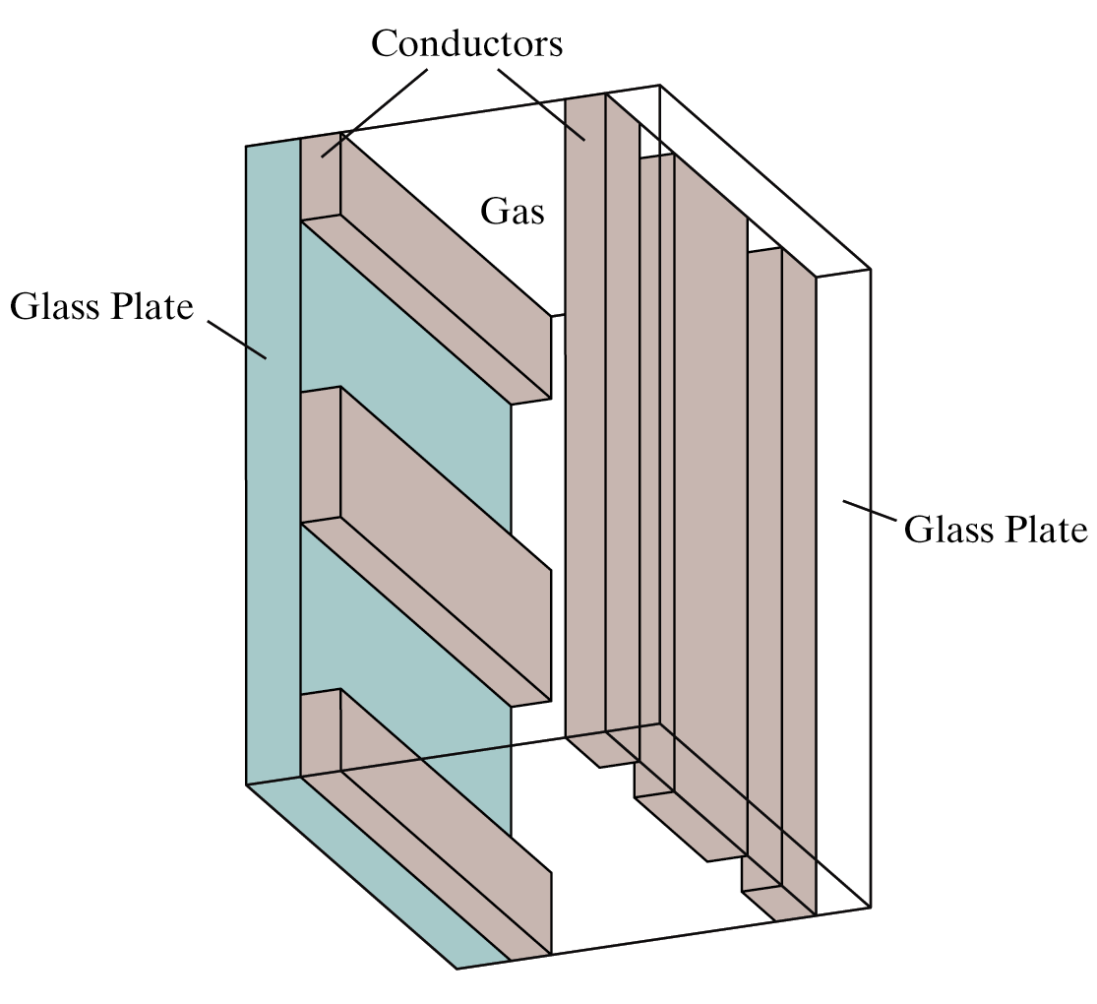
Plasma-Panel Displays
Applying voltages to crossing pairs of conductors causes the gas (usually a mixture including neon) to break down into a glowing plasma of electrons and ions
Images taken from Hearn & Baker, “Computer Graphics with OpenGL” (2004)

Slide 10
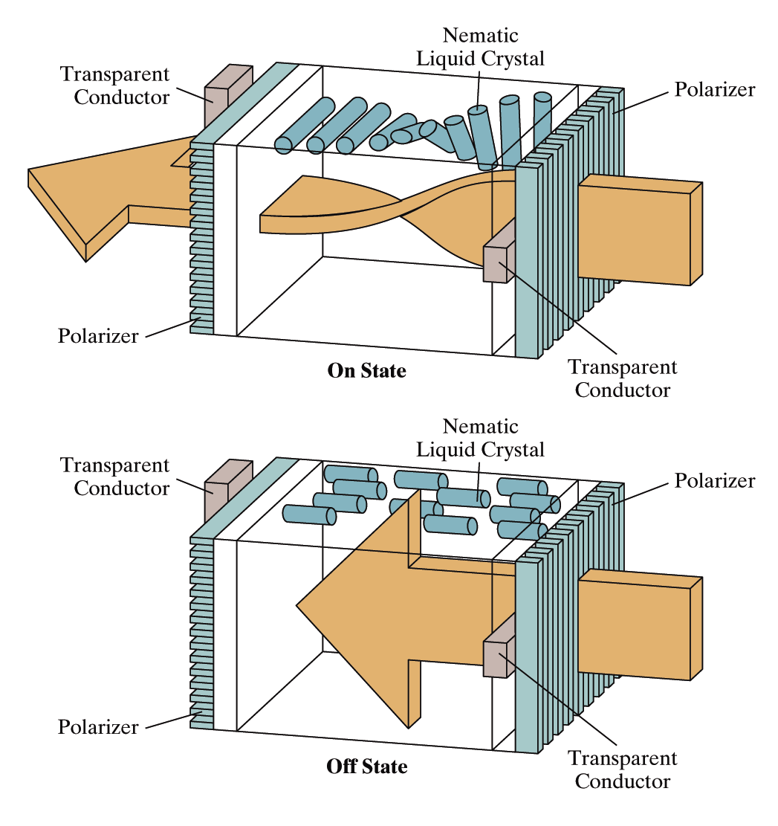
Liquid Crystal Displays
Light passing through the liquid crystal is twisted so it gets through the polarizer
A voltage is applied using the crisscrossing conductors to stop the twisting and turn pixels off
Images taken from Hearn & Baker, “Computer Graphics with OpenGL” (2004)

Slide 11
The Problem Of Scan Conversion
A line segment in a scene is defined by the coordinate positions of the line end-points
y
(7, 5)
(2, 2)
x

Slide 12
The Problem (cont…)
But what happens when we try to draw this on a pixel based display?
How do we choose which pixels to turn on?

Slide 13
Considerations
Considerations to keep in mind:
  The line has to look good
    Avoid jaggies
  It has to be lightening fast!
    How many lines need to be drawn in a typical scene?
    This is going to come back to bite us again and again

Slide 14
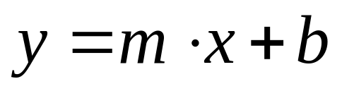
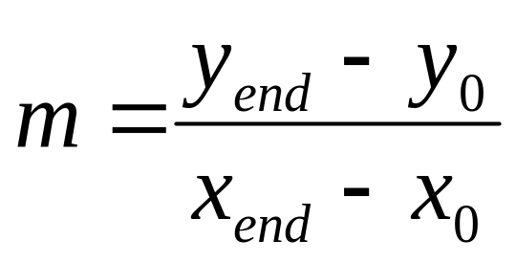
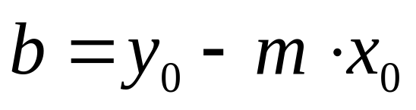
Line Equations
Let’s quickly review the equations involved in drawing lines
Slope-intercept line equation:
y
y_{end}
where:
y₀
x₀
x_{end}
x

Slide 15
Lines & Slopes
The slope of a line (m) is defined by its start and end coordinates
The diagram below shows some examples of lines and their slopes
m = ∞
m = -4
m = 4
m = -2
m = 2
m = -1
m = 1
m = -¹/₂
m = ¹/₂
m = -¹/₃
m = ¹/₃
m = 0
m = 0

Slide 16
A Very Simple Solution
We could simply work out the corresponding y coordinate for each unit x coordinate
Let’s consider the following example:
y
(7, 5)
5
2
(2, 2)
2
7
x

Slide 17
A Very Simple Solution (cont…)
5
4
3
2
1
0
0
1
2
3
4
5
6
7

Slide 18
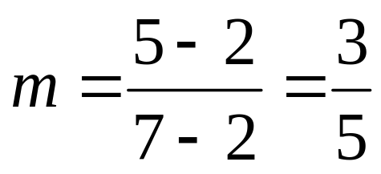
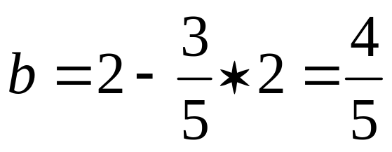
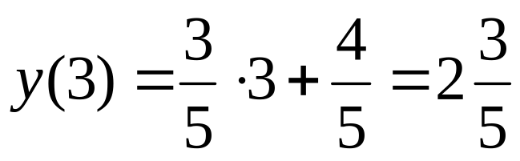
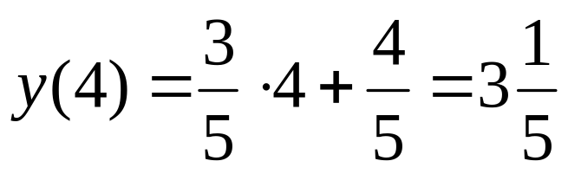
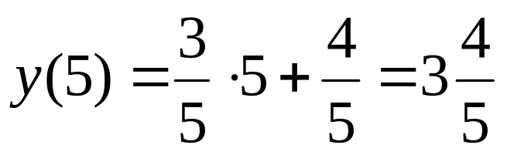
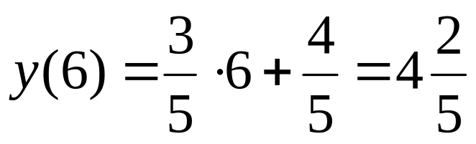
A Very Simple Solution (cont…)
y
(7, 5)
First work out m and b:
5
2
(2, 2)
2
3
4
5
6
7
x
Now for each x value work out the y value:

Slide 19
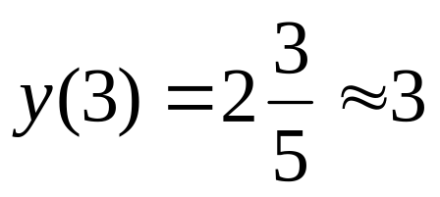
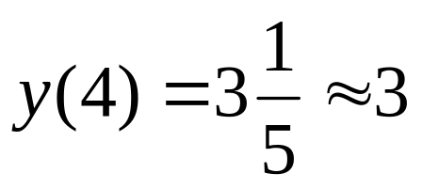
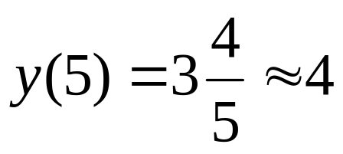
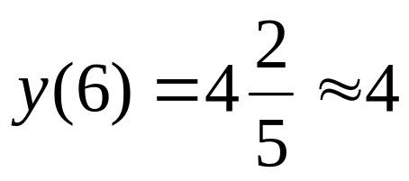
A Very Simple Solution (cont…)
Now just round off the results and turn on these pixels to draw our line
7
6
5
4
3
2
1
0
0
1
2
3
4
5
6
7
8

Slide 20
A Very Simple Solution (cont…)
However, this approach is just way too slow
In particular look out for:
  The equation y = mx + b requires the multiplication of m by x
  Rounding off the resulting y coordinates
We need a faster solution

Slide 21
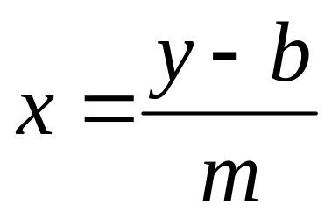
A Quick Note About Slopes
In the previous example we chose to solve the parametric line equation to give us the y coordinate for each unit x coordinate
What if we had done it the other way around?
So this gives us:
where: and

Slide 22
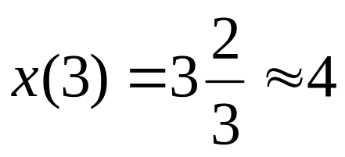
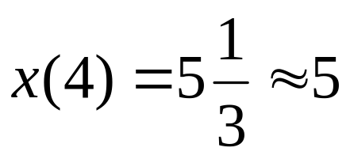
A Quick Note About Slopes (cont…)
Leaving out the details this gives us:
We can see easily that
this line doesn’t look
very good!
We choose which way
to work out the line
pixels based on the
slope of the line
7
6
5
4
3
2
1
0
0
1
2
3
4
5
6
7
8

Slide 23
A Quick Note About Slopes (cont…)
If the slope of a line is between -1 and 1 then we work out the y coordinates for a line based on it’s unit x coordinates
Otherwise we do the opposite – x coordinates are computed based on unit y coordinates
m = ∞
m = -4
m = 4
m = -2
m = 2
m = -1
m = 1
m = -¹/₂
m = ¹/₂
m = -¹/₃
m = ¹/₃
m = 0
m = 0

Slide 24
A Quick Note About Slopes (cont…)
5
4
3
2
1
0
0
1
2
3
4
5
6
7

Slide 25
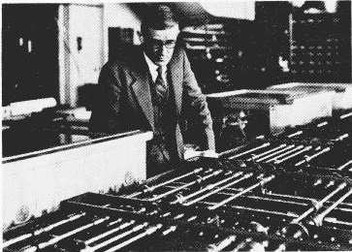
The DDA Algorithm
The digital differential analyzer (DDA) algorithm takes an incremental approach in order to speed up scan conversion
Simply calculate y_{k+1} based on y_{k}
The original differential analyzer was a physical machine developed by Vannevar Bush at MIT in the 1930’s in order to solve ordinary differential equations.
More information here.

Slide 26
The DDA Algorithm (cont…)
Consider the list of points that we determined for the line in our previous example:
(2, 2), (3, 2³/₅), (4, 3¹/₅), (5, 3⁴/₅), (6, 4²/₅), (7, 5)
Notice that as the x coordinates go up by one, the y coordinates simply go up by the slope of the line
This is the key insight in the DDA algorithm

Slide 27
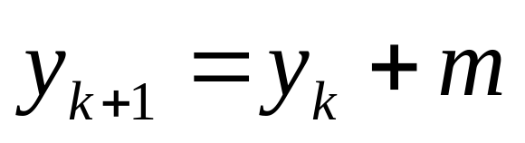
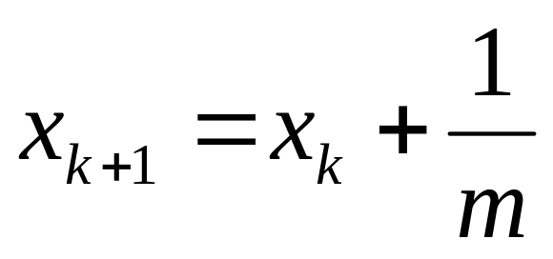
The DDA Algorithm (cont…)
When the slope of the line is between -1 and 1 begin at the first point in the line and, by incrementing the x coordinate by 1, calculate the corresponding y coordinates as follows:
When the slope is outside these limits, increment the y coordinate by 1 and calculate the corresponding x coordinates as follows:

Slide 28
The DDA Algorithm (cont…)
Again the values calculated by the equations used by the DDA algorithm must be rounded to match pixel values
(x_{k}+1, round(y_{k}+m))
(round(x_{k}+ ¹/_{m}), y_{k}+1)
(x_{k}, y_{k})
(x_{k}+ ¹/_{m}, y_{k}+1)
(x_{k}+1, y_{k}+m)
(x_{k}, y_{k})
(x_{k}, round(y_{k}))
(round(x_{k}), y_{k})

Slide 29
DDA Algorithm Example
Let’s try out the following examples:
y
y
(2, 7)
7
(7, 5)
5
2
2
(2, 2)
(3, 2)
2
7
x
2
3
x

Slide 30
DDA Algorithm Example (cont…)
7
6
5
4
3
2
0
1
2
3
4
5
6
7

Slide 31
The DDA Algorithm Summary
The DDA algorithm is much faster than our previous attempt
  In particular, there are no longer any multiplications involved
However, there are still two big issues:
  Accumulation of round-off errors can make the pixelated line drift away from what was intended
  The rounding operations and floating point arithmetic involved are time consuming

Slide 32
Conclusion
In this lecture we took a very brief look at how graphics hardware works
Drawing lines to pixel based displays is time consuming so we need good ways to do it
The DDA algorithm is pretty good – but we can do better
Next time we’ll like at the Bresenham line algorithm and how to draw circles, fill polygons and anti-aliasing

