Slide 1
Transformations

Slide 2
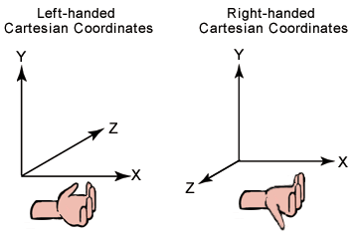
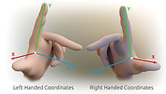

Slide 3
Window-to-Viewport Mapping
Definitions
World Coordinate System - This is object space or the space in which the application model is defined.
Screen Coordinate System - The space in which the image is displayed.
World Window (or clipping) - This is the rectangle in the world defining the region that is to be displayed.
Interface Window - The window opened on the raster graphics screen in which the image will be displayed.
Viewport - The rectangular portion of the interface window that defines where the image will actually appear (usually the entire interface window but in some cases modified to be a portion of the interface window).
Viewing Transformation - The process of mapping a world window in World Coordinates to the Viewport.

Slide 4
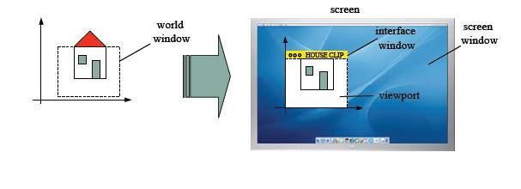

Slide 5
Description
Window-to-Viewport mapping is the process of mapping or transforming a two-dimensional, world-coordinate scene to device coordinates.
In particular, objects inside the world or clipping window are mapped to the viewport.
The viewport is displayed in the interface window on the screen. In other words, the clipping window is used to select the part of the scene that is to be displayed. The viewport then positions the scene on the output device.

Slide 6
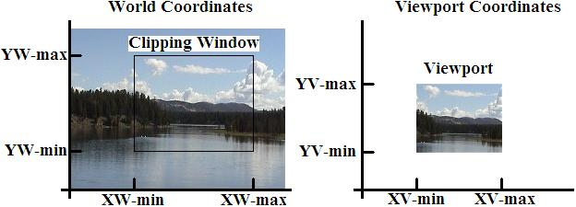

Slide 7
Development of the Window-To-Viewport Mapping
This mapping or transformation involves developing formulas that start with a point in the world window, say (xw, yw). The formula is used to produce a corresponding point in viewport coordinates, say (xv, yv).

Slide 8
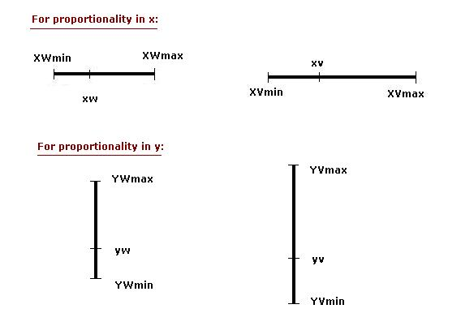
We would like for this mapping to be "proportional" in the sense that if xw is 30% of the way from the left edge of the world window, then xv is 30% of the way from the left edge of the viewport. Similarly, if yw is 30% of the way from the bottom edge of the world window, then yv is 30% of the way from the bottom edge of the viewport. The picture below shows this proportionality.

Slide 9
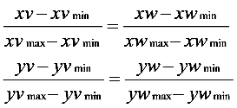
Using this proportionality, the following ratios must be equal.

Slide 10

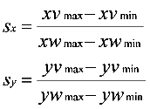
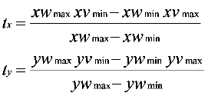
By solving these equations for the unknown viewport position (xv, yv), the following becomes true:
The scale factors (Sx, Sy) would be:
And the translation factors (Tx, Ty) would be:

Slide 12
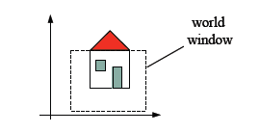
World Coordinate System (Object Space)
−Space in which the application model is defined;
The representation of an object is measured in some physical or abstract units.
−Space in which the object geometry is defined.
World Window (CLIPPING AREA)
−Rectangle defining the part of the world we wish to display.

Slide 13
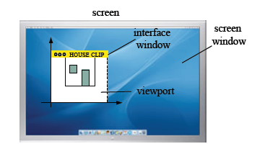
Screen Coordinate System (Image Space)
−Space in which the image is displayed; Example 800x600 pixels.
−Usually measured in pixels
−Space in which the object’s raster image is defined.
Interface Window
−Visual representation of the screen coordinate system for windowed displays (coordinate system moves with the interface window)

Slide 14
Viewport
−A rectangle on the raster graphics screen (or interface window) defining where the image will appear, usually the entire screen or interface window.

Slide 15
gluOrtho2D(left, right, bottom, top)
Sets up a 2-D orthographic viewing region or world window. Defined by two vertical
clipping planes left and right and two horizontal clipping planes bottom and top.
The world window by default is (-1,1,-1,1).
Defines a 2-D orthographic projection matrix.
glViewport(x, y, width, height)
Sets up the viewport in the interface window, where x,y specify the lower left corner, and width, height its dimensions.
By default, it uses the whole graphics area of the interface window.

Slide 16
Viewing Transformations
−The process of mapping from a world window (world coordinates) to a viewport (screen coordinates) .
Window-Viewport Mapping
Given a window and viewport, what is the transformation matrix that maps the window from world coordinates into the viewport in screen coordinates?

Slide 17
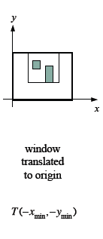
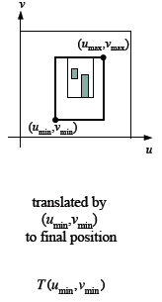
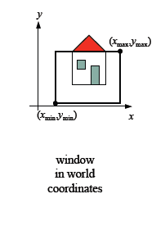
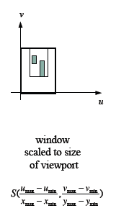
This matrix can be given as a three-step transformation composition as suggested by the following sequence of pictures:

Slide 18

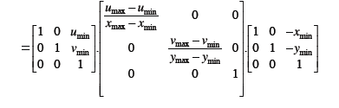
Multiply P=M_{wv}[x y 1]^{T} gives the expected result Mwv is also called as normalization transformation for Window to Viewport.

Slide 19
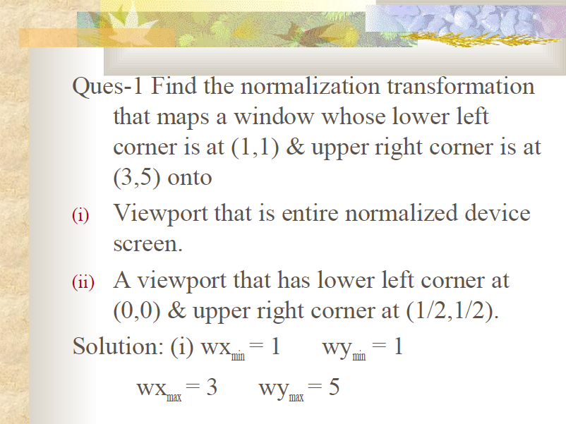

Slide 20
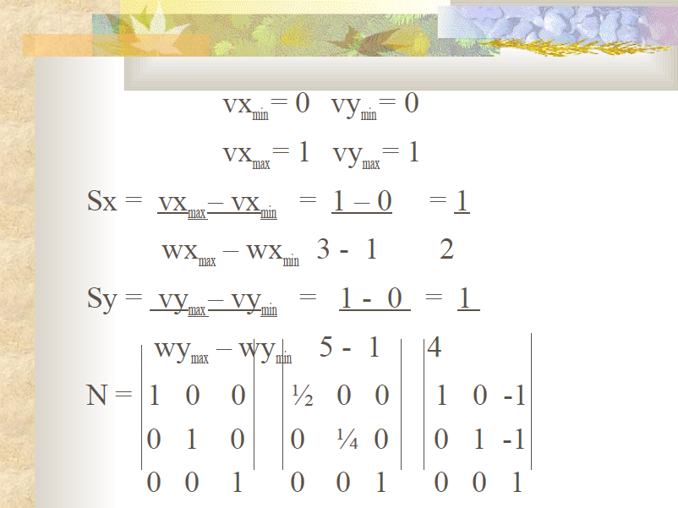

Slide 21
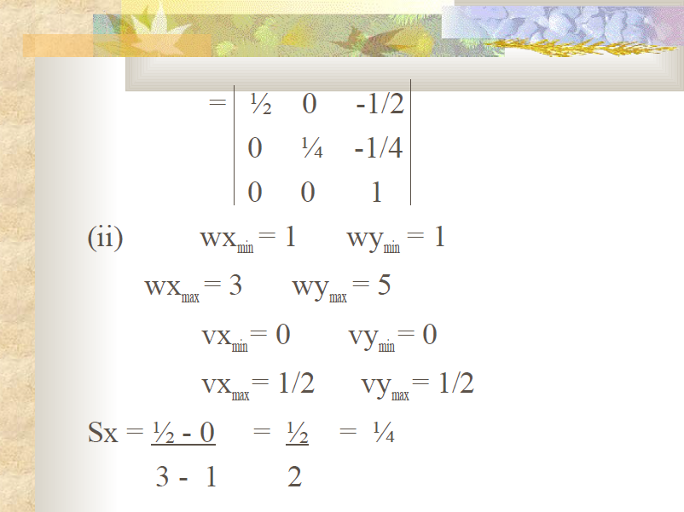

Slide 22
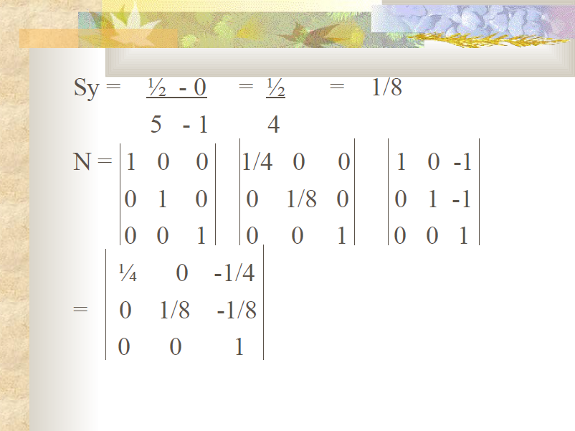

Slide 23
