Slide 1
UNIT-II
B. NEELIMA

Slide 2
Overview
2D Transformations
Basic 2D transformations
Matrix representation
Matrix composition
Window to view port transformation
3D Transformations
Basic 3D transformations
Same as 2D
Transformation as change in coordinate systems
Viewing in 3D
3D viewing process
Specification of an arbitrary 3D view
Types of projections
Color models for raster graphics

Slide 3
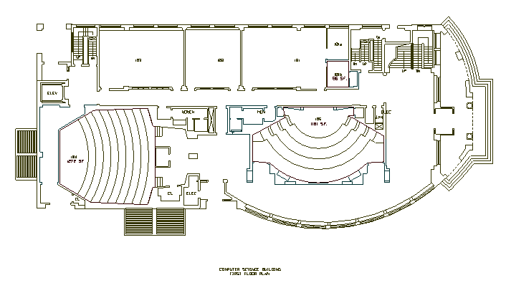
2D Modeling Transformations
Modeling
Coordinates
Scale
Translate
y
x
Scale
Rotate
Translate
World Coordinates

Slide 4
2D Modeling Transformations
Modeling
Coordinates
y
x
Let’s look at this in detail…
World Coordinates

Slide 5
2D Modeling Transformations
Modeling
Coordinates
y
x
Initial location at (0, 0) with x- and y-axes aligned

Slide 6
2D Modeling Transformations
Modeling
Coordinates
y
x
Scale .3, .3
Rotate -90
Translate 5, 3

Slide 7
2D Modeling Transformations
Modeling
Coordinates
y
x
Scale .3, .3
Rotate -90
Translate 5, 3

Slide 8
2D Modeling Transformations
Modeling
Coordinates
y
x
Scale .3, .3
Rotate -90
Translate 5, 3
World Coordinates

Slide 9
Scaling
Scaling a coordinate means multiplying each of its components by a scalar
Uniform scaling means this scalar is the same for all components:
× 2

Slide 10
Scaling
Non-uniform scaling: different scalars per component:
How can we represent this in matrix form?
X × 2, Y × 0.5

Slide 11
2-D Rotation
(x’, y’)
(x, y)
x’ = x cos(θ) - y sin(θ)
y’ = x sin(θ) + y cos(θ)
θ

Slide 12
2-D Rotation
x = r cos (φ)
y = r sin (φ)
x’ = r cos (φ + θ)
y’ = r sin (φ + θ)
Trig Identity…
x’ = r cos(φ) cos(θ) – r sin(φ) sin(θ)
y’ = r sin(φ) sin(θ) + r cos(φ) cos(θ)
Substitute…
x’ = x cos(θ) - y sin(θ)
y’ = x sin(θ) + y cos(θ)
(x’, y’)
(x, y)
θ
φ

Slide 13
2-D Rotation
This is easy to capture in matrix form:
Even though sin(θ) and cos(θ) are nonlinear functions of θ,
x’ is a linear combination of x and y
y’ is a linear combination of x and y

Slide 14
Basic 2D Transformations
Translation:
x’ = x + t_{x}
y’ = y + t_{y}
Scale:
x’ = x * s_{x}
y’ = y * s_{y}
Shear:
x’ = x + h_{x}*y
y’ = y + h_{y}*x
Rotation:
x’ = x*cosΘ - y*sinΘ
y’ = x*sinΘ + y*cosΘ
Transformations
can be combined
(with simple algebra)

Slide 15
Basic 2D Transformations
Translation:
x’ = x + t_{x}
y’ = y + t_{y}
Scale:
x’ = x * s_{x}
y’ = y * s_{y}
Shear:
x’ = x + h_{x}*y
y’ = y + h_{y}*x
Rotation:
x’ = x*cosΘ - y*sinΘ
y’ = x*sinΘ + y*cosΘ

Slide 16
Basic 2D Transformations
Translation:
x’ = x + t_{x}
y’ = y + t_{y}
Scale:
x’ = x * s_{x}
y’ = y * s_{y}
Shear:
x’ = x + h_{x}*y
y’ = y + h_{y}*x
Rotation:
x’ = x*cosΘ - y*sinΘ
y’ = x*sinΘ + y*cosΘ
(x,y)
(x’,y’)
x’ = x*s_{x}
y’ = y*s_{y}

Slide 17
Basic 2D Transformations
Translation:
x’ = x + t_{x}
y’ = y + t_{y}
Scale:
x’ = x * s_{x}
y’ = y * s_{y}
Shear:
x’ = x + h_{x}*y
y’ = y + h_{y}*x
Rotation:
x’ = x*cosΘ - y*sinΘ
y’ = x*sinΘ + y*cosΘ
(x’,y’)
x’ = (x*s_{x})*cosΘ - (y*s_{y})*sinΘ
y’ = (x*s_{x})*sinΘ + (y*s_{y})*cosΘ

Slide 18
Basic 2D Transformations
Translation:
x’ = x + t_{x}
y’ = y + t_{y}
Scale:
x’ = x * s_{x}
y’ = y * s_{y}
Shear:
x’ = x + h_{x}*y
y’ = y + h_{y}*x
Rotation:
x’ = x*cosΘ - y*sinΘ
y’ = x*sinΘ + y*cosΘ
(x’,y’)
x’ = ((x*s_{x})*cosΘ - (y*s_{y})*sinΘ) + t_{x}
y’ = ((x*s_{x})*sinΘ + (y*s_{y})*cosΘ) + t_{y}

Slide 19
Basic 2D Transformations
Translation:
x’ = x + t_{x}
y’ = y + t_{y}
Scale:
x’ = x * s_{x}
y’ = y * s_{y}
Shear:
x’ = x + h_{x}*y
y’ = y + h_{y}*x
Rotation:
x’ = x*cosΘ - y*sinΘ
y’ = x*sinΘ + y*cosΘ
x’ = ((x*s_{x})*cosΘ - (y*s_{y})*sinΘ) + t_{x}
y’ = ((x*s_{x})*sinΘ + (y*s_{y})*cosΘ) + t_{y}

Slide 20
Overview
2D Transformations
Basic 2D transformations
Matrix representation
Matrix composition
3D Transformations
Basic 3D transformations
Same as 2D

Slide 21
Translation
Translation - repositioning an object along a straight-line path (the translation distances) from one coordinate location to another.
(x’,y’)
(t_{x},t_{y})
(x,y)

Slide 22
Translation
Given:
We want:
Matrix form:

Slide 23
Translation Examples
P=(2,4), T=(-1,14), P’=(?,?)
P=(8.6,-1), T=(0.4,-0.2), P’=(?,?)
P=(0,0), T=(1,0), P’=(?,?)

Slide 24
Recall
A point is a position specified with coordinate values in some reference frame.
We usually label a point in this reference point as the origin.
All points in the reference frame are given with respect to the origin.

Slide 25
Scale
Scale - Alters the size of an object.
Scales about a fixed point
(x’,y’)
(x,y)

Slide 26
Scale
Given:
We want:
Matrix form:

Slide 27
Rotation
Rotation - repositions an object along a circular path.
Rotation requires an Θ and a pivot point

Slide 28
Rotation

Slide 29
Example
P=(4,4)
Θ=45 degrees

Slide 30
Let’s look at the equations

Slide 31
Combining them
We must do each step in turn. First we rotate the points, then we translate, etc.
Since we can represent the transformations by matrices, why don’t we just combine them?

Slide 32
2D Transformation
Translation
y
P’(x’, y’)
d_{y}
P(x, y)
x
d_{x}

Slide 33
2D Transformation
Scaling
y
P₁(x₁, y₁)
y₁
y₀
1
P₀(x₀, y₀)
y₁
2
1
y₀
x
2
1
x₁
1
x₀
x₁
x₀
2
2

Slide 34
2D Transformation
Rotation
y
P’(x’, y’)
P(x, y)
θ
x

Slide 35
2D Transformation
Derivation of the rotation equation
y
P’(x’, y’)
rsin(φ+θ)
P(x, y)
rsinφ
r
θ
φ
x
rcos(φ+θ)
rcosφ

Slide 36
Homogenous Coordinates
We need to do something to the vertices
By increasing the dimensionality of the problem we can transform the addition component of Translation into multiplication.

Slide 37
Homogenous Coordinates
Homogenous Coordinates - term used in mathematics to refer to the effect of this representation on Cartesian equations. Converting a pt(x,y) and f(x,y)=0 -> (x_{h},y_{h},h) then in homogenous equations mean (v*x_{h},v*y_{h},v*h) can be factored out.
What you should get: By expressing the transformations with homogenous equations and coordinates, all transformations can be expressed as matrix multiplications.

Slide 38
Final Transformations - Compare Equations

Slide 39
Combining Transformations

Slide 40
Homogeneous coordinates 1
Uniform representation of translation, rotation, scaling
Uniforme representation of points and vectors
Compact representation of sequence of transformations
H&B 7-2:225-228

Slide 41
Homogeneous coordinaten 2
Add extra coordinate:
P = (p_{x} , p_{y} , p_{h}) or
x = (x, y, h)
Cartesian coordinates: divide by h
x = (x/h, y/h)
Points: h = 1 (for the time being…),
vectors: h = 0
H&B 7-2:225-228

Slide 42
Translation matrix
H&B 7-2:225-228

Slide 43
Rotation matrix
H&B 7-2:225-228

Slide 44
Scaling matrix
H&B 7-2:225-228

Slide 45
Inverse transformations
H&B 7-3:228

Slide 46
Combining transformations 1
H&B 7-4:228-229

Slide 47
Combining transformations 2
H&B 7-4:229

Slide 48
Combining transformations 3
H&B 7-4:229

Slide 49
Rotation around a point 1
R
1) 2) 3)
H&B 7-4:229-230

Slide 50
Rotation around a point 2
R
1) 2) 3)
H&B 7-4:229-230

Slide 51
Rotation around point 3
R
1) 2) 3)
H&B 7-4:229-230

Slide 52
Rotation around point 4
R
1) 2) 3)
H&B 7-4:229-230

Slide 53
Scaling w.r.t. point 1
F
1) 2) 3)
H&B 7-4:230-231

Slide 54
Scaling w.r.t.point 2
F
1) 2) 3)
H&B 7-4:230-231

Slide 55
Scaling w.r.t.point 3
F
1) 2) 3)
H&B 7-4:230-231

Slide 56
Scale in other directions 1
1) 2) 3)
H&B 7-4:230-231

Slide 57
Scale in other directions 2
1) 2) 3)
H&B 7-4:230-231

Slide 58
Scale in other directions 3
1) 2) 3)
H&B 7-4:230-231

Slide 59
Order of transformations 1
Rotation, translation… Translation, rotation…
y’
y’’
y’’
x’’
x’’
y
y
y’
x’
x’
x
x
Matrix multiplication does not commute.
The order of transformations makes a difference!
H&B 7-4:232

Slide 60
Homogenous Coordinates
Homogenous Coordinates - term used in mathematics to refer to the effect of this representation on Cartesian equations. Converting a pt(x,y) and f(x,y)=0 -> (x_{h},y_{h},h) then in homogenous equations mean (v*x_{h},v*y_{h},v*h) can be factored out.
What you should get: By expressing the transformations with homogenous equations and coordinates, all transformations can be expressed as matrix multiplications.

Slide 61
Final Transformations - Compare Equations

Slide 62
Matrix Representation
Represent 2D transformation by a matrix
Multiply matrix by column vector ⇔ apply transformation to point

Slide 63
Matrix Representation
Transformations combined by multiplication
Matrices are a convenient and efficient way
to represent a sequence of transformations!

Slide 64
2x2 Matrices
What types of transformations can be represented with a 2x2 matrix?
2D Identity?
2D Scale around (0,0)?

Slide 65
2x2 Matrices
What types of transformations can be represented with a 2x2 matrix?
2D Rotate around (0,0)?
2D Shear?

Slide 66
2x2 Matrices
What types of transformations can be represented with a 2x2 matrix?
2D Mirror about Y axis?
2D Mirror over (0,0)?

Slide 67
2x2 Matrices
What types of transformations can be represented with a 2x2 matrix?
2D Translation?
NO!
Only linear 2D transformations
can be represented with a 2x2 matrix

Slide 68
Linear Transformations
Linear transformations are combinations of …
Scale,
Rotation,
Shear, and
Mirror
Properties of linear transformations:
Satisfies:
Origin maps to origin
Lines map to lines
Parallel lines remain parallel
Ratios are preserved
Closed under composition

Slide 69
Homogeneous Coordinates
Q: How can we represent translation as a 3x3 matrix?

Slide 70
Homogeneous Coordinates
Homogeneous coordinates
represent coordinates in 2 dimensions with a 3-vector
Homogeneous coordinates seem unintuitive, but they make graphics operations much easier

Slide 71
Homogeneous Coordinates
Q: How can we represent translation as a 3x3 matrix?
A: Using the rightmost column:

Slide 72
Translation
Homogeneous Coordinates
Example of translation
α
t_{x} = 2 t_{y} = 1

Slide 73
Homogeneous Coordinates
Add a 3rd coordinate to every 2D point
(x, y, w) represents a point at location (x/w, y/w)
(x, y, 0) represents a point at infinity
(0, 0, 0) is not allowed
y
2
(2,1,1)
or (4,2,2)
or (6,3,3)
1
Convenient coordinate system to represent many useful transformations
x
1
2

Slide 74
Basic 2D Transformations
Basic 2D transformations as 3x3 matrices
Translate
Scale
Rotate
Shear

Slide 75
Affine Transformations
Affine transformations are combinations of …
Linear transformations, and
Translations
Properties of affine transformations:
Origin does not necessarily map to origin
Lines map to lines
Parallel lines remain parallel
Ratios are preserved
Closed under composition

Slide 76
Projective Transformations
Projective transformations …
Affine transformations, and
Projective warps
Properties of projective transformations:
Origin does not necessarily map to origin
Lines map to lines
Parallel lines do not necessarily remain parallel
Ratios are not preserved
Closed under composition

Slide 77
Overview
2D Transformations
Basic 2D transformations
Matrix representation
Matrix composition
3D Transformations
Basic 3D transformations
Same as 2D

Slide 78
Matrix Composition
Transformations can be combined by matrix multiplication
p’ = T(t_{x},t_{y}) R(Θ) S(s_{x},s_{y}) p

Slide 79
Matrix Composition
Matrices are a convenient and efficient way to represent a sequence of transformations
General purpose representation
Hardware matrix multiply
p’ = (T * (R * (S*p) ) )
p’ = (T*R*S) * p

Slide 80
Matrix Composition
Be aware: order of transformations matters
Matrix multiplication is not commutative
p’ = T * R * S * p
“Global”
“Local”

Slide 81
Matrix Composition
What if we want to rotate and translate?
Ex: Rotate line segment by 45 degrees about endpoint a and lengthen
a
a

Slide 82
Multiplication Order – Wrong Way
Our line is defined by two endpoints
Applying a rotation of 45 degrees, R(45), affects both points
We could try to translate both endpoints to return endpoint a to its original position, but by how much?
a
a
a
Wrong
Correct
T(-3) R(45) T(3)
R(45)

Slide 83
Multiplication Order - Correct
Isolate endpoint a from rotation effects
First translate line so a is at origin: T (-3)
Then rotate line 45 degrees: R(45)
Then translate back so a is where it was: T(3)
a
a
a
a

Slide 84
Matrix Composition
Will this sequence of operations work?

Slide 85
Matrix Composition
After correctly ordering the matrices
Multiply matrices together
What results is one matrix – store it (on stack)!
Multiply this matrix by the vector of each vertex
All vertices easily transformed with one matrix multiply

Slide 86
Window to View Port Coordinate Transformation
A world-coordinate area selected for display is called a window.
An area on a display device to which a window is mapped is called a viewport.
The window defines what is to be viewed; the viewport defines where it is to be displayed.

Slide 87
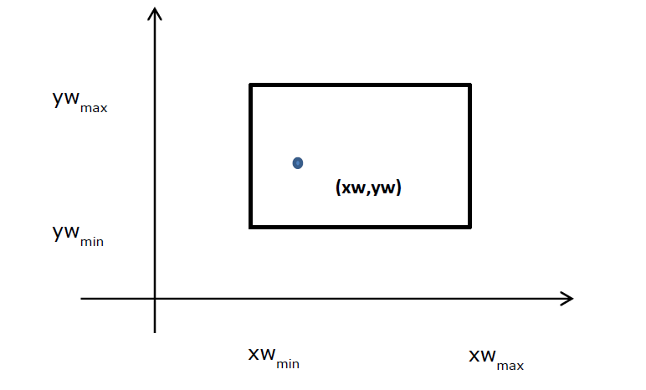

Slide 88
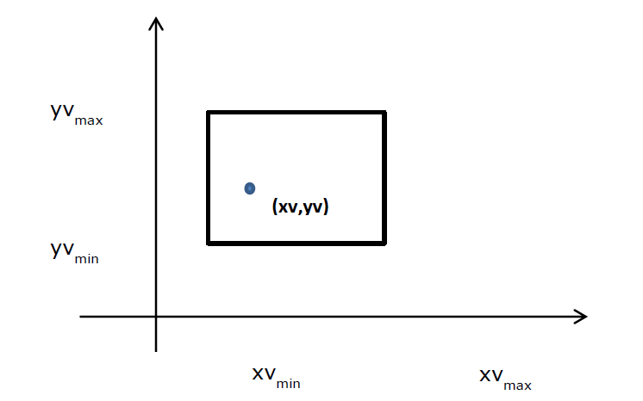

Slide 89
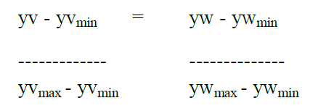
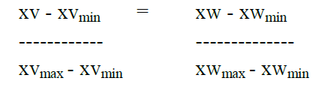
A point at position (xw,yw) in the window is mapped into position (xv, yv) in the associated viewport. To maintain the same relative placement in the viewport as in the window, we require that

Slide 90
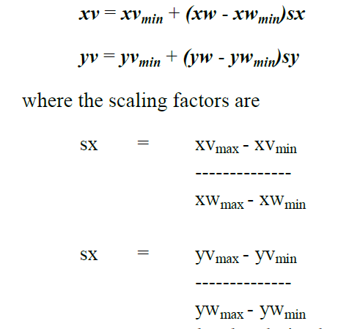
Solving these expressions for the viewport position (xv, yv), we have

Slide 91
The above equation can also be derived with a set of transformations that converts the window area into the viewport area. This conversion is performed with the following sequence of transformations:
Perform a scaling transformation using a fixed-point position of (xwmin, ywmin) that scales the window area to the size of the viewport.
Translate the scaled window area to the position of the viewport.
Relative proportions of objects are maintained if the scaling factors are the same (sx = sy). Otherwise, world objects will be stretched or contracted in either the x or y direction when displayed on the output device.

Slide 92
Overview
2D Transformations
Basic 2D transformations
Matrix representation
Matrix composition
3D Transformations
Basic 3D transformations
Same as 2D

Slide 93
Translation
Move (translate, displace) a point to a new location
Displacement determined by a vector d
Three degrees of freedom
P’=P+d
P’
d
P

Slide 94
Translation Using Representations
Using the homogeneous coordinate representation in some frame
p=[ x y z 1]^{T}
p’=[x’ y’ z’ 1]^{T}
d=[dx dy dz 0]^{T}
Hence p’ = p + d or
x’=x+d_{x}
y’=y+d_{y}
z’=z+d_{z}
note that this expression is in
four dimensions and expresses
that point = vector + point

Slide 95
Translation Matrix
We can also express translation using a
4 x 4 matrix T in homogeneous coordinates
p’=Tp where
T = T(d_{x}, d_{y}, d_{z}) =
This form is better for implementation because all affine transformations can be expressed this way and multiple transformations can be concatenated together

Slide 96
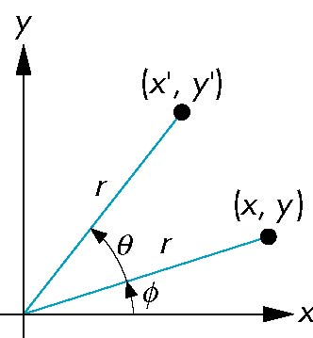
Rotation (2D)
Consider rotation about the origin by θ degrees
radius stays the same, angle increases by θ
x = r cos (φ + θ)
y = r sin (φ + θ)
x’=x cos θ –y sin θ
y’ = x sin θ + y cos θ
x = r cos φ
y = r sin φ

Slide 97
Rotation about the z axis
Rotation about z axis in three dimensions leaves all points with the same z
Equivalent to rotation in two dimensions in planes of constant z
or in homogeneous coordinates
p’=R_{z}(θ)p
x’=x cos θ –y sin θ
y’ = x sin θ + y cos θ
z’ =z

Slide 98
Rotation Matrix
R = R_{z}(θ) =

Slide 99
Rotation about x and y axes
Same argument as for rotation about z axis
For rotation about x axis, x is unchanged
For rotation about y axis, y is unchanged
R = R_{x}(θ) =
R = R_{y}(θ) =

Slide 100
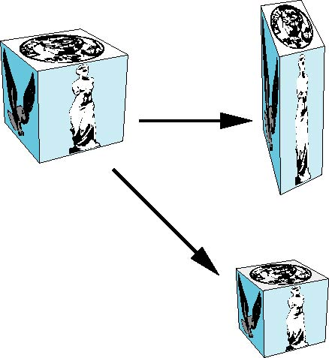
Scaling
Expand or contract along each axis (fixed point of origin)
x’=s_{x}x
y’=s_{y}y
z’=s_{z}z
p’=Sp
S = S(s_{x}, s_{y}, s_{z}) =

Slide 101
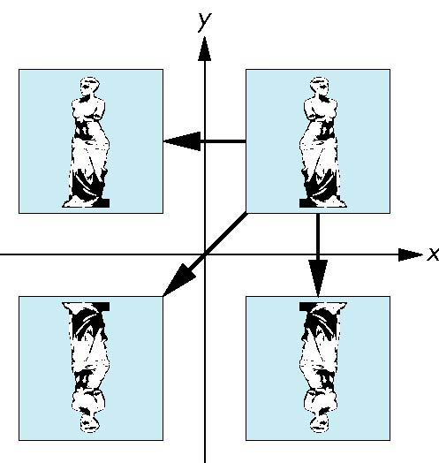
Reflection
corresponds to negative scale factors
s_{x} = -1 s_{y} = 1
original
s_{x} = -1 s_{y} = -1
s_{x} = 1 s_{y} = -1

Slide 102
Inverses
Although we could compute inverse matrices by general formulas, we can use simple geometric observations
Translation: T⁻¹(d_{x}, d_{y}, d_{z}) = T(-d_{x}, -d_{y}, -d_{z})
Rotation: R ⁻¹(θ) = R(-θ)
Holds for any rotation matrix
Note that since cos(-θ) = cos(θ) and sin(-θ)=-sin(θ)
R ⁻¹(θ) = R ^{T}(θ)
Scaling: S⁻¹(s_{x}, s_{y}, s_{z}) = S(1/s_{x}, 1/s_{y}, 1/s_{z})

Slide 103
Concatenation
We can form arbitrary affine transformation matrices by multiplying together rotation, translation, and scaling matrices
Because the same transformation is applied to many vertices, the cost of forming a matrix M=ABCD is not significant compared to the cost of computing Mp for many vertices p
The difficult part is how to form a desired transformation from the specifications in the application

Slide 104
Order of Transformations
Note that matrix on the right is the first applied
Mathematically, the following are equivalent
p’ = ABCp = A(B(Cp))
Note many references use column matrices to present points. In terms of column matrices
p^{T}’ = p^{T}C^{T}B^{T}A^{T}

Slide 105
General Rotation About the Origin
A rotation by θ about an arbitrary axis
can be decomposed into the concatenation
of rotations about the x, y, and z axes
R(θ) = R_{z}(θ_{z}) R_{y}(θ_{y}) R_{x}(θ_{x})
y
v
θ_{x} θ_{y} θ_{z} are called the Euler angles
θ
Note that rotations do not commute
We can use rotations in another order but
with different angles
x
z

Slide 106
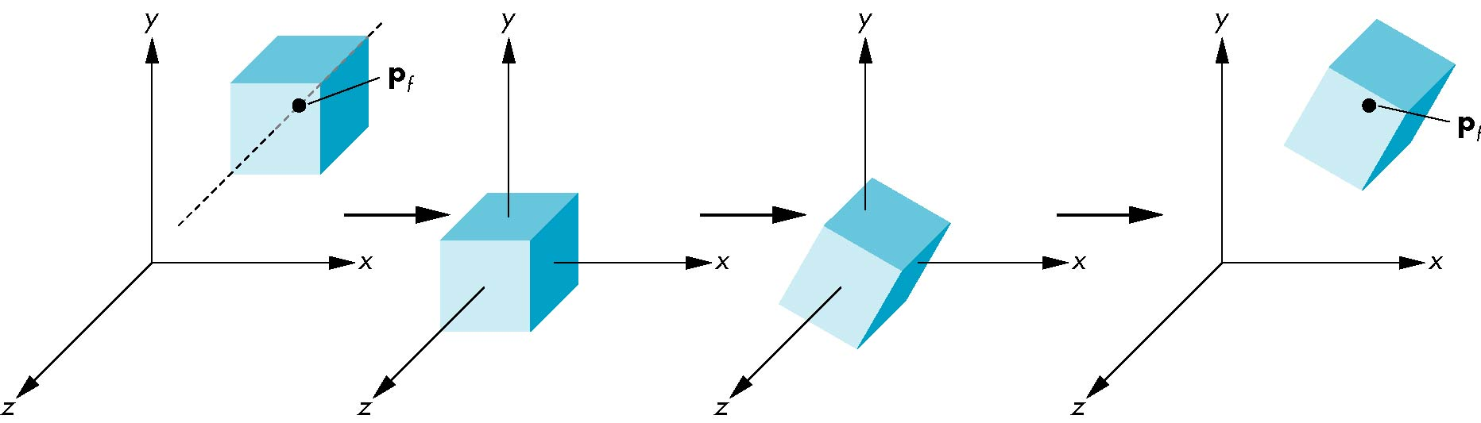
Rotation About a Fixed Point other than the Origin
Move fixed point to origin
Rotate
Move fixed point back
M = T(p_{f}) R(θ) T(-p_{f})

Slide 107
2x2 -> 3x3 Matrices
We can combine transformations by expanding from 2x2 to 3x3 matrices.

Slide 108
3D Transformations
Same idea as 2D transformations
Homogeneous coordinates: (x,y,z,w)
4x4 transformation matrices

Slide 109
Basic 3D Transformations
Identity
Scale
Translation
Mirror about Y/Z plane

Slide 110
Basic 3D Transformations
Rotate around Z axis:
Rotate around Y axis:
Rotate around X axis:

Slide 111
Reverse Rotations
Q: How do you undo a rotation of θ, R(θ)?
A: Apply the inverse of the rotation… R⁻¹(θ) = R(-θ)
How to construct R-1(θ) = R(-θ)
Inside the rotation matrix: cos(θ) = cos(-θ)
The cosine elements of the inverse rotation matrix are unchanged
The sign of the sine elements will flip
Therefore… R⁻¹(θ) = R(-θ) = R^{T}(θ)

Slide 112
Summary
Coordinate systems
World vs. modeling coordinates
2-D and 3-D transformations
Trigonometry and geometry
Matrix representations
Linear vs. affine transformations
Matrix operations
Matrix composition

