Slide 1
Network Layer - II

Slide 2
Topics
Congestion Control Algorithms:
introduction
General techniques for Congestion Control
Congestion Prevention Policies
Congestion Control in Virtual-Circuit Subnets
Congestion Control in Datagram Subnets
Load Shedding, Jitter Control
Quality Of Service:
Requirements
Techniques for Achieving Good Quality of Service
Integrated Services
Differentiated Services

Slide 3
Congestion Control Algorithms

Slide 4
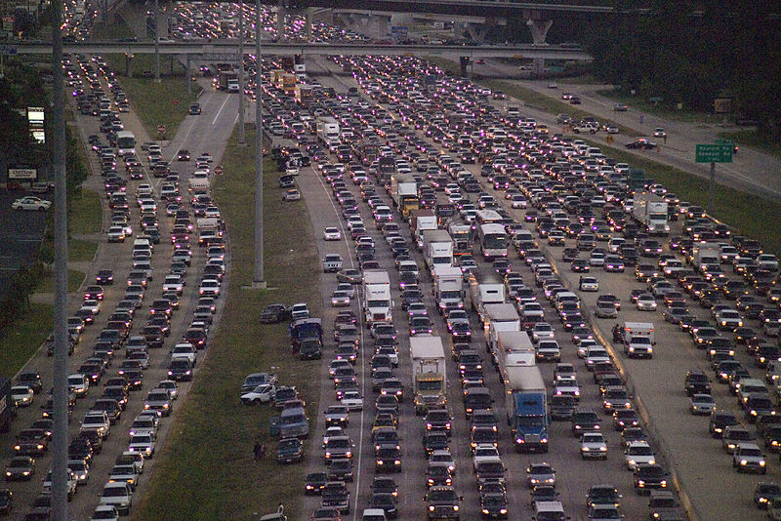
Traffic congestion

Slide 5
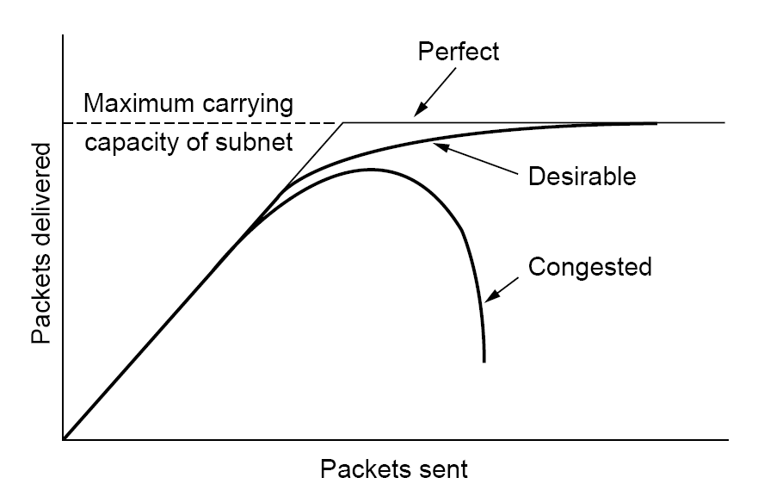
What is congestion?
When too many packets are present in the subnet, performance degrades. This situation is called congestion
At very high trafffic, performance collapses completely and almost no packets are delivered.

Slide 6
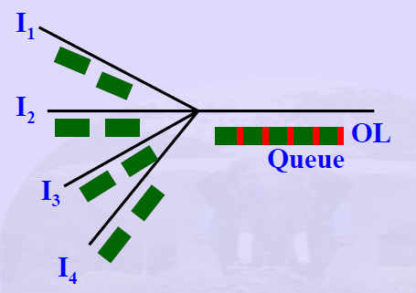
Reasons for congestion
Insufficient memory at routers
If there is insufficient memory to hold all packet, packets will be lost.
Congested /Overloaded router
All incoming packet require the same output line

Slide 7
Reasons for congestion
Insufficient memory at routers
But adding more memory will make congestion worse.
By the time a packet gets to the front of the queue , it may time out, so this will cause retransmissions. It will increase the load all the way to the destination
Infinite memory at the router
queue
Sender
Router
Retransmission ( duplicate)
Packet times out

Slide 8
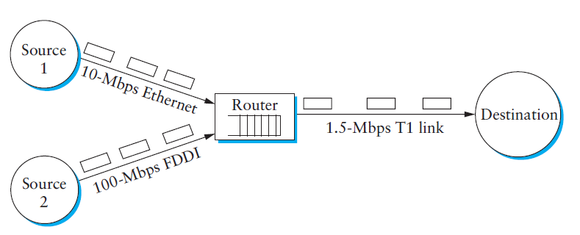
Reasons for congestion
If routers have slow processors
If the routers' CPUs are slow , queues can build up, even though there is excess line capacity.
low-bandwidth outgoing lines
Upgrading the lines but not changing the processors, or vice versa, often helps a little

Slide 9
Congestion control vs. Flow control
Congestion control
Ensures that subnet is able to carry the offered traffic.
Global issue - involves the behavior of all the hosts, all the routers and other related factors
Flow control
makes sure that a fast sender cannot continually transmit data faster than the receiver is able to receive it.
Local Issue - frequently involves some direct feedback from the receiver to the sender (point to point traffic)

Slide 10
Congestion Control Techniques

Slide 11
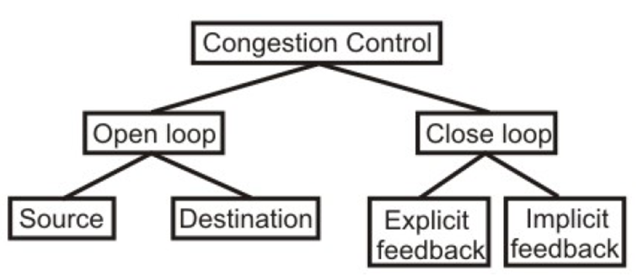
Congestion Control Techniques
Open loop : Prevent or avoid congestion, ensuring that the system(network) never enters a Congested State (static)
Close loop :allow system to enter congested state, detect it, and remove it. (dynamic)

Slide 12
Open loop solutions
attempt to solve the problem by a good design
Once system is up and running, midcourse corrections are not made
further divided into ones that act at the source versus ones that act at the destination

Slide 13
Open loop solutions
Essential points for Open Loop solutions are
deciding when to accept new traffic
when to discard which packets
making scheduling decisions.
All of these decisions are based on a sensible system design
( do not depend on the current network state.)

Slide 14
Closed loop solutions
Based on the concept of feedback.
This approach can be divided into 3 steps
Monitor the system to detect when and where congestion occurs.
To pass this information to the places where actions can be taken.
Adjust the system operation to correct the problem.

Slide 15
Closed loop solutions
monitor the system to detect any congestion
Metrics used to monitor for congestion
percentage of discarded packets
average queue lengths
number of packets that time out and are retransmitted
the average packet delay
Standard deviation of packet delay

Slide 16
Closed loop solutions
Pass information to where action can be taken
Approaches :
Send special packets (choke) back to its source to inform the problem.
Use bit field in the packet to indicate that a threshold is exceeded
The source sends out probe packets at regular intervals to explicitly ask about the congestion.

Slide 17
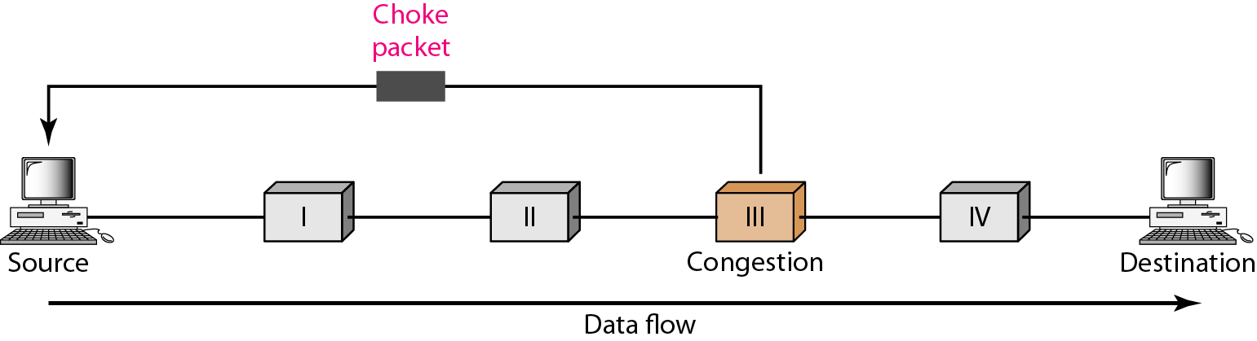
Closed loop solutions
Sending special packets (choke) back to its source to inform the problem.
Extra packets increase the load at that moment of time, but reduces the congestion later

Slide 18
Closed loop solutions
Adjust system operation to correct the problem
Increase resources
Increase the bandwidth
Increase memory
Use a faster processor
Or Decrease load
denying service to some users
degrading service to some users
tell the hosts to reduce their outgoing traffic

Slide 19
Closed loop solutions
Can be divided into two categories.
Explicit approach: special packets are sent back to the sources to curtail down the congestion
Implicit approach : the source itself acts pro-actively and tries to deduce the existence of congestion by making local observations

Slide 20
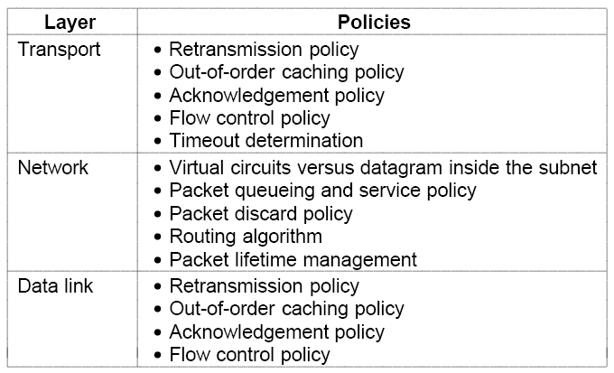
Congestion Prevention Policies
Policies that affect congestion.

Slide 21
Congestion Prevention Policies - At data link layer
Retransmission policy :
How fast a sender times out and what it transmits upon timeout.
if a sender times out very fast , this will create extra retransmissions causing a router to forward duplicates.
In this regard selective repeat better than Go Back N protocol

Slide 22
Congestion Prevention Policies - At data link layer
Out-of-order packets
If receivers routinely discard all out-of-order packets , these packets will have to be transmitted again later
Acknowledgement policy
If each packet is immediately, the acknowledgement packets generate extra traffic.
Piggybacking causes extra timeouts and retransmissions may result.
Flow control scheme : A tight flow control scheme reduces the data rate and thus helps fight congestion.

Slide 23
Congestion Prevention Policies - At the network layer
The choice between using virtual circuits and using datagram's affects congestion
since many congestion control algorithms work only with virtual-circuit.
Packet queuing and service policy
Relates to whether routers have one queue per input line, one queue per output line, or both.
It also relates to the order in which packets are processed (e.g., round robin or priority based).

Slide 24
Congestion Prevention Policies - At the network layer
Discard policy
the rule telling which packet is dropped when there is no space.
A good routing algorithm can help avoid congestion by spreading the traffic over all the lines
Packet lifetime management deals with how long a packet may live before being discarded

Slide 25
Congestion Prevention Policies - At the transport layer
First 4 are same as those in the data link layer
Time out determination.
If the timeout interval is too short, extra packets will be sent unnecessarily.
If it is too long, congestion will be reduced but the response time will suffer whenever a packet is lost.

Slide 26
Congestion Control in Virtual-Circuit Subnets
Congestion is dynamically controlled in virtual-circuit subnets and includes the following techniques
Admission control
Select alternative routes
Negotiate level of service

Slide 27
Congestion Control in Virtual-Circuit Subnets
Admission control. :
Once congestion has been signaled, no more virtual circuits are set up until the problem has gone away.
Thus, attempts to set up new transport layer connections fail.
telephone system also uses admission control.

Slide 28
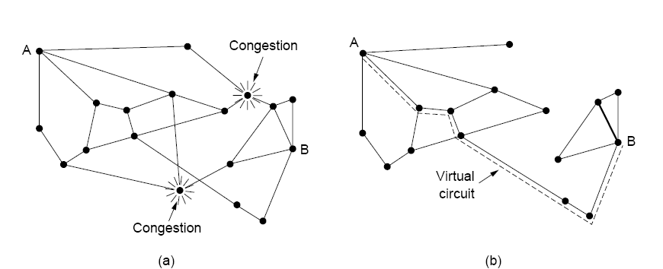
Congestion Control in Virtual-Circuit Subnets
selecting alternative route : allow new virtual circuits but carefully route all new virtual circuits around problem area.
(a) A congested subnet. (b) A redrawn subnet that eliminates the congestion. A virtual circuit from A to B is also shown.

Slide 29
Congestion Control in Virtual-Circuit Subnets
Negotiate level of service
This host normally specifies the volume and shape of the traffic, quality of service required, and other parameters.
the subnet will agree to this and typically reserve required resources along the path when the circuit is set up
These resources can include table and buffer space in the routers and bandwidth on the lines.

Slide 30
Congestion Control in Datagram Subnets

Slide 31
Congestion Control in Datagram Subnets
For each output line, router maintains an estimate u of its utilization: u_{new} = au_{old} + (1 – a) f
a → a constant.
f (0 or1) → a sample of the instantaneous line utilization, made periodically.
If u_{new} > threshold value , the output line enters a warning state.
If a packet’s output line is in warning state, some action is taken
The warning bit
Choke packets

Slide 32
The Warning Bit
Router sets a special bit in the packet’s header.
Destination copies the bit into the next ACK and sends to the source.
The sender monitors the number of ACK packets it receives with the warning bit set and adjusts its transmission rate accordingly.
As long as the warning bits continue to flow in, the source continues to decrease its transmission rate.

Slide 33
Choke Packets
The router in trouble sends a choke packet back to the source host, giving it the destination found in the packet.
The original packet is tagged so that it will not generate any more choke packets.
When the source gets a chock packet, it cuts rate by half, and ignores further choke packets coming from the same destination for a fixed period
After that period has expired, the host listens for more choke packets. If one arrives, the host cut rate by half again. If no choke packet arrives, the host may increase rate

Slide 34
Choke Packets
The original packet is tagged so that it will not generate any more choke packets.
Congestion
(u >Thr)
Host
router
router
Tagged
Packets
(to prevent
further choke
packet generation
at later routers)
Choke
Packet

Slide 35
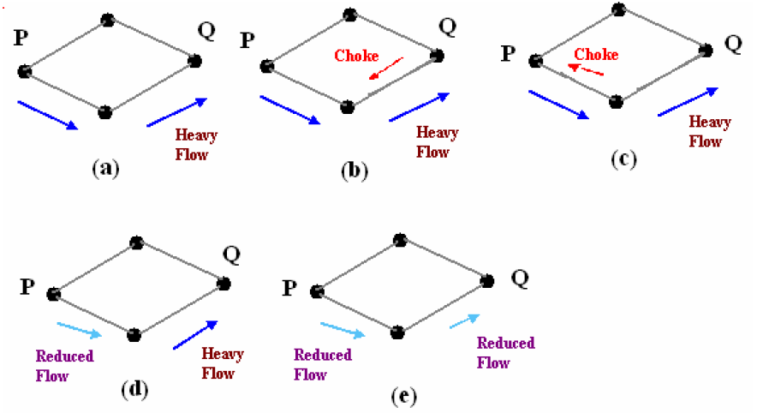
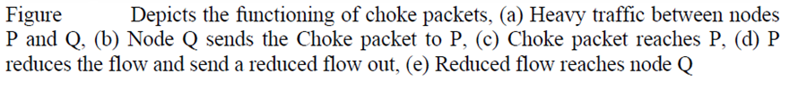
Choke Packets - example

Slide 36
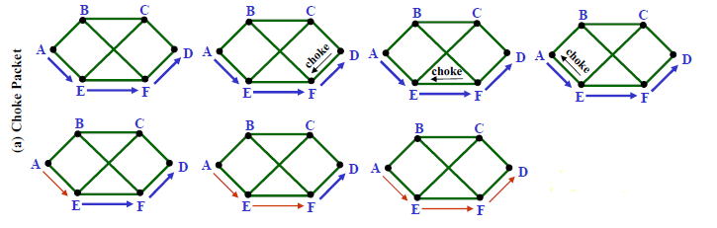
Problem with Choke Packet method
At high speeds over long distances, this method does not work well because by the time choke packet reach the source, already a lot of packets destined to the same original destination would be out from the source.
Choke packet has reached A
But D is receiving data at high speed
D is still receiving data at high speed
A reduces its traffic

Slide 37
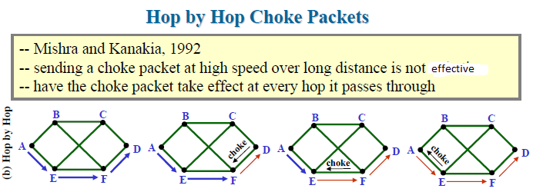
Hop-by-Hop Choke Packets
As soon as the choke packet reaches F, F is required to reduce the flow to D. Doing so will require F to devote more buffers to the flow, since the source is still sending away at full blast, but it gives D immediate relief

Slide 38
Load Shedding
A router , when heavily loaded and none of the methods work , can just pick packets drop. This is known as Load Shedding .
Approaches to discard packets
Select packets at random
Based on application
For File Transfer : keep old, discard new
For multimedia : keep new , discard old
Intelligence discard policy

Slide 39
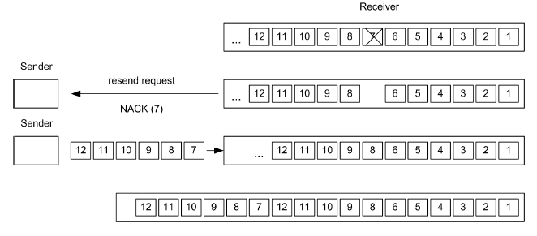
Load Shedding
Discarding old packets
Discarding packet 7 provokes retransmission of these six packets

Slide 40
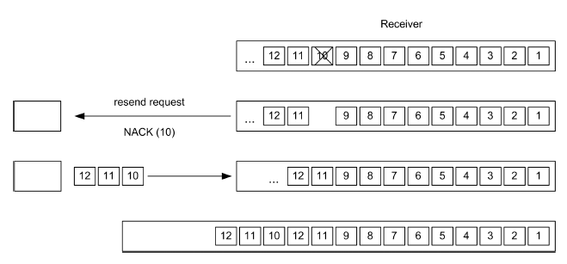
Load Shedding
Discarding new packets
Alternatively, the router can discard packet 10 so that only three packets have to be resend

Slide 41
Load Shedding
To implement intelligent discard policy,
For this , applications must mark their packets in priority classes
When packets have to be discarded, routers can first drop packets from the lowest class packets, then the next lowest class, and so on

Slide 42
Random Early Detection (RED)
A load shedding technique .
idea is to avoid congestion rather than react to it.
i.e. Discard packets before all buffer space is exhausted
drop packets before the situation has become hopeless.

Slide 43
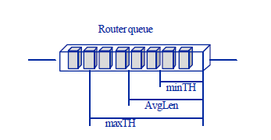
Random Early Detection (RED)
Routers maintain a running average of their queue lengths . When the average queue length on some line exceeds a threshold, the line is said to be congested and action is taken.

Slide 44
Random Early Detection (RED)
The RED algorithm
When a new packet arrives , calculate of the average queue length ,avg_qlen, compare it with two thresholds THmin and THmax.
If avg_qlen < THmin,
queue packet;
If THmin ≤ avg_qlen < THmax,
calculate probability P, with probability P discard packet, with probability (1-P) queue packet;
If avg_qlen ≥ THmax,
pick packet at random and discard .

Slide 45
Random Early Detection (RED)
How should the router tell the source about the problem?
send it a choke packet
puts even more load on the already congested network
Discard the selected packet and not report it
When a source notices the lack of ACK, it reduces transmission rate.

Slide 46
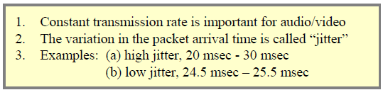
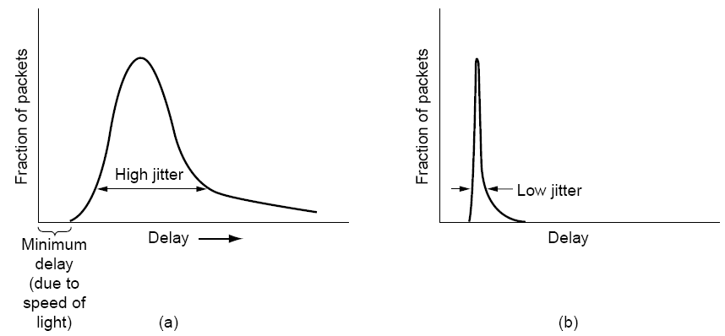
Jitter Control
(Not Acceptable)
(Acceptable)
(a) High jitter. (b) Low jitter

Slide 47
Jitter Control
Different delays between packets cause jittering
Sender
Receiver
P1
At t0
P1
At t20
P2
At t1
P2
At t21
P3
At t2
P3
At t22
P4
At t3
P4
At t23
all have the same delay, 20 units of time, so no jitter

Slide 48
Jitter Control
Different delays between packets cause jitter
Sender
Receiver
P1
At t0
P1
At t21
P2
At t1
P2
At t23
P3
At t2
P3
At t21
P4
At t3
P4
At t28
have different delays: 21,22, 19, and 25, so there is jitter

Slide 49
Jitter Control
How to control Jitter?
When a packet arrives check to see how much the packet is behind or ahead of its schedule
store this info. in the packet and update at each hop.
behind schedule ? Transmit immediately
ahead of schedule ? hold it just long enough to get it back on schedule. Then transmit.

Slide 50
Jitter Control
Note :
In some applications, such as video on demand, jitter can be eliminated by buffering at the receiver.
For real time applications (Internet telephony and videoconferencing) , buffering delay is not acceptable

Slide 51
Quality of Service

Slide 52



Why Quality of Service?
Multimedia applications: network audio and video
QoS
network provides application with level of performance needed for application to function.

Slide 53
Why Quality of Service?
Growth of multimedia networking
Congestion control techniques
Can reduce congestion and improve network performance
But may not achieve QOS for multimedia traffic.
so we need other alg. in addition to Congestion control Tech. to achieve QOS.

Slide 54
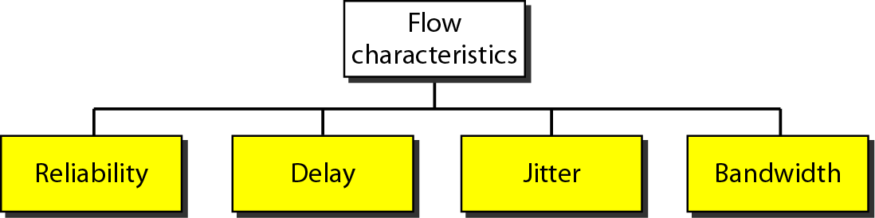
What is a Flow?
A stream of packets from a source to a destination is called a flow.
A Flow needs 4 characteristics:
Together these determine the QoS (Quality of Service) the flow requires.

Slide 55
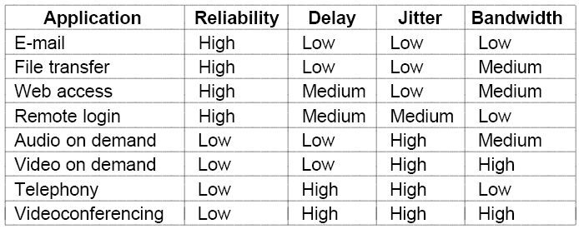
Quality-of-Service Requirements
Different applications need different QOS

Slide 56
Techniques for Achieving Good Quality of Service
Overprovisioning
Buffering
Traffic Shaping
The Leaky Bucket Algorithm
The Token Bucket Algorithm
Resource Reservation
Admission Control
Proportional Routing
Packet Scheduling

Slide 57
Overprovisioning
providing so much router capacity, buffer space, and bandwidth so that the packets just fly through easily .
But it is expensive.
the telephone system is overprovisioned

Slide 58
Buffering
Flows can be buffered on the receiving side before being delivered.
Buffering them does not affect the reliability or bandwidth,
But increases the delay, but it smooths out the jitter.
Helps a lot for audio and video on demand.

Slide 59
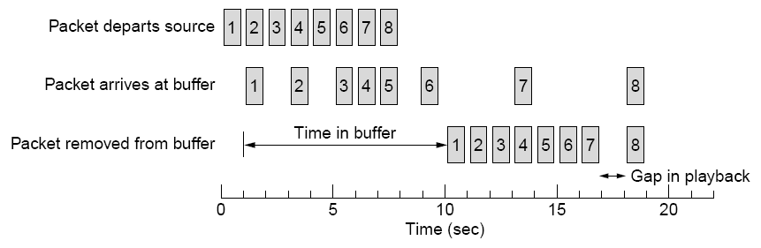
Buffering
Example :
Smoothing the output stream by buffering packets

Slide 60
Traffic Shaping
If the source outputs the packets at non - uniform rate, congestion may occur in the network.
Traffic shaping is a mechanism to control the amount and the rate of the traffic sent to the network.
Traffic shaping, smooths out the traffic on the server side, rather than on the client side.

Slide 61
Traffic Shaping
Traffic shaping Algorithms:
leaky bucket Algorithm
first proposed by Jonathan S. Turner ,1986
Used in ATM networks
Token bucket Algorithm

Slide 62
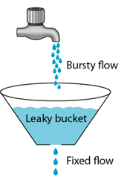
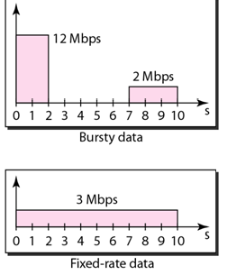
Leaky Bucket Algorithm
The leaky bucket enforces a constant output rate (average rate) regardless of the burstiness of the input.
It drops the packets if the bucket is full

Slide 63
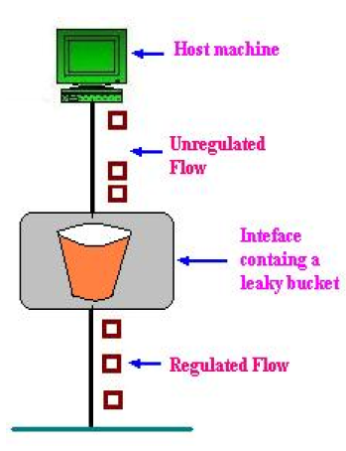
Leaky Bucket Algorithm
Either built into the network hardware interface or implemented by the operating system.
Conceptully the bucket is a finite internal queue

Slide 64
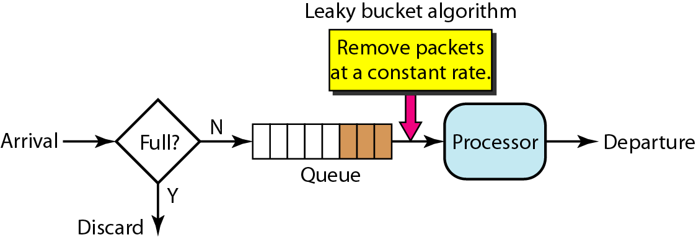
Leaky Bucket Implementation
Algorithm for fixed -length packets
The leaky bucket consists of a finite queue.
When a packet arrives, if there is room on the queue it is appended to the queue; otherwise, it is discarded.
At every clock tick, one packet is transmitted
Leaky Bucket

Slide 65
Leaky Bucket Implementation
Algorithm for variable -length packets
For variable length packets though, allow a fixed number of bytes per tick
Initialize a counter to n at the tick of the clock
If n is greater than the size of the packet, send packet and decrement the counter by the packet size. Repeat this step until n is smaller than the packet size
Reset the counter and go to step 1

Slide 66
Leaky Bucket – Example
Data at 25MB/sec for 40msec every second
Network
Host
Operates at 2MB /sec
Data at 25MB/sec for 40msec every second
Network
Host
Operates at 2MB /sec
We need a Leaky bucket of size 1MB and with output rate at 2MB/sec
2MB/sec (constant rate)

Slide 67
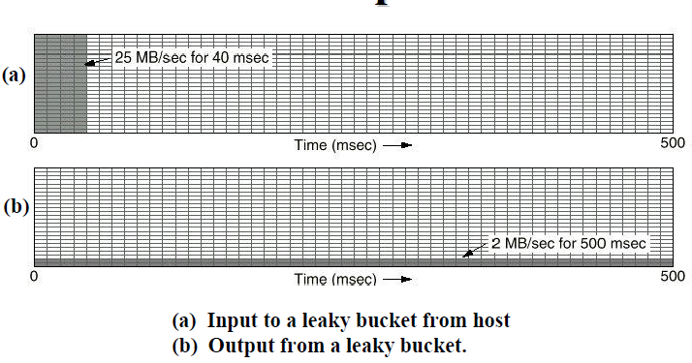
Leaky Bucket – Example
the output drains out at a uniform rate of 2 MB/sec for 500 msec.

Slide 68
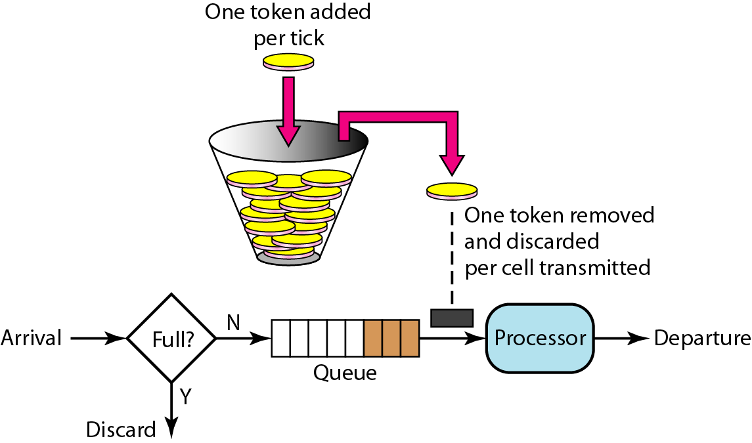
The Token Bucket Algorithm
For many applications, it is better to allow the output to speed up somewhat when large bursts arrive.
The token bucket allows bursty traffic at a regulated maximum rate.
For a packet to be transmitted, it must capture and destroy one token.

Slide 69
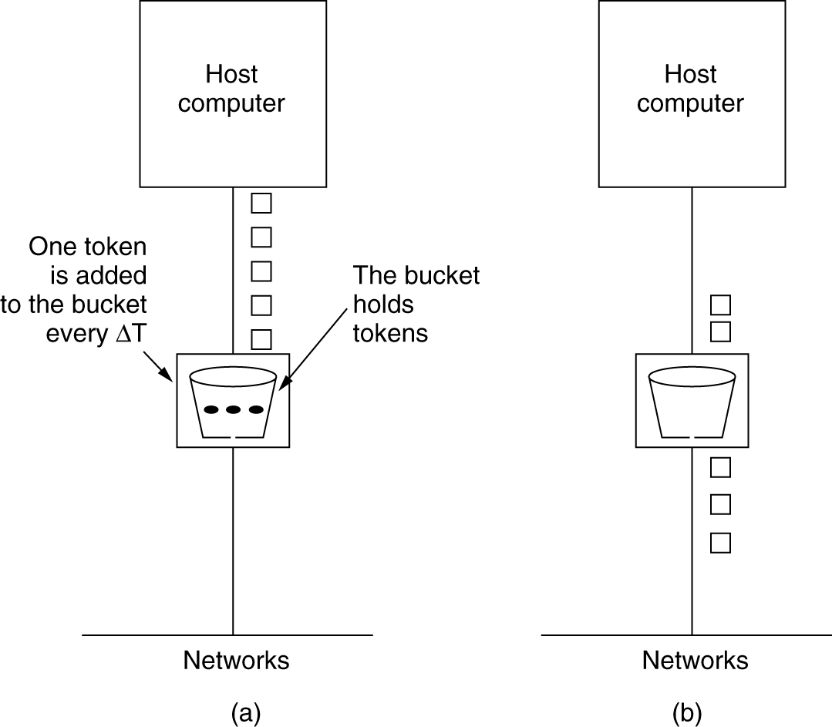
The Token Bucket Algorithm
The token bucket algorithm. (a) Before. (b) After

Slide 70
The Token Bucket Algorithm
The maximum output rate (m) is given by :
m = c/s + ρ
c → the token bucket capacity
s → the burst length in seconds
ρ → the token generating rate

Slide 71
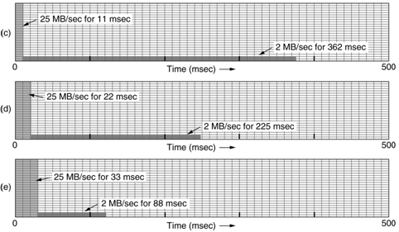
The Token Bucket – Example
M = 25 MB/sec, and ρ =2 MB/sec
Output from token bucket
C = 250 KB
C = 500 KB
C = 750 KB

Slide 72
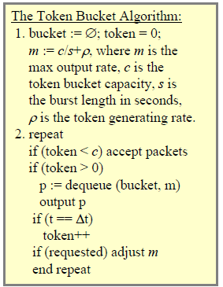
The Token Bucket Algorithm

Slide 73
Token Bucket vs. leaky Bucket
Token
Leaky
allows the output rate to vary
bucket holds tokens
Idle hosts can capture and save up tokens
never discards packets when bucket is full
enforces a constant output rate
bucket holds data
Does not allow idle hosts to save up permissions
discards packets when bucket is full

Slide 74

Combined Token - leaky Bucket
A potential problem with the token bucket algorithm is that it allows large bursts again
To overcome this , insert a leaky bucket after the token bucket
The rate of the leaky bucket should be higher than the token bucket's ρ but lower than the maximum rate of the network
Output from a 500KB token bucket feeding a 10-MB/sec leaky bucket.

Slide 75
Exercise
A source generates data in terms of bursts: 3 MB bursts lasting 2 msec once every 100 msec. The network offers a bandwidth of 60 MB/sec. The leaky bucket has a capacity of 4 MB.
How does the output look like?
What should be the minimum capacity of the leaky bucket to avoid loss?

Slide 76
Exercise
An ATM network uses a token bucket scheme for traffic shaping. A new token is put into the bucket every 5 µsec. Each token is good for one cell, which contains 48 bytes of data. What is the maximum sustainable data rate?
A computer on a 6-Mbps network is regulated by a token bucket. The token bucket is filled at a rate of 1 Mbps. It is initially filled to capacity with 8 megabits. How long can the computer transmit at the full 6 Mbps?

Slide 77
Resource Reservation
Primarily for connection-oriented networks
During connection setup:
Request resources (e.g., buffer space, bandwidth) from the network
If the network has enough available resources to support the new connection, the connection will be established
Otherwise, the connection will be rejected

Slide 78
Resource Reservation
Src
Router
Router
Dest
10 Mbps
available
4 Mbps
available
6 Mbps
available
Case 1: Source attempts to connect to destination, and attempts to
reserve 4 Mbps for the connection
Result: Connection accepted. There is enough bandwidth
available. Available link bandwidths updated.
Case 2: Source attempts to connect to destination, and attempts to
reserve 5 Mbps for the connection
Result: Failure. There is not enough bandwidth available on
one of the links.

Slide 79
Resource Reservation
Once we have a specific route for a flow, it becomes possible to reserve resources along that route
Three kinds of resources :
Bandwidth
Buffer space
CPU cycles

Slide 80
Resource Reservation
Bandwidth
Reserving bandwidth means not oversubscribing any output line.
Buffer space
For a good quality of service, some buffers can be reserved for a specific flow
So, the flow does not have to compete for buffers with other flows.

Slide 81
Resource Reservation
CPU cycles
Making sure that the CPU is not overloaded is needed to ensure timely processing of each packet.
A router cannot operate at theoretical capacity
Due to statistical fluctuations in the load
Even at the theoretical capacity
queues can build up and delays can occur

Slide 82


Resource Reservation
CPU cycles
Mean delay experienced by a packet, T, is
ƛ → mean arrival rate of packets
µ → mean processing capacity of router
ƛ /µ → the CPU utilization.
When there is no(light) load

Slide 83
Resource Reservation
CPU cycles
For example ;
if ƛ = 950,000 packets/sec ,
and µ = 1,000,000 packets/sec,
then ρ = 0.95
so T = 20 µs , instead of 1 µsec

Slide 84
Admission Control
When a flow is offered to a router, it has to decide whether to admit or reject the flow.
The decision is based on
its capacity
how many commitments it has already made for other flows.

Slide 85
Admission Control
Flow Specification
A set of flow parameters is called a flow specification
sender produces a flow specification
As the specification propagates along the route, each router examines it and modifies the parameters.
When it gets to the other end, the parameters can be established.

Slide 86
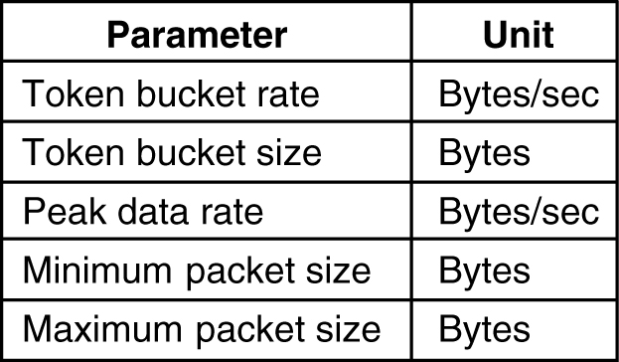
Admission Control
An example Flow Specification
Peak rate: Defines the maximum rate at which packets can be sent in short interval time.

Slide 87
Admission Control
Mapping a flow specification into a set of specific resource reservations is implementation specific
Example :
router capacity =100,000 packets/sec
flow rate = 1 MB/sec
minimum and maximum packet sizes = 512 bytes
the router can calculate that it might get 2048 packets/sec from that flow.
So it must reserve 2% of its CPU capacity for that flow

Slide 88
Admission Control
Tight flow specification is more useful to the routers
Example:
Assume router capacity =100,000 packets/sec
inaccurate flow specification :
token bucket rate = 5 MB/sec
packet can vary from 50 - 1500 bytes
the router can calculate that the packet rate will vary from about 3500 packets/sec to 105,000 packets/sec
So the router may reject the flow.

Slide 89
Exercise
The CPU in a router can process 2 million packets/sec. The load offered to it is 1.5 million packets/sec. If a route from source to destination contains 10 routers, how much time is spent being queued and serviced by the CPUs?

Slide 90
Packet Scheduling
If a router is handling multiple flows, one flow might use too much of its capacity and starve other flows .
To avoid such attempts, various packet scheduling algorithms have been devised.
Fair queuing algorithm (Nagle, 1987).
Weighted fair queueing

Slide 91
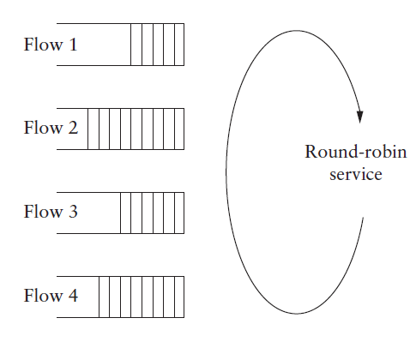
Packet Scheduling
Fair queuing
Routers have multiple queues for each output line, one for each source.
Take first packet in each queue on a round-robin basis
packet-by-packet round robin

Slide 92
Packet Scheduling
Fair queuing Problem
It gives more bandwidth to hosts that use large packets than to hosts that use small packets
Demers et al. (1990) suggested an improvement .
simulate a byte-by-byte round robin, instead of a packet-by-packet round robin .

Slide 93
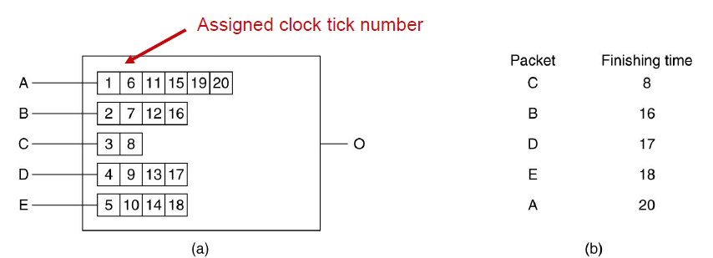
Packet Scheduling
Fair queuing : An improvement.
Scan queues repeatedly until tick is found at which packet is done
Sort them in order of their finishing and send in that order
Byte-By-byte round robin
(a) A router with five packets queued for line O. (b) Finishing times for the five packets

Slide 94
Packet Scheduling
Fair queuing : An improvement.
Problem : it gives all hosts the same priority
In many situations, it is desirable to give video servers more bandwidth than regular file servers
This modified algorithm is called weighted fair queueing

Slide 95
Packet Scheduling
Weighted Fair Queuing.
Packets are assigned to different classes and admitted to different queues.
The queues are weighted based on the priority of the queues.
higher priority means a higher weight

Slide 96
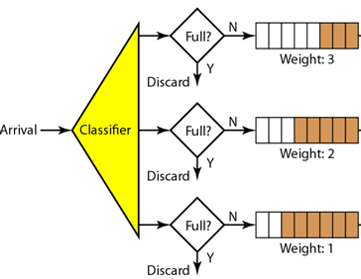
Packet Scheduling
Weighted Fair Queuing.
The system processes packets in each queue in a round-robin fashion with number of packets selected from each queue based on the corresponding weight.
if the weights are 3, 2, and 1, three packets are processed from the first queue,
two from the second queue, and one from the third queue

Slide 97
Integrated Services - Congestion Control for Multicasting - Known as flow-based algorithms - An architecture for streaming video (by IETF) (Internet Engineering Task Force)

Slide 98
What are Integrated Services?
An architecture that specifies the elements to guarantee quality of service (QoS) for streaming multimedia (video/audio)
Flow-based algorithms that aim at unicast and multicast applications . Examples
Unicast - On-demand video streaming
Multicast - Digital TV stations broadcasting programs

Slide 99
RSVP—The Resource reSerVation Protocol
Multiple senders transmit to multiple receivers
Sender puts group address in its packets
Individual receiver can switch channels
Optimizes use of bandwidth while eliminating congestion
The basic idea is that, to avoid congestion, extra information can be broadcasted to the group periodically

Slide 100
RSVP—The Resource reSerVation Protocol
the protocol uses multicast routing using spanning trees.
To send to a group, a sender puts the group's address in its packets.
The standard multicast routing algorithm then builds a spanning tree covering all group members.

Slide 101
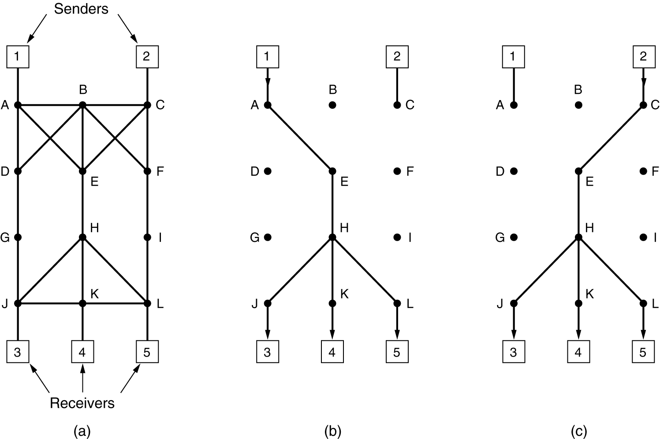
RSVP—The Resource reSerVation Protocol
An example :
(a) A network, (b) The multicast spanning tree for host 1. (c) The multicast spanning tree for host 2.

Slide 102
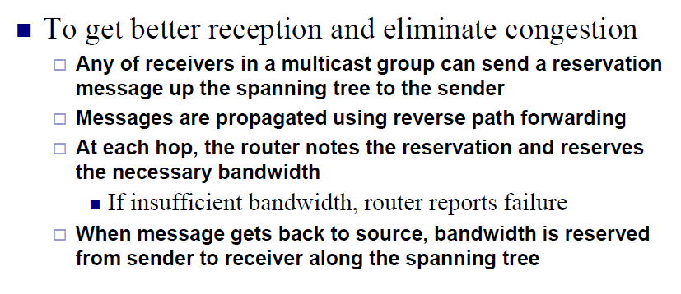
RSVP—The Resource reSerVation Protocol

Slide 103
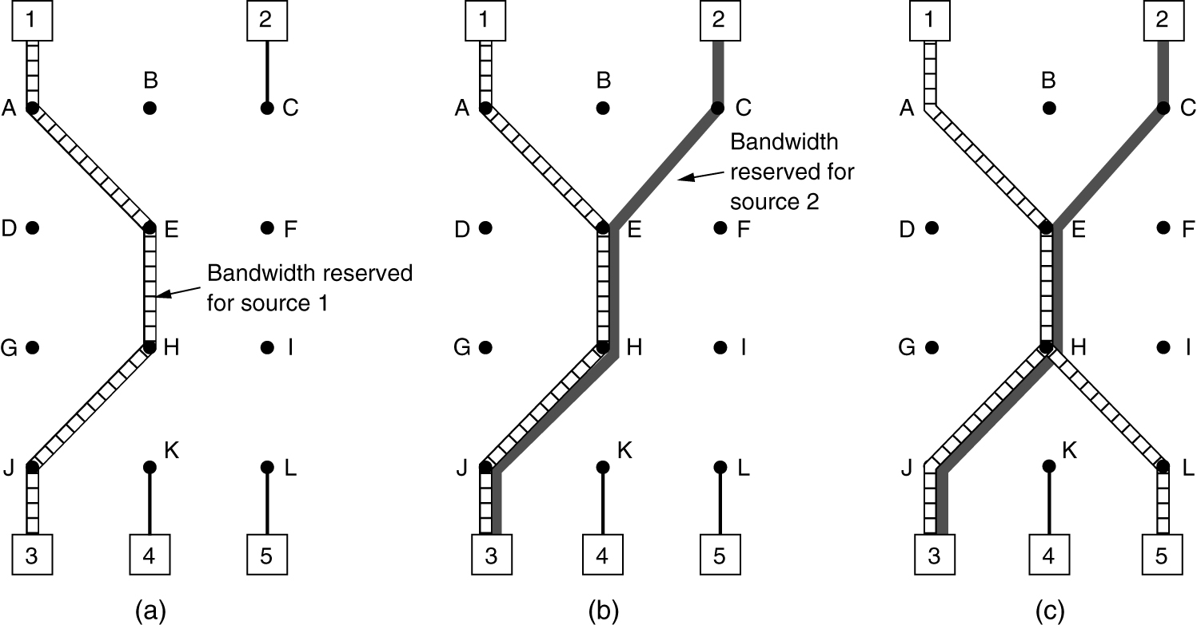
RSVP—The Resource reSerVation Protocol
(a) Host 3 requests a channel to host 1. (b) Host 3 then requests a second channel, to host 2. (c) Host 5 requests a channel to host 1.

Slide 104
Differentiated Services

Slide 105
Drawbacks of Flow-based algorithms (like RSVP)
Require an advance setup to establish each flow
not very scalable
Routers need to maintain internal state for each flow .
Router code requires substantial changes
complex router-to-router exchanges for setting up flows

Slide 106
Differentiated Services
A simpler approach designed by the IETF called, Differentiated Services (DiffServ).
DiffServ takes a class-based approach to QoS
Implemented locally in each router without advance setup

Slide 107
How it works ?
Differentiated services are offered by a set of routers that form an administrative domain.
Customers can sign up for DiffServ;
packets sent by such customers carry a Type of Service field.
Depending on the service class of a packet, it may receive preferential treatment(service).

Slide 108
How it works ?
An operator might charge extra for each premium packet transported
Advantages :
No advance setup,
No resource reservation
No time-consuming end-to-end negotiation
Two kinds of forwarding for differentiated services
Expedited forwarding
Assured forwarding

Slide 109
Expedited Forwarding
Network-independent service classes
Idea is to have two classes of service
regular
expedited
The expedited packets should be able to transit the subnet as though no other packets were present

Slide 110
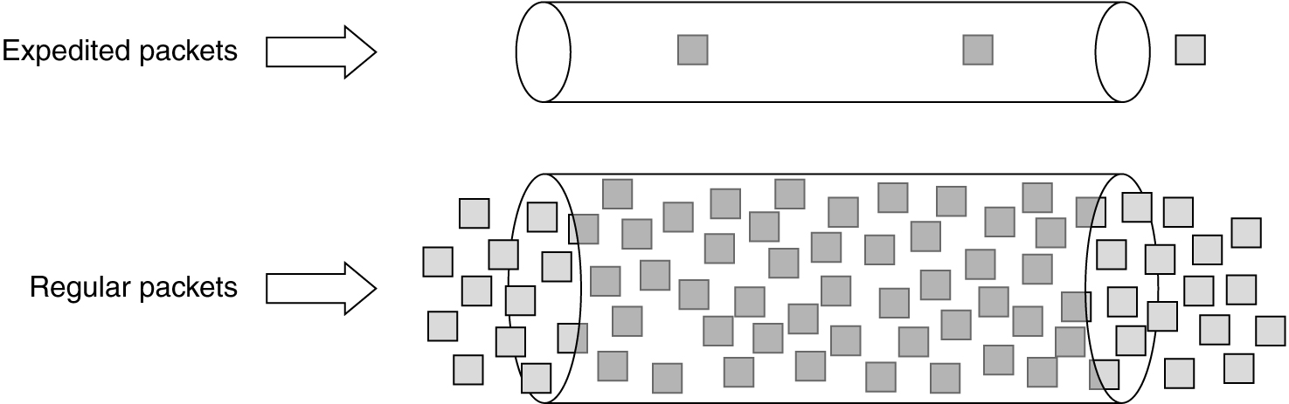
Expedited Forwarding
The two logical pipes shown in the figure represent a way to reserve bandwidth
Expedited packets experience a traffic-free network

Slide 111
Differentiated Services
Expedited Forwarding : Implementation
Have two output queues for each outgoing line :
one for expedited packets
one for regular packets.
When a packet arrives, it is queued accordingly
Packet scheduling : weighted fair queueing
expedited traffic is given twice as much bandwidth as it needs

Slide 112
Differentiated Services
Assured Forwarding
Defines four priority classes, each class having its own resources.
Defines three discard probabilities for packets that are undergoing congestion: low, medium, and high
Taken together, these two factors define 12 service classes

Slide 113
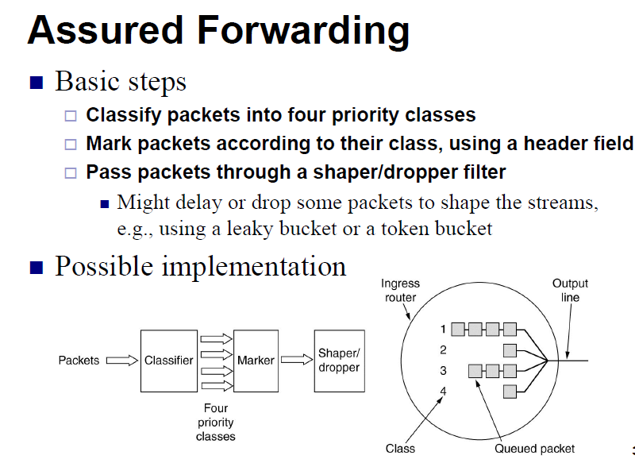
Differentiated Services

