Slide 1
Transport Layer
UNIT-IV

Slide 2
Topics to be discussed
Network layer design issues:
  Store and Forward packet Switching,
  Services Provided to the Transport Layer,
  Implementation of Connectionless Service,
  Implementation of Connection-Oriented Service,
  Comparison of Virtual Circuit and Datagram Subnets;
Routing algorithms:

Slide 3
The Transport Service

Slide 4
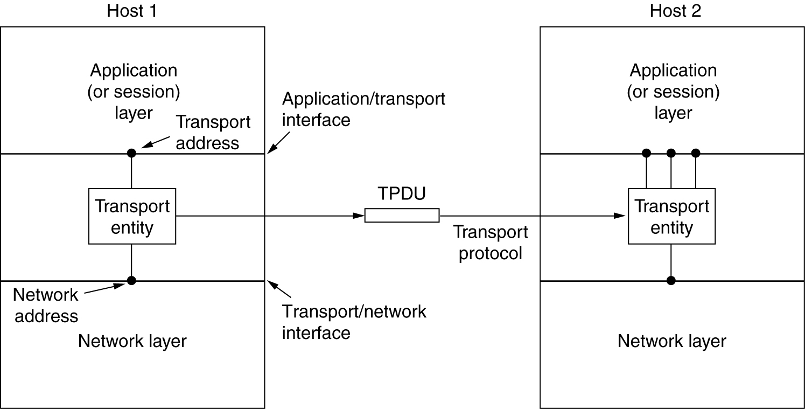
Services Provided to the Upper Layers
The ultimate goal of the transport layer is to provide efficient, reliable, and cost-effective service to its users. hardware and/or software within the transport layer that does the work is called the transport entity.
The (logical) relationship of the network, transport, and application layers

Slide 5
Services Provided to the Upper Layers
2 types of services : (similar to network layer)
connection-oriented transport service :
    Has 3 phases : establishment, data transfer, and release.
    Addressing and flow control are also similar network layer
The connectionless transport service is also very similar to the connectionless network service.
Why transport layer ?
The users have no real control over the network layer, so they cannot solve the problem of poor service by using better routers or putting more error handling in the data link layer.

Slide 6
Services Provided to the Upper Layers
Difference ?
  The transport code runs entirely on the users' machines, but the network layer mostly runs on the routers, which are operated by the carrier (at least for a wide area network).
Application programmers can write code according to a standard set of primitives and have these programs work on a wide variety of networks, without having to worry about dealing with different subnet interfaces and unreliable transmission.

Slide 7
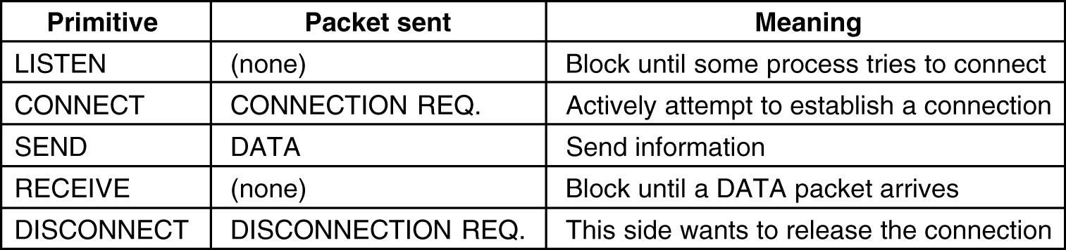
Transport Service Primitives
To allow users to access the transport service, the transport layer must provide some operations to application programs, that is, a transport service interface. Each transport service has its own interface.

Slide 8
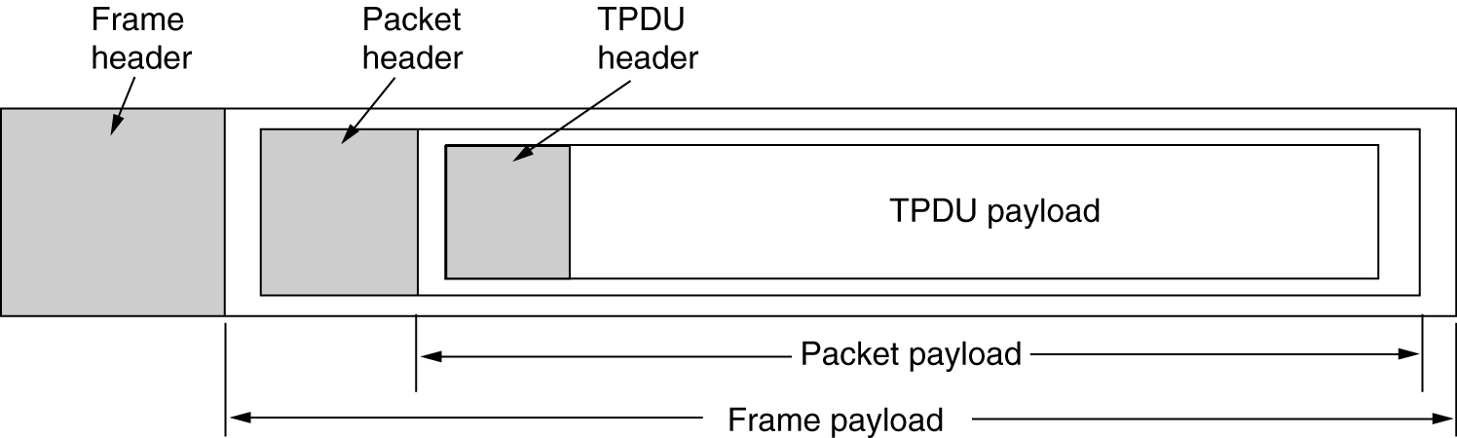
Transport Service Primitives
To allow users to access the transport service, the transport layer must provide some operations to application programs, that is, a transport service interface. Each transport service has its own interface.

Slide 9
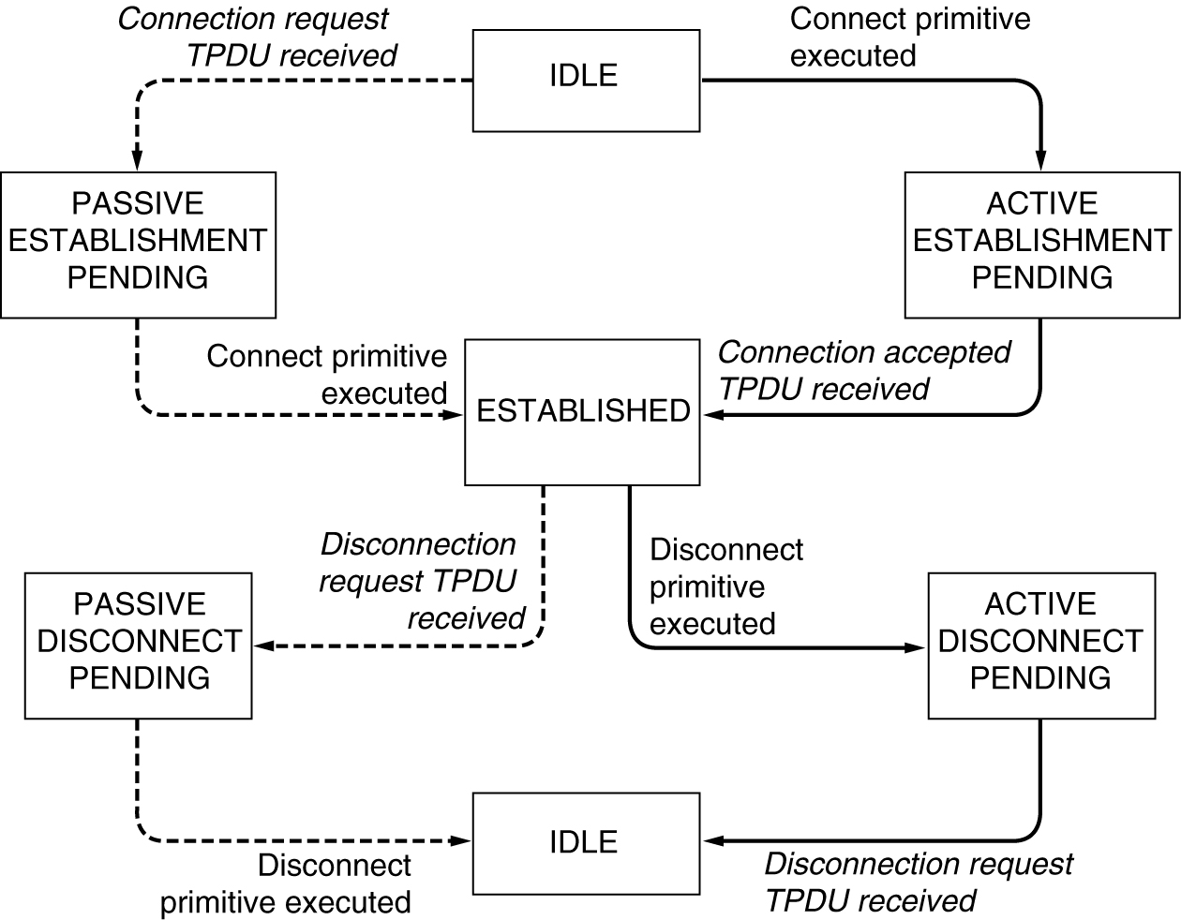
Transport Service Primitives
A state diagram for a simple connection management scheme. Transitions labeled in italics are caused by packet arrivals. The solid lines show the client's state sequence. The dashed lines show the server's state sequence

Slide 10
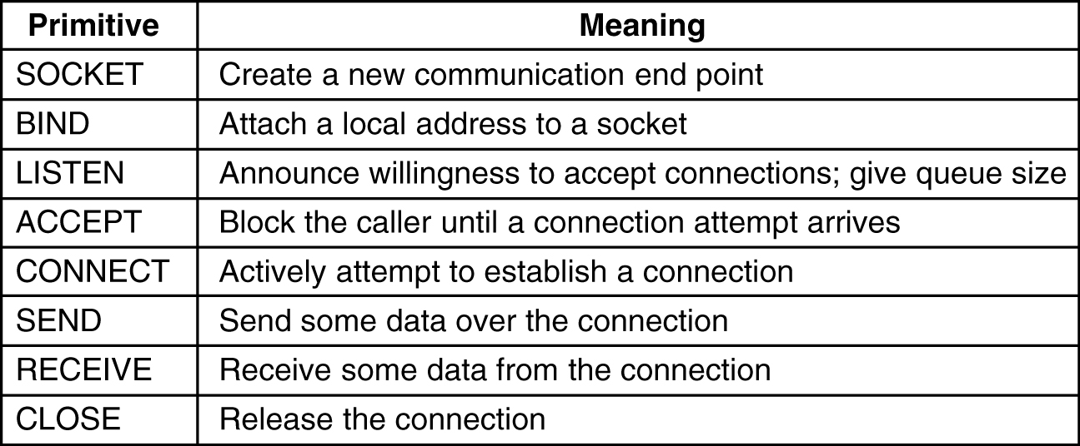
Berkeley Sockets
set of transport primitives, the socket primitives used in Berkeley UNIX for TCP.

Slide 11
Elements of Transport Protocols
At the data link layer, two routers communicate directly via a physical channel, whereas at the transport layer, this physical channel is replaced by the entire subnet
(a) Environment of the data link layer.
(b) Environment of the transport layer.

Slide 12
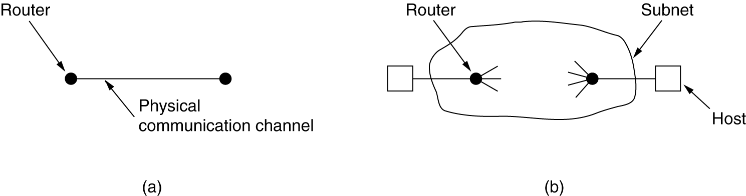
data link protocol v/s transport layer
At the data link layer, two routers communicate directly via a physical channel, whereas at the transport layer, this physical channel is replaced by the entire subnet
(a) Environment of the data link layer.
(b) Environment of the transport layer.

Slide 13
data link protocol v/s transport layer
In the data link layer, it is not necessary for a router to specify which router it wants to talk to—each outgoing line uniquely specifies a particular router.
In the transport layer, explicit addressing of destinations is required.

Slide 14
data link protocol v/s transport layer
the process of establishing a connection over the wire of is simple.
In the transport layer, initial connection establishment is more complicated.

Slide 15
data link protocol v/s transport layer
Potential existence of storage capacity in the subnet
The consequences of the subnet's ability to store packets can sometimes be disastrous and can require the use of special protocols.

Slide 16
data link protocol v/s transport layer
Presence of a large and dynamically varying number of connections in the transport layer
The larger number of connections that must be managed make the idea of dedicating many buffers to each one less attractive and may require a different approach

Slide 17
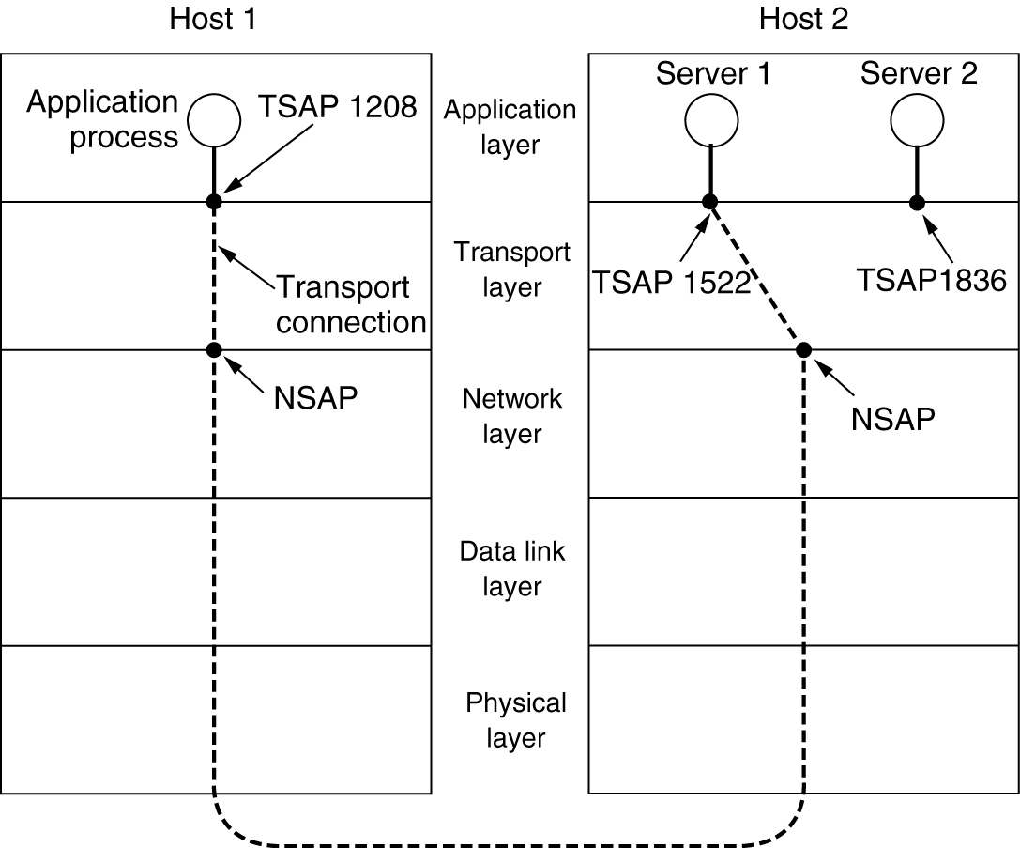
Addressing
The method normally used is to define transport addresses
These end points are Transport Service Access Point
TSAPs, NSAPs and transport connections.

Slide 18
Addressing
How does the user process on host 1 know that the time-of-day server is attached to TSAP 1522?
One scheme is known as the initial connection protocol
Each machine that wishes to offer services to remote users has a special process server that acts as a proxy

Slide 19
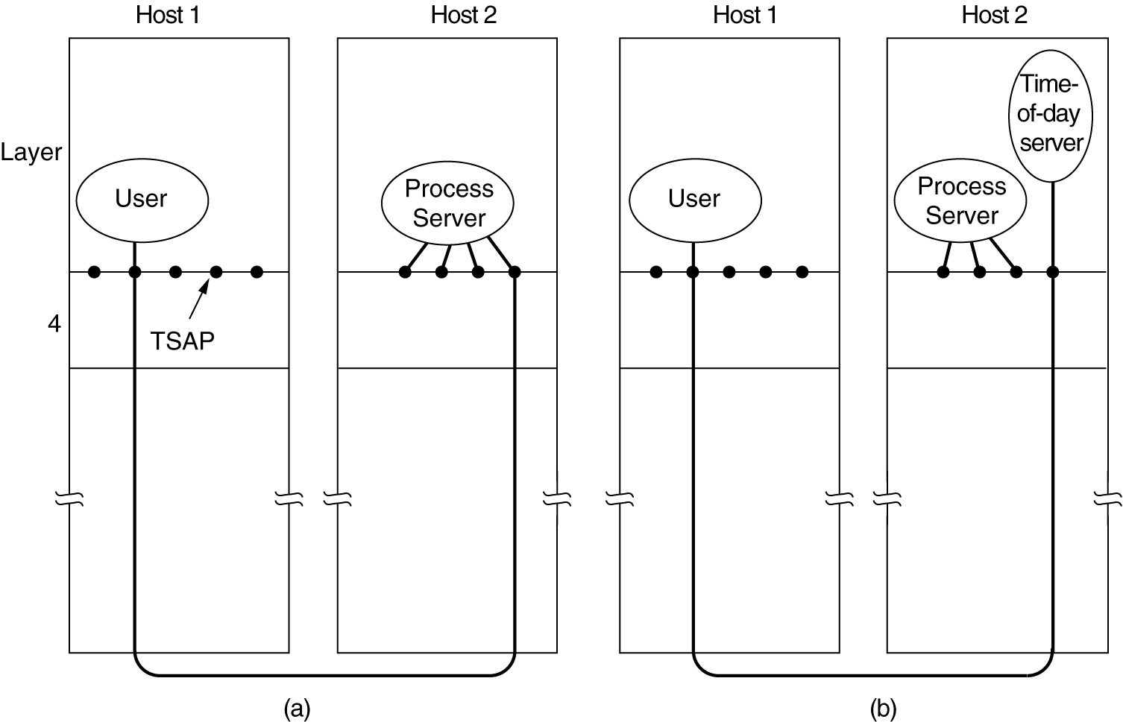
Addressing
Connection protocol
How a user process in host 1 establishes a connection with server1 in host 2.

Slide 20
Addressing
Connection using Name server or a directory server
To find the TSAP address corresponding to a given service name, a user sets up a connection to the name server (which listens to a well-known TSAP).
The user then sends a message specifying the service name, and the name server sends back the TSAP address.

Slide 21
Connection Establishment
Problem of existence of delayed duplicates
Solutions :
throw-away transport addresses
  In this approach, each time a transport address is needed, a new one is generated. When a connection is released, the address is discarded and never used again

Slide 22
Connection Establishment
Problem of existence of delayed duplicates
Solutions :
Give each connection a connection identifier
  After each connection is released, each transport entity could update a table listing obsolete connections
  It requires each transport entity to maintain a certain amount of history information indefinitely

Slide 23
Connection Establishment
Problem of existence of delayed duplicates
Solutions :
Ensure that no packet lives longer than some known time
    Restricted subnet design.
    Putting a hop counter in each packet.
    Timestamping each packet

Slide 24
Connection Establishment
Problem of existence of delayed duplicates
Solutions :
Ensure that no packet lives longer than some known time
    Restricted subnet design.
    Putting a hop counter in each packet.
    Timestamping each packet

Slide 25
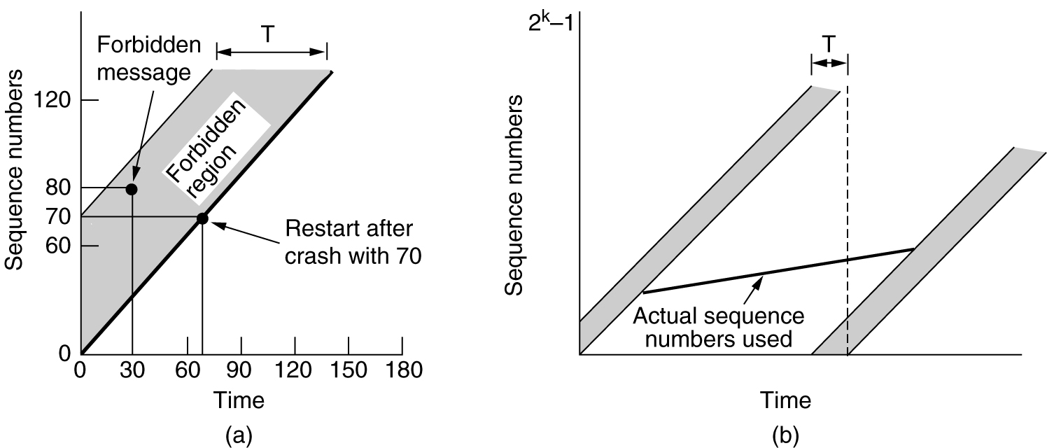
Connection Establishment
TPDUs may not enter the forbidden region.
(b) The resynchronization problem.

Slide 26
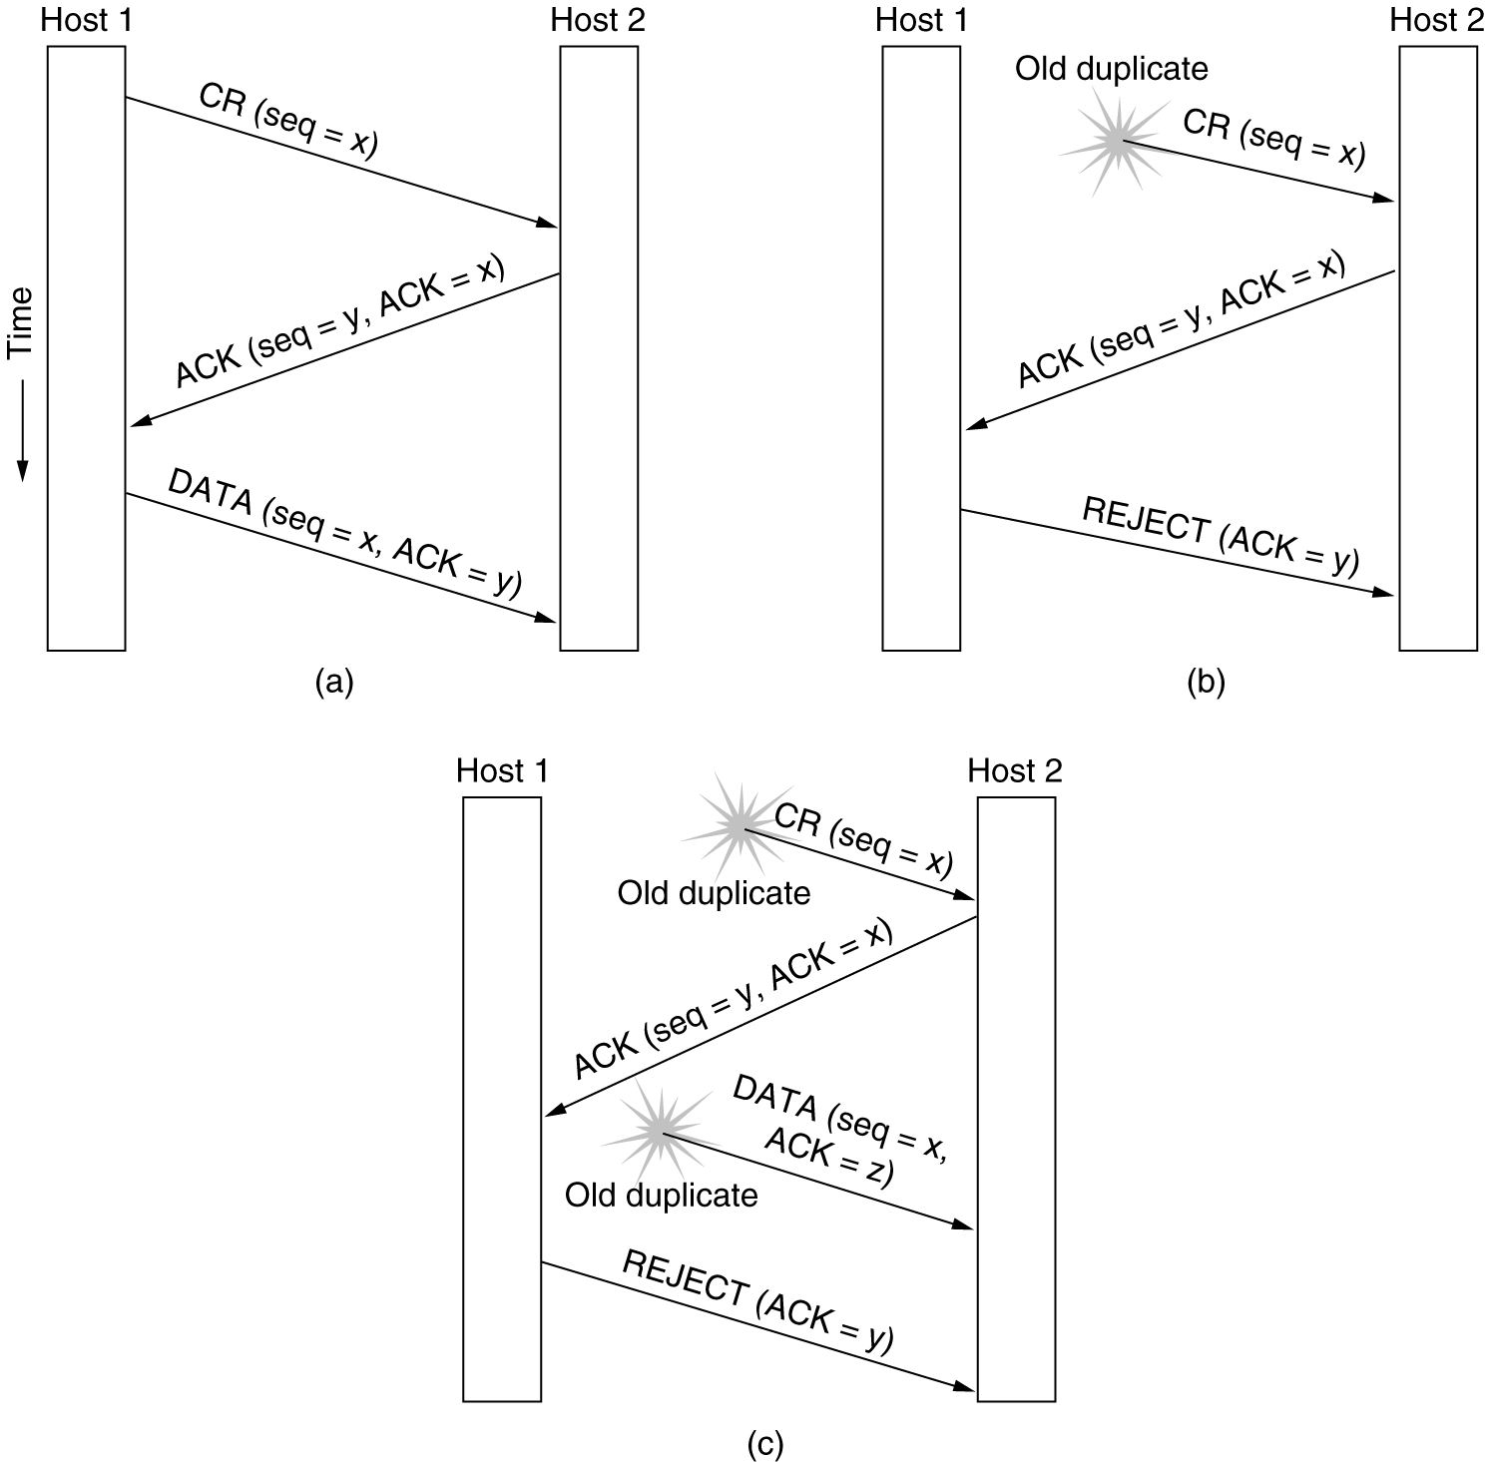
3 three-way handshake. CR denotes CONNECTION REQUEST.
(a) Normal operation,
(b) Old CONNECTION REQUEST appearing out of nowhere.

Slide 27
Connection Establishment
3 three-way handshake. CR denotes CONNECTION REQUEST.
Duplicate CONNECTION REQUEST and duplicate ACK.

Slide 28
Connection Release
two styles of terminating a connection:
asymmetric release
  Release of one unidirectional connection
symmetric release
  the connection as two separate unidirectional connections and requires each one to be released separately.

Slide 29
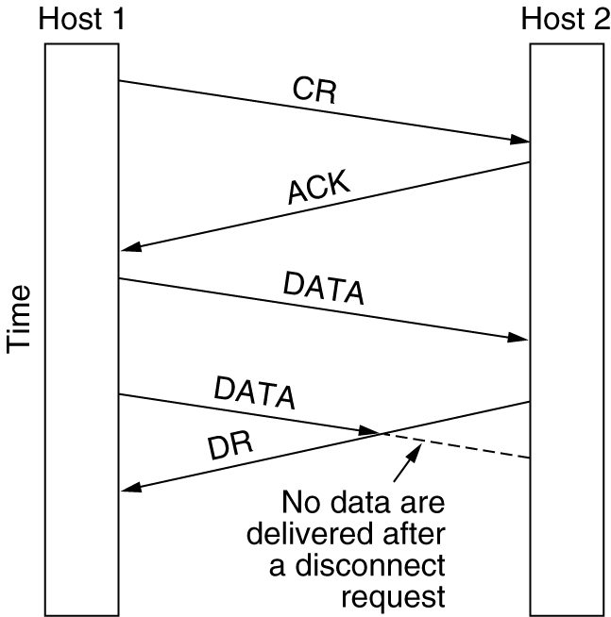
Connection Release
Asymmetric release is abrupt and may result in data loss.:
Abrupt disconnection with loss of data.

Slide 30
Connection Release
Symmetric release works like this :
Host 1 says: I am done. Are you done too?
If host 2 responds: I am done too. Goodbye.
the connection can be safely released. So no data loss

Slide 31
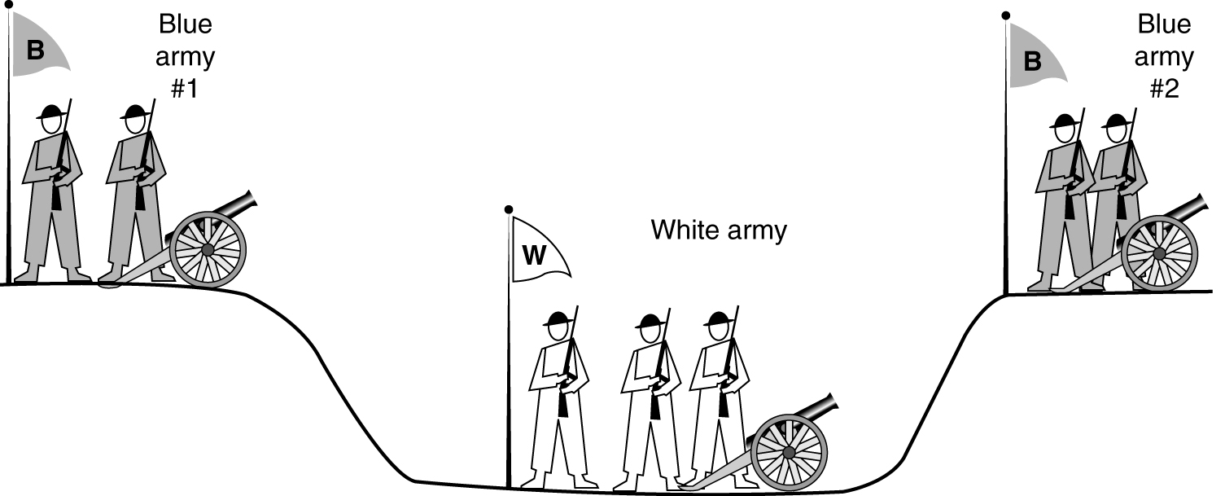
Connection Release
Two-army problem :
If neither side is prepared to disconnect until it is convinced that the other side is prepared to disconnect too, the disconnection will never happen.

Slide 32
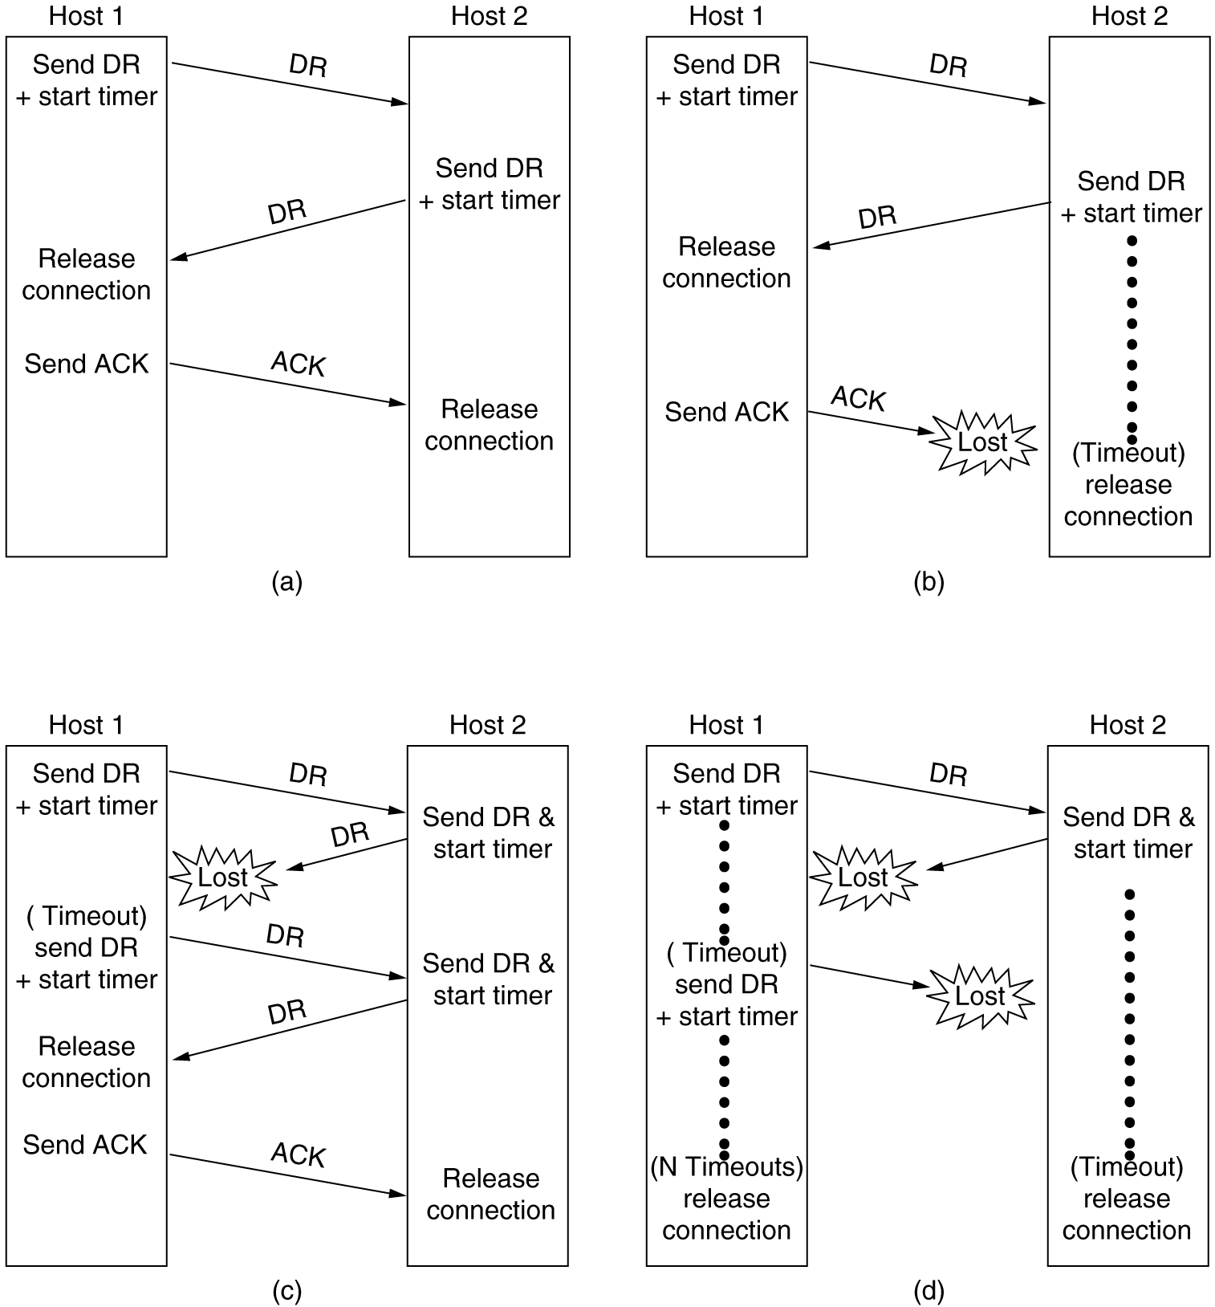
Connection Release
Four protocol scenarios for releasing a connection. (a) Normal case of a three-way handshake. (b) final ACK lost.

Slide 33
Connection Release
(c) Response lost. (d) Response lost and subsequent DRs lost.

Slide 34
Flow Control and Buffering
It is impractical to implement the data link buffering strategy in the transport layer
if the network service is unreliable, the sender must buffer all TPDUs sent
with reliable network service
  Sender need not retain copies of the TPDUs if receiver always has buffer space .
  If receiver cannot guarantee that every incoming TPDU will be accepted, the sender will have to buffer anyway

Slide 35
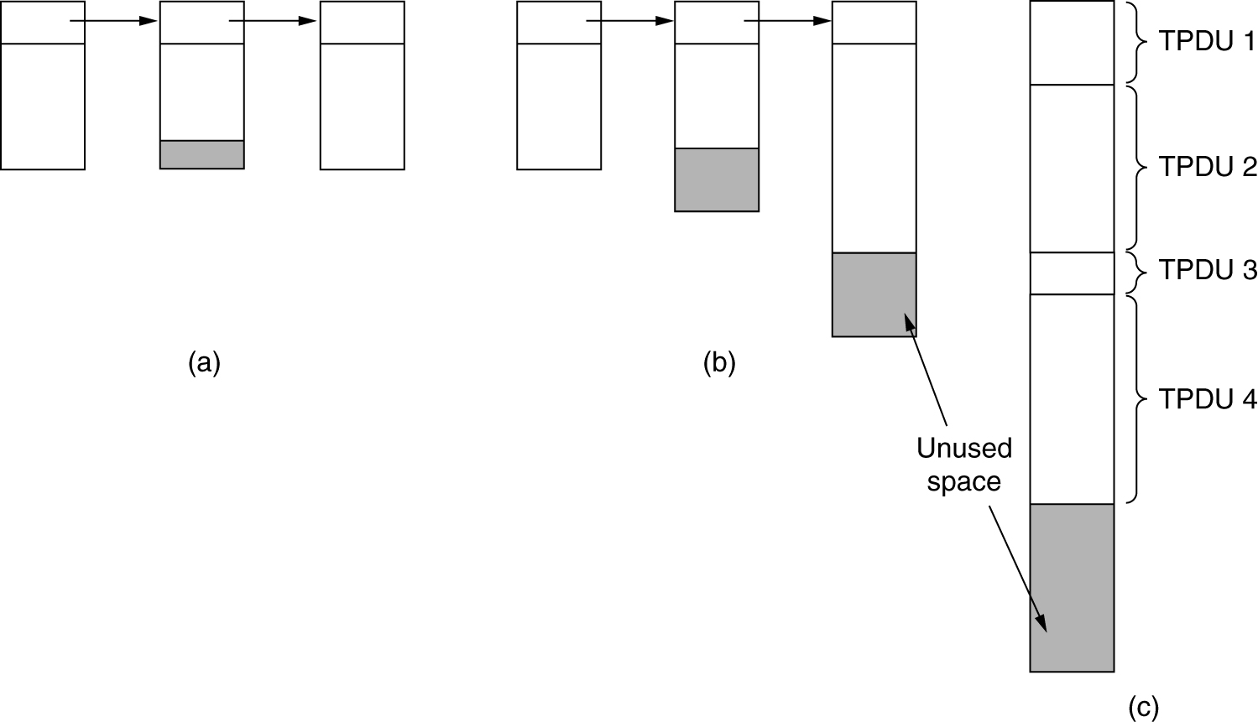
Flow Control and Buffering
If the receiver has agreed to do the buffering, what about the buffer size?
(a) Chained fixed-size buffers. (b) Chained variable-sized buffers.
(c) One large circular buffer per connection.

Slide 36
Flow Control and Buffering
The optimum trade-off between source buffering and destination buffering depends on the type of traffic carried by the connection.
  For low-bandwidth bursty traffic → buffer at the sender
  For high-bandwidth traffic → buffer at the receiver

Slide 37
Flow Control and Buffering
Managing dynamic buffer allocation
  The sender requests a certain number of buffers,
  The receiver then grants as many of these as it can afford
  Every time the sender transmits a TPDU, it must decrement its allocation, stopping altogether when the allocation reaches zero
  The receiver then separately piggybacks both acknowledgements and buffer allocations

Slide 38
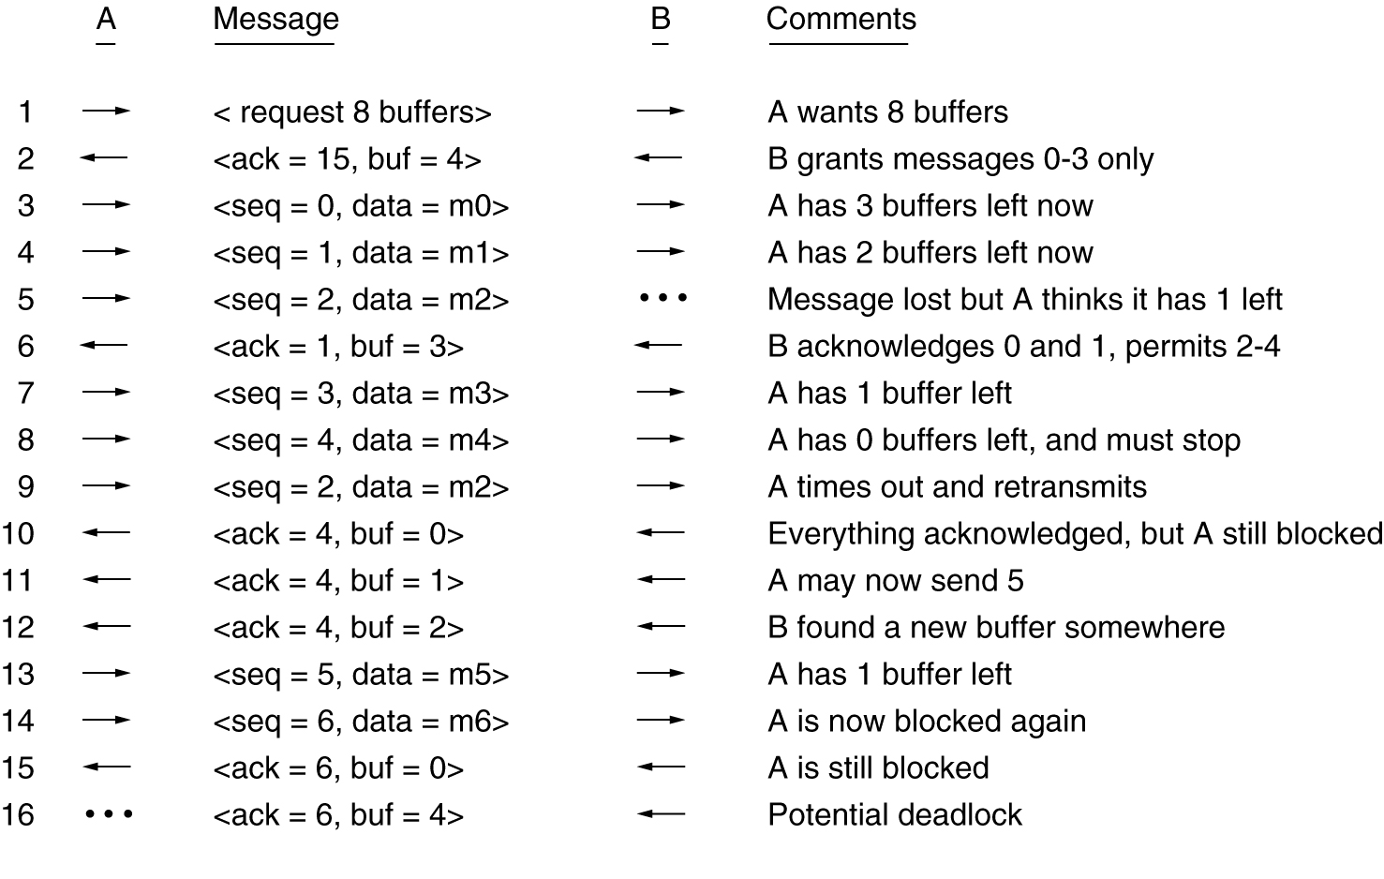
Flow Control and Buffering
Managing dynamic buffer allocation : Example
A datagram subnet with 4-bit sequence numbers

Slide 39
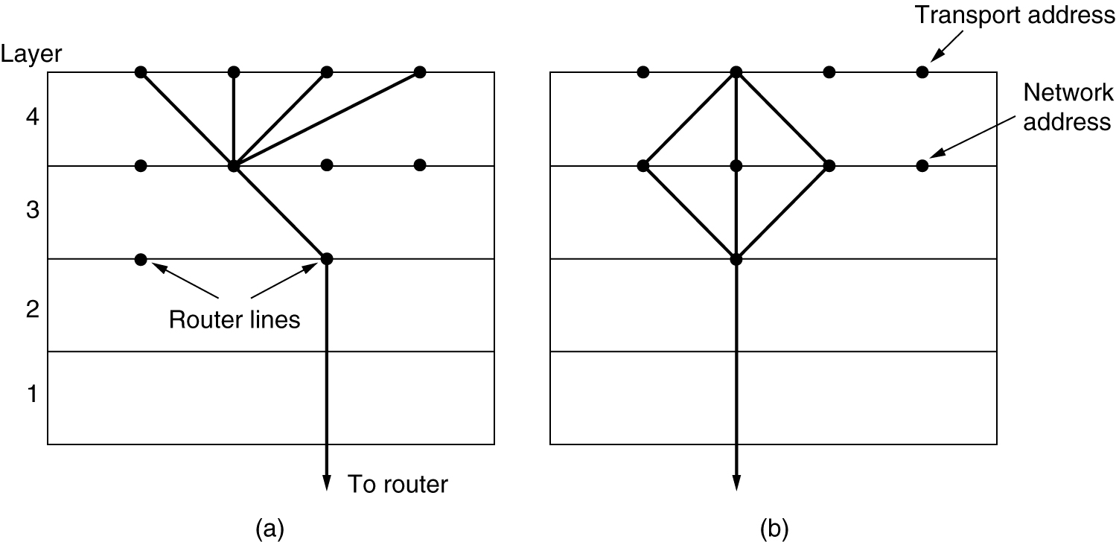
Multiplexing
(a) Upward multiplexing. (b) Downward multiplexing.

Slide 40
Crash Recovery
How to recover from host crashes?
Three events are possible at the server:
  sending an acknowledgement (A),
  writing to the output process (W),
  and crashing (C).
The three events can occur in six different orderings:
AC(W), AWC, C(AW), C(WA), WAC, and WC(A)

Slide 41
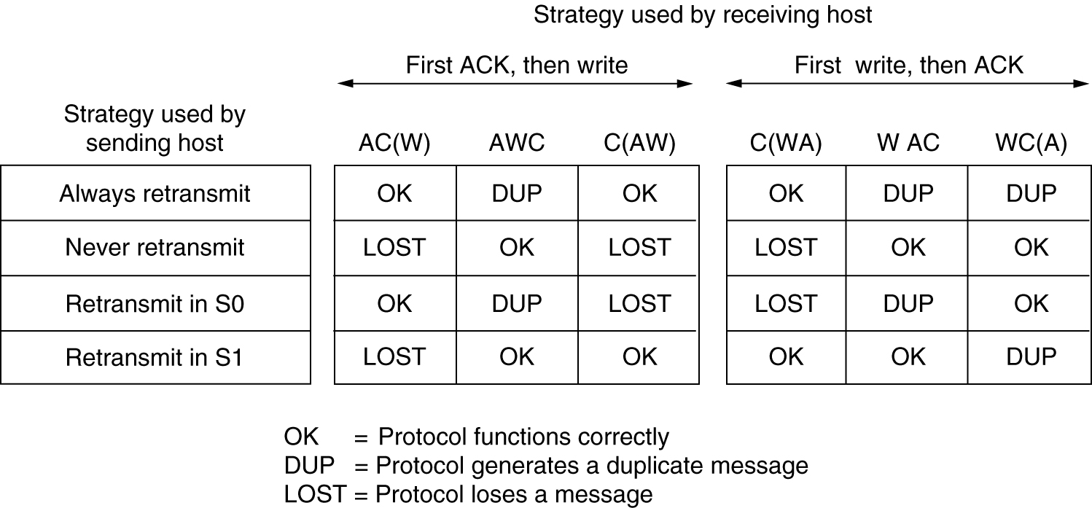
Crash Recovery
How to recover from host crashes?
Different combinations of client and server strategy.

