Slide 1


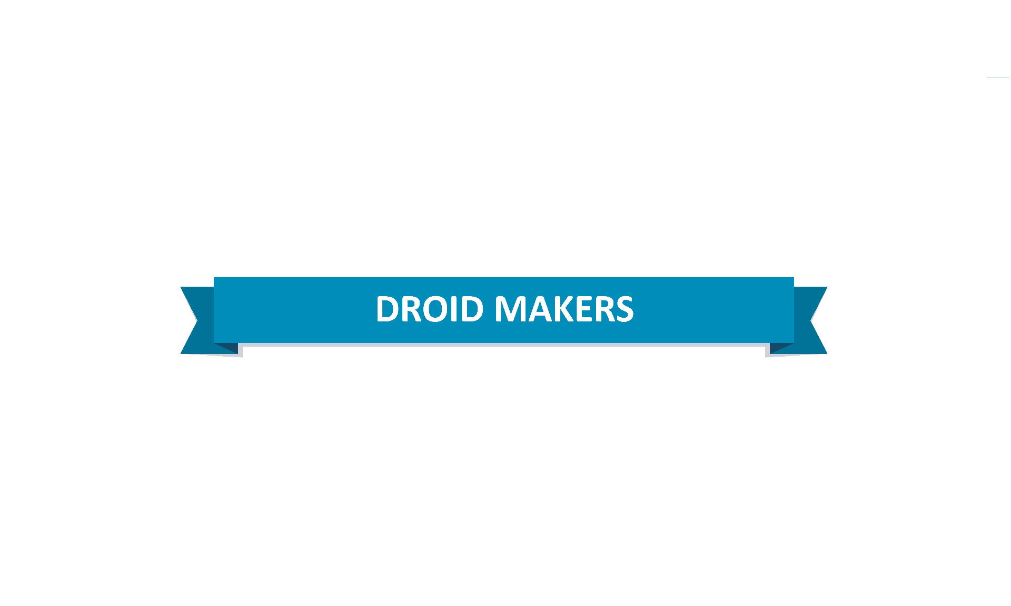
SMART INDIA
HACKATHON 2018
GOVERNMENT OF CHANDIGARH
PREDICTIVE STUDENT ANALYSIS

Slide 2

Objective:
To identify the students in the verge of dropping out of college.
To ensure students remain in college.
To do psychometric and performance analysis.
To provide career guidance.
To promote student’s welfare

Slide 3
Technology Stack:
Android studio
MySQL
Firebase (Expert group only)
Java
XML (Extended Markup Language)
PHP

Slide 4
Modules:
Module Name | Team member Name
Student | Sanjay Raj D
Mentor | Mohamed Rifoy R
Psychiatrist (Doctor) | Yuvaraja S
Expert group | Pankaj Krishna A

Slide 5
Student
Login Psychometric analysis Performance analysis Career guidance Responses Logout
Usecase:
Mentor
Login Performance analysis validation Provide solution Logout
Psychiatrist (Doctor)
Login Psychometric analysis validation Provide solution Logout
USECASE SCENARIO
Expert group
Login Provide career guidance (Chat) Logout

Slide 6
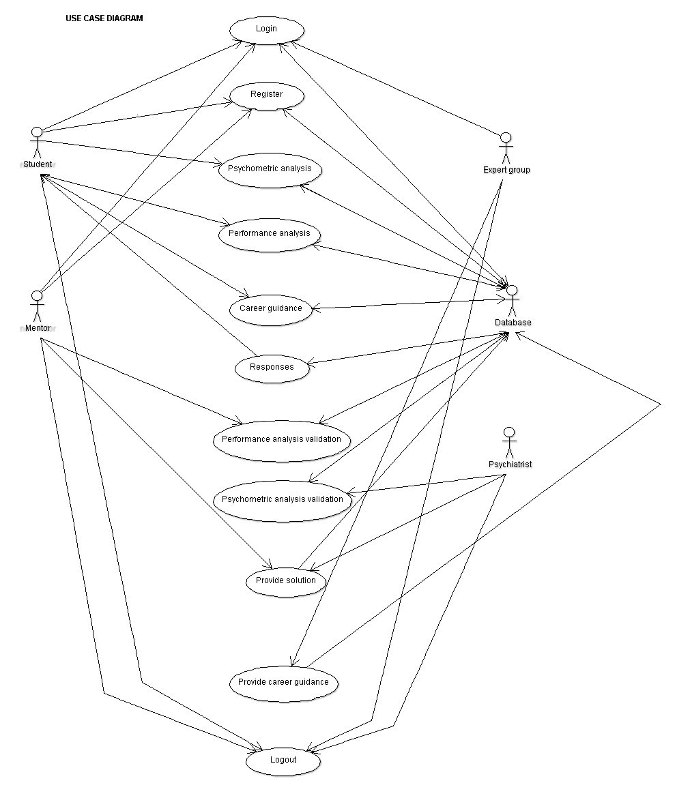

Slide 7
Student:
Database
Login
Psychometric analysis
Performance analysis
Carrier guidance
Responses
(Mail)
Take test
Take test
Chat with expert group
View solution
Logout

Slide 8
Mentor:
Login
Performance analysis validation
Database
Provide solution to student (Mail)
Logout

Slide 9
Psychiatrist:
Login
Psychometric analysis validation
Database
Provide solution to student (Mail)
Logout

Slide 10
Expert group:
Login
Database
Chat with student
Provide carrier guidance
Logout

Slide 11
Metrics

Slide 12
ADJUSTMENT | DESCRIPTION | SCORE RANGE
 |  | Men (194) | Women (274)
HOME | Excellent | 0-1 | 0-1
 | Good | 2-3 | 2-3
 | Average | 4-7 | 4-5
 | Unsatisfactory | 8-9 | 6-8
 | Very Unsatisfactory | 10 and above | 9 and above
HEALTH | Excellent | 0-1 | Zero
 | Good | 2-3 | 1-2
 | Average | 4-5 | 3-6
 | Unsatisfactory | 6-8 | 7-9
 | Very Unsatisfactory | 9 and above | 10 and above
SOCIAL | Very Aggressive | 0-2 | 0-3
 | Aggressive | 3-6 | 4-6
 | Average | 7-9 | 7-9
 | Retiring | 10-12 | 10-12
 | Very Retiring | 13 and above | 13 and above
EMOTIONAL | Excellent | 0-1 | 0-1
 | Good | 2-7 | 2-7
 | Average | 8-15 | 8-14
 | Unsatisfactory | 16-21 | 15-21
 | Very Unsatisfactory | 22 and above | 22 and above
EDUCATIONAL | Excellent | 0-1 | 0-1
 | Good | 2-4 | 2-4
 | Average | 5-9 | 5-8
 | Unsatisfactory | 10-14 | 9-12
 | Very Unsatisfactory | 15 and above | 13 and above
TOTAL SCORE | Excellent | 0-8 | 0-6
 | Good | 9-21 | 7-20
 | Average | 22-47 | 21-45
 | Unsatisfactory | 48-60 | 46-55
 | Very Unsatisfactory | 60 and above | 56 and above

Slide 13
Novelty:
The application comprises of lot of innovative things which includes the establishment of analyzing student’s mind set and providing solutions to their problems.

Slide 14
Social feasibility:
The application is socially feasible since this application eliminates the difficulties faced by students In their college life. Students and faculties are expecting these kind of application for the welfare of students.

Slide 15
Economical feasibility:
This application is economically feasible since it requires only small capitation amount and requires affordable operation amount for management of large amount of database.

Slide 16
Conclusion:
Thus the mobile application for solving problems faced by students will definitely be helpful for the students and their parents and faculties. As younger generation we wish to take part in student’s welfare, we developed this application for the students of our nation.

