Slide 1
Zero Knowledge Proofs
Rounak Das
Notes:
My topic is a cryptographic primitive known as zero knowledge proofs
Before going into that let’s take a look at … <spacebar>

Slide 2
What is that?
An interactive proof system
Prover
Verifier
Messages: Commitment, Challenge and Response
Verify response
Notes:
Interactive proof system, They consist of a prover who is trying to prove the statement to the verifier.
They communicate by exchanging messages of the type commitment – a kind of setup message, challenge and response. Then the verifier can verify the response wrt the commitment. And accept if it all goes well.

Slide 3
What is that?
Zero Knowledge Interactive Proofs
1985, Goldwasser, Micali and Rackoff
Extension of Interactive Proofs
Interactive Proofs may leak the information being proved
Prove: 26781 is not a prime
26781 = 113×237
But now the verifier knows the factorization!
ZKPs try to convince without revealing
Probabilistic
Always a non-zero probability that the Prover just guessed
But typically very small
Notes:
On to ZKPs. They were first introduced in 1985 as an extension of the interactive proofs.
The motivation came from the fact that interactive proofs leak the statement being proved. For example If I tell you prove that a number is composite – you can just show me its factorization. But then I’ll know the factors of that number – which may not be desirable.

Slide 4
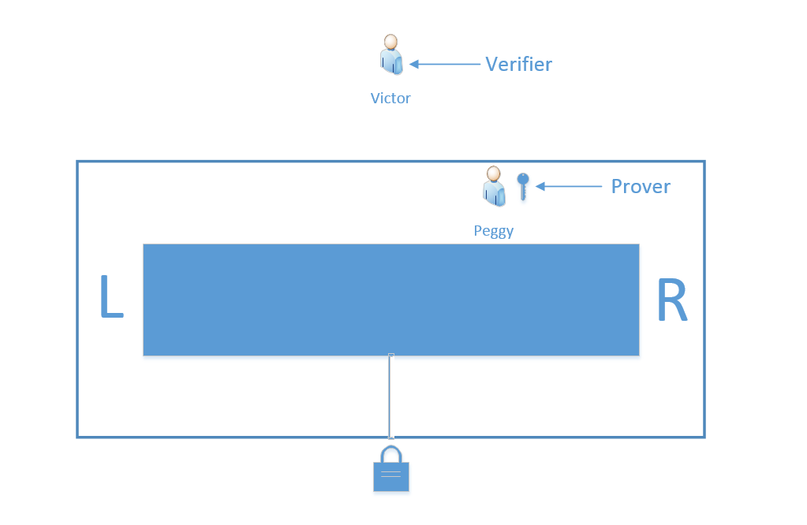
Enter The Cave
Notes:
This is a classic example of a ZKP. Here we have a cave. The front wall is glass so that we can see through it. The tunnel is separated into two parts – L & R – by a locked door. Victor is our verifier. Peggy is our prover. I did not come up with the names. And the goal of this exercise is for peggy to prove to victor that she has the key to this door without showing him the key

Slide 5
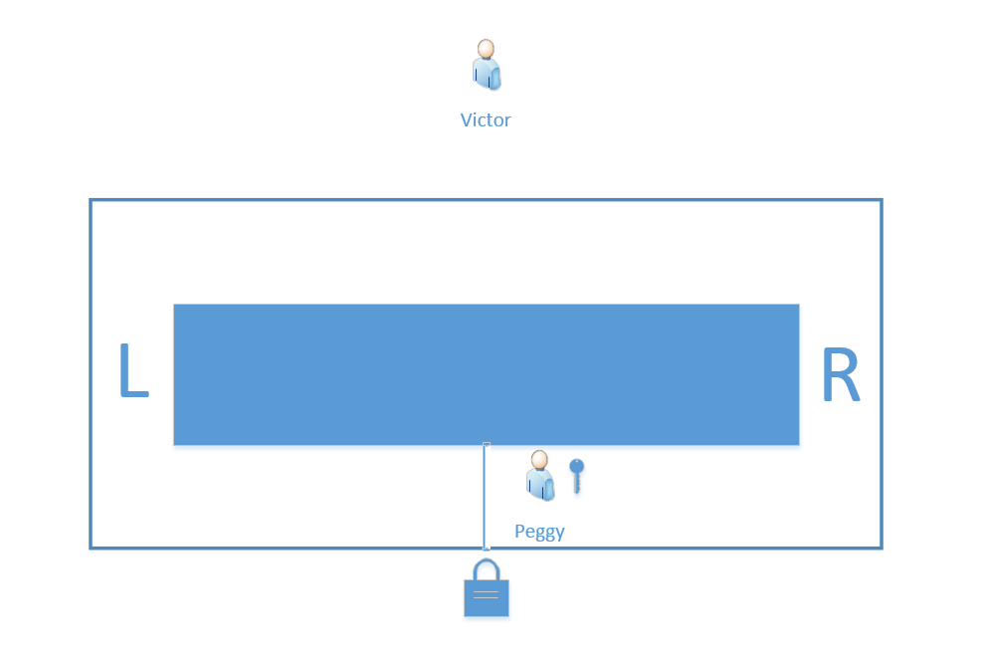
The Commitment
Notes:
The commitment is as follows: Victor closes his eyes. Peggy chooses a random side – L or R and goes into that side. Point is that victor does not know where peggy went. Lets say peggy went to R.

Slide 6
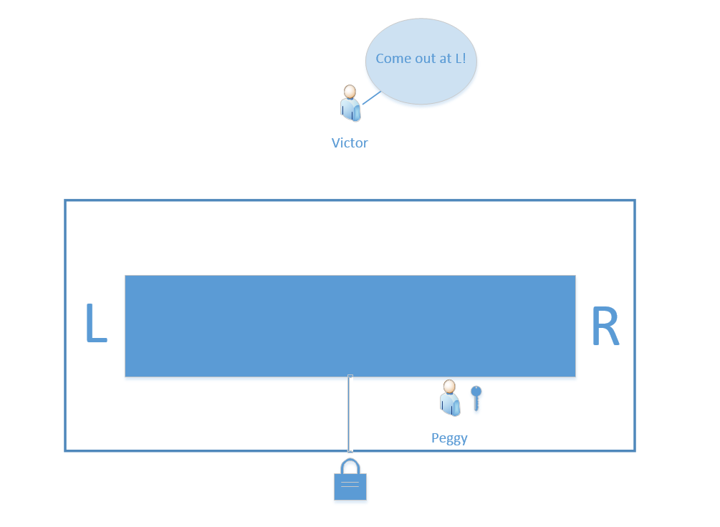
The Challenge
Notes:
Now victor chooses a side at random. And tells peggy to come out that side. Now if victor chose the same side as peggy – R – then peggy doesn’t need her key. She can just walk back. But if victor chooses L …

Slide 7
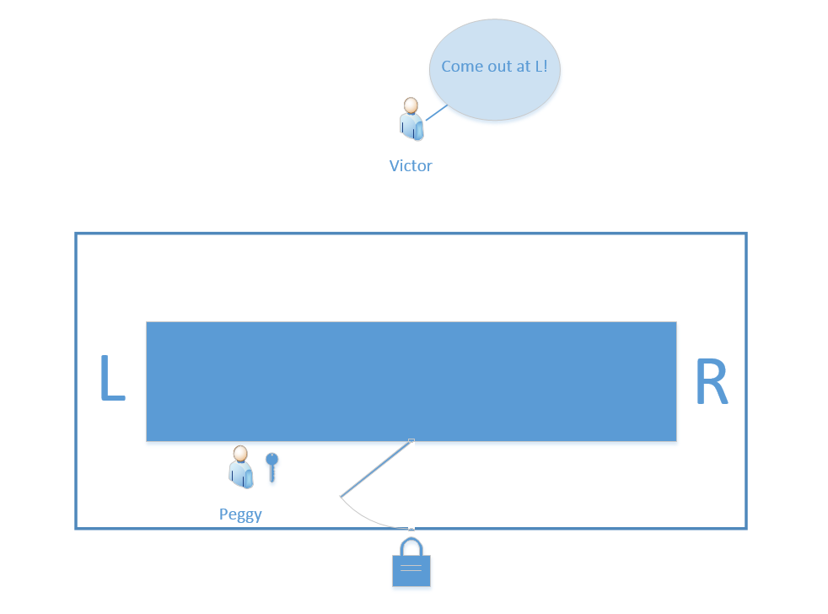
The Response
Notes:
… then peggy must use her key to open the door and come out the other side. Now the chance of this happening is 50%. So theres a 50% chance that peggy cheated and she doesn’t have the key. Those are not good odds. But we can improve them …

Slide 8
Many Rounds Later…
1 round
Cheating probability: ½
50% convinced
2 rounds
Cheating probability: ¼
75% convinced
…
40 rounds
Cheating probability: one in a million million
Highly convinced
Notes:
… By repeating this procedure many times.
Do it twice and we have a 25% chance that peggy cheated.
if we do it 40 times, then there’s only a one in a million million chance that peggy cheated – that she and victor chose the same side 40 times.
So now victor can say with confidence that she has the key – but victor has no idea what the key looks like. That is zero-knowledge.

Slide 9
Essential Properties
Completeness
If the statement is true, then the verifier will be convinced of it.
Soundness
If the statement is false, then cheating provers cannot convince the verifier that it is true.
Zero Knowledge
If the statement is true, then no cheating verifier learns anything except that the statement is true.
Notes:
Every ZKP must have 3 properties:
The first two are properties of every interactive proof – they basically say that it’s always possible to proof something that’s true, and always impossible to prove something that’s false. This protects against cheating provers.
The third property is what this presentation is about. The zero knowledge property protect against cheating verifiers. It states that after a successful proof the only piece of knowledge revealed is that the statement is true – and nothing else.

Slide 10
Zero Knowledge?
How do we know a protocol is zero-knowledge?
Does it leak the secret?
Can we simulate a proof without the secret?
Prover and Verifier collude
Make fake transcripts
Edit out failures
Have preplanned sequences
Fakes are indistinguishable from original!
Knowledge of secret not required – original proof did not leak it!
Notes:
So how can we tell if a proof is indeed zero-knowledge?
The formal way is to see if we can simulate it.
In the cave example if we recorded victor and peggy going through the whole proof and then showed it to somebody – they would be convinced that peggy has the key.
Now can we make a fake recording? If peggy didn’t have the key and she conspired with victor they could choose a preplanned sequence of Ls and Rs. So that she succeeds every time. And the resulting recording would be indistinguishable from the actual one.
So we don’t need to know the secret to efficiently simulate the proof – so the original proof did not leak the secret.
Contrast with the earlier example – If we prove by showing the factorization of a number then making these fake transcripts is impossible without actually factoring the number.

Slide 11
Practical Examples
Different Types:
Proof of Membership
Proof of knowledge
Proof of Identity
Computational Zero Knowledge
Perfect Zero Knowledge
Fiat-Shamir Identity Scheme
Schnorrs Scheme
Guillou-Quisquarter
Graph Isomorphisms
Graph 3-colorings
Notes:
Membership leaks exactly 1 bit. Knowledge and identity are equal. Computational is probabilistic – rounds based.
Schnorr iden -> Schnorr signature -> DSA

Slide 12
Example: Fiat-Shamir
Based on the Quadratic Residue problem
Computing x, given x² (mod n) is hard if factorization of n is not known
Setup:
Requires trusted central authority T
T selects n s. t. it is a Blum integer
n = p∙q
p and q are kept secret
Select t (number of rounds)
Notes:
For a concrete example let’s take a look at the Fiat-Shamir identity scheme.
Now in an identity scheme the prover tries to prove their identity to the verifier – but the system must make sure the verifier can’t impersonate as the prover later.
The fiat-shamir scheme is based on the quadratic residure problem – that is we have a number in Z_{n} then finding out its square root is a hard problem if n is composite and we don’t know it’s factorization. It’s equivalent to the integer factorization problem.
To setup we need a trusted authority to choose n for us. Now for security n needs to be a blum integer – that is a product of two primes which are 3 mod 4. It also select k and t which are security parameters

Slide 13
Example: Fiat-Shamir
Each entity computes their key-pair
Choose secret key
Choose s
1 ≤ s ≤ n-1, gcd(s, n) = 1
Usually use k-vectors instead of just one value.
Calculate public key
Compute v
v = 1/s² (mod n)
Publish v
Keep s secret
Notes:
Now the prover must select a private key. They do this by selecting k numbers s1 – sk that are coprime to n, called s-values. And we also need a k-bit vector b1 – bk. This is our secret key.
We compute the public key from the secret key by taking inverse square of each si, called v-values. We publish the v-values, and keep the s-values secret.

Slide 14
Example: Fiat-Shamir
Commitment, Challenge and Response:
Verifier checks if: x == (± y² ∙ v)
Notes:
Each round in fiat-shamir goes like this.
First the commitment. Prover choses a random number r, and sends r^2 mod n to the verifier.
Then the challenge. The verifier sends a k-bit string. This is a selection vector. He’s choosing which of the s-values are part of this round.
Then the response is this. r times the selective produst of s-values.
Then the verifier can verify by checking this. You can see that y^2 is r^2 times s^2. So that times v which is equal to 1/s^2 will cancel the s^2 and leave r^2 which is x.

Slide 15
Example: Fiat-Shamir
Challenge-Response continues for t rounds
Probability of successfully cheating: 2^{-t}
Zero Knowledge Proof?
Complete
Prover knows s, can compute both y = r (e=0) and y = rs (e=1) easily
Verifier is always convinced
Sound
Prover doesn’t know s, can only compute either y = r or y = rs (by choosing x = r²/v)
Needs to know Verifiers choice in advance or be able to compute square root!
Zero Knowledge
Only things revealed are x = r² mod n and either y = r or y = rs
Can simulate by defining x = y² or x = y²/v
Indistinguishable!
Notes:
Now we repeat this t times and fiat-shamir guarantees that we will accept a false proof with probability 2^-kt. So kt determines how good the proof is.
But is this a ZKP?
Now it is complete because if prover knows s, then she can respond correctly no matter what the verifier challenges us.
Now it is sound, because if prover doesn’t know s, then they can only answer correctly if they either knew the challenge beforehand or could solve the quadratic residue problem.
And it is zero knowledge because we can simulate it efficiently. No need to know s, we just set x accordingly. Transcripts will be indistinguishable.

Slide 16
Applications and Attacks
Applications:
Digital signature schemes (Fiat-Shamir heuristic)
e-voting (honest behavior in a mix-net)
Anonymous auctions
… and many more
Attacks:
Man-in-the-Middle
Impersonation
Replay attack
Notes:
Finally… we can apply ZKPs in a lot of places.
The main one is in creating Signature schemes. The Fiat-shamir heuristic is a mechanism that can turn any ZKP into an equivalent signature scheme. This is how DSA was created.
We can use them for anonymous voting, proofs of non-membership in auctions and may other places.
And of course no talk on a cryptographic protocol is complete without attacks targeting said protocol. These are too complex to get into now. Of these replay attacks are the most dangerous where you just copy a successful transcript and use it again later, perhaps to impersonate someone.

Slide 17
References
Goldwasser, Micali, Rackoff “The Knowledge Complexity of Interactive Proof Systems” (1985)
Feige, Fiat, Shamir “Zero Knowledge Proofs of Identity” (1989)
Guillou, Quisquater “How to Explain Zero-Knowledge Protocols to your Children” (1998)
Menezes, Oorschot; Chapter 10 from “Handbook of Applied Cryptography” (1996)
Trappe, Washington; Chapter 14 from “Introduction to Cryptography with Coding Theory” (2002)

Slide 18
Thank you!

Slide 19
Bonus: Fiat-Shamir Example
p = 683, q = 811 so that n = 553913
3 challenges per round: k = 3, single round: t = 1
Alice selects key-pair:
s₁ = 157, s₂ = 43215, s₃ = 4646 (private key)
b₁ = 1, b₂ = 0, b₃ = 1
v₁ = 441845, v₂ = 338402, v₃ = 124423 (public key)
Challenge Response:
Alice chooses r = 1279, x = 25898; sends this to Bob
Bob sends back 3-bit vector: (0,0,1)
Alice computes response: y = r ∙ s₃ mod n = 403104
Bob verifies: y² v₃ mod n = 25898 = x => Accept!

Slide 20
Bonus: Graph 3-Coloring
Checking if a graph is 3-Colorable is hard
Also hard to 3-Color a graph
Peggy: “I have a 3-Coloring for graph G!”
Victor: “Prove it!”
Both parties know G and the vertex labels i (1 ≤ i ≤ |G.V|)
Commitment: E(color(v_{i}), k_{i}) for each vertex v_{i}
k_{i} is particular to v_{i} for this round
Peggy chooses new keys next round
Challenge: (i,j) where v_{i} and v_{j} are adjacent (1 ≤ i, j ≤|G.V|)
Response: k_{i} and k_{j}
Verify: D(color(v_{i}), k_{i}) ≠ D(color(v_{j}), k_{j})

Slide 21
Bonus: Graph 3-Coloring

