Slide 1
Skip Lists
A alternative to binary search trees for highly concurrent environments
Notes:
So today I’m gonna be talking about Skip Lists. It’s an uncommon data structure. As in most of us haven’t encountered them. So let us begin by talking about the motivation behind it.

Slide 2
Motivation: Concurrency
Hardware is concurrent
Multi-core processors
Instruction level pipelining
Hardware support is abundant
Writing concurrent software is hard
We don’t think in parallel
One copy of everything
Concurrency is usually an afterthought
W
R
R
R
Notes:
Why do we need a new data structure?
OS has lots of support, new languages are based around it
Parallel code comes with its own set of problems
Shared resources are biggest bottleneck
Reader and writers on larger scale

Slide 3
Concurrent Data Structures
Accessing shared data is the most common operation that may need to be parallelized
Notes:
Data is the most important shared resource
Data structures need to be concurrent

Slide 4
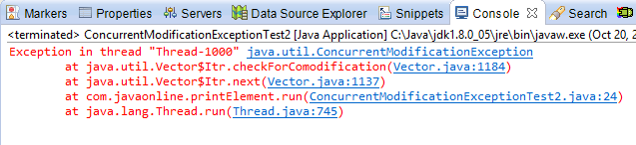
Concurrent Access
Must maintain consistency
Multiple readers allowed while there are no writers
No readers while there’s a writer
Only one writer at a time
else we get:
Notes:
Maintaining consistency is a big problem if concurrency is allowed

Slide 5
Locking
Coarse-grained Locking
Lock the whole data structure
Obviously correct, also simple
But inefficient
Fine-grained Locking
Each piece or node will have its own lock
Lock only a piece of the data structure
Only lock those nodes that need to be modified
Lock-free Synchronization
Atomic CAS
Transactional Memory
Notes:
Locking is the simplest method to ensure consistency
Lock-free: Atomic operations, Native compare-and-set, advanced = MCAS
Mainly focus on FGL

Slide 6
Linked Lists vs. Binary Trees
Balanced Binary Search Trees
Sorted Doubly Linked Lists
The Good: Simple linear data structure; anybody can make one!
The Bad: Worst case O(n) performance
The Good: Worst case O(logn) performance
The Bad: Far more complex to implement
Notes:
Two main data structures for an ordered map data structure

Slide 7
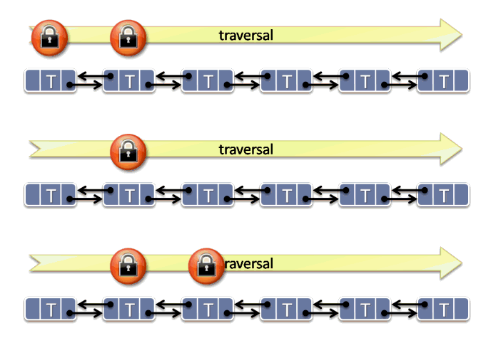
Locking a Linked List
Hand-over-Hand locking
Localized updates: lock only those nodes
While traversing the list each thread keeps at most 2 locks
Lock node
Lock node.next
Unlock node
All locks are acquired in the same order (no deadlocks!)
Advantage: Many threads can safely operate on the list at the same time
Notes:
Localized Updates: Each operation requires only a few nodes to be modified
No deadlock: Strict hierarchy in resources like in OS
Insert, Delete require 2-3 locks each

Slide 8
Locking a Binary Tree
Let’s try to do the same thing here too
Each node has it’s own lock
Acquire locks in one direction: up the tree
But how many locks would we need?
Too many!
Rebalancing and rotating may modify a large portion of the tree
At worst even the root lock may be required
Lower depth nodes become high contention resources – bottleneck!
Solutions exist but are too complicated to be practical
Transactional memory
MCAS
Lock-free trees
Notes:
Transactional memory: DBMS like synchronization at RAM level
MCAS: Multiword Compare-and-Swap
Problem!

Slide 9
Skip Lists
What, how And why?

Slide 10
Introducing the Skip List
Skip lists were first described in 1989 by William Pugh
Non-deterministic data structures
Probabilistic balancing
Expected runtime of O(logn) for search
Worst case is O(n)
Notes:
Probabilistic balancing as opposed to strict balancing in trees
Perfect skip lists: 2nd ones skip 2, 4th ones skip 4 and so on – Impractical
Expected number of levels for n nodes is logn

Slide 11
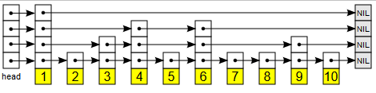
Skip List: What it looks like
Multileveled linked list
With sentinel node in the front
Lowest level is a normal sorted linked list
Upper levels can skip some nodes in the middle
Each nodes level is random
Each node promotes itself with a probability p
Usually ½
Notes:
Linked lists stacked on top of each other
Indexed skip lists: each pointer also stores its length, optimization for queries like nth value in map

Slide 12
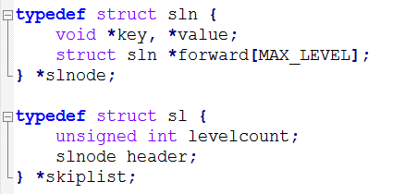
Skip Lists: In Code
Here’s a sample in C
Holds key-value pairs
Might contain up to MAX_LEVEL levels
forward holds the pointers for each level in the list, forward[0] is the base pointer
The header is a sentinel
ConcurrentSkipListMap and ConcurrentSkipListSet in Java are implemented using Skip Lists
Notes:
Ordered maps: competitors = Red-Black tree
So easy most don’t provide a standard implementation

Slide 13
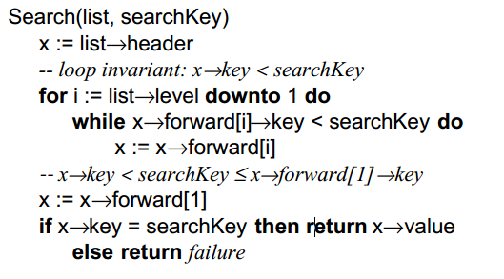
Skip List: Search
Start at the top
For each level from top to bottom
Skip all nodes that have a smaller key
This is like taking a shortcut
Prunes the search space, probabilistically
If search key is found then exit
Notes:
The most important function; dominates both insertion and deletion

Slide 14
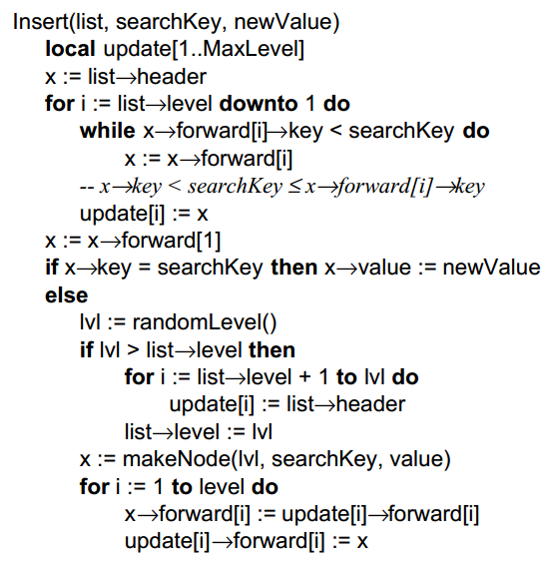
Skip List: Insertion
Insertion is similar to search
Find out where the node need to go
From top left, skip all smaller and NIL nodes
Keep going down and insert at bottom level
Afterwards, elevate the new node up a random level
Need to keep track of all pointer to update
Notes:
Coin flip; head -> promote node and flip again, tails -> end insertion

Slide 15
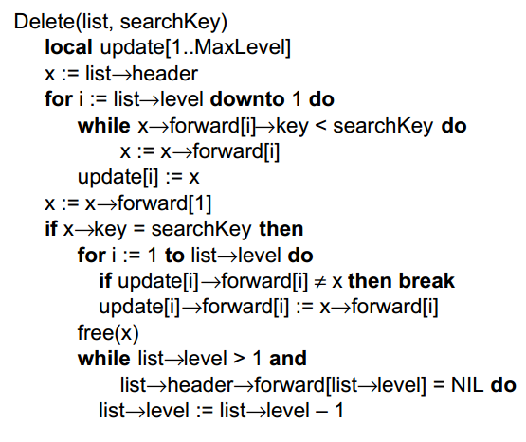
Skip Lists: Deletion
Very similar to Insertion
Might need to decrease level

Slide 16
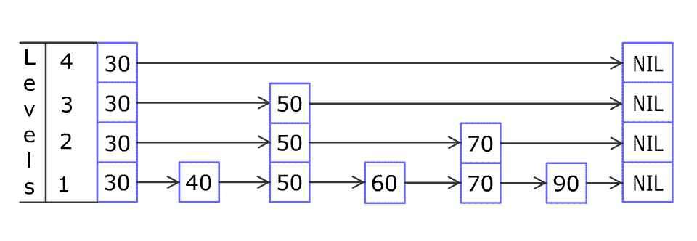
Skip List: Insertion
Notes:
4 levels, 6 nodes

Slide 17
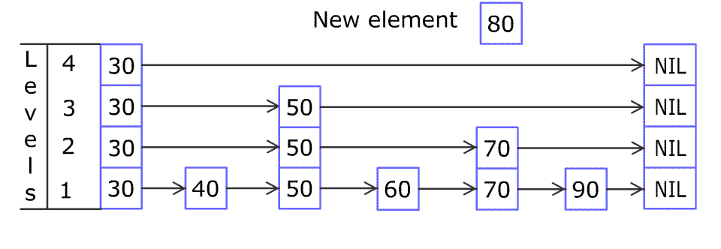
Skip List: Insertion

Slide 18
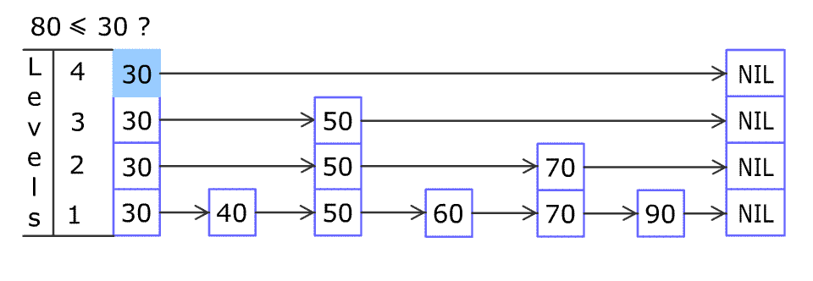
Skip List: Insertion

Slide 19
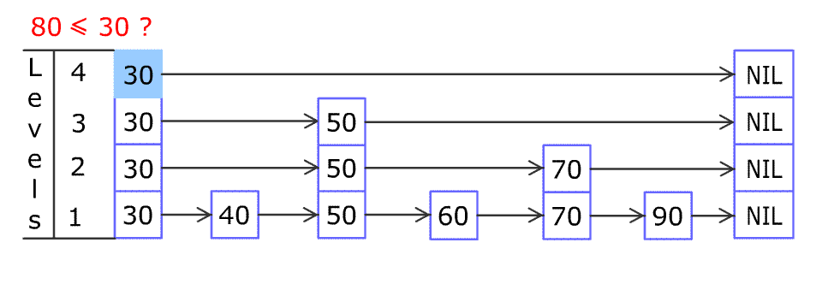
Skip List: Insertion

Slide 20
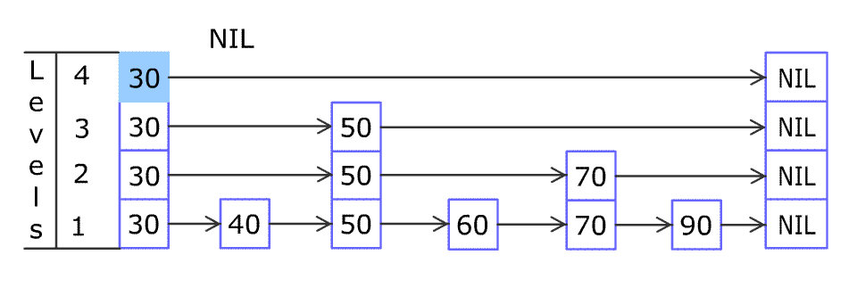
Skip List: Insertion

Slide 21
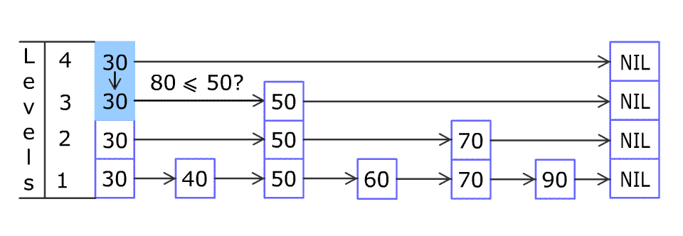
Skip List: Insertion

Slide 22
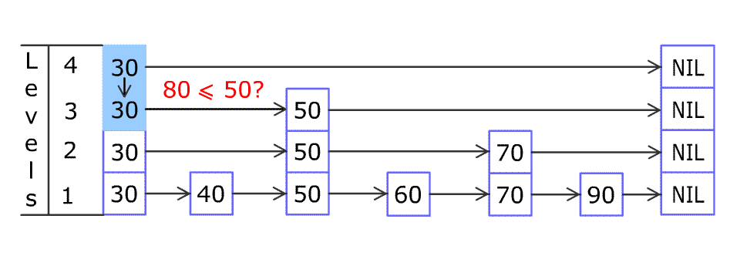
Skip List: Insertion

Slide 23
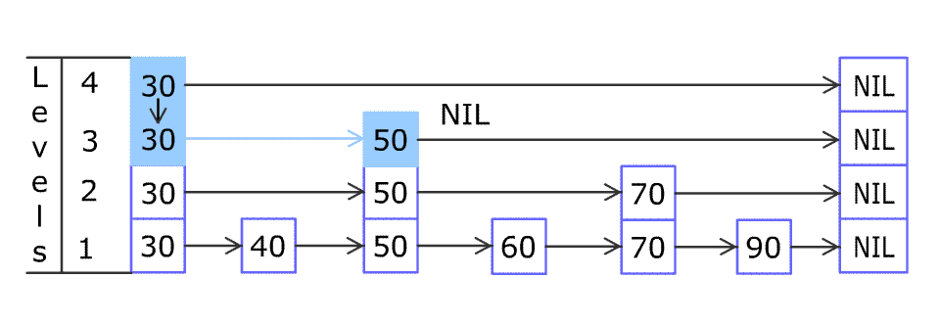
Skip List: Insertion

Slide 24
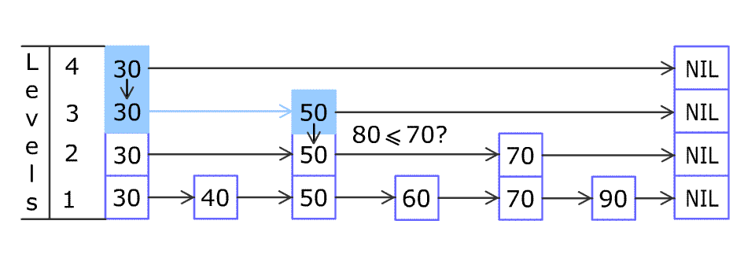
Skip List: Insertion

Slide 25
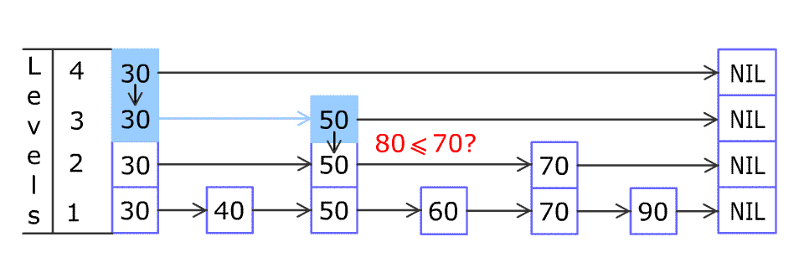
Skip List: Insertion

Slide 26
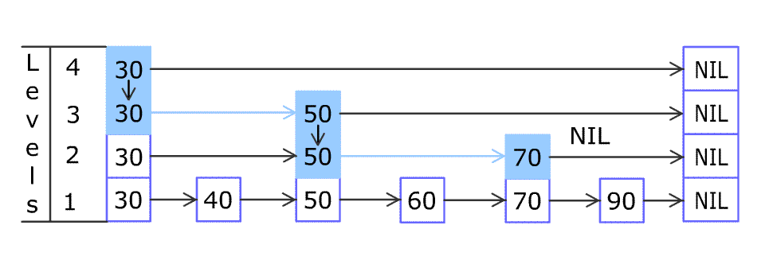
Skip List: Insertion

Slide 27
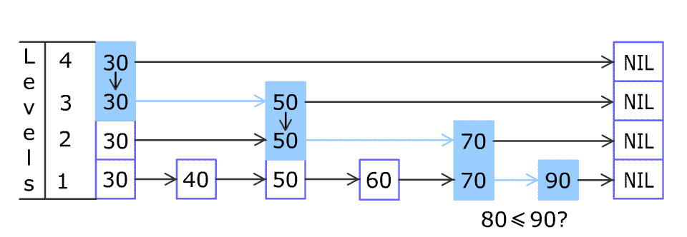
Skip List: Insertion

Slide 28
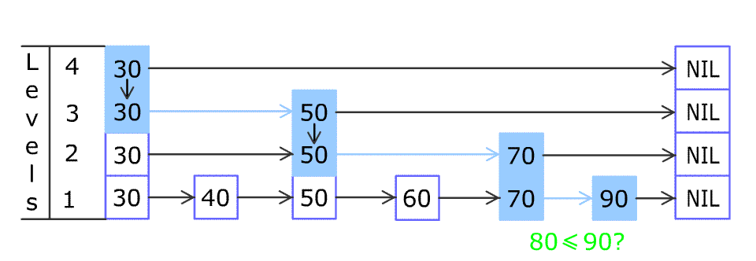
Skip List: Insertion

Slide 29
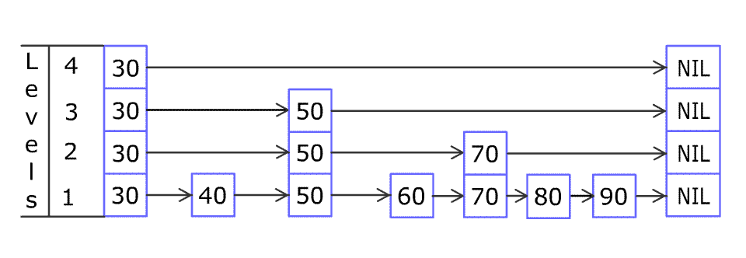
Skip List: Insertion

Slide 30
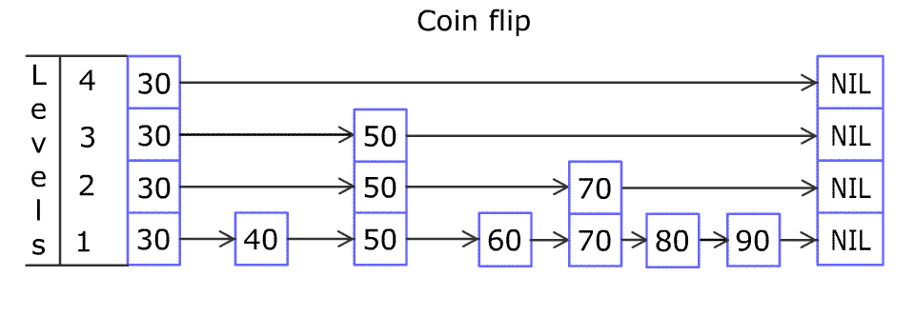
Skip List: Insertion

Slide 31
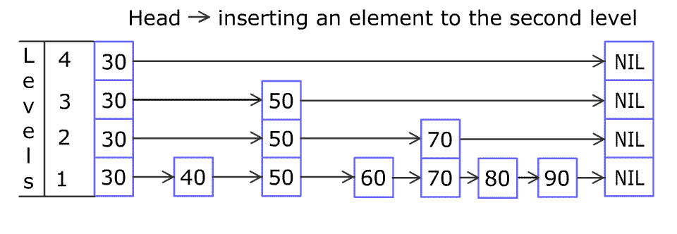
Skip List: Insertion

Slide 32
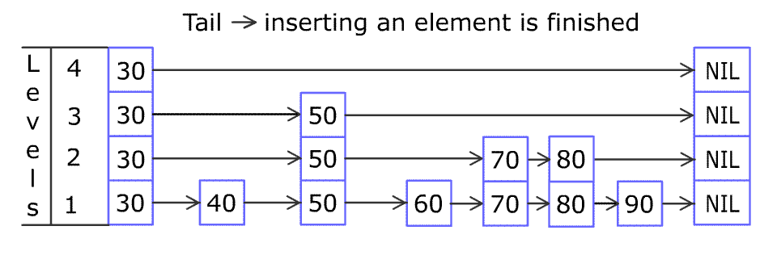
Skip List: Insertion

Slide 33
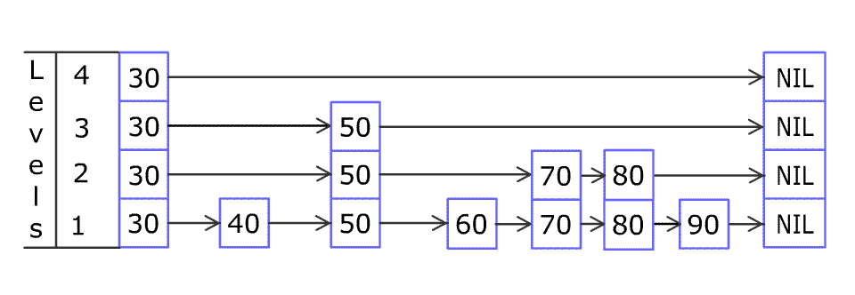
Skip List: Insertion

Slide 34
Skip Lists: Performance
Internally locked Skip List vs. Globally locked Tree
Using ConcurrentSkipListMap and TreeMap from Javas standard library
Create of 100,000 Integer to String mapping in each map
Both maps are identical
Generate random integers and access the corresponding keys
Same entries accessed for each map
Steadily increase number of threads accessing the Maps at a time
1, 2, 4 etc.
Dense: each thread accesses 100,000 random entries
Sparse: each thread accesses 1000 random entries

Slide 35
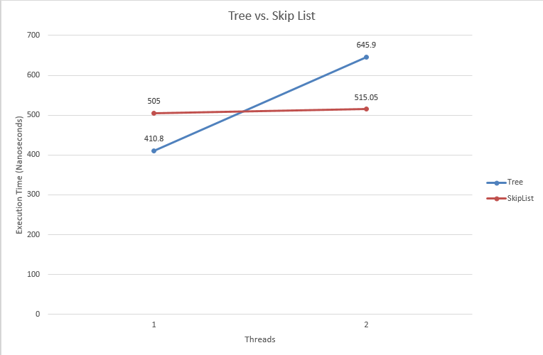
Skip Lists: Performance
Binary Trees are better in single threaded applications
But even with only 2 threads Skip Lists pull ahead
Notes:
Global locks are just too inefficient!

Slide 36
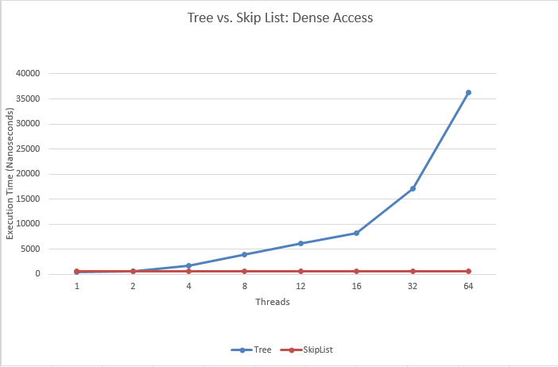
Skip Lists: Performance
Accessing lots of data
It keeps getting worse
Notes:
Obviously all the threads are being serialized by the Global lock of the TreeMap
The SkipListMap enjoys somewhat constant access times

Slide 37
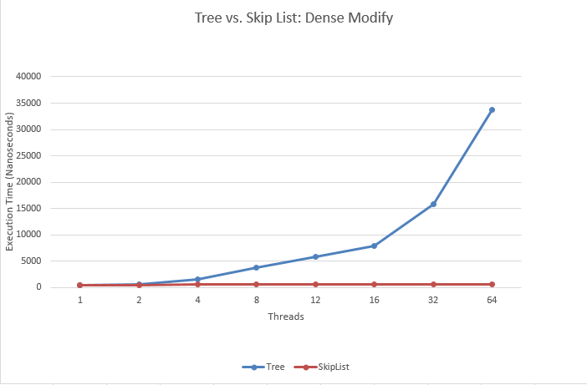
Skip Lists: Performance
Modifying lots of data
Similar story
Notes:
Obviously all the threads are being serialized by the Global lock of the TreeMap
The SkipListMap enjoys somewhat constant access times

Slide 38
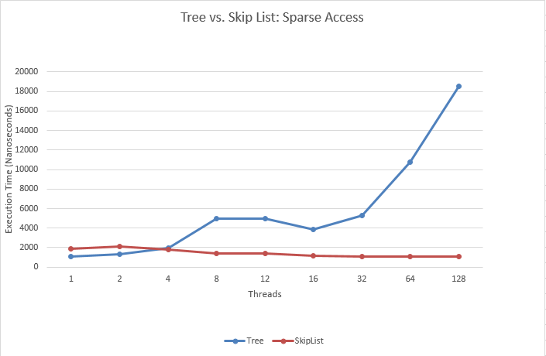
Skip Lists: Performance
Accessing little bit of data
Somewhat better scaling
Notes:
Obviously all the threads are being serialized by the Global lock of the TreeMap
The SkipListMap enjoys somewhat constant access times

Slide 39
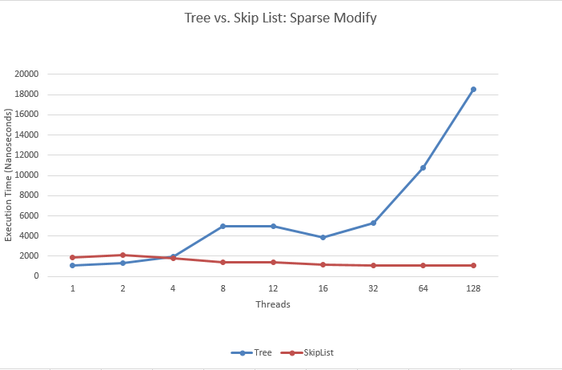
Skip Lists: Performance
Modifying little bit of data
Similar story
Notes:
Obviously all the threads are being serialized by the Global lock of the TreeMap
The SkipListMap enjoys somewhat constant access times

Slide 40
Skip Lists: Advantages
Skip Lists are better for highly concurrent environments
Localized updates are better
Better performance for bulk data access
Scale significantly better than Red-Black trees as parallelism increases
Global locks are bad; don’t scale
Finer locking mechanisms are rather convoluted
Lock-free skip lists are possible!
Perform about as well as locking ones
Next time, when you want a lock-free concurrency-friendly data structure consider a Skip List!
Notes:
Not talking about disadvantages

Slide 41
Conclusions
References:
Keir Fraser "Paractical Lock-freedom" http://www.cl.cam.ac.uk/techreports/UCAM-CL-TR-579.pdf
William Pugh "Skip lists: A probabilistic alternative to balanced trees" ftp://ftp.cs.umd.edu/pub/skipLists/skiplists.pdf
Thomas Papadakis "Skip Lists and Probabilistic Analysis of Algorithms" https://cs.uwaterloo.ca/research/tr/1993/28/root2side.pdf
Kier Fraser "Concurrent Programming without Locks" http://www.cl.cam.ac.uk/research/srg/netos/papers/2007-cpwl.pdf
http://www.drdobbs.com/parallel/choose-concurrency-friendly-data-structu/208801371
All data and code used can be found here:
https://github.com/DroidX86/skip-stats
Including all the references, further reading and this presentation
Notes:
For parallel performance: Skip Lists are good, Trees are bad

Slide 42
Rounak Das
Thank You!
Jadavpur University; BCSE-IV

Slide 43
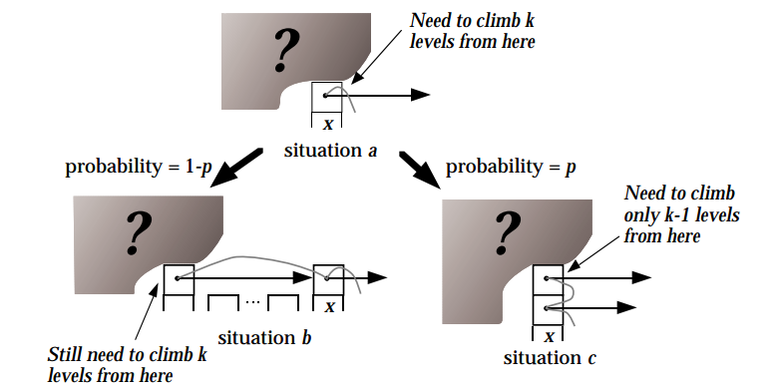
Skip Lists: Analysis
Runtime is dominated by time to search
Analyze the search path backwards
At any point we are here:
p is the probability of adding a level to a node

Slide 44
Skip Lists: Analysis
Let p = ½ for simplicity
Expected number of steps to walk through k levels
C(k) = 1 + ½*C(k-1) + ½*C(k)
Or, C(k) = 2 + C(k-1)
C(k) = 2*k by expansion
Expected number of levels in the tree is log(n)
At level 1 = n/2
At level 2 = n/4 and
…
At level log(n) = 1
k can be log(n) at most
C(k) = O(logn)

