Slide 1
Skip Lists
A alternative to binary search trees for highly concurrent environments

Slide 2
Motivation: Concurrency
Nearly all major software released nowadays is multithreaded to some extent
Multi-core processors
Instruction level pipelining
Hardware support is abundant
Software is not

Slide 3
Concurrency
We don’t think in parallel
One copy of everything
Concurrency is usually an afterthought
W
R
R
R
Notes:
The difficulty arises partly from how the human mind works and partly from having shared resources

Slide 4
Concurrent Data Structures
Accessing shared data is the most common operation that may need to be parallelized

Slide 5
Linked Lists vs. Binary Trees
Sorted Linked Lists
Balanced Binary Search Trees
The Good: Simple linear data structure; anybody can make one!
The Bad: Worst case O(n) performance
The Good: Worst case O(logn) performance
The Bad: Far more complex to implement
Notes:
Skip this

Slide 6
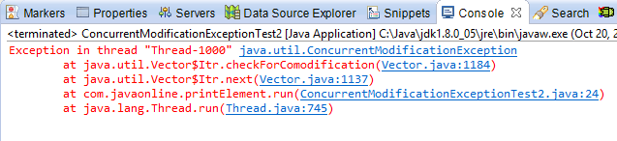
Concurrent Access
Must maintain consistency
Multiple readers allowed while there are no writers
No readers while there’s a writer
Only one writer at a time
else we get:
Notes:
Reader and writers but on a bigger scale, RW problem on each data item

Slide 7
Locking
Coarse-grained Locking
Lock the whole data structure
Obviously correct, also simple
But inefficient
Fine-grained Locking
Lock only a piece of the data structure
Each piece or node will have its own lock
Only lock those nodes that need to be modified
Optimistic Synchronization
Lock-free Synchronization
Notes:
Optimistic: Try without sync, if it works, it works else do sync
Lock-free: Atomic operations, Native compare-and-set, advanced = MCAS

Slide 8
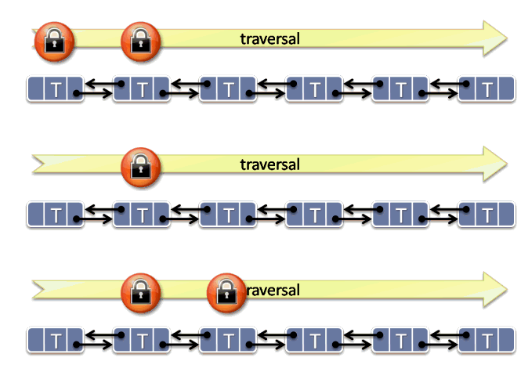
Locking a Linked List
Hand-over-Hand locking
Each operation requires at most 2 nodes to be modified
Lock only those 2 nodes
While traversing the list each thread keeps at most 2 locks
All locks are acquired in the same order (no deadlocks!)
Advantage: Many threads can safely operate on the list at the same time
Notes:
Updates are localized
Strict hierarchy in resources in OS
Delete requires 3 nodes (prev, cur and next)

Slide 9
Locking a Binary Tree
Let’s try to do the same thing here too
Each node has it’s own lock
Acquire locks in one direction: up the tree
But how many locks would we need?
Too many!
Rebalancing and rotating may modify a large portion of the tree
At worst even the root lock may be required
Lower depth nodes become high contention resources – bottleneck!
Solutions exist but are too complicated to be practical

Slide 10
Skip Lists
What, how And why?

Slide 11
Introducing the Skip List
Skip lists were first described in 1989 by William Pugh
Probabilistic Data structure
Multi-leveled sorted linked list
Linked list with shortcuts to forward nodes
Same asymptotic expected time bounds as balanced binary trees!
O(logn) average case
But worst case is O(n)
Very simple to implement!

Slide 12
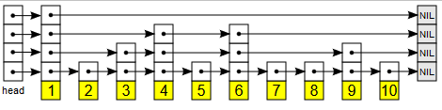
Skip List: What it looks like
Multileveled linked list
With sentinel node in the front
Lowest level is a normal sorted linked list
Upper levels skip some nodes in the middle
How many nodes are skipped is random

Slide 13
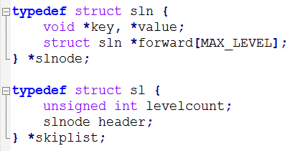
Skip Lists: In Code
Here’s a sample in C
Holds key-value pairs
Might contain up to MAX_LEVEL levels
forward holds the pointers for each level in the list, forward[0] is the base pointer
The header is a sentinel
ConcurrentSkipListMap and ConcurrentSkipListSet in Java are implemented using Skip Lists

Slide 14
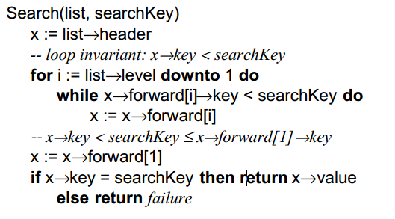
Skip List: Search
Start at the top
For each level from top to bottom
Skip all nodes that have a smaller key
This is like taking a shortcut
Prunes the search space, probabilistically
If search key is found then exit

Slide 15
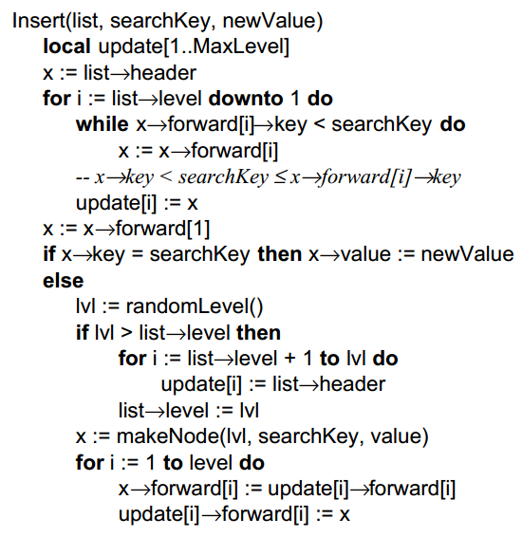
Skip List: Insertion
Insertion is similar to search
Find out where the node need to go
From top left, skip all smaller and NIL nodes
Keep going down and insert at bottom level
Afterwards, elevate the new node up a random level
Need to keep track of all pointer to update

Slide 16
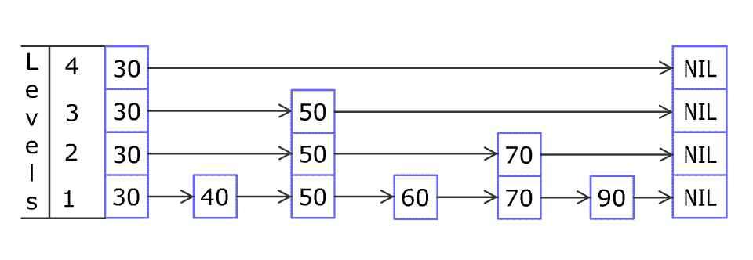
Skip List: Insertion

Slide 17
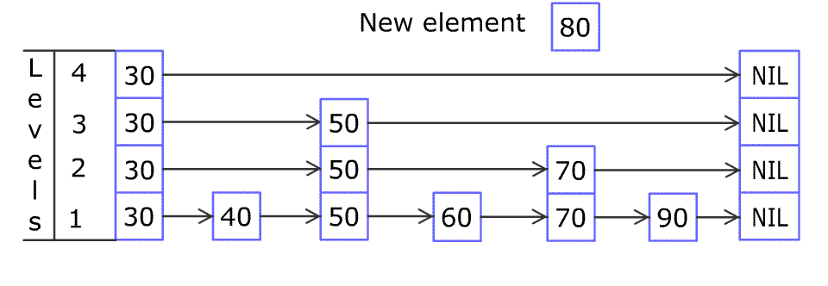
Skip List: Insertion

Slide 18
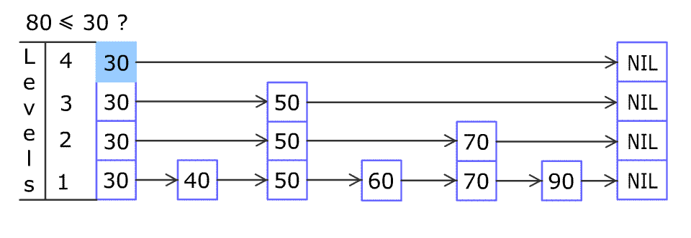
Skip List: Insertion

Slide 19
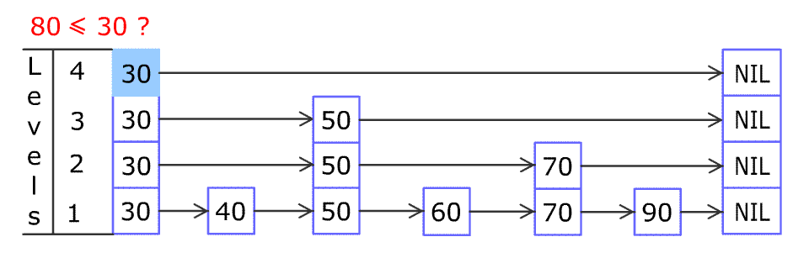
Skip List: Insertion

Slide 20
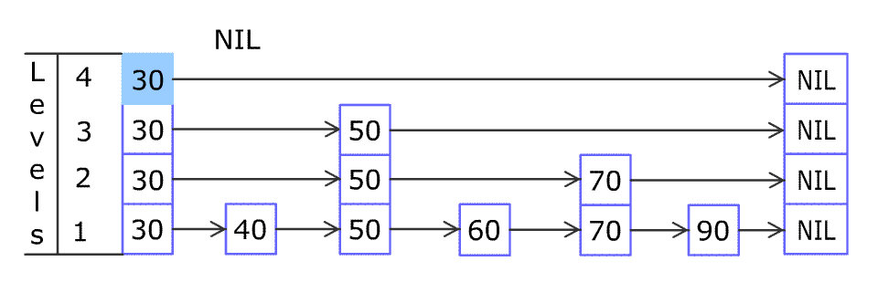
Skip List: Insertion

Slide 21
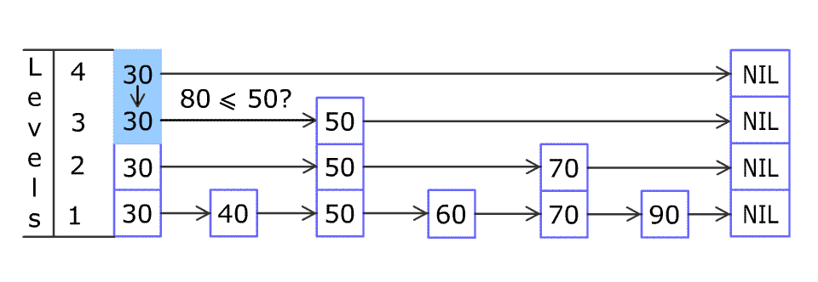
Skip List: Insertion

Slide 22
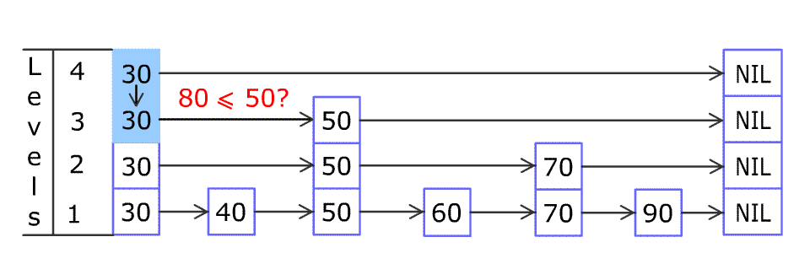
Skip List: Insertion

Slide 23
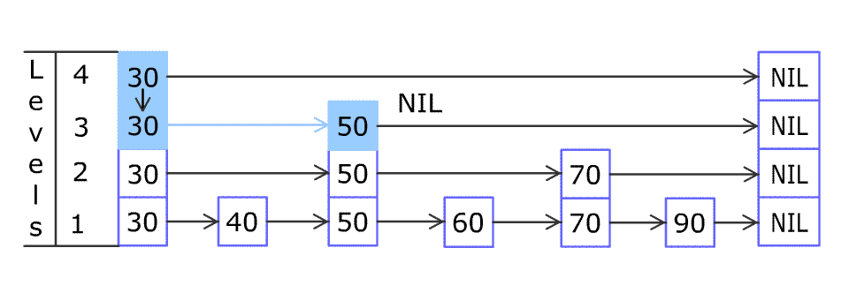
Skip List: Insertion

Slide 24
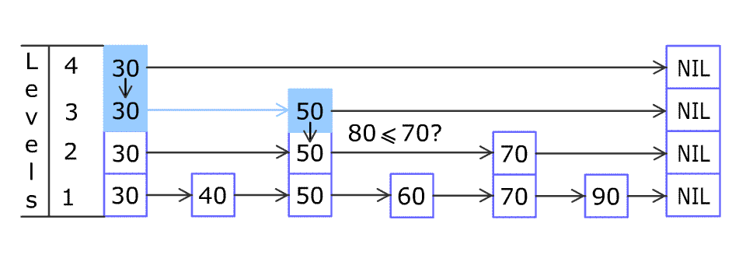
Skip List: Insertion

Slide 25
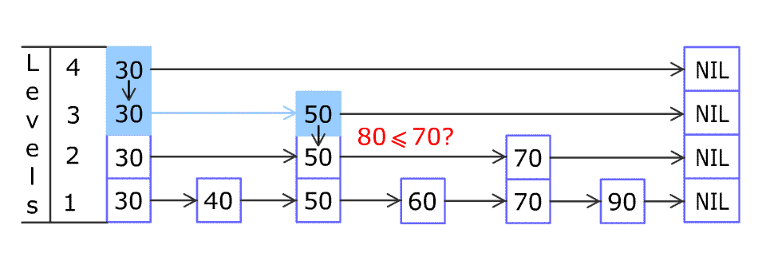
Skip List: Insertion

Slide 26
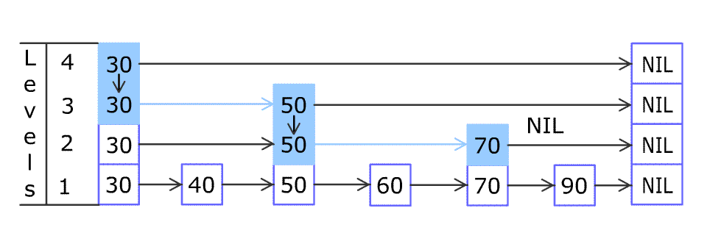
Skip List: Insertion

Slide 27
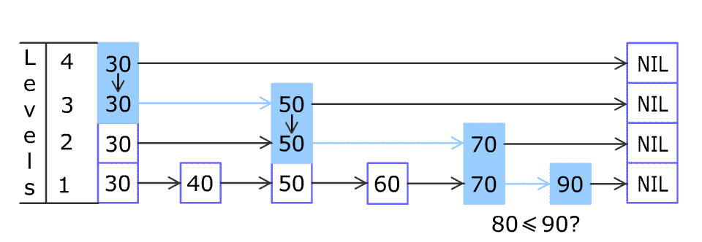
Skip List: Insertion

Slide 28
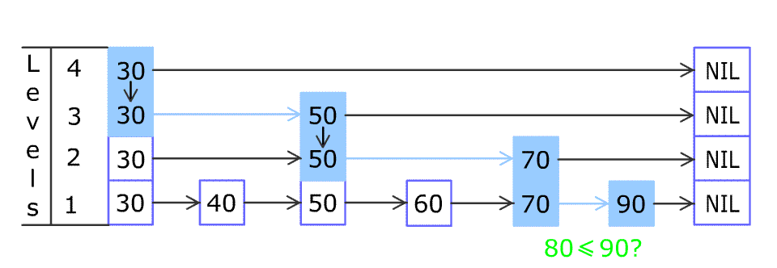
Skip List: Insertion

Slide 29
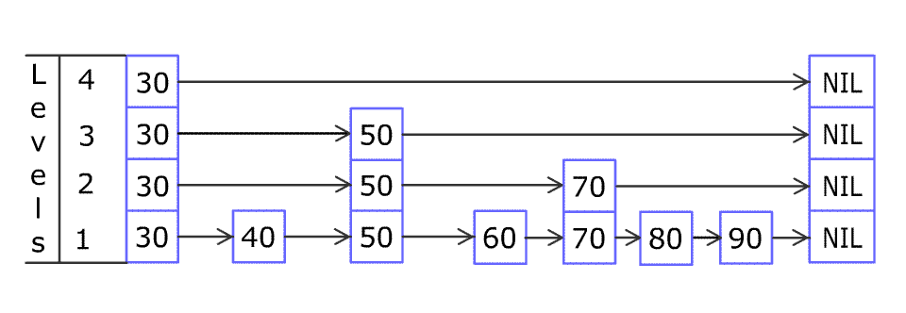
Skip List: Insertion

Slide 30
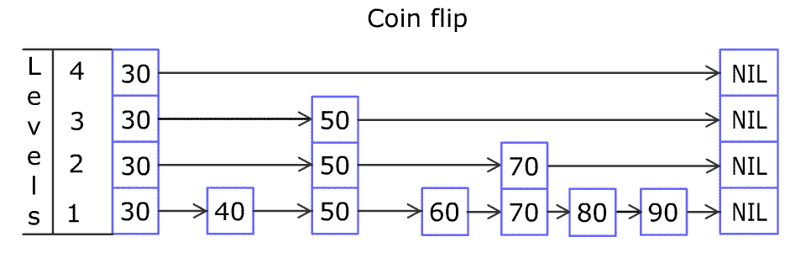
Skip List: Insertion

Slide 31
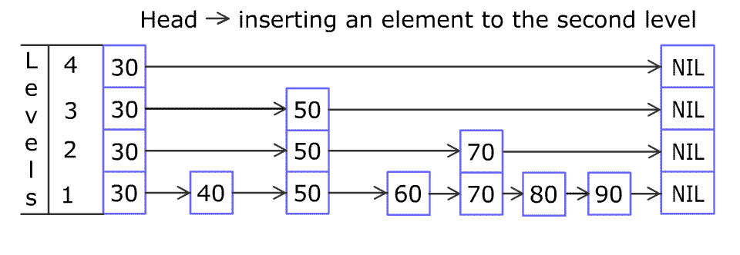
Skip List: Insertion

Slide 32
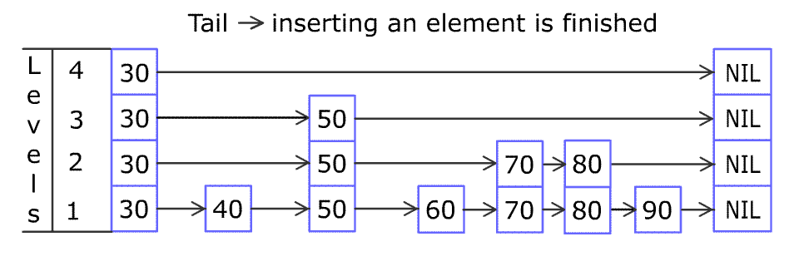
Skip List: Insertion

Slide 33
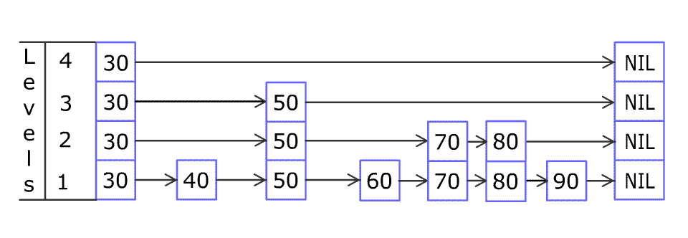
Skip List: Insertion

Slide 34
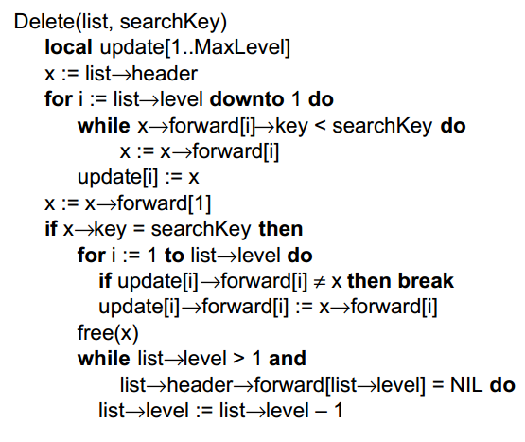
Skip Lists: Deletion
Very similar to Insertion
Might need to decrease level

Slide 35
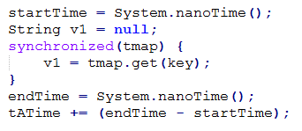

Skip Lists: Performance
Skip Lists
Binary Trees
No global lock; Internally locked
Globally locked
Notes:
The skip list code is also more intuitive

Slide 36
Skip Lists: Performance
Using ConcurrentSkipListMap and TreeMap from Javas standard library
Create of 100,000 Integer to String mapping in each map
Both maps are identical
Generate random integers and access the corresponding keys
Same entries accessed for each map
Steadily increase number of threads accessing the Maps at a time
1, 2, 4 etc.
Dense: each thread accesses 100,000 random entries
Sparse: each thread accesses 1000 random entries

Slide 37
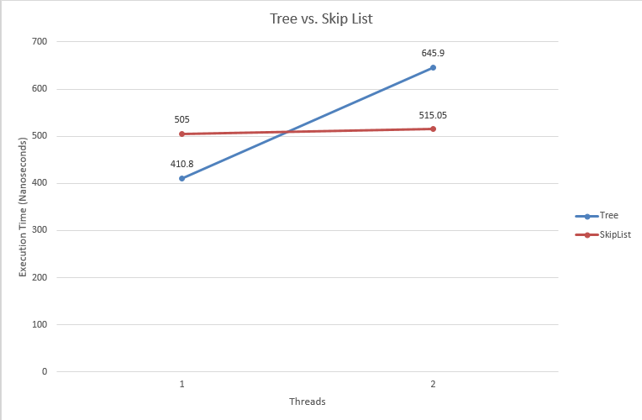
Skip Lists: Performance
Binary Trees are better in single threaded applications
But even with only 2 threads Skip Lists pull ahead
Notes:
Global locks are just too inefficient!

Slide 38
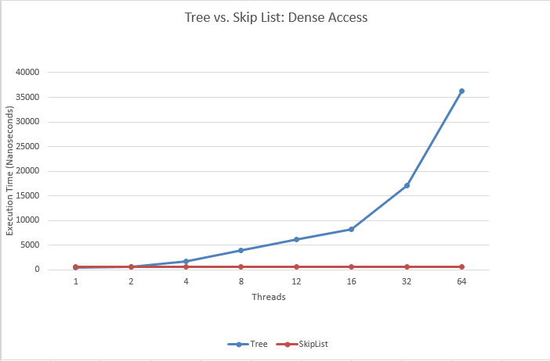
Skip Lists: Performance
Accessing lots of data
It keeps getting worse
Notes:
Obviously all the threads are being serialized by the Global lock of the TreeMap
The SkipListMap enjoys somewhat constant access times

Slide 39
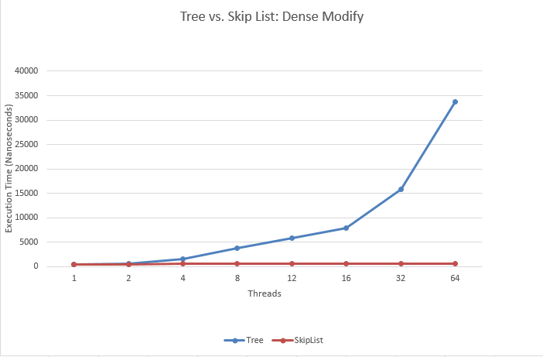
Skip Lists: Performance
Modifying lots of data
Similar story
Notes:
Obviously all the threads are being serialized by the Global lock of the TreeMap
The SkipListMap enjoys somewhat constant access times

Slide 40
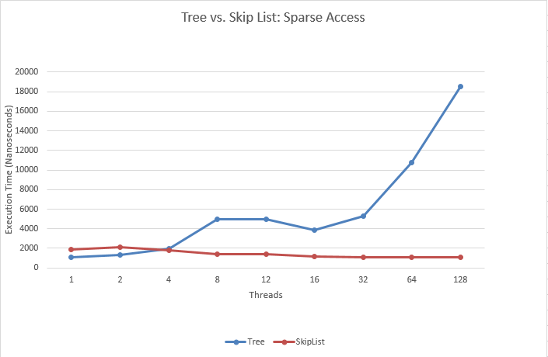
Skip Lists: Performance
Accessing little bit of data
Somewhat better scaling
Notes:
Obviously all the threads are being serialized by the Global lock of the TreeMap
The SkipListMap enjoys somewhat constant access times

Slide 41
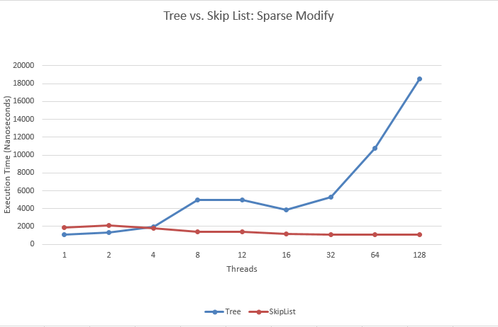
Skip Lists: Performance
Modifying little bit of data
Similar story
Notes:
Obviously all the threads are being serialized by the Global lock of the TreeMap
The SkipListMap enjoys somewhat constant access times

Slide 42
Skip Lists: Advantages
Skip Lists are better for highly concurrent environments
Better performance for bulk data access
Localized updates are better in this case
Scale significantly better than Red-Black trees as parallelism increases
Global locks are bad; don’t scale
Finer locking mechanisms are rather convoluted
Lock-free skip lists are possible!
Perform about as well as locking ones
Notes:
Not talking about disadvantages

Slide 43
Conclusions
Skip Lists are good when you have lots of threads trying to access (and modify) the same data at the same time
Trees don’t respond well to parallel access
Next time, when you want a lock-free concurrency-friendly data structure consider a Skip List!
All data and code used can be found here:
https://github.com/DroidX86/skip-stats
Including all the references, further reading and this presentation

Slide 44
Rounak Das
Thank You!
Jadavpur University; BCSE-IV, Roll: 001201051036

