Slide 1




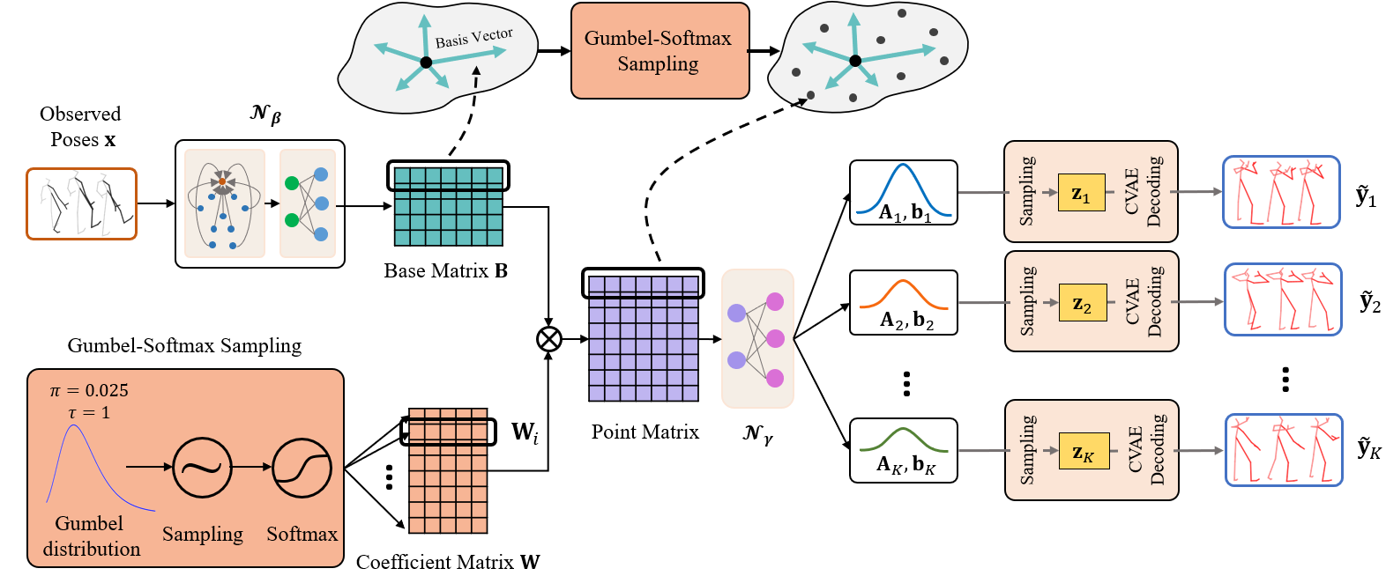
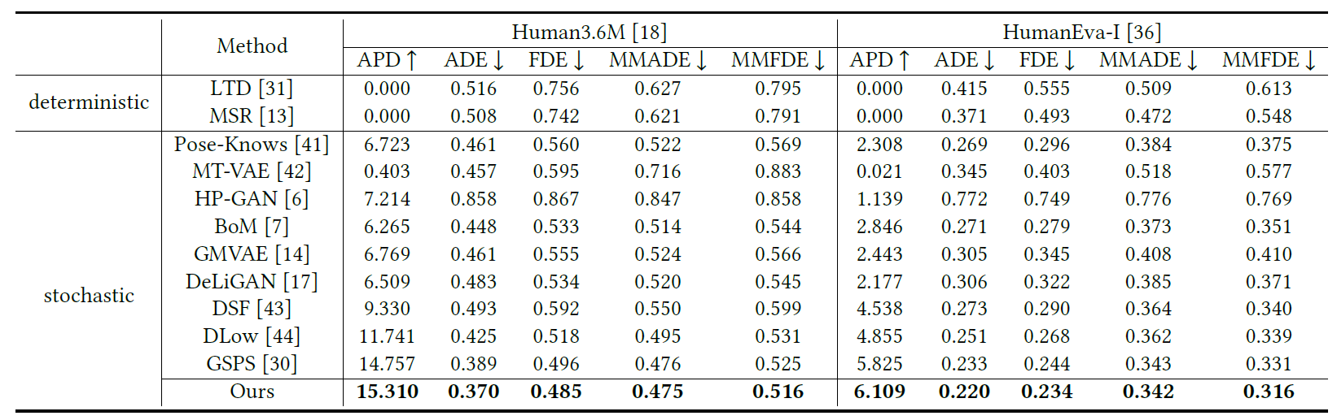
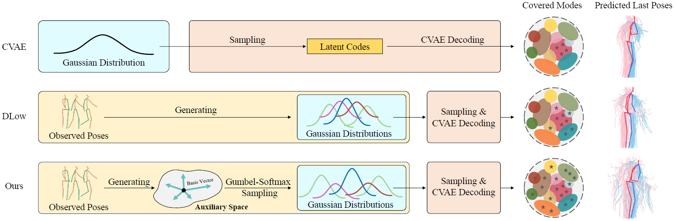
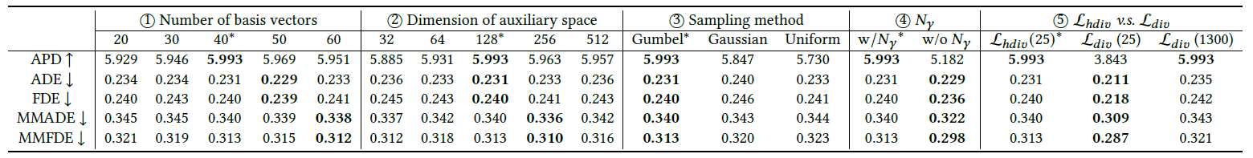
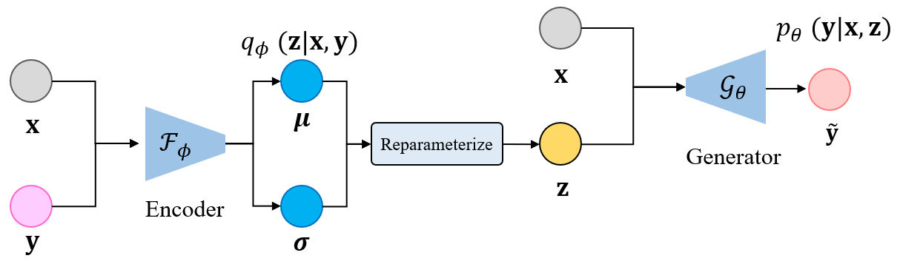
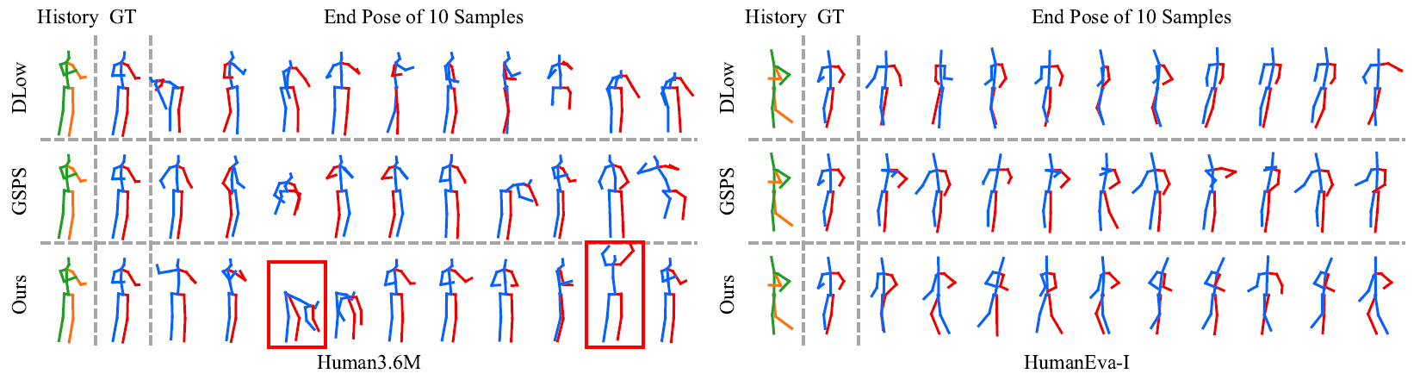
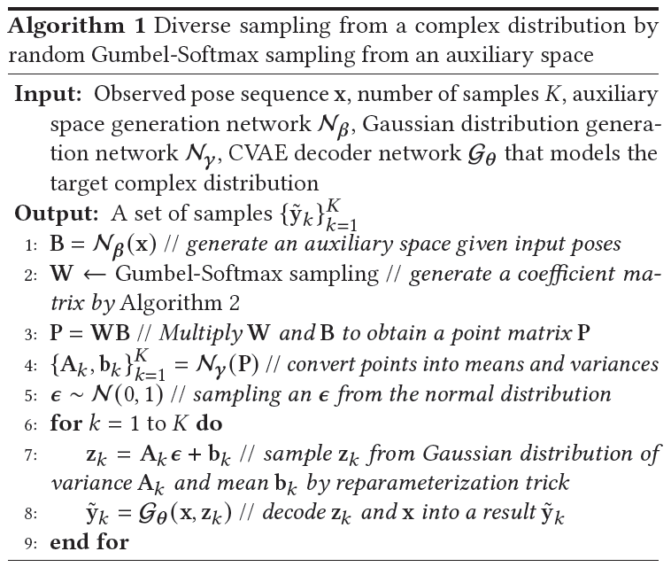
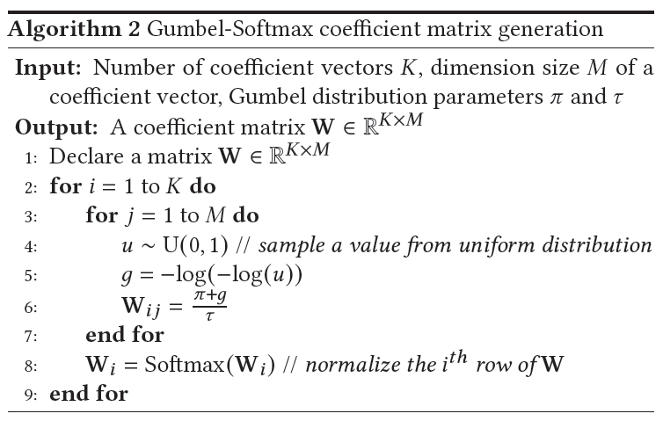
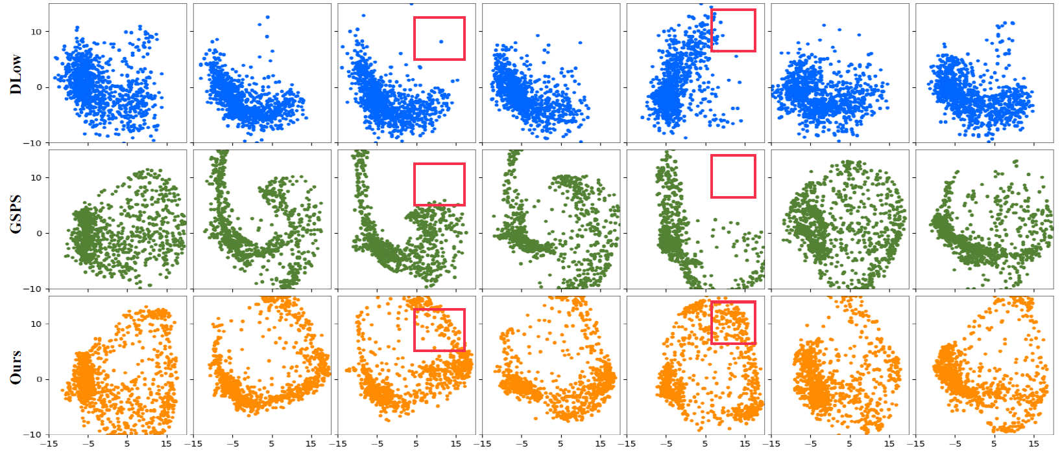

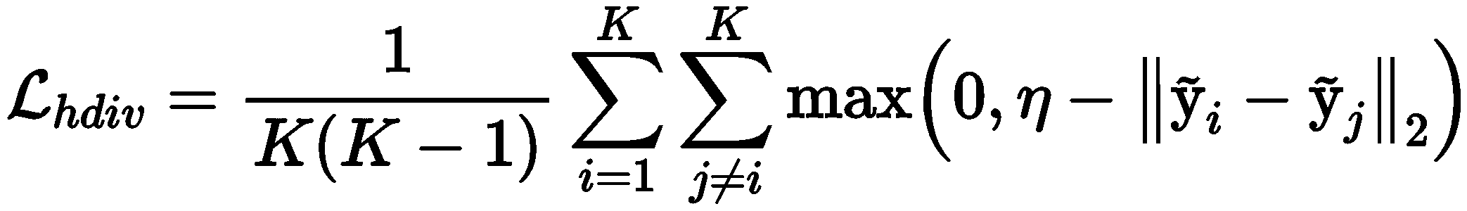
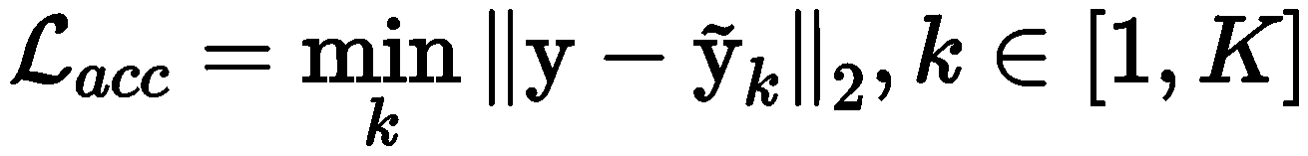

Diverse Human Motion Prediction via Gumbel-Softmax Sampling from an Auxiliary Space
MM22-fp0856
Lingwei Dang$^{1}$, Yongwei Nie$^{1∗}$, Chengjiang Long$^{2}$, Qing Zhang$^{3}$, Guiqing Li$^{1}$
$^{1}$South China University of Technology, $^{2}$Meta Reality Lab, $^{3}$Sun Yat-sen University
csdanglw@mail.scut.edu.cn, {nieyongwei, ligq}@scut.edu.cn, clong1@fb.com, zhangqing.whu.cs@gmail.com
Background & Motivation
Proposed Approach
Quantitative Results
Diverse human motion prediction aims at predicting multiple possible future sequences from the observed one.
Poses obtained by previous simple deep generative networks are not diverse enough.
Recent work attempted to model the conditional distribution of data but it can only cover a fixed number of modes.
We propose a novel sampling strategy for sampling very diverse results from an imbalanced multimodal distribution.
Approach Overview
Comparisons with baselines
Ablation study results
Architecture of the pretrained CVAE
Qualitative Results
Comparisons with baselines
Contributions
A novel sampling method converts the sampling of the distribution into randomly sampling of points from an auxiliary space for diverse and accurate sampling.
A Gumbel-Softmax sampling method and a hinge-diversity loss both improve the performance of our method.
Extensive experimental results demonstrate the effectiveness of our approach.
Pseudocode for the overall approach and the Gumbel-Softmax sampling strategy
Holistic views of results after the dimension reduction by PCA
Datasets & Metric & Project
Datasets: Human3.6M, HumanEva-I Dataset
Metrics: APD, ADE, FDE, MMADE, MMFDE
Link: https://github.com/Droliven/diverse_sampling
Loss functions
[MSRGCN] Dang L, Nie Y, Long C, et al. MSR-GCN: Multi-Scale Residual Graph Convolution Networks for Human Motion Prediction. ICCV, 2021.
[DLow] Yuan Y, Kitani K. Dlow: Diversifying latent flows for diverse human motion prediction. ECCV, 2020.
[GSPS] Mao W, Liu M, Salzmann M. Generating smooth pose sequences for diverse human motion prediction. ICCV, 2021.
This work is sponsored by Prof. Yongwei Nie's and Prof. Guiqing Li's Natural Science Foundation of China projects (62072191, 61972160), and their Natural Science Foundation of Guangdong Province projects (2019A1515010860, 2021A1515012301).
Key References
Acknowledgement

