Slide 1




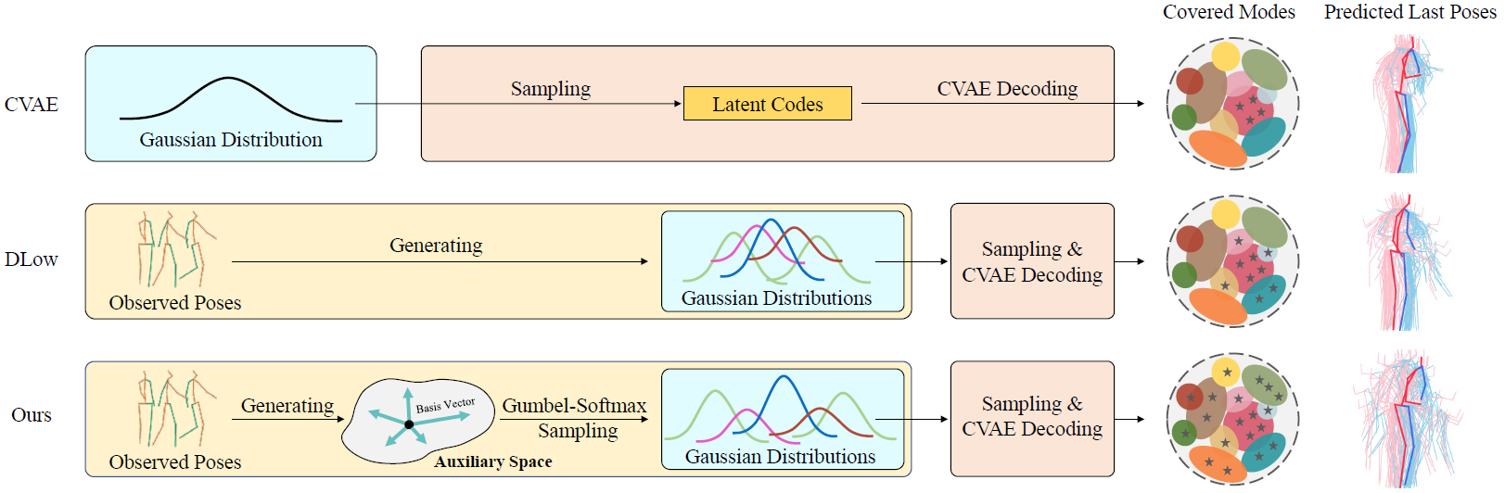
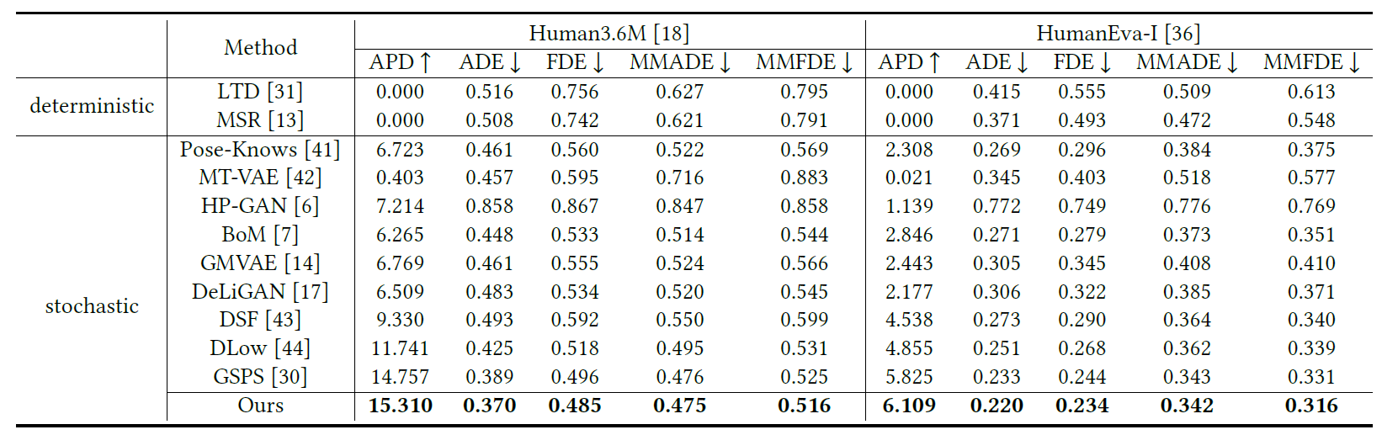
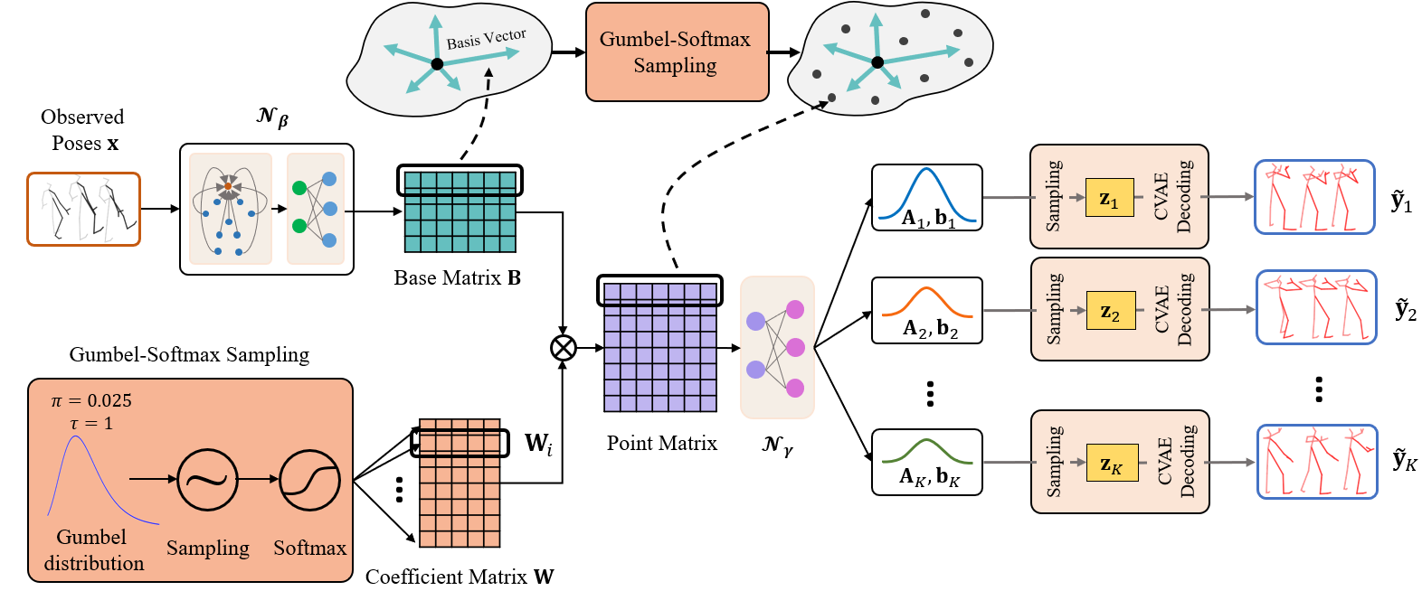
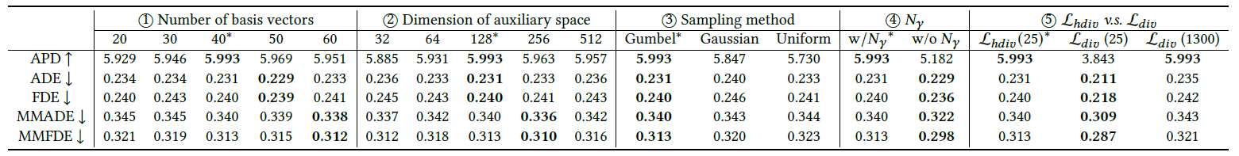
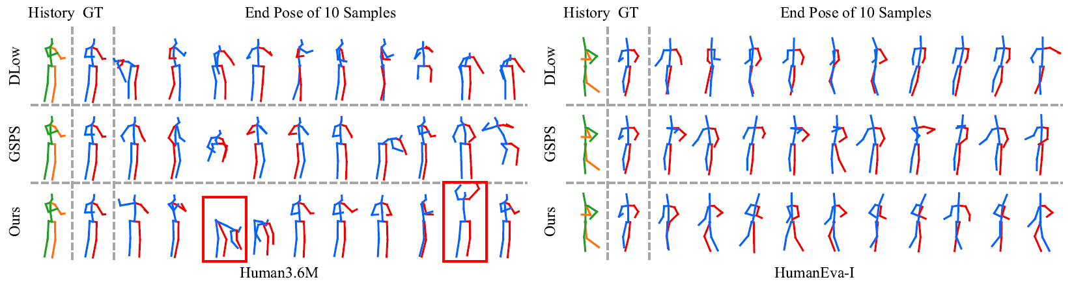
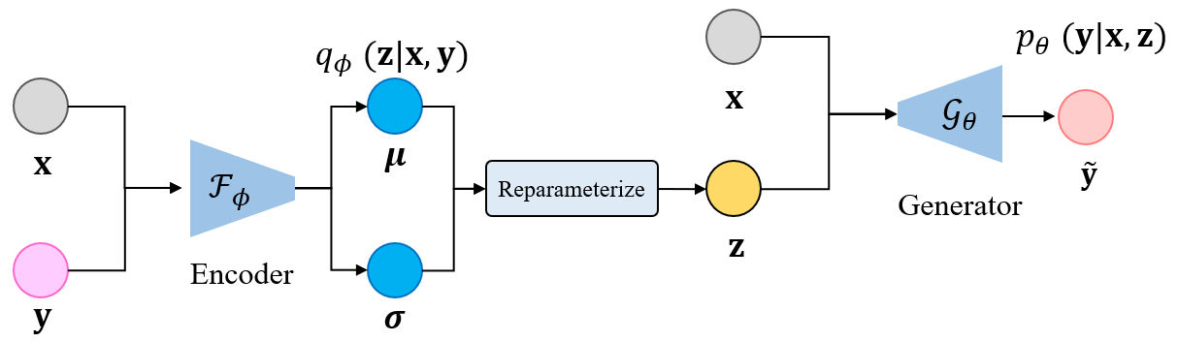
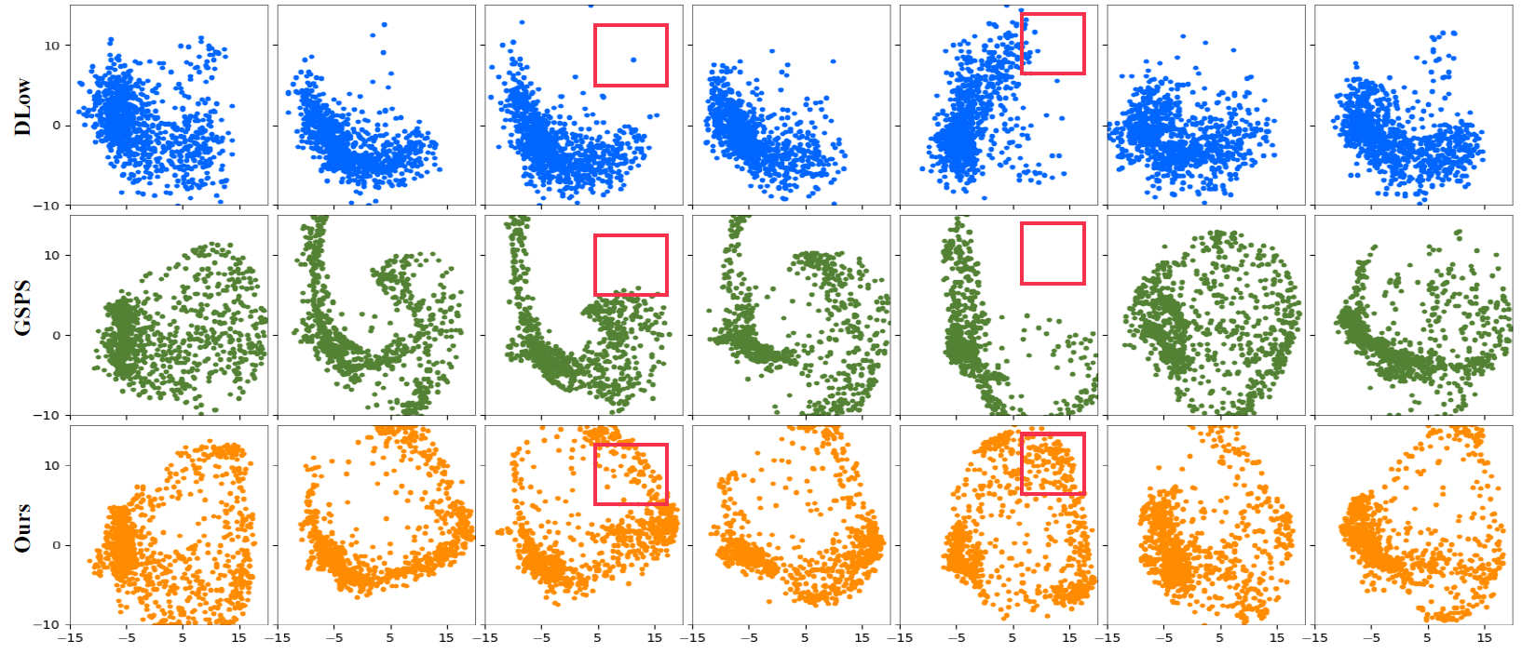
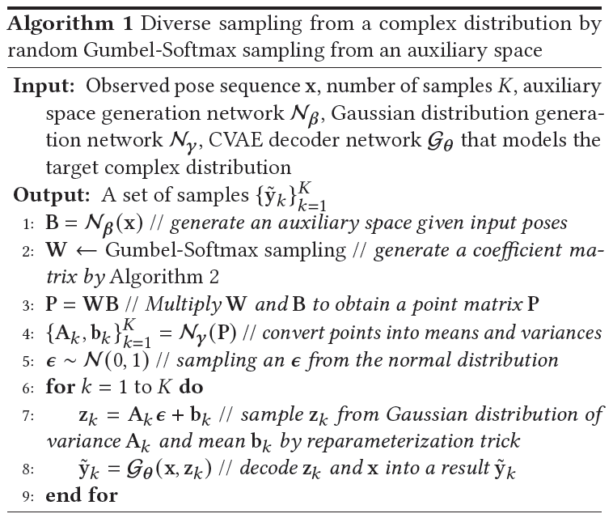
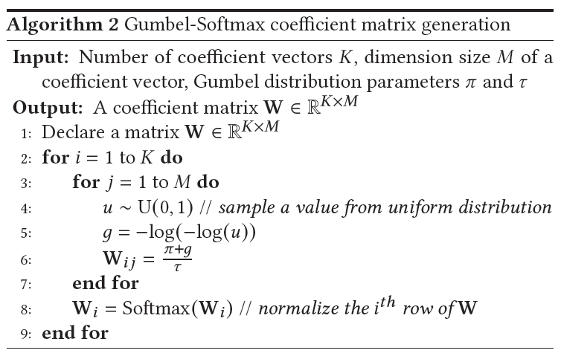

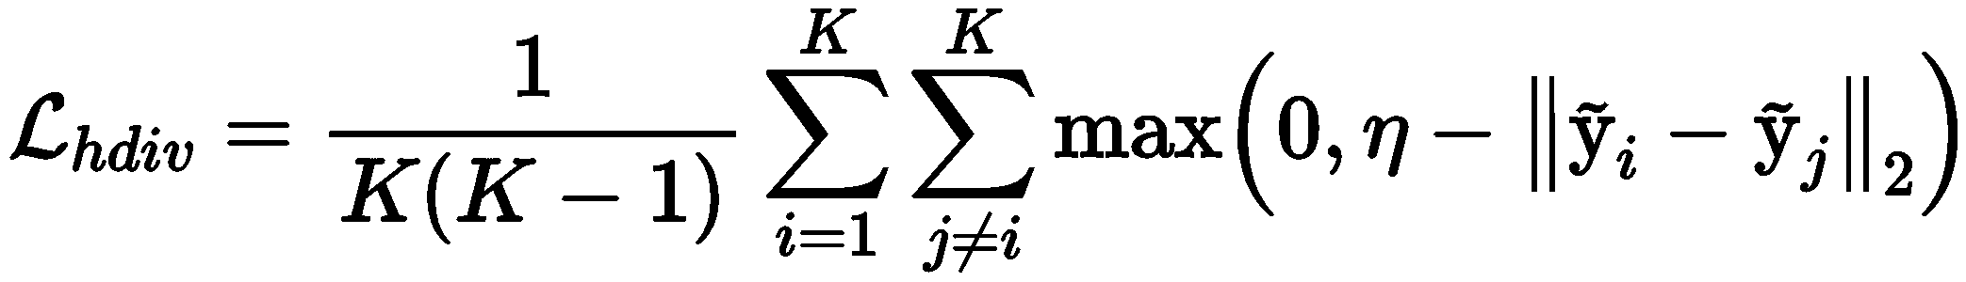
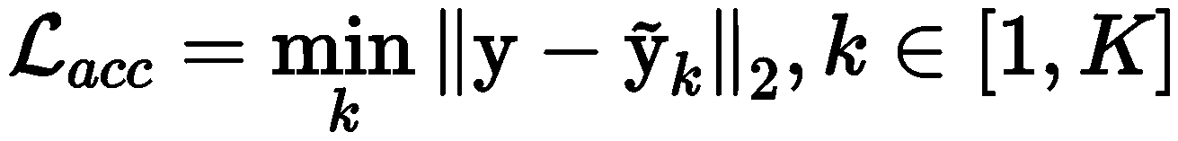

MM22-fp0856
Diverse Human Motion Prediction via Gumbel-Softmax Sampling from an Auxiliary Space
Lingwei Dang$^{1}$, Yongwei Nie$^{1∗}$, Chengjiang Long$^{2}$, Qing Zhang$^{3}$, Guiqing Li$^{1}$
$^{1}$South China University of Technology, $^{2}$Meta Reality Lab, $^{3}$Sun Yat-sen University
$^{∗}$Corresponding author: nieyongwei@scut.edu.cn
+
Contributions
Background & Motivation
Diverse human motion prediction aims at predicting multiple possible future sequences from the observed one.
Poses obtained by previous deep generative networks are not diverse enough.
Recent work attempted to model the conditional distribution of data but it can only cover a fixed number of modes.
We propose a novel sampling strategy for sampling very diverse results from an imbalanced multimodal distribution.
A novel sampling method converts the sampling of the distribution into randomly sampling of points from an auxiliary space for diverse and accurate sampling.
A Gumbel-Softmax sampling method and a hinge-diversity loss both improve the performance of our method.
Extensive experimental results demonstrate the effectiveness of our approach.
Quantitative Results
Comparisons with baselines
Proposed Approach
Approach Overview
Ablation study results
Qualitative Results
Comparisons with baselines
Architecture of the pretrained CVAE
Holistic views of results after the dimension reduction by PCA
Pseudocode for the overall approach and the Gumbel-Softmax sampling strategy
Datasets & Metric & Project
Loss functions
Datasets: Human3.6M, HumanEva-I Dataset
Metrics: APD, ADE, FDE, MMADE, MMFDE
Link: https://github.com/Droliven/diverse_sampling
[MSRGCN] Dang L, Nie Y, Long C, et al. MSR-GCN: Multi-Scale Residual Graph Convolution Networks for Human Motion Prediction. ICCV, 2021.
[DLow] Yuan Y, Kitani K. Dlow: Diversifying latent flows for diverse1 human motion prediction. ECCV, 2020.
[GSPS] Mao W, Liu M, Salzmann M. Generating smooth pose sequences for diverse human motion prediction. ICCV, 2021.
 Key References
This work is sponsored by Prof. Yongwei Nie's and Prof. Guiqing Li's Natural Science Foundation of China projects (62072191, 61972160), and their Natural Science Foundation of Guangdong Province projects (2019A1515010860, 2021A1515012301).
Acknowledgement 

