Slide 1
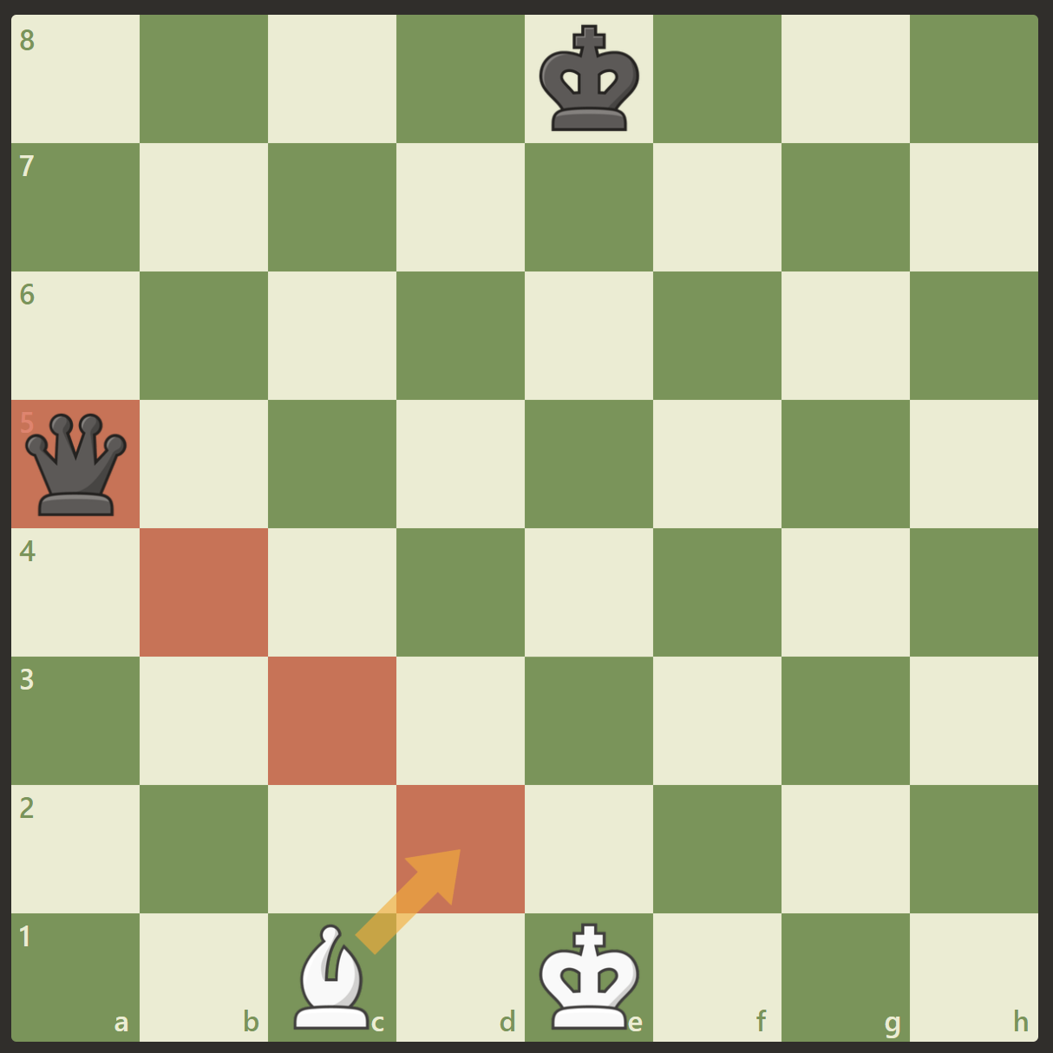
Direct checks: have to move the piece between or captures the enemy piece.
Solution:
Expansion starting at the king looking at enemy attacks

Slide 2
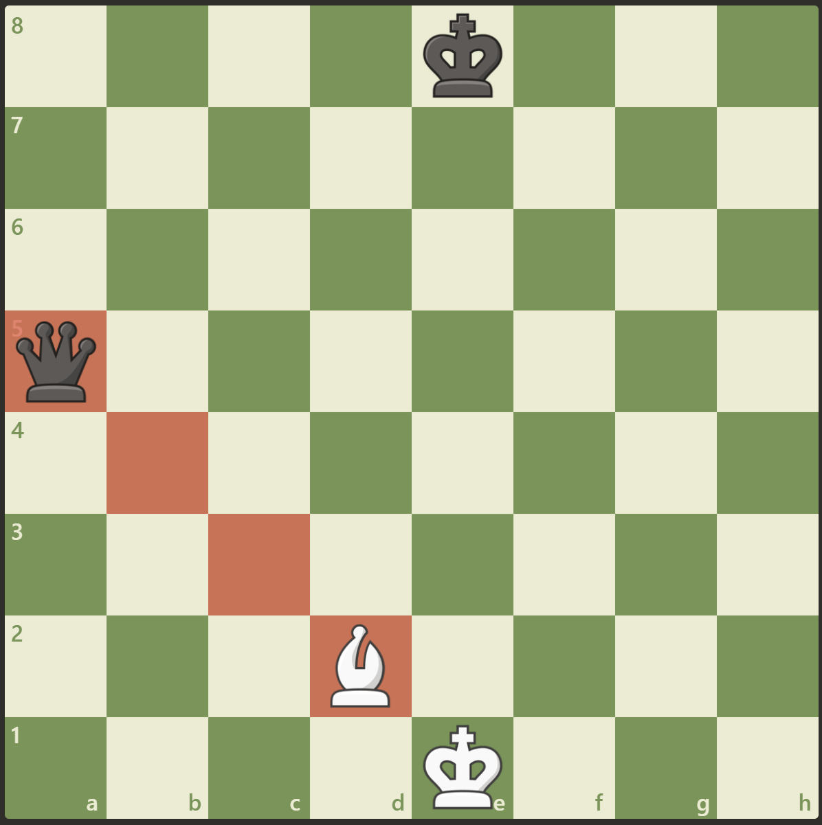
Pins: pinned piece has to stay within the pin column
Solution:
Expansion from the king looking at enemy attacks through, x-ray through only 1 friendly piece, don’t look for knight or pawn checks obviously

Slide 3
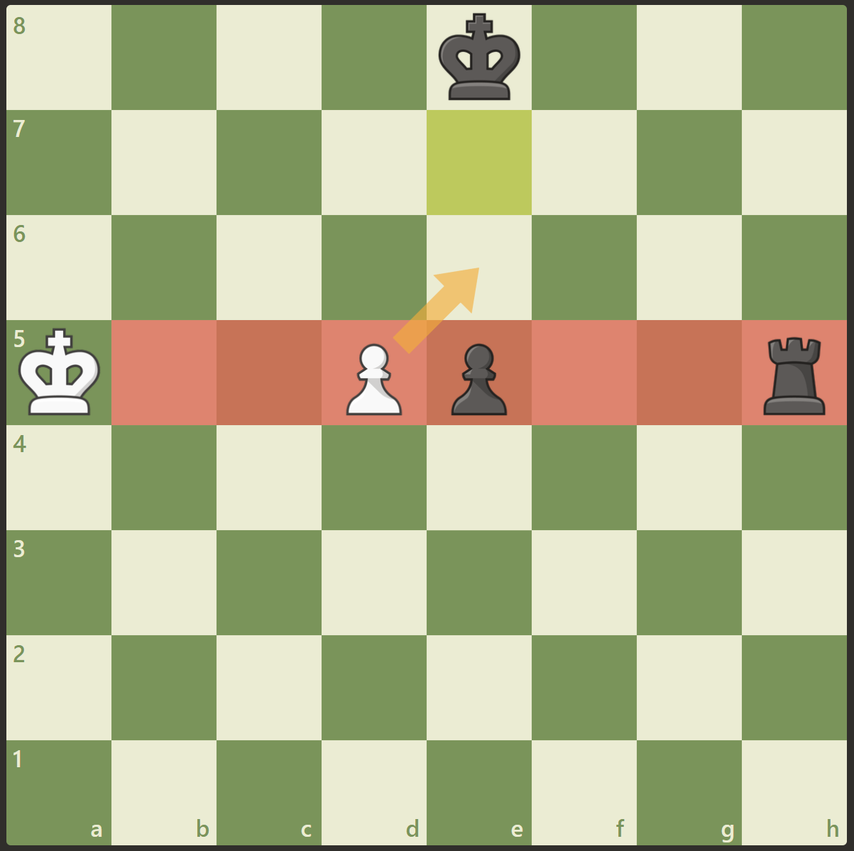
En-passant pin: pawn can’t take with en-passant because it would reveal an attack on the king
Solution:
Given the king is on the right rank, expansion sideways which can x-ray through only 1 friendly pawn and 1 enemy pawn

Slide 4
For king moves and castles, just check like before, I don’t think it’s worth it to do a whole map for this
Slight optimisation: when the king moves left or right, keep the result of the ‘in check’ function to use for castling

Slide 5
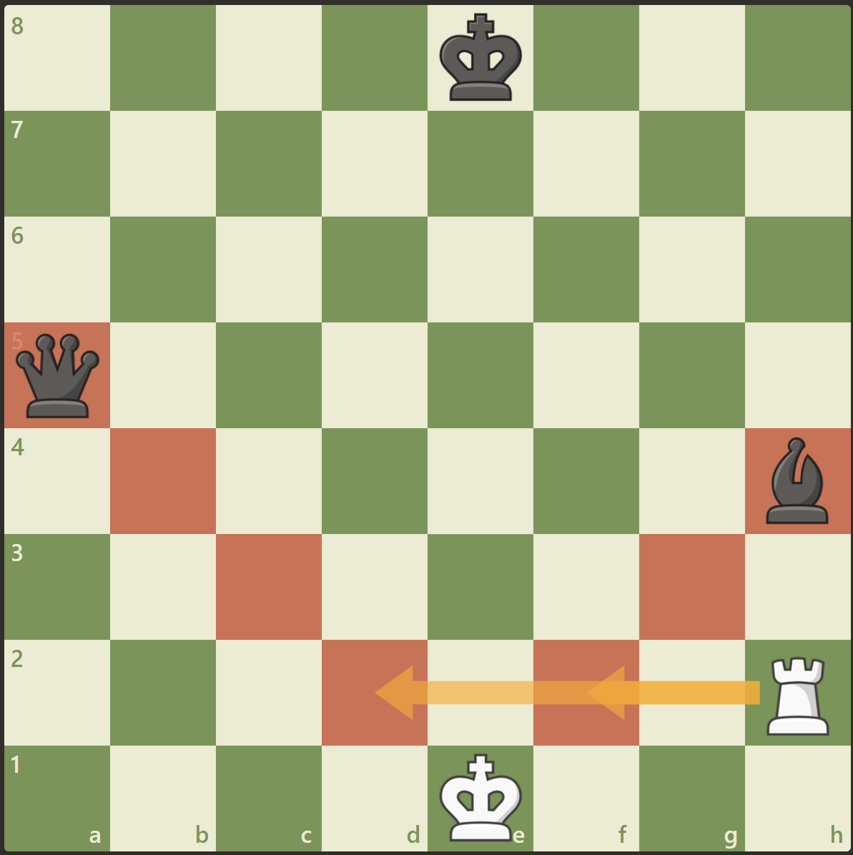
Double checks: nothing can move except the king
Solution:
Have a flag for double checks, if so no one else can move except the king

