Slide 1


Introduction to Open AI
<Cloud Computing Day - 8 />

Slide 2
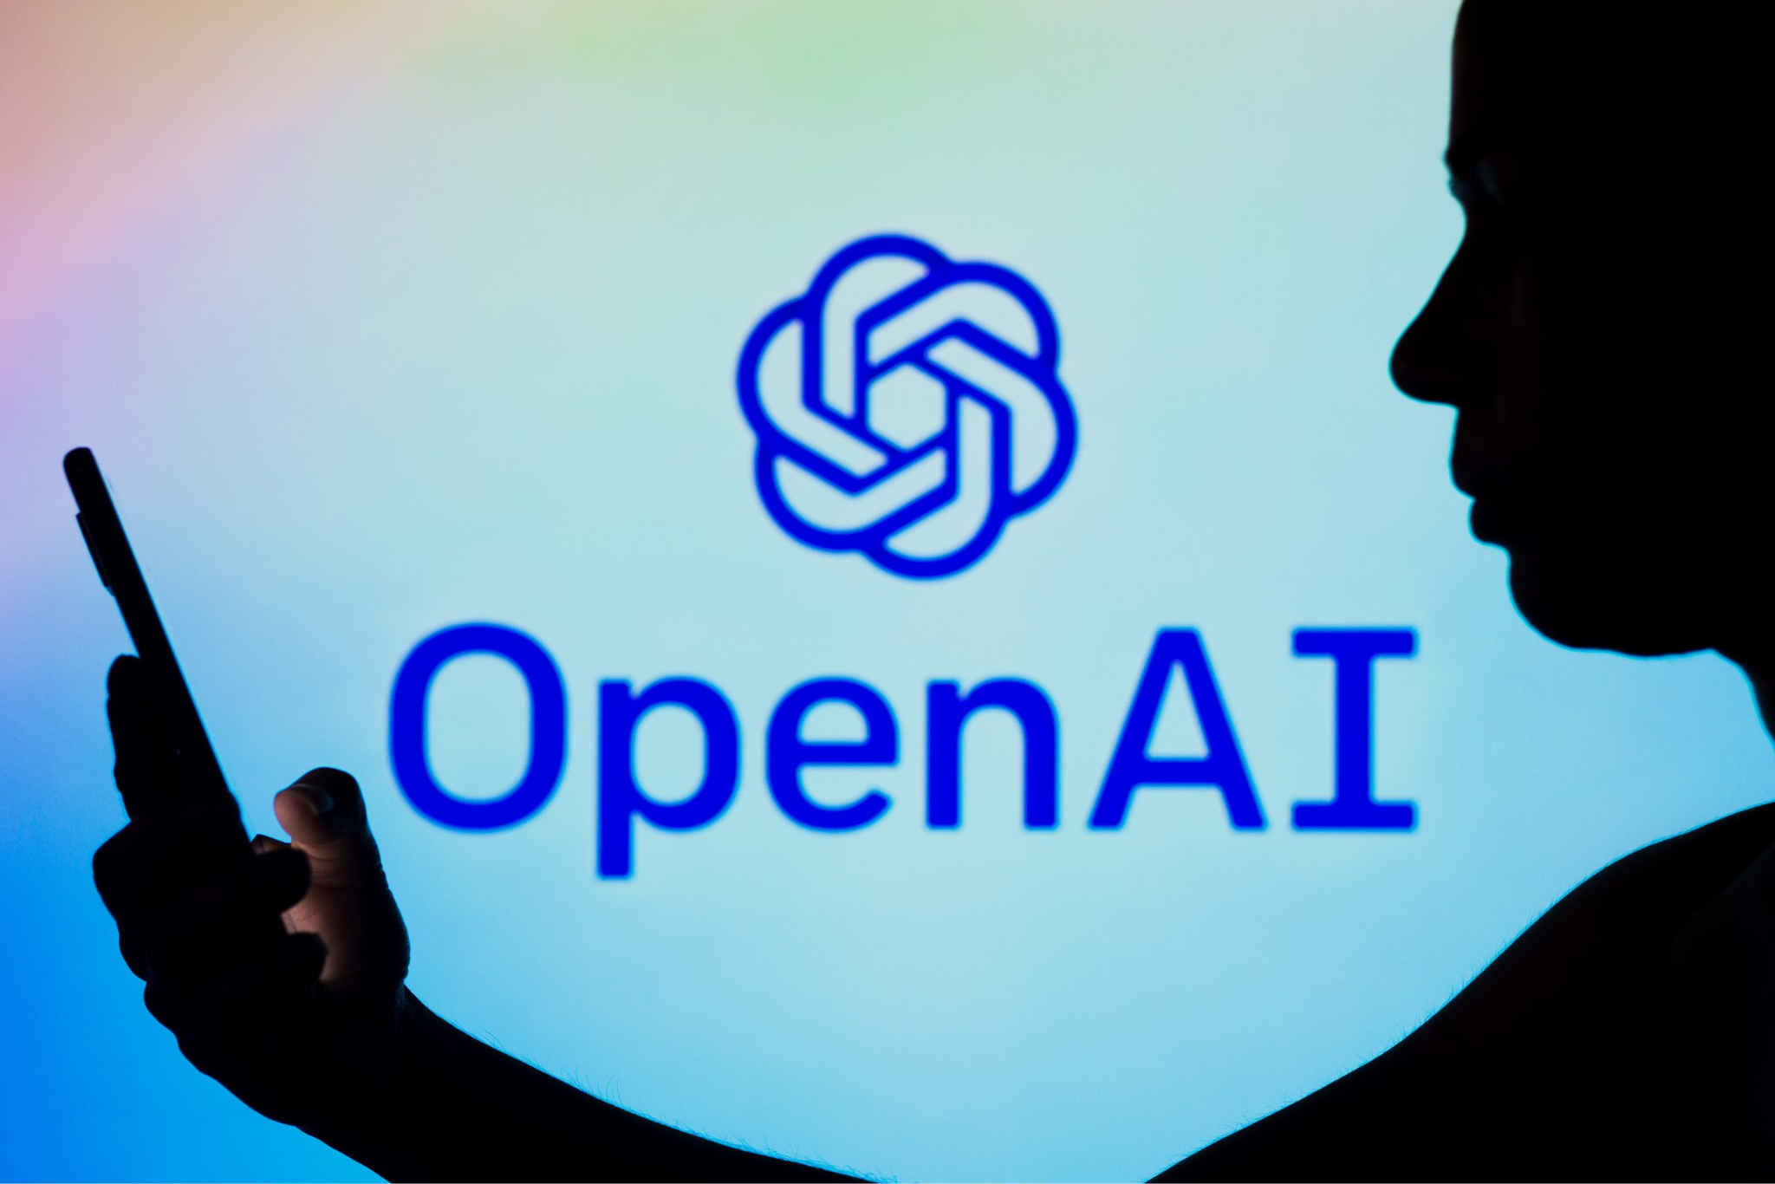
INTRODUCTION
OpenAI is an artificial intelligence research organization renowned for its advancements in natural language processing and machine learning. Founded in 2015, OpenAI has developed cutting-edge AI models like GPT-3 and focuses on promoting AI technology for the benefit of humanity while addressing ethical and safety concerns.

Slide 3
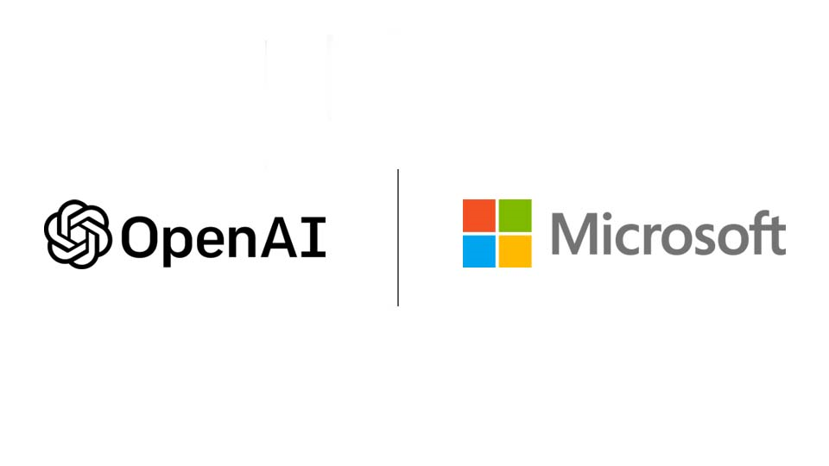

Slide 4
Microsoft's $13 billion bet on OpenAI carries huge potential along with plenty of uncertainty. Microsoft invested an additional $2 billion in OpenAI between 2019 and early 2023.

Slide 5
01
Open AI Playground

Slide 6
Open AI Playground
The OpenAI Playground is an interactive web interface for experimenting with AI models.
It provides access to powerful AI models like GPT-3.5 .
Users can experiment with natural language processing, content generation, and more.

Slide 7
Use Cases

Slide 8
Use Cases
Chatbots
Content Generation
Sentimental Analysis
Can power chatbots and virtual assistants that engage users in natural, human-like convo.
Generating high-quality content for multi purposes
Users can leverage the platform to analyze the sentiment of text data.

Slide 9

Let’s dive into hands on play with OpenAI Playground.

Slide 10
THANK YOU for joining!

