Slide 1


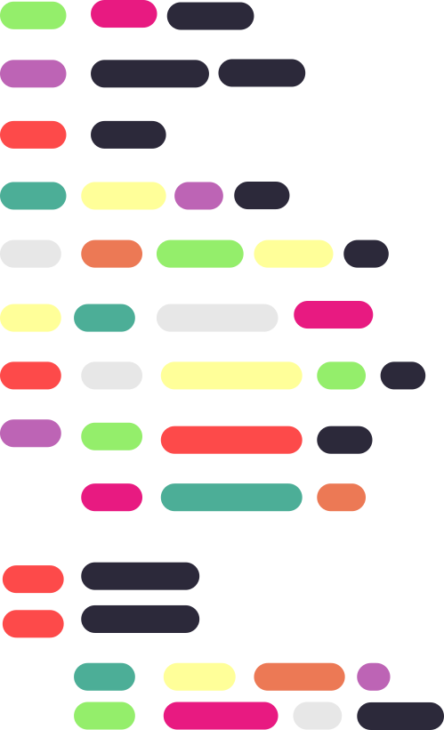
{
Welcome to
Arrays
}

Slide 2
{
Agenda
1)Basic Syntax of Arrays
2)Numerical Memory
allocation
}

Slide 3
{
Basic Syntax:
In Java, an array is a data structure that allows you to store multiple values of the same data type in a single variable. Here's the basic syntax for declaring and using arrays in Java:
int[] numbers = {1, 2, 3, 4, 5};
int[][] matrix = {{1, 2, 3}, {4, 5, 6}, {7, 8, 9}};
}

Slide 4
{
Numerical Memory Allocation:
Numerical memory allocation in Java refers to reserving memory space for numeric data, such as integers or floating-point values, within variables or arrays based on their data types and sizes.
int[][] matrix = new int[3][3];
}

Slide 5
{
Welcome to
Merging Arrays in Java
}

Slide 6
{
Agenda
Union In Arrays
Intersection In Arrays
}

Slide 7
{
Union:
The union of two arrays is a new array that contains all the distinct elements from both input arrays, without any duplicates.
To compute the union of two arrays, you iterate through both arrays and add each unique element to the result array. To ensure uniqueness, you may need to check if an element already exists in the result array before adding it.
}

Slide 8
{
Intersection In Arrays:
The intersection of two arrays is a new array that contains all the elements that are common to both input arrays.
To compute the intersection of two arrays, you iterate through one array and check if each element exists in the other array. If it does, you add it to the result array.
}

Slide 9
{
Welcome to
Sorting Arrays
}

Slide 10
{
Agenda
Bubble Sort
Linear Search
}

Slide 11
{
Bubble Sort:
Bubble Sort is a simple sorting algorithm that repeatedly steps through the list, compares adjacent elements, and swaps them if they are in the wrong order. The pass through the list is repeated until the list is sorted.
}

Slide 12
{
Linear Search:
Linear Search is a simple search algorithm that sequentially checks each element in a list or array until the desired element is found or the list is exhausted.
}

Slide 13
{
Welcome to
Vectors
}

Slide 14
{
Agenda
Vectors
Advantages over arrays
}

Slide 15
{
Vectors:
Vectors in Java, part of the java.util package, are dynamic and resizable collections. They can grow or shrink in size as needed, making them more flexible than arrays.
}

Slide 16
{
Advantages over arrays:
Dynamic Sizing: Vectors are dynamically resizable, meaning they can grow or shrink in size as needed. You don't need to specify their size at the time of creation, unlike arrays, which have a fixed size. This flexibility simplifies handling collections of data, especially when you don't know the exact size in advance.
Automatic Resizing: When a vector reaches its capacity, it automatically doubles its size, ensuring that you can continue to add elements without worrying about exceeding its capacity. This resizing process is handled internally, saving you the trouble of managing it manually.
Insertion and Deletion: Vectors provide methods for inserting and removing elements at specific positions in the collection. Arrays do not offer such functionality natively, and you would need to write custom code to achieve similar operations.
}

Slide 17



Thanks!
< Do you have any questions? >
mail: vitacmsc@gmail.com
website: https://vitchennai.acm.org/
vitchennai.acm.org
acm_vitcc
ACM VITC

