Slide 1



{
Welcome to
Inheritance
}

Slide 2
{
Agenda
What is Inheritance?
Why we use inheritance?
}

Slide 3
{
Inheritance:
Inheritance is a fundamental concept in object-oriented programming that allows a new class to inherit properties and behaviors (fields and methods) from an existing class.
}

Slide 4
{
Why inheritance?
Superclass and Subclass: Inheritance involves two classes: the superclass (base class) and the subclass (derived class). The superclass is the existing class that provides the properties and behaviors to be inherited, while the subclass is the new class that inherits from the superclass.
Code Reuse: Inheritance allows you to reuse code from the superclass in the subclass. The subclass inherits all the non-private fields and methods of the superclass, making it easier to build on existing functionality.
}

Slide 5
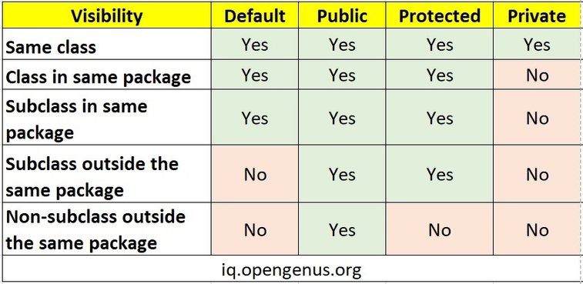
{
Access modifiers:
}

Slide 6



Thanks!
< Do you have any questions? >
mail: vitacmsc@gmail.com
website: https://vitchennai.acm.org/
vitchennai.acm.org
acm_vitcc
ACM VITC

