Slide 1


GRAPHS & TREES
{
<Competitive Programming Day-3>
...
}

Slide 2
Contents
Tree Traversals
DFS n BFS
Example problem

Slide 3
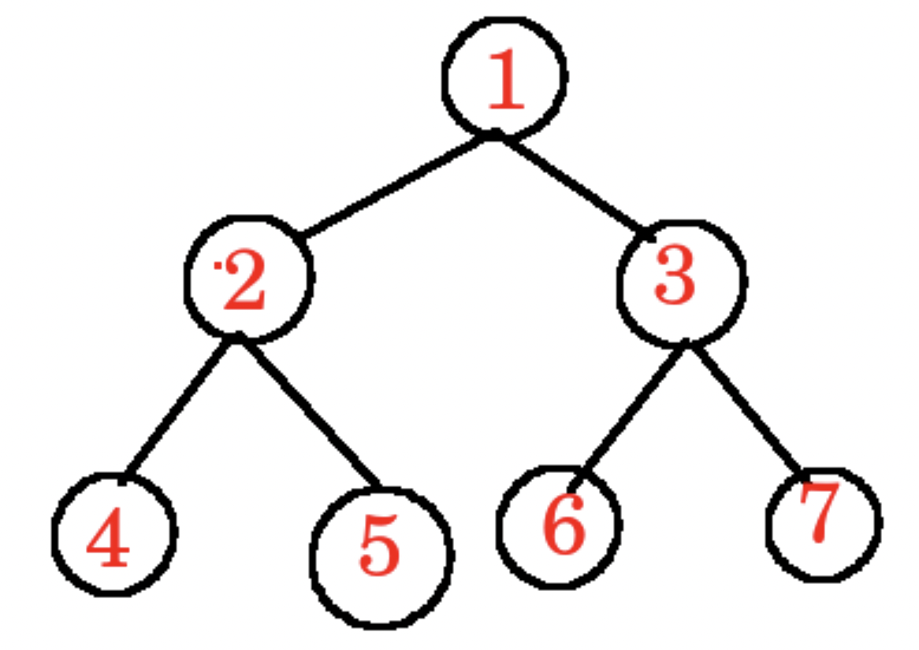
Tree Traversals
Pre order Traversal
(Root Left Right)
1,2,4,5,3,6,7
Post order Traversal
(Left Right Root)
4,5,2,6,7,3,1
In Order Traversal
(Left Root Right)
4,2,5,1,6,3,7

Slide 4
BFS & DFS
BFS explores nodes level by level, starting from the source node and moving outward. It ensures that all nodes at the current level are visited before moving on to the next level. This property makes it useful for tasks like finding the shortest path in an unweighted graph, as it guarantees that the shortest path to any node is discovered before longer paths.
BFS is implemented using a queue data structure to maintain the order of nodes to be processed. It guarantees that nodes are processed in the order they are discovered resulting in a breadth-first exploration of the graph.
DFS explores the graph by going as deep as possible along one branch before exploring other branches, making it useful for certain tasks where depth-first exploration is desired.
DFS really helps in cycle detection, back tracking algorithms, topological sorting etc.
}
..

Slide 5
Problem: To return the DFS of a given graph
*
An adjacency list is built to hold vertex’s connections, and a class for expressing an undirected graph is defined in the Java code. It is initialised with the number of vertices. It offers techniques for appending edges between vertices, such as a depth-first search (DFS) algorithm that traverses the graph recursively. A technique that ensures that DFS starts from all unvisited vertices and initialises a boolean array to monitor visited vertices encapsulates the DFS algorithm. The code is demonstrated in the main method, which builds a graph with seven vertices, adds edges to indicate connections, and then does a DFS traversal beginning at vertex 0 and outputs the order in which the vertices are visited.

Slide 6
Thank you for watching!
{
..
}
..

