Slide 1
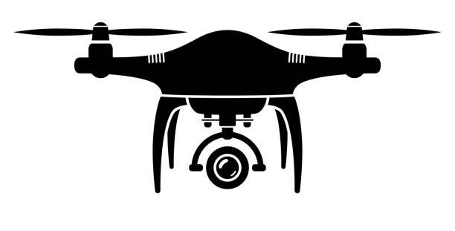
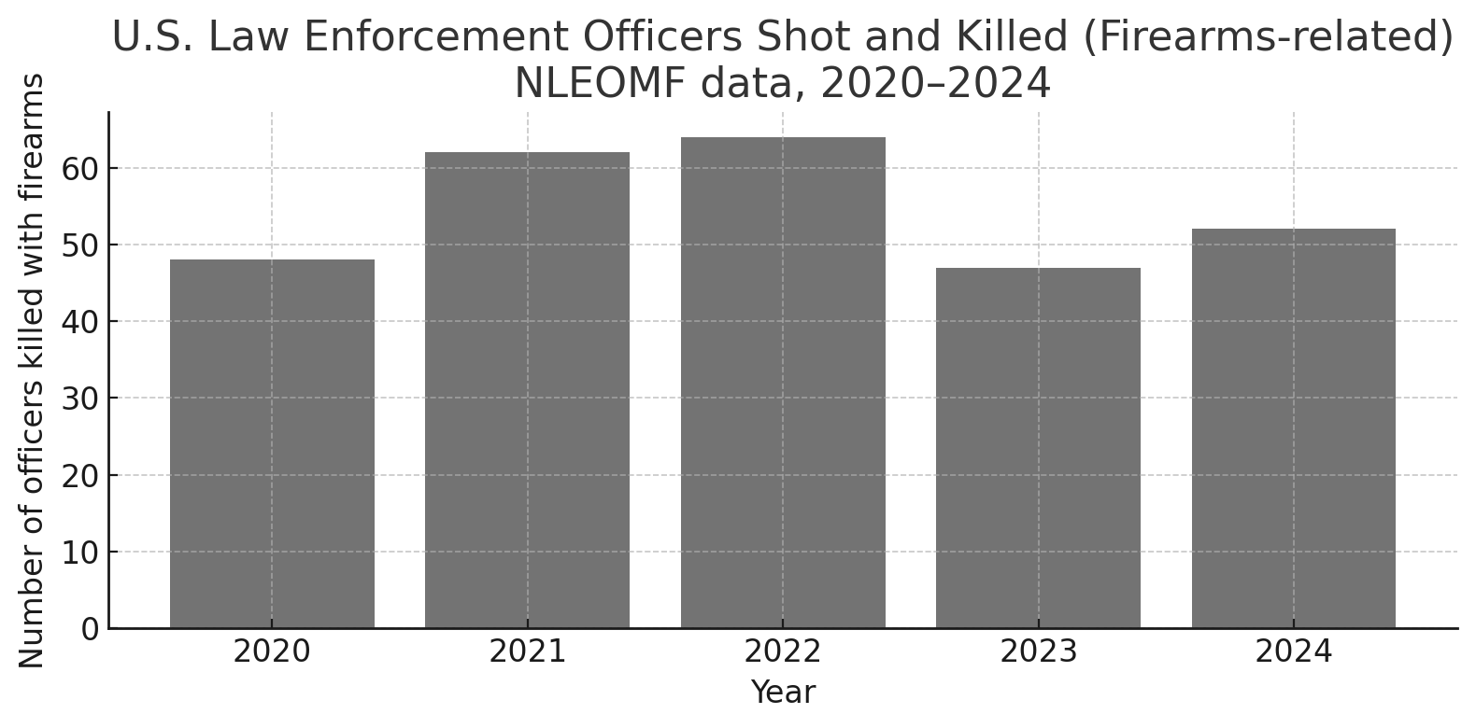

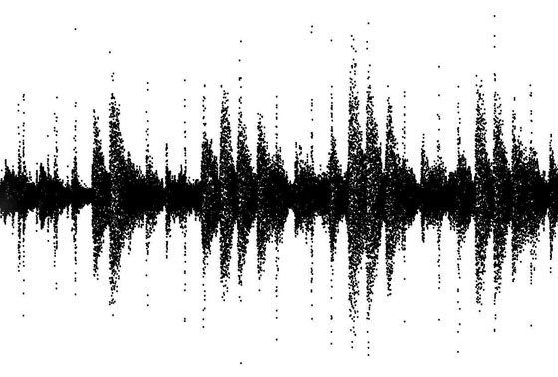
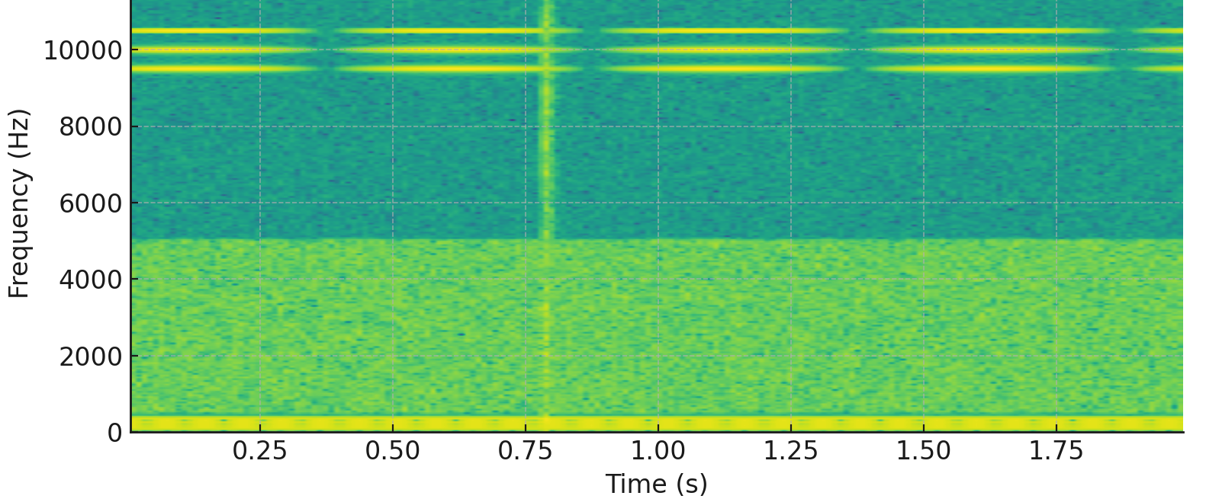

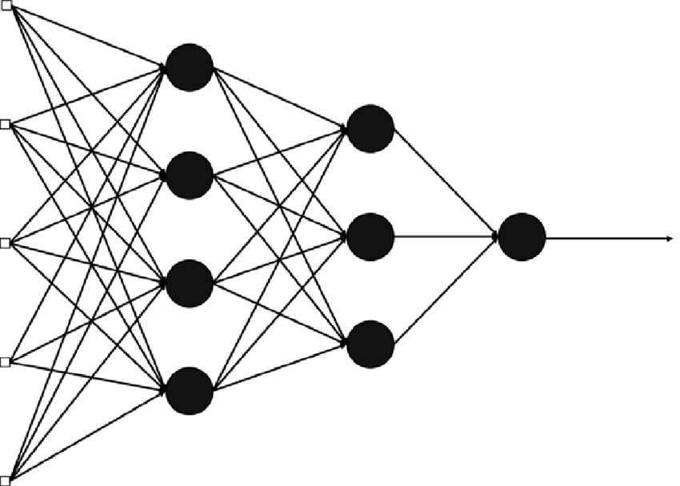
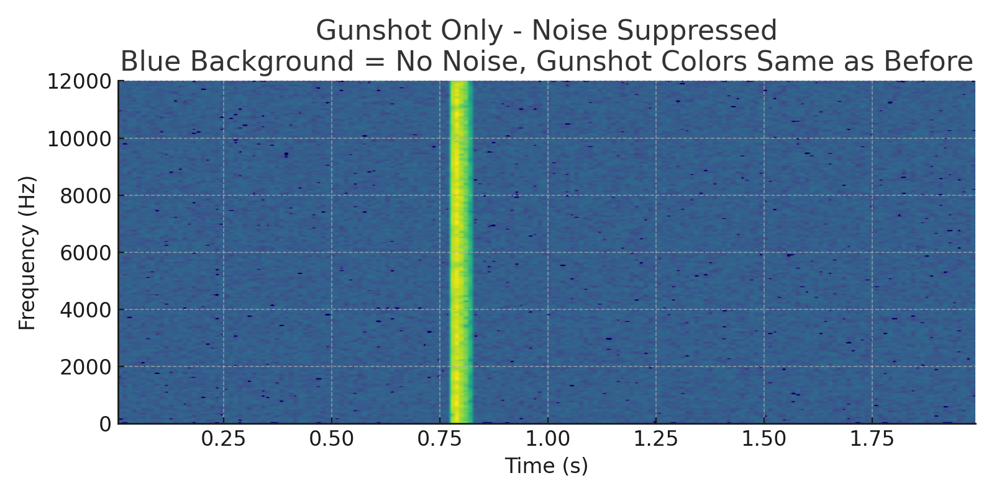
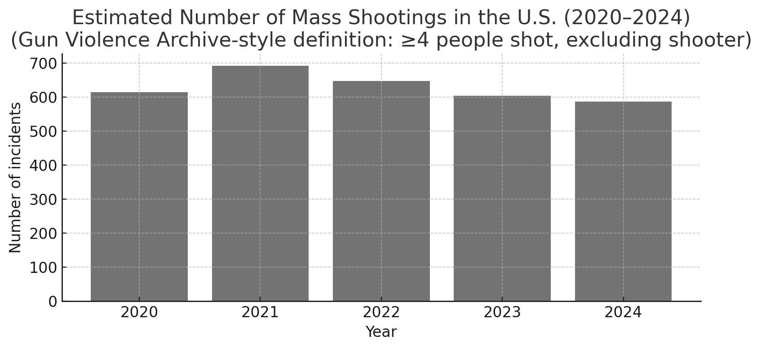

What?
Why?
How?
Gunshot audio
STFT
Denoised
Again, feed in CNN
Identify Sound Location (DOA)
Notes:
Good afternoon, everyone!
So, UAV that stands for unmanned aerial vehicle. Many autonomous vehicle comes under it.
But our project focusing one drone.
I think we all know about drone but most of us know it from war perspective right. We will see news ukrain war drone attack,
Israel drone attach etc etc. but I think we do not hear how drone will help us in emergency response and large-scale surveillance in real time example is California wildfires – thermal imaging drones.

