Slide 1
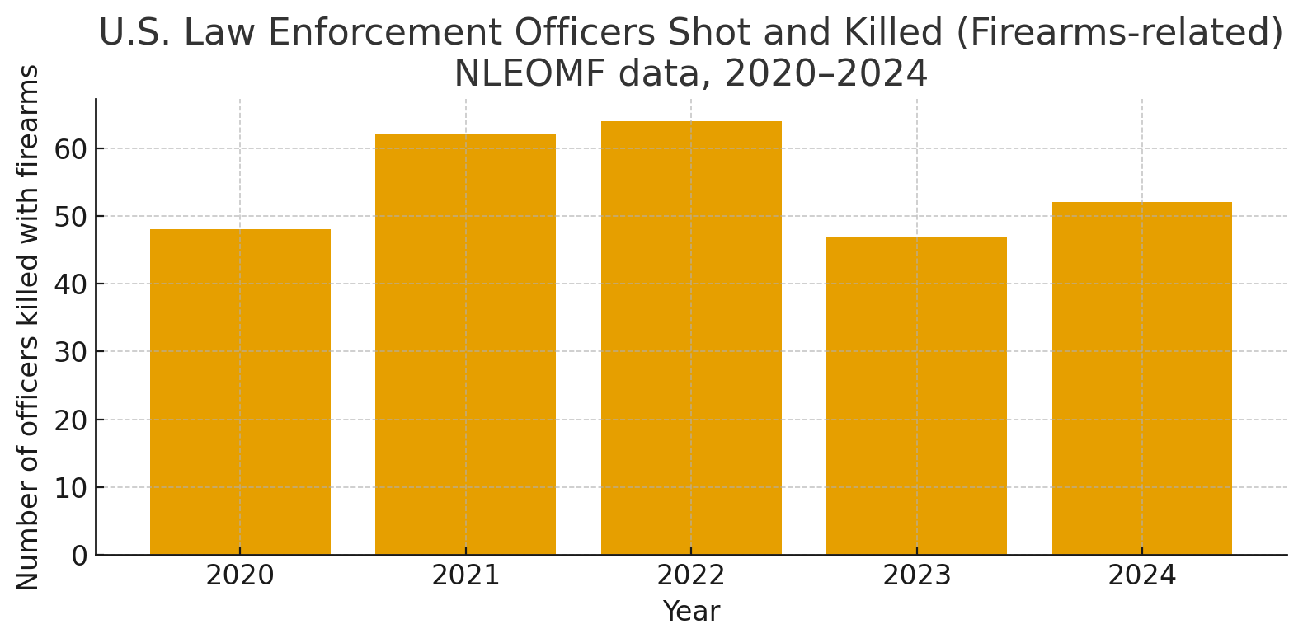
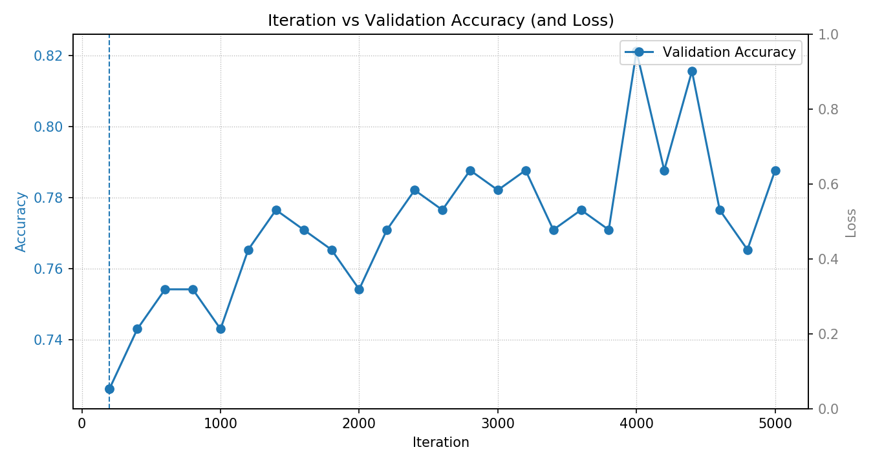
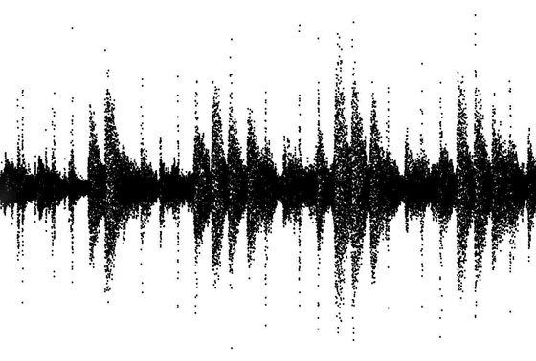
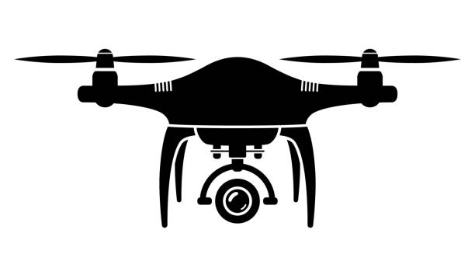

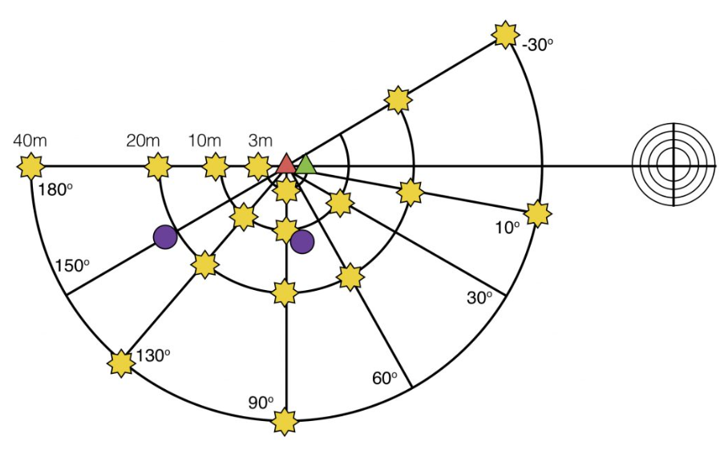
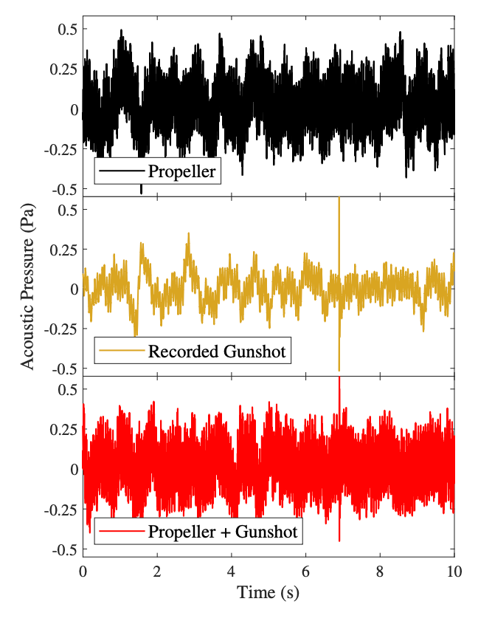
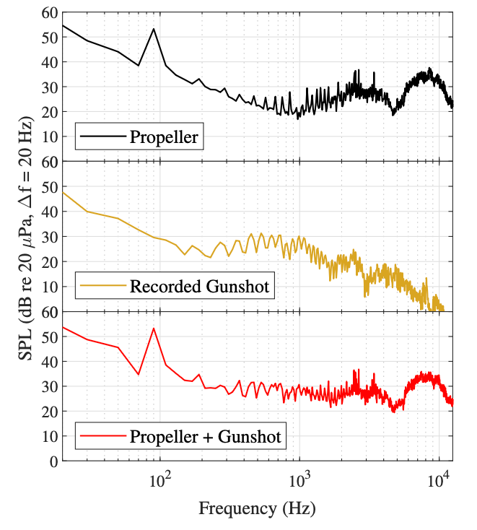
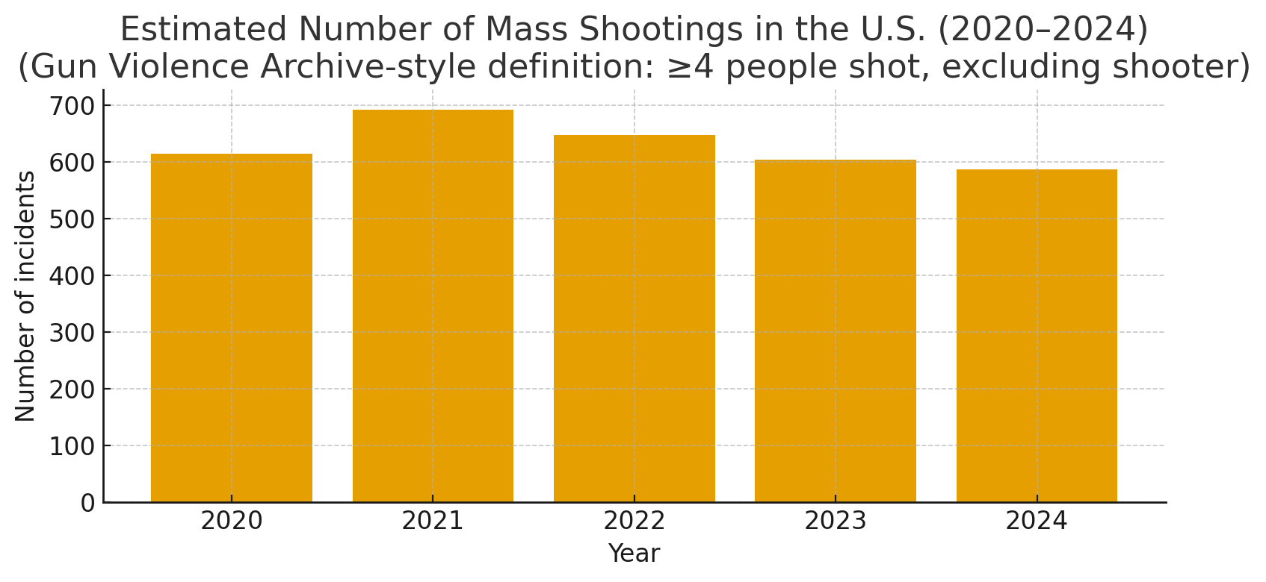
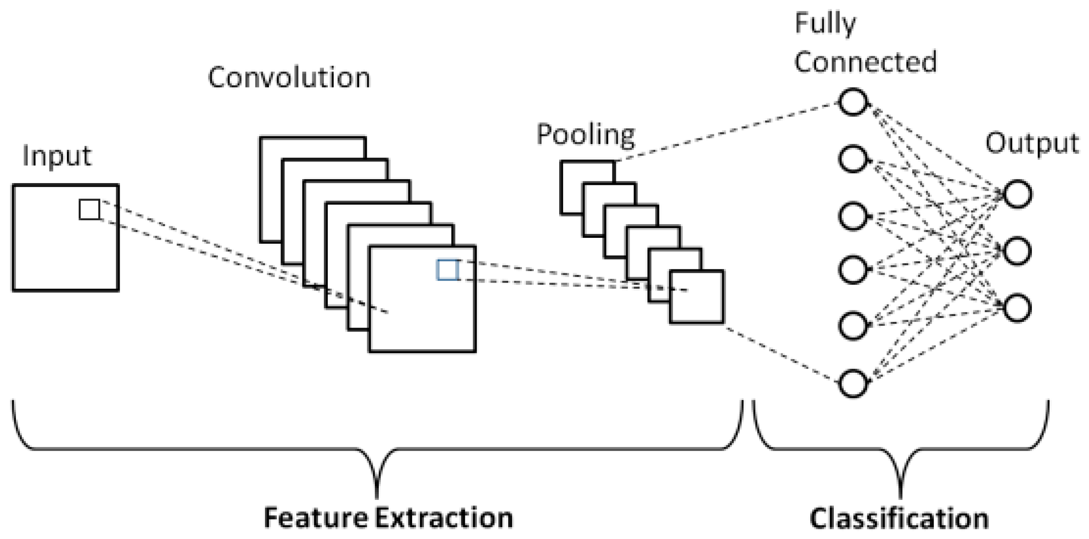
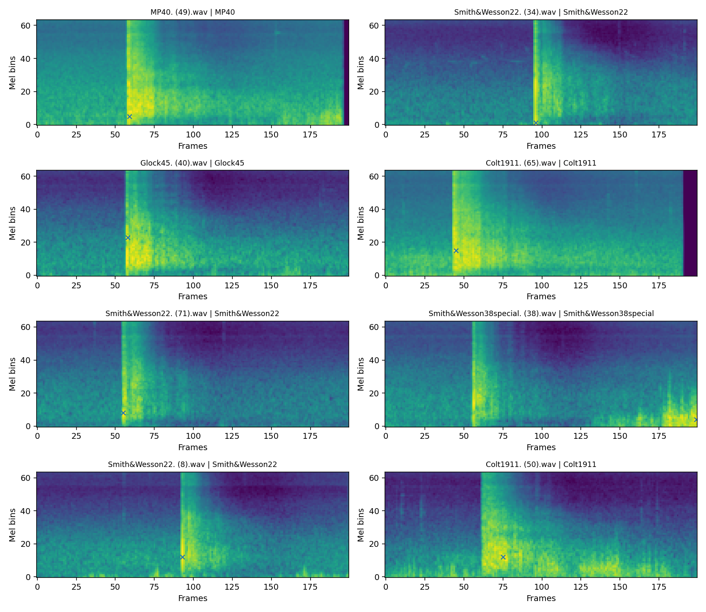
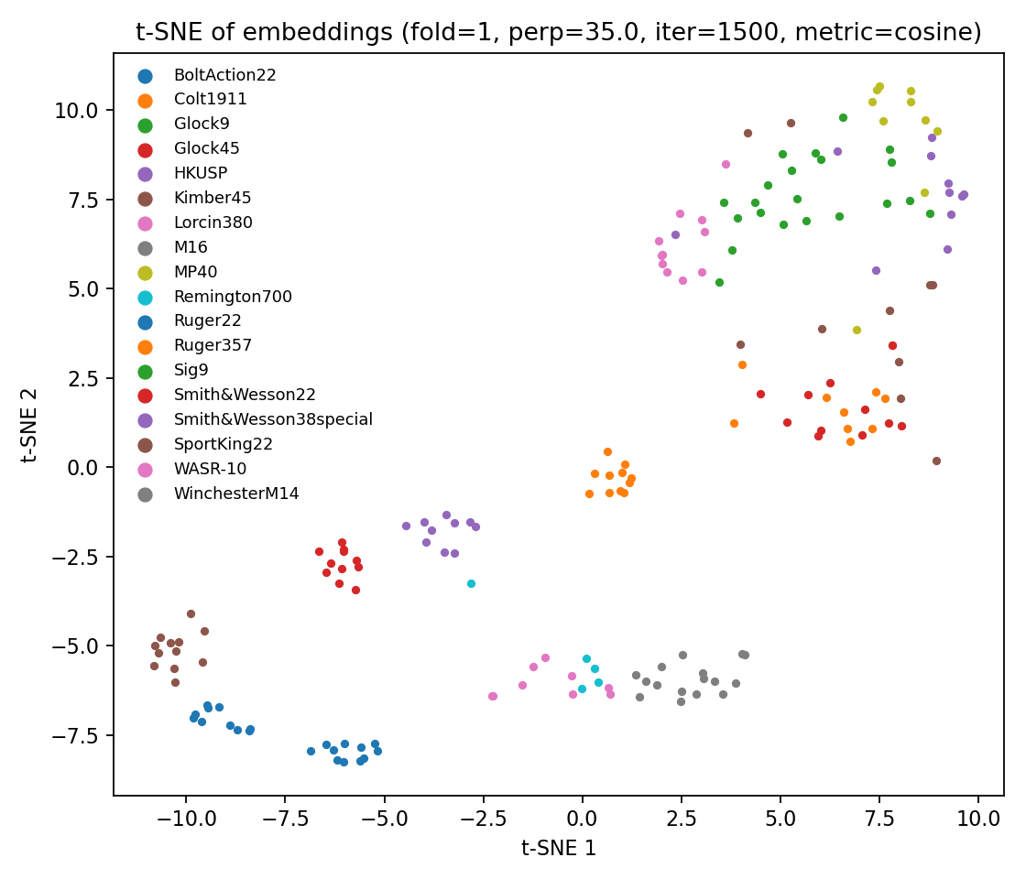
Noise Reduction and Sound Source Localization for UAV
CONTRIBUTORS:
Kowshik Chowdhury
Peng Jiang
College of Information Science & Technology
School of Interdisciplinary Informatics
University of Nebraska at Omaha
Abstract
Motivation (cont.)
Research Design (cont.)
Result & Progress (cont.)
● Unmanned Aerial Vehicles (UAVs) are becoming essential tools for public safety, particularly in high- risk situations such as emergency response and large-scale surveillance.
● Their mobility allows rapid deployment over areas that may be unsafe for human operators.
● This offering real-time audio and visual intelligence to support decision making, in extreme scenarios such as gunshot detection.
Phase 2 - System Integration & Real-World Testing
⇨ Build the UAV Acoustic Testbed: Build a real-world UAV audio testbed equipped with a microphone array and an NVIDIA Jetson Nano to support real-time data capture and on-board processing.
⇨ Deploy the Pre-trained AI Model: Deploy the pre-trained DL model onto the UAV testbed and verify that it operates efficiently under real-world drone noise and hardware constraints.
Source: Daily media & National Law Enforcement Officers
⇨ Controlled Environment Evaluation: Evaluate system performance in a controlled environment by playing gunshot audio through a speaker at varying distances and angles to measure robustness and classification accuracy.
Detect and Locate Gunshot
● If we see on last five years gunshot events in USA on an average 630 events occurred.
● For the same years, police officers were killed on an average is 53 officers.
⇨ After training of our CNN model for classification of gunshots we achieved 82% accuracy.
● However, one of the major barriers to reliable UAV- based acoustic monitoring is the strong ego-noise produced by propellers and motors.
● Taking into consideration this challenge requires noise reduction strategies that can detect weak but meaningful signals.
Research Design
Result & Progress
Design of this research will be accomplished by two phases
Currently we are in phase 1
⇨ We have collected the 18 types
of gunshots from varying angles.
⇨ We created DL model that classify the gunshots.
⇨ With collaboration of OSU we collected frequency of drone noise in three RPMs.
Conclusion
Phase 1 - Data collection and model development
● The expected outcomes of this research include,
⇨ A deep learning-based noise reduction system specifically tailored for UAV acoustic conditions.
⇨ Demonstrate improvements in intelligibility, noise reduction and localization for gunshots.
● Suppose when we use UAVs for our surveillance this useful sound can help us to locate any abnormal situations around our surroundings such as any criminal activity or any rescue activity.
Introduction
⇨ Gather a diverse set of gunshot recordings representing multiple firearm types, calibers and recording distances to ensure broad coverage of real-world scenarios.
⇨ UAV microphones struggle because of strong ego-noise
◉ UAVs use microphones and other sensors to capture sound.
◉ The propellers and rotors generate very loud ego- noise.
◉ This noise masks the signal of interest and severely reduces SNR.
◉ Traditional sound processing methods start to fail in these low-SNR, dynamic conditions.
⇨ Acquire drone noise data across a range of propeller speeds. This allows the model to learn how UAV acoustic signatures vary with flight conditions and improves robustness in low-SNR environments.
References
⇨ Why ego-noise is hard to remove
◉ UAV ego-noise has:
゜ Harmonic narrowband from the propellers.
゜ Broadband turbulence components.
◉ This mix makes it difficult for traditional filters to separate noise from useful signals.
⇨ Develop a baseline deep learning model capable of distinguishing gunshot audio from UAV ego-noise. This includes feature extraction, model selection, hyperparameter tuning, and initial evaluation.
Wang, L., & Cavallaro, A. (2022). Deep learning assisted sound source localization from a flying drone. IEEE Sensors Journal, 22(24), 23706–23718.
Different SPI values across various RPM levels from drone propellers.
SPL spectra for the various operations at 2850RPM
Acknowledgment
Motivation
⇨ Combine and Preprocess Datasets integrate the gunshot and drone noise datasets, apply noise augmentation, and prepare training data to simulate realistic in-flight acoustic conditions.
3) Trained CNN model with gunshot audio
This work is supported by the Autonomous Systems TRust & Assurance (ASTAR) Lab at the University of Nebraska at Omaha, with funding from NSF Award #2451471 and the Nebraska Research Initiative (NRI).
⇨ Train and Validate the Model train the CNN-based model using the combined dataset and conduct controlled validation to measure accuracy, recall, and robustness under low-SNR conditions.
Source: Wikipedia & business insider
Input verification
Output verification

