Slide 1

A Dog Life

Slide 2

Site Map:
SITE
MAP
INFORMATION
HOW TO SELECT A GOOD PET
HOME
GROOMING
SERVICES

Slide 3

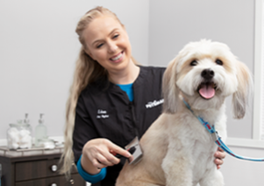
Information:
Contact:
Date &
Time:
Location:
Owners
Names:
Services:

Slide 4
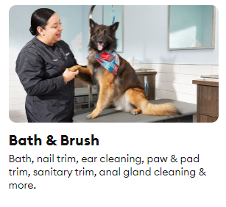
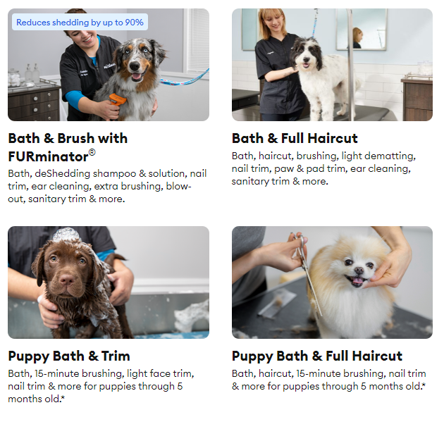
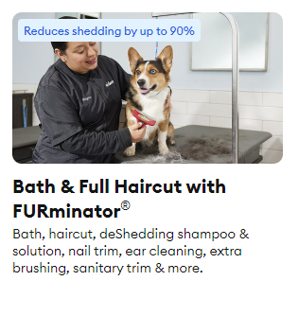
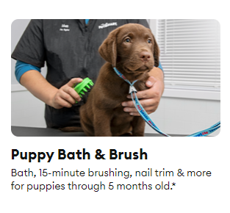

Grooming Salon

Slide 5





HOW TO SELECT A GOOD PET

