Slide 1

Site Map:
SITE
MAP
INFORMATION
HOW TO SELECT A GOOD PET
HOME
GROOMING
SERVICES

Slide 2





A Dog Life
Homepage
Homepage Grooming Map to Store Contact US

Slide 3

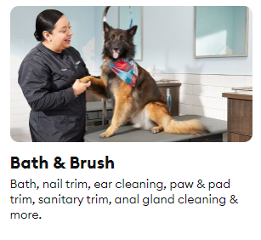
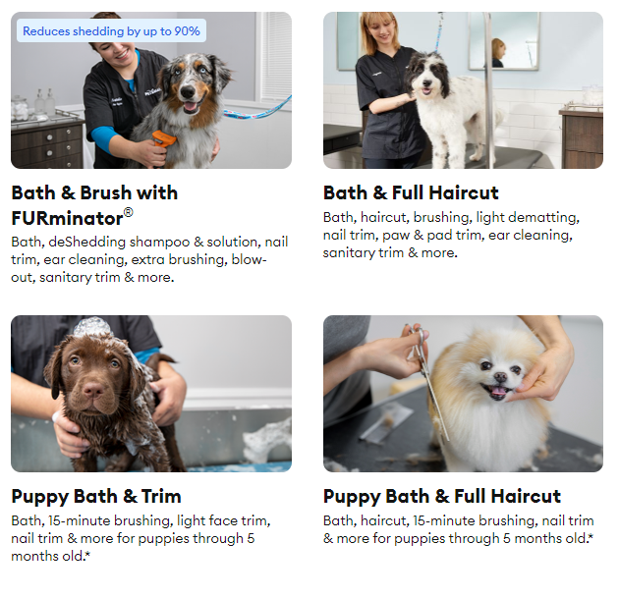
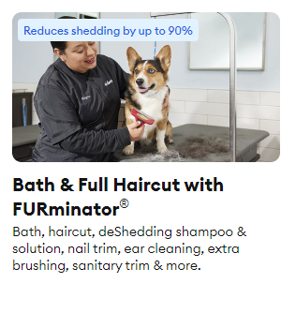
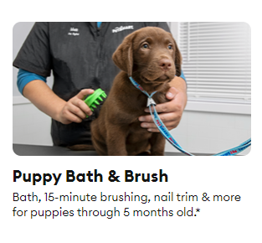

Grooming Salon
Homepage Grooming Map to Store Contact US
Selecting the Right Dog

Slide 4

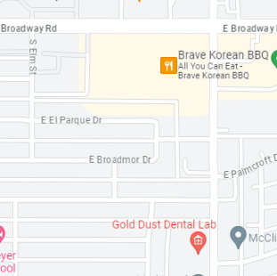
Map to Store:
Homepage Grooming Map to Store Contact US
(480)123-4567
1751 E Broadway Rd,
Tempe, AZ 85282

Slide 5

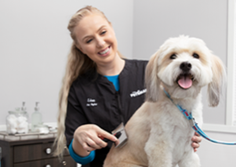
Contact Us:
Homepage Grooming Map to Store Contact US
Date &
Time:
Owners
Names:
Contact:
Pets
Names:
Services:

Slide 6
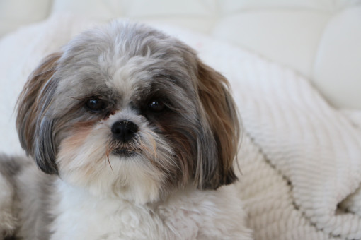
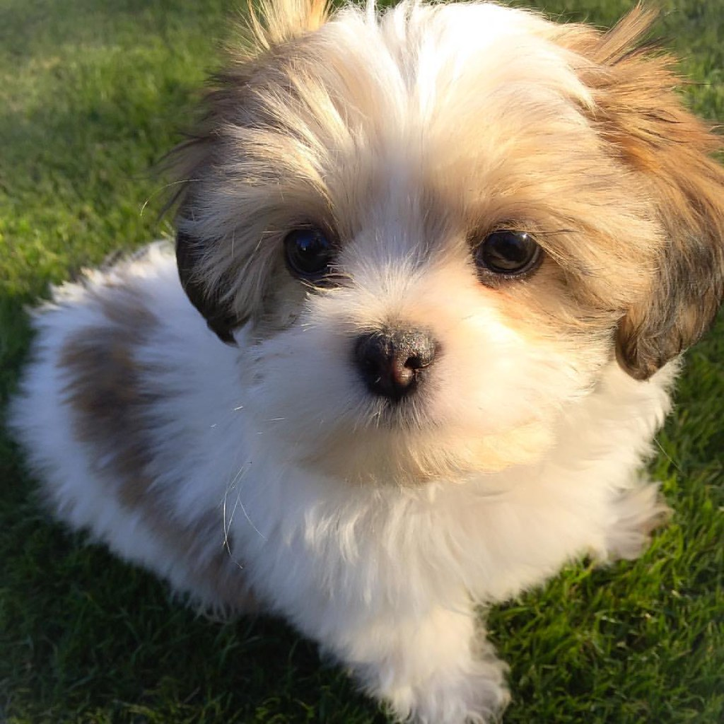
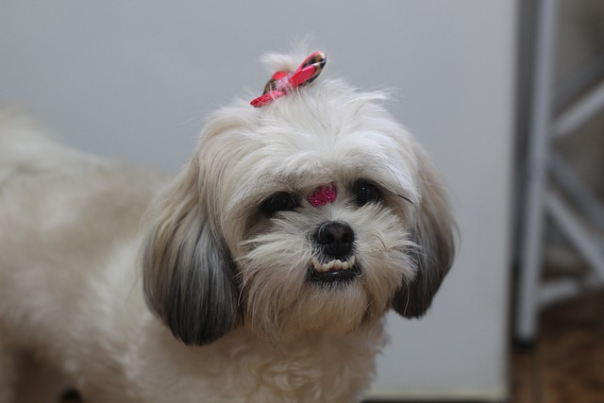


HOW TO SELECT A GOOD PET
Grooming

