Slide 1
There is no place like the parents` home
A multi-level Analysis of intergenerational cohabitation across europE
Julia Büschges, Free University of Berlin, Germany

Slide 2
research question & Topic
Why do young adults stay with their parents during a life phase that is commonly characterized by independence? How can the relevant factors be integrated into a theoretical framework?
Key driver of residential autonomy: economic independence (Furstenberg et al., XX)
Strong impact of national welfare policies on household compositions (Kaplan, 2012)
Cohabitation as an information source indicating which economic insecurities are not sufficiently counterbalanced by existing welfare policies
Notes:
Many public programs insure against the same type of labour market shocks that living arrangements respond to,
Social security benefits have the purpose to allow for a high level of employment. Cohabitation of young adults and their
parents therefore can be seen as an information source indicating which economic insecurities are not sufficiently counterbalanced by existing welfare policies.

Slide 3
Szydlik`s theory of intergenerational solidarity
Micro level
opportunities: e.g. living space
needs: economic, social, care
Meso level
family structure: e.g. relationship status, number of children
Macro level
cultural-contextual factors: e.g. national family expenses, overall economic situation
Notes:
In 2008, sociologist and life course researcher Szydlik proposed his theoretical model of intergenerational solidarity.
As its name suggests, the model applies to various types of family solidarity, including support, contact frequency as
well as cohabitation.
According to the model, at the micro-level, solidarity between adult children and their parents is influenced
by their respective needs and opportunities.
These, in turn, are affected by the family structure at the meso-level.
Lastly, cultural-contextual factors at the macro-level have an impact on all, family structure as well as potential needs and opportunities.

Slide 4
Critical appraisal
Reduction to two core dimensions: need & opportunity
Introduction of social motivation as a third dimension
Taking in a relative in need implies a feeling of solidarity
Reciprocal nature of solidarity
Notes:
Both family structure and cultural-contextual structures exert their effect either via the need or the opportunity
channel. This stepwise development of the model convinced me that it can be boiled down to the two core dimensions of need and opportunity.
For instance, welfare state policies, which lead to crowding out, affect residency decisions by decreasing the young adults’ as well as their parent’s need for shared living.
This behaviour is in its motivations similar to young adults and parents living separately who, for example, give support with daily
chores, assume responsibility for care or provide financial assistance.
By fostering social relationships feelings of reciprocity and even obligation are generated.

Slide 5
HypothesEs I
Young adults whose parents support grandparents are more likely to cohabitate than their peers whose parents do not support the older generation
Young adults whose parents provide support to their other adult children are more likely to cohabitate than those whose parents do not support their adult offspring
Notes:
Parents who provide regular support to their children are anticipated to have a strong sense of family cohesion
and normative intergenerational solidarity.
More so, this connection can be presumed to be even stronger for parents who support
other adult children as such behaviour is not only indicative of general familialistic
values but feelings of parental responsibility for their adult children.

Slide 6
Hypotheses II
High family expenditures and a good overall economic situation are expected to be negatively associated with the likelihood of intergenerational cohabitation
High expenditures for old age security decreases the parental need for support and in turn their motivation to accommodate their adult children
Notes:
Contributing to this effect, generous
welfare state policies are commonly linked to a decline in family solidarity and financially
stable parents are more likely to support their children monetarily rather
than offering cohabitation.
On a larger scale, the coverage of pension benefits is
closely associated to pension entitlement supplementing earning-related pensions.
Analogous to the aforementioned hypothesis, it can be therefore argued that…

Slide 7
Data set & case selection
Data set: Survey on Health, Aging and Retirement in Europe (SHARE), wave 5 (2013)
Exclusion criteria
Young adult disabled
Parent in care facilities
12.509 young adults from 20-39 and their parents

Slide 8
Operationalization
Dependent variable: cohabitation vs. living autonomously
Independent variables, i.a.:
parental familial support
Survey: Parents indicate number children supported & frequency
Calculation: Share of children supported multiplied by average support frequency, mean value for parental couples, grouped in 5 categories
Notes:
Focus on problematic variables.
How can I do it better?
Social support: single child no information

Slide 9
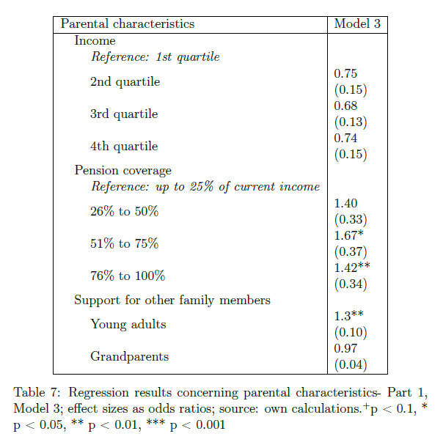
Results: Familial Support
Notes:
Logistic regression, 3 levels: young adult, parental household, country
Scale 0-5
The odds ratio of 1.3 for the support of adult children indicates that an increase of one on the support
scale corresponds to a 26% higher chance of living together. Respectively,
children of parents scoring two values higher have a 52% greater probability
of shared residency.
Hence, the hypothesis, which states a connection between parental support for adult children and the likelihood of
intergenerational cohabitation, can be sustained.
Turning to support provided to the grandparents, no significant impact on the young adults’ place of residence
can be found.
The fact that support for children seems to have an effect but not support for grandparents suggests that both behaviours may not be
rooted in the same normative solidarity, but values specific to one’s children or parents.
It is very well conceivable for one person to have strong feelings of parental duty towards one’s children, but only a weak sense of filial responsibility
towards one’s parents, or vice versa.

Slide 10
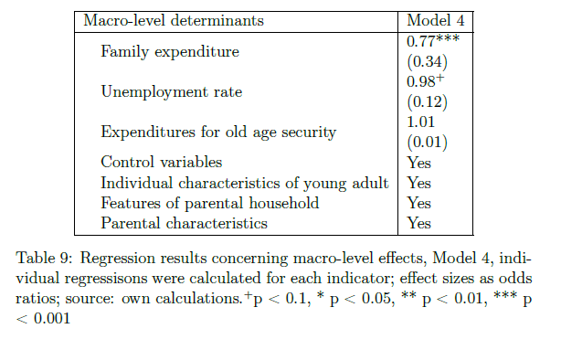
Results: Contextual factors
Notes:
As the odds ratio shows, the more a country invests in family
support, the lower the probability of resident young adults to live with their
parents. To be precise, an increase of expenditure of 1% corresponds to an on average around 30% lower likelihood of cohabitation. This effect size seems
quite impressive. Taking a look at the values of family expenditures in the selected countries however, it becomes
evident that they range only between 1.3% and 4%.
With each additional percent of the active population being unemployed, cohabitation in the respective country becomes 2% more likely.
At first sight, this effect seems almost meaningless because of the small effect size.
However, unemployment rates differ substantially between the analysed countries, from around 3% to almost 20%
Turning to the last Hypothesis, it was assumed that high public expenses
for old age security would guarantee financial security. The results of the regression
show that there is no empirical evidence supporting this claim.

Slide 11
Bibliography
Kaplan, 2012
Szydlik, 2008
Furstenberg et al, XX

