Slide 1
Project Part 2
By Veronica Dean, Michael Winay, Derek Ruggirello, and Hassan Almusawai
04/05/2022

Slide 2
What to Expect
-An application free of bugs that provide full functionality
-Update as needed
-Create strong foundation
-Hands on approach
-Teamwork

Slide 3
Getting to the details..
-The homepage will will have four web links at the top
-”BarMaster” will simulate a Bartender/Server’s user interface
-This app will store, forward, and search user inserted drinks and cocktails
- A graphical UI will at least track servers, drinks, times and recipe quantities
-A terms and conditions acceptance page will be provided

Slide 4
Programs used
Javascript
HTML
CSS
Python
Collaborated on Github

Slide 5
Timeline
Planning/Research 1 week
Design/Consultation 1 week
Development Up to 2 weeks
Testing/Launch 1 week

Slide 6
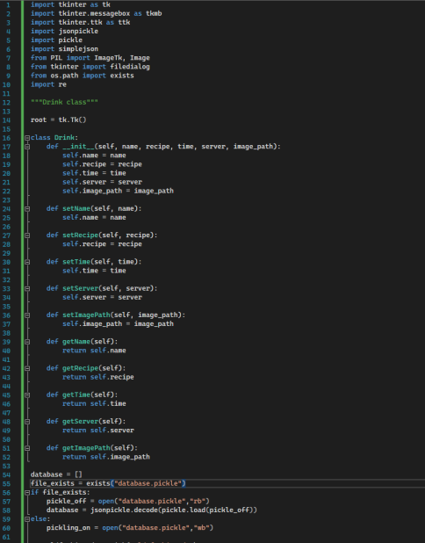
Organization and code

Slide 7
Cloud Computation
On-Demand Self-Service – A user can continuously monitor the allotted network storage, server uptime, and computing...

Slide 8
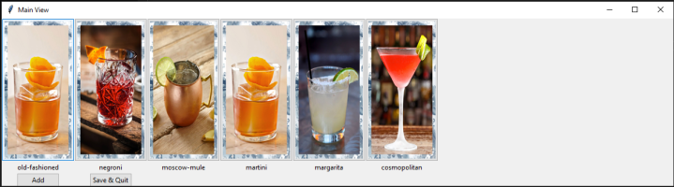
Sample Webpage Idea

Slide 9
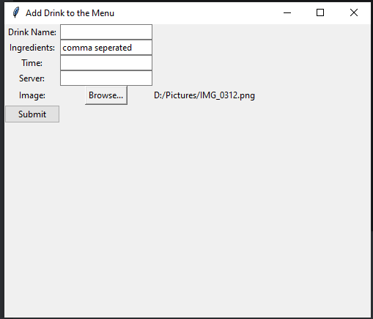
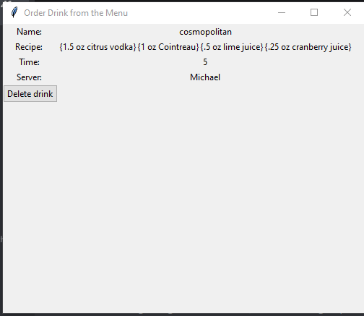
Adding and viewing the data

Slide 10
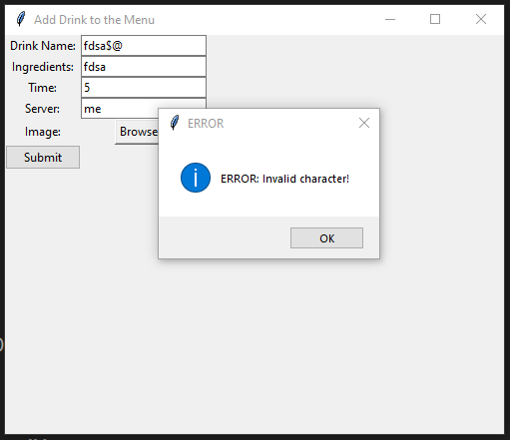
Attempts to add “forbidden” characters will result in the following error:

Slide 11
Thank you for your time!
From all of Forestview Group 5 thank you for your time, and keep us in mind for your future application needs!

