Slide 1
VOLUNTEER PROJECT
Beach Clean-Up Project
Making our coastline cleaner, safer and healthier through community volunteering.
Group Members:
Melusi Buthelezi
Philasande Shozi
Lwazi Gamede
Tlotliso Lekhoba
Amahle Xulu
Sinoyolo Lumkwana
Presented by: Melusi Buthelezi, Philasande Shozi, Lwazi Gamede, Tlotliso Lekhoba, Amahle Xulu, Sinoyolo Lumkwana Class: [Insert class] Date: [Insert date]
Volunteer Project • Slide 1

Slide 2
1. Organisation Identified
The organisation must be relevant to the topic of the project.
Organisation
Why it is relevant
Local Community Beach Clean-Up Project This is a community-based environmental volunteering initiative that helps keep public beaches clean and protects the coastal environment.
The organisation is directly relevant because our project focused on volunteering to remove litter from the beach and improve the environment for people, animals and the wider community.
Volunteer Project • Slide 2

Slide 3
2. Reason for Choosing the Organisation
We chose this organisation because we wanted to contribute directly to protecting the environment by helping to remove litter from the beach. Beach pollution can make public spaces unsafe and can harm marine life, so volunteering in a clean-up project allowed us to make a practical and positive difference in our community.
Main objective
To help create a cleaner, safer and healthier beach environment through practical community service.
Volunteer Project • Slide 3

Slide 4
3. Four Needs Identified
Needs identified during the visit before volunteering began.
1
3
Litter and plastic waste on the beach
Limited public awareness about responsible waste disposal
2
4
Insufficient regular cleaning and maintenance
The need for teamwork and additional volunteers during clean-up activities
Volunteer Project • Slide 4

Slide 5
4. Practical Ways We Addressed the Needs
Collect litter and plastic waste and place it into the correct rubbish bags or containers.
Clean the beach area by removing visible waste from the sand and surrounding areas.
Encourage awareness by setting a good example and reminding people to dispose of waste responsibly.
Work as a team by dividing tasks, cooperating with other volunteers and helping to maintain the clean-up area.
Volunteer Project • Slide 5

Slide 6
5. Volunteering Activities and Group Roles
Replace the placeholders below with the actual names of your group members.
Member 1: Melusi Buthelezi
Member 3: Lwazi Gamede
I helped collect litter and plastic waste from the beach. I also worked with the group to separate and place waste into the correct bags or containers.
I helped organise the group and made sure that tasks were shared fairly. I also helped keep the group focused on completing the clean-up.
Member 2: Philasande Shozi
Member 4: Tlotliso Lekhoba
I helped clean the assigned beach area and checked areas where litter was difficult to see. I also assisted other group members when they needed help.
I helped collect waste and contributed to keeping the beach clean. I also supported teamwork by cooperating with the other volunteers throughout the activity.
Volunteer Project • Slide 6

Slide 7
How the 5–6 Volunteer Hours Were Used
Hour 1
Hours 2–3
Arrival, safety instructions and preparation of equipment.
Collecting litter, plastic and other waste from the beach.
Hours 4–5
Final hour
Continuing the clean-up, checking the area and helping other volunteers.
Sorting and disposing of collected waste, packing equipment and reviewing the work completed.
Total time spent volunteering: 5–6 hours (according to the completed timesheet).
Volunteer Project • Slide 7

Slide 8
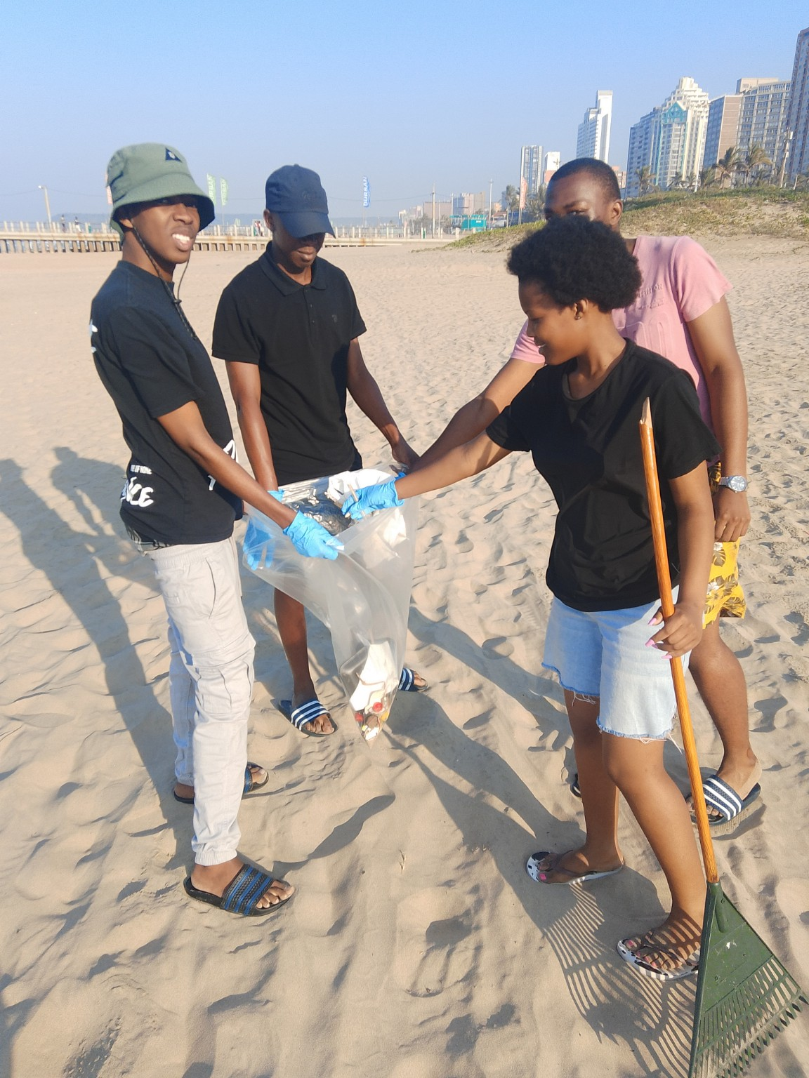
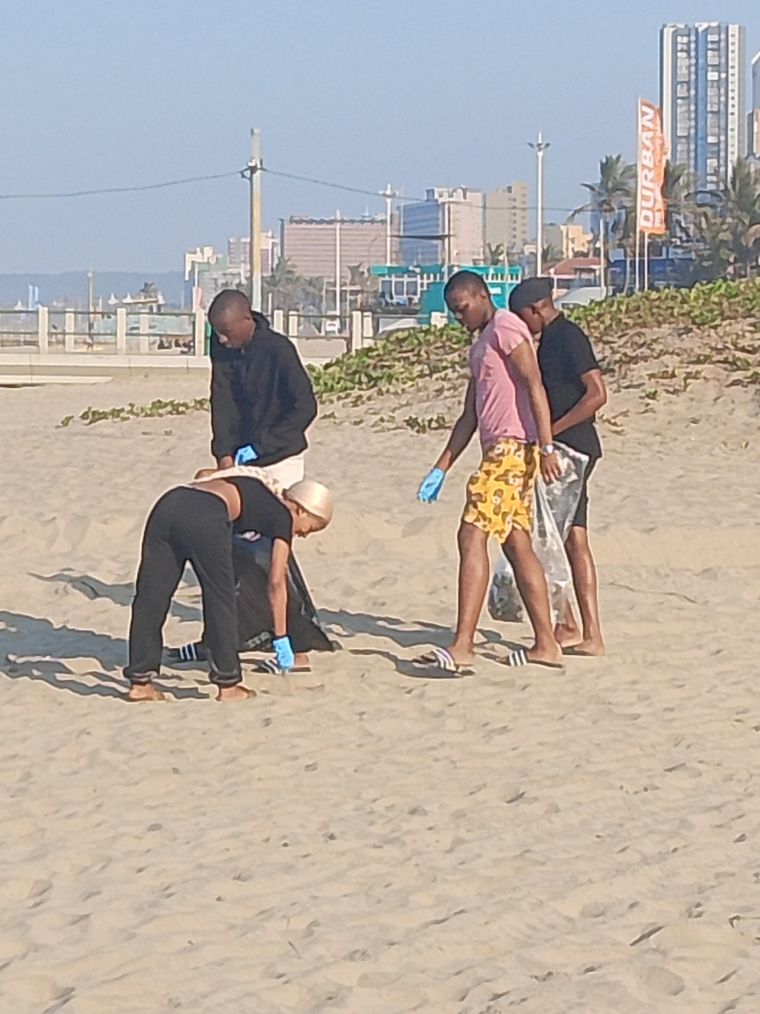
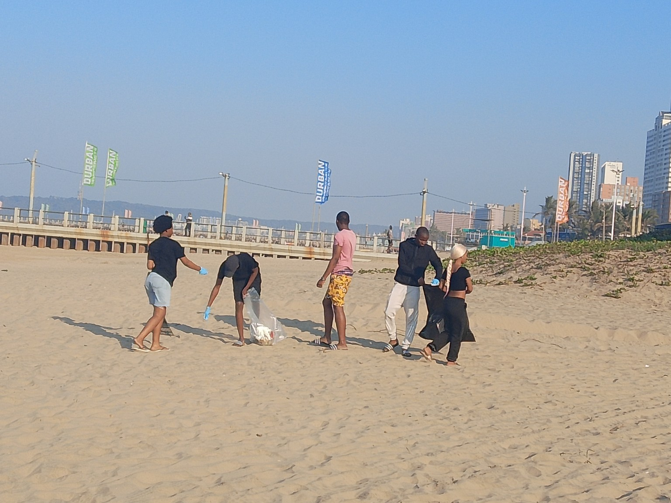
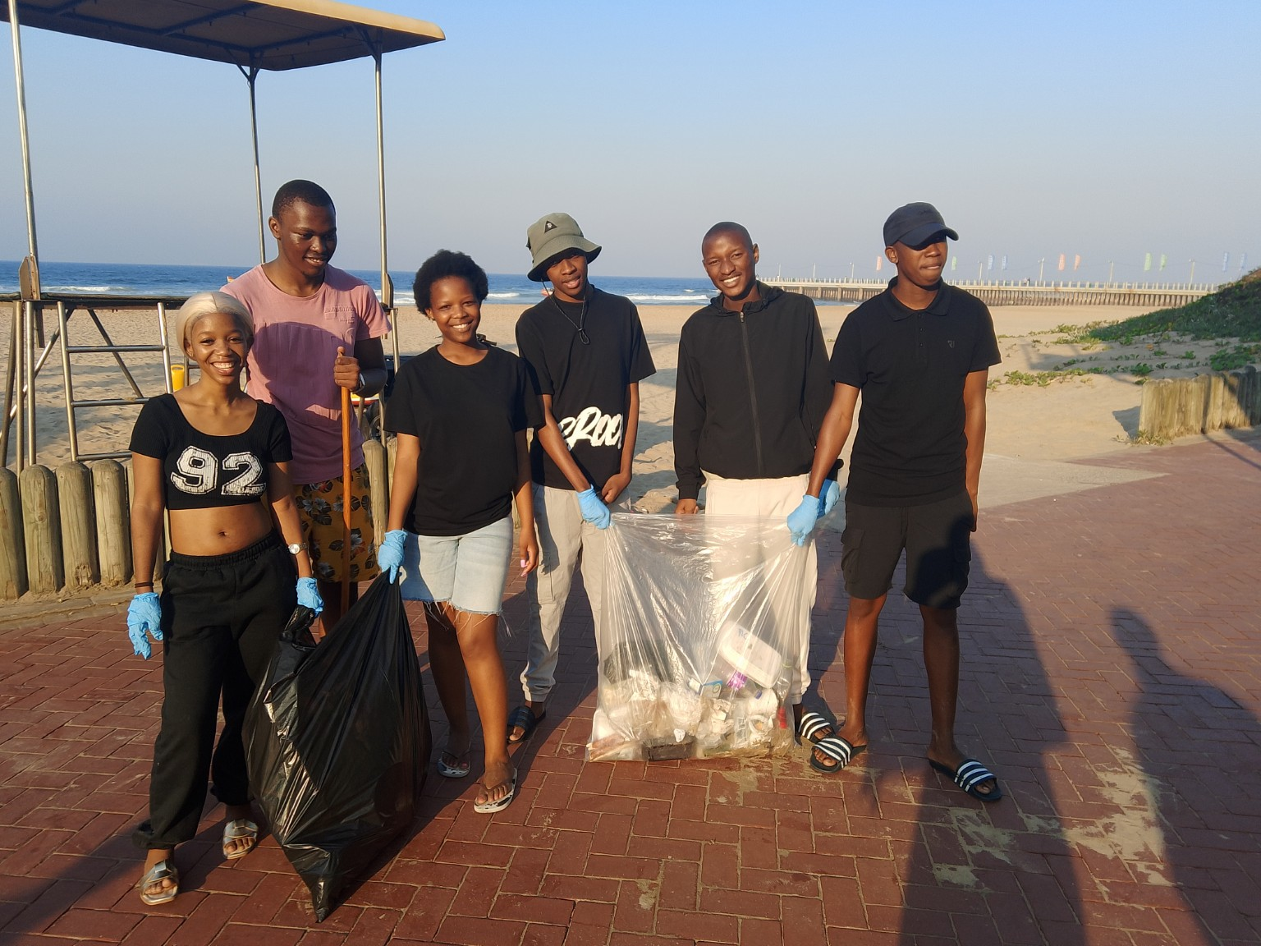
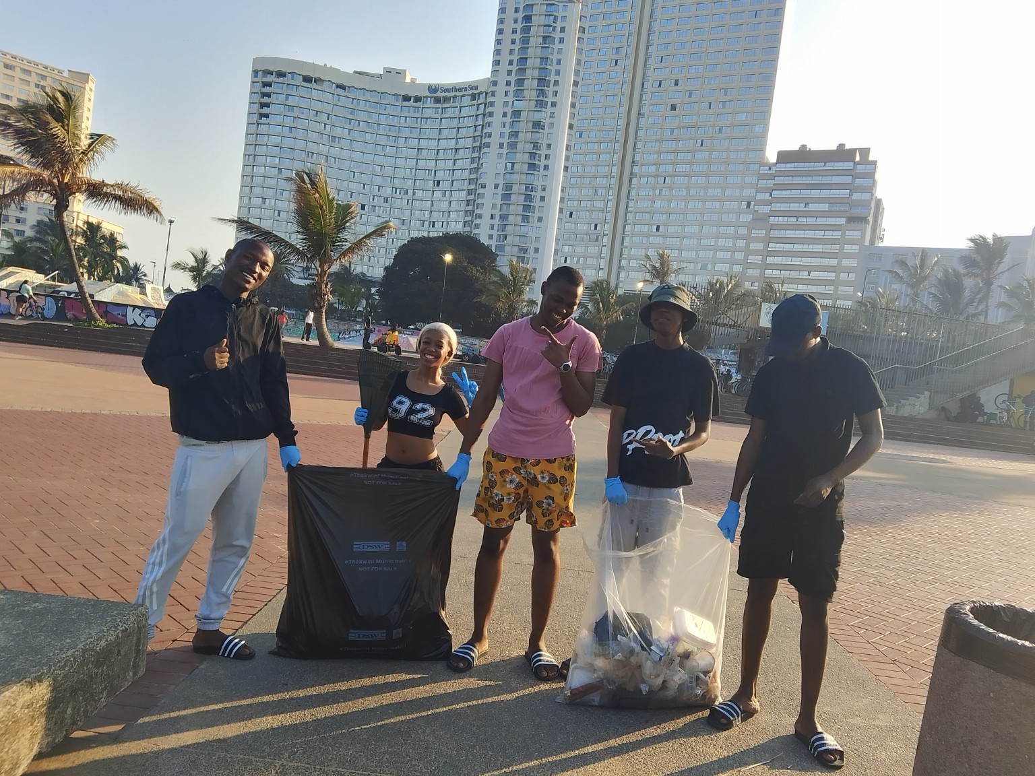
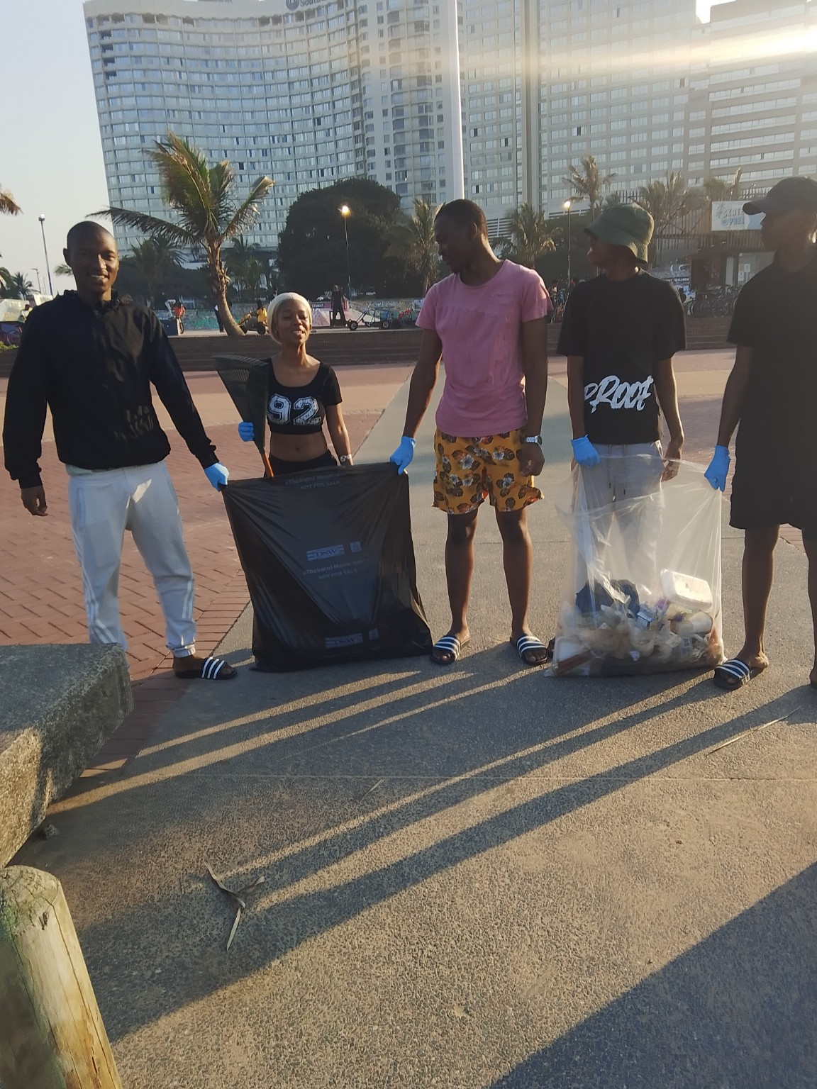
Evidence of Participation
Insert at least three photographs. Every group member should appear in at least two photos.
Photo 4: Group collecting waste
Photo 5: Cleaning the beach
Photo 6: Group working together
Volunteer Project • Slide 8

Slide 9
Impact of the Volunteer Project
The beach was made cleaner and safer for people using the area.
Removing waste helped reduce pollution and the possible harm to marine life.
The project encouraged teamwork, communication, leadership and responsibility.
Our group learned that small actions can make a positive difference in the community.
Volunteer Project • Slide 9

Slide 10
Conclusion
Our beach clean-up volunteering project was a valuable experience because it allowed us to identify a real environmental need and respond to it through practical action. By working together, we removed waste, improved the cleanliness of the beach and contributed to a healthier environment. The project also helped us develop important skills such as teamwork, communication, organisation, leadership and responsibility. We learned that volunteering can benefit both the community and the volunteers who take part.
Thank you
Questions?
Volunteer Project • Slide 10

Slide 11
Checklist Before Submission
Organisation identified and relevant to the volunteer topic.
One clear reason for choosing the organisation.
Four different needs identified.
Four practical actions that address the four needs.
At least 5–6 hours of volunteering completed and recorded.
At least two sentences written about each group member's role.
At least five sentences describing the group's activities.
At least five sentences explaining how the hours were used.
At least three photographs submitted, with all members appearing in at least two.
Proof of participation and a fully completed, signed timesheet included.
Volunteer Project • Slide 11

Slide 12
EVIDENCE OF PARTICIPATION
Photographic evidence of our beach clean-up volunteer project
Beach Clean-Up Volunteer Project • Group Evidence

