Slide 1
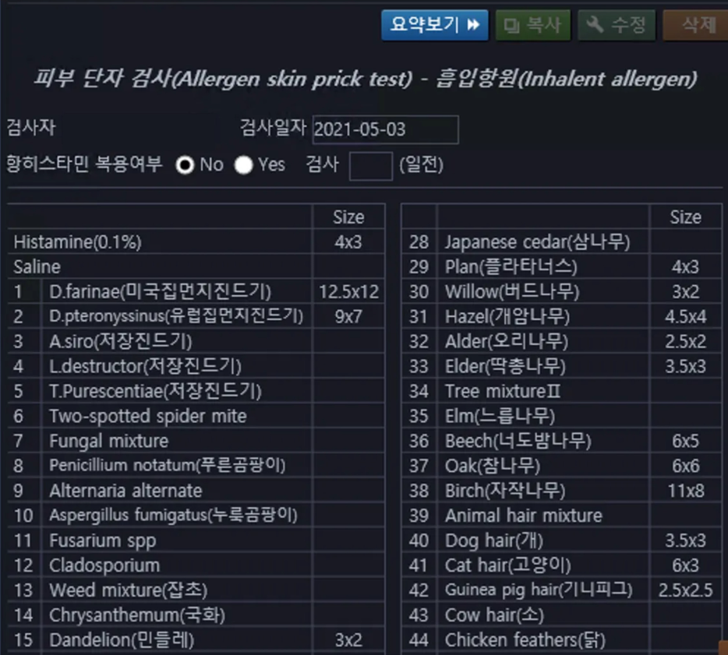
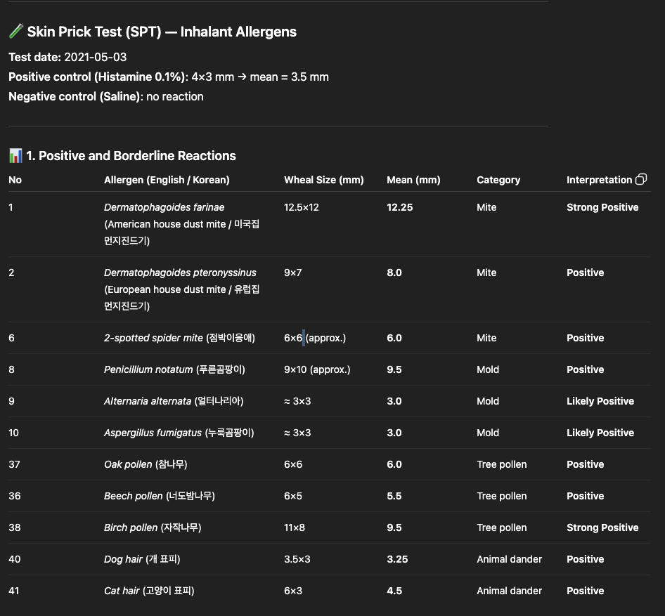
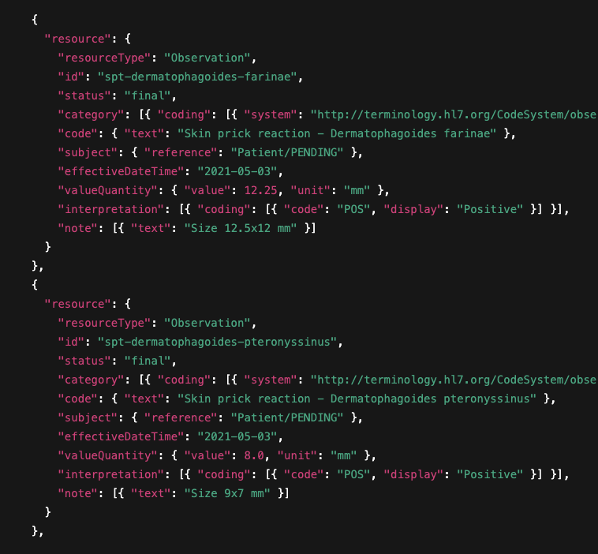
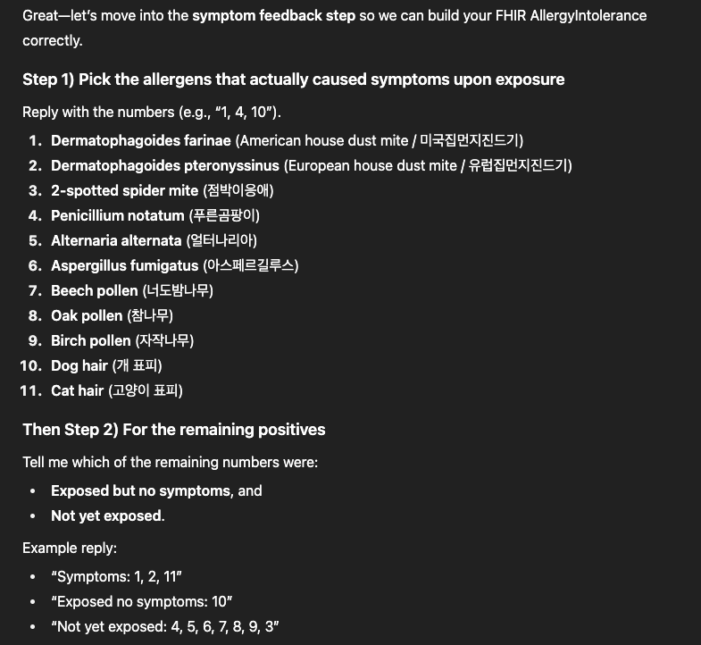
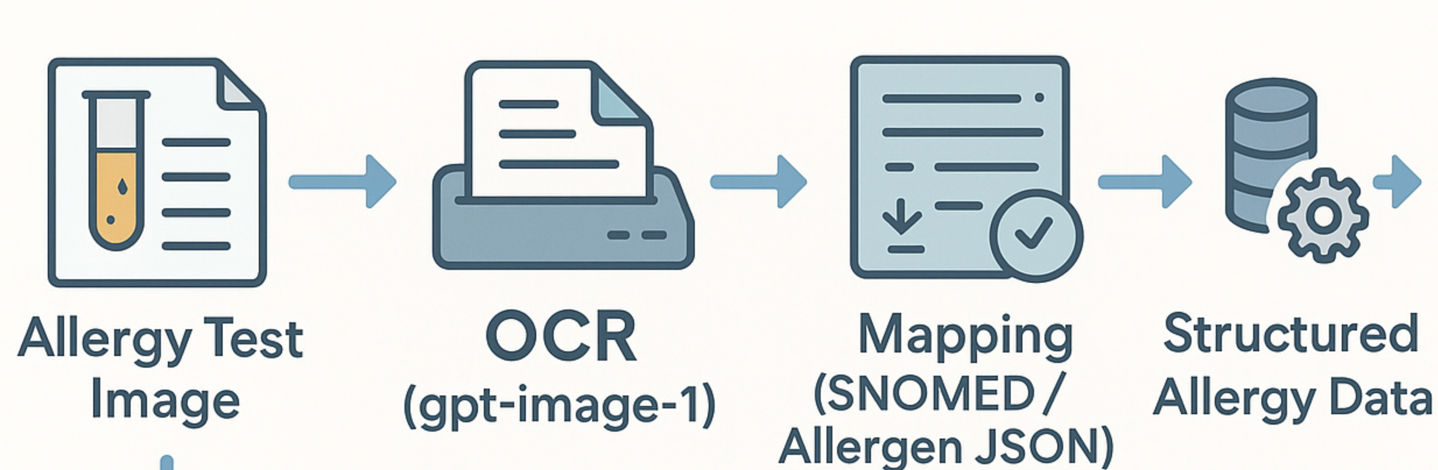
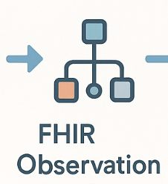
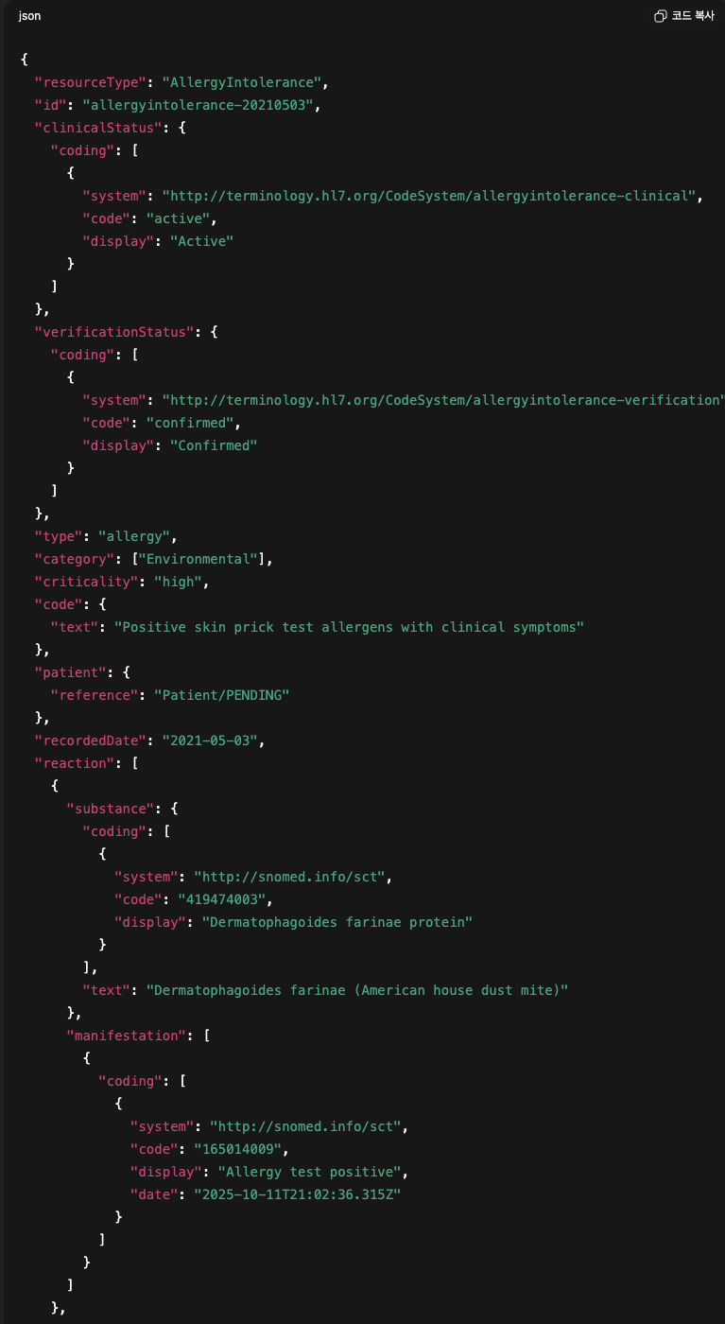
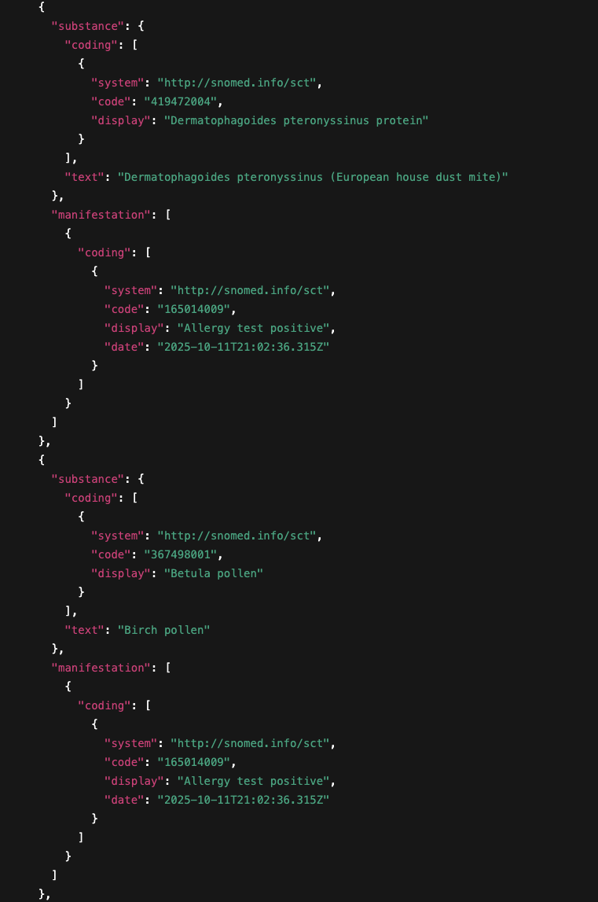
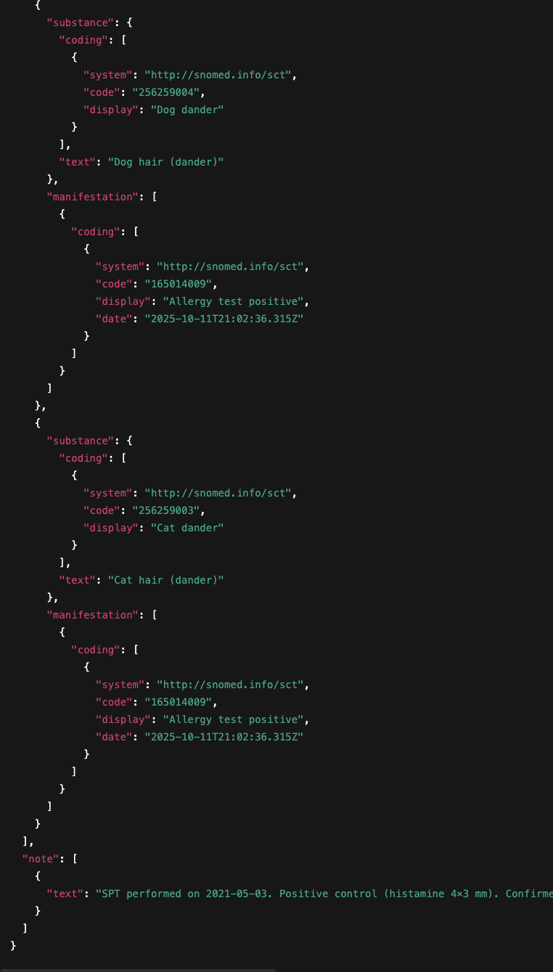


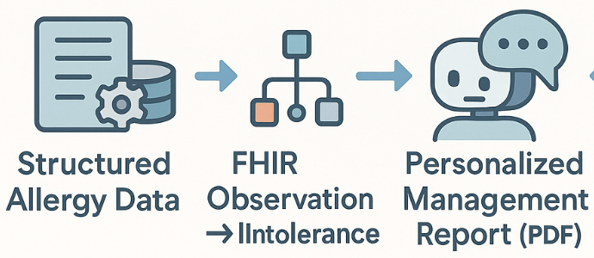

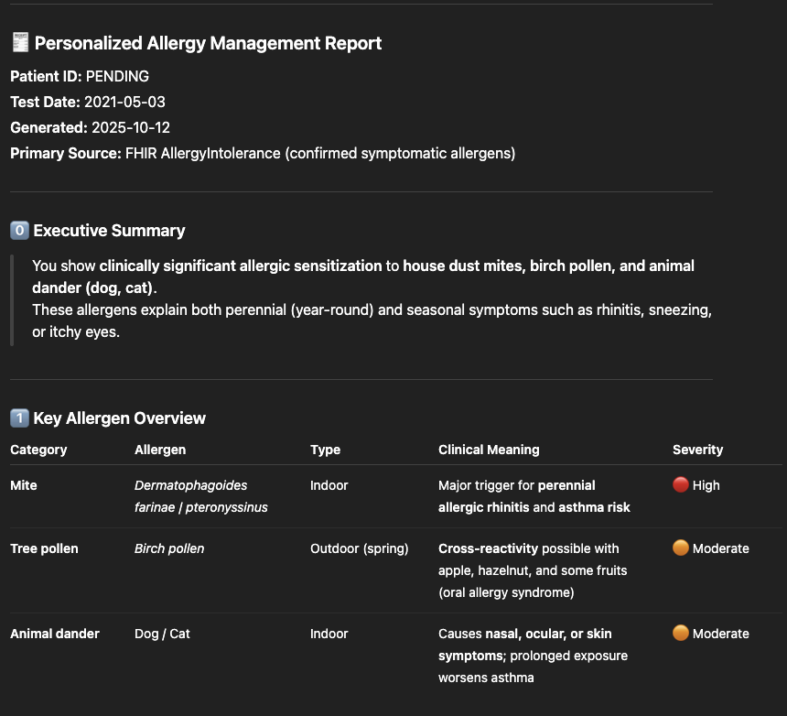
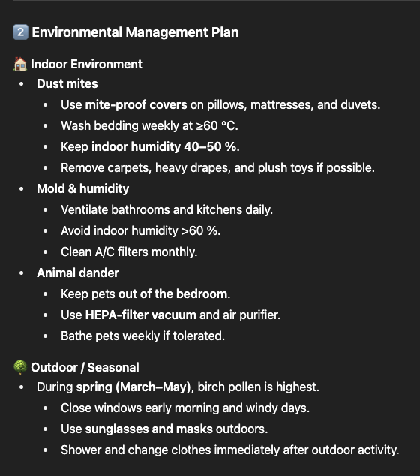
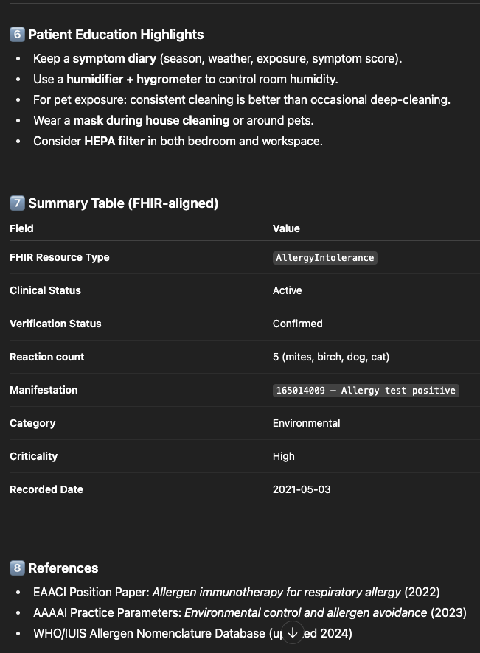
Development of a System Using Large Language Models to Convert Patient Allergy Test Results into HL7 FHIR AllergyIntolerance International Patient Summaries
Min-Gyu Kang^{1,2,}, Hyesin Jung¹, Kyu¹nglim Lee¹, Hyungki Kim¹, Kicheol Yu¹, HK Won, YJ, Bae^{1,} Sung-Il Woo¹ and ³Sang-Heon Kim
¹Chungbuk National University Hospital, Cheongju, Republic of Korea
²Chungbuk National University, Gaesin Campus, Cheongju, Republic of Korea;
³Hanyang University and Hanyang University Hospital, Seoul, Repiblic of Korea;
Introduction
Patients with allergies commonly undergo various diagnostic tests, such as skin prick tests (SPT) and Multiple Allergen Simultaneous Tests (MAST). Despite the clinical importance of these tests, it remains challenging for patients to accurately maintain, interpret, and utilize their personal allergy information. The HL7 FHIR (Fast Healthcare Interoperability Resources) standard has been widely adopted internationally to enable structured healthcare data exchange. However, user-friendly tools that allow patients or clinicians to directly convert allergy test results into standardized, FHIR-compatible formats are still lacking.
Result
(1) Inpur sample files
(2) OCR and mapping
Objective
To address this gap, this study aimed to develop an LLM-assisted allergy data processing system built using Python and a patient-friendly Streamlit interface. The platform supports both MAST and SPT test results, automatically transforming unstructured outputs into FHIR Observation resources. Subsequently, through an integrated symptom verification survey, the system identifies clinically relevant allergens and converts only those into HL7 FHIR AllergyIntolerance resources aligned with the International Patient Summary (IPS) standard.
This approach bridges the gap between raw laboratory data and standardized clinical knowledge, promoting patient-centered interoperability in allergy care.
(3) FHIR Observation Resource
(3) Chatbot
System Architecture Overview
(5) FHIR AllergyIntolerance Resource
(6) Patient-centered Allergy Management Report
Data Processing Workflow
Step | Module | Function | Output
1 | gpt-image-1 | OCR + Extract data | raw JSON
2 | allergen_map_prompt_v2.json | SNOMED 화 | standardized JSON
3 | allergyintolerance_builder.py | HL7 FHIR 변환 | FHIR JSON
4 | Chatbot Feedback | 증상 입력 / 분류 | user-labeled JSON
5 | allergy_management_reporter.py | 리포트 생성 | PDF/Markdown
Clinical Impact & Futyre Direction
This study enhances allergy data interoperability through the HL7 FHIR IPS framework, enabling seamless integration between EMR and personal health management systems. By automating patient-centered allergy data processing, it introduces an AI-powered HL7 FHIR Generator that simplifies standardized data conversion.
Future development will expand the system to include food and drug allergy modules, LLM-based symptom severity prediction, and multilingual FHIR report generation. Integration with EMR systems via FHIR POST APIs will support real-time clinical data exchange, moving toward a fully interoperable and intelligent allergy management ecosystem.

